Slide 1





Endcap Tracking Layer Project
WBS 01.02.01 – Sensors and Bump Bonding
Subsystem Scope, Cost, Schedule and Risk
DOE Review Backup Material
Subsystem Manager: Mathieu Benoit/Chris Rogan (ORNL/KU)
Review Date: June 14-16, 2022
Notes:
Briefly introduce yourself:
CAM for xx System
Experience with …
Good design team with mix of skills

Slide 2
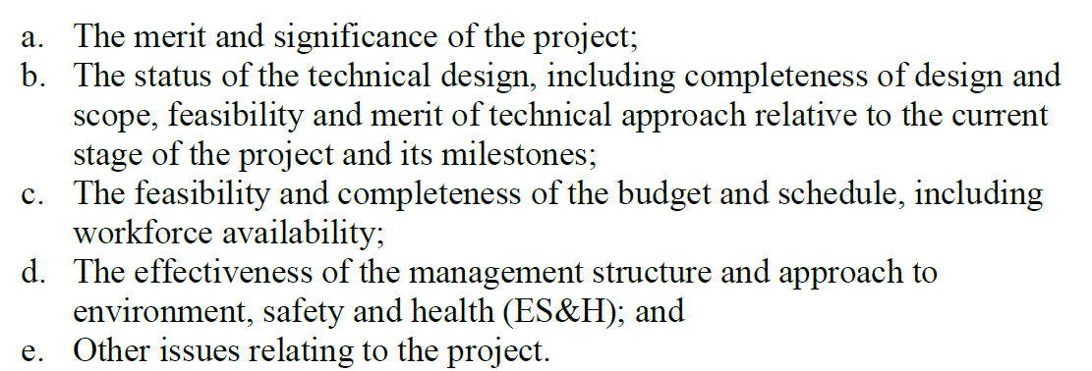
DOE Charge

Slide 3
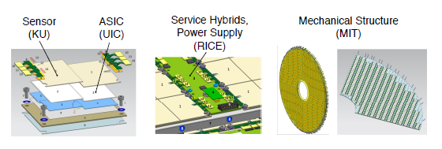
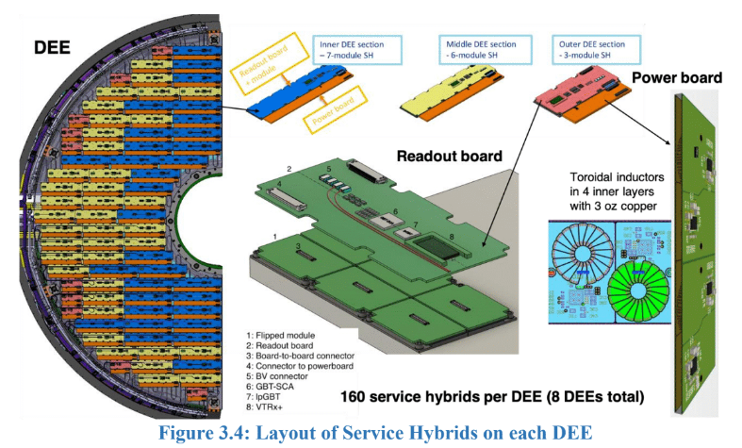
Scope Overview
Charge Questions – 1
The Sensors and bump-bonding scope covers the prototyping, preproduction and production of the sensors + ASIC assemblies that are required to produce modules to populate ETL disks. This includes the prototyping for vendor selection, the characterization of the produced sensors, and subsequently the bump-bonded assemblies, to insure the ETL requirements in terms of active channel, timing and thermal performance are met. The sensors produced are the active components of the ETL: They provide the fast signal from detected particle interactions that is transmitted via the bumps (bump bonding) to the readout ASIC for the digitization of the information and transmission to the DAQ system
The team at ORNL has the key knowledge and experience in sensor design, simulation, characterization and production of Silicon sensors.
The team at KU and ORNL have long experience in producing and testing bump-bonded assemblies for previous HEP and NP physics project, and maintains the privileged relationship with the keys vendors to ensure a successful project execution
Sensor + Bump-bonding KU+ ORNL

Slide 4
Scope Overview
Project Organizational Chart

Slide 5
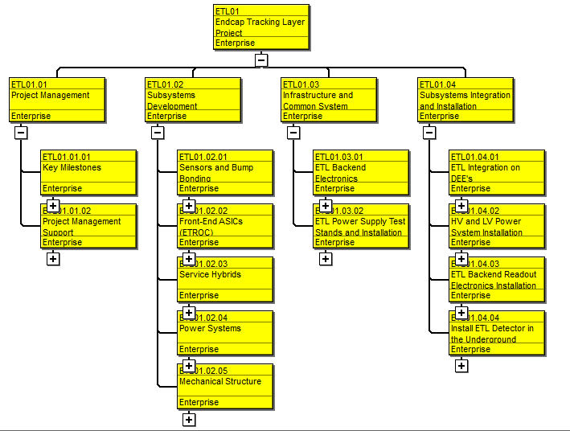
Scope Overview
Project WBS Overview

Slide 6
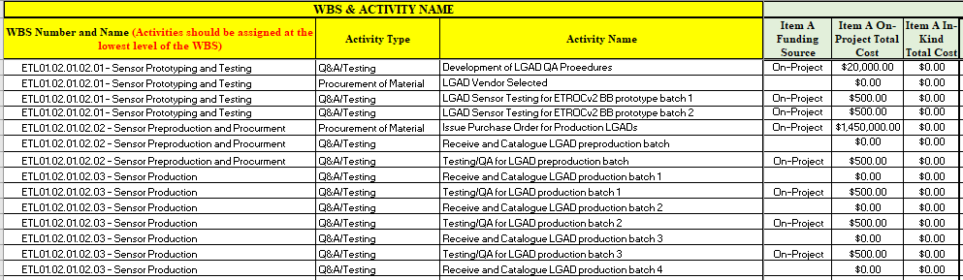
Cost Development
The main cost drivers for material for this scope consists of procurement of sensors and bump-bonding services for the prototyping, preproduction and production steps.
The Sensor procurement cost for the two purchases planned are estimated from current quotes obtained from one of the targeted vendors. The vendor qualification and selection by the international collaboration currently under way will determine the final cost for these items
The bump-bonding services costs are estimated from previous experience with the CMS tracker. This estimate will be updated after vendor qualification and selection by the international collaboration
The labor required for the execution of the scope have been estimated from current experience from ORNL and KU team members. Sensor and bump-bonded assemblies' characterization, QA\QC has been exercised in past projects and in the R&D phase of the current project and are used to informed the current estimates .

Slide 7
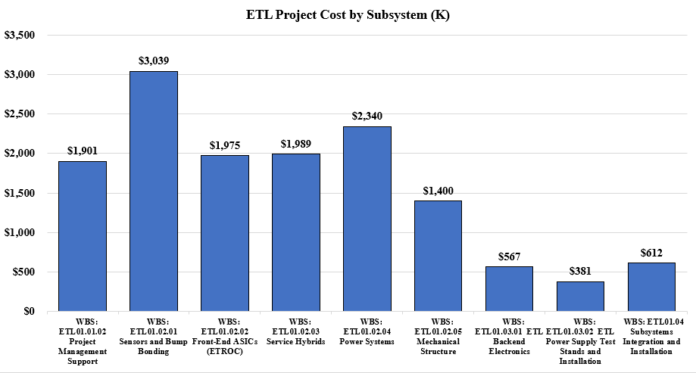
Cost Overview – Subsystem Relative Cost

Slide 8
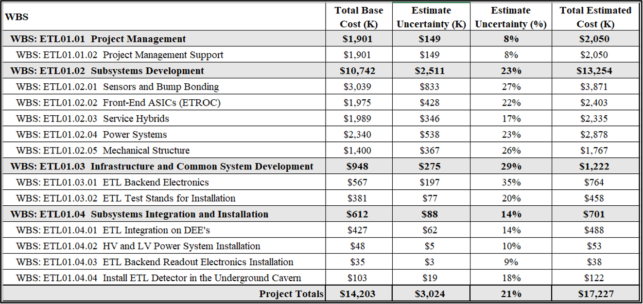
Cost Overview – Base Cost and Estimate Uncertainty

Slide 9
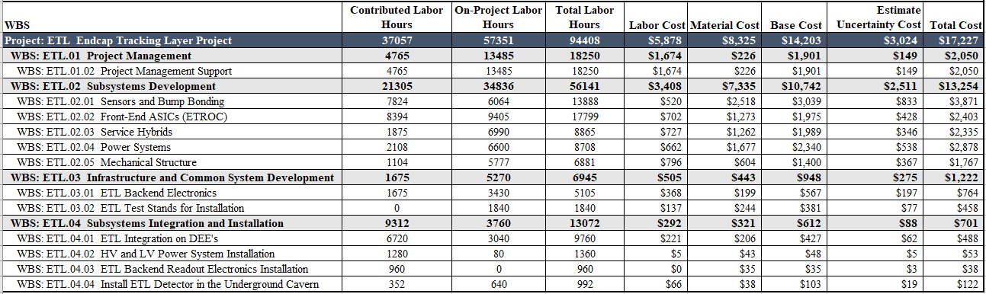
Cost Overview – Labor Hours and Cost

Slide 10
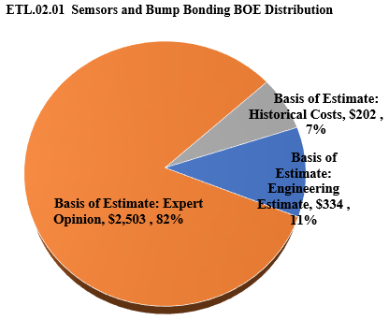
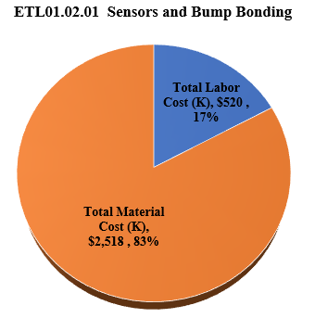
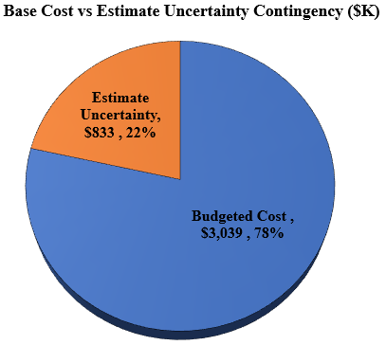
Cost Overview

Slide 11
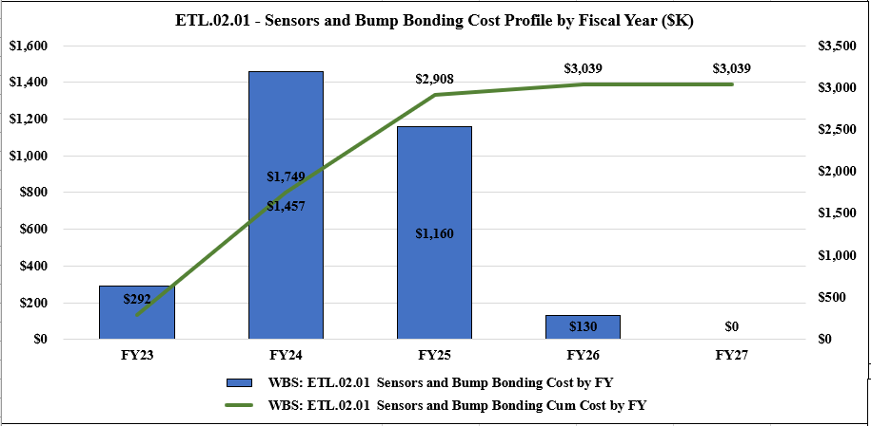
Cost Overview - Profile

Slide 12
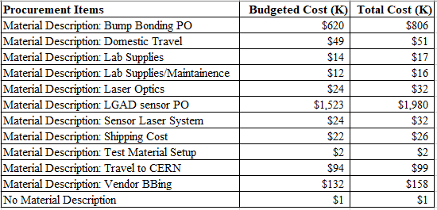
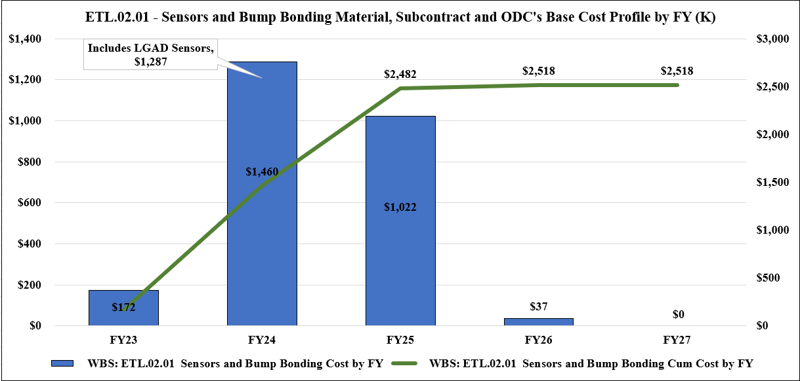
Cost Overview - Procurements

Slide 13
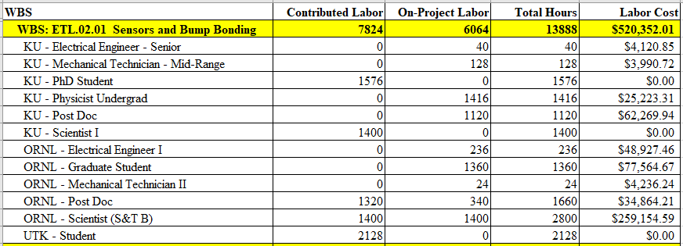
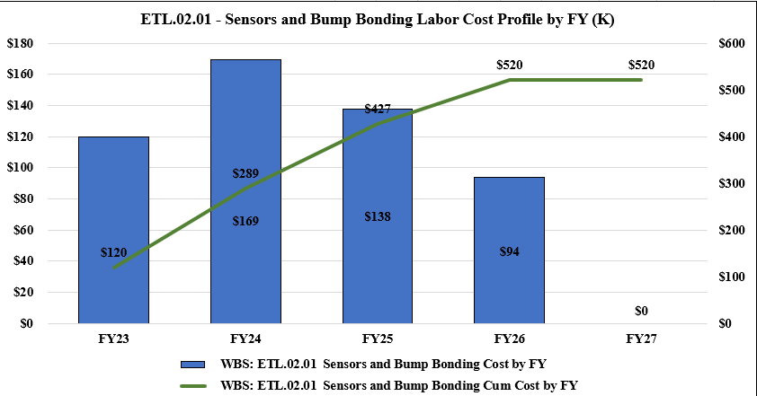
Cost Overview - Labor

Slide 14
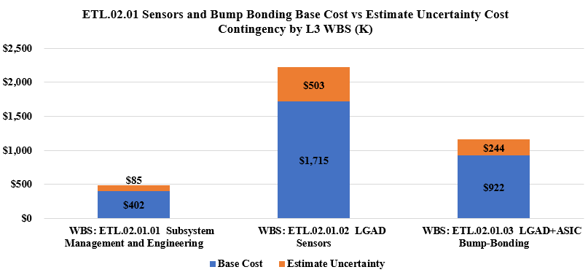
Cost Contingency
What was your strategy for assigning estimate uncertainty to your subsystem?

Slide 15
Schedule Development
Charge Questions – 2,5,6
The current schedule has been developed in close synergy with the international collaboration, based on our experience and the experience from collaborators during the R&D Phase of the project. Key milestones are :
LGAD Sensors
  Milestone: LGAD Sensors Start : March 1st 2023
  Milestone: LGAD Sensor Prototype and Testing at ORNL Complete : September 7th 2023
  Milestone: LGAD Sensor Preproduction and Procurement at ORNL Start : September 8th 2023
  Milestone: LGAD Sensor Preproduction and Procurement at ORNL Complete : March 15th 2024
  Milestone: LGAD Sensor Production at ORNL Start : March 11th 2024
  Milestone: LGAD Sensors Complete : May 20th 2025
Bump bonding
  Milestone: LGAD+ASIC Bump Bonding Start : March 01st 2023
  Milestone: Bump Bonding Prototyping and Testing at KU Complete : June 3rd 2024
  Milestone: Bump Bonding Preproduction and Procurement at KU and ORNL Start : June 4th 2024
  Milestone: Bump Bonding Preproduction and Procurement at KU and ORNL Complete : January 9th 2025
  Milestone: Bump-Bonding Production at KU and ORNL Start : May 25th 2025
  Milestone: LGAD+ASIC Bump Bonding Complete : July 14th 2026
The main external dependencies are associated to vendor lead time, which is subject to uncertainties. Internal dependencies are related to the delivery of ASIC from the ASIC Scope, the delivery of sensors to the bump bonding vendors for sensor assemblies which depend on the sensor scope

Slide 16
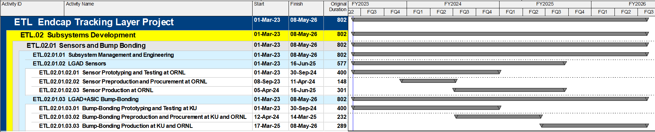
Schedule Development - Overview

Slide 17
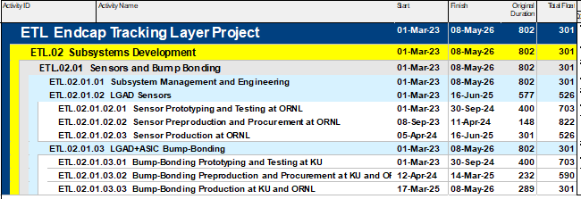
Schedule Development
Based on current planning, relative to the July 22, 2027, CMS ready for Installation underground date, the Sensors and Bump Bonding subsystem carries over a year of float.

Slide 18
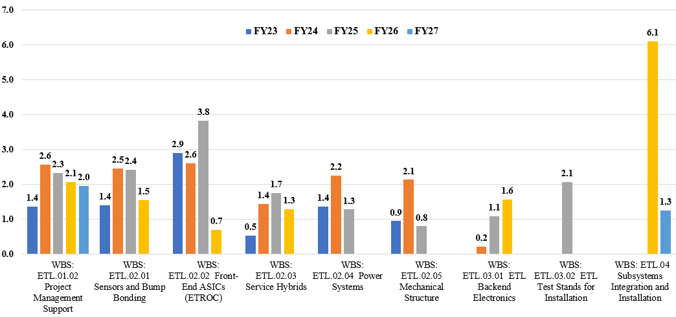
Resource Analysis – Total FTEs per Fiscal Year

Slide 19
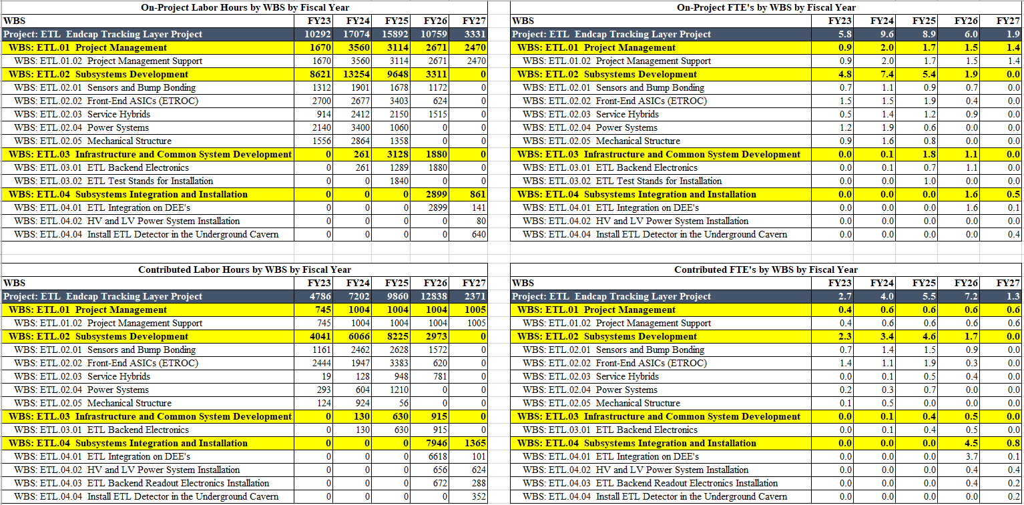
Resource Analysis – Hours and FTEs Contributed vs On-Project

Slide 20
Risk Management
Charge Question - 5
In addition to previously subsystem specific risks, these additional risks are considered in the risk register :
The following opportunities are also considered :
Lower cost for procurement of sensors (Likely, 20% savings)
Lower procurement cost of the bump-bonding hybridation services (Likely, 20% savings)
COVID/Pandemic Events
Higher Overhead Rates
Labor Resource Availability
Escalation on Material/Higher Material Cost
Funding shortfall or availability mismatch
Exchange Rate fluctuations affect the project cost in a greater than typical amount
Contractor Availability
Equipment Failures
Unforeseen Technical Issues
Additional, Unforeseen Design Required
The Loss of KEY Project Personnel
Procurement and Fabrication Delays
*Details available in risk register

Slide 21
Risk Management
Charge Question – 5,6
Regular meetings between the project management and subsystem managers will be held to carefully review the status of the schedule, assess the likeliness or listed risks and retired or add risks as the project is being executed.
Mitigation strategy for the risks listed will be applied
Ensure sharing of knowledge between key personnel involved
Keep close contact with vendors to ensure prompt notification of delays or production issues
Contract multiple vendors for large procurement
Simulate and anticipate production issues such as damage during transport by proceeding to exercise to assess likeliness and possible impact

Slide 22
Quality and ES&H
Charge Question - 6
Through the prototyping phase of the scope, a QA/QC document will be prepared as reference for the criteria to be used to assess and control the quality of the produced item
  The document will define specific characterization metrics to be acquired for each produced units
  The document will define the material and experimental setup to be used to carry the QA/QC during preproduction and production
  Through the preproduction and production, the defined QA/QC procedure will be followed to assess the quality of the production and provide feedback to project management on the state of the production
ES&H aspects of the project will be carefully assessed with the help of KU and ORNL ES&H representants
  Local and international ES&H policies will be followed and periodically assessed in collaboration with the ORNL and KU representants
  Best practices, guidelines and regulation regarding the COVID pandemic will be followed to ensure the safety and health of the labor involved in the project

Slide 23
Subsystem Management Strategy
Charge Question - 6
The sensors and bump-bonding subsystem will be managed by the project manager
  Weekly meeting will be planned with the involved project managers at KU and ORNL to assess the status of the project and identify possible issues
  The statusing of the schedule will be performed monthly by the managers in collaboration with personnel to keep track of the project evolution and produce EVMS metrics that will be used by project management to evaluate the state of the project execution and identify possible issues
  The risk register will be periodically scrubbed to retired past risks and identify new risk that can occur during project execution

Slide 24
Summary
The sensor and bump bonding subsystem covers the prototyping and production of LGAD sensors and their hybridation to the ETROC ASIC by bump bonding for the construction of modules for the CMS ETL
The established schedule and cost are based on expert opinion and previous experience, along with preliminary vendor quotes when available
The risks associated to the subsystem have been recorded in terms of management uncertainties and risks/opportunities in the risk register
The Management strategy as been established and will be followed during project execution
The TRL (5)of the subsystem is at a sufficient level to proceed with project execution
Quality and ES&H are being considered at every step of the project and will follow best practices, guidelines and regulations .

Slide 25
Discussion

