Slide 1





Endcap Timing Layer Project
WBS 01.02.02 – Front-End ASIC’s (ETROC)
WBS 01.03.01 – Back-End Electronics
Subsystem Scope, Cost, Schedule and Risk
Subsystem Manager: Zhenyu Ye (UIC)
Review Date: June 15, 2022
Notes:
Briefly introduce yourself:
CAM for xx System
Experience with …
Good design team with mix of skills

Slide 2
Scope Overview
Project Organizational Chart

Slide 3
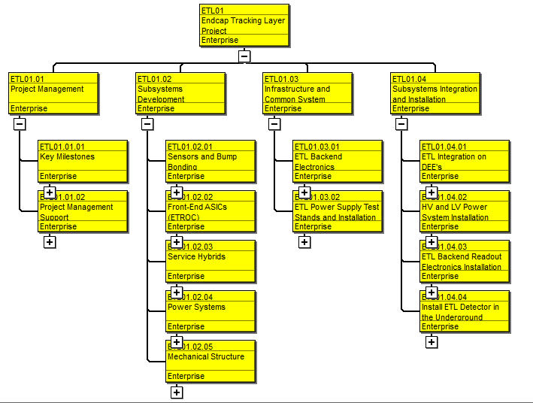
Scope Overview
Charge Question – 1
Project WBS Overview

Slide 4
Scope Overview - 01.02.02 Front-End ASIC (ETROC)
Charge Question - 1
ETL Module
What is ETROC:
front-end ASIC bump-bonded to LGAD, to read out 16x16 pixels, each 1.3 mm x 1.3 mm
Requirement:
ASIC contribution to time resolution < 40ps
Deal with small signal size: ~20fC down to ~10fC
Power consumption < 1W/chip
L1 buffer latency: 12.5 us
Radiation hardness: tolerate 100 Mrad TID
ETROC Building Blocks
Desirable:
waveform sampler for 1-2 pixels for monitoring and calibration purpose

Slide 5
Scope Overview - 01.02.02 Front-End ASIC (ETROC)
Charge Question - 1
ETROC0: single channel with preamp + discriminator - submitted Dec 2018
Status: preamp and discriminator functional; jitter and power consumption match with simulation,
TID test at 100Mrad good, tested with wire-bonded LGAD in test beam with ~30 ps resolution
ETROC1: 4x4 clock tree, preamp + discr + TDC - Aug 2019
Status: TDC and bare ETROC1 works well; tested with bump-bonded LGAD in beam with ~ 42-46 ps resolution, led by UIC
01.02.02 (Scope)
ETROC2: 16x16 clock tree - Jul 2022
Goal: supporting circuitries, PLL, waveform sampler, fast/slow control, L1 buffer, …
Bench, beam, irradiation test
Probe testing development
ETROC3: 16x16 full functionality - Mar 2024
Goal: intended as pre-production
ETROC: final production chip - Mar 2025
Goal: 40k good ETROCs by Sept 2025
Purchase of 50% wafers, QA/QC
16x16 clock tree for ETROC

Slide 6
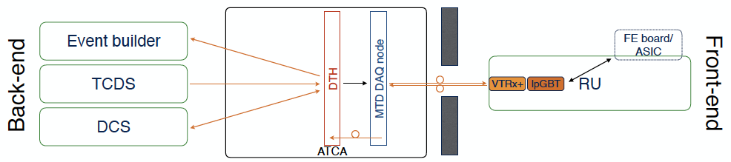
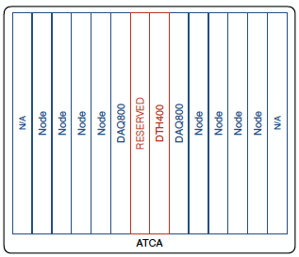
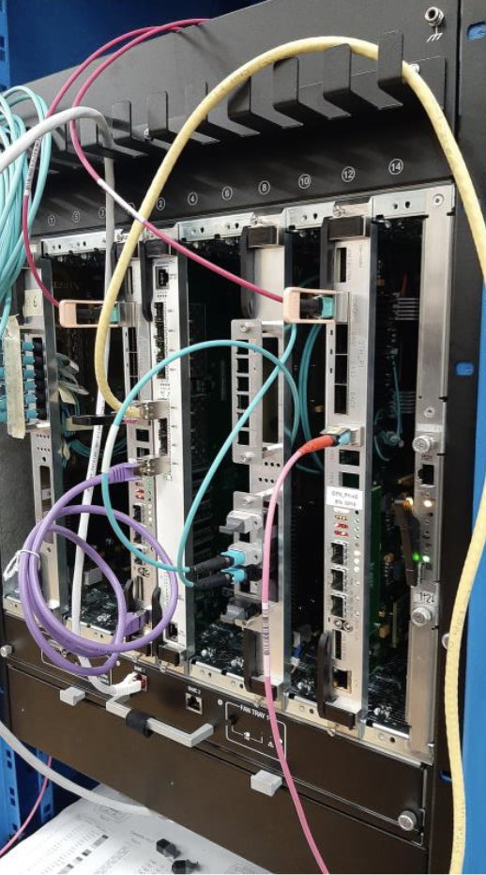
Scope Overview - 01.03.01 Back-End Electronics
Charge Question - 1
ETL Backend Electronics consists of 2 ACTA crates, 2 DTH400 boards, 4 DTH800 boards, and 14 DAQ boards
Receive and distribute trigger, clock and control signals to front-end
Receive and analyze timing and monitoring data, and send the data to central DAQ

Slide 7
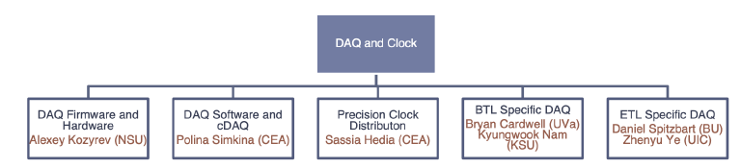
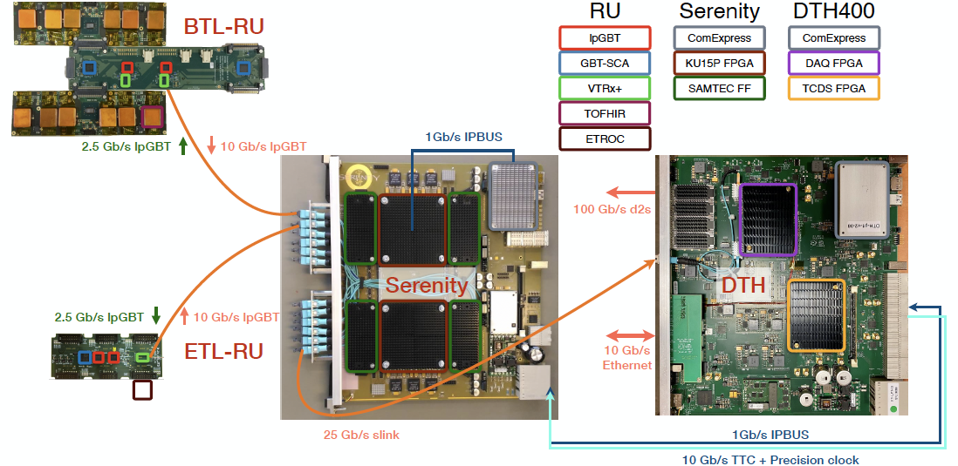
Scope Overview - 01.03.01 Back-End Electronics
Charge Question - 1
01.03.01 (Scope)
Contribute to FPGA firmware development utilizing knowledge and experience from ETROC3 testing
Purchase of 50% of hardware
Burn-in test

Slide 8
Cost Development
Charge Question – 2
Purchase of 50% of ETROC production wafers: 475*0.5 wafers (3940 CHF per wafer from historical cost based on CERN contract with IMEC B1379/PH/LHC)
Purchase of 50% of backend electronics: 1 ACTA crate (9k CHF), 1 DTH400 (12k CHF), 2 DTH800 (12k CHF each) and 7 DAQ boards (15k CHF each) from engineering estimate
Testing setup for front-end ASICs: probe station (quoted $150k), $10k probe cards (expert opinion), $50k of other testing equipment (historical cost)
Two iterations of prototyping for front-end ASICs - ETROC2/3: development of setup and procedure for bench, beam and irradiation tests for ASICs mounted on carrier boards, and development of probing test on the wafer level
Contribution to ETL DAQ firmware development: utilizing knowledge and experience from ETROC3 testing setup development (expert opinion)
Labor rates and hours: expert opinion by MTD L3 Front-End ASIC and L2 DAQ managers

Slide 9
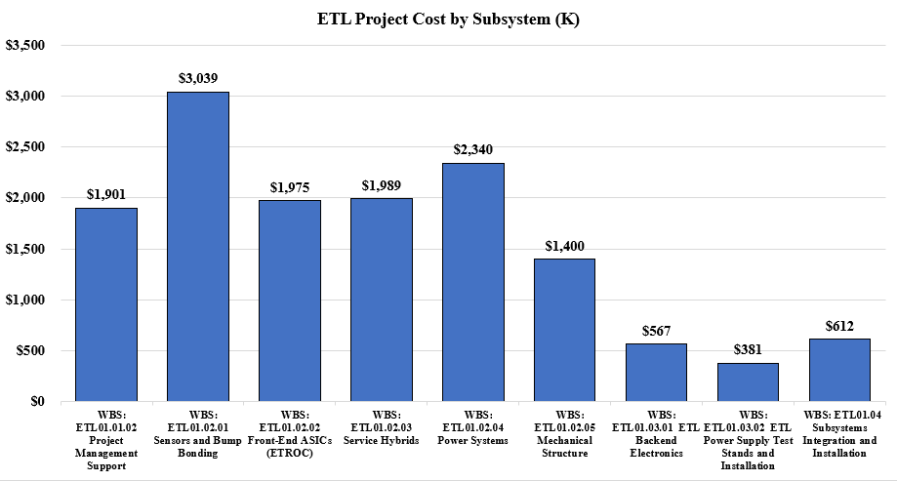
Cost Overview – Subsystem Relative Cost

Slide 10
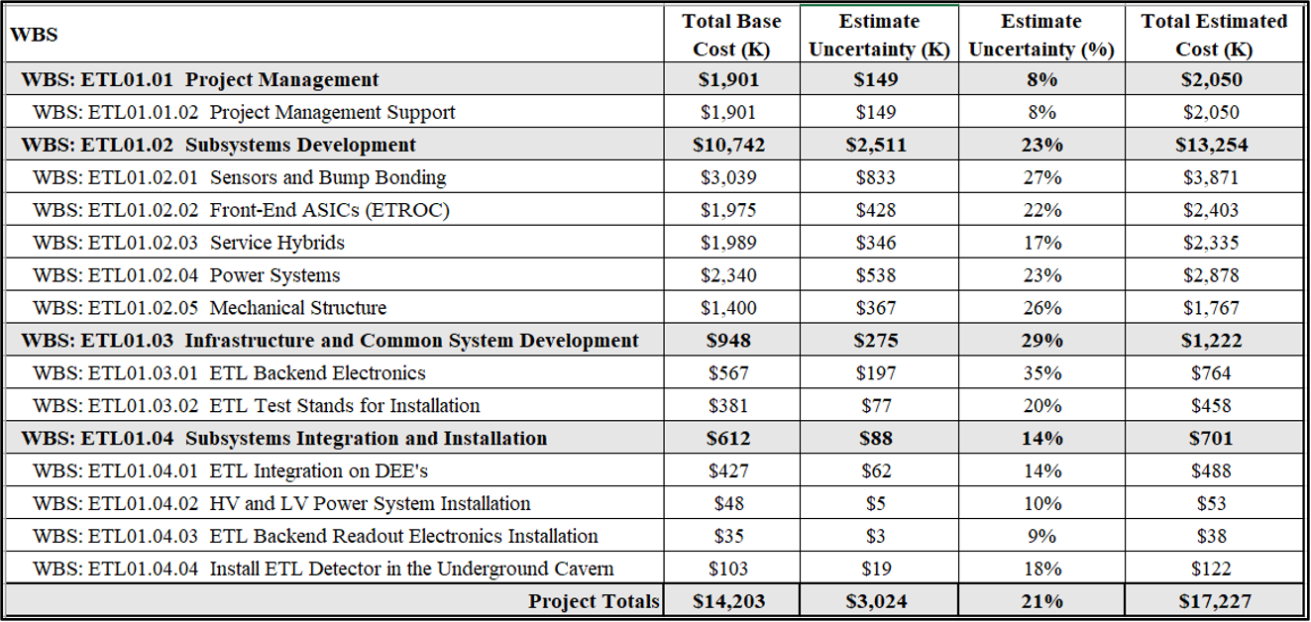
Cost Overview – Base Cost and Estimate Uncertainty

Slide 11
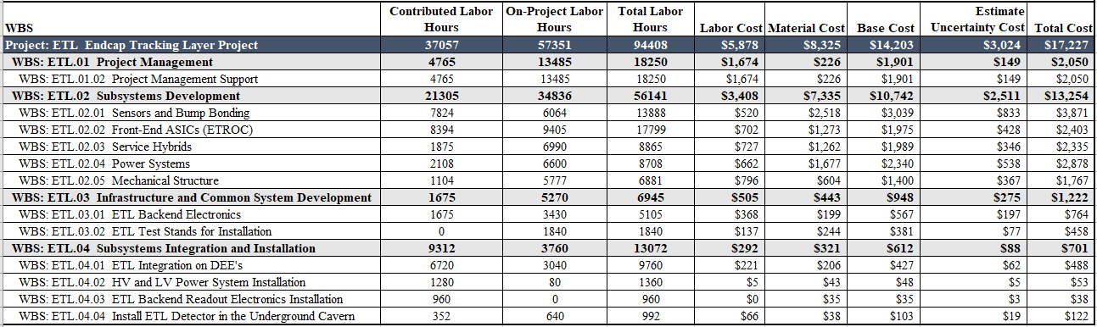
Cost Overview – Labor Hours and Cost

Slide 12
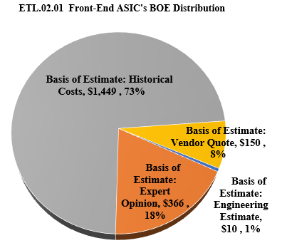
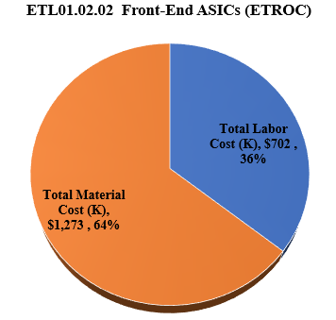
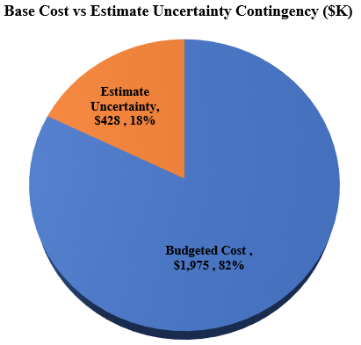
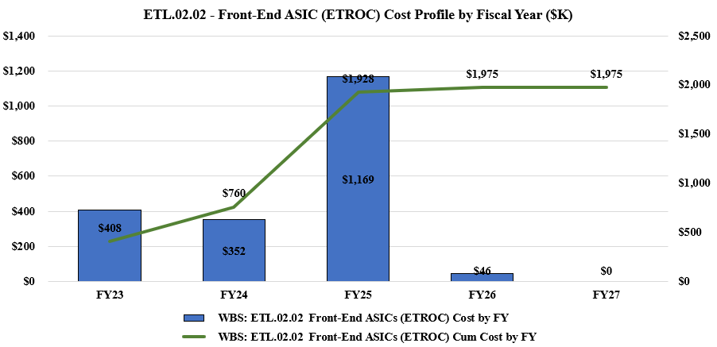
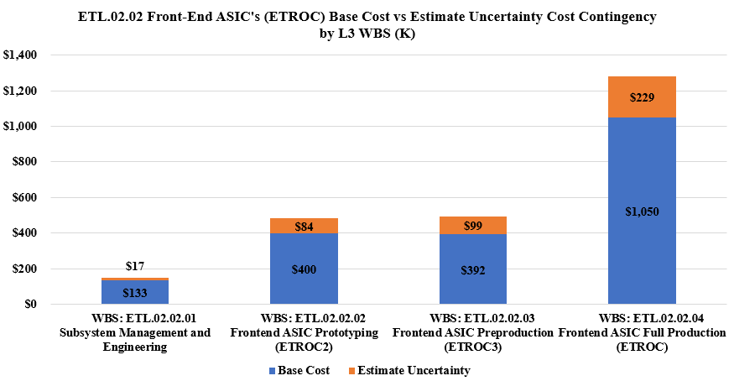
Cost Overview – 01.02.02 Front-End ASIC (ETROC)
Charge Question - 2

Slide 13
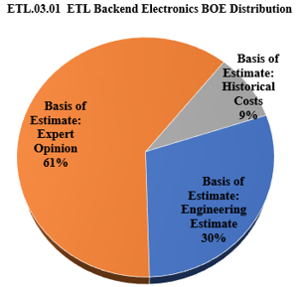
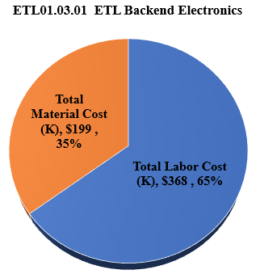
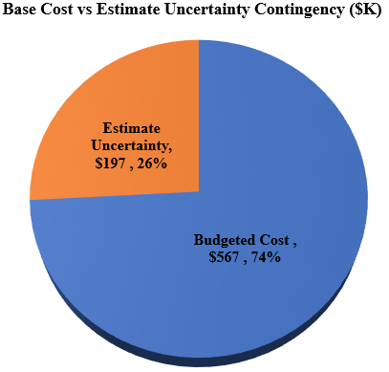
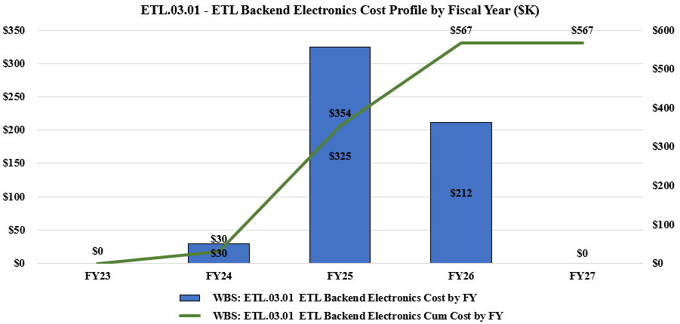
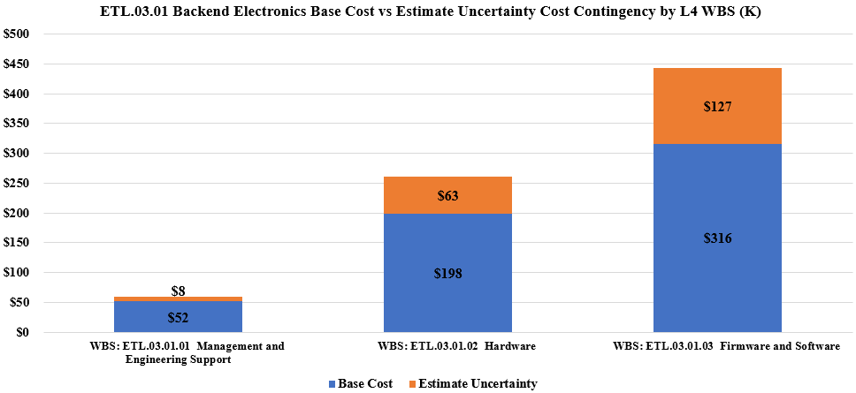
Cost Overview – 01.03.01 Backend Electronics
Charge Question - 2

Slide 14
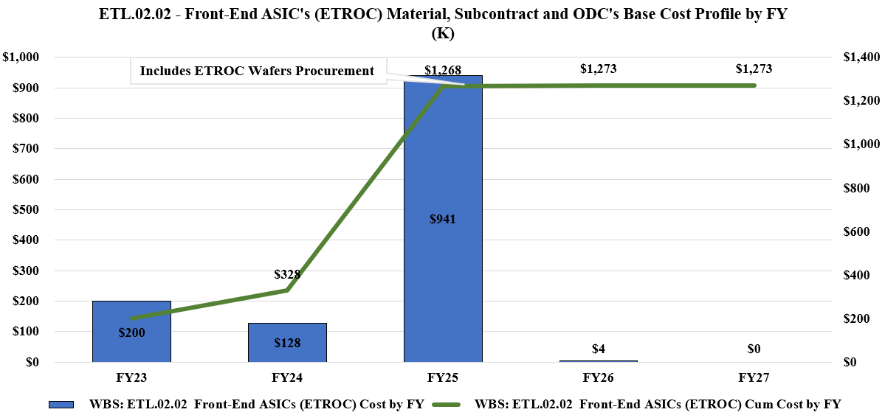
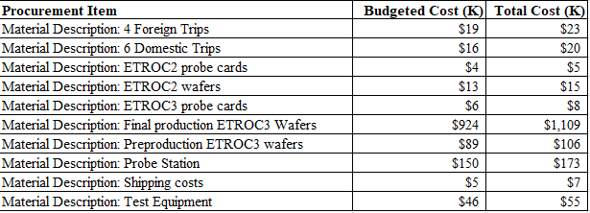
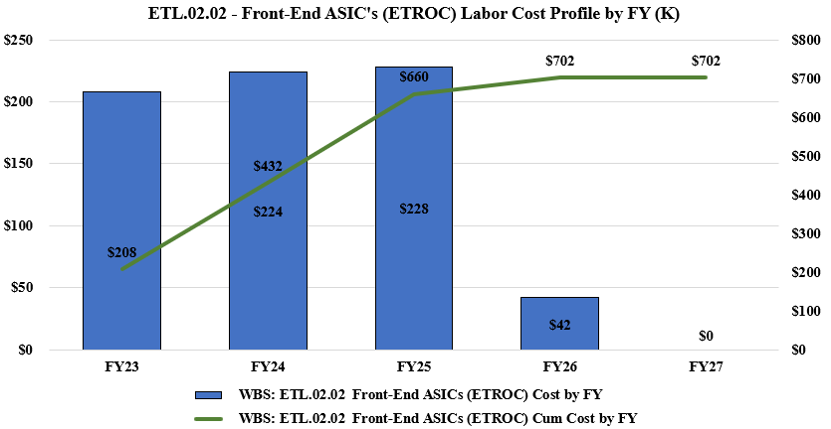
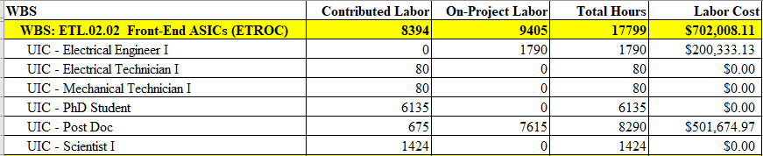
Cost Overview – 01.02.02 Front-End ASIC (ETROC)

Slide 15
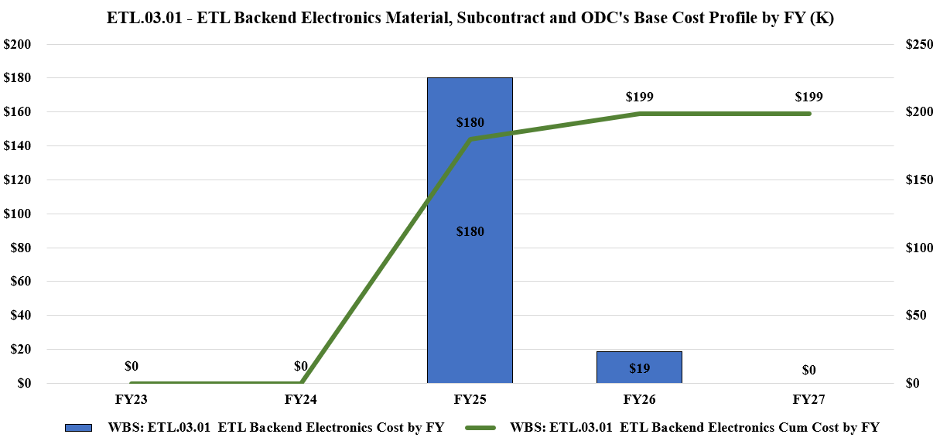
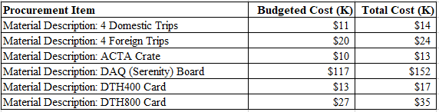
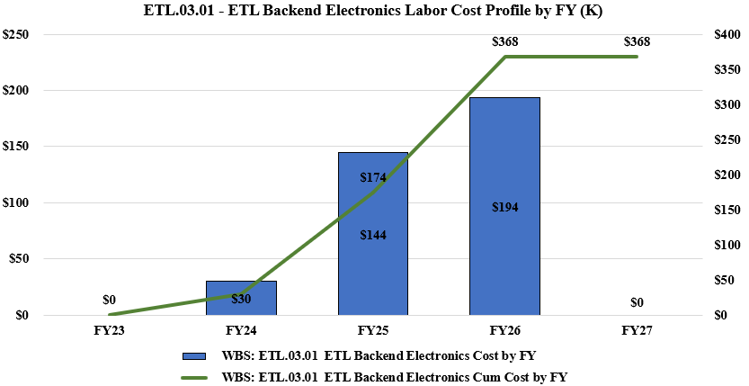
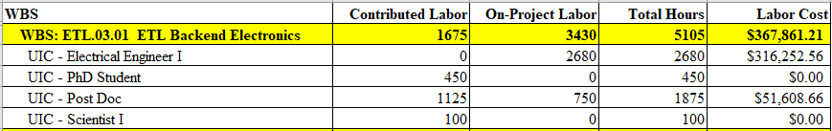
Cost Overview – 01.03.01 Backend Electronics

Slide 16
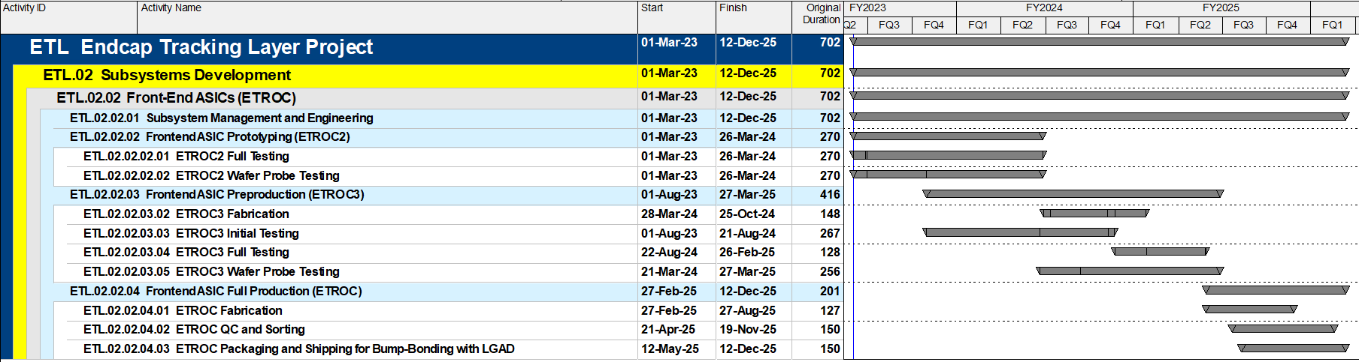
Schedule Development – 01.02.02 Front-End ASIC (ETROC)
Charge Question – 2, 5, 6
Submission of ETROC3 (March 2024) after full functionality and irradiation test of ETROC2
Final ETROC production (Feburary 2025) after full functionality and irradiation test of ETROC3
Parallel development of ETROC wafer-level probing test setup and procedure with ETROC2/3
Risk in possible schedule delay if prototype or preproduction does not meet the specification
This subsystem lands on the critical path against the forecasted subsystem completion date. The critical path flows through ETROC2 prototype and ETROC3 preproduction. A delay of this subsystem will lead to delay in bump-bonding and module assembly. Together these activities carry over 9 months of float.

Slide 17
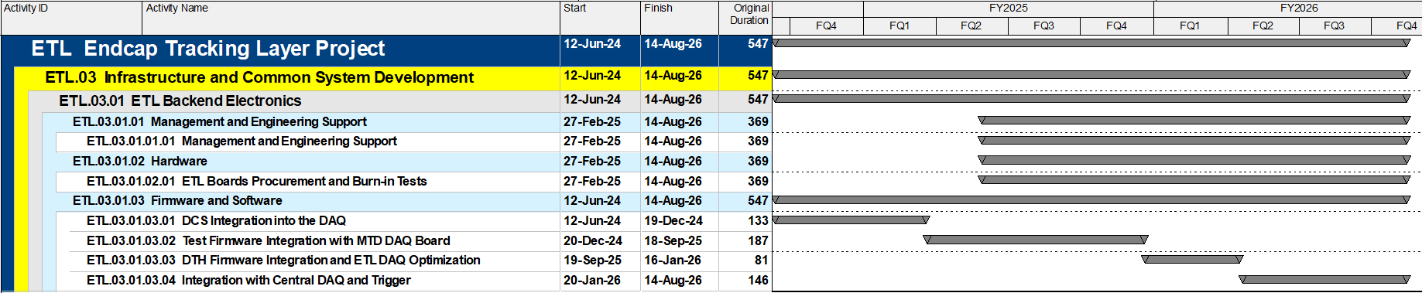
Schedule Development – 01.03.01 Backend Electronics
Charge Question – 2, 5, 6
Procurement of backend electronics hardware will start after ETROC3 functionality & irradiation testing
ETL DAQ firmware development will start after firmware development for ETROC3 testing
Possible delay in schedule can come from delay from vendors on hardware components
Based on current planning, relative to the July 22, 2027, CMS Ready for Installation Underground date, the Backend Electronics subsystem finishing in August 2026, carries nearly 1 year of float.

Slide 18
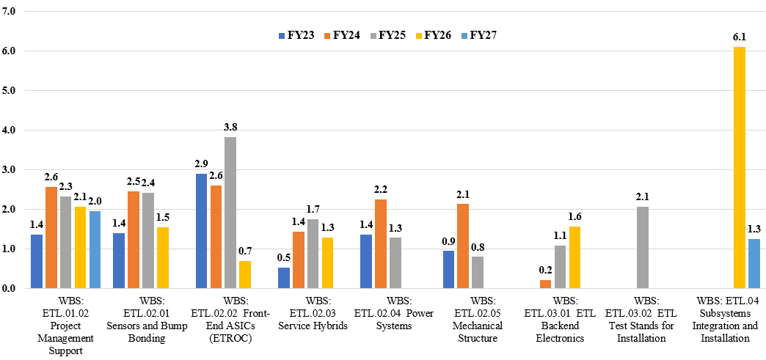
Resource Analysis – Total FTEs per Fiscal Year

Slide 19
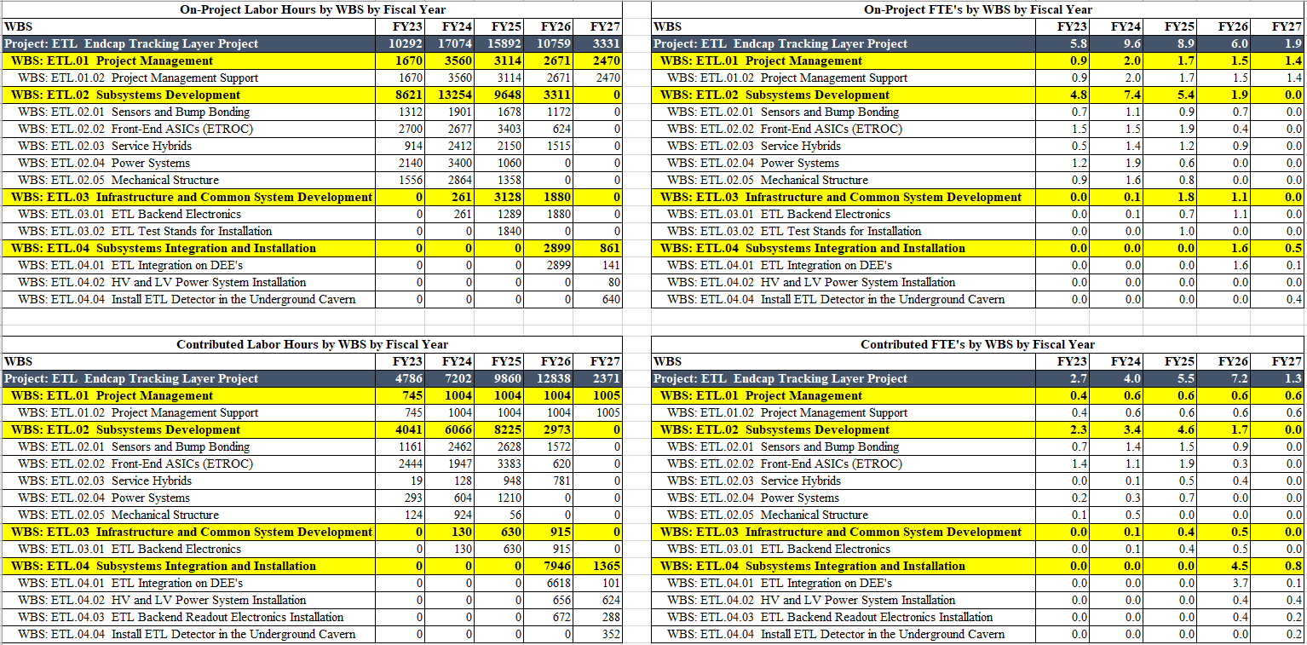
Resource Analysis – Hours and FTEs Contributed vs On-Project

Slide 20
Risk Management - 01.02.02 Front-end ASIC (ETROC)
Charge Question - 5
Prototype does not meet specification (Significant)
  Additional prototype cycle is needed, which can lead to cost increase and schedule delay
  Risk Mitigation: carry out extensive design simulation and verification. Test key functionality in earlier prototypes.
Pre-production ASIC does not meet specification (Significant)
  Additional pre-production run is needed, which can lead to cost increase and schedule delay
  Risk Mitigation: test full functionality in ETROC2 and use extensive design simulation and verification before submission.

Slide 21
Risk Management - 01.03.01 Backend Electronics
Charge Question - 5
MTD DAQ board overheating problem (Negligible)
  Need a few additional boards or crates
  Risk Mitigation: Special heatsinks are being designed by the board designers. ATCA test crates mimicking the operational crates are simulated and being tested.
MTD DAQ board optical transceiver failure (Negligible)
  Transceiver performance degradation due to overheating
  Risk Mitigation: Heat dissipation is simulated and tested under synthetic loads. Special heatsinks are designed. The error monitoring will be implemented in the DAQ FPGA.
Delay in MTD DAQ board (Negligible)
  Delay may occur due to technical difficulty or supply problem
  Risk Mitigation: consider multiple options for DAQ board design
Delay in external common-component delivery (Negligible)
  DTH integration and DAQ commission may get delayed. Not on critical path
  Risk Mitigation: maintain close contact with the manufacturers and designers.

Slide 22
Quality and ES&H
Charge Questions - 6
QA/QC is an integral part of the subsystem development
01.02.02 Front-End ASIC:
  intensive bench, beam, irradiation tests for ETROC2 and ETROC3 to ensure they are consistent with design specification
  develop wafer-level probe-testing procedure and criteria with ETROC2 and ETROC3
  Probe-test each ETROC production wafer after receiving it from the vendor and before bump-bonding with LGAD sensors
01.03.01 Backend Electronics:
  Hardware and firmware will be prototyped during development phase
  Full system burn-in tests after final hardware and firmware are available
ES&H will follow the policies and guidelines at the working sites.

Slide 23
Management Strategy
Charge Questions - 6
Subsystem manager Ye (in-kind) and postdoc (on-project) will monitor the progress of the projects, register new risks and retire expired risks, calling regular meetings within the subsystem itself and attending the meetings and periodic reviews with other subsystems.
UIC Electric engineers, Postdocs, PhD students will work in the large ETL collaboration on front-end ASIC testing and backend electronics firmware development.

Slide 24
Summary
We propose to contribute to CMS ETL front-end ASIC and backend electronics, including
  50% of ”CORE” contribution (M&S for production)
  Testing of prototype front-end ASICs
  Final production ASIC wafer QA/QC
  Backend DAQ firmware development
The proposed contribution is in line with UIC group’s expertise and experiences in front-end ASIC testing and Silicon detector design and fabrication (3D VICTR chip, ETROC0 and ETROC1, STAR Intermediate Silicon Tracker, STAR Forward Silicon Tracker)
The activities are anticipated to start in March 2023 and end in Aug 2026. Management plan, cost estimate and risk assessment are presented, together with cost contingency and risk mitigation plan.

