Slide 1





Endcap Timing Layer Project
WBS 01.02.05 – Mechanical Structure
Subsystem Scope, Cost, Schedule and Risk
DOE Review Backup Material
Subsystem Manager: Boleslaw Wyslouch (MIT)
Review Date: June 14-16, 2022
Notes:
Briefly introduce yourself:
CAM for xx System
Experience with …
Good design team with mix of skills

Slide 2
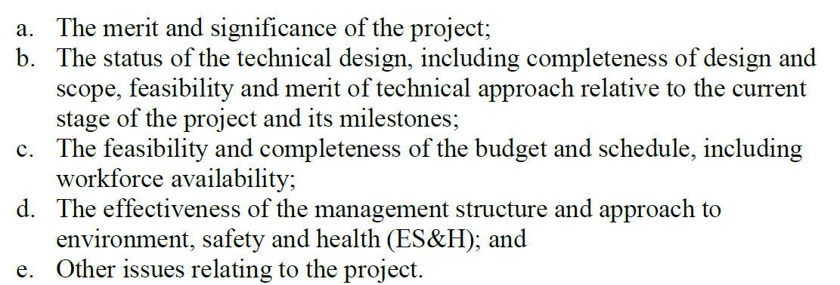
DOE Charge

Slide 3
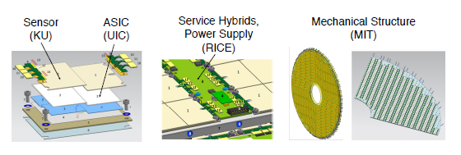
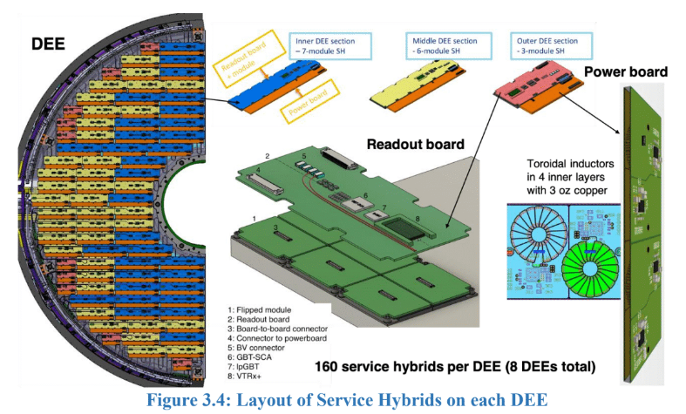
Scope Overview: Mechanical Structure for ETL
Support for layers of ETL sensors and electronics on the CMS endcap
Defines environment for sensor operation: ~-30 C via CO2 cooling, <10kW/endcap
Has to fit in a limited space along z-axis
Conceptual design is well advanced
Final design, prototyping and fabrication will be the responsibility of MIT Bates Research and Engineering Center

Slide 4
MIT Bates Research and Engineering Center
Bates was a site of an electron accelerator, DOE user facility until 2005
After the end of operations the engineering personnel established DOE NP supported “Center of Excellence” specializing in Mechanical Engineering
About 15 engineers and technicians working on various projects, mostly related to Nuclear Physics at National Laboratories
Designing detector support structures (MVTX @ sPHENIX, GlueX @JLAB), Vacuum and beams (nEDM@ORNL, RiSe@FRIB), magnets (MOLLER@JLAB) plus many other non NP projects
Very well plugged into the worldwide network of manufacturers
A team of an engineer, designer and project manager will be available to design and produce the ETL mechanical structure.

Slide 5
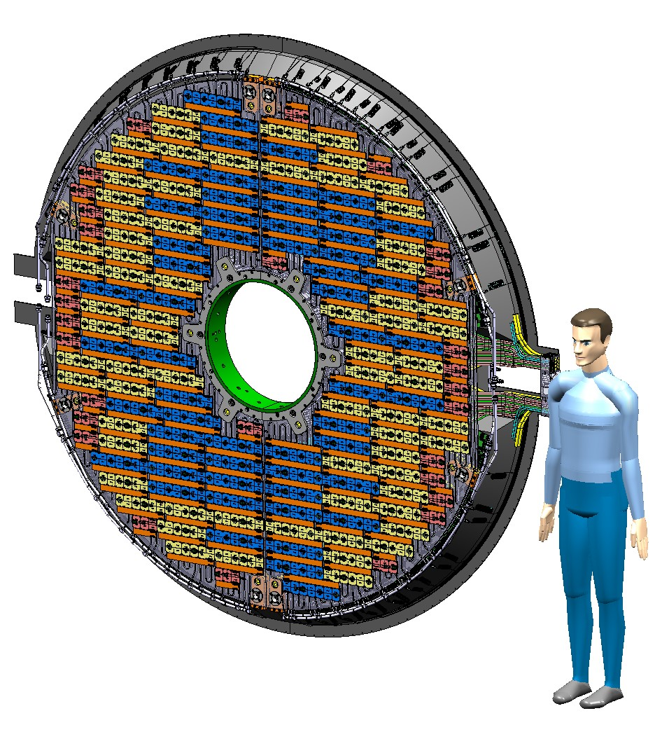
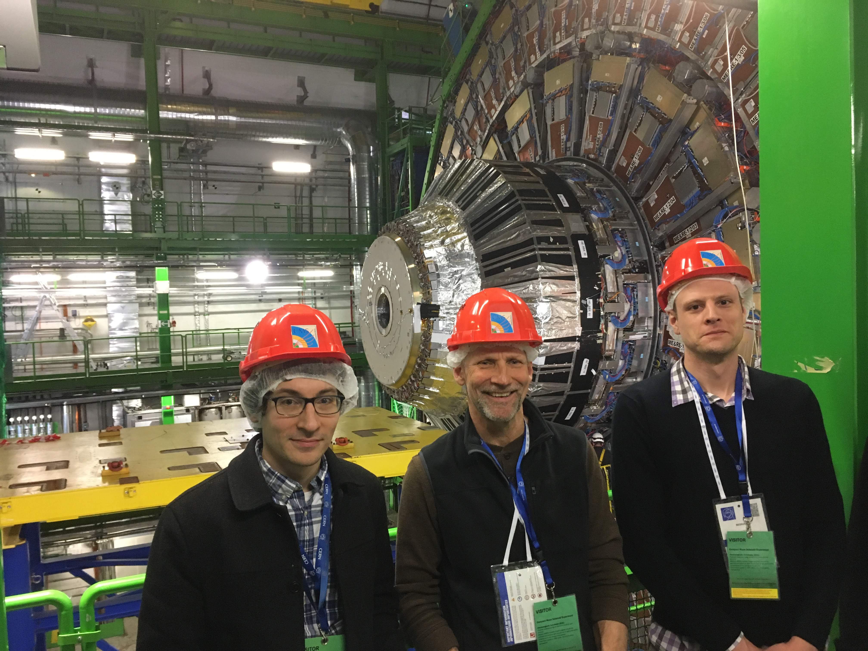

Scope Overview: Big Picture
ETL will be a ring of approx. 2.6m diameter, 10 cm thick, mounted on the new forward hadronic calorimeter

Slide 6
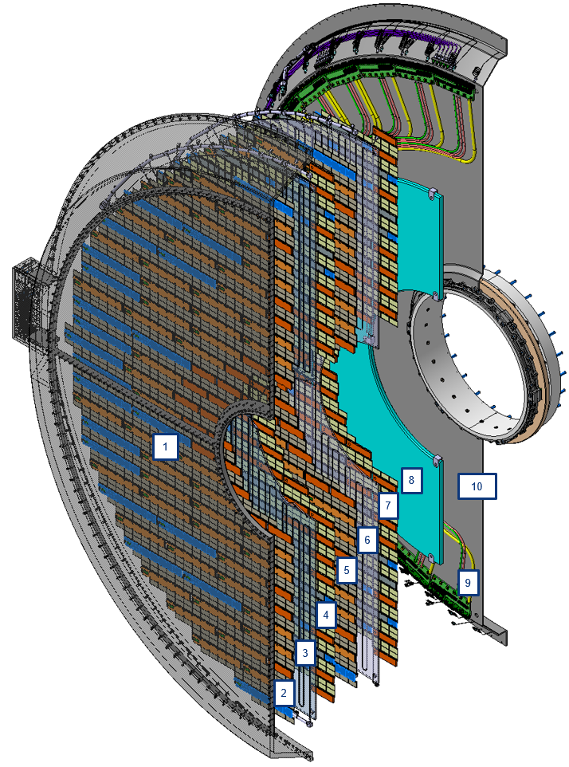
ETL building blocks
Element | Elements in Z
1 | Thermal screen
 | Gap between thermal screen and front disc
2 | Front face of electronics of the front DEE
3 | Front disc
4 | Rear face of electronics of the front DEE
 | Gap between front and back discs
5 | Front face of electronics of the back DEE
6 | Back disc
7 | Rear face of electronics of the back DEE
 | Gap between cables and back disc
8 + 9 | Patch panels 0 + cables [9] + moderator [8] at the innermost section
10 | Back support plate
 | Gap between ETL back support plate and HgCal thermal screen

Slide 7
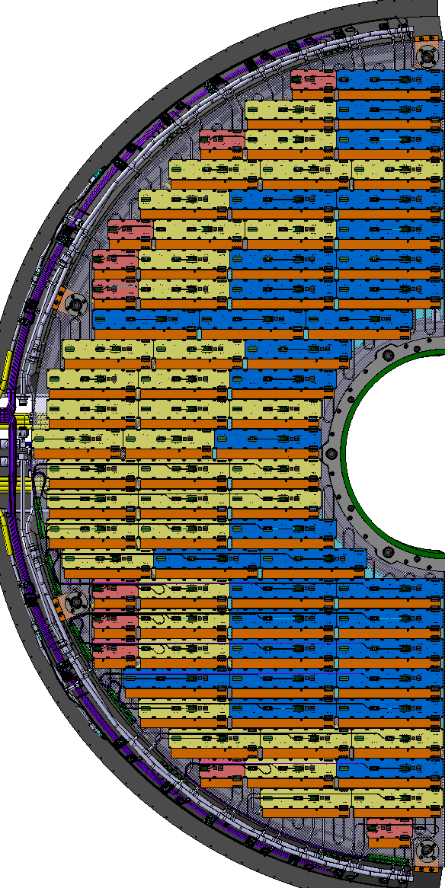
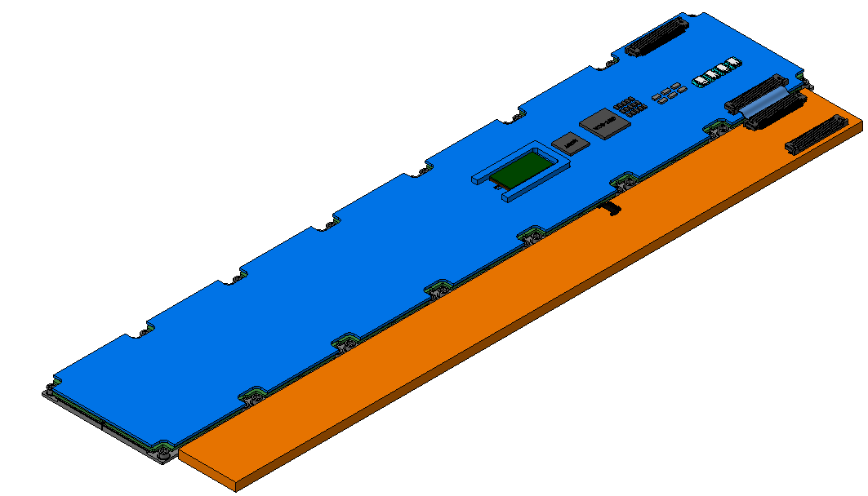
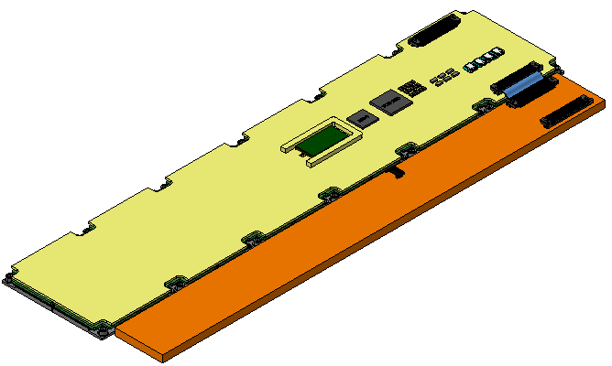
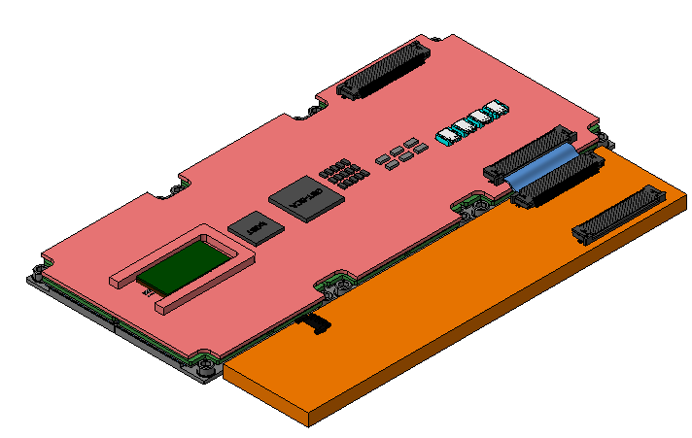
Scope Overview: Module placement
Inner DEE section
– 7-module SH
Middle DEE section
- 6-module SH
Outer DEE section
- 3-module SH
Readout board
+ module
Power board
  2 x LV AWG 18
  8 x BV AWG 30 (4 supplies + 1 return)
  2 x DSS AWG 30
  3 fibers
  2 x LV AWG 18
  4 x BV AWG 30 (3 supplies + 1 return)
  2 x DSS AWG 30
  3 fibers
  2 x LV AWG 18
  2 x BV AWG 30 (1 supply + 1 return)
  2 x DSS AWG 30
  3 fibers
Need to balance of phase space coverage and mechanical requirements
Careful evaluation of cooling and power distribution
Interplay between mechanical structure and module design

Slide 8
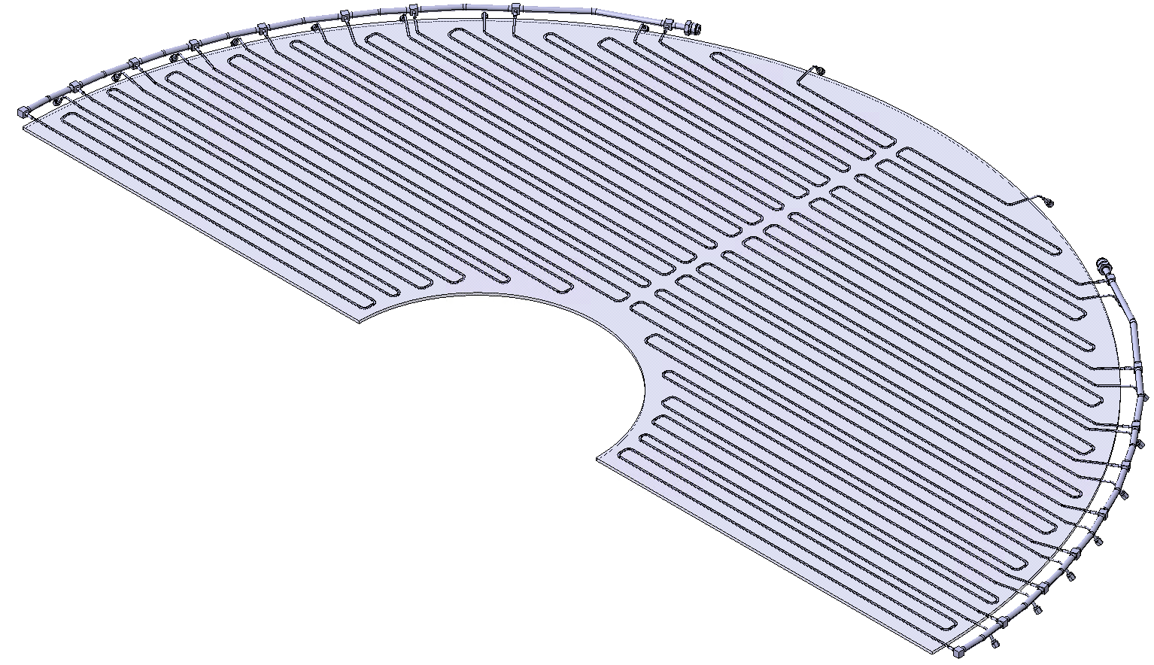
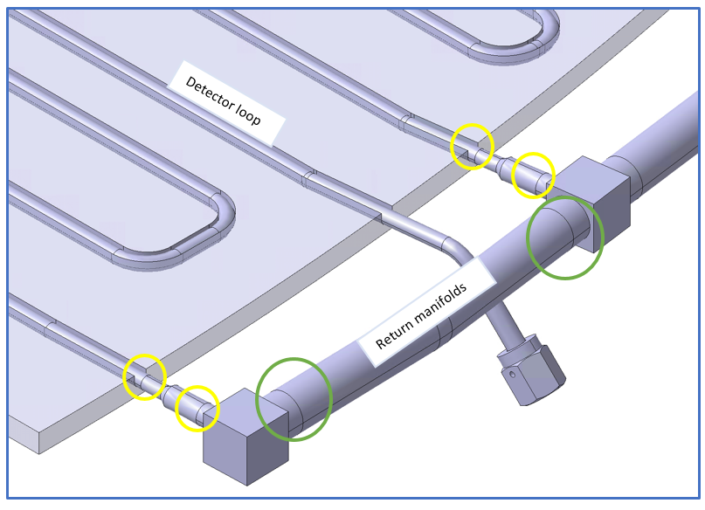
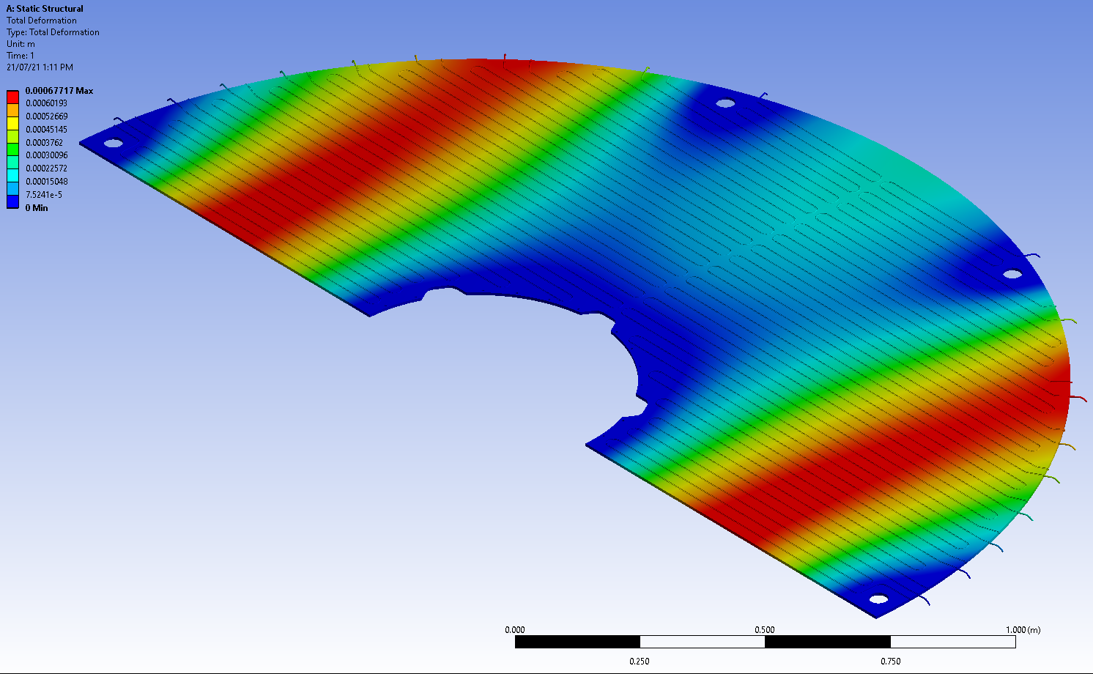
Cooling discs – DEE mechanics
One detector END consists of four 180deg segments, so called DEEs made out of Aluminum
Each segment is cooled down by one manifold with set of 18 cooling loops.
For given plate thickness, depending on the manufacturing process, the thickness tolerance can be maintained within +/- 0.005” (0.127mm), the flatness tolerance +/-0.015” (0.381mm).
While disc is place horizontally, under maximum load of mounted electronics and services, the disc deformation can reach 0.7mm as shown in the preliminary ANSYS simulation.
DEE – 180 deg segment

Slide 9
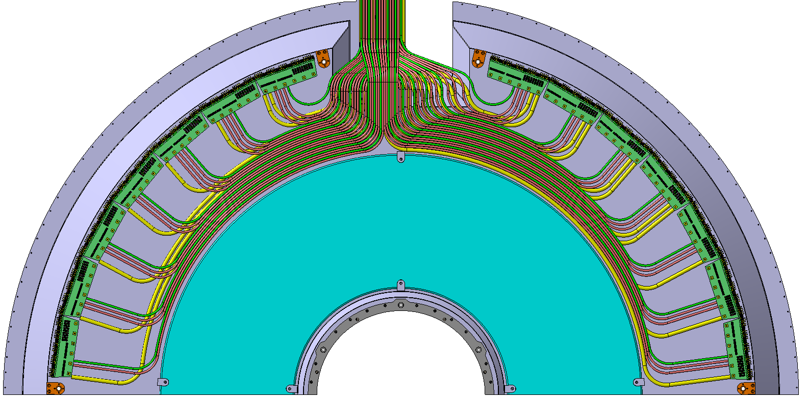
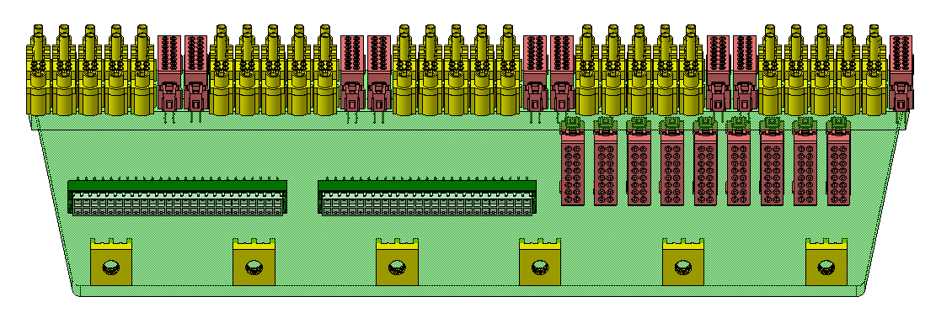
ETL – back plate and services in cold volume
Back plate will be made out of carbon fiber, shaped to attach to the rest of CMS and to support the two DEEs
It will contain cables, neutron moderator and patch panels
Detailed engineering study of production methods, cost and manufacturers is available from CERN
340mm
460mm
1000mm
Front moderator
- 20mm thick
400mm
850mm

Slide 10
Scope Overview
Project Organizational Chart

Slide 11
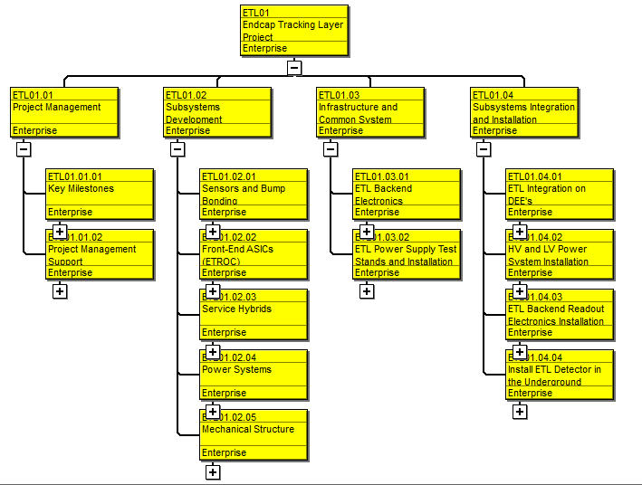
Scope Overview
Project WBS Overview

Slide 12
Cost Development
Charge Question - 2
CERN engineer Natalia Koss has developed a very detailed design for the mechanical structure and associated services.
The plan for MIT Bates engineers is to join forces with CERN and finalize the design and produce the final structure. This includes detailed structural and thermal simulations and interface with all other ETL systems
The cost and schedule estimate was developed by detailed discussion of each individual activity in the plan between CERN and MIT engineers
The length of tasks (labor) needed to complete the project was estimated using engineers’ experience working on similar NP and HEP projects.
The cost of manufacturing of the elements of the structure (materials) was estimated either by scaling up from the small prototypes or by similarity with other experiments and knowledge of the manufacturing capabilities available to MIT
The team is now in the process of obtaining quotes for manufacturing of major elements

Slide 13
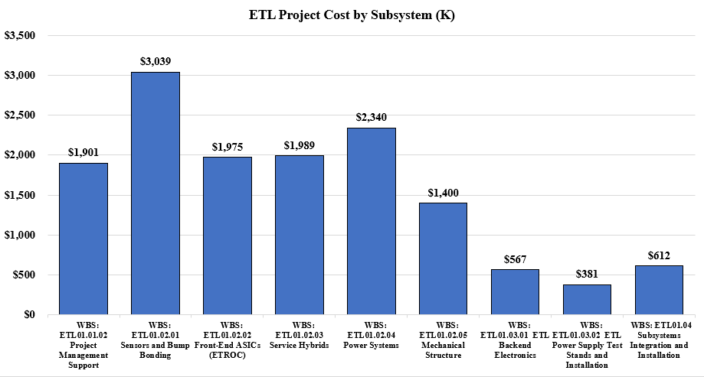
Cost Overview – Subsystem Relative Cost

Slide 14
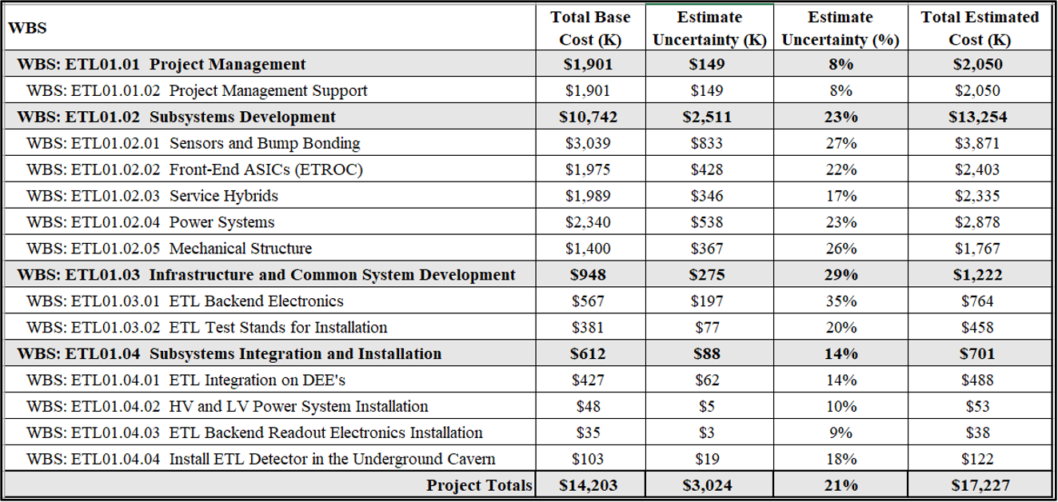
Cost Overview – Base Cost and Estimate Uncertainty

Slide 15
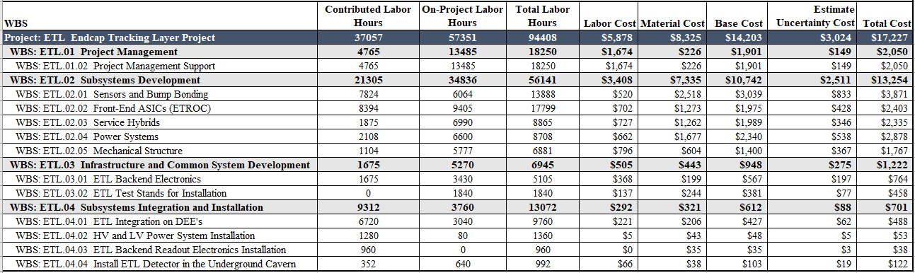
Cost Overview – Labor Hours and Cost

Slide 16
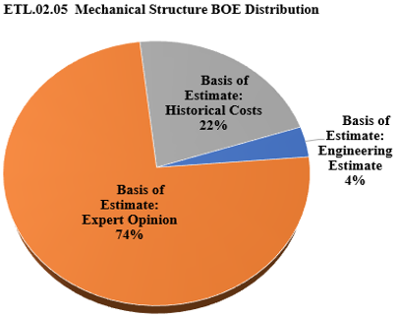
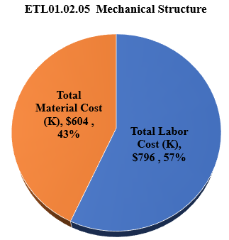
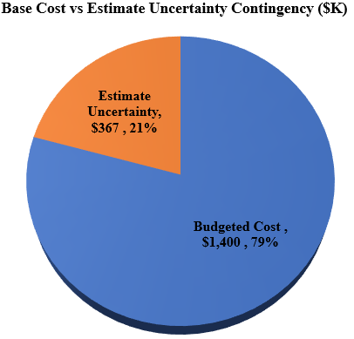
Cost Overview

Slide 17
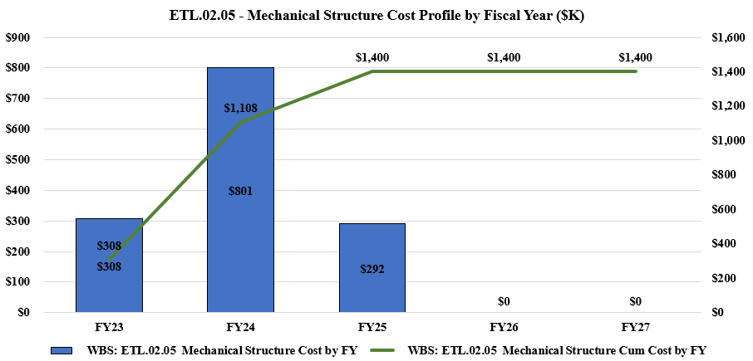
Cost Overview - Profile

Slide 18
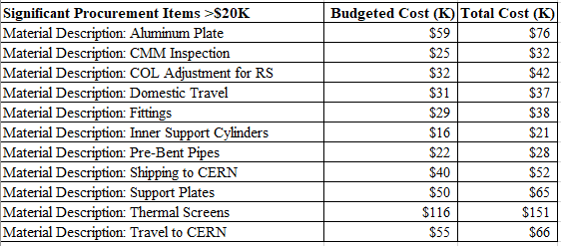
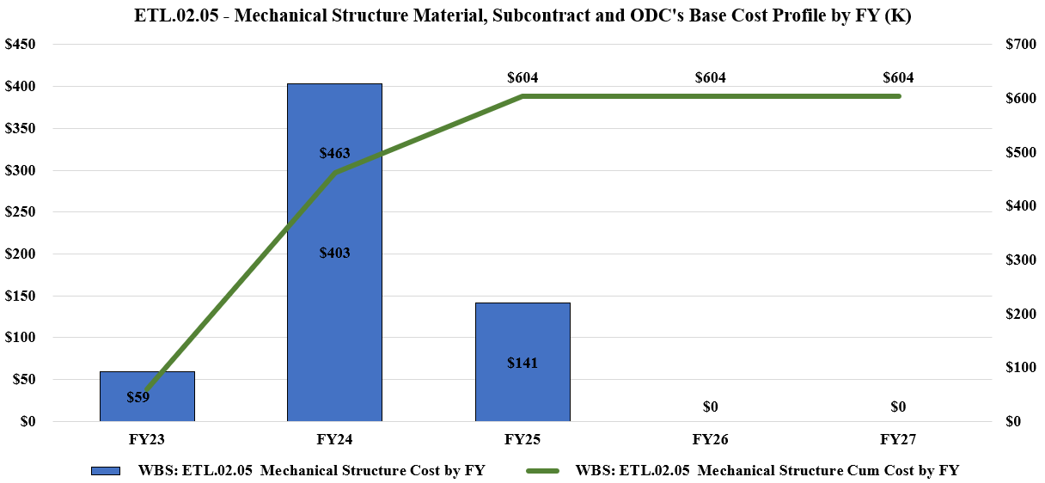
Cost Overview – Procurements

Slide 19
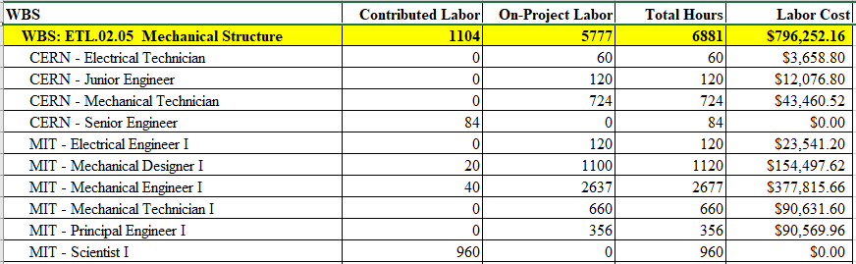
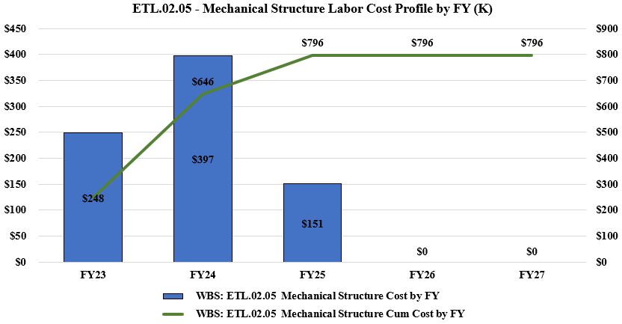
Cost Overview - Labor

Slide 20
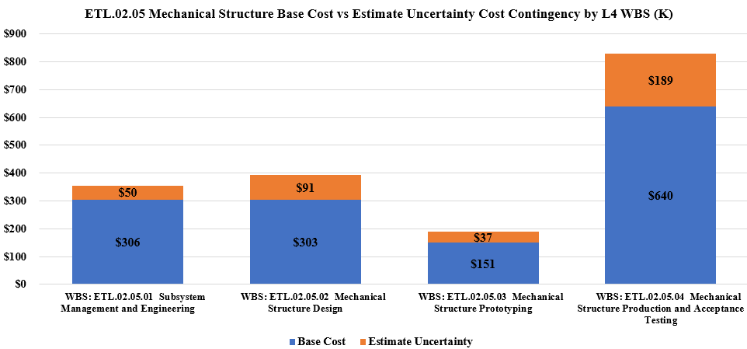
Cost Contingency
Duration of the final design was estimated by the engineers, based on past experiences and the existing conceptual design. The uncertainty was allocated for each activity. Many of the truly new designs and activities were Expert Opinion (~30%) and most others were Historical Costs (~15%). This is based on the experience at CERN and at MIT Bates and it includes several small prototypes built to-date. We expect for this to be improved shortly, when the MIT Bates engineers fully engage with this project

Slide 21
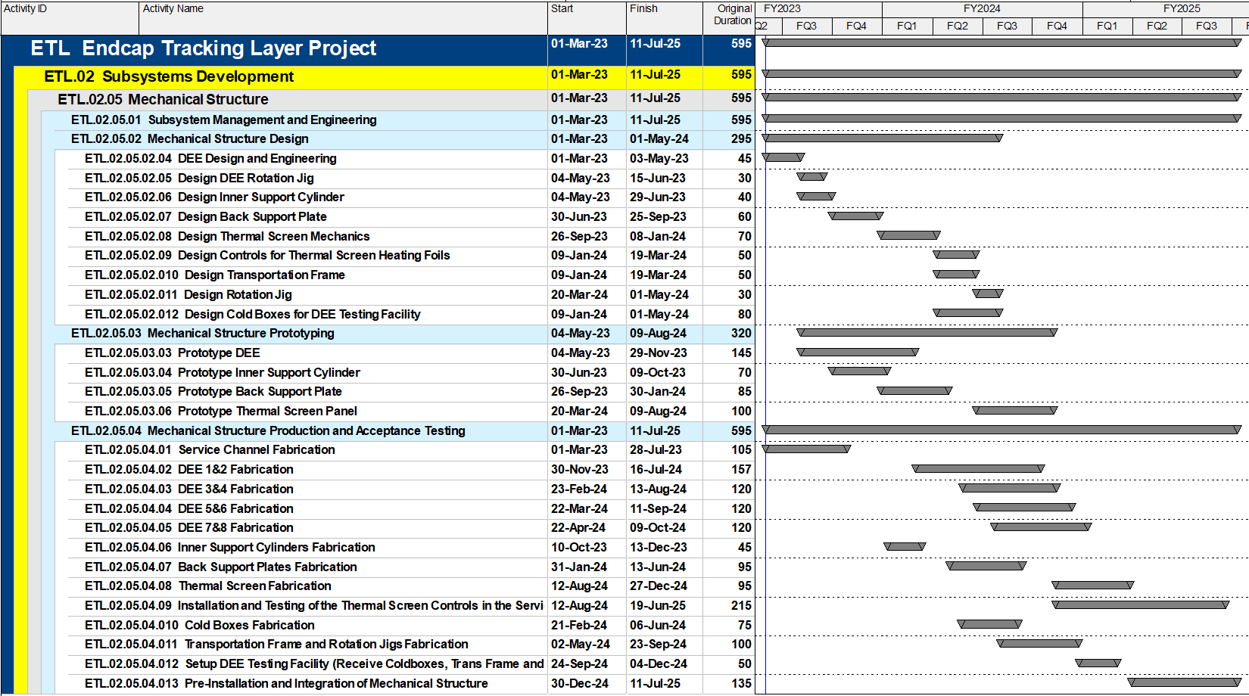
Schedule Development - Overview
The duration and sequence was developed by the detailed analysis of each individual task and estimated using the experience of CERN and MIT engineers
The start date was assumed to be on March 1, 2023. End date of June 2025 coincides with the first availability of ETL modules and the start of integration
MIT Bates engineers often work on more than one project such that fraction of their time on the project can be less than 100%
All the elements of the mechanical structure follow similar pattern: final design, one prototype, fabrication of all elements, acceptance testing and shipment to CERN.

Slide 22
Schedule Development
Based on current planning, relative to the July 22, 2027, CMS Ready for Installation Underground date, the Mechanical Structure subsystem finishing in July 2025, carries 2 years of float.

Slide 23
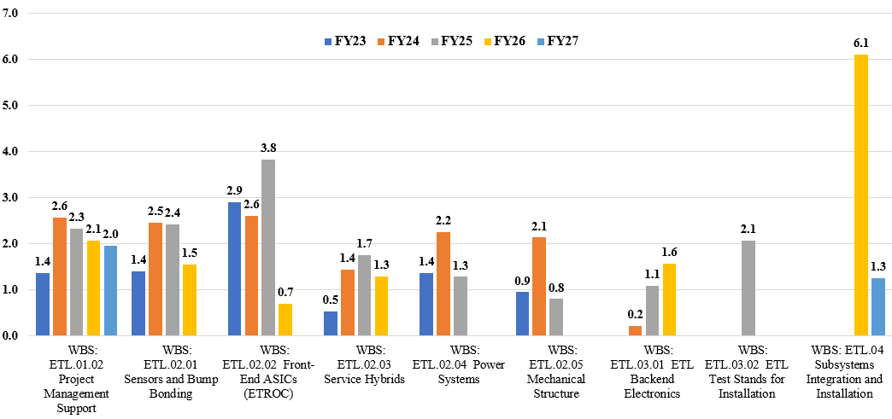
Resource Analysis – Total FTEs per Fiscal Year

Slide 24
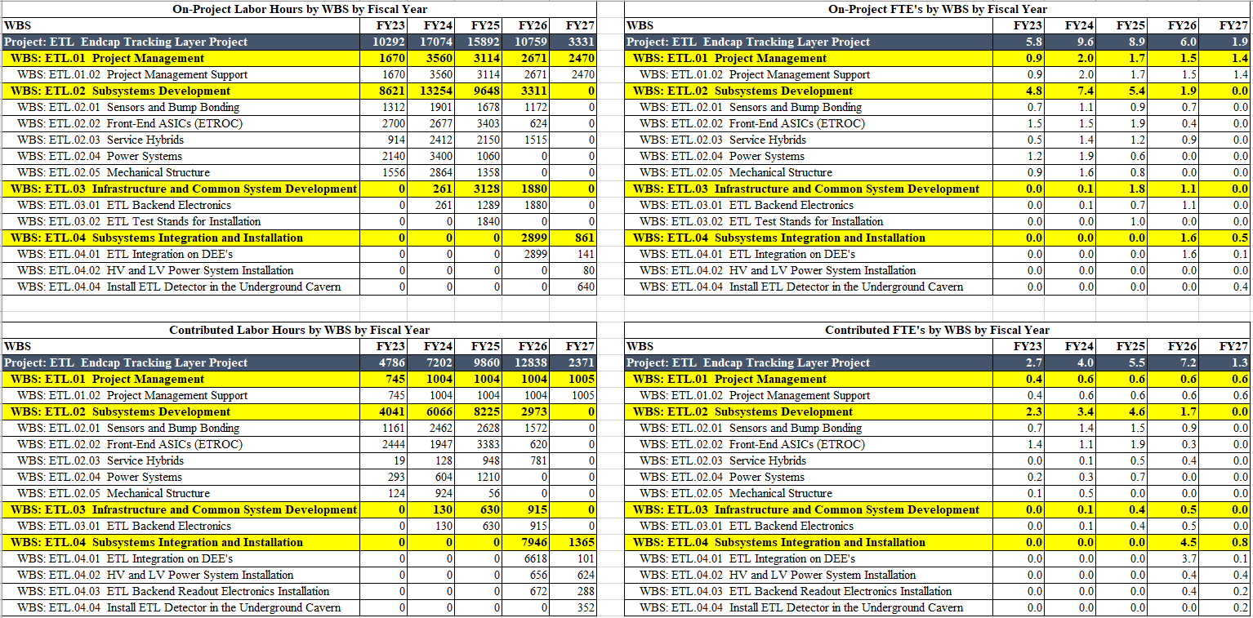
Resource Analysis – Hours and FTEs Contributed vs On-Project

Slide 25
Risk Management
Mechanical support forms an interface that connects all the other elements of ETL together
The detailed design needs to match the requirements of all the other elements as well as the changes in detectors adjacent to ETL
The biggest risk is due to unexpected changes that require rework of the elements of the support structure
  Additional engineering labor
  Re-work of some of the elements
The corresponding elements in the Risk register were written in consultation with experienced engineers
Good communication with the other subsystem is the best way to minimize design delays

Slide 26
Quality and ES&H
The quality of the mechanical structure is mainly in the precision of manufacturing and a good fit to the attaching elements
  All elements will be measured to verify the tolerances. They will be measured using coordinate measuring machine and available to CMS, most likely in the alignment database
  There will be a complete “dry fit” of the structure before the integration with the sensor modules starts
The Environmental and Safety risks are minimal and they involve risks typical to machining of elements and handling of large, delicate structures
The Bates Engineering team follows MIT safety protocols which are consistent with National Laboratory and Industrial standards

Slide 27
Management Strategy
Mechanical structure will be built by a team of MIT Bates engineers in close collaboration with CERN engineer
MIT Bates has long experience of design and fabrication of detectors for Nuclear Physics
We plan for an engineer and a designer to work together with an additional part time Bates engineer who would be managing day to day schedule and progress.
Bates engineers will be taking active roles in the larger ETL collaboration, attending meetings and being subject of periodic reviews.

Slide 28
Summary
We have a plan to finalize the design and produce mechanical support structure for the ETL detector
The cost and schedule were developed during several days of detailed discussions between MIT Bates engineers and CERN engineer
The work is now in progress to get updated quotes for some of the large elements that need to be fabricated
On day one of the approved project we will take over handling and changes to all the ETL structure drawings and start working on the final DEE design

Slide 29
Discussion

Slide 30
Backup Slide 1

Slide 31
Backup Slide 2

Slide 32
Backup Slide 3

