Slide 1





Endcap Timing Layer Project
WBS 01.04 – Subsystems Integration and Installation
Subsystem Scope, Cost, Schedule and Risk
DOE Review Backup Material
Subsystem Manager: Boleslaw Wyslouch (MIT)
Review Date: June 14-16, 2022
Notes:
Briefly introduce yourself:
CAM for xx System
Experience with …
Good design team with mix of skills

Slide 2
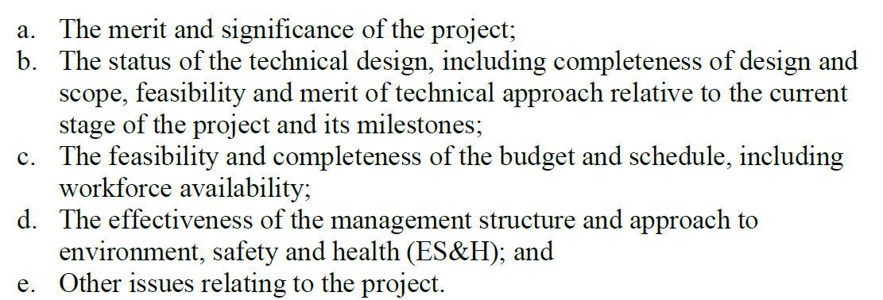
DOE Charge

Slide 3
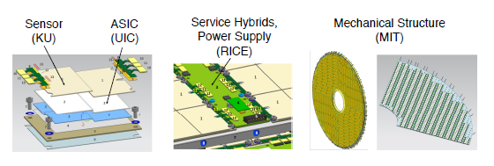
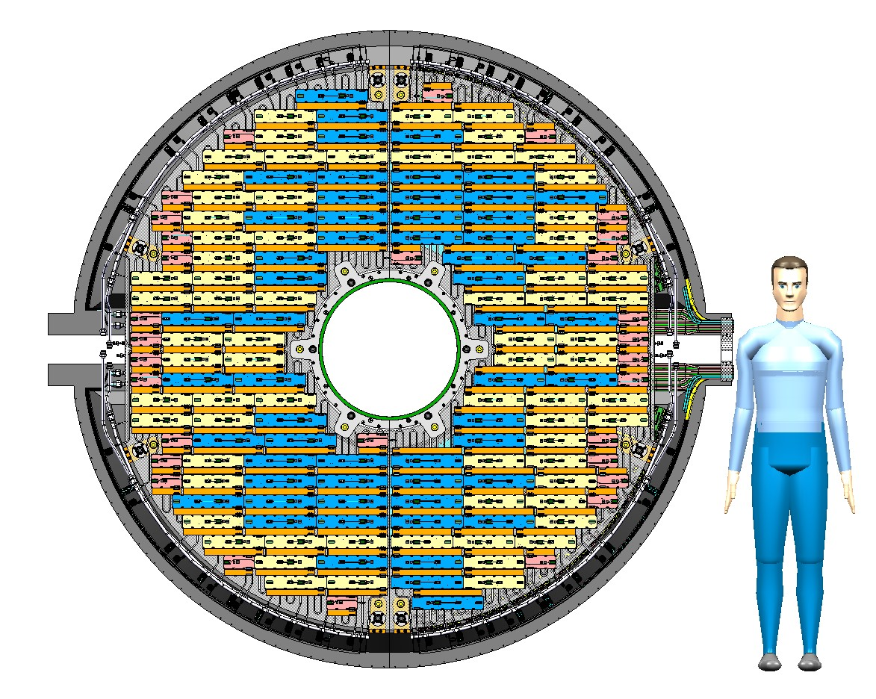
Scope Overview: Integration and Installation
All ETL elements need to be integrated into four complete half-endcap “packages”
Half-endcaps need to be fully tested on the surface
After testing, the four half-endcaps need to be lowered into the CMS cavern and attached to the CMS experiment
Installation needs to be scheduled and synchronized with the multiple other systems: strong external dependency!

Slide 4
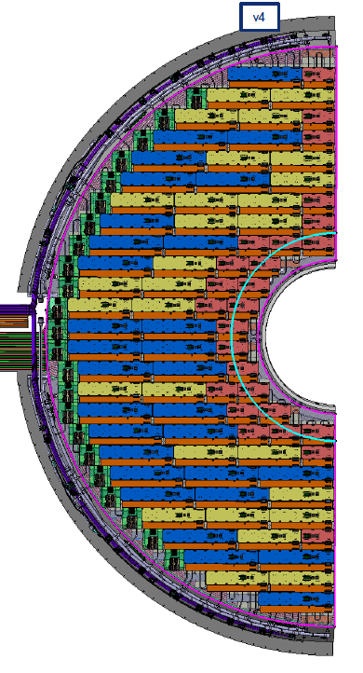
Scope Overview: Integration
Sensor Modules, Service cables etc. are installed on both sides of individual DEEs
  Work performed at a surface laboratory space available at CERN
  About 1300 service hybrids containing 8000 modules need to be attached to the eight DEEs
  Using rotation and transportation fixtures prepared together with the mechanical structure
  Collaboration effort using students, postdocs and technicians
    Experts on modules, power supplies, electronics and mechanics working together
Fully equipped DEEs are then attached to the supporting elements of the mechanical structure to form half-endcaps
Followed by the system testing on the surface

Slide 5
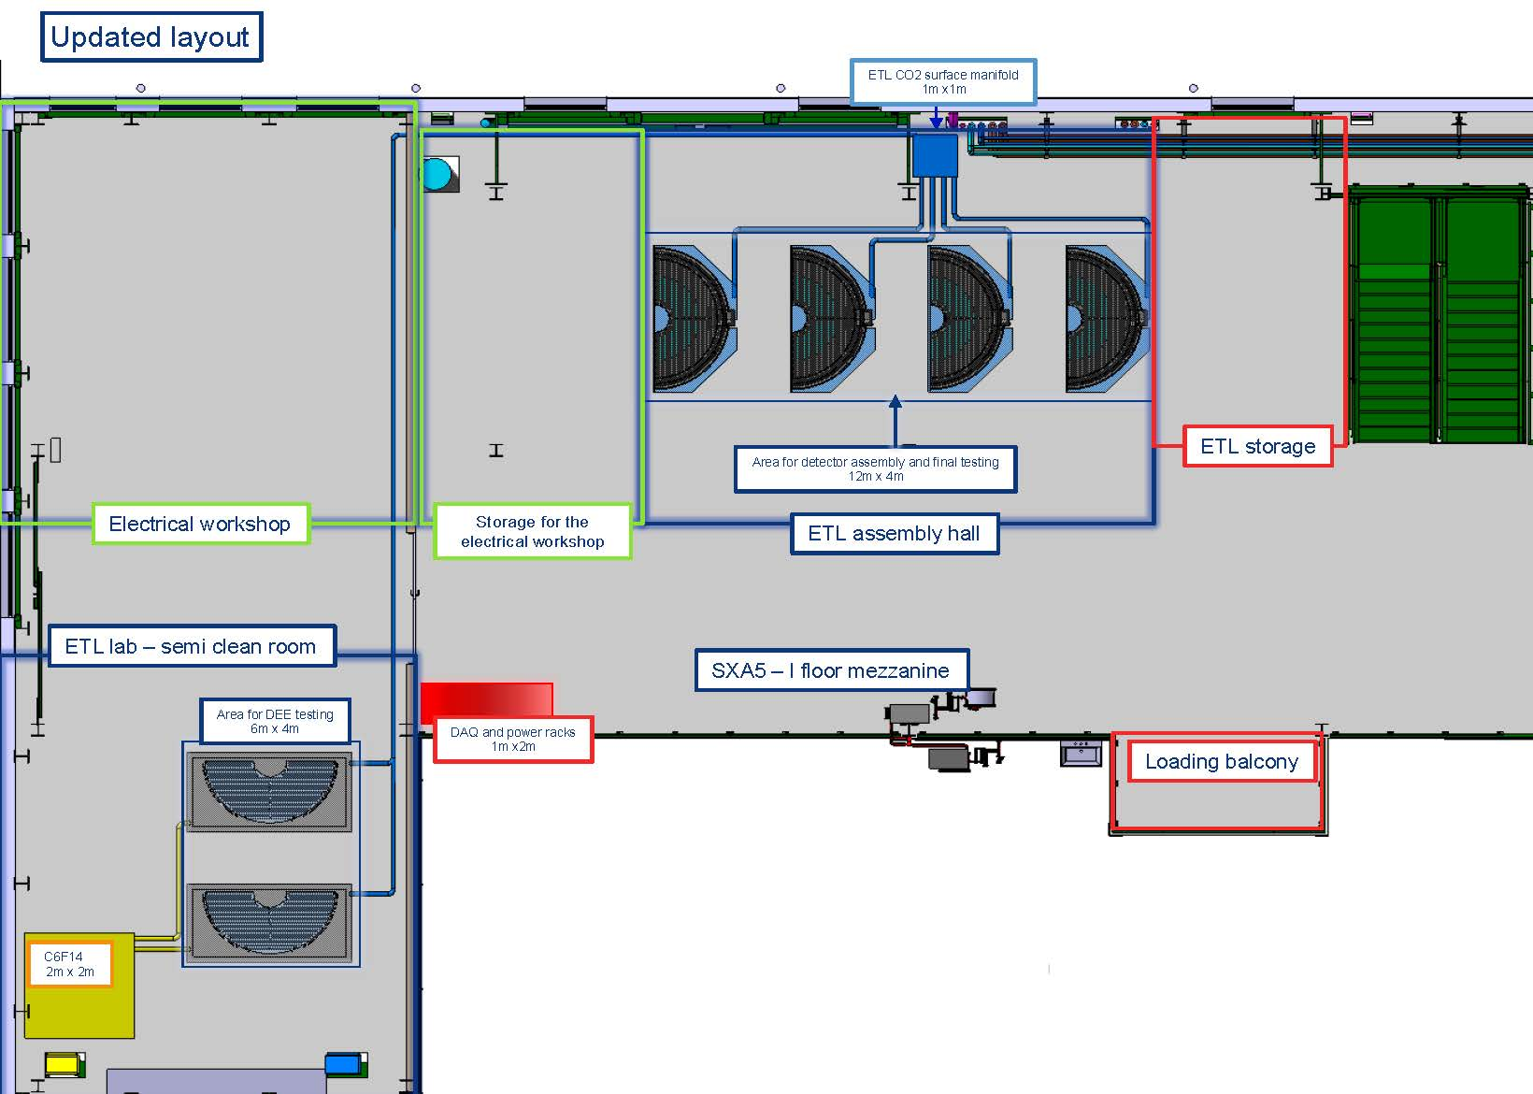
Planning for the integration and testing site at CERN
Assembly area on the CMS experiment site
Rooms to install modules on DEEs
Enough space to test completed half-endcaps

Slide 6
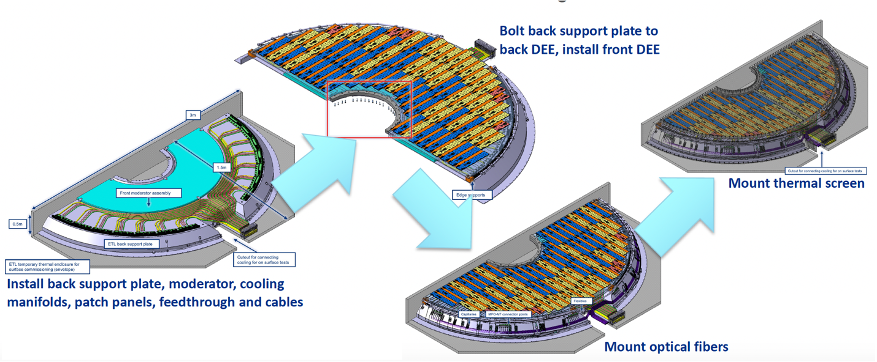
Scope Overview: Integration
Attaching DEEs to the Mechanical Structure to form the half-endcaps

Slide 7
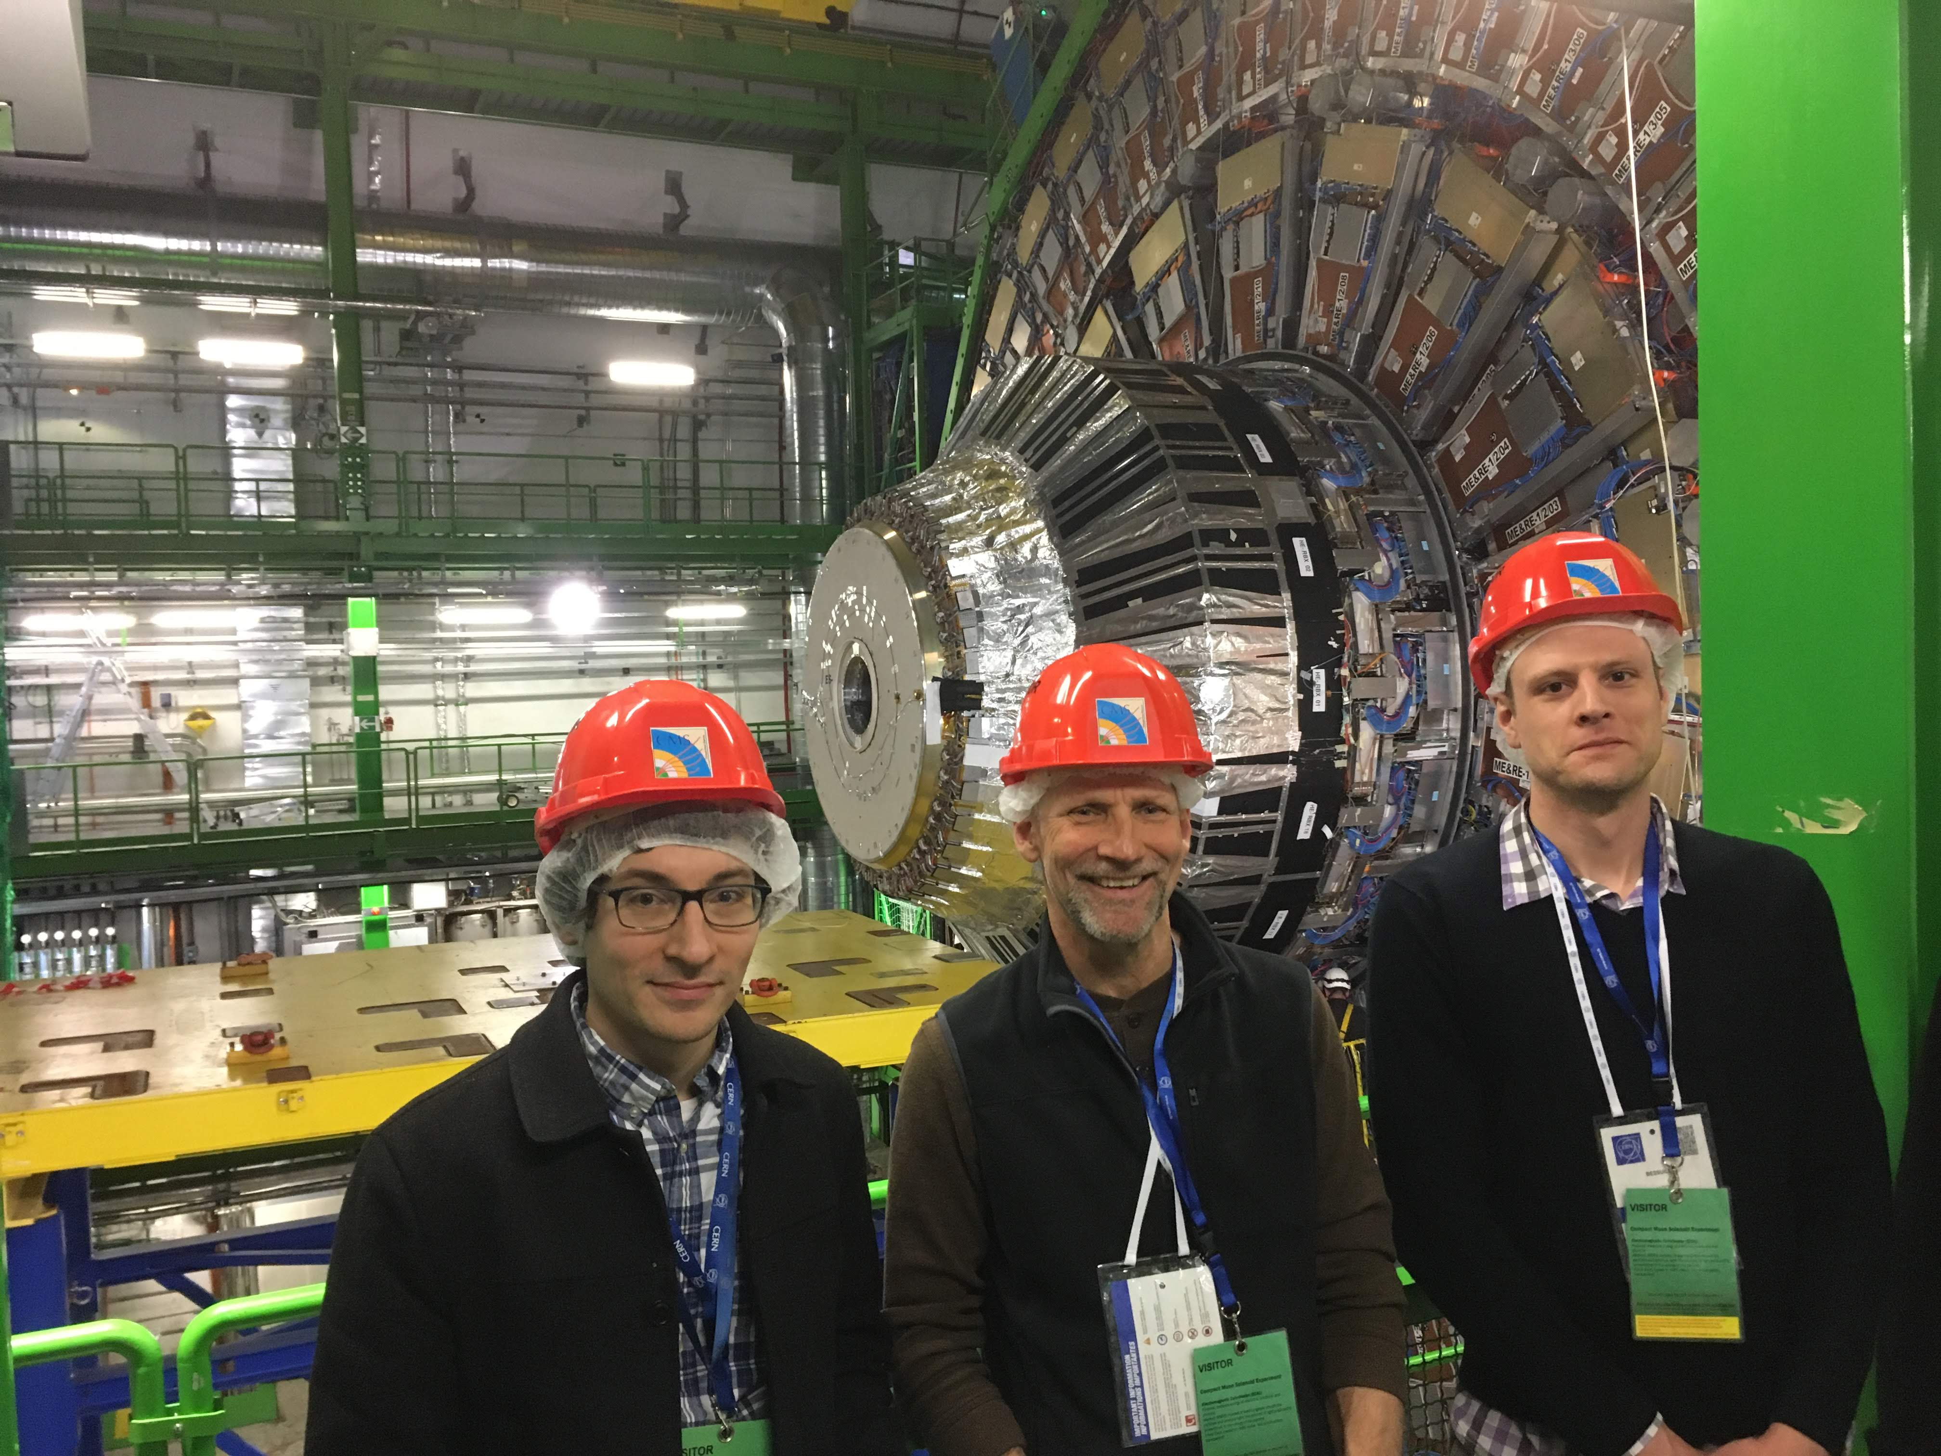
Scope Overview: Installation
Fully equipped and tested half-endcaps will be lowered into the detector cavern and attached to the CMS forward and backward calorimeters
Low Voltage, High Voltage and readout cables will have to be pre-positioned at the periphery of the ETL and connected to the detector
The installation will be carefully synchronized with the CMS Technical Coordination team
Present start date of the installation, according to TC is June 2028 and CMS needs to be ready for data taking in early 2029

Slide 8
Scope Overview
Project Organizational Chart

Slide 9
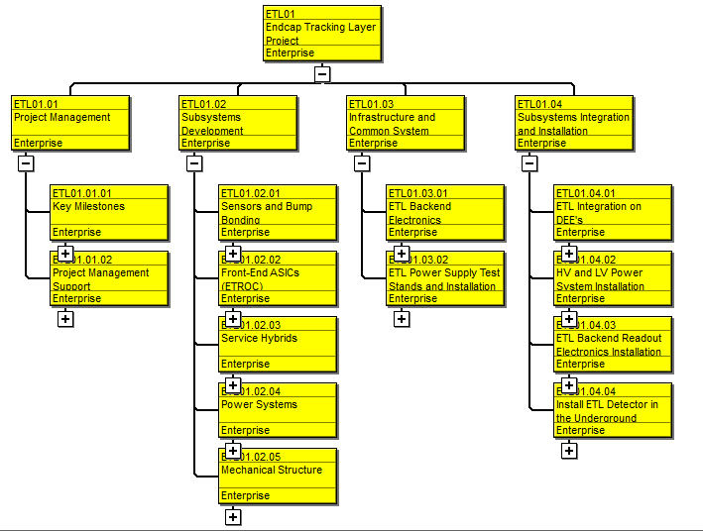
Scope Overview
Project WBS Overview

Slide 10
Cost Development
Charge Question - 2
The schedule and cost estimates are based on discussions with the experts
The main cost is in the labor needed to assemble and test the detector and then install it in the cavern
Since this is a collaborative effort, we prepared a first estimate where we only list DOE NP contributions. Experts from all elements of the detector will be involved
The schedule was developed based on a logical sequence of steps needed to integrate and install the detector
The duration of the tasks is an estimate based on past experience of physicists and engineers involved in similar installations before
We assume that CERN technician will be needed for both integration and installation tasks
Schedule includes Cost of Living Adjustments for students and postdocs (in-kind contributed labor)

Slide 11
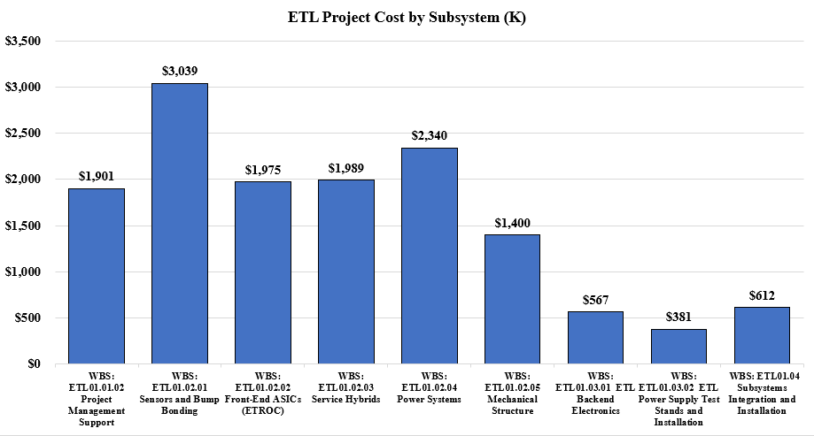
Cost Overview – Subsystem Relative Cost

Slide 12
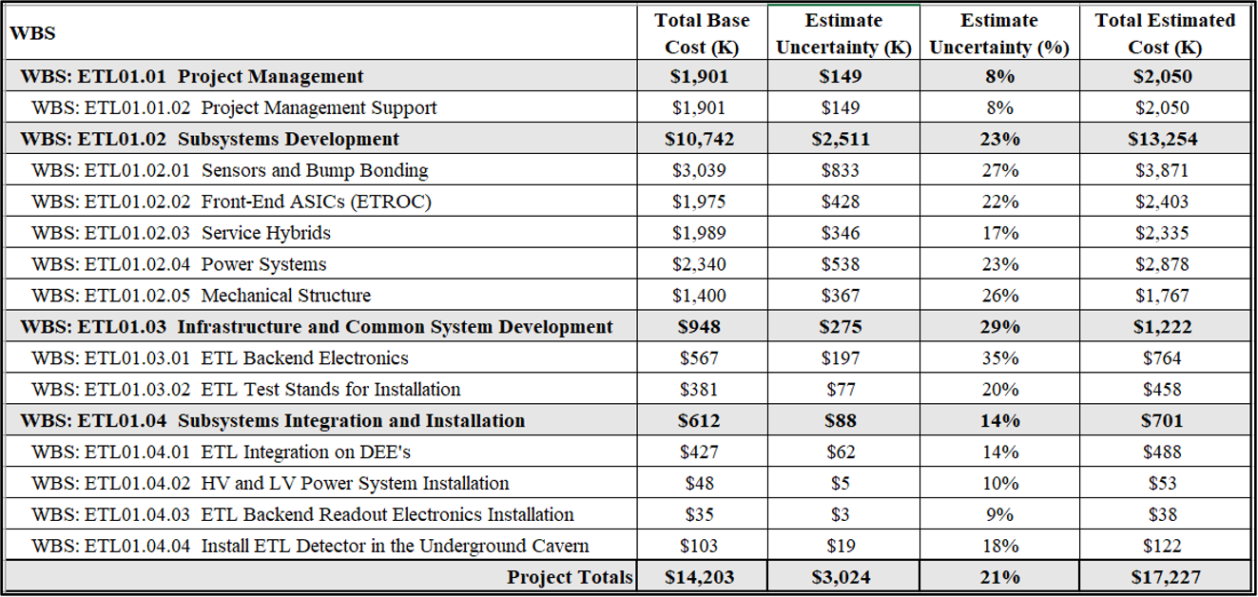
Cost Overview – Base Cost and Estimate Uncertainty

Slide 13
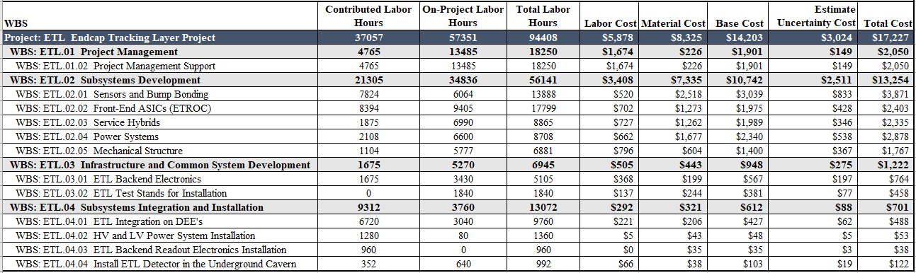
Cost Overview – Labor Hours and Cost

Slide 14
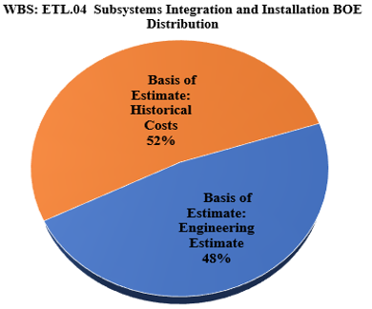
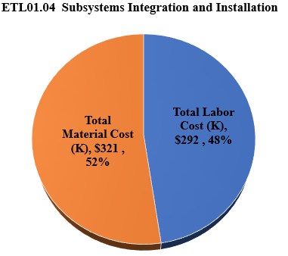
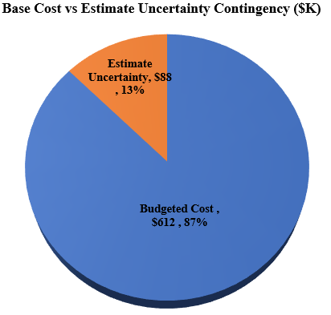
Cost Overview

Slide 15
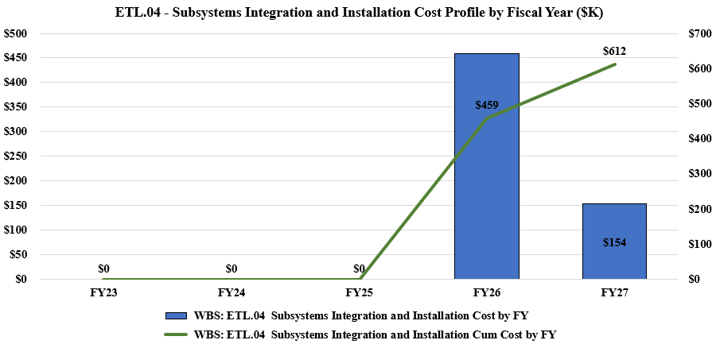
Cost Overview - Profile

Slide 16
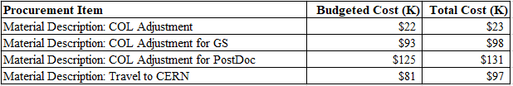
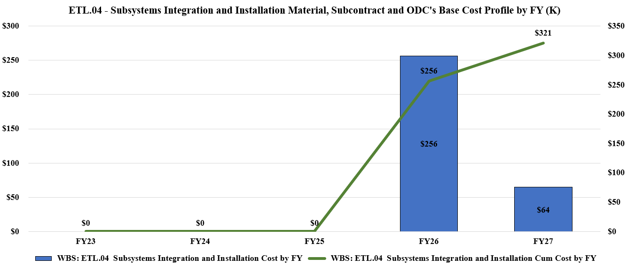
Cost Overview – Cost of Living and Travel

Slide 17
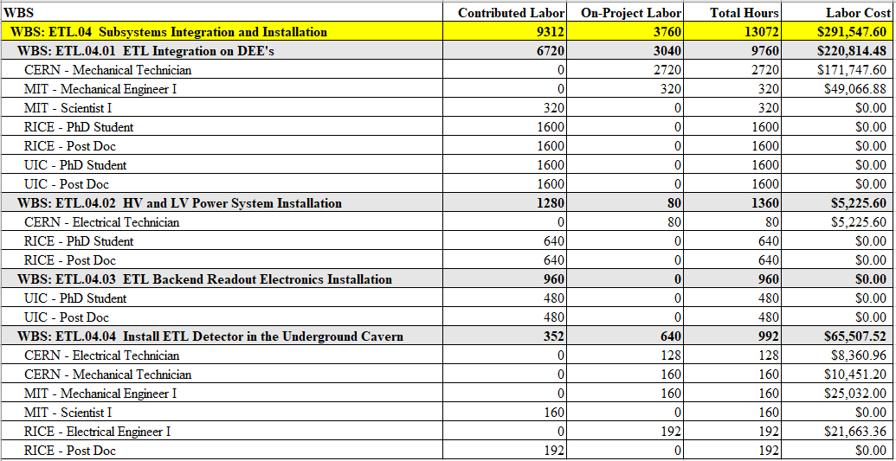
Cost Overview – Labor Breakdown

Slide 18
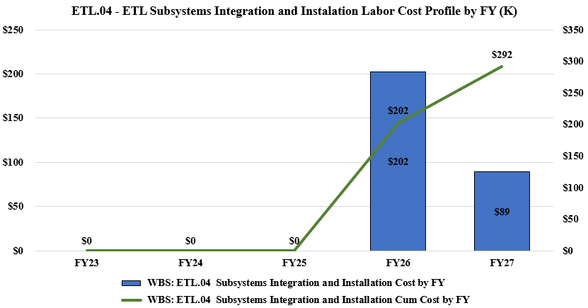
Cost Overview – Labor Profile

Slide 19
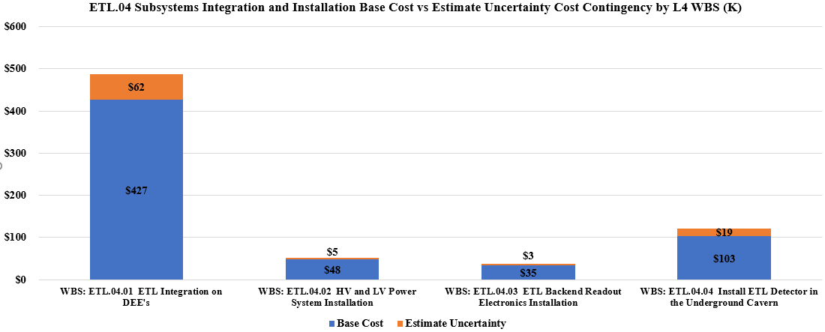
Cost Contingency
The cost is dominated by the labor needed to conduct integration and installation. The number of people who can work on the detector is well defined. So to the first approximation the risks have to do with how well we can escalate the present costs to the far future

Slide 20
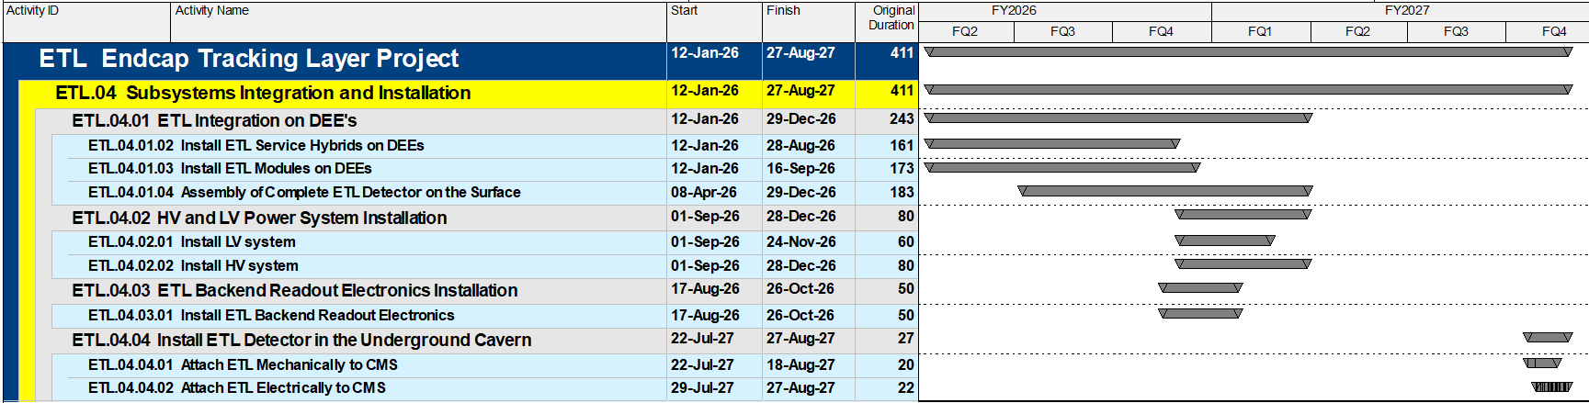
Schedule Development - Overview
Integration of sensor modules and electronics on DEEs depends on the availability of all these elements as well as the mechanical structure.
Complete assembly of the half-endcaps, including readout testing is expected to take one year
The earliest this can start is in FQ2 of FY2026
The overall CMS schedule has ETL installation underground with earliest starting date in July 22 of 2027 and latest starting date in August 2028
The exact schedule of the HV and LV power system installation as well as the installation of the Readout Electronics will be synchronized with the overall CMS schedule: strong external dependence
Delays in the availably of the elements of the detector, as well as delays to the overall CMS schedule may impact ETL schedule

Slide 21
Schedule Development
Based on current planning, relative to the April 21, 2028, CMS Detector Ready date, the Subsystem Integration and Installation subsystem finishing in August 2027, has about 1 year of float.

Slide 22
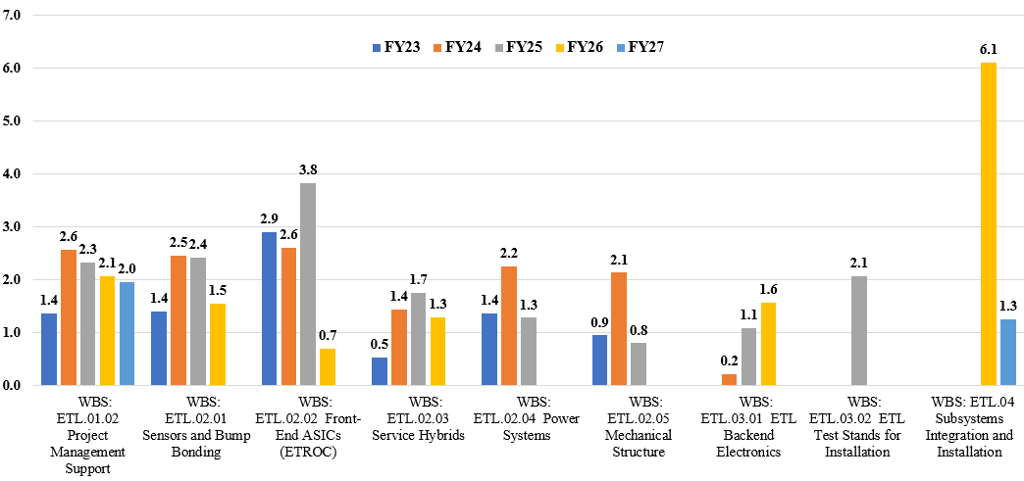
Resource Analysis – Total FTEs per Fiscal Year

Slide 23
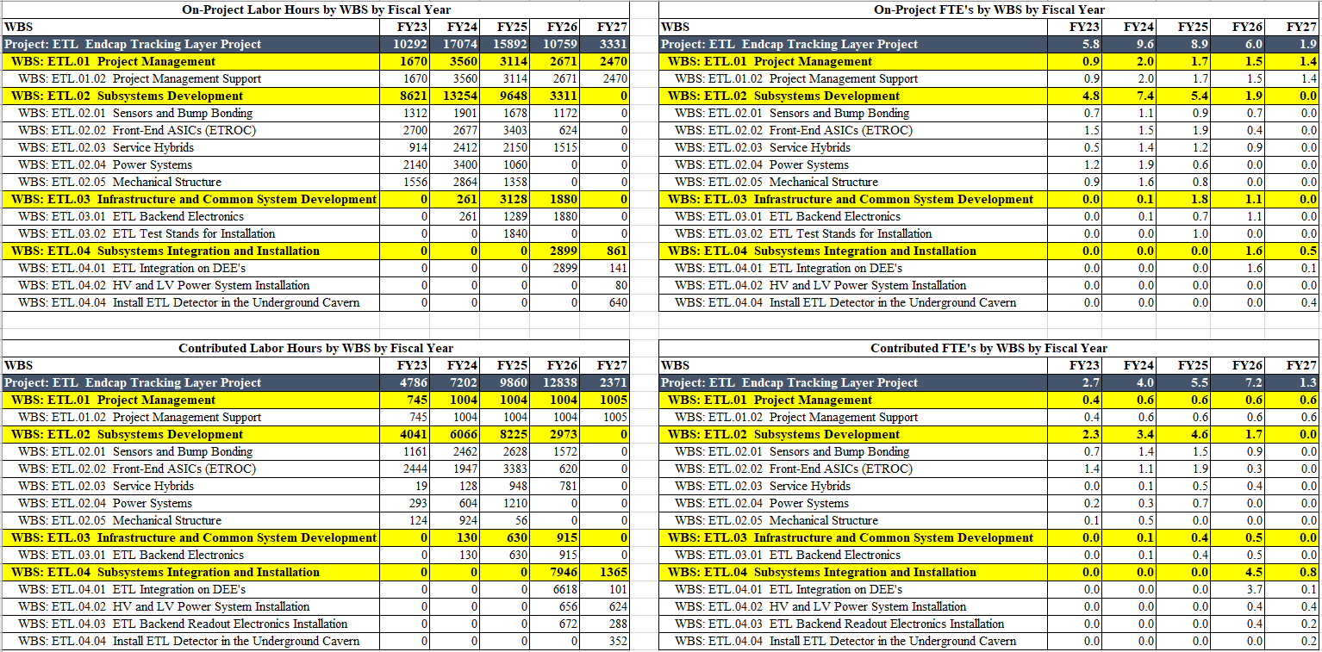
Resource Analysis – Hours and FTEs Contributed vs On-Project

Slide 24
Risk Management
Risk to integration and installation consists of the
  Delays in availability of elements needed for assembly.
  Risks inherent to transportation and movement of large equipment
Significant delays beyond the existing ~one year float would compress the underground installation schedule requiring shift work or other costly adjustments, this is considered unlikely
Delays will affect the start date of the Integration process presently scheduled for early in FY26
There are 2 Low and 2 Medium Risks in the Risk registry
Delays in ETL integration and installation may result in reshuffling of schedules for the whole experiment
Such changes will require close communication with sub-system managers, the Technical Coordination and collaborating institutions
Integration and Installation teams will have to maintain good information sharing with the overall CMS upgrade project

Slide 25
Quality and ES&H
Charge Questions - 6
Integration of the modules and electronics on the DEEs will likely be a long and tedious process
  We will develop detailed module attachment and testing procedures to assure quality and safety of the process
  We do not expect any safety issues related to this part of the project
Installation of the half-endcaps underground
  The safety risks are related to the movement of large objects at large heights
  Because of that the installation will require significant help and expertise of CERN riggers and CERN technicians
We will follow the CERN safety standards for this part of the process

Slide 26
Management Strategy
Charge Question - 6
Unlike the individual subsystems, the integration and installation of ETL will take place exclusively at CERN starting in summer of 2026 and leading to Run 4 start in 2029.
The direct manager will have to be stationed at CERN and interface with all the subsystems and CERN Technical Coordination.
We have long experience with identifying such people from institutions collaborating in this project and to manage such collaborative activities within CMS organization

Slide 27
Summary
Integration and Installation of ETL is presently included in the project planning in a preliminary form
The schedule and scope of these activities is well defined. The start of integration and installation are dependent on the availability of elements provided by other subsystems within this project as well as from the international collaborators
The installation itself depends on the LHC schedule and it is part of the CMS-wide detector upgrade activities
There are many precedents of how to manage such projects at CERN, we will be ready to take on the leadership responsibilities

Slide 28
Discussion

