Slide 1
RDDS measurements at RITU and prospects at HIE-ISOLDE
T. Grahn
University of Jyväskylä
HIE-ISOLDE Spectrometer Workshop, Lund 10.-11.3.2011

Slide 2
Outline
Tagging instrumentation at JYFL
Lifetime measurements utilising selective tagging methods at JYFL
Plunger device at MINIBALL
Plunger device at HIE-ISOLDE spectrometer?

Slide 3
BACKGROUND AND MOTIVATION
Shape coexistence in the neutron-deficient Pb region: large body of spectroscopic information obtained with stable beams but the knowledge of transition probabilities was missing.
→ Couple the Köln plunger device to JUROGAM + RITU at the University of Jyväskylä (JYFL).
¹⁸⁶Pb & ¹⁹⁴Po: First Recoil Distance Doppler-Shift (RDDS) lifetime measurements employing the RDT technique. Improved lifetime information on ¹⁸⁸Pb using the recoil-gating method (PRL 97, 062501 (2006) & NPA 801, 83 (2008)).
Demonstrated that RDDS lifetime measurements are possible for such exotic species.
→ Ongoing programme to study lifetimes in nuclei far from stability.
RDDS measurements in the light Pb region are complementary to the Coulomb excitation measurements carried out at REX-ISOLDE.
→State lifetimes set constraints in the analysis of Coulomb excitation data.

Slide 4
Examples of physics cases
Shape coexistence: ^{186,188}Pb, ¹⁹⁴⁻¹⁹⁶Po, ^{180,182}Hg, ¹⁷⁵Au, ^{174,175}Pt, ¹⁸²Pt.
Transition between deformed and spherical structures: ¹⁶⁶⁻¹⁶⁸Os.
Collectivity and shell evolution above ¹⁰⁰Sn: ^{108,110}Te, ¹⁰⁹I.
Recoil-isomer tagging, e.g. ¹⁴⁴Ho
The RITU separator renders it possible to access very neutron-deficient nuclei and RDT method results to a very clean γ-ray spectrum for RDDS studies.

Slide 5
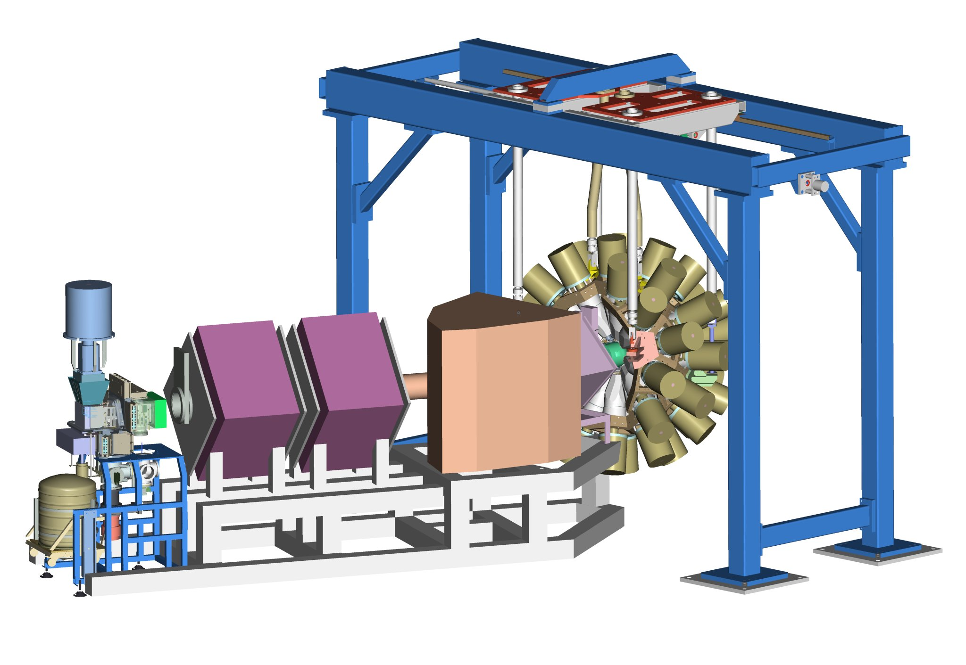
Tagging instrumentation at JYFL
JUROGAM II
24+15 Ge+BGO detectors, eff. 6%
GREAT
Focal plane spectrometer
RITU
Gas-filled recoil separator,
transmission 20-50%
TDR
Total Data Readout, triggerless data acquisition system with 10 ns time stamping

Slide 6
Recoil-Decay Tagging (RDT) method
RITU recoil separator
Beam from K130 cyclotron
GREAT DSSD
GREAT spectrometer
JUROGAM Ge-detector array
Power of the method: recoiling evaporation residue and its subsequent characteristic decay observed ⇒unique tag for the prompt radiation.

Slide 7
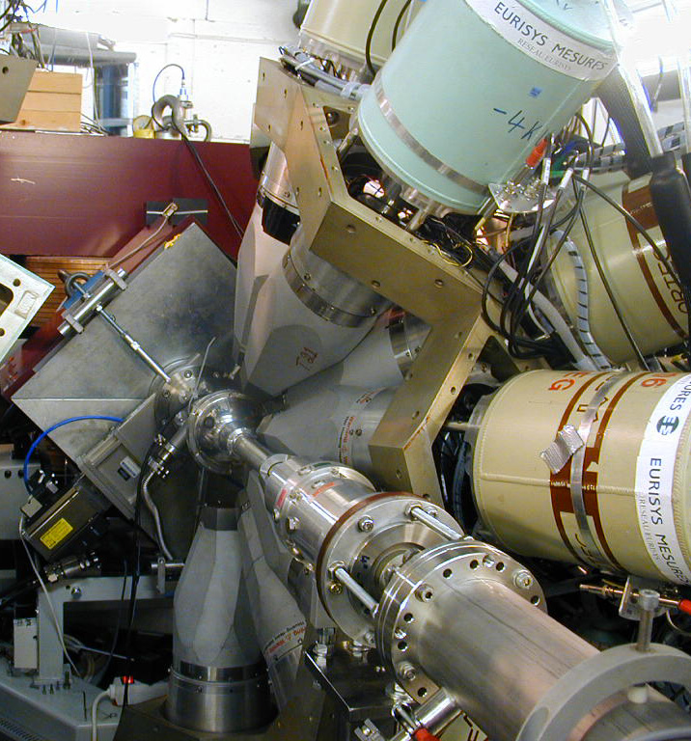
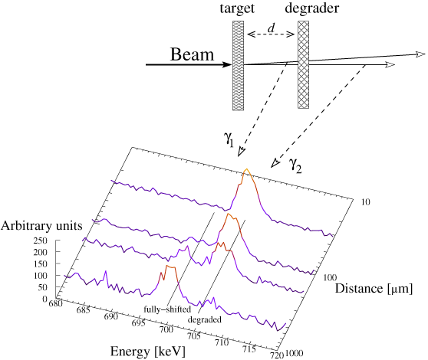
RDDS lifetime measurements at JYFL
First ever Recoil Distance Doppler-Shift (RDDS) lifetime measurements utilising a gas-filled recoil separator and the RDT technique → a special plunger device with a degrader foil designed by the University of Köln.

Slide 8
RDDS lifetime measurements at JYFL
The Köln plunger device at RITU:
  `Standard´ stopper foil replaced by a degrader foil in order to allow evaporation residues to enter RITU.
  Moveable target allows the target-to-degrader distance to be varied.
  Motors operate in vacuum, therefore it has to be isolated from the He gas of RITU ⇒ C window.

Slide 9
RDDS lifetime measurements at JYFL
Difficulties/limitations
Use of the degrader foil:
  JUROGAM II Ge-detector counting rate increases.
  With a 1 mg/cm² Mg foil, RITU transmission efficiency cut by a factor of 2/3.
  Doppler-shift difference rather low: v/c = 4% → v/c =3%.
    Suitable θ:
  Only 15 of JUROGAM II Ge-detectors can be used; 5 at 158° and 10 at 134°.
  Ge efficiency reduced significantly.
Reaction cross section & residue:
  Measurements down to 50 μb level carried out.
  The nucleus of interest has to have a sufficient p- or α-decay branch for RDT.
  If the exit channel of the reaction is dominant, recoil gating will provide a rather clean tag.

Slide 10
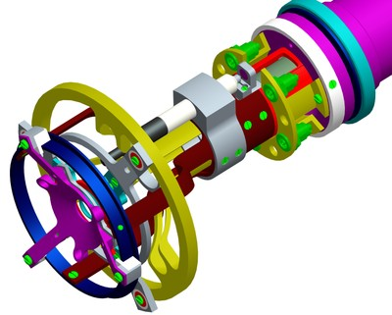
RDDS lifetime measurements at JYFL
The DPUNS plunger device
  Based on the Köln plunger design, constructed by University of Manchester.
  Can operate in He of RITU ⇒ differential pumping.
  To be completed in 2011.
  Dedicated instrument for RITU and MARA.

Slide 11
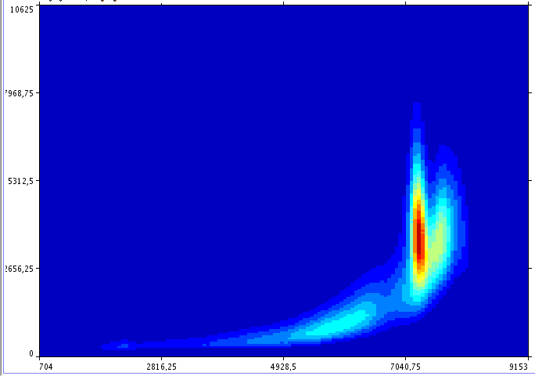
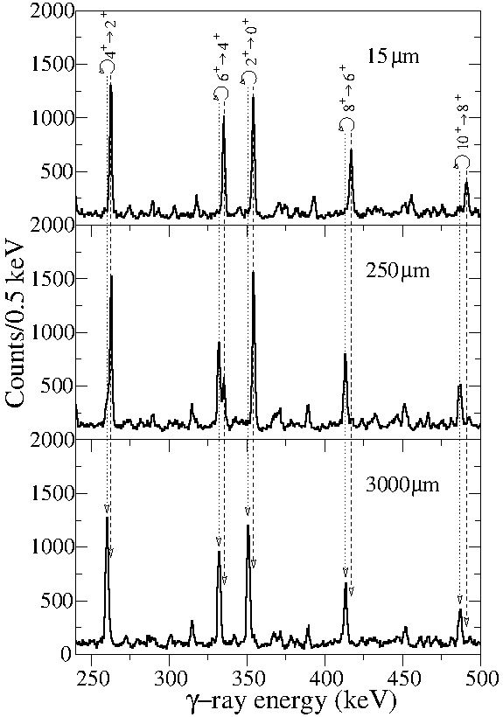
Lifetimes in ^{180,182}Hg
Typical TOF-Gas dE spectrum
Recoils
⁹⁶Mo(⁸⁸Sr,2n)¹⁸²Hg, E=310 MeV.
Recoil-gated projections of γγ-coincidence spectra.

Slide 12
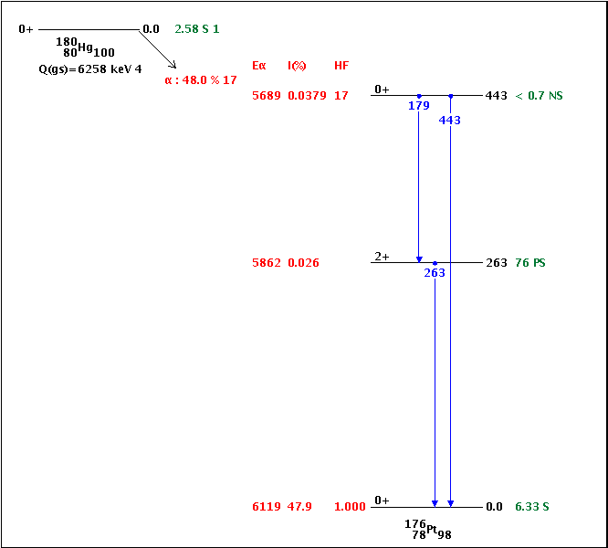
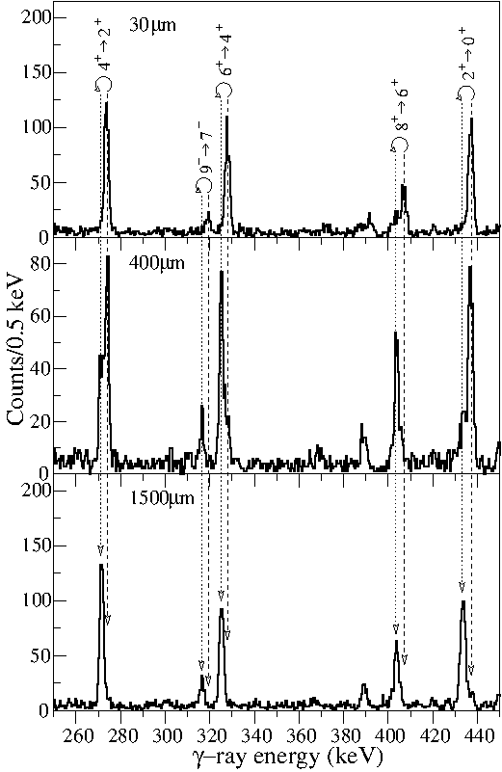
Lifetimes in ^{180,182}Hg
⁹⁴Mo(⁸⁸Sr,2n)¹⁸²Hg, E=300 MeV.
RDT singles γ-ray spectra, tagged with ¹⁸⁰Hg α decay, at three target-to-degrader distances.

Slide 13
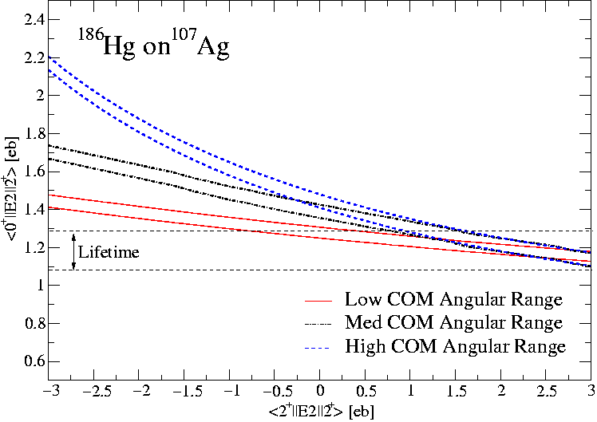
Lifetimes in ^{180,182}Hg
High collectivity of the states with I ^{π} ≥ 4 indicate their prolate deformed character.
The results support the shape coexistence of weak oblate and intruding prolate structures
Complementary measurements: Coulomb excitation studies of ^{182,184,186,188}Hg at REX-ISOLDE
Transition quadrupole moments of selected Hg nuclei.
T. Grahn et al., PRC 80, 014324 (2009)

Slide 14
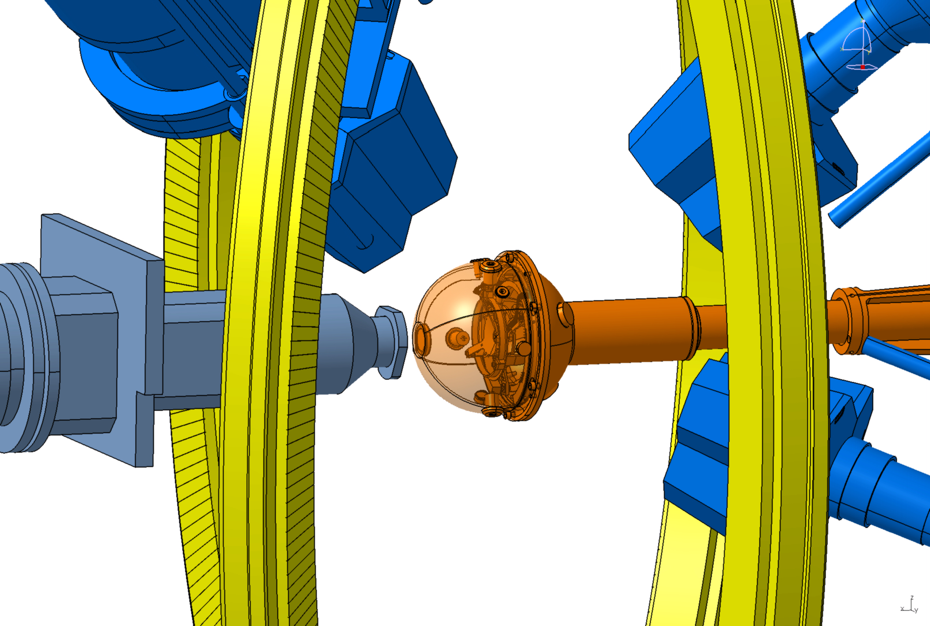
Plunger device at MINIBALL
Project jointly managed by Demokritos Athens and IKP Köln.
The plunger device is based on the Köln design.
The design process is ongoing.

Slide 15
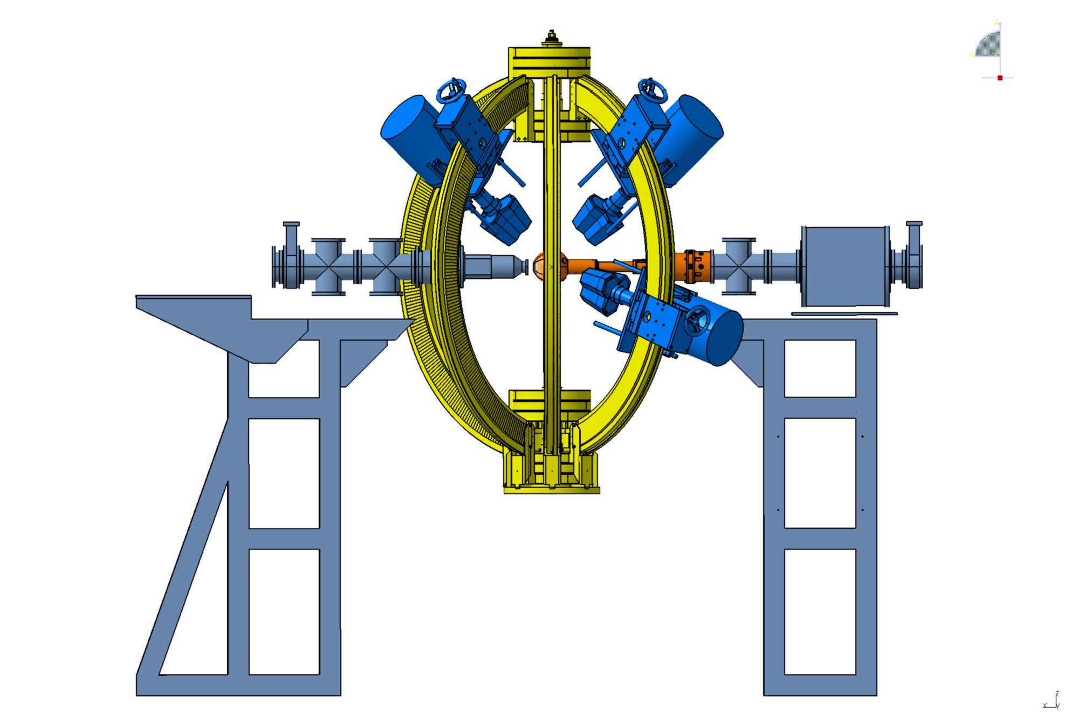
Plunger device at MINIBALL
Target chamber incorporates the plunger device upstream and the CD Si detector downstream.
Experience gained in JYFL experiments with the `CoulEx plunger’ (Köln plunger device + particle detector array).

Slide 16
Plunger device at HIE-ISOLDE spectrometer?
HIE-ISOLDE spectrometer LoI: Several physics cases and methodologies:
  Transfer reactions
  Deep inelastic reactions
  Fusion-evaporation reactions
Several experimental scenarios for the plunger device could be envisaged.
Plunger device is relatively easy to couple with a separator.

Slide 17
Plunger device at HIE-ISOLDE spectrometer?
Deep inelastic & transfer reactions
  Reaction kinematics could be problematic.
  However, such studies have been carried out at CLARA-PRISMA, LNL (see e.g. D. Mengoni et al., EPJA 42, 387 (2009)).
Fusion-evaporation reactions
  Difficulties: low beam intensity, low cross section.
  Beam intensity at JYFL usually 1 pnA ⇔ ~10⁸ pps, cross sections down to 50 μb.
  Similar intensities could be achieved at HIE-ISOLDE, due to the projected intensity increase, for radioactive beams `not so far from stability´.

Slide 18
Plunger device at HIE-ISOLDE spectrometer?
Would provide a complimentary method to Coulomb excitation in measurements of transition probabilities.
Not sensitive to reaction mechanism and target excitations.
May provide access to measurements of transition probabilities in regions of the nuclear chart otherwise inaccessibly with Coulomb excitation (deep-inelastic/fusion-evaporation reactions).

