Slide 1




Impact in GridPP
Rose Cooper – rose.cooper@stfc.ac.uk
GridPP 48 Collaboration meeting
Notes:
The abstract pattern can be removed or repositioned if required. Be careful to ‘Send to Back’ so that it does not obscure any important information.

Slide 2
Who am I?
Rose Cooper, STFC – Scientific Computing Department
GridPP impact officer
Other roles:
  Service manager of RAL FTS
  Admin for Grid Tools
Notes:
Please replace photo of presenter with a portrait of your own. 1) Send the geometric shape overlay to the back – Right-Click > Send to Back > Send to Back. 2) Replace image – use the guides provided to correctly position it. 3) Send your portrait to the back so that the geometric overlay re-appears over the portrait.

Slide 3


Overview
1 What is impact?
2 Importance of impact
3 Examples of impact of GridPP
4 How can we continue the impact of GridPP?
Image © STFC Alan Ford
Notes:
To replace photo with one of your own. 1) Send the geometric shape overlay to the back – Right-Click > Send to Back > Send to Back. 2) Replace image – use the guides provided to correctly position it. 3) Send your image to the back so that the geometric overlay re-appears over the image. Remember to delete the image credit if using your own image.

Slide 4
What is impact?
According to UKRI:
  Improving understanding of ourselves and the world around us
  Improving lives and increasing prosperity
  Addressing industrial and societal challenges
  Relationships with their communities and partners
Showing that we can deliver computing commitments, whilst also meeting these additional goals.
Notes:
what changes/ improvements are brought about by the work we all do
not just external, can be internal within you organisations
shows the value of the work we do and the effect it has on those who need/use our services/projects

Slide 5
Importance of Impact
Impact is a core consideration throughout the grant application process at STFC/UKRI
Helps to show the wide reaching value of the work we do
Demonstrates that we are the best people to be doing the work
Notes:
being able to show examples of impact essential for applying for funding (at RAL), likely still important at other institutes
not just something we’re working on for ourselves or for the sake of it, shows the wider use cases of the work we produce and where and how that work is utilised by others
It’s one thing to just make a tool to solve a problem, but making a quality tool that has wide reaching uses and applications within our community is important to demonstrate. emphasises the quality of out work

Slide 6

Examples of impact from GridPP
Notes:
The abstract pattern can be removed or repositioned if required. Be careful to ‘Send to Back’ so that it does not obscure any important information.

Slide 7
Networking improvements
Janet as a network has been scaled to meet the needs of its users
  GridPP is also the community with the largest data transfer needs in the .ac.uk community
Paved the way for others larger communities such as SKA when moving large volumes of data over a network.
Notes:
Happened on the 18th & 19th of June
Had learned lessons from previous attempt
better support the large data transfer needs of the community
SKA will be moving comparable volumes of data, so having a robust network that can handle this volume of traffic is essential

Slide 8
Predicted future requirements
Aggregate bandwidth requirements by 2024:
  Tier 1: 200 Gbit/s
  Tier-2 (large): 100 Gbit/s
  Tier-2 (other): 10-20 Gbit/s (and in some cases 40 Gbit/s)
Data challenge scale:
Likely to require closer to 500 Gbit/s links by 2027
 | 2023 | 2025 | 2027
Bandwidth scale for RAL Tier-1 (Gbit/s) | 90 (data challenge) | 180 (data challenge) | 500 (operation)

Slide 9
Current network configuration
RAL now connected to Janet by 2x100G links, as well as a separate 100Gbit/s dedicated connection to CERN
The large Tier-2 sites are also moving to 100Gbit/s links with Imperial being the first of these
15 out of 19 UK sites have IPv6, and 80% of the Tier 2 storage sites have IPv6 enabled
Notes:
imperial has 100gb links to data center in slough and to its south ken campus
also a leading example of deploying ipv6 on campus, having dual stack ipv4/ipv6 through most of its infrastructure
useful as wlcg move to using ipv6, both initial support leading to ipv6 only in the future

Slide 10
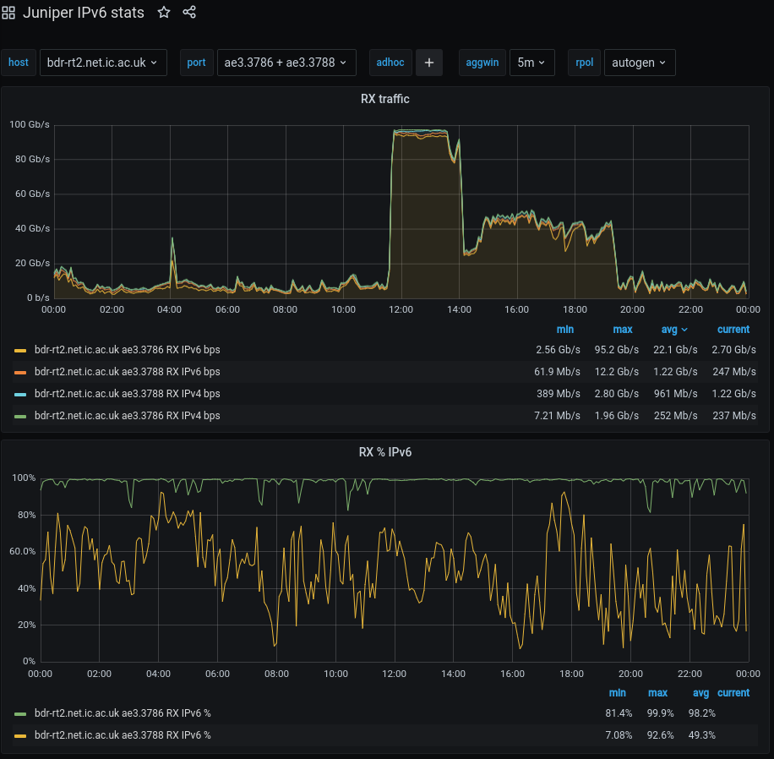
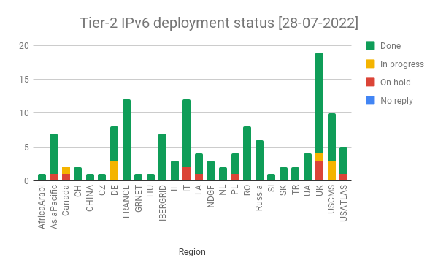
Deployment status
Credit: https://twiki.cern.ch/twiki/bin/view/LCG/WlcgIpv6#WLCG_Tier_2_IPv6_deployment_stat
Notes:
say what the colours all represent
mention that it’s mostly green!
Also tested ipv6 transfer cability
Imperial monitoring of the 100GB link
bulk file transfer to imperial in march 2022
link was filled and 100% IPv6
Great demonstration of the performance and capability of both IPv6 and Janet

Slide 11
XRootD workshop
Organised by Ian Collier, run by Sam Skipsey and Matt Doidge
  had 10 attendees, 5 from GridPP side and 5 from SKA
Used to educate new users of the system
  informal introduction to what XRootD does, why we use it, and how to set it up
  Making a client, basic config., authorization, etc.
Will be needed when using a system like FTS

Slide 12
Cybersecurity updates
Work done by GridPP instrumental in updates and improvements at STFC/UKRI
Also an impact on security discussions around IRIS
  Deloitte workshop
  policy discussions
Will also have a positive impact moving forward as work begins on new projects

Slide 13
Thematic CERN school on security
Took place June 19th-25th 2022 at the MEDILS institute, Split, Croatia
Full title: CERN School of Computing “Security of research computing infrastructures”
Aimed at people working in academia and research institutes, who need to ensure security and resilience of computing resources they manage, and want to be prepared to detect and handle possible security incidents

Slide 14
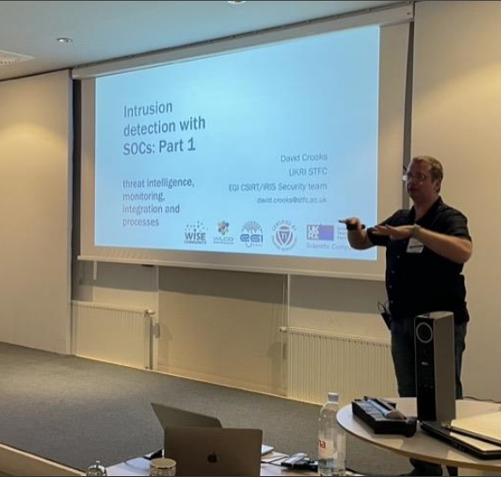
Thematic CERN school on security
36 students were able to attend
Mixture of lectures & workshops
Covering topics such as incident response, logging, detection, protection and prevention
Image © STFC John Dawson
Credit: https://indico.cern.ch/event/1096032/contributions/4956643/attachments/2479306/4255804/2022.07%20-%20tCSC%20on%20Security%20(GDB).pdf
Notes:
PLEASE DELETE/REPLACE PHOTO CREDIT IF CHANGING THE IMAGE.

Slide 15
Ada Lovelace day
October 12th 2021, STFC hosted a virtual computing themed challenge day for 180 children in Years 7, 8 and 9 to mark Ada Lovelace’s achievements
Aim of the day was to repair the Ada Lovelace, the first ship to Mars carrying a crew, after mission critical hardware & software failed.
Event was co ordinated & supported by GridPP staff

Slide 16
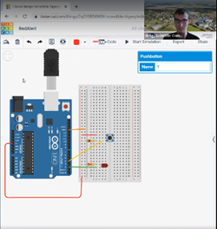
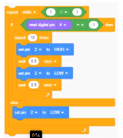
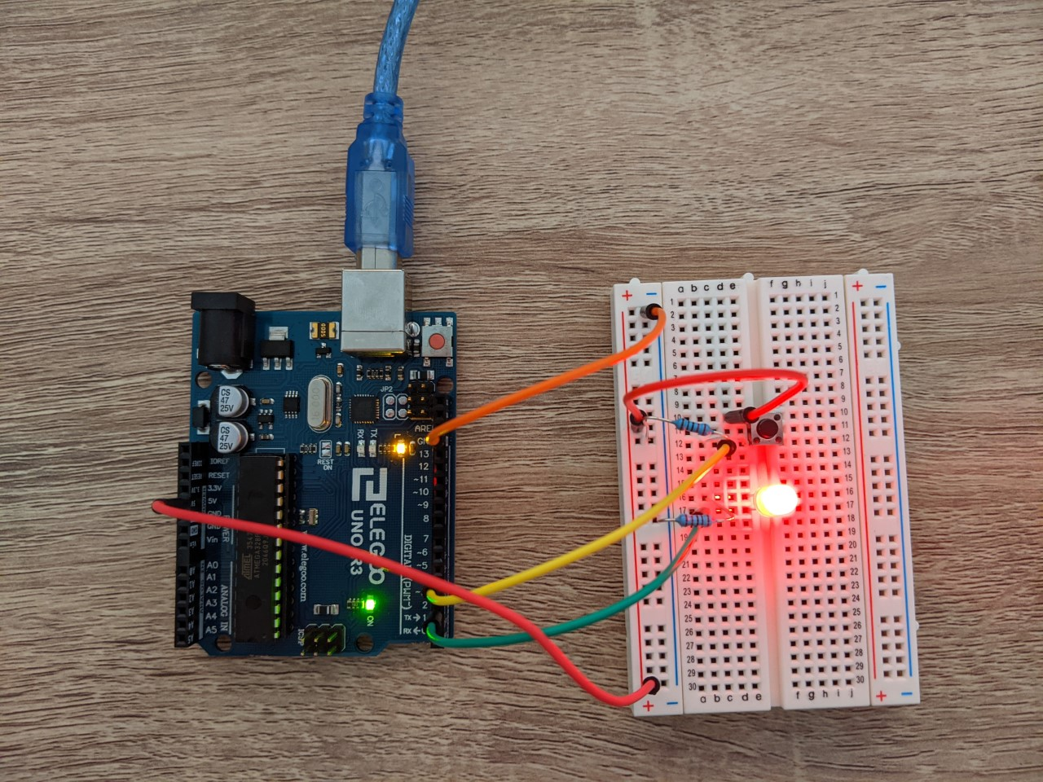
Ada Lovelace day
Combination of working with physical Arduinos as well as virtual
All conducted remotely via zoom
Day also included a data centre tour & a career talk
Image © STFC John Dawson
Credit: Greg Corbett
Notes:
PLEASE DELETE/REPLACE PHOTO CREDIT IF CHANGING THE IMAGE.

Slide 17
What I need from you?
Notes:
The abstract pattern can be removed or repositioned if required. Be careful to ‘Send to Back’ so that it does not obscure any important information.

Slide 18
Have you been involved in work that has generated impact?
Do you have any examples of impact that haven’t been included in these slides?
  public engagement activities
  non LHC work
  improvements within your organisation
Did you do or make something that didn’t exist before?
What has changed?
Notes:
throw to audience
ask what they’ve been doing/working on
generally just riff a bit

Slide 19
Examples of activities that generate impact.
enhancing community capability through technological developments and training
enabling success outside the LHC programme through the STFC IRIS project and beyond
raising awareness of e-Infrastructure and its importance to modern scientific endeavour through outreach and engagement
generating industrial impact through shared projects drawing on our accumulated experience and driving the development of commercially important technologies and tools
enhancing education and teaching practice through continuing involvement in programmes such as the research in schools.
Notes:
just read it

Slide 20
Thank you
Any questions?
If you think you’ve had impact, or know of a piece of impactful GridPP work, please let me know: rose.cooper@stfc.ac.uk
Notes:
The abstract pattern can be removed or repositioned if required. Be careful to ‘Send to Back’ so that it does not obscure any important information.

