Slide 1
XRootD at RAL
Jyothish Thomas
jyothish.thomas@stfc.ac.uk

Slide 2
XRootD
The XROOTD project aims at giving access to data repositories of many kinds.
It is based on:
  a scalable architecture (client/server services)
  a communication protocol (root)
  and a set of plugins and tools based on those. (e.g. XrdCeph)
It provides features such as authentication/authorization, integrations with other systems, etc..
[1] https://xrootd.slac.stanford.edu/

Slide 3
Ceph
Ceph is an open source software-defined storage solution designed to address the block, file and object storage needs of modern enterprises[2].
In object storage, instead of a hierarchical file system, objects exist in a flat structure with a unique identifier (instead of a file name).
Highly scalable cloud storage
Echo - Large erasure coded HDD Ceph cluster for S3/XrootD/GridFTP access at RAL
[2] https://ubuntu.com/ceph/what-is-ceph

Slide 4
The proxy/Ceph setup
XrootD server machine
users
Proxy
(authentication, memory cache)
Ceph
(operations)
Echo

Slide 5
XrdCeph
xrootd-ceph[1] is a Storage layer XRootD plug-in for interfacing with Ceph storage platform. It uses the libradosstriper library to interface with the core storage format (RADOS).
xrootd-ceph-buffered is a new functionality of xrootd-ceph developed by James Walder that includes I/O buffering at the XrdCeph layer
[3] https://github.com/xrootd/xrootd-ceph
XrootD
XrdCeph
libradosstriper
RADOS (Ceph)

Slide 6
Deployment Cycle at RAL
Code development
Testing: local/dev/preprod/limited prod
Deployment (gateways / Worker nodes)
Monitoring

Slide 7
In detail
common
Gateway
Code changes
PR & code review
Generate RPM
Local testing (VM)
Dev testing (e.g. dev GWs)
WorkerNode
Monitoring
Full prod rollout
Limited prod rollout
Aquilon sandbox & pre-prod testing
Push RPM to repo server
Close ticket
Test on WN tranche
Build and test container on single WN
Edit dockerfile

Slide 8
Upgrade to xrootd 5.5
Main relevant features introduced between 5.3.3 and 5.5:
  Scitoken support for authentication
  Paged io
Paged IO – perform checksum in flight to reduce transmission errors
  Will need xrootd-ceph-buffered for good performance

Slide 9
Current Status
Vector reads are not working as intended in jobs
Identified an issue on paged reads
Difference in stat speed between webdav(extended HTTP) and root
Identified reason for slow Deletes
Gateways are generally stable
Additional gateways introduced
Added XrdCeph repos for Enterprise Linux 8

Slide 10
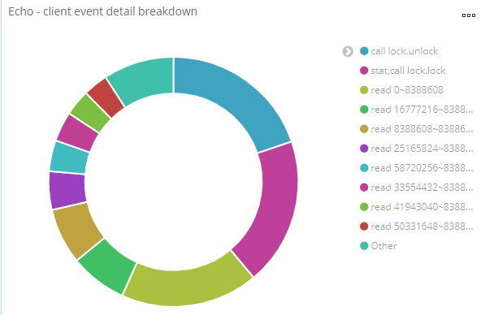
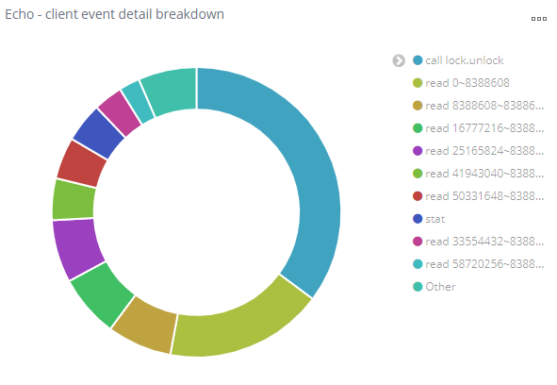
Vector read issues
Lockless reads deployed over the worker nodes.
  No lock metadata operations found in monitoring
  Proportional number of operations, with and without lock operation; the lock operation disappears
  No noticeable improvement on the job success rate

Slide 11
Paged read issue
We identified a bug preventing paged reads in Xrootd 5.4.3
This has been fixed and will be available with the XrootD 5.5 clients

Slide 12
Difference in stat speed between root and webdav

Slide 13
Deletes
Historically VOs used GridFTP for deletes and they never mentioned any problems with it.
Since switching to XRootD/Webdav it was observed that deletes were taking a long time to process (~20 seconds). It wasn’t clear if this was caused by higher load, or the fact that we had changed protocols.
We checked the XRootD code and it should be able to parallelise deletes.
After testing it was discovered that the XrootD proxy was serialising them so we are going to remove that.

Slide 14
XrdCeph for EL8
Versions 5.3.5 and buffered-5.3.5 are available on el8
  Available at http://repos.gridpp.rl.ac.uk/yum/xrootd-ceph/nautilus/el8/x86_64/
Workernode containers with EL8 xrootd will be deployed soon

Slide 15
Plans and features
Switch to buffered IO as the default version of XrdCeph
Improve stability and error handling
Unified proxy and ceph service setup
Upgrade to XrootD 5.5
Additional monitoring
Implement vector reads at the xrdceph layer
Scitoken support
  Waiting on issue #1763 merge in xrootd 5.5 for wlcg-testing
Evaluate use of xrootd redirectors for load balancing
Merge libradosstriper into XrdCeph
StatLS implementation for XrdCeph
CI and testing improvements

Slide 16
XrootD-Ceph Buffered
Asynch | Buffer | Root/webdav | Write | Read
No | No | root | 28 MB/s | 113MB/s
No | No | webdav | 32MB/s | 134MB/s
Yes | No | Root | 27.7MB/s | 146MB/s
Yes | No | webdav | 37MB/s | 128MB/s
No | Yes | Root | 60.24MB/s | 128MB/s
No | Yes | Webdav | 61MB/s | 146.3MB/s
Yes | Yes | Root | 64MB/s | 128MB/s
Yes | yes | Webdav | 63MB/s | 126MB/s
Tested on an EL7 VM with unified setup and XrootD 5.3.3. Asynch segsize of 67108864

Slide 17
Improve stability and Error handling
Covering interaction bugs between xrootd, xrootd-ceph and clients
Testing latest xrootd versions while release candidates are in the works
Additional periodical check for xrootd status – monitor socket states

Slide 18
Unify proxy and ceph services
  Reduce cross-talk within xrootd
  High CPU loads in split setups due to memory cache
  Harder to debug/identify issues
  Easier to manage permissions

Slide 19
Additional monitoring
Currently RAL has monitoring that covers:
  Xrootd state check
  Bytes I/O
  Load
  Memory usage
  Number of xrootd connections
  TCP socket states
  file operations.
In addition to these, we made an additional monitoring for the outputs of xrootd reports [2]
[4] https://xrootd.slac.stanford.edu/doc/dev54/xrd_config.htm#_report

Slide 20
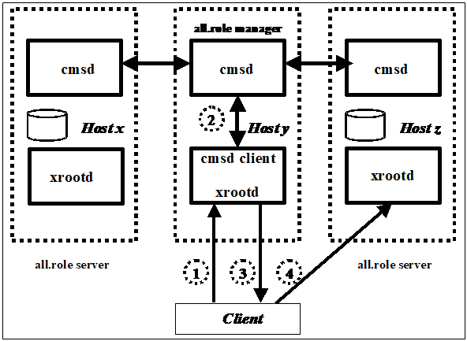
Redirector load balancing
To investigate efficiency of redirectors with a unified setup compared with the DNS round robin currently in use to balance load between gateways
https://xrootd.slac.stanford.edu/doc/dev54/cms_config.htm#_Toc53611049

Slide 21
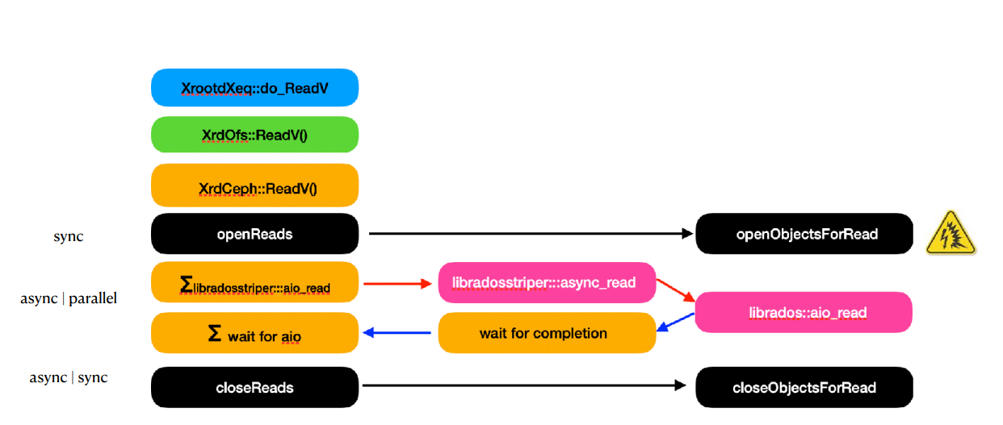
Implement vector reads at the XrdCeph Layer
A.J. Peters, How-to get real asynch IO

Slide 22
Merge libradosstriper with XrdCeph
The goal is to have a single code base combining libradosStriper and XrdCeph, which could be easily maintained by RAL. We would like to maximise throughput by parallelising operations / transfers where possible.

Slide 23
StatLS (spaceinfo and query space support)
Allows users to query the current and available space in each pool
Functionality implemented in XrdCeph 5.3.8, needs unified setup for the right permissions
Example:
[root@host-172-16-105-133 ~]# xrdfs 172.16.105.133:1094 spaceinfo atlas
Path: atlas
Total: 17182000000000000
Free: 17181999966445568
Used: 33554432
Largest free chunk: 17181999966445568

Slide 24
CI and Testing improvements
Implemented scripts to:
  Automate dependency installation on fresh dev VMs
  Automate compilation of xrootd-ceph
  automate and improve RPM deployment
    Renaming RPMs for version containing alpha features
  Perform basic functionality tests
3 step testing before full deployment:
  Dev/VM testing
  Pre-prod testing
  Single prod machine testing

Slide 25
Thank you

Slide 26
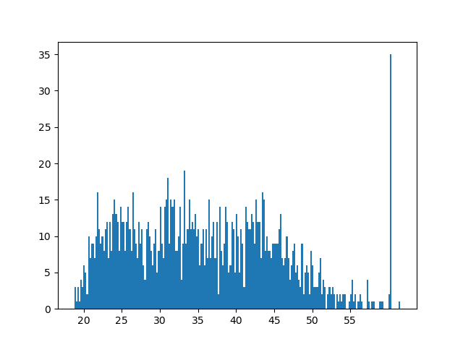
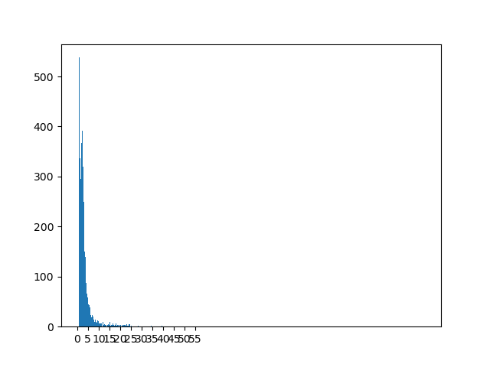
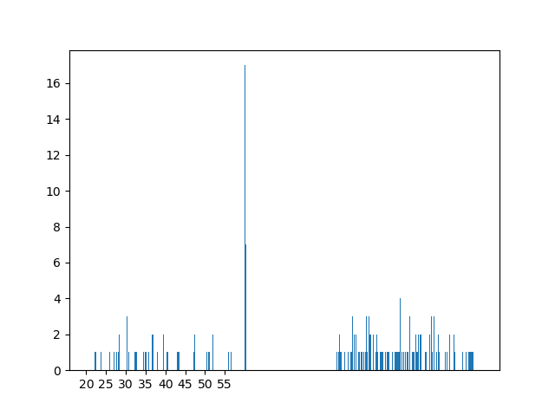
Vector read issue (more)
From testing at RAL, another issue that might be causing the issue was identified to be the XRootD TLS
This did not result in improved Job success rates.
Full test report
No memcache/tls | Memcache, no tls | Tls, no memcache
Average successful read time: 28.7s | Average successful read time: 3.63s | Average successful read time: ~35s
Success rate: 97.58% | Success rate: 100% | Success rate: 22%

Slide 27
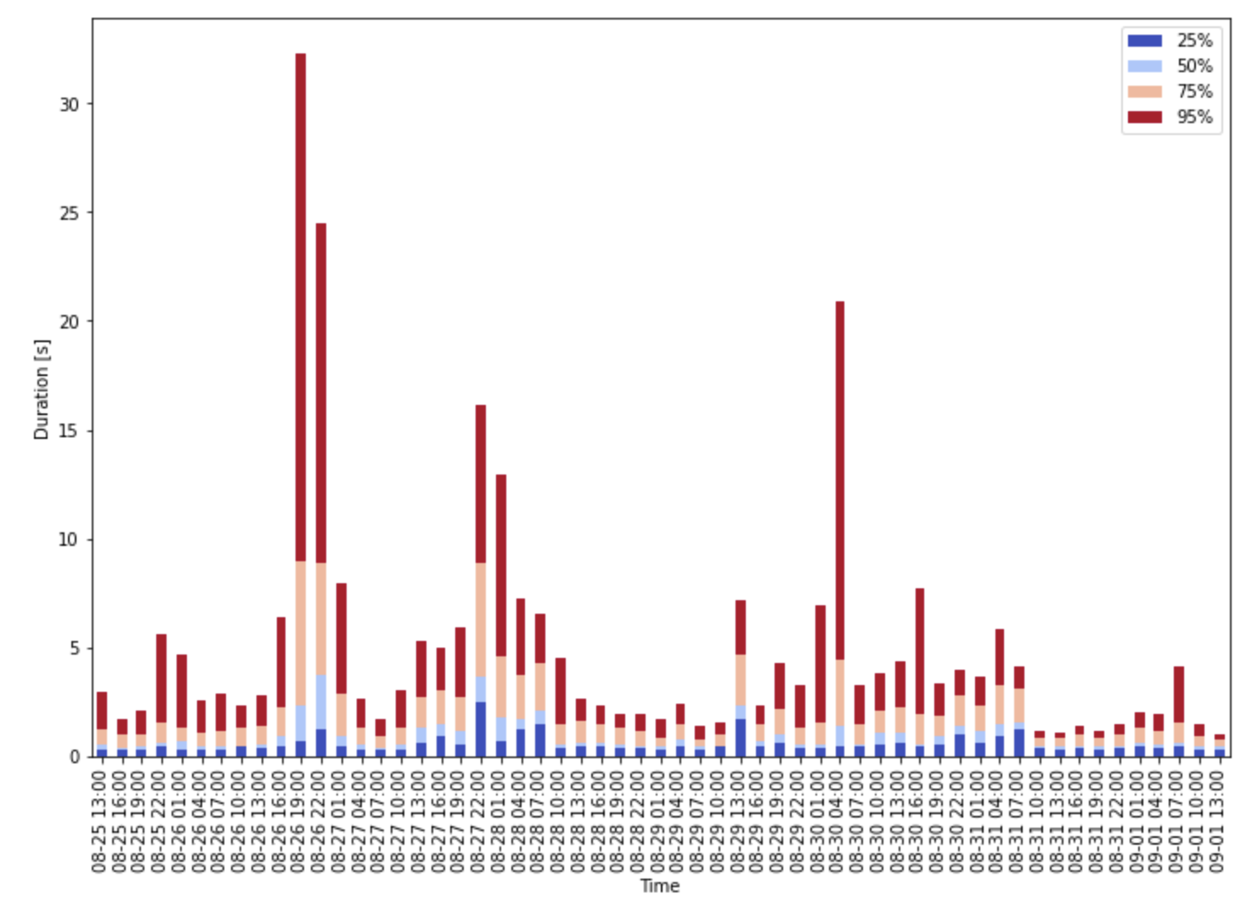
Delete Speed (more)
Switch to unified

Slide 28
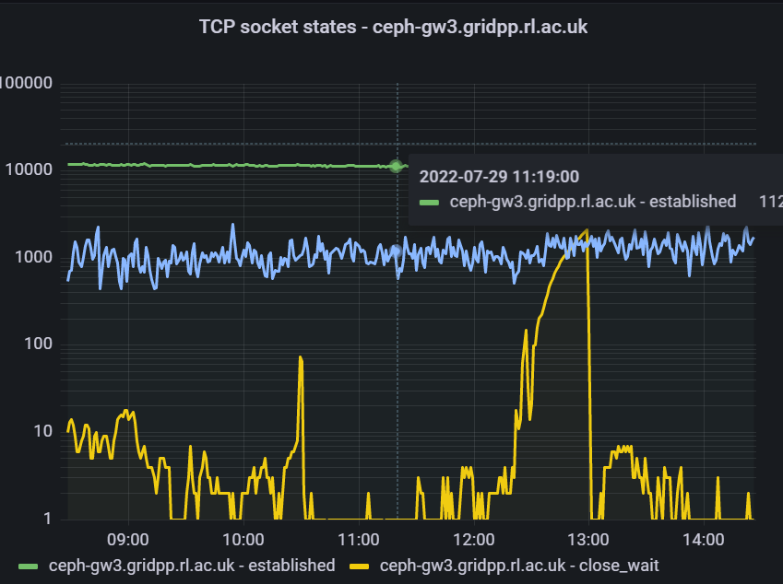
CLOSE_WAIT
Identified by an exponential rise in sockets in CLOSE_WAIT state and number of XRootD connections
Client requests fail at this point
Caused by failure to end sessions
Gets fixed on service restart

Slide 29
Servers using XRootD
XRootD gateways
Webdav gateways
Alice gateways
Worker nodes
  Xcache instead of proxy
  Perform reads in xcache, writes on external gateways
CMS AAA redirectors

Slide 30
Paged read issue in details
Identified bug that resulted in incorrect system readV call (iovcnt greater than maximum), causing clients to crash when requesting preads.
Fixed client-side in 5.5 with commit https://github.com/xrootd/xrootd/tree/26eb65159521fd4bfe6b557f933ee1cc9bd34411

Slide 31
Debugging
#include <fstream>
{
using namespace std;
ofstream myfile;
myfile.open ("/tmp/debug2.txt", std::ios_base::app);
myfile << "example:"<<var<<"\n";
myfile.close();
}

