Slide 1

Status of MPE-MI Systems
226th Machine Protection Panel Meeting
Raffaello Secondo
on behalf of TE-MPE-MI
10th June 2022

Slide 2

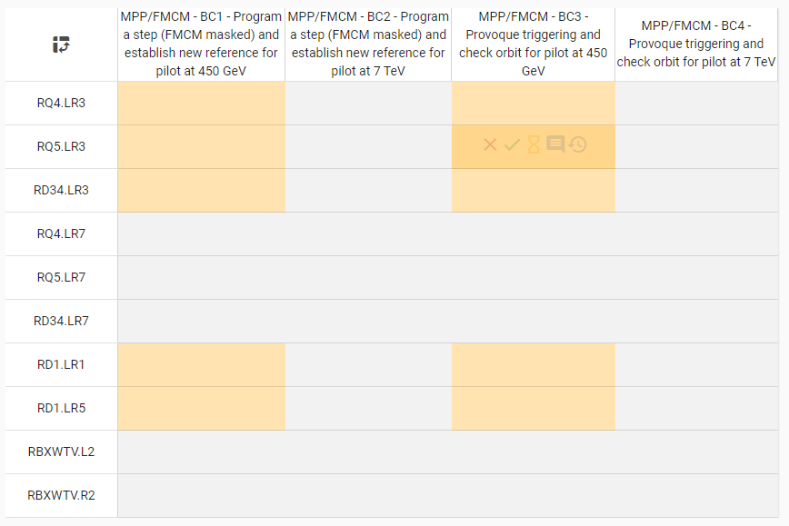

Interlocks System Status - I
WIC
PIC
FMCM:
  WIC triggers before the FMCM.
  Tests to be carried out at injection energy at least for the most critical circuits: RD1 and RD34.
  Tests with pilot beam done yesterday for RD1.LR1.
  To be repeated for RD1.LR5 and RD34 at injection energy.
  Procedure to be reviewed/updated?

Slide 3
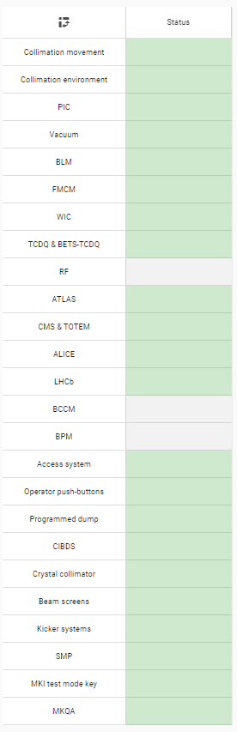
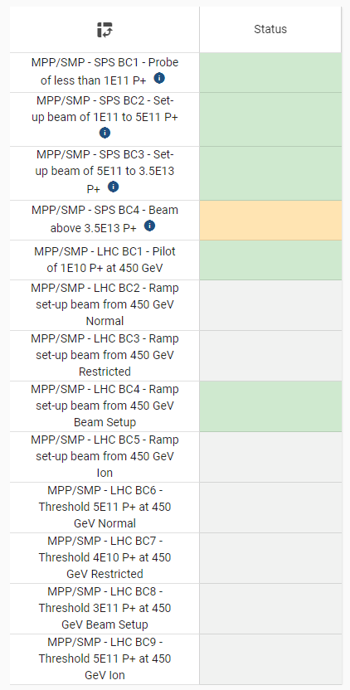
Interlocks System Status - II
BIS:
  User link connections to be validated:
    RF (never in final commissioned state)
    BCCM not operational yet
    BPM (point 6) → next week
    LHCb VELO: not yet ready
SMP:
  Beam tests (Ramp Energy, SBF TRUE→ FALSE)

