Slide 1
Rapid Synchronization Recovery from Single Event Effects in the Large Hadron Collider
Anatoliy Martynyuk – 8th of June 2022

Slide 2
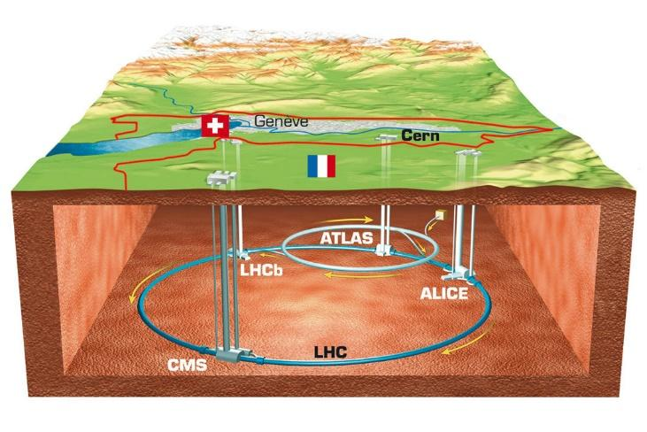
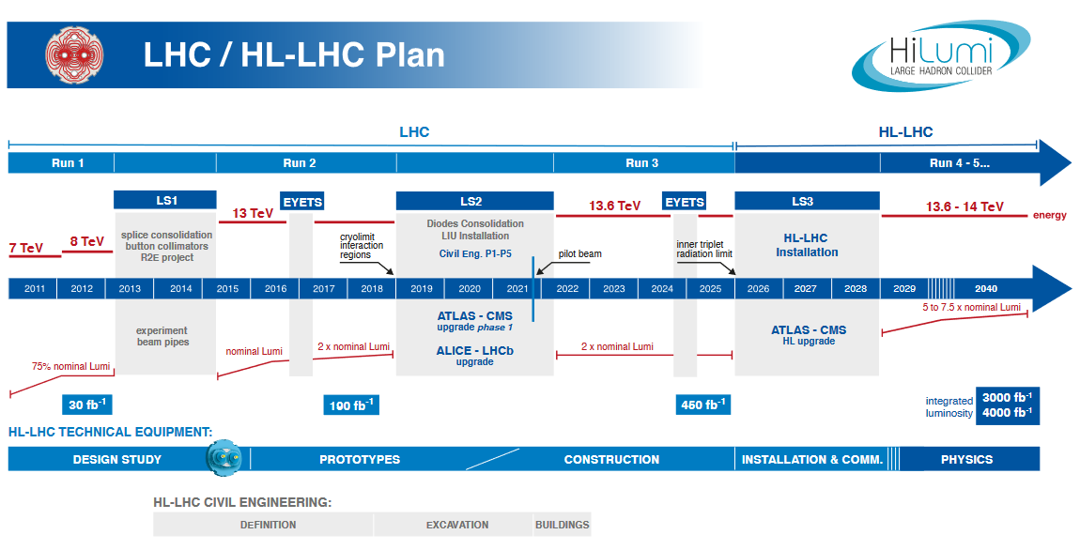
The Large Hadron Collider
The largest particle accelerator in the world
Operation involves speeding subatomic particles up to near light speed, colliding them and recording the output results of the collision
Anticipating a significant upgrade in luminosity through 2029

Slide 3
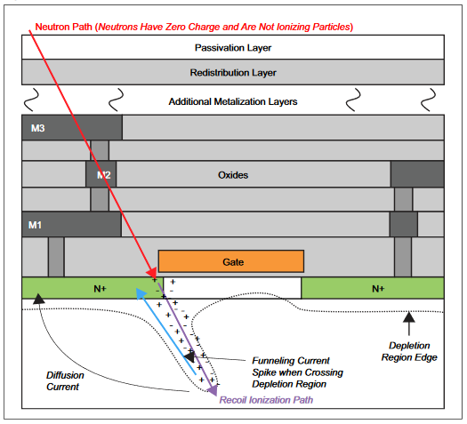
Single Event Effects: Physics
SEEs are a consequence of subatomic particles creating charged paths resulting in current/voltage spikes
Single Event Upset (SEU): Event occurred in memory and flipped a bit
Single Event Transient (SET): Event occurred on a wire and triggered a glitch
Notes:
Figure out the physics of SEEs a little more

Slide 4
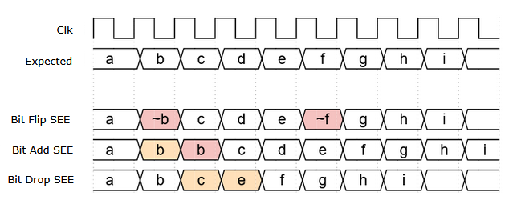
Single Event Effects: Digital Abstraction
We can ignore how or where an SEE occurs and deal with the result of its occurrence: bit flips, bit duplication/adds and bit deletion/drops
Bit flips are a result of memory upsets, and glitches being sampled
Adds and drops are a result of glitches and frequency drift in the clock or in clock generating logic
Notes:
How exactly do SEEs affect the RD53?

Slide 5
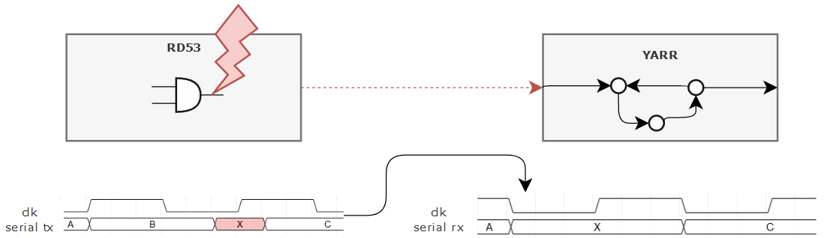
Single Event Effects: At the LHC
RD53 Pixel Readout Chip is at the collision site and experiences high radiation
YARR DAQ is far from radiation site and experiences effectively no radiation
However, YARR has to deal with SEE effects passed to it by the RD53

Slide 6
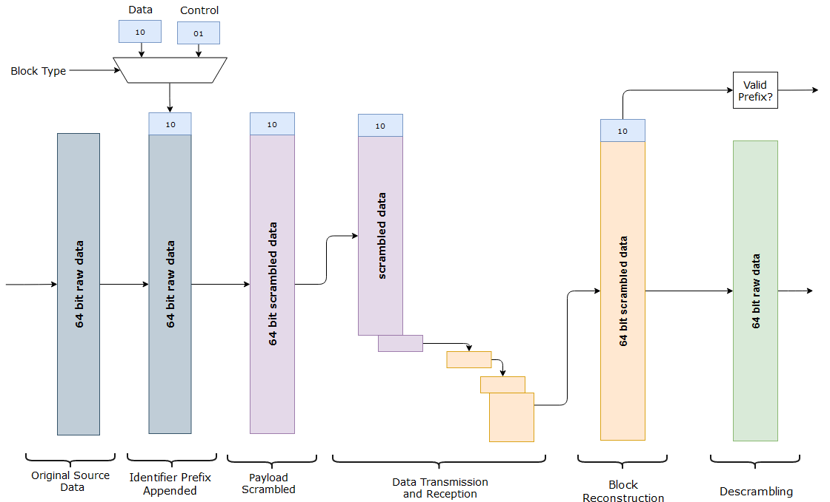
64b/66b Encoding
Communication is done over a single differential pair
Each block contains 64 payload bits and 2 alignment/header bits
Protocol features:
  Stream alignment
  Guaranteed transition
  Statistical DC Balancing
Notes:
“To reduce analog communication complications we want an even number of 1s and 0s”

Slide 7
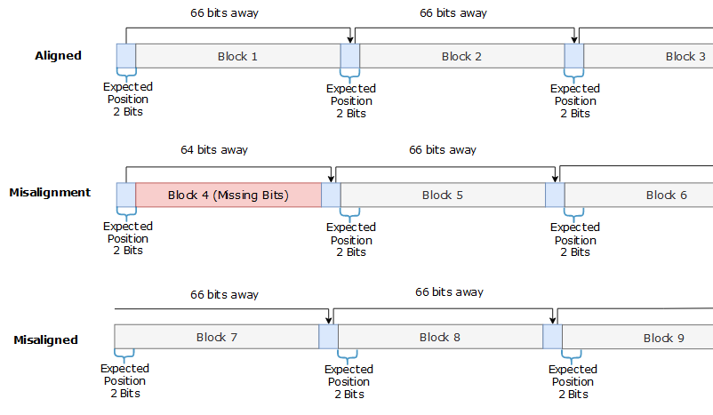
Stream Alignment
Alignment based around stream periodicity
YARR expects a 01 or 10 every 66 bits received and monitors the position where the bits are expected
Once misaligned, the stream needs to be shifted to move header bits back into expected position

Slide 8
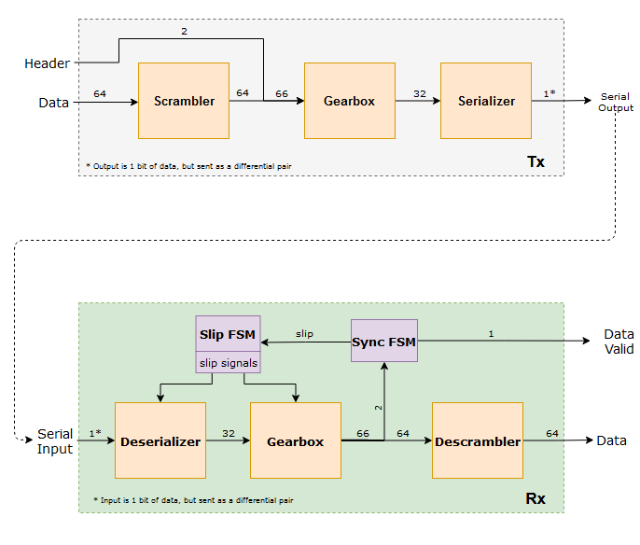
Communication Tx/Rx
Communication hardware is responsible for the implementation of the 64b/66b protocol
Each block in the Tx has a reverse counterpart in the Rx
The scrambler effectively randomizes the payload for an even number of ones and zeros
Gearbox transforms each 66-bit input into two 32-bit outputs

Slide 9
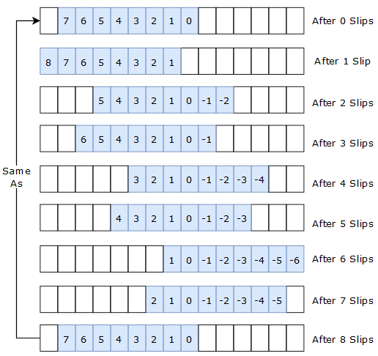
Original Scheme: Serializer Bitslip
Serializer operates in DDR mode to keep up with 1.28 Gbps data rate
DDR serializer utilizes bit slip module to drop and add bits
Abstractly view as a 15-bit buffer with a selection window that snaps back after 8 “slips”
Notes:
Check the details of the serializer

Slide 10
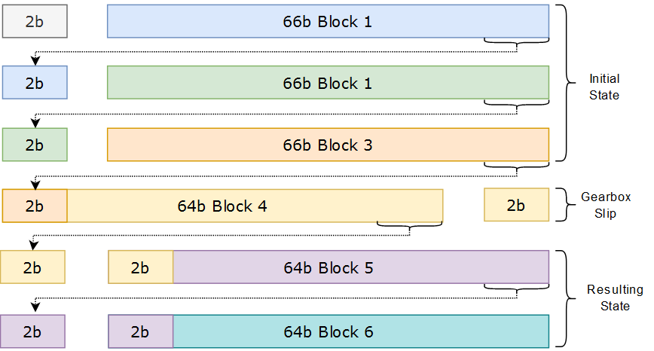
Original Scheme: Gearbox Slip
Rx Gearbox build 66-bit blocks from the serial data processed by the deserializer by utilizing an internal buffer.
The buffer allows the gearbox to maintain a 66-bit block as well as the bottom two bits of the previous block
The gearbox can opt to use the two bits of the previous block, effectively shifting the data stream by 2 bits

Slide 11
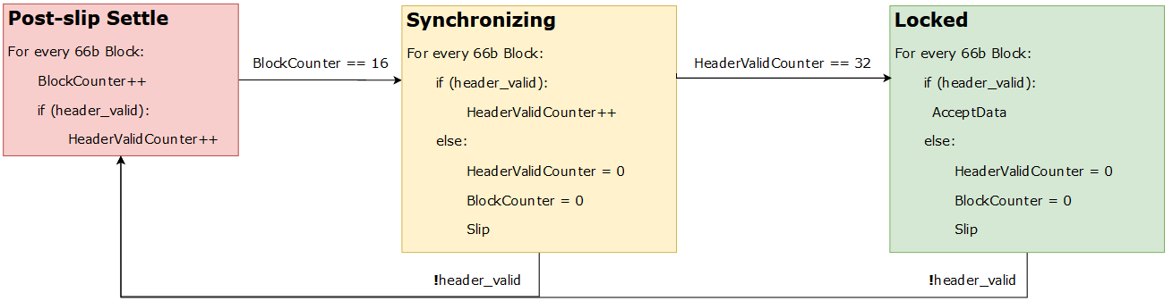
Original Scheme: Control FSM
Synchronizing state counts a minimum of 16 consecutive valid words before the system locks on
Any single invalid header desynchronizes and moves the FSM to the Settle state unless the FSM is already there
Slip activates either the gearbox or serializer slip
There are 8 serializer slips for every gearbox slip

Slide 12
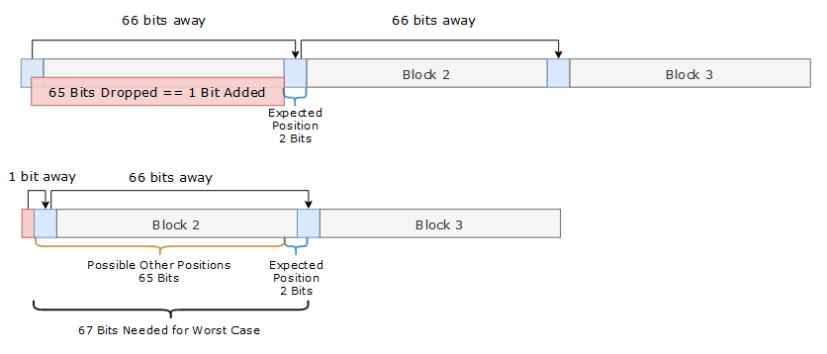
Fully Parallel (FP) Alignment
Goal is to utilize parallelism to monitor multiple possible positions simultaneously
By monitoring every possible position, the slip mechanisms become redundant

Slide 13
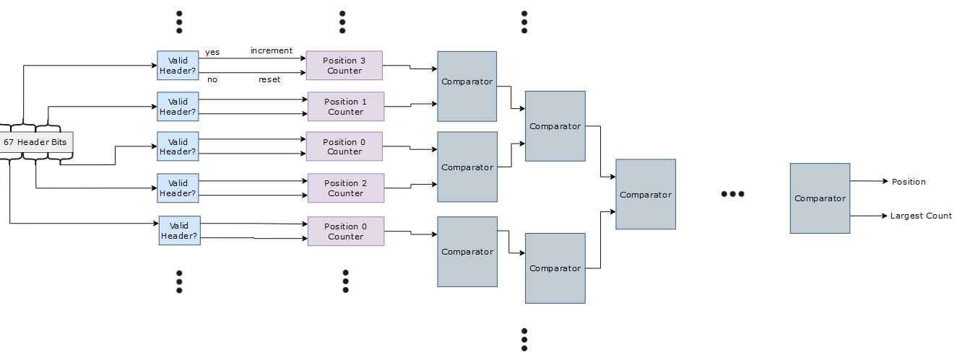
Fully Parallel (FP) Alignment
However, evaluating every possible position is costly:
  Combinatorial logic requires pipelining to meet timing constraints
  Combinatorial logic and pipelining overhead demand significant FPGA resources

Slide 14
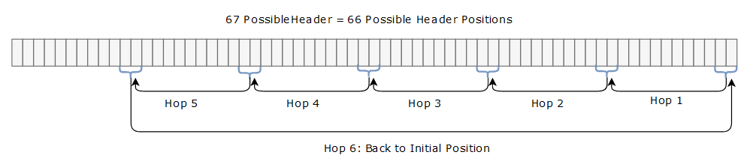
Header Seeker (HSn) Alignment
HSn utilizes less parallelism to reduce resources and pipelining costs but aims to retain the benefits of FP
By assigning multiple positions to an individual seeker/monitor, a small group of seekers can monitor the full 66 position range
Seekers hop between their assigned positions whenever the position being monitored has invalid header/alignment bits.

Slide 15
Header Seeker (HSn) Variants
With 66 positions, variations with 33, 22, 11, 6, 3, and 2 seekers are possible
Seekers can do up to 8 hops per 66-bit block
Even when one seeker is locked onto the correct header, the remaining seekers continue to rotate through their assigned positions

Slide 16
Performance Comparison
Simulated shifting stream bits by n, with n swept from 1 to 65.
Variants have too good of performance to be clearly visible, see next slide.
Last 4 “Original” system data points are the result of the Serializer’s slip pattern.

Slide 17
Performance Comparison
16 initial blocks lost because of the minimum number of consecutive valid blocks required to achieve synchronization
Additional lost blocks while aligner detects sync loss and determines the new correct alignment
16

Slide 18
Resource Utilization Comparison
Targeted a Kintex 7 T160 Xilinix FPGA, using Vivado Mapping tools
Original system leveraged existing logic for alignment
Developed variants added significant additional logic

Slide 19
FP and HSn Variant Tradeoffs
Summary of LUT resource utilization vs average of blocks lost during resynchronization
Logic outside of the aligner utilize 0.22% of FPGA resources

Slide 20
Future Work
The number of consecutive valid headers required for synchronization can be mathematically optimized with sufficient data. The performance enhancement would be significant compared to the negligible cost in resources of the additional FPGA resources
The system can be improved, or a variant can be developed, which address bit flips. The aligners in this project are built to recover quickly from adds or drops but not flips

Slide 21
Questions?

Slide 22
Extra Slides

Slide 23
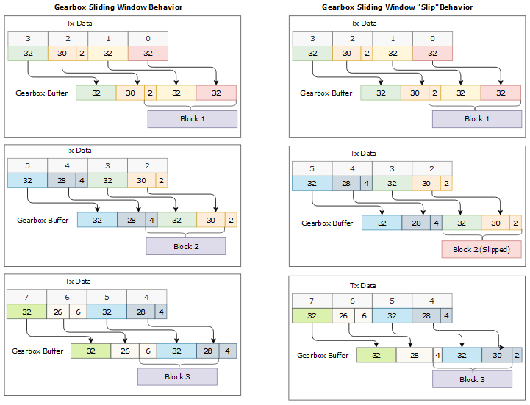
Original Scheme: Gearbox Bitslip

Slide 24
Differences Between Variants
HS3-HS33 all use equally spaced hop differences:
  HS11 seeker 0 will check position 0, 11, 22 …
HS2 seekers span a range and move in opposite directions:
  Seeker 0 checks 0, 1, …, 33 while seeker 1 will check 66, 65, …, 34
Seeker 1 is an improved original with up to 8 hops per 66b word instead of 1

Slide 25
Performance Trendlines
Hops are still performed unidirectionally, but having multiple seekers means the starting positions at desync are mostly random
However, multiples of n in an HSn scheme have a predetermined number of hops and show linear ascending behavior

Slide 26
Negative Effects of Seeker Competition
Seekers determine correct position by eliminating incorrect positions.
With more seekers, the probability of one incorrect position seeing multiple correct header bits increases.
For that reason, HSn can occasionally outperform FP

Slide 27
Utilization with HS1 Included

