Slide 1
WP15 & EN-EL cabling review 2022
Overview
EN-EL project team
10/06/2021

Slide 2
Agenda
  Introduction
  Specific points
    AC distribution
    Decabling
    Signal cabling
    Optical fibres

Slide 3
Introduction
  The scope of the review is to re-assess the cost of cabling related to WP15 (WP17 is not in the scope). A detailed agenda is being prepared and will be presented at later stage.
  EL need your support to confirm the needs you have expressed so far, in the form of pre-DIC, pre-DIFs or power requests (deadline 24th of June)
  Connectors shall be specified, where this is applicable
  WP15 will also freeze, in the next weeks, the baseline for the integration in the tunnel
  Based on those points EN-EL will carry out a cost estimation, using the costs of the new frame contract (manpower, cables etc.)

Slide 4
AC distribution
  Reference document
  LHC and Service Areas - Electrical power supply users' requirements
  Users shall verify needs by 24.06.2022 (specific meetings organized with VSC to address specific issues)

Slide 5
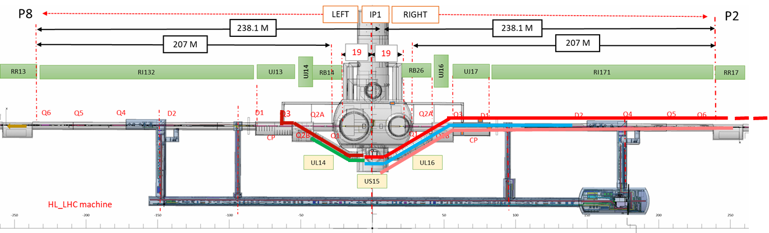
De-cabling / Re cabling BASE of the estimation
EDMS 2378603 - HL-LHC DE-CABLING AND RE-CABLING CAMPAIGNS OF LSS1 AND LSS5
(Covered Collaterally Impacted Cables, except TE- VSC,TE- CRG. Obsolete cables
not in the scope of the document)
Cable lists extracted by JC Guillaume for de-cabling cost estimation (P1L, P5 complete) from 2018
2020
Beginning
2021
RQF 1679659 of TE- VSC P5 left only,
RQF1610736 of TE-CRG P1 and P5 complete.
 | A. Obsolete Cables | B. Collaterally Impacted Cables
1. LHC LSS cables | A1 (3056c. 460,4 km) | B1 (82c. 9,6 km)
2. Local cables | A2 (1317c. 65,6 km) | B2
3. Traversing cables | A3 | B3 (186c. 31,3 km) B31 (86c. 18,2 km) B32 (9c. 0,5km)
EDMS 2607295
June
2021
Total A_= 4373 c. 526 km Total B_363c. 59,6 km
HL-LHC LSS Cable: A1 (Obsolete) and B1 (de-cabling /re-cabling total)
No change on the baseline
Local Cable: A2 (Obsolete) and B2 (not applicable)
Traversing Cable: A3 (Obsolete) and B3 (total de-cabling /re-cabling )
Reviewed baseline
Traversing Cable: B31 (partial de-cabling /re-cabling )
Traversing Cable : B32 (pulled back (non destructive method) a few meters)
August
2022
HL-LHC De-cabling Road Map Approval
time

Slide 6
De-cabling / Re cabling
CABLING REVIEW EL:
- The technical information from the previous slide will be used:
- De-cabling: 4373 cables, 526 km;
- Collaterally Impacted Cables: 363cables, 59,6km;
- Cost update with the new S262 electrical installation contract will be prepared.
NO ADDITIONAL INFORMATION REQUIRED!
After validation of the Road Map between EN-EL and HL-LHC, an additional
presentation with the general strategy will follow.

Slide 7
Signal cables (1/2)
  Starting point: the following pre-DICS. Any (big) change?
Group | Work Package | System | Baseline 21.05.2021 DIC Version | DIC | Date | Cable Quantity (IP1+IP5)
BE-CEM | WP 05 | COLLIMATORS LSS | RQF1211983 | Pre-DIC Collimator LSS1R LS3.xlsx | 22/01/2019 | 352
BE-CEM | WP 06b | WORLD FIP NETWORK | RQF1681973 | PREDIC_HL-LHC_UL557_FGC.xlsx | 28/10/2020 | 64
BE-CO | WP 17.5 | REMOTE RESET / TIMING GMT | RQF1428605 | 1-pre-DIC_CABLING_PAQ_DIC_v3.xls | 31/10/2019 | 88
BE-GM-HPA | WP 15.4 | MOTORS | RQF1708450 | HL-LHC_EN-SMM-HPA_REV2.xlsx | 08/12/2020 | 368
BE-GM-HPA | WP 15.4 | SENSOR CAPACITIVE | RQF1708450 | HL-LHC_EN-SMM-HPA_REV2.xlsx | 08/12/2020 | 172
BE-GM-HPA | WP 15.4 | TT HP | RQF1708450 | HL-LHC_EN-SMM-HPA_REV2.xlsx | 08/12/2020 | 100
BE-GM-HPA | WP 15.4 | WORLD FIP NETWORK | RQF1708450 | HL-LHC_EN-SMM-HPA_REV2.xlsx | 08/12/2020 | 24
EN/AA | WP 17.4 | SAFETY SYSTEM (DI-SSS-SMSI) SOUT | RQF1809653 | HL-LHC1_PreDIC.xlsx | 28/03/2019 | 788
EN/AA | WP 17.4 | SAFETY SYSTEM (DI-SSS-SMSI) SURFACE | RQF1809653 | HL-LHC1_PreDIC.xlsx | 28/03/2019 | 200
EN/AA | WP 17.4 | RED PHONES | RQF1809692 | PRE_DIC_CABLE_HL_LHC_1.xlsx | 12/07/2018 | 20
EN/AA | WP 17.4 | ACCESS SYSTEM | RQF1805494 | ACCESS SYSTEM | 29/03/2019 | 24
EN/AA | WP 17.4 | GAS DETECTION SOUT | RQF1805435 | GAS DETECTION SOUT | 11/04/2019 | 86
EN/AA | WP 17.4 | GAS DETECTION SURF | RQF1805435 | GAS DETECTION SURF | 11/04/2019 | 84
EN-CV | WP 17.3 | COOLING & VENTILATION | RQF1220688 | CABLING_PAQ_DIC_v3_EN_CV_20191029.xls | 29/10/2019 | 110
EN-MME | WP 04 | CRAB STRAIN MEASUREMENT | RQF1804585 | Ticket annulé le 27/05 |  | 0
IT-CS | WP 17.5 | GSM / TETRA | RQF1386632 | HL-LHC_Point1_CABLING_PAQ_DIC_v3.xls | 30/07/2019 | 70
SY-BI | WP 13 | BRAN | RQF1804676 | LS3_DIC_BRAN_IP1_R.xls | 25/03/2019 | 48
SY-BI | WP 13 | BPM Collimators | RQF1186137 | Pre-DIC for LS3 BPM Collimators Pt1R.xlsx | 25/12/2018 | 196
SY-BI | WP 13 | IT BPM | RQF1725483 | 2-2020-11-04_dic_bpm_ip1r.xlsx | 04/11/2020 | 304
SY-EPC | WP 06b | ETHERNET EPI to PC | RQF1214768 | Pre-DIC_EPI_FGC3_HL-LHC-UR15-R_v1.xlsx | 25/01/2019 | 64
SY-RF | WP 04 | RF POWER | RQF1211735 | 20190108 Pré-DIC - List of Cables RF Power - HL-LHC - 1 IPside.xls | 08/01/2019 | 400
SY-RF-CS | WP 04 | RF CONTROL POWER | RQF1254672 | Pré-DIC - List of Cables RF PLC Power - HL-LHC - 1 IPside.xlsx | 12/03/2019 | 176
SY-RF-FB | WP 04 | RF CC FC IPR | RQF1804508 | LhcCc-DIC-LLRFv2.xls | 14/11/2016 | 236
TE-CRG | WP 09 | CRYOGENICS + INSTRUMENTATION | RQF1610736 | DIC_HiLumi_P1_P5_V6.xls | 08/09/2021 | 1296
TE-MPE | WP 07 | INSTRUMENTATION | RQF1219096 | preDIC_HL-LHC-R1_rev.xlsx | 22/10/2020 | 704
TE-VSC | WP 12 | INSULATION VACUUM (IV) | RQF1679659 | Pre-DIC_LSS5_LS3_v13.xlsx | 16/10/2020 | 380
TE-VSC | WP 12 | BEAM VACUUM (BV) | RQF1679659 | Pre-DIC_LSS5_LS3_v13.xlsx | 16/10/2020 | 832

Slide 8
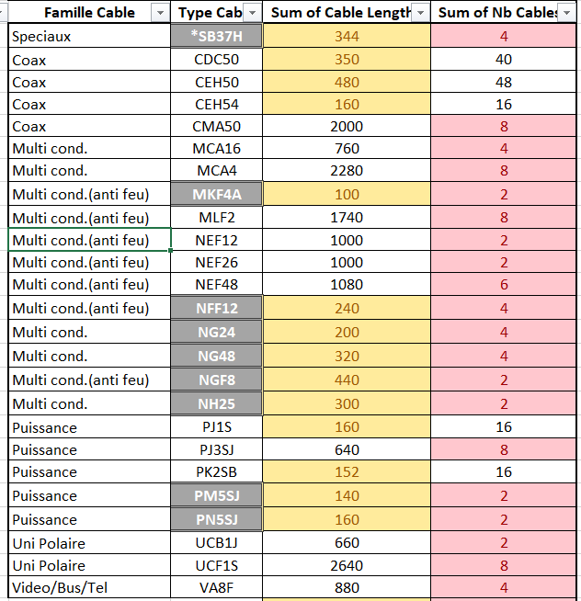
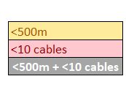
Signal cables (2/2)
  Can the users optimize the use of some cables? < 500m, <10 cables

Slide 9
Optical fibres
  Starting point: the following pre-DIF. Any (big) change?
Group | Work Package | System | Caller | DIF | Deadline | # Links | Last update
SY-RF | WP 4 | RF Interlock | David Christian Glenat | RQF1255540 | LS3 | 16 | 13/03/2019
SY-RF | WP 4 | RF System, Remote Timing | Gino Cippola | RQF1863232 | LS3 | 56 | 26/08/2021
TE-CRG | WP 9 | Cryogenics | Bert Marc J Ivens | RQF1430677 | LS3 | 48 | 15/10/2021
SY-BI | WP 13 | BPM | Michal Krupa | RQF1219092 | LS3 | 72 | 11/05/2021
SY-BI | WP13 | DOROS | Tom Levens | RQF1551601 / RQF1551603 | LS3 | 48 | 17/12/2021
BE-GM | WP 15.4 | FSI Systems | Mateusz Sosin | RQF1708445 | LS3 | 1152 | 12/03/2020
BE-CEM | WP 17.5 | White Rabbit, GMT | Ioan Kozsar | RQF1428590 | LS3 | 40 | 08/12/2020
EN-EL | WP 17.2 | EN-EL ENC | Sonia Infante | RQF1273533 | 2023 | 96 | 08/10/2019
IT-CS | WP 17.5 | IT Network | Christian Burlet | RQF1799745 / RQF1799761 | 2023 | 120 | 20/09/2021
IT-CS | WP 17.5 | IT Network | Christian Burlet | RQF1799770 / RQF1799773 | LS3 | 312 | 15/06/2021
SY-STI | WP 15.2 | Pont roulant TAXN | Jean-Louis Grenard | RQF1985266 | LS3 | 5 | 15/06/2021
SY-BI | WP13 | BGV | Helene Guerin | RQF1941450 | YETS 22-23 | 12 | 15/06/2021
SY-BI |  | EO-BPM | Thibaut Lefevre | RQF1712941* | YETS 22-23 | 25 | 15/12/2020
EN-AA |  | Fire detection | Denis Raffourt | RQF1565962 / RQF1568059* | 2023 | 12 | 09/04/2020
* Related to HL-LHC but included in other project.
Cost update with the new FO installation contract and the new procurements contracts will be prepared.

Slide 11
Additional slides

Slide 12
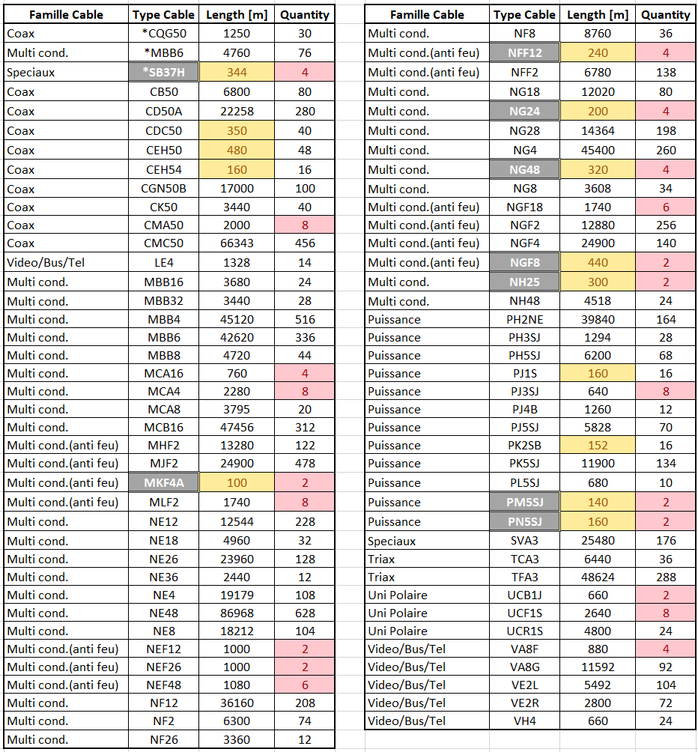

Slide 13
