Slide 1
HL-LHC Layout version 1.6:
- Release procedure for P1 and P5
- Changes implemented in Layout version 1.6
- Changes left for Layout version 1.7
J. Oliveira, G. Aparicio
10/06/2022

Slide 2
Release Procedure of the Layout version 1.6
The drawings corresponding to the layout of the long straight sections of P1 and P5 are available in the drawing folder in EDMS 2746400.
The reviewers will have until the 22nd of June of 2022 to deliver their comments.
For the released documents to be shown in the 24th June 2022 HL-LHC WP15 meeting, if the comments lead to major changes in the drawings.

Slide 3
Changes implemented in Layout version 1.6
Changes in general layout
  TAXS vacuum chamber length at LSS1R and LSS1L ( WP8 Meeting #94.)
  Change of the MQXFA/B magnetic lengths
  Removal warm BPM close to D1
  TAXN-Collimators-D2 layout due to the change in the VAB and the TAXN lengths
  D2: new interface with DFM
  Relocation of the crab cavities for independent cool down system
  BPTQXs length increased
  Relocation of BPTQR and BPQTX
  Relocation of TCLMs at Q4 and Q5 and collimator at Q5 due to VAB length change
  TCLMB/Cs length reduced to 1200mm
  New VABs lengths implemented according with EDMS 2740685
  New PPS (TOTEM) space reservations
  Relocation of the collimators between Q4 and Q5 to free space to PPS(TOTEM) stations
Changes in drawings
  TAXS: update wireframe and interface of LSS1R and LSS1L
  DCM: update wireframe and interface
  DFX: update wireframe and interface
  DFM: update wireframe and position
  D2: update wireframe with new interface for DFM
  Crab Cavities latest design: update wireframe and interface
  Sector valves update
  Relocation of the DQRs to free space to PPS (TOTEM) stations
  Minor visual correction on the inner triplet wireframes on the bellows interconnection.
  Update wireframes with correct jumper height and orientation: D2, CC1, CC2, Q4
  Update wireframes with correct interfaces: D1, DCM, DFX .
  Include vertical cores longitudinal position.

Slide 4
Changes left for Layout version 1.7
From WP3:
  In collaboration with WP12 the insulation vacuum ancillaries must be provided and inserted in the layout database.
  Interfaces of the cryoassemblies to be defined in terms of naming and location and after to be inserted in the layout database.
The HL-LHC Q4 is a copy of the LHC Q4 with a standard jumper connection module added done by WP15 to represent a more realistic space reservation.
  WP3 must provide the final design to transform the previous design in a standalone cryoassembly.
  WP2/WP5 studies to protect the correctors that may lead to changes in the layout.
  Study of the connection to the QXL that may lead to changes in the drawings.
  WP3/WP9 Maintenance volume for the DSL connection.
From WP4:
  Ancillaries for Crab Cavities in terms of insulation vacuum
From WP6a DFX position or widening to compensate the 30 mm space between LDQD (DCM) and the DFX and proper alignment/positioning in the 3D models.
From WP9 the QXL and QRL layout coming from the contractor including the interconnections, service modules, and ancillaries such as the insulation vacuum ones. All these elements must be inserted in the layout database.
From WP12 the layout must be provided for the other sides of the of P1 and P5 because it is only provided, at the time of writing, for the LSSR5 and it does not match the sector valves lengths agreed as mentioned in the EDMS 2740685.
From WP13 to provide the update of design of the BPTQRs since for now we only have a space reservation.
From WP15 produce the wireframes for the left side assemblies to include directly in the SmarTeam item of the WP3 assemblies.
If approved by CERN management detailed integration of PPS (Totem)

Slide 5
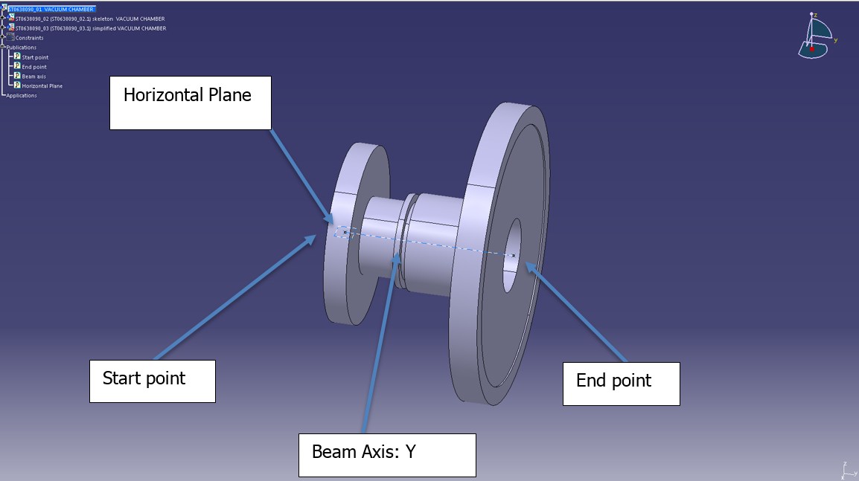
DMU compatibility of the 3D models
It is required for the LHC digital mock-up toolkit to work with the simplified 3D models delivered to the integration team for the beamline equipment.
  The Start Point (0, 0, 0) with respect to the reference system of CATIA is centred with the beam axis being the Y axis in the reference system of CATIA.
  Additionally, that the Z axis direction matches the normal to the machine plane (mind not the local vertical).
  Exception to equipment out of the beamline that shall have a reference point in the beamline to anchor the 3D model or a defined interface.
Image retrieved from EDMS 2030484.

Slide 6
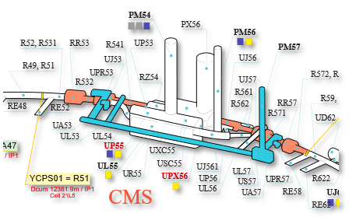
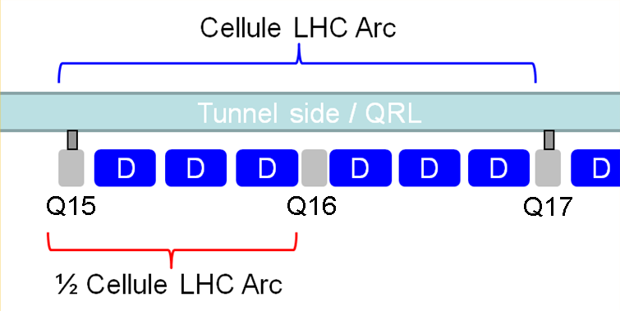
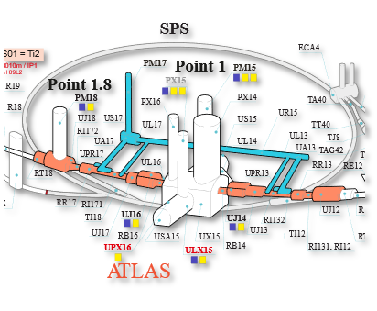

LHC sectioning of the 3D models
Civil engineering works will be defining the sectioning for the services and cavern simplified 3D models as today is done by the LHC integration team.
The HL-LHC half-cells will be defining the sectioning for the machine and QXL/QRL simplified 3D models as today is done by the LHC integration team.
These half-cells are defined inside the layout drawings of the long straight sections.
IP | ½ Cells
1 | 1,2,3,4,5,6,7
5 | 1,2,3,4,5,6,7
https://accelerators-synoptics.web.cern.ch/lhc-underground/

Slide 7

Thank you for your time.
“Strive not to be a success, but rather to be of value.” – Albert Einstein

Slide 8
Spare Slides

Slide 9
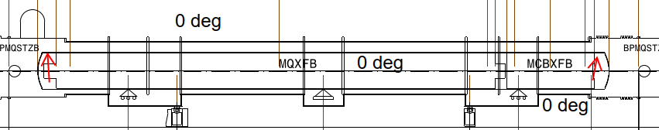
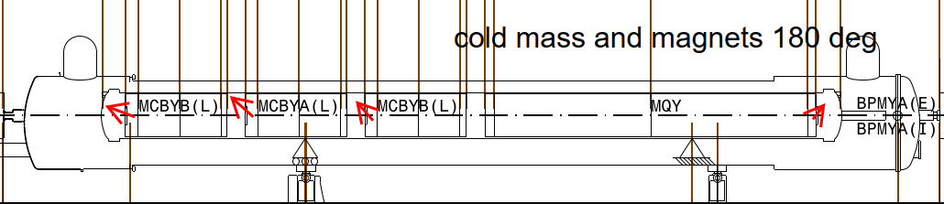
Convention for the rotation of cryoassemblies, coldmasses and magnets.

Slide 10
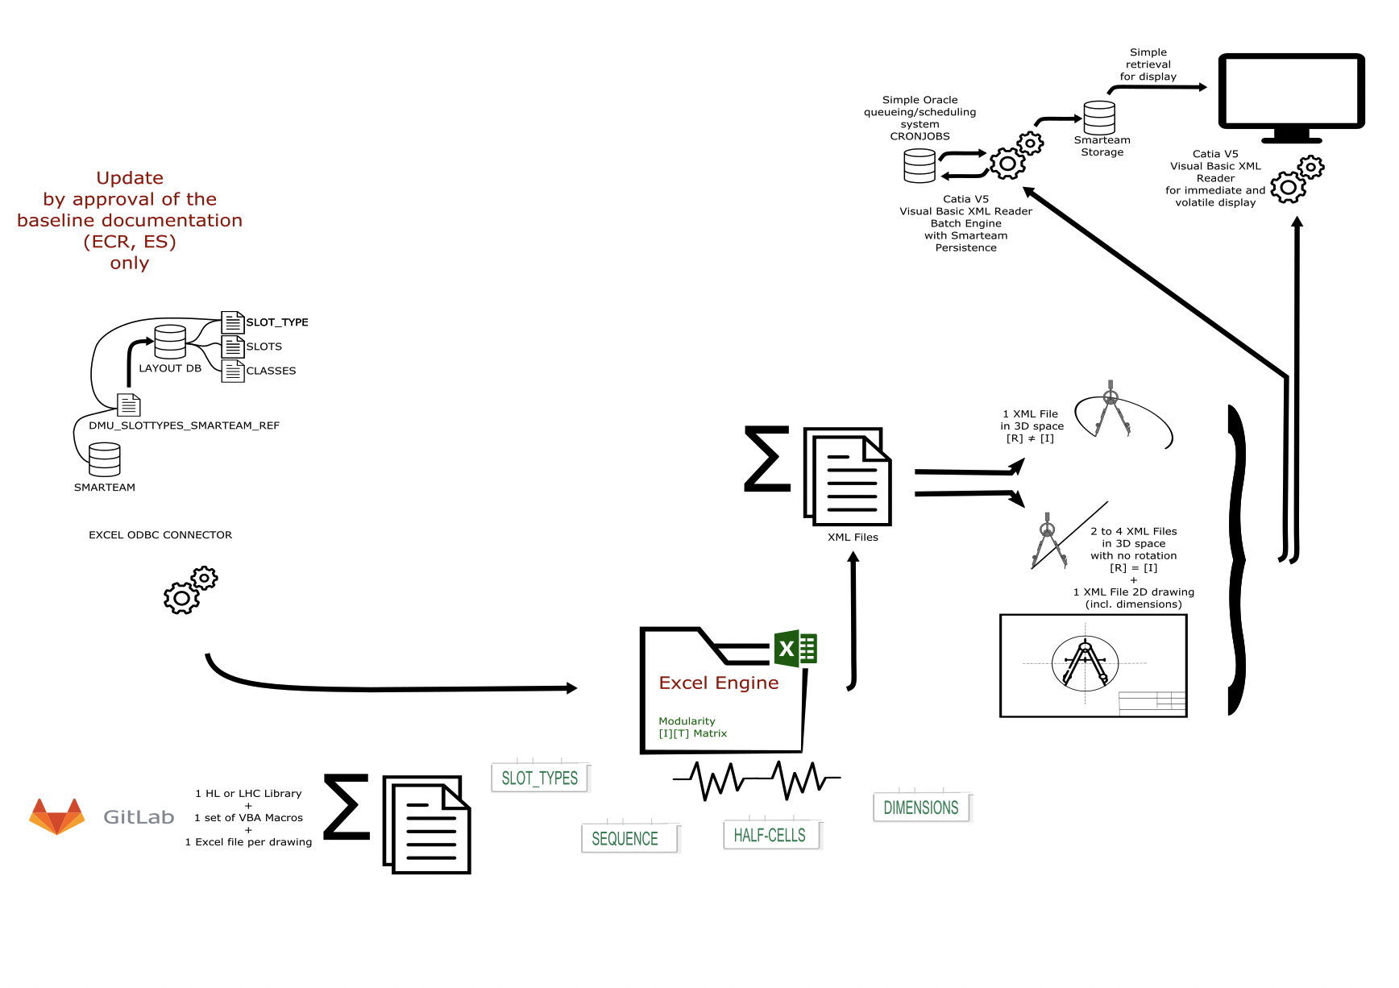

Digital Mock-up Excel Engine

