Slide 1
Introduction to FPGA acceleration
Introduction to FPGA acceleration
14/04/2021
Marco Barbone
m.barbone19@imperial.ac.uk

Slide 2
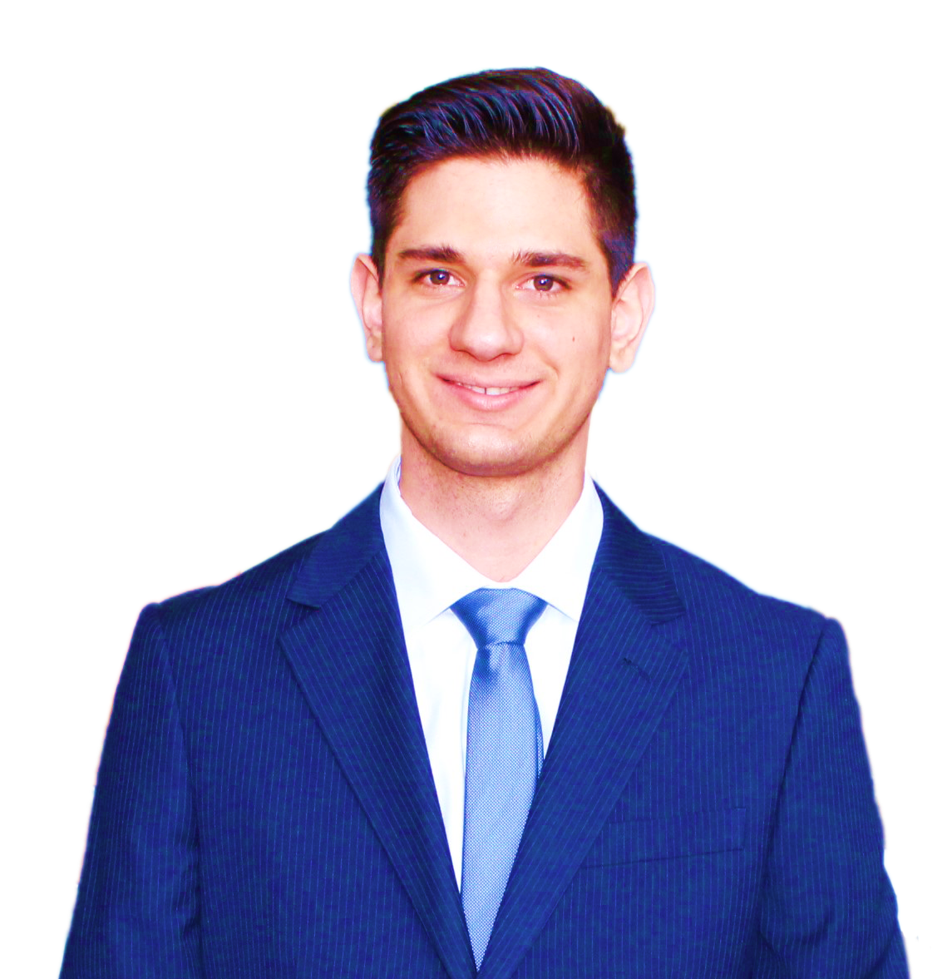
About me
M.Sc. in Computer Science and Networking Scuola superiore Sant’Anna & Università di Pisa
CERN OpenLab Summer student
Research Software Engineer, Maxeler Technologies
Ph.D. Student, Custom Computing research group, Imperial College London, Supervisor Prof. Wayne Luk
Member of Imperial College CMS group
Associate Ph.D. Student, The Institute of Cancer Research, London
Software engineer, Intel

Slide 3
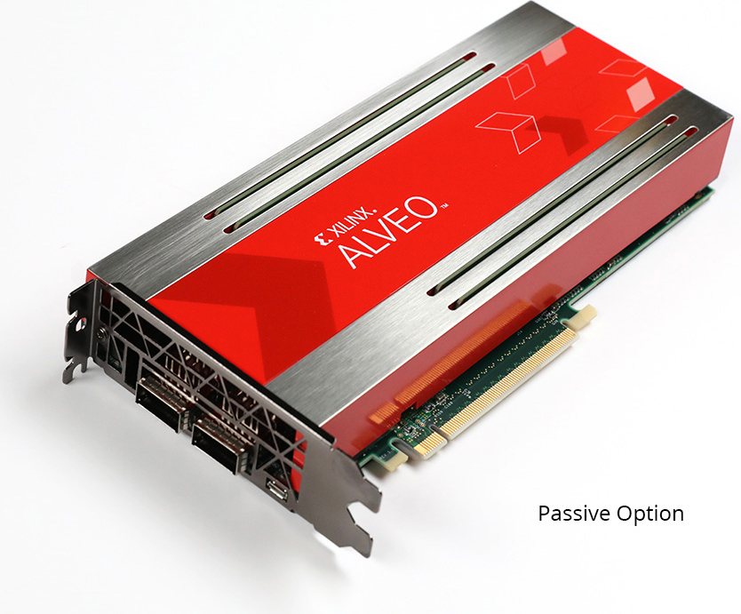
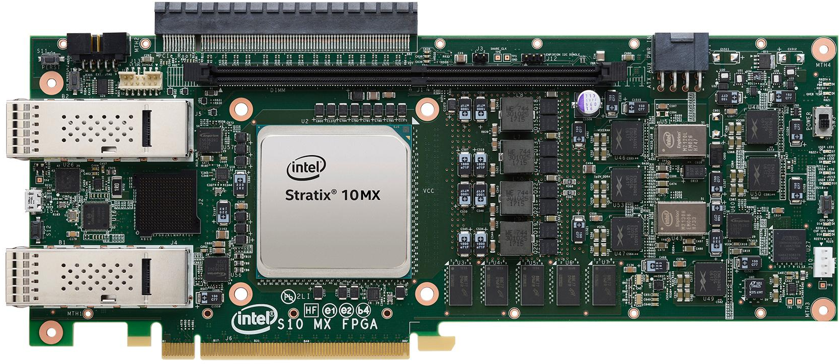
What is an FPGA?
A field-programmable gate array (FPGA) is an integrated circuit designed to be configured by a customer or a designer after manufacturing – hence the term "field-programmable".
https://www.xilinx.com/content/dam/xilinx/imgs/kits/u200-hero-p.jpg https://www.intel.com/content/dam/altera-www/global/en_US/support/boards-kits/stratix10/mx_fpga/stratix10mxboardtop.jpg/_jcr_content/renditions/cq5dam.web.1920.1080.jpeg https://en.wikipedia.org/wiki/Field-programmable_gate_array

Slide 4
Microsoft’s Project Brainwave
“Microsoft’s Project Brainwave is a deep learning platform for real-time AI inference in the cloud and on the edge. A soft Neural Processing Unit (NPU), based on a high-performance field-programmable gate array (FPGA), accelerates deep neural network (DNN) inferencing, with applications in computer vision and natural language processing. Project Brainwave is transforming computing by augmenting CPUs with an interconnected and configurable compute layer composed of programmable silicon.”
https://www.microsoft.com/en-us/research/project/project-brainwave/
https://www.microsoft.com/en-us/research/blog/microsoft-unveils-project-brainwave/

Slide 5
Amazon EC2 F1
Amazon EC2 F1 instances use FPGAs to enable delivery of custom hardware accelerations. F1 instances are easy to program and come with everything you need to develop, simulate, debug, and compile your hardware acceleration code, including an FPGA Developer AMI and supporting hardware level development on the cloud. Using F1 instances to deploy hardware accelerations can be useful in many applications to solve complex science, engineering, and business problems that require high bandwidth, enhanced networking, and very high compute capabilities. Examples of target applications that can benefit from F1 instance acceleration are genomics, search/analytics, image and video processing, network security, electronic design automation (EDA), image and file compression and big data analytics.
https://aws.amazon.com/ec2/instance-types/f1/

Slide 6
DNA Sequencing: DRAGEN Platform
The DRAGEN Platform enables labs of all sizes and disciplines to do more with their genomic data. The DRAGEN Platform uses highly reconfigurable field-programmable gate array technology (FPGA) to provide hardware-accelerated implementations of genomic analysis algorithms, such as BCL conversion, mapping, alignment, sorting, duplicate marking, and haplotype variant calling.
https://www.illumina.com/products/by-type/informatics-products/dragen-bio-it-platform.html

Slide 7

Genomics DNA sequencing
The dataflow architecture for Smith-Waterman Matrix-fill and Traceback alignment stages, to perform short-read alignment on NGS data that delivers ×18 speedup over the respective Bowtie2 standalone components, while our codesigned Bowtie2 demonstrates a 35% boost in performance.
https://ieeexplore.ieee.org/document/8892144

Slide 8
FPGAs fill the gap between software and hardware
Programmable
Fixed
Interpreted program
Compiled program
FPGA implementation
Program
Interpreter
Program
Machine Language
Machine Language
Program
Microarchitecture
Microarchitecture
Microarchitecture
Circuits
Circuits
Circuits
Electrons
Electrons
Electrons
Performance

Slide 9
Field Programmable Gate Array
FPGA is a reconfigurable substrate
  Reconfigurable functions, interconnection of functions, input/output
FPGAs fill the gap between software and hardware
  higher throughput than software
  lower latency than software
  more flexibility than hardware
Not always true!
Onur Mutlu, Digital Design and Computer Architecture, Spring 2020

Slide 10
Latency
FPGAs achieve lower latency than software:
  latency in the order of microseconds
  latency constant and predictable
CPUs are not suitable as thread overhead is ≈ 10 microseconds
GPUs are even worse since PCIe bus sys-call requires milliseconds
Examples:
  Ultra low latency trading
  CERN trigger system
https://www.velvetech.com/blog/fpga-in-high-frequency-trading/
https://indico.cern.ch/event/557251/contributions/2245644/attachments/1310074/2143323/thea_trg_intro_isotdaq2017.pdf

Slide 11
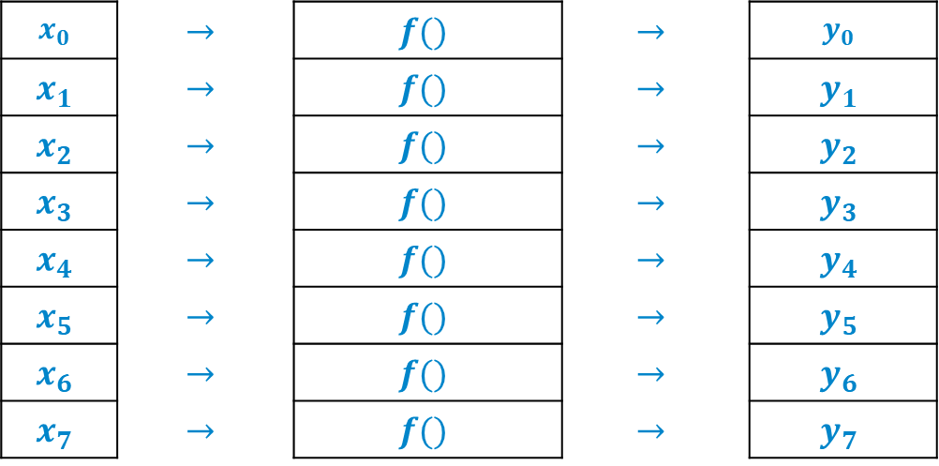
Throughput
$$x_{0}$$ | $$→$$ | $$f()$$ | $$→$$ | $$y_{0}$$
$$x_{1}$$ | $$→$$ | $$f()$$ | $$→$$ | $$y_{1}$$
$$x_{2}$$ | $$→$$ | $$f()$$ | $$→$$ | $$y_{2}$$
$$x_{3}$$ | $$→$$ | $$f()$$ | $$→$$ | $$y_{3}$$
$$x_{4}$$ | $$→$$ | $$f()$$ | $$→$$ | $$y_{4}$$
$$x_{5}$$ | $$→$$ | $$f()$$ | $$→$$ | $$y_{5}$$
$$x_{6}$$ | $$→$$ | $$f()$$ | $$→$$ | $$y_{6}$$
$$x_{7}$$ | $$→$$ | $$f()$$ | $$→$$ | $$y_{7}$$

Slide 12
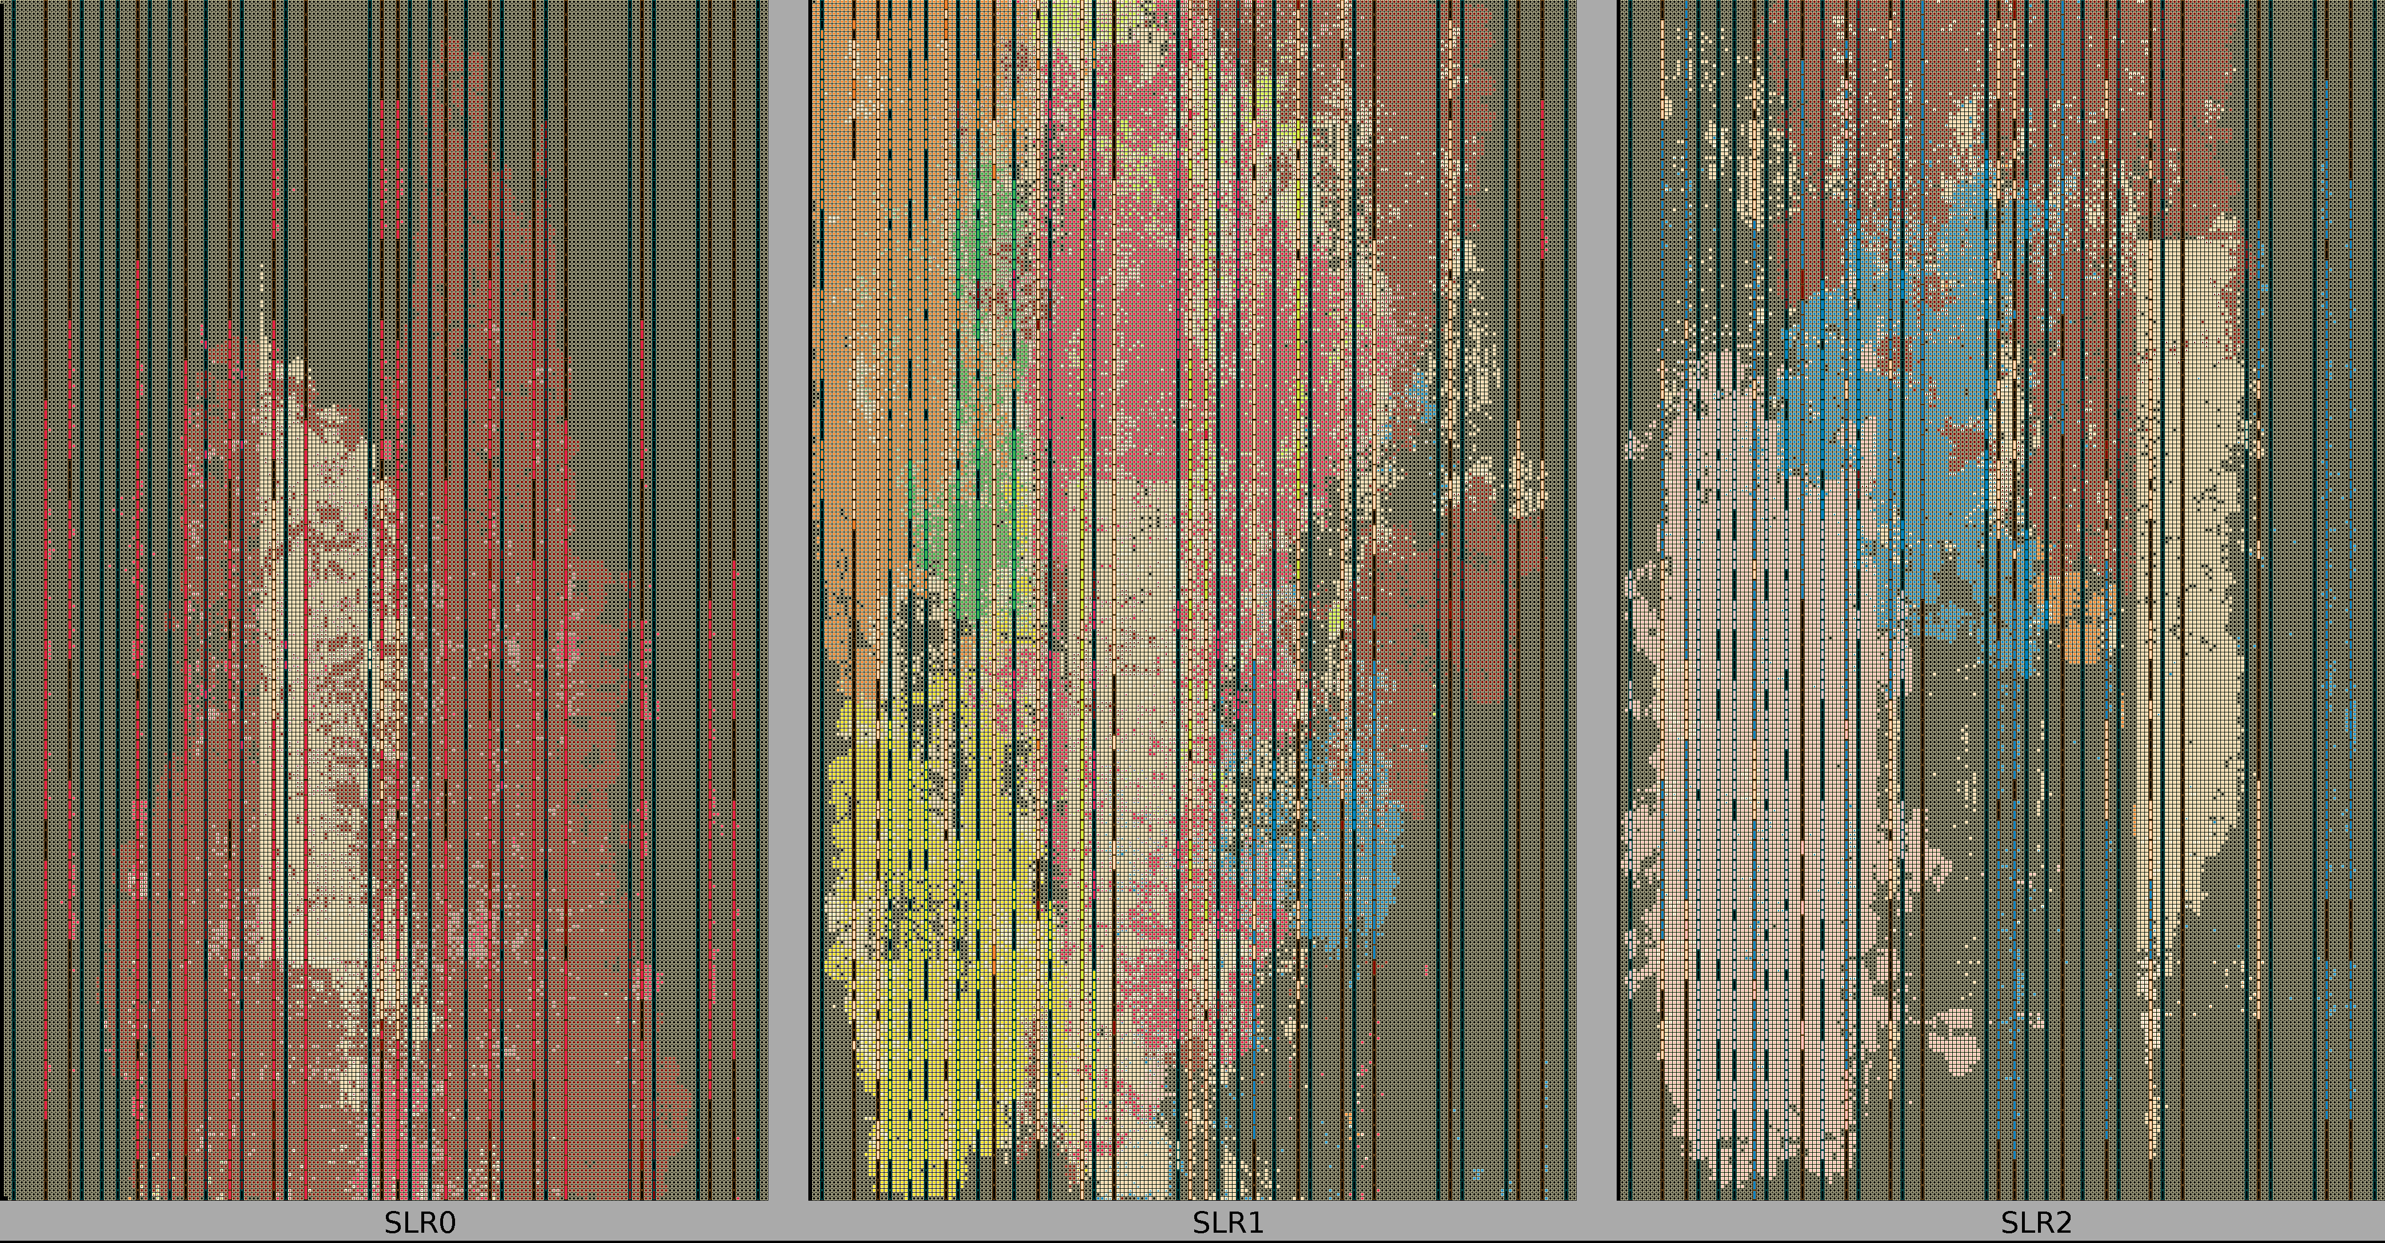


















Throughput
$$f()$$
$$f()$$
$$f()$$
$$f()$$
$$f()$$
$$f()$$
$$f()$$
$$f()$$
$$f()$$
$$f()$$
$$f()$$
$$f()$$
$$f()$$
$$f()$$
$$f()$$
$$f()$$
$$f()$$
$$f()$$
Maxeler MaxCompiler

Slide 13
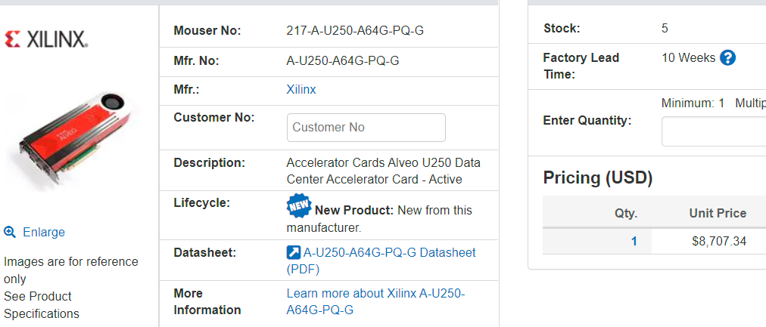
FPGA Accelerator Card
Price $8,707.34
https://eu.mouser.com/

Slide 14
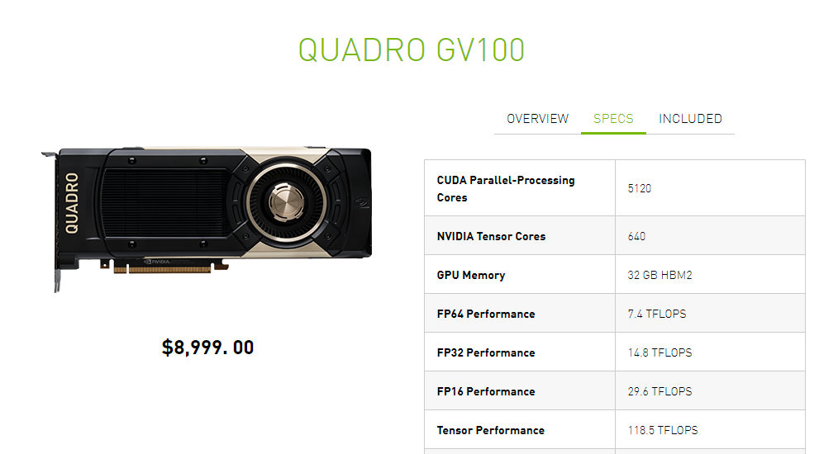
GP-GPU
5120 CUDA cores
Price $8,999
https://www.nvidia.com/en-us/design-visualization/store/

Slide 15
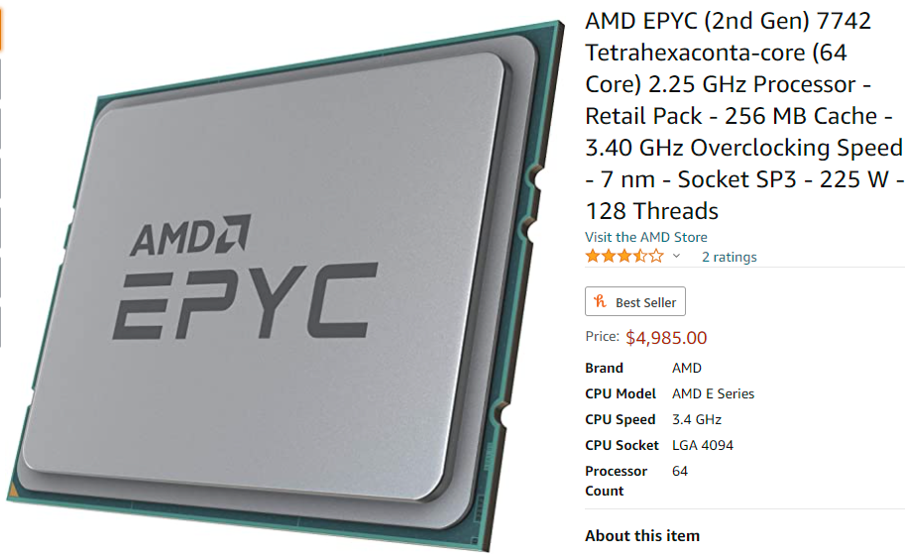
CPU
FPGA: $8,707.34
64-CORE CPU: $4,985 + RAM
5120 CUDA cores GPU: $8,999
64 cores
Price $4,985 + RAM
https://www.amazon.com/

Slide 16
FPGA have higher throughput than CPUs (and GPUs) if the workload:
  Has many branch mispredictions
  Has many cache faults
CPU: Intel(R) Core(TM) i7-8700 CPU @ 3.20GHz
L1 latency = 2 cycles
L2 latency = 15 cycles
L3 latency = 32 cycles
https://github.com/DiamonDinoia/cpp-learning/blob/master/cache-latency/cache_test.c

Slide 17
Simulator example
void main_loop() {
while (true) {
for (x=0; x<ROW; x++) {
for(y=0;y<COL;y++){
switch (cell_to_char(PLANET[x][y])) {
case 'S':
if(UPDATE[x][y]==0 && shark_rule2(pw, x, y, k, l)==ALIVE) {
shark_rule1 (pw ,x , y, k, l);
}
break;
case 'F':
if(UPDATE[x][y]==0){
fish_rule4(pw, x, y, k, l);
fish_rule3(pw, x, y, k, l);
}
break;
}
}
}
}
}
https://github.com/DiamonDinoia/wator/

Slide 18
int shark_rule2 (wator_t* pw, int x, int y, int *k, int* l){
int i=0;
long rand=random();
motion move[4];
if (DEATH[x][y]==pw->sd) {
DEATH[x][y]=0;
PLANET[x][y]=char_to_cell('W');
BIRTH[x][y]=0;
return DEAD;
}
if(DEATH[x][y]<pw->sd){
DEATH[x][y]++;
}
if (BIRTH[x][y]<pw->sb){
BIRTH[x][y]++;
return ALIVE;
}
if (BIRTH[x][y]==pw->sb) {
BIRTH[x][y]=0;
inizialize_motion(pw, x, y, move);
i=partialsort(move, 'W');
if(!i){
return ALIVE;
}
new_coordinate(x, y, k, l, rand%i, move);
return ALIVE;
}
return ERROR;
}
Total of 9 branches in 50 lines of code

Slide 19
Metrics
perf record -e branch,branch-misses `./wator
[ perf record: Woken up 108 times to write data ]
[ perf record: Captured and wrote 28.441 MB perf.data (620737 samples) ]
perf report -n --symbols=main_loop

Slide 20

316K branches
304K branch-misses

Slide 21
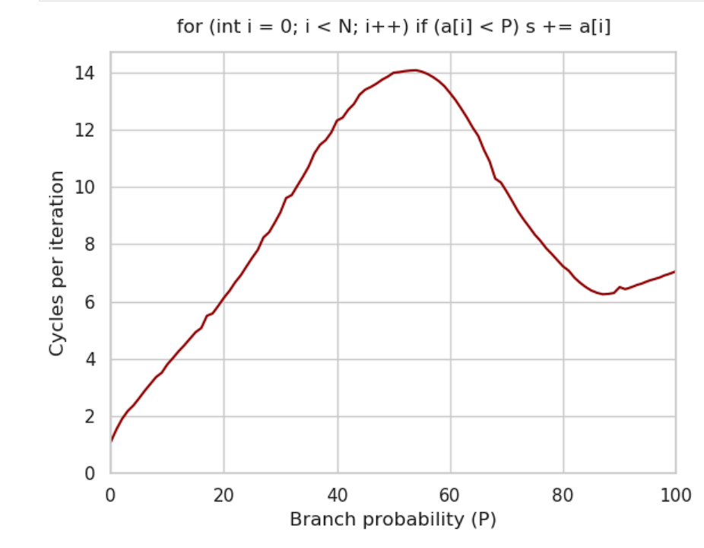
https://github.com/sslotin/amh-code/blob/main/branching/plot.ipynb

Slide 22
Workload Examples
FPGA | GPU
Sparse Matrix | Dense Matrix
Sparse Graph | Dense Graphs
Graph Neural Network | Convolutional Neural Network
Decision tree
(Monte-Carlo) Simulation
Genomics computation
https://ieeexplore.ieee.org/document/8685122

Slide 23
Process a
Process b
Proton
Process c
Particle
Electron
Photon
Process n

Slide 24
FPGA Programming

Slide 25
FPGA Design Flow
Place & Route
might take days!
Problem Definition
High-level Synthesis (HLS)
Hardware Description Language (HDL)
Verilog, VHDL
Logic Synthesis
Xilinx Vivado
Intel Quartus
Google XLS MaxCompiler
Vivado HLS
oneAPI
Placement and Routing
Bitstream Generation
Programming the FPGA

Slide 26
 | CPU | GPU | FPGA
Engineering time | short | medium | very long
Compilation time | short | short | very long
Debugging | easy | medium | hard
Maintainability | easy | medium | hard

Slide 27
Avoid running Place and Route
  Simulate VHDL, Verilog using ModelSim
ModelSim is slow!
  It is possible to execute very small testbenches in a reasonable amount of time

Slide 28
FPGA Design Flow
Problem Definition
High-level Synthesis (HLS)
Hardware Description Language (HDL)
Logic Synthesis
Placement and Routing
Bitstream Generation
Programming the FPGA

Slide 29
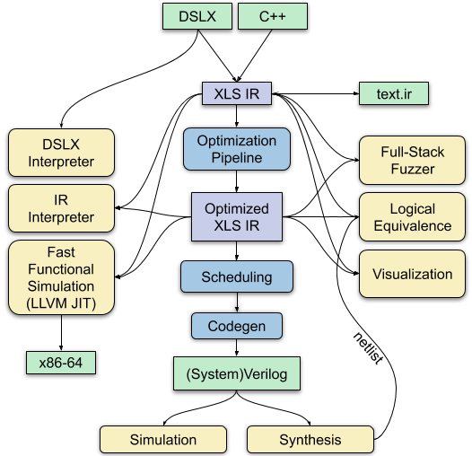
It generates a
X86-64
executable from
source
https://github.com/google/xls

Slide 30
High-level Synthesis (HLS)
Using HLS toolchains makes unit testing possible in a reasonable amount of time
It is easy to interface with a reference software implementation to compare the results
It makes FPGA programming much less cumbersome

Slide 31
Double floating-point multiplication in Verilog
double_multiplier multiplier_39759952(
.clk(clk),
.rst(rst),
.input_a(wire_39069600),
.input_a_stb(wire_39069600_stb),
.input_a_ack(wire_39069600_ack),
.input_b(wire_39795024),
.input_b_stb(wire_39795024_stb),
.input_b_ack(wire_39795024_ack),
.output_z(wire_39795168),
.output_z_stb(wire_39795168_stb),
.output_z_ack(wire_39795168_ack));
Using a library
function!
https://github.com/dawsonjon/fpu/blob/master/double_multiplier/test_bench.v

Slide 32
https://github.com/google/xls

Slide 33
Scheduling
7 clock cycles
c
multiplier
b
adder
Delay here!
a

Slide 34
FPGA Programming with HLS
 | CPU | GPU | FPGA Sim | FPGA Hw
Engineering time | short | medium | medium | medium
Compilation time | short | short | short | Very long
Debugging | easy | medium | medium | medium
Maintainability | easy | medium | medium | medium

Slide 35
HLS
Advantages:
  simplify programming
  reduces engineering time
  Allows “rapid prototyping”
Disadvantages:
  Nowadays HLS still achieves less performance than hand-written optimized Verilog/VHDL

Slide 36
Performance
HLS still requires significant engineering effort depending on the size of the problem
Hardware builds still take significant amount of time
What if the FPGA does not perform as hoped?
Reengineer the problem and start from scratch?
Optimize the code a build several times?

Slide 37
Performance Modelling

Slide 38
Software engineering
Given problem P you are tasked to solve it:
  Select the “best algorithm”
  The one with lower computational complexity?
  Linearize memory accesses
When using accelerators there are additional complications:
  PCIe bandwidth is limited
  The accelerator have on-die memory and on-chip memory
38

Slide 39
Performance Modelling Objective
To understand the major factors that dictate performance when using compute co-processors
  Bandwidths and latencies of the various interconnects
  The capacities of different memories
  Impact of data movements
  Accelerator specific properties, e.g., for FPGA
    Hardware/arithmetic operations space
    Clock frequency
    Fine-grain tunable numeric operations and their impact
    Other custom computing approaches, e.g., compression
Accelerator compute capabilities
Georgi Gaydadjiev, Advanced Parallel Programming 2019-20
39

Slide 40
FPGA Performance
FPGA Performance is predictable
There is no context switch, garbage collector or any background process
The bitstream will be executed the same number of clock cycles every time
The number of clock cycles needed can be computed easily
Further read: Nils Voss et al. (2021), On Predictable Reconfigurable System Design
https://doi.org/10.1145/3436995

Slide 41
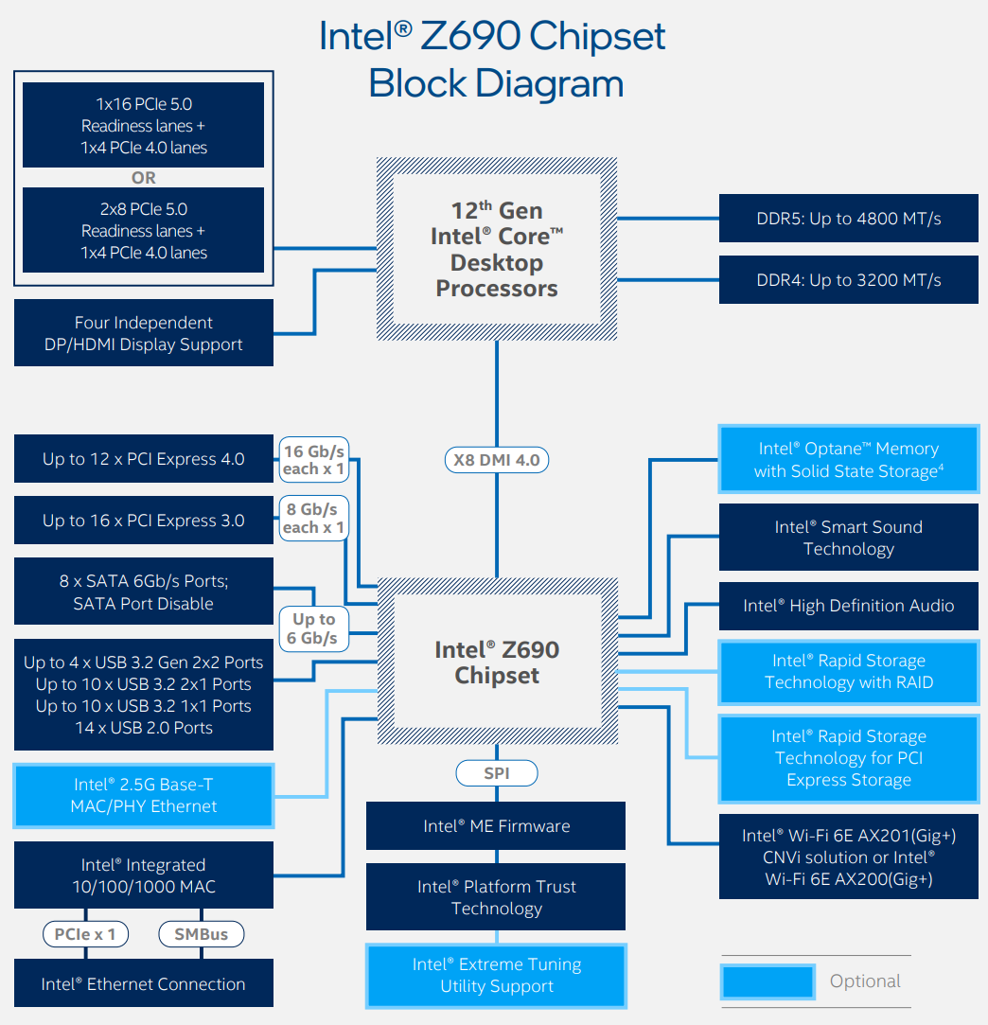
Modern Intel
PC Architecture
https://www.notebookcheck.net/fileadmin/Notebooks/News/_nc3/Intel_12th_gen_alder_lake_architecture_z690_block_diagram.png

Slide 42
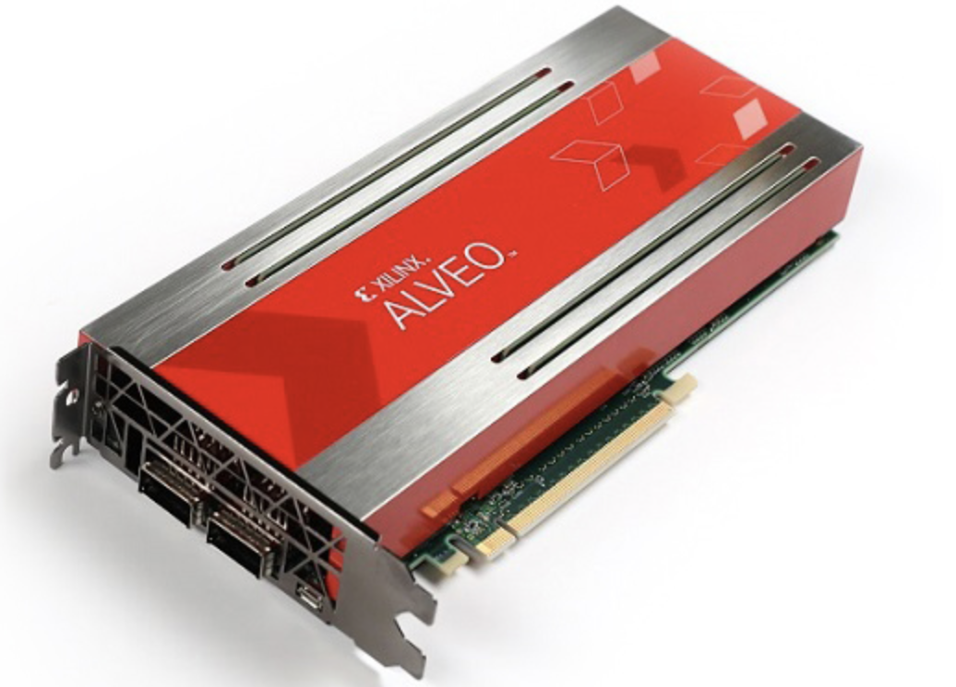
Xilinx Alveo U250 Data Center Accelerator Card
64 GB DDR4 @600MHz
4 channels of 64-bit 16G RDIMMs
available bandwidth: 77 GB/s
or 2,400 MT/s
Power = 225W
54MB On-chip Memory
available at 38 TB/s
100 Gbit Eth
(QSFP28) x 2
16x PCI-Express
Georgi Gaydadjiev, Advanced Parallel Programming 2019-20
42

Slide 43

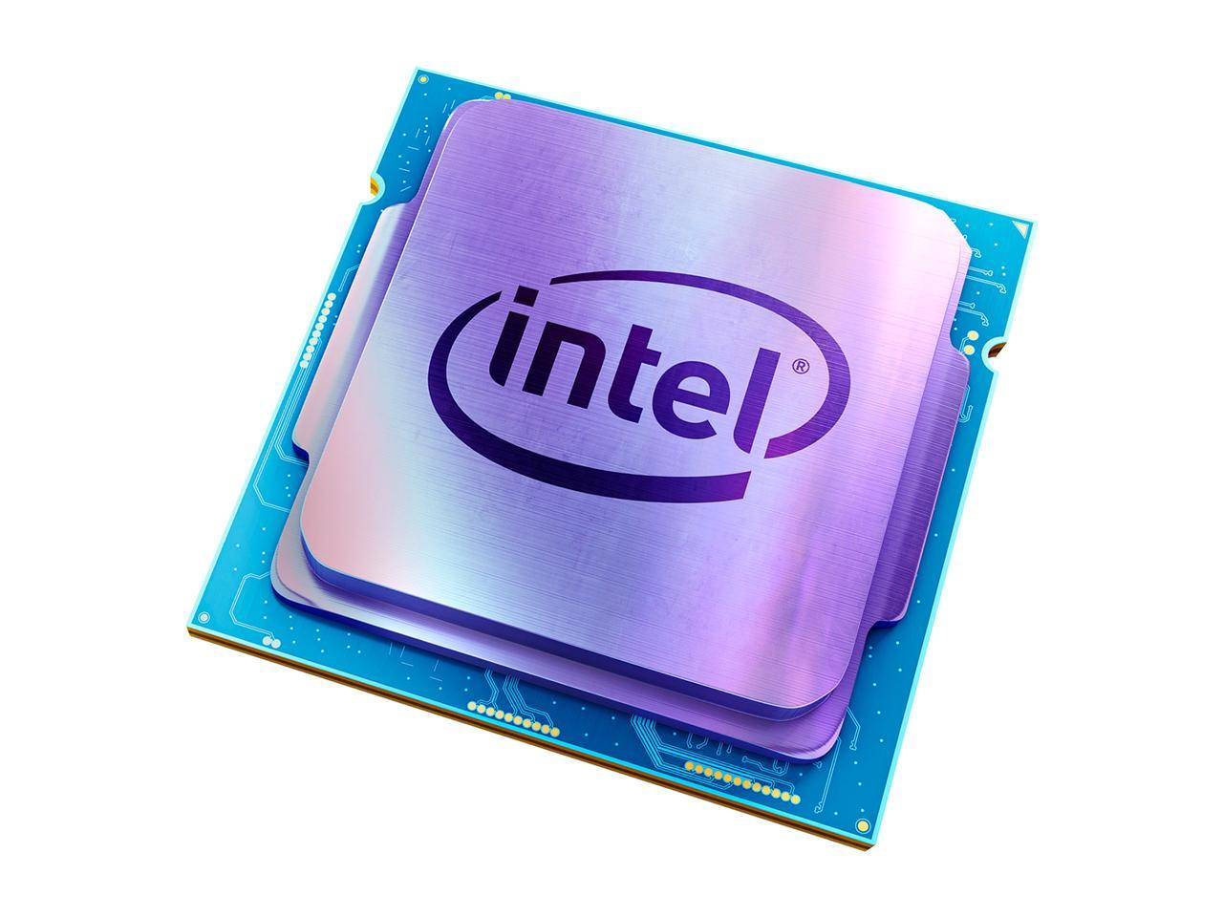
Modern System Architecture
77 GB/s
PCIe 3.0 (x16) | 15.75 GB/s
PCIe 4.0 (x16) | 31.51 GB/s
100 Gbit
Ethernet
https://en.wikipedia.org/wiki/DDR4_SDRAM https://c1.neweggimages.com/ProductImageCompressAll1280/19-118-122-V19.jpg https://www.xilinx.com/products/boards-and-kits/alveo/u250.html
43

Slide 44
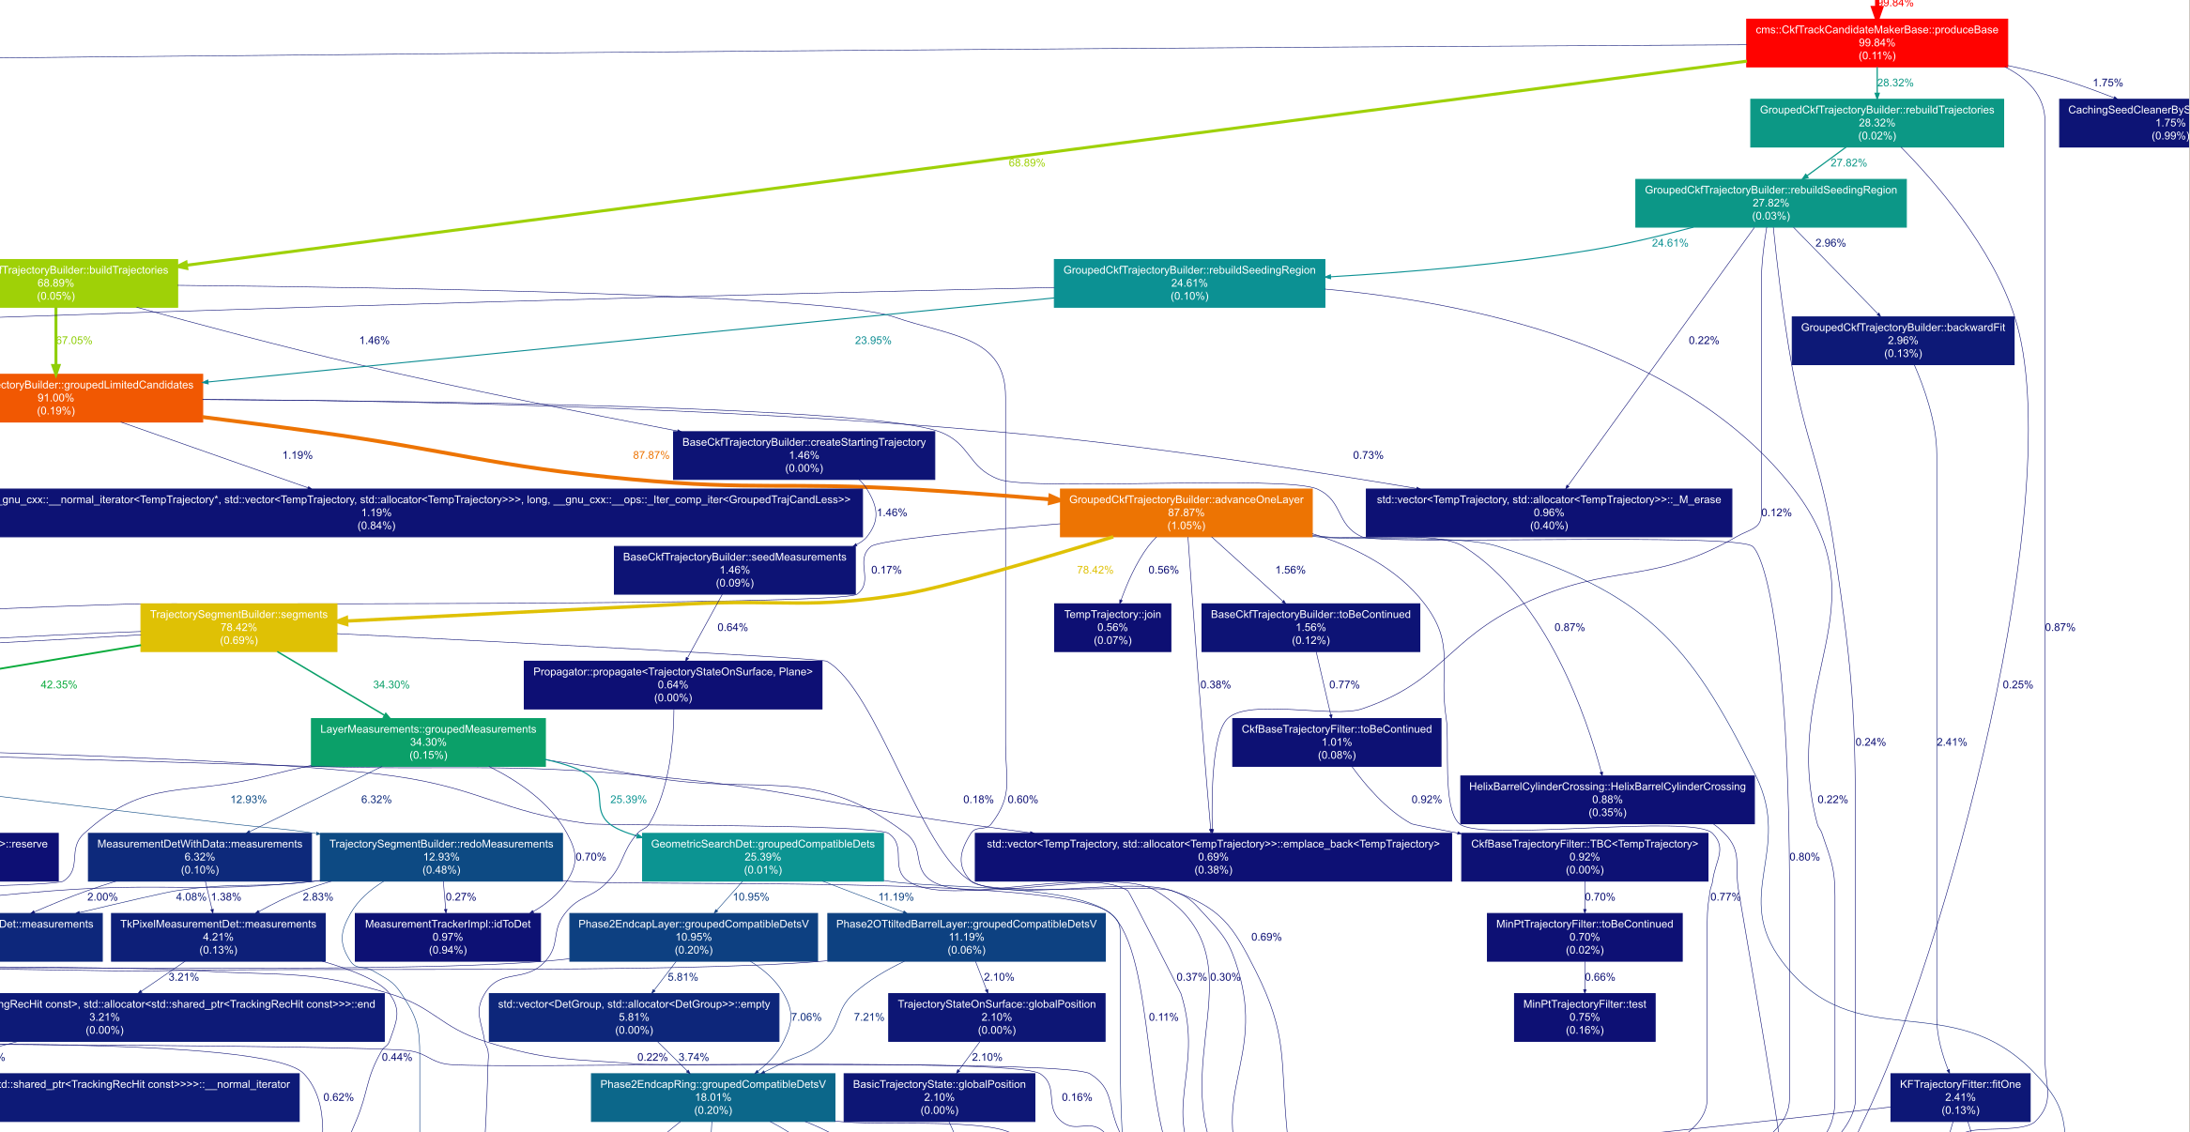
CMS Particle Track Reconstruction Callgraph
Bottleneck
Våge, Liv H

Slide 45
If compute bound -> optimize the algorithm, increase clock frequency
If I/O bound, find a strategy to reduce the I/O (caching, compression accelerate other portion of the code)
Repeat until theoretical limit reached

Slide 46
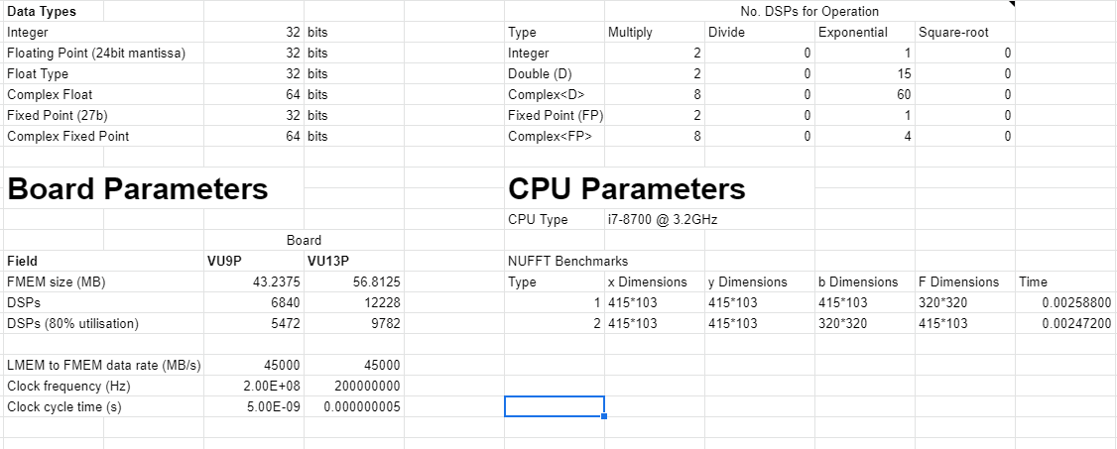
Performance Model example

Slide 47
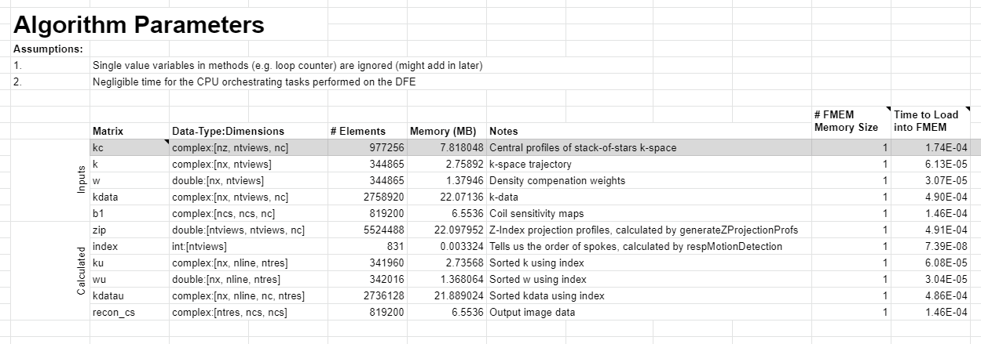
Performance Model example

Slide 48
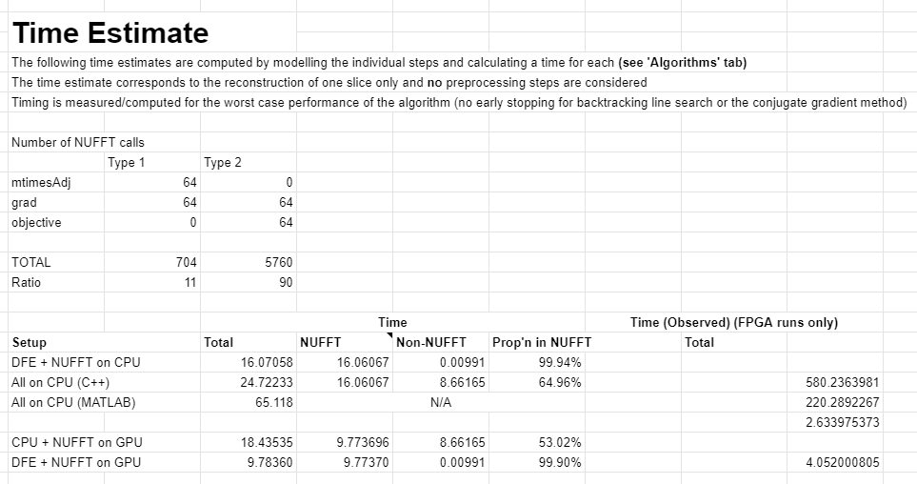
Performance Model example
Setup |  | Total time (s)
DFE + NUFFT on CPU |  | 16.07058
All on CPU (C++) |  | 24.72233
All on CPU (MATLAB) |  | 65.118
CPU + NUFFT on GPU |  | 18.43535
DFE + NUFFT on GPU |  | 9.78360

Slide 49
FPGA Design Flow (simplified)
High-level Synthesis (HLS)
Problem Definition
Benchmark
Architecture
Hardware Description Language (HDL)
Modelling and performance prediction
Logic Synthesis
Final Architecture
Placement and Routing
Bitstream Generation
Programming the FPGA

Slide 50
Monte Carlo example

Slide 51
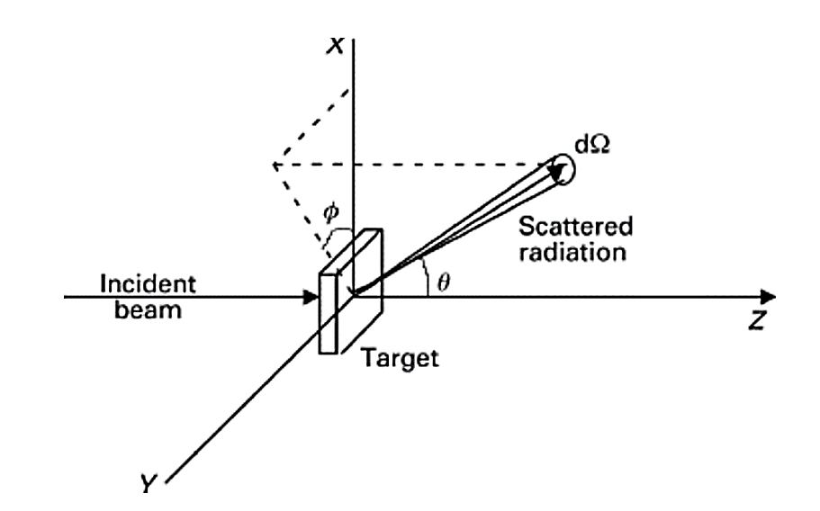
Elastic scattering
A simulation of e-/e+ transport considering only elastic scattering as possible interactions described by scattering of spin-less e-/e+ on an exponentially screened Coulomb potential
Source: Kotlarchyk M. Scattering theory. Encyclopedia of Spectroscopy and Spectrometry, 1999.

Slide 52
Monte Carlo Simulation
Scattered radiation
final position
Many particles are simulated to achieve statistical significance
Source: Kotlarchyk M. Scattering theory. Encyclopedia of Spectroscopy and Spectrometry, 1999.

Slide 53
Workload selection
Not all workloads benefits from FPGA acceleration!
FPGA have higher throughput than CPUs (and GPUs) if the workload:
  Has many branch mispredictions
  Has many cache misses
  (optional) Embarrassingly parallel
  (optional) Independency
Monte Carlo fits all!

Slide 54
Workload partitioning -- Decide the acceleration target
Determine the acceleration potential accounting for the major factors that dictate performance when using compute co-processors:
  Bandwidths and latencies of the various interconnects
  The capacities of different memories
  Impact of data movements
  Accelerator specific properties, e.g., for FPGA
    Hardware/arithmetic operations space
    Clock frequency
    Fine-grain tunable numeric operations and their impact
    Other custom computing approaches, e.g., compression
Accelerator compute capabilities
Courtesy of Georgi Gaydadjiev, Advanced Parallel Programming 2019-20
54

Slide 55
Requirements
We assume that FPGA should achieve 10x speed-up (over a modern parallel CPU) to be worth the engineering-effort
The simulation of one particle requires 34.5 iterations on average
Assuming an FPGA architecture capable of computing 1 iteration per clock cycle to achieve a 10x speed-up the FGPA clock frequency should be 250Mhz
Alternatively, a parallelism > 1 at a lower clock frequency

Slide 56
Modelling
FPGA resources
Data requirements
Measured
limiting factor
Parallelism
Arithmetic operations

Slide 57
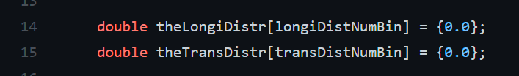
Resource measurements
Memory requirements for line 14-15:
sizeof(double)*longiDistNumBin + sizeof(double)*transDistNumBin

Slide 58
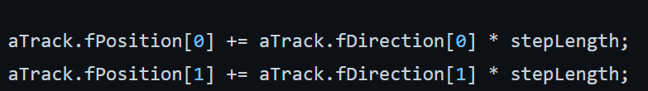
Resource measurements (continued)
2 single-precision floating-point additions
2 single-precision floating-point multiplications
Check the resource table: https://www.xilinx.com/html_docs/ip_docs/pru_files/floating-point.html#virtexu
2 DSPs for addition + 3 DSPs for multiplication = 10 DSPs

Slide 59
Model findings
Parallelism = 1
  DSP utilization = 127
  On-chip memory requirement = 10Mb
The VU9P FPGA used in this study has 6840 DSP and 345Mb on-chip memory
The architecture requires 1.86% DSPs and 3.35% on-chip memory resources
Theoretical parallelism while aiming at consuming at most 50% of the on-chip memory resources is 15
Limiting factor

Slide 60
Resulting architecture
FPGA
CPU
RNG (96bits/clk)
Particle
Particle simulator
Raw data
Parallel instances
Aggregation
RNG (96bits/clk)
Particle
Particle simulator
Raw data

Slide 61
Final design
$$Instance$$
$$Instance$$
$$Instance$$
$$Instance$$
$$Instance$$
$$Instance$$
$$Instance$$
$$Instance$$
$$Instance$$
$$Instance$$
$$Instance$$
$$Instance$$
$$Instance$$
$$Instance$$
$$Instance$$
Maxeler MaxCompiler

Slide 62
Measurement results
Parallelism = 15
  DSP utilization = 1904 (27%)
  On-chip memory requirement = 300Mb (86%) (scheduling overhead)
Higher parallelism could limit the achievable clock frequency

Slide 63
Test configurations
Hardware:
AMD Ryzen 5900x 12-cores 3.7GHz (4.8GHz) CPU
Xilinx's Alveo U200 Data Center accelerator card Xilinx VU9P FPGA
Toolchain:
MaxCompiler 2021.1
Vivado 2019.2
OpenMP

Slide 64
Test configurations (continued)
Simulation configuration:
100M histories
6 MeV beam
Water
The FPGA clock frequency was limited to 200MHz

Slide 65
Performance measurements
The FPGA accelerated version is:
110x faster than multi-core implementation (12-cores)
10x cost-equivalent speedup
The theoretical 128x does not account for overhead and CPU data aggregation
Using MaxCompiler the architecture achieves 300Mhz resulting in a
160x speedup

Slide 66
Performance measurements
$$FPGA=\frac{parallel time}{FPGA time}$$

Slide 67
Summary
FPGAs are becoming widely used in industry as accelerators for suitable challenges (ultra low latency inference, graph processing and genomics)
Recent toolchain developments making programming FPGAs more accessible
FPGAs can be multiple orders of magnitude faster than CPUs and GPUs when accelerating suitable workloads
Following a formal methodology and HLS toolchains high performance can be achieved with no previous FPGA programming experience

Slide 68
Current projects

Slide 69
Training AI on FPGA
Collaboration between:
  Imperial College London
  University of Pisa (Avalanche developers)
  CERN (hls4ml)
Part 1: select training algorithms suitable for FPGA
Part 2: integrate the training algorithm into hls4ml

Slide 70
Continual AI on FPGA
Collaboration between:
  Imperial College London
  University of Pisa (Avalanche developers)
  CERN (hls4ml)
Part 1: investigate FPGA-compatible continual AI strategies
Part 2: FPGA design and implementation

Slide 71
Neutrino Energy Reconstruction with GNN at Hyper-K
Collaboration between:
  Imperial College London
  The Hyper-Kamiokande experiment
Pure Machine Learning project that requires to design and optimize a GNN

Slide 72
Contact us
If interested send an email to:
m.barbone19@imperial.ac.uk
subject: [Info-Application] [Project name]
Details such as: start-end date
If you will be working full-time or part-time during that period
Logistics with your home institution will be left to you! (e.g., finding a home institution supervisor
Attach your CV!

Slide 73
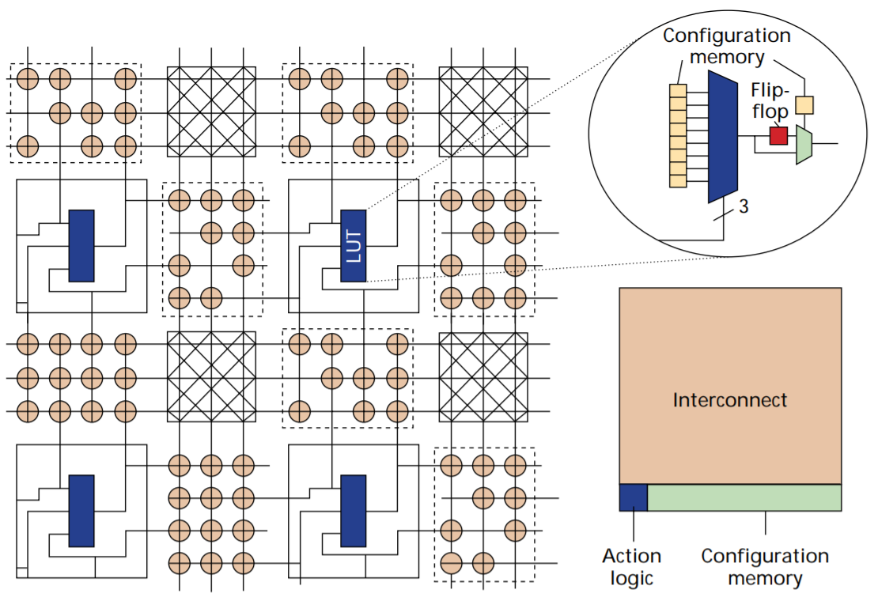
FPGA Architecture (Backup)
Look-Up Tables (LUT) and Switches
Andre DeHon, “The Density Advantage of Configurable Computing”, Computer, 2000

Slide 74
Data Input
0 0 0
3-bit input LUT (3-LUT)
0 0 1
3-LUT can implement
any 3-bit input function
0 1 0
0 1 1
output (1 bit)
1 0 0
Multiplexer (Mux):
Selects one of the data input corresponding to select input
1 0 1
1 1 0
1 1 1
Select Input
3
input (3 bits)
Onur Mutlu, Digital Design and Computer Architecture, Spring 2020

Slide 75
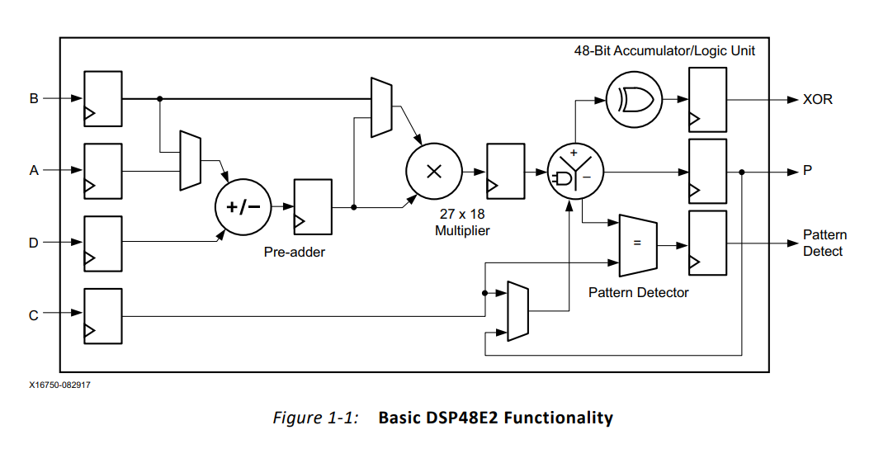
DSP block
https://www.xilinx.com/support/documentation/user_guides/ug579-ultrascale-dsp.pdf

Slide 76







Example
$$g()$$
$$g()$$
$$g()$$
$$f(g())$$
$$f()$$
$$f()$$
$$f()$$
$$f()$$
$$f()$$
$$f()$$
$$f()$$
$$h()$$
$$f()$$
$$h()$$
$$f()$$
$$l()$$
Maxeler MaxCompiler

Slide 77
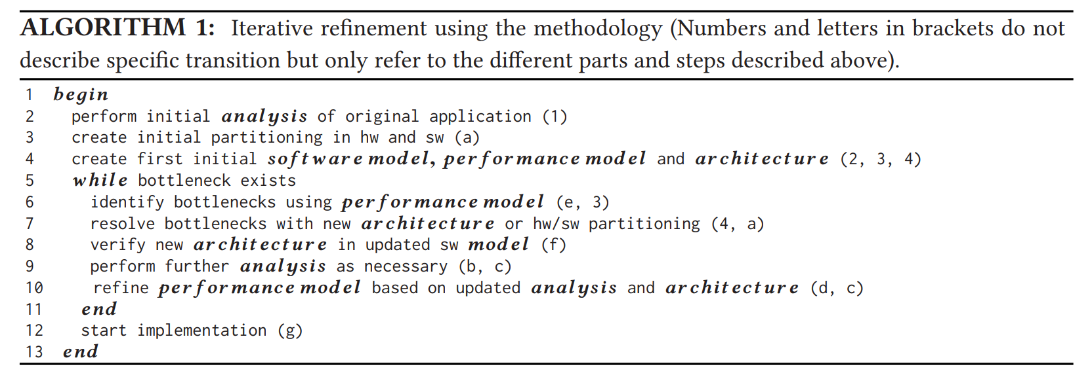

Slide 78
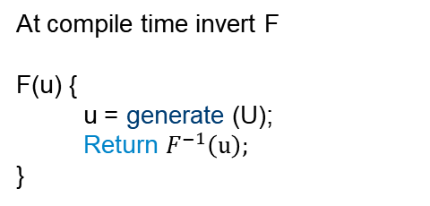
Rejection sampling
Inversion method
At compile time invert F
F(u) {
  u = generate (U);
  Return $F^{−1}\left(u\right);$
}
F(u) {
  do { generate (U) }
  while ( U > threshold);
  Return U;
}
No while loop!

Slide 79
Rejection sampling
Inversion method
RNG
Sample
RNG
Inverse
Stall
Stall
Value
Inversion method is the most efficient on FPGA (Thomas2006)
Source: https://www.doc.ic.ac.uk/~wl/papers/iee07dt.pdf

