Slide 1
JUNO Workloads
Xiaofei Yan, Tao Lin
19st Sept 2022

Slide 2
Outline
Over view of JUNO Experiment
Data Processing Workflow
Workloads at JUNO
Event mixing (or Pileup) in MC Production
Answer questions

Slide 3
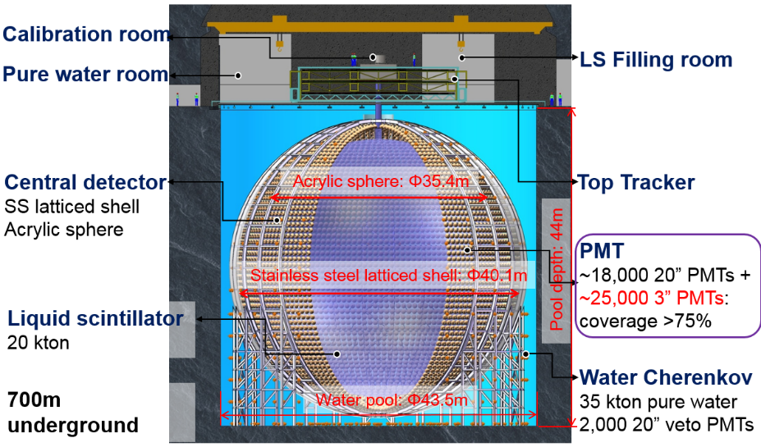
The JUNO Experiment
The Jiangmen Underground Neutrino Observatory (JUNO):
  Neutrino detected by Inverse Beta Decay (IBD);
  Baseline: ~53 km from 2 nuclear power plants sites (26 GWth in 2020);
  20 kilotons high light yield and high transparency
  liquid scintillator;
  >75% PMT photocathode coverage;
Goals of JUNO:
  Main: to determine the neutrino mass hierarchy at
  3-4 σ sensitivity within 6 years by <3% energy
  resolution @ 1 MeV;
  Other: solar oscillation parameters, supernova
  neutrino, geo-neutrino, etc.

Slide 4
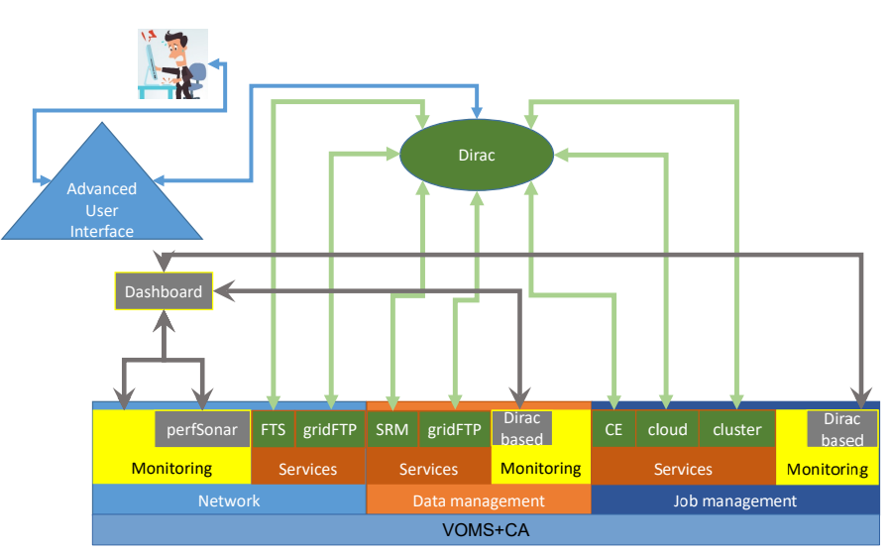
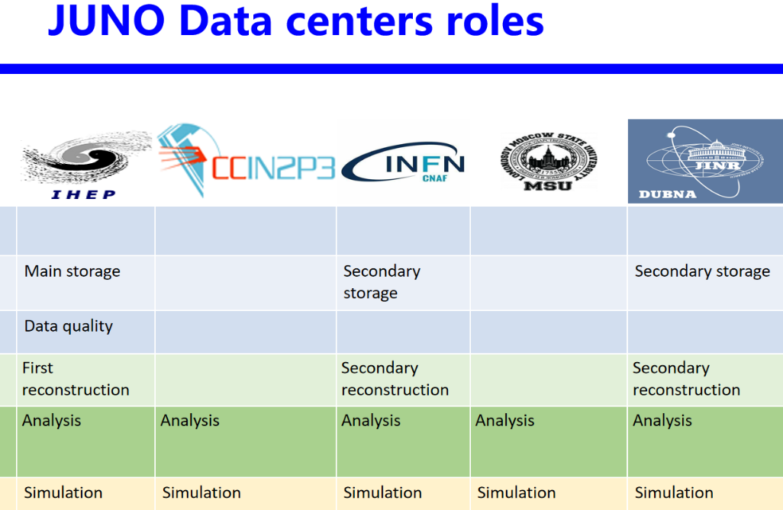
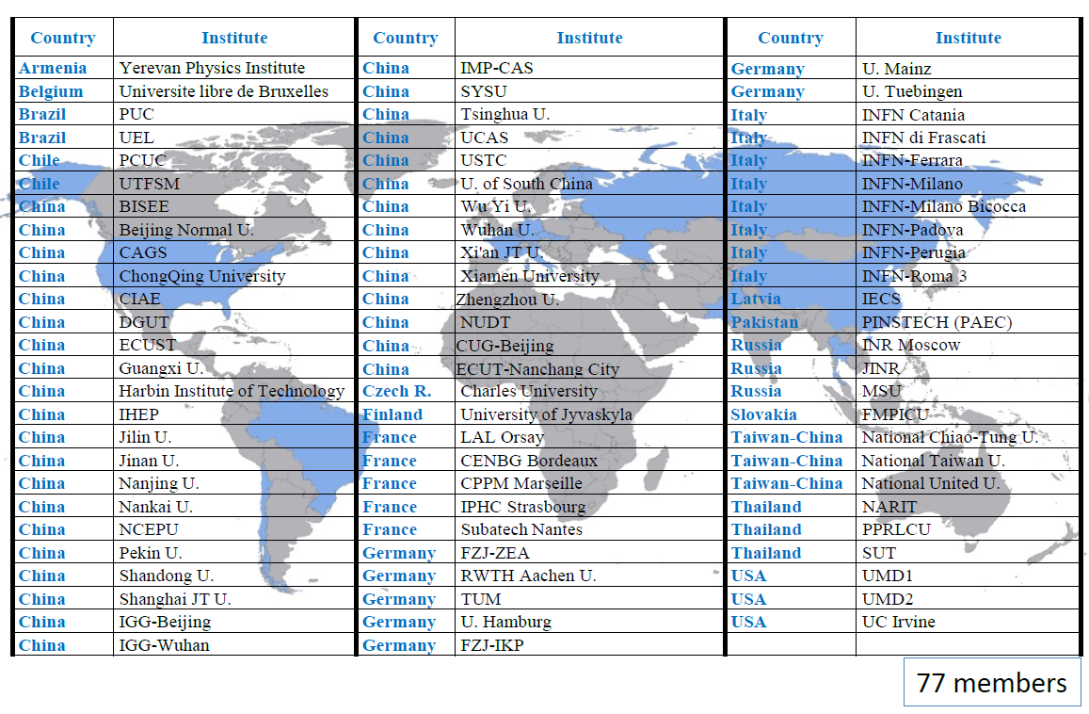
JUNO Computing
JUNO Distributed Computing system was built on DIRAC
  Handles heterogeneous and distributed resources
  Provides workload management (WM) and data management (DM)

Slide 5
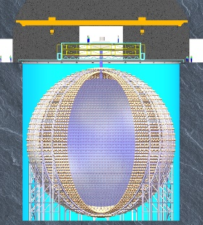
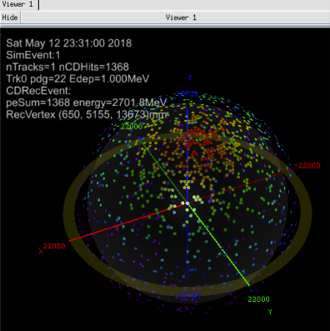
Overview of Data Processing Workflow (1)
Raw Data
(t/q, waveform)
Simulation
JUNO Detector
ROOT
(t/q, waveform)
ElecEvent
Parameter
Service
Parameter Database
Waveform Rec & Calib
ROOT
(t/q)
CalibEvent
CondDB
Service
Calibration Constants
Event
Reconstruction
Geometry
Service
Geometry
ROOT
(point, track)
RecEvent
Event Display
Physics Analysis
Persistent Data and I/O
Event Data Model
Algorithms
Services
Non-Event Data
SNiPER Framework
Notes:
Here you can find the overview of data processing workflow. We use the event data modle fot the different proceduce. Now use simulation data produce ElecEvent, The Elecevent stay in memory, Can be store in disk. And is the input file of wave rec and Calib.
After Juno dector is ready We can use this procedure to detal with real data. The Right of the picture is junodb service. We store this data in disk for juno-workload container.

Slide 6
Overview of Data Processing Workflow (2)
There are three steps in JUNO simulation
  Physics Generator
  Detector Simulation
  Electronics simulation (Event mixing) + OEC (optional)
The first two steps are running together
The third step could run w/o or w/ reconstruction algorithms
  w/o reconstruction: waveforms stored.
  w/ reconstruction: no waveforms stored, saving disk usage.
JUNO-Workload
tut_detsim.py GEN-SIM
tut_det2elec.py Elect-SIM
tut_elec2calib.py Calib REC
tut_calib2rec.py Event REC
Physics Generator
Detector Simulation
Electronics Simulation
GenEvent
SimEvent
ElecEvent
tut_detsim.py
tut_det2elec.py
Notes:
Here are first two steps of juno-workload.

Slide 7
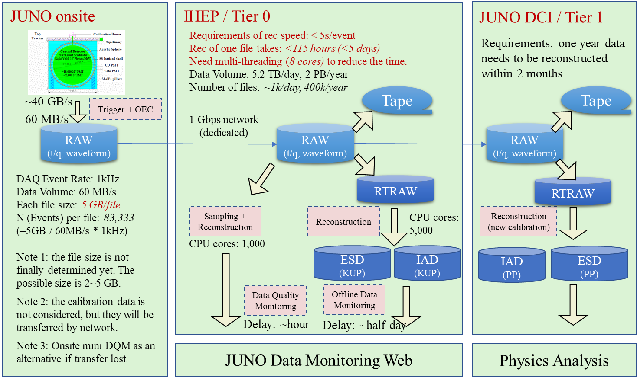
Workloads at JUNO
Keep Up Production (KUP) at Tier 0
Data Quality Monitoring (DQM)
Physics Production (PP) at DCI
MC Production at DCI
Real Data
MC Data
Notes:
Here is the real workload for JUNO experiment. JUNO onsite generate raw data. Data quality Monitoring(DQM) to check the raw data. And fast reconstruction for the data(Tier 0). PP at DCI.
Real data for fist 3. MC for simulation data.

Slide 8
MC Production (1)
Due to all the physics signals and backgrounds need to be produced before event mixing, the MC production include two major steps
  Production of different samples at detector simulation level
  Event mixing, electronics simulation and reconstruction
The radioactivity backgrounds are pre-mixed to reduce the number of input files.
Physics Signals
Pre-Mixed radioactivity
ElecSim
Cosmic ray muons
ElecSim EDM files
DetSim EDM files

Slide 9
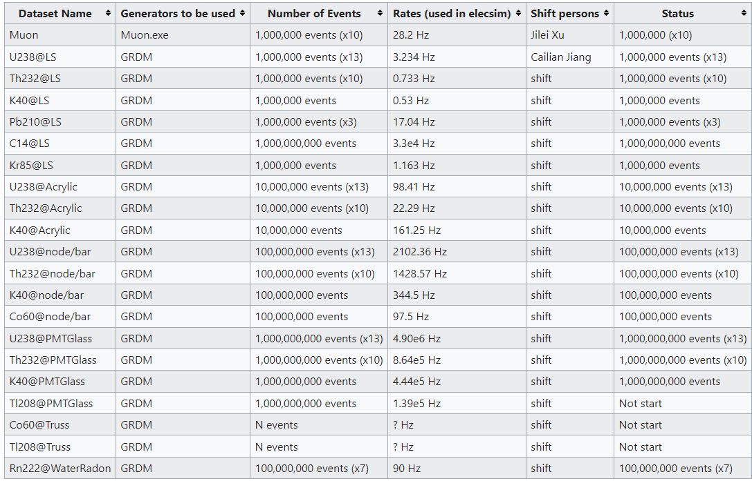
MC Production (2)
About 20 radioactivity backgrounds need to be produced in MC production

Slide 10
Questions(1)
Please details the workloads provided to the Task force
  Does your experiment process the whole chain (gen-sim-reco) event by event, or is each step (gen, sim, reco) processing a whole set of events before moving to the next step?
    Two types:
      Mock Data: inclusive Need to separate
      Physics events, such as IBD without event mixing, Could be done both.
    Do things both ways, but processing step by step is better/more convenient
  In the case of the generation (simulation) which physics process (pileup configuration) is used?
    Each radioactivity particle present in the medium/detector is simulated independently then merged at the electronics simulation step. At this step we can have more than 20 different sets of input files, each with their own different rate. [TODO: put correct number for sets of input files]
    Random trigger is in digi-level, pre-mixing is in hit level . random trigger could be used for MC tuning.
  Do these workloads represent the processing chain submitted on the grid?
  Do they include some extra-step not used in production? Eg debug modules
    Most workloads are submitted to grid, however for now merging of files is being done locally due to the very specific requirements needed for that task.
    Extra step is pre-mixing.

Slide 11
Questions(2)
Software stack
  Are the software features currently in the container still the most recent ones?
    Upgrade two version
  Could you summarise the plans about future, known, major upgrades of the software foreseen in your Experiment?
    Software evolutions should be mostly following LHC standards. We need however to include some GPU acceleration (particularly for simulating photon propagation).
    a standalone example is now working with Opticks.
    Wenjie had developed a GPU based rec. SYCL based (in future)
  Do you plan / have done to migrate your offline code to non-x86 CPUs (ARM/Power) or to adopt accelerators (GPUs)
    need to use GPUs for photon propagation (currently in preparation based on Opticks – https://simoncblyth.bitbucket.io/opticks/). Some discussion about an ARM port is also being discussed to use some opportunistic resources available.

Slide 12
Experience in integrating the Experiment’s workloads in the HEP standalone containers
  What is your overall experience in using the build procedure designed by the HEPiX Benchmarking WG to create standalone containers?
      Use other experiment’s workloads such as LHCb, to create juno workload project.
    Do you have comments about the resolution measured by the working group in the repeated executions of your workloads during the validation procedure?
      Current JUNO workload software，initialization and finalization phases included in the reported time.
    Do you have suggestions? What would you improve?
      Current JUNO software version, output only event running time.
In the scenario that an HEPscore22 benchmark will be defined from a combination of the current HEP-workloads (Run3, year 2021/22), what would be the position of your Experiment about these statements:
If we know the percentage of total CPU time spent on different workloads such as simulation, reconstruction etc., we can obtain the weighted average of benchmarking results by using the percentage as a weight. The weighted average might be better than an average benchmarking result for a specific HEP experiment.

Slide 13
Thanks and questioans！

Slide 14
Backup Slides

Slide 15
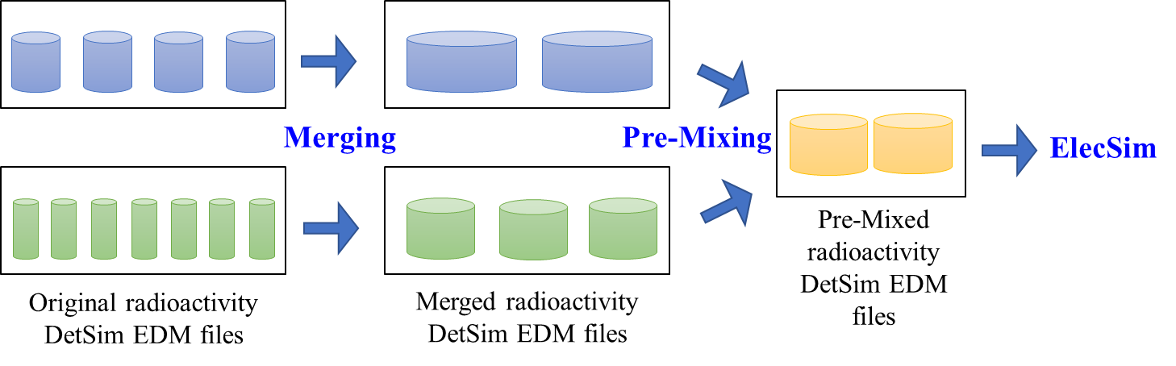
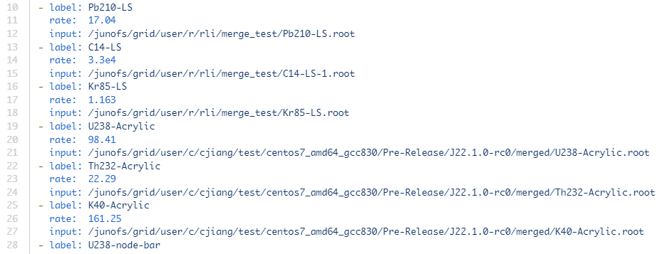
MC Production (3)
The radioactivity backgrounds data are merged and pre-mixed.
Note: This extra step is currently processed at local computing node.
Using a YAML file to specify all the inputs and rates.

