Slide 1



LHCb workloads in the
HEPscore benchmark
Andrea Valassi (CERN IT)
HEPscore workshop, Monday 19th September 2022
https://indico.cern.ch/event/1170924/contributions/4954486/
Many thanks to C. Bozzi, G. Corti and the whole LHCb Simulation team!
Many thanks to R. Sobie and V. Innocente for the studies cited here!

Slide 2
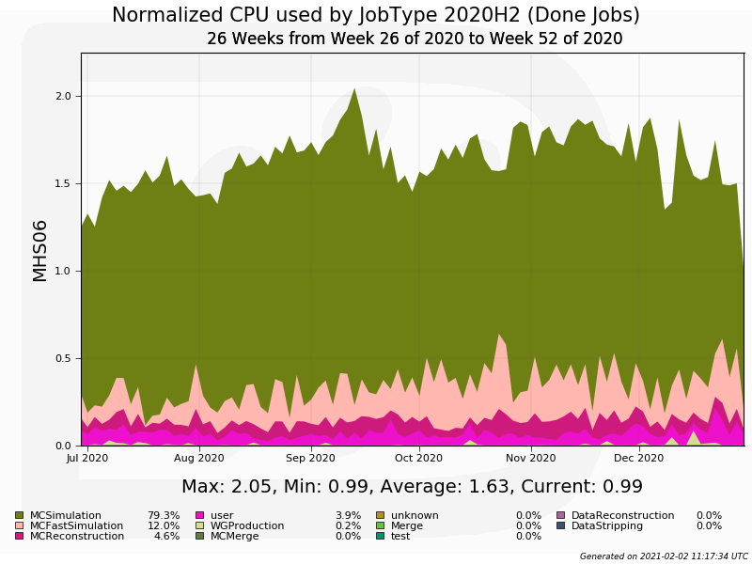
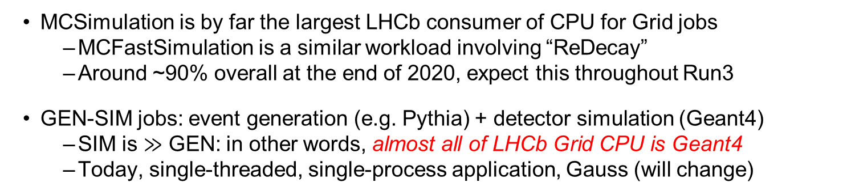
LHCb Grid workloads (slide from Feb 2021)
MCSimulation is by far the largest LHCb consumer of CPU for Grid jobs
  MCFastSimulation is a similar workload involving “ReDecay”
  Around ~90% overall at the end of 2020, expect this throughout Run3
GEN-SIM jobs: event generation (e.g. Pythia) + detector simulation (Geant4)
  SIM is $≫$ GEN: in other words, almost all of LHCb Grid CPU is Geant4
  Today, single-threaded, single-process application, Gauss (will change)
In Q3-Q4 2020:
MCSimulation (GEN-SIM): 79%
MCFastSimulation (GEN-SIM with Redecay): 12%

Slide 3
LHCb “v2021” SIM workload for HEPscore
HEP-SCORE candidate uses workload agreed with LHCb Simulation team in 2021
  See the benchmark script for details
Software details: this uses an LHCb "SIM10" software release from 2021
  See a typical logfile for details
  Gauss v55r1 on x86_64-centos7-gcc9-opt, single process, single threaded
  GEN: Pythia8, inclusive B-physics events (options/10000000.py)
  Pileup configuration nu=3.8, minimum bias is generated for each event (no I/O)
  No spillover from adjacent beam crossings (“off-time pileup”: prev/next event)
  SIM: Geant4-10-06-patch02 (29 May 2020)
  AppConfig v3r404, DecFiles v31r7, CondDB sim-20210617-vc-md100
  Default setup processes 5 reproducible events, ~10 minutes on a typical CPU
The application runs GEN+SIM (starts from random seeds), separate scores exist
  The recommended SIM score uses SIM-only throughput for n-1 events
  Skip readback of magnetic field and other initialization tasks during the 1st event
This is representative of what LHCb runs in production jobs on the Grid
  "SIM9" is the default for Run2, but "SIM10" productions already exist for Run3

Slide 4
Aside: LHCb SIM differs from other SIMs
Context (extensively described in this workshop! also see backup slides)
  (1) Analysis of correlation of experiment workloads with one another [R. Sobie]
    Goal: speed up HEPscore - can we remove some workloads from the "mix"?
    Finding: large deviations (20% to 40%) between LHCb SIM and other SIMs
  (2) Analysis of software profiles of experiment workloads [V. Innocente]
    Finding: ~50% of CPU time in LHCb SIM is in G4LogicalBorderSurface::GetSurface!
      This is very different from the SIM profiles in other experiments
      Vincenzo's observation: workload uses G4 10.6, performance was improved in G4 10.7
LHCb reply on these observations
  Thanks a lot, extremely useful studies! Will certainly try G4 10.7 soon
  Large use of G4LogicalBorderSurface is due to RICH detector physics (mirrors)
    RICH and CALO have always been the two largest consumers of CPU in LHCb SIM
    RICH was optimized in SIM9
    CALO (via Geant4) was optimized in SIM10 (for info, SIM10 is 40% faster than SIM9)
  It is important to keep LHCb in the HEPscore mix precisely because it differs
More generally (personal observation):
  Different workloads stress the CPUs in different ways and may scale differently
    (This will be a theme in my talk tomorrow about Madgraph on SIMD CPUs)
  If a workload scales differently, it is not necessarily "wrong", it is just different

Slide 5
Expected evolution of LHCb SIM
The "v2021" LHCb workload is now ~as-good-as-it-gets representative of Run3
  "SIM10": as of today, there is no more recent SIM version in production
  Several changes are on the way, however...
LHCb has moved from gcc9 to gcc11 as default compiler since 2021
  But this change by itself does not justify building a new container today
LHCb will move from single-threaded Gauss to multi-threaded Gauss-on-Gaussino
  Timescale: fully replace SIM10 by end 2023, not before
LHCb will move from G4 10.6 to a more recent version of G4 such as G4 10.7
  Timescale: not before the migration to Gauss-on-Gaussino is completed
More exotic changes on the way: ARM (and Power9)
  x86 is still the only CPU architecture used in production (and for Grid jobs)
  An old ARM build exists, and the effort to port the code to ARM is restarting
  No builds on Power9 yet - the interest and motivation are there, not the effort...
  Note: GPUs in LHCb are used for HLT but not in Grid/SIM (no Geant4 on GPU)

Slide 6
Other questions from the TF
As per the guidelines: https://new.cernbox.cern.ch/s/AMLHAgWKPMWjNjp
Experience in integrating LHCb workloads in the HEP standalone containers?
  Integration was easy for LHCb (AV co-developed the HEP-workloads framework)
About the HEPscore "mix"
  It seems reasonable to keep the benchmark mix unchanged for 3-5 years
  LHCb SIM should be part of the "mix" because it is different from other SIMs
  Averaging technique: no strong opinion (give more weight to SIMs, if anything)
Any other comments
  Thanks for the good work! The studies by Randy and Vincenzo were very useful

Slide 7
Backup slides

Slide 8
For reference – previous talks
In LHCb
  LHCb Simulation Meeting, Wed 24th Aug 2022, https://indico.cern.ch/event/1187106
  LHCb Simulation Meeting, Tue 9th Feb 2021, https://indico.cern.ch/event/1004421
  LHCb Computing Management, Thu 28th Jan 2021, https://indico.cern.ch/event/984385
  LHCb Week, Computing Parallel, Thu 04th Mar 2019, https://indico.cern.ch/event/802489
In the benchmarking WG and TF
  (HEPscore Task Force, Wed 16th Jun 2021, https://indico.cern.ch/event/1030676)
  (HEPscore Task Force, Wed 5th May 2021, https://indico.cern.ch/event/1030672)
  HEPscore Task Force, Wed 3rd Feb 2021, https://indico.cern.ch/event/992804
  (HEPiX benchmarking WG, Fri 3rd Jul 2020, https://indico.cern.ch/event/872154)
  Benchmarking pre-GDB, Tue 8th Oct 2019, https://indico.cern.ch/event/739897
  System performance WG, Wed 6th Mar 2019, https://indico.cern.ch/event/772026
  HEPiX benchmarking WG, Fri 1st Feb 2019, https://indico.cern.ch/event/782598

Slide 9
Backup slides
  (from LHCb Simulation Meeting, Wed 24th Aug 2022) https://indico.cern.ch/event/1187106

Slide 10
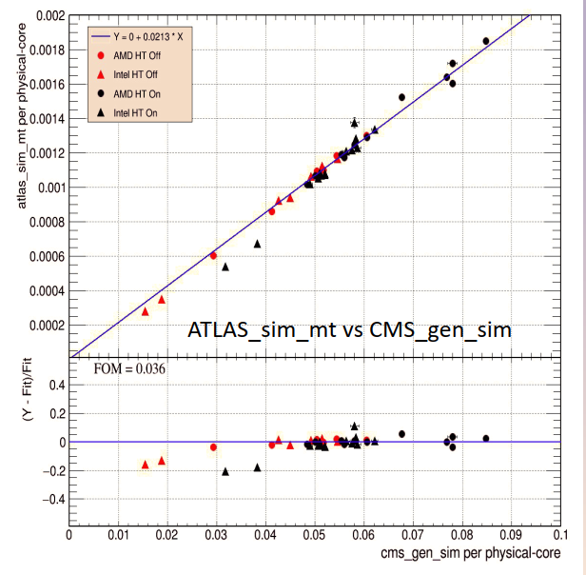
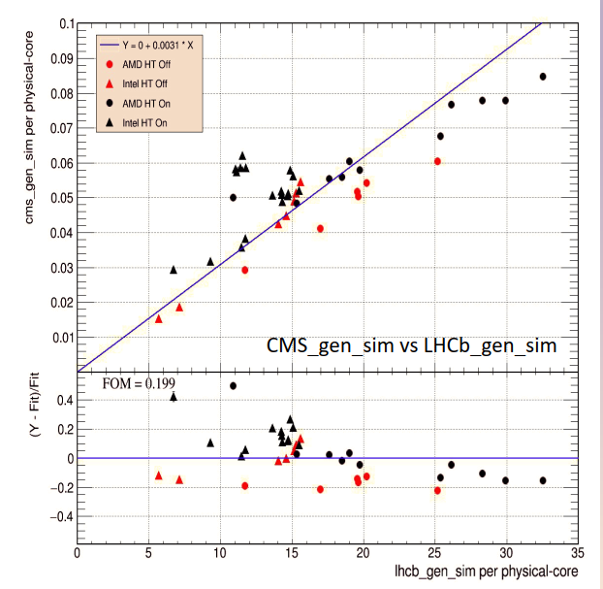
LHCb SIM is different (1) – throughput scaling
Results presented by Randy Sobie to the WG in May 2022
  https://indico.cern.ch/event/1104203
Study correlation of SIM throughputs of LHCb/ATLAS/CMS SIM on different CPUs
  ATLAS and CMS are in reasonable agreement with one another
  LHCb behaves quite differently! Why?...

Slide 11
LHCb SIM is different (2) – software profiling
Results presented by Vincenzo Innocente in email threads in July 2022
  He will make a detailed presentation at the workshop in September
CPU time profiling in LHCb/ATLAS/CMS/ALICE SIM on different CPUs
  LHCb behaves very differently! (See details on the next three slides)
  Almost 50% of CPU time is in G4LogicalBorderSurface::GetSurface
  Why? Vincenzo’s suggestion: “the code in question (G4LogicalBorderSurface) has changed between G4 10.6 and 10.7: it is now a map and the search should be faster (in may opinion a hashmap would be even better)”
Questions:
  Was it known in LHCb that 40-50% of SIM is in G4LogicalBorderSurface?
  Which official Geant4 version does Geant4-10-06-patch02 correspond to?
  Have you tried Geant4 10.7 and did you observe different performance?

Slide 12
SIM software profiling – LHCb
Results presented by Vincenzo Innocente in email threads in July 2022
  He will make a detailed presentation at the workshop in September
LHCb 20 events
>>> 40.69% python libG4geometry.so [.] G4LogicalBorderSurface::GetSurface
>>> 5.18% python libCLHEP-2.4.4.0.so [.] CLHEP::RanluxEngine::flat
>>> 2.34% python libCLHEP-2.4.4.0.so [.] CLHEP::RanluxEngine::flatArray
>>> 1.63% python libxerces-c-3.2.so [.] xercesc_3_2::DOMDeepNodeListImpl::nextMatchingElementAfter
>>> 1.51% python libG4geometry.so [.] G4Navigator::LocateGlobalPointAndSetup
>>> 0.97% python libG4processes.so [.] G4VEmProcess::PostStepGetPhysicalInteractionLength
>>> 0.95% python libG4tracking.so [.] G4SteppingManager::DefinePhysicalStepLength
>>> 0.94% python libG4geometry.so [.] G4VoxelNavigation::ComputeStep
>>> 0.80% python libG4tracking.so [.] G4SteppingManager::InvokePSDIP
>>> 0.78% python libG4processes.so [.] G4VProcess::ResetNumberOfInteractionLengthLeft
>>> 0.75% python libDetDescLib.so [.] LHCb::MagneticFieldGrid::fieldVectorLinearInterpolation
>>> 0.75% python libG4global.so [.] G4PhysicsVector::Value
>>> 0.68% python libstdc++.so.6.0.27 [.] __cxxabiv1::__vmi_class_type_info::__do_dyncast
>>> 0.67% python libG4geometry.so [.] G4SubtractionSolid::Inside
>>> 0.60% python libm-2.17.so [.] __ieee754_log_avx
>>> 0.54% python libG4processes.so [.] G4ProductionCutsTable::ScanAndSetCouple
>>> 0.52% python libGaussTools.so [.] virtual thunk to GiGaStepActionSequence::UserSteppingAction(G4Step const*)
>>> 0.51% python libG4processes.so [.] G4UniversalFluctuation::SampleFluctuations

Slide 13
SIM software profiling – ATLAS
Results presented by Vincenzo Innocente in email threads in July 2022
  He will make a detailed presentation at the workshop in September
ATLAS 10 events
>> 9.01% athena.py libGeoSpecialShapes.so [.] LArWheelCalculator_Impl::DistanceCalculatorSaggingOff::DistanceToTheNeutralFibre
>> 3.32% athena.py libimf.so [.] __libm_sincos_e7
>> 2.92% athena.py libG4processes.so [.] G4VEmProcess::PostStepGetPhysicalInteractionLength
>> 2.12% athena.py libG4geometry.so [.] G4Navigator::LocateGlobalPointAndSetup
>> 1.97% athena.py libGeoSpecialShapes.so [.] LArWheelCalculator::parameterized_sincos
>> 1.85% athena.py libG4processes.so [.] G4UniversalFluctuation::SampleFluctuations
>> 1.61% athena.py libimf.so [.] __libm_atan2_l9
>> 1.51% athena.py libG4processes.so [.] G4UrbanMscModel::SampleCosineTheta
>> 1.43% athena.py libG4geometry.so [.] G4PolyconeSide::Inside
>> 1.43% athena.py libG4geometry.so [.] G4VoxelNavigation::ComputeStep
>> 1.40% athena.py libG4tracking.so [.] G4SteppingManager::DefinePhysicalStepLength
>> 1.22% athena.py libMagFieldElements.so [.] BFieldCache::getB
>> 1.16% athena.py libGeo2G4Lib.so [.] LArWheelSolid::search_for_nearest_point
>> 1.14% athena.py libG4geometry.so [.] G4Navigator::LocateGlobalPointWithinVolume
>> 1.11% athena.py libG4geometry.so [.] G4AtlasRK4::Stepper
>> 1.03% athena.py libG4tracking.so [.] G4SteppingManager::Stepping
>> 1.01% athena.py libG4geometry.so [.] G4VCSGfaceted::Inside
>> 1.01% athena.py libG4geometry.so [.] G4Navigator::ComputeStep
>> 1.01% athena.py libG4geometry.so [.] G4NavigationLevel::operator=
>> 1.01% athena.py libG4geometry.so [.] G4TouchableHistory::GetVolume
>> 1.00% athena.py libG4tracking.so [.] G4SteppingManager::InvokePSDIP
>> 0.94% athena.py libG4processes.so [.] G4Transportation::PostStepDoIt

Slide 14
SIM software profiling – ALICE
Results presented by Vincenzo Innocente in email threads in July 2022
  He will make a detailed presentation at the workshop in September
ALICE 10 events
> 2.91% o2-sim-device-r libg4root.so [.] TG4RootDetectorConstruction::GetG4VPhysicalVolume
> 2.74% o2-sim-digitize libO2TPCSimulation.so [.] o2::tpc::Digitizer::process
> 2.19% o2-sim-digitize libO2TRDSimulation.so [.] o2::trd::Digitizer::convertHits
> 1.86% o2-sim-device-r libO2Field.so [.] o2::math_utils::Chebyshev3D::Eval
> 1.72% o2-sim-device-r libG4processes.so [.] G4RToEConvForGamma::ComputeValue
> 1.57% o2-sim-digitize libO2TRDSimulation.so [.] o2::trd::SimParam::timeResponse
> 1.51% o2-sim-device-r libGeom.so.6.24.06 [.] TGeoSubtraction::Contains
> 1.45% o2-sim-device-r libG4processes.so [.] G4GEMProbability::CalcProbability
> 1.13% o2-sim-device-r libGeom.so.6.24.06 [.] TGeoUnion::Contains
> 0.99% o2-sim-digitize libO2TPCSimulation.so [.] o2::tpc::SAMPAProcessing::getShapedSignal
> 0.89% o2-sim-device-r libGeom.so.6.24.06 [.] TGeoNavigator::Safety
> 0.88% o2-sim-device-r libHist.so.6.24.06 [.] TGraph::Eval
> 0.78% o2-sim-device-r libGeom.so.6.24.06 [.] TGeoTranslation::MasterToLocal
> 0.77% o2-sim-digitize libO2TRDSimulation.so [.] o2::trd::SimParam::crossTalk
> 0.72% o2-sim-device-r libGeom.so.6.24.06 [.] TGeoIdentity::MasterToLocal
> 0.72% o2-sim-device-r libg4root.so [.] TG4RootNavigator::SynchronizeHistory
> 0.67% o2-sim-device-r libBase.so.18.4.7 [.] FairMCApplication::Stepping
> 0.66% o2-sim-device-r libGeom.so.6.24.06 [.] TGeoVoxelFinder::GetNextCandidates
> 0.62% o2-sim-device-r libG4processes.so [.] G4RToEConvForElectron::ComputeValue
> 0.61% o2-sim-device-r libG4tracking.so [.] G4SteppingManager::DefinePhysicalStepLength
> 0.61% o2-sim-device-r libG4geometry.so [.] G4Region::BelongsTo
> 0.61% o2-sim-device-r libO2SimulationDataFormat.so [.] o2::data::Stack::ReorderKine
> 0.58% o2-sim-device-r libg4root.so [.] TG4RootDetectorConstruction::GetNode
>

