Slide 1


MadGraph5_aMC@NLO (MG5aMC)
as a benchmark for
GPUs and vector CPUs
Andrea Valassi (CERN IT)
HEPscore Workshop, Tuesday 20th September 2022
https://indico.cern.ch/event/1170924/contributions/4954511
Many thanks to S. Roiser, O. Mattelaer and the whole madgraph4gpu team!
And many thanks to S. Ponce, H. Grasland, S. Lantz, L. Atzori, D. Giordano for useful discussions on SIMD!

Slide 2
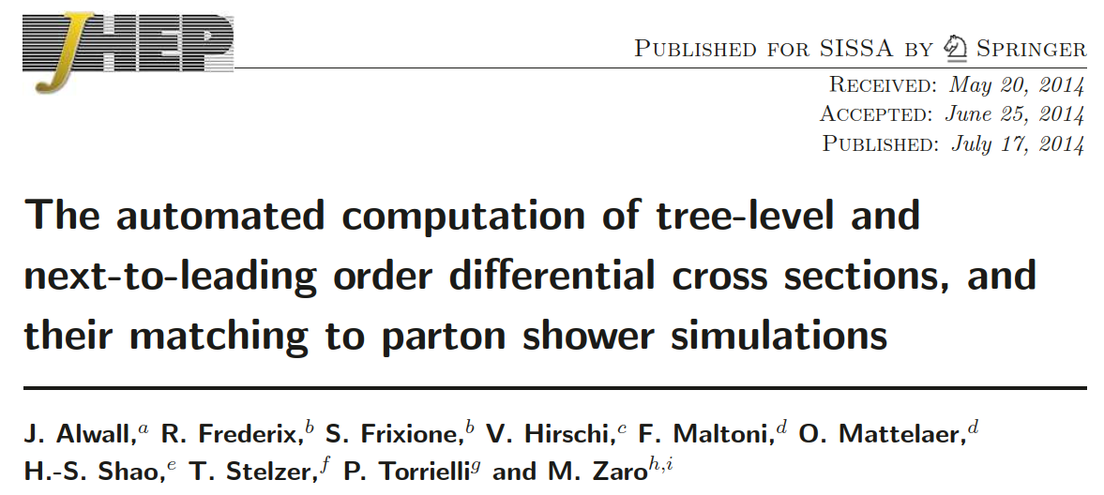
What is Madgraph5_aMC@NLO (MG5aMC)?
A MC physics event generator routinely used by ATLAS, CMS and others
  One of the many GEN steps in the LHC experiment production workflows
A highly flexible software application supporting many physics scenarios
  The relevant code for a given collision process is auto-generated

Slide 3
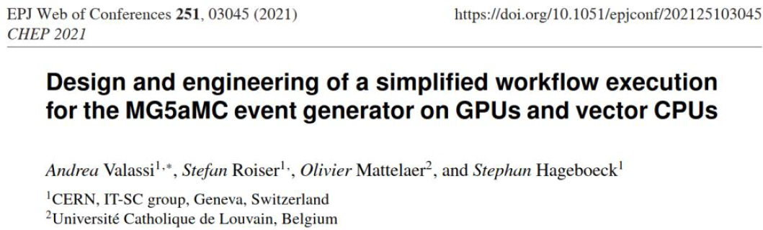
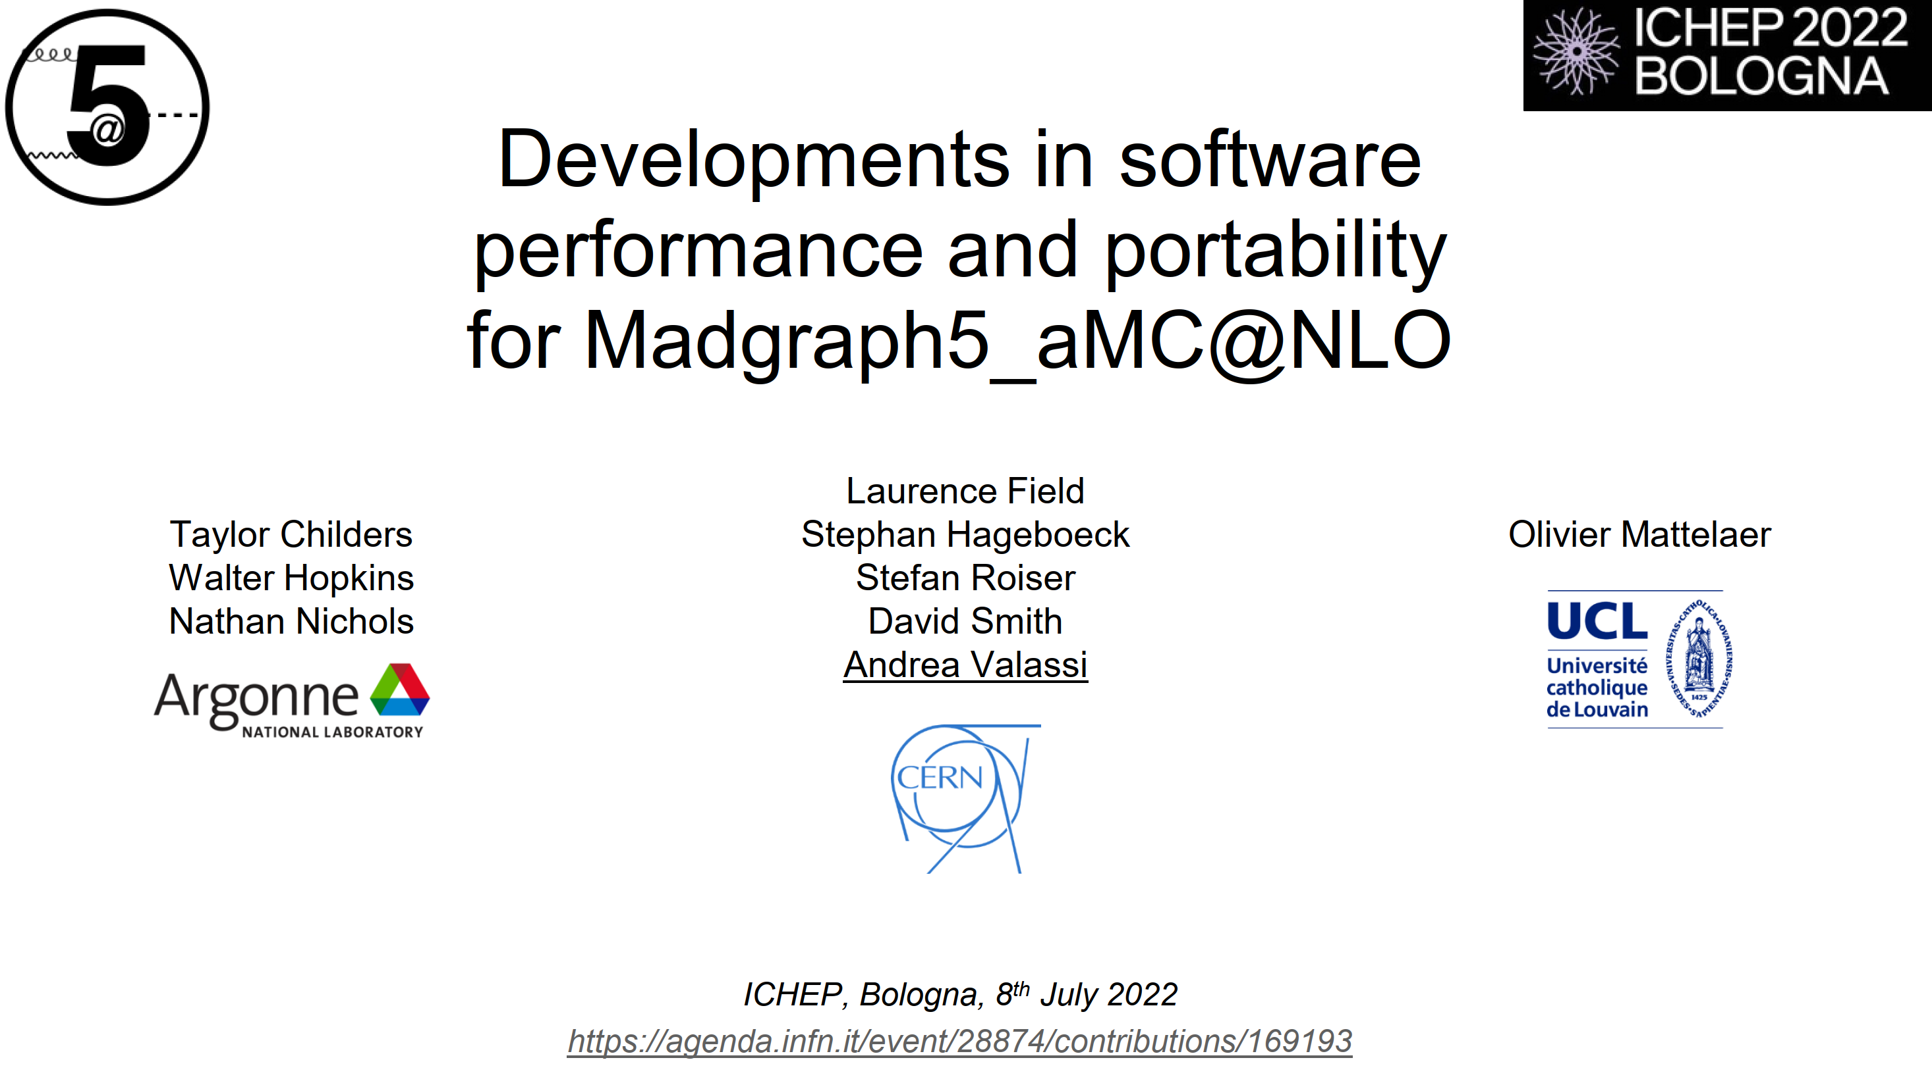
What is madgraph4gpu?
An ongoing project (since 2020) to speed up MG5aMC and port it to GPUs
  Specifically: speed up "matrix elements" (ME) calculations: scattering amplitudes
  No production release for the experiments yet, but hopefully soon...
The software behind the HEP-workloads container described in this talk!
  I will only describe here the implementation in CUDA/C++ (but others exist)
Last status update was at ICHEP (July), next one will be at ACAT (October)
  New results in this talk with respect to the ICHEP talk include:
    C++/CPU performance with several CPU processes in parallel
    C++/CPU performance on Intel Gold 6130 using gcc11 (and with many CPU processes)
    CUDA/GPU performance with several CPU processes in parallel

Slide 4
Why a HEP-workloads container based on madgraph4gpu?
Interesting for future HEPscore extensions to GPUs
  Potentially a future GPU workload consuming significant Grid resources?
Interesting for future HEPscore extensions for vectorisation on CPUs
  Huge (up to x16) overall performance differences between no-SIMD and SIMD
    The current HEPscore workloads are largely insensitive to SIMD (i.e. exploit it poorly)
  Benchmarking is a multi-dimensional problem: AVX512 support, FMA units etc...
Interesting for future HEPscore extensions to heterogeneous processing
  Work in progress on understanding how to keep both the CPU and the GPU busy
With one essential perk: cross-platform reproducibility of results
  The exact same results can be obtained on GPUs, CPUs or CPUs+GPUs

Slide 5
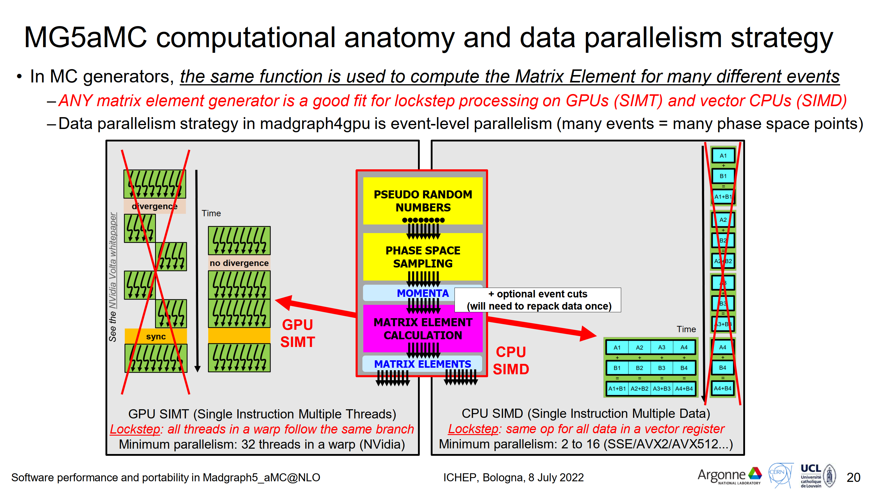
Why MG5aMC on GPUs and vector CPUs?
An ideal fit for (event-level) data parallelism!

Slide 6
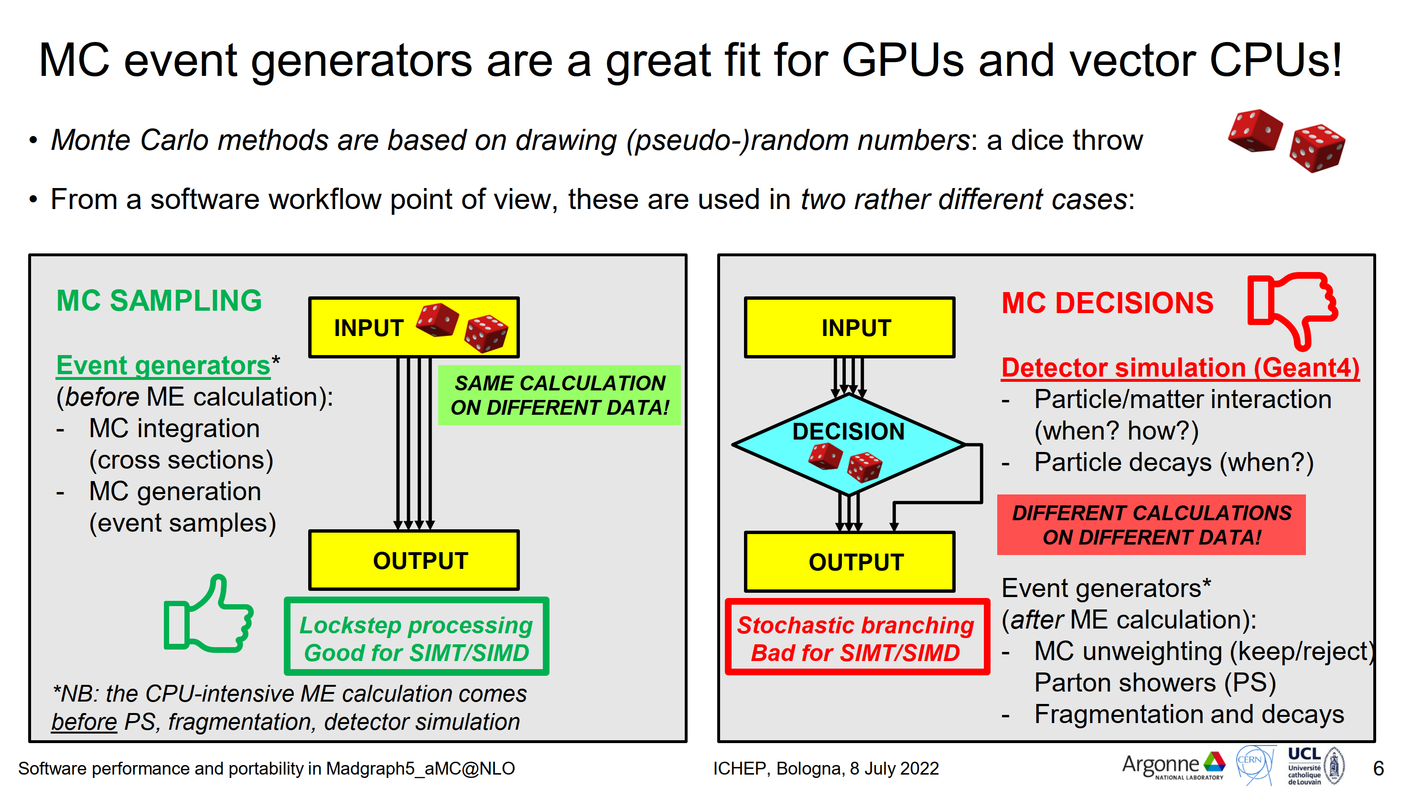
Most other HEP workloads are not so lucky

Slide 7
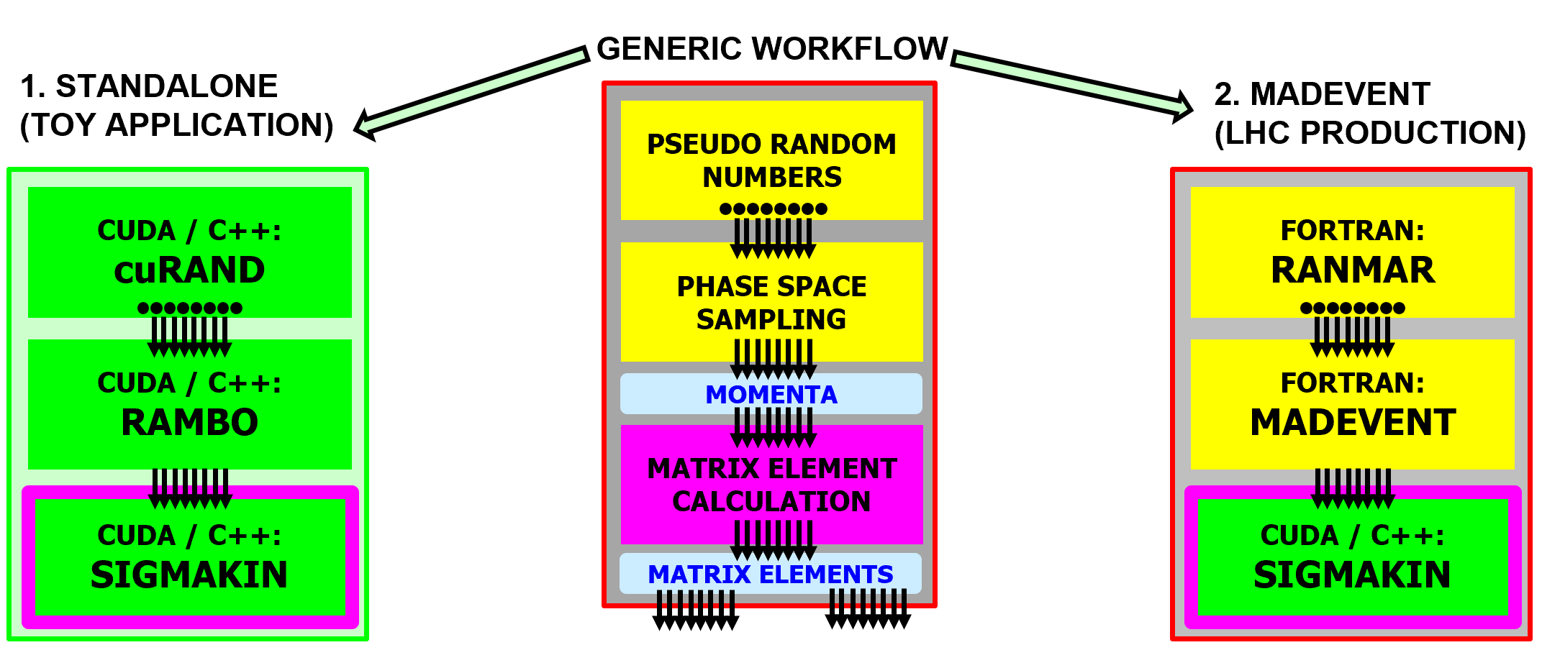
"Standalone" and "MadEvent" applications
We are working on two applications in parallel
  1. Standalone: used since 2020 to optimize the ME calculation (all CUDA/C++)
  2. MadEvent: current main focus, future production version for the experiments
    Inject the new/faster CUDA/C++ ME calculation into the existing Fortran framework
The current HEP-workloads container (v0.6) is based on the standalone app
  Eventually, the MadEvent app will also be integrated into HEP-workloads

Slide 8
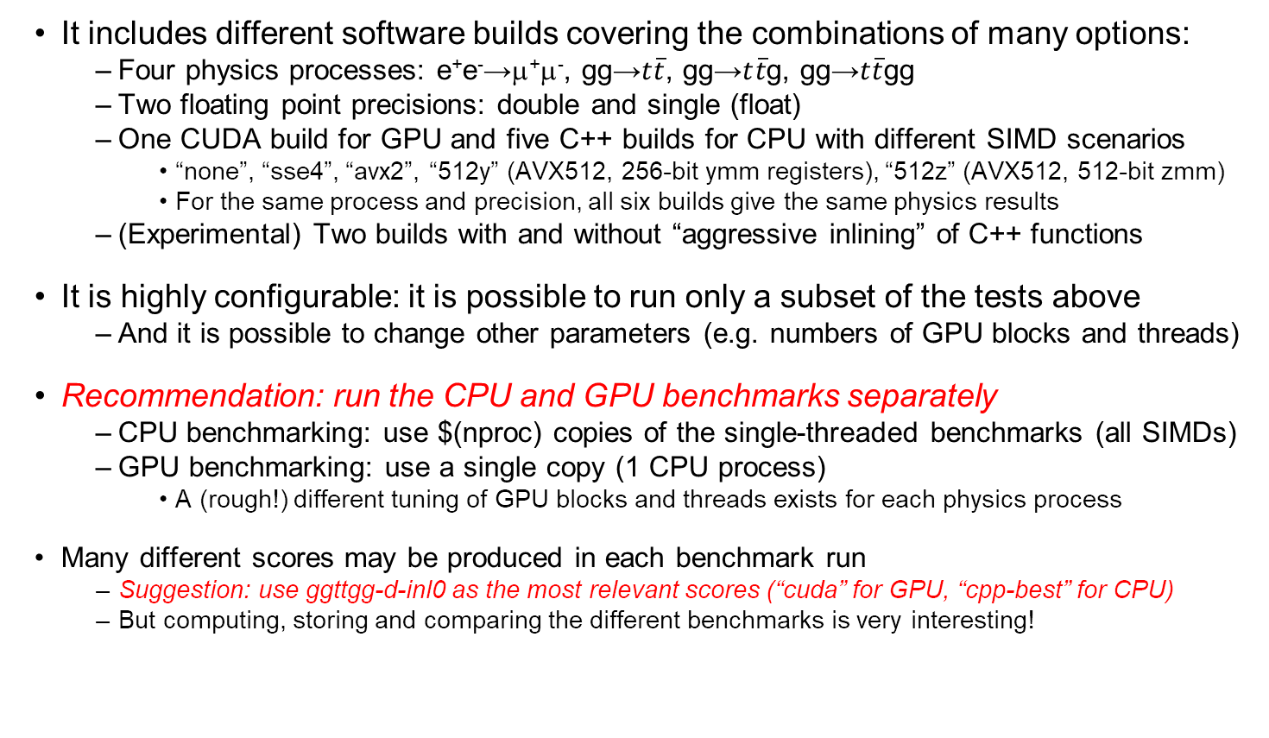
A few details on the v0.6 container
It includes different software builds covering the combinations of many options:
  Four physics processes: e⁺e⁻→μ⁺μ⁻, gg→$t\overline{t}$, gg→$t\overline{t}$g, gg→$t\overline{t}$gg
  Two floating point precisions: double and single (float)
  One CUDA build for GPU and five C++ builds for CPU with different SIMD scenarios
    “none”, “sse4”, “avx2”, “512y” (AVX512, 256-bit ymm registers), “512z” (AVX512, 512-bit zmm)
    For the same process and precision, all six builds give the same physics results
  (Experimental) Two builds with and without “aggressive inlining” of C++ functions
It is highly configurable: it is possible to run only a subset of the tests above
  And it is possible to change other parameters (e.g. numbers of GPU blocks and threads)
Recommendation: run the CPU and GPU benchmarks separately
  CPU benchmarking: use $(nproc) copies of the single-threaded benchmarks (all SIMDs)
  GPU benchmarking: use a single copy (1 CPU process)
    A (rough!) different tuning of GPU blocks and threads exists for each physics process
Many different scores may be produced in each benchmark run
  Suggestion: use ggttgg-d-inl0 as the most relevant scores (“cuda” for GPU, “cpp-best” for CPU)
  But computing, storing and comparing the different benchmarks is very interesting!

Slide 9
Are we efficiently exploiting the hardware?
(a.k.a. estimating “realized potential” [Markus Schulz])
In the following I present the results of a few tests using the v0.6 container
  Out of the many independent dimensions of efficiency I will try to probe only two
  (...After Vincenzo’s talk yesterday I realize there’s so many other ways to study this!...)
Data parallelism (SIMD and SIMT): lockstep processing on multiple data
  CPU, AVX512 example: 512-bit “zmm” registers fit 8 (8-byte) doubles or 16 floats (4-byte)
    Compare no-SIMD to “512z” (AVX512/zmm) SIMD builds, maximum speedup is x8 and x16
  GPU, NVidia V100 example: every “warp” includes 32 threads
    The number of GPU “threads per block” is hardcoded in madgraph4gpu to multiples of 32
    Not shown in next slides: NVidia profiling tools show no thread divergence (branch efficiency 100%)
Task parallelism: filling the system with as many hardware threads as possible
  CPU: increase #copies (single-threaded CPU processes) in parallel in the bmk-driver
    throughput plateau around $(nproc) i.e. number of physical cores time hyper-threading
  GPU: increase the GPU “grid size” (#blocks * #threads-per-block) in low-level options
    throughput plateau depends (in ways I do not yet understand) on #SM, #threads-per-SM etc...
    in addition: increase #copies (CPU processes, each with a GPU grid) in the bmk-driver
      this is useful with a view to future heterogenous processing scenarios...

Slide 10
SIMD on CPU (C++)

Slide 11
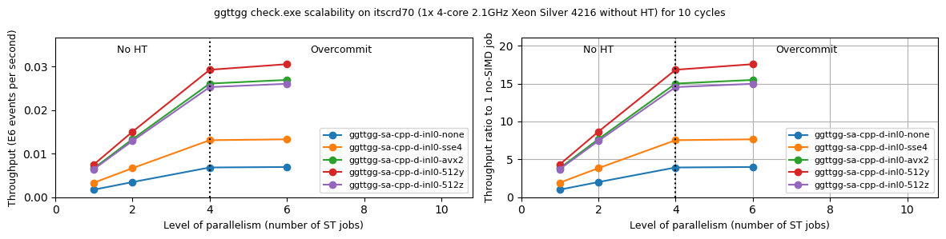


4-core Silver 4216, double precision (double)
gg→$t\overline{t}$gg
gg→$t\overline{t}$gg
Both plots - with respect to throughput of no-SIMD (blue)
  SSE4 (yellow) ~ x2 (two 8-byte doubles in a 128-bit register)
  AVX2 (green) ~ x4 (four 8-byte doubles in a 256-bit register)
  512y (red) ~x4 is 10% higher than AVX2 (same register width + AVX512 set): “BEST”
  512z (purple) is worse than AVX2 or 512y (?! will come back to this...)
Right plot, absolute scale is ratio to one-core no-SIMD: total speedup ~ x16 because
  ~ x4 from SIMD (512y)
  ~ x4 from 4 cores

Slide 12
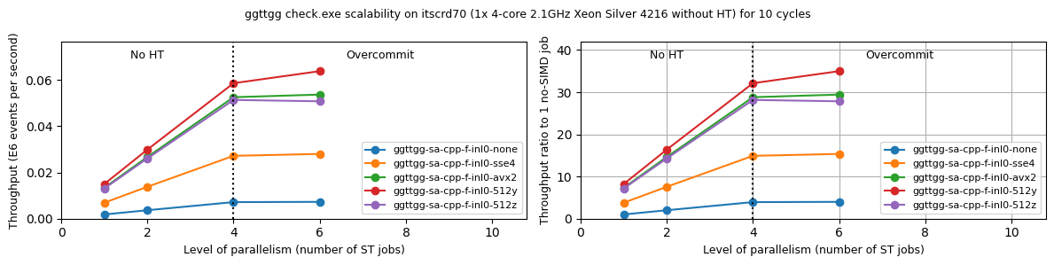
4-core Silver 4216, single precision (float)
gg→$t\overline{t}$gg
gg→$t\overline{t}$gg
Both plots - with respect to throughput of no-SIMD (blue)
  SSE4 (yellow) ~ x4 (four 8-byte floats in a 128-bit register)
  AVX2 (green) ~ x8 (eight 8-byte floats in a 256-bit register)
  512y (red) ~ x8 is 10% higher than AVX2 (same register width + AVX512 set): “BEST”
  512z (purple) is worse than AVX2 or 512y (?! will come back to this...)
Right plot, absolute scale is ratio to one-core no-SIMD: total speedup ~ x32 because
  ~ x8 from SIMD (512y)
  ~ x4 from 4 cores

Slide 13
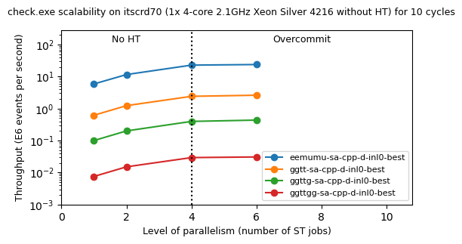
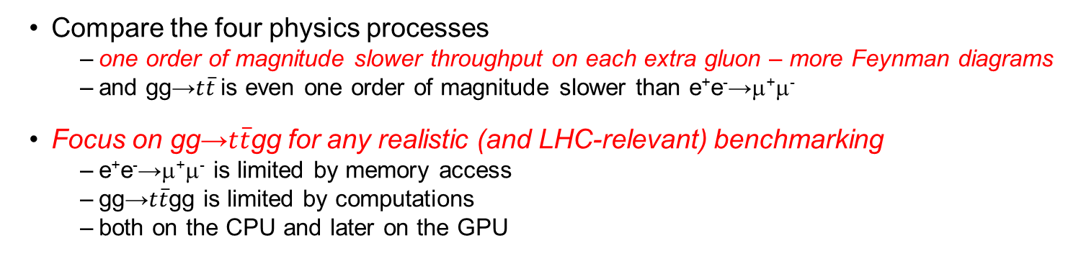
4-core Silver 4216, double precision (double)
Compare the four physics processes
  one order of magnitude slower throughput on each extra gluon – more Feynman diagrams
  and gg→$t\overline{t}$is even one order of magnitude slower than e⁺e⁻→μ⁺μ⁻
Focus on gg→$t\overline{t}$gg for any realistic (and LHC-relevant) benchmarking
  e⁺e⁻→μ⁺μ⁻ is limited by memory access
  gg→$t\overline{t}$gg is limited by computations
  both on the CPU and later on the GPU

Slide 14
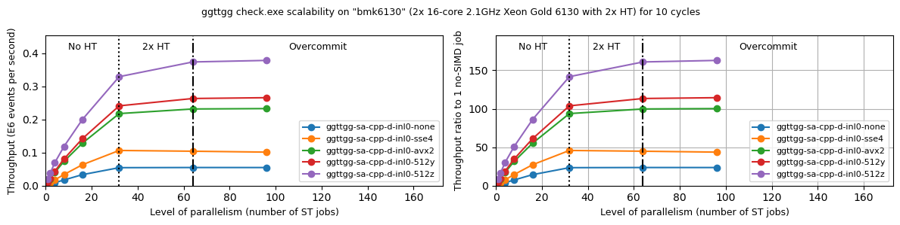


2x16-core 2xHT Gold 6130, double precision
gg→$t\overline{t}$gg
gg→$t\overline{t}$gg
Both plots - with respect to throughput of no-SIMD (blue)
  SSE4 (yellow) ~ x2 (two 8-byte doubles in a 128-bit register)
  AVX2 (green) ~ x4 (four 8-byte doubles in a 256-bit register)
  512y (red) ~x4 is 10% higher than AVX2 (same register width + AVX512 set): “BEST”
  512z (purple) ~ x6-x8 (eight 8-byte doubles in a 512-bit register): “BEST”
    AVX512/zmm much better on Gold 6130 (two FMA units) than on Silver 4216 (one FMA unit)!
    The speedup of 512z is lower than x8 (and decreases with #cores) – clock slowdown?
Right plot, ratio to one-core no-SIMD: total no-HT speedup ~ x150 because
  ~ x6 from SIMD (512z)... lower than x8 but not bad!
  ~ x25 from 32 cores... lower than x32 but not bad!
  HT also gains a tiny bit more...

Slide 15
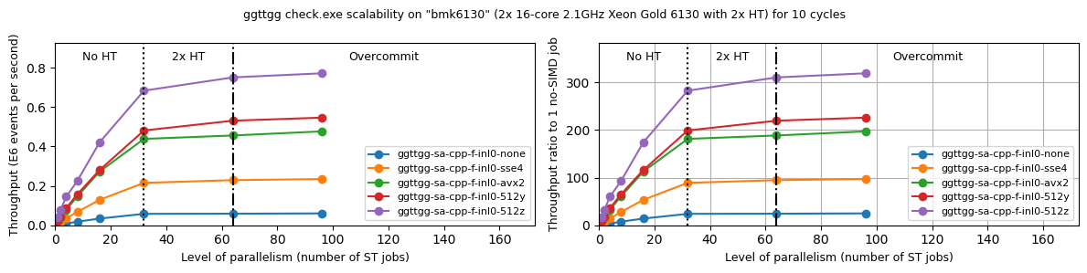
2x16-core 2xHT Gold 6130, single precision
gg→$t\overline{t}$gg
gg→$t\overline{t}$gg
Both plots - with respect to throughput of no-SIMD (blue)
  SSE4 (yellow) ~ x4 (four 8-byte floats in a 128-bit register)
  AVX2 (green) ~ x8 (eight 8-byte floats in a 256-bit register)
  512y (red) ~x8 is 10% higher than AVX2 (same register width + AVX512 set): “BEST”
  512z (purple) ~ x12-x16 (sixteen 8-byte floats in a 512-bit register): “BEST”
    AVX512/zmm much better on Gold 6130 (two FMA units) than on Silver 4216 (one FMA unit)!
    The speedup of 512z is lower than x16 (and decreases with #cores) – clock slowdown?
Right plot, ratio to one-core no-SIMD: total no-HT speedup ~ x300 because
  ~ x12 from SIMD (512z)... lower than x16 but not bad!
  ~ x25 from 32 cores... lower than x32 but not bad!
  HT also gains a tiny bit more...

Slide 16
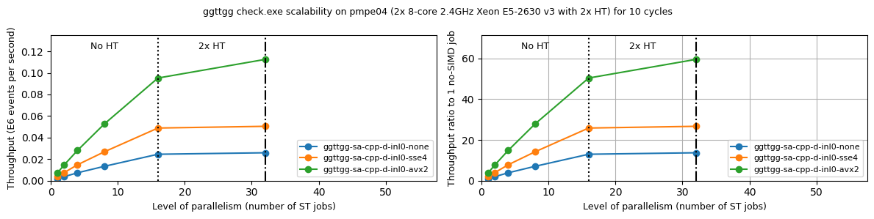
2x8-core 2xHT Haswell E5-2630, double
Best is AVX2 – Haswell does not support AVX512

Slide 17
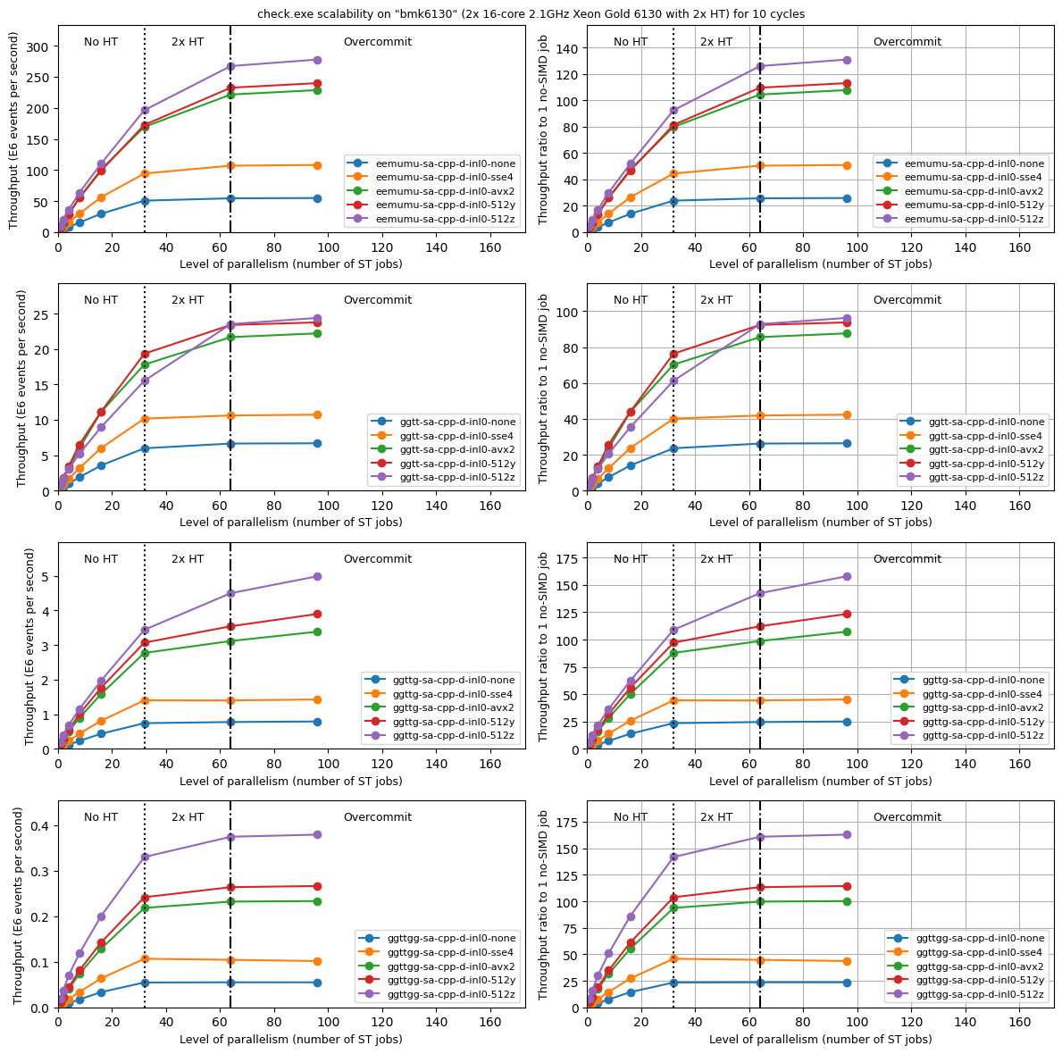



Gold 6130, double – compare four processes
The relative benefit of 512y and 512z is different in different processes
  512y is best for gg→tt
  Complex interplay of data access and computation?
Even for the same type of GEN workload using the same software, different processes stress different parts of the hardware...
Note: throughput increase for overcommit in ggttgg is a measurement bug (processes run too few events)
e⁺e⁻→μ⁺μ⁻
gg→$t\overline{t}$
gg→$t\overline{t}$g
gg→$t\overline{t}$gg

Slide 18
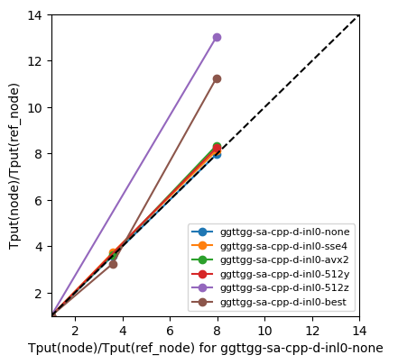
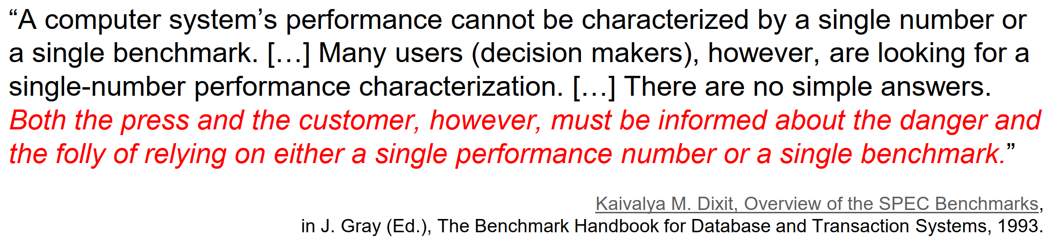
Correlation plot (à la HEPscore vs HS06)
Blue curve: no SIMD
  essentially a straight line
  three nodes have similar frequencies
  power per core very similar
Focus on brown curve: best SIMD
  Silver (reference) has best=512y
  Haswell has best=avx2
    No support for AVX512
    Haswell ~10% below the diagonal
  Gold has best best=512z
    Two FMA units instead of one
    Gold ~50% above the diagonal
Gold
Best is 512z
~1.5 x 512y
Silver
(reference node)
Best is 512y
Haswell
Best is avx2
~0.9 x 512y

Slide 19
GPU (CUDA)
and heterogenous (GPU/CUDA + CPU/Fortran)

Slide 20
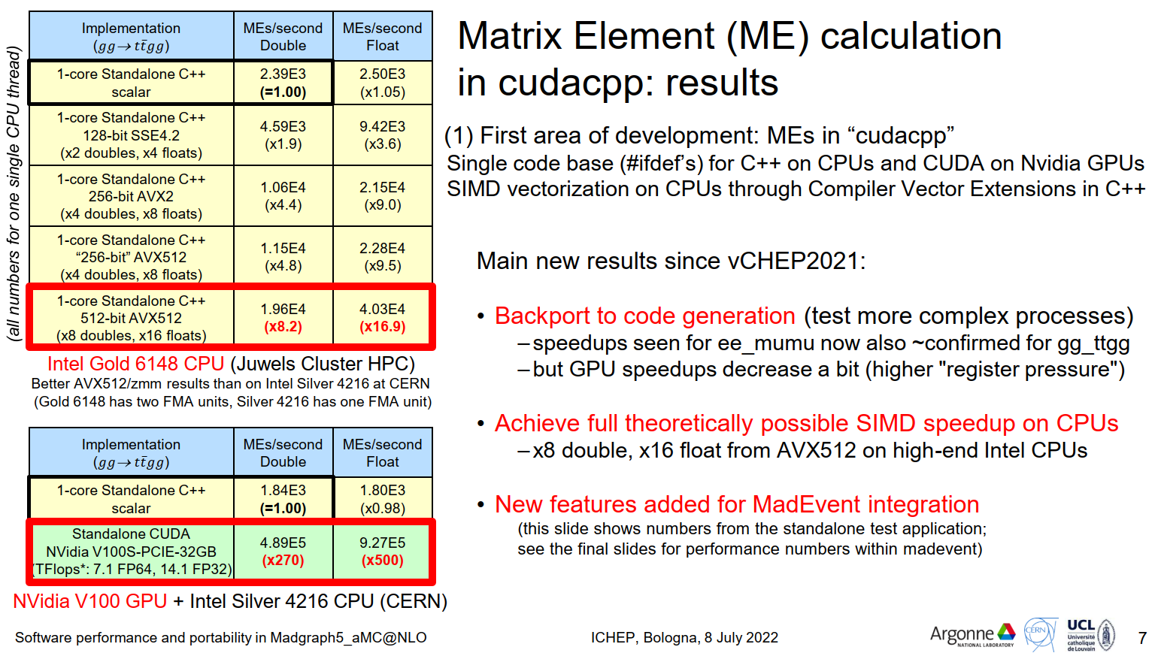
GPU vs CPU throughput with the same output
One full NVidia V100 GPU vs 1 typical CPU core gives a O(100)-O(1000) speedup
  Internally, maximizing the throughput depends on a lot of fine tuning...
  Note also that float performance is x2 double performance (twice the number of FLOPs)

Slide 21
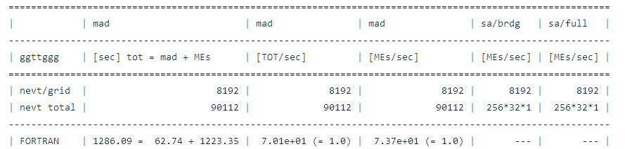
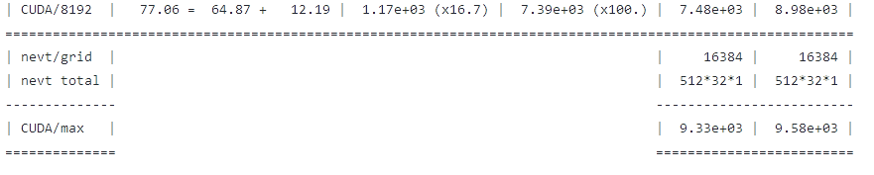
O(100) speedup? Don’t forget Amdahl!
Current production MG5aMC (MadEvent/Fortran + MEs/Fortran)
  Matrix Element calculation is 95% of the overall time
Prototype new MG5aMC (MadEvent/Fortran + MEs/CUDA)
  Using a GPU speeds up the ME calculation by a factor 100 here (can do even better)
  The overall speedup is only a factor 20 - Amdahl’s law: 1 / (1.00 - 0.95)
  Currently, the bottleneck in our full prototype is still on the CPU (MadEvent)

Slide 22
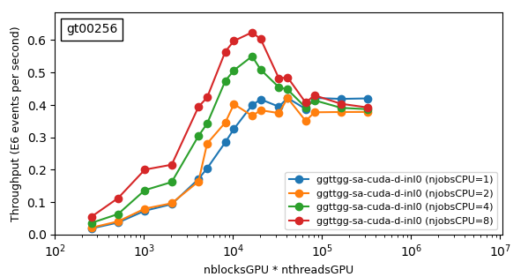
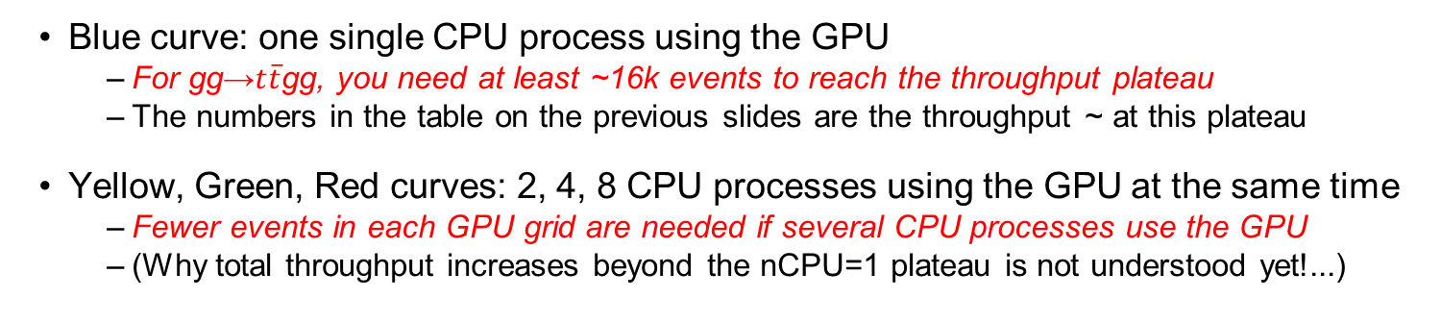
One NVidia V100 on a 4-core Silver CPU
Throughput variation as a function of GPU grid size (#blocks * #threads)
This is the number of events processed in parallel in one cycle
Blue curve: one single CPU process using the GPU
  For gg→$t\overline{t}$gg, you need at least ~16k events to reach the throughput plateau
  The numbers in the table on the previous slides are the throughput ~ at this plateau
Yellow, Green, Red curves: 2, 4, 8 CPU processes using the GPU at the same time
  Fewer events in each GPU grid are needed if several CPU processes use the GPU
  (Why total throughput increases beyond the nCPU=1 plateau is not understood yet!...)

Slide 23
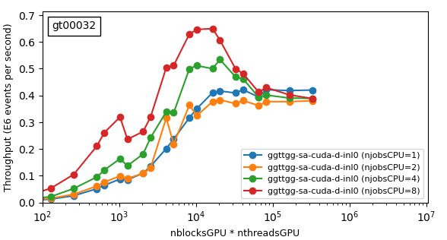
256 vs 32 threads per GPU block
Very similar results, ~no change
Some fine tuning possible of course

Slide 24
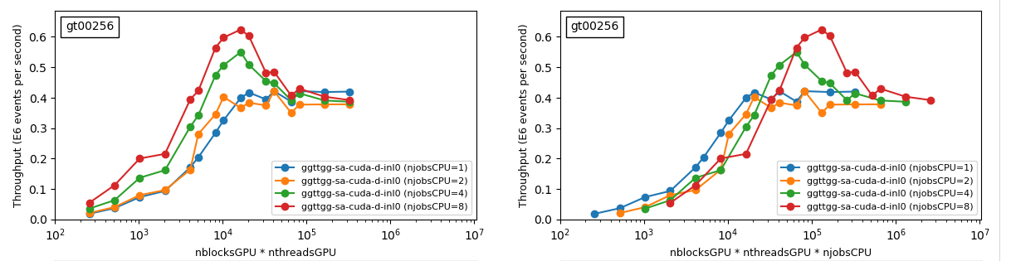
One NVidia V100 on a 4-core Silver CPU
The same four curves as before – with the x-axis redefined
  Total throughput as a function of GPU grid size per CPU process times #processes
Using several processes reaches the same throughput faster, with a small overhead
  (Does it even allow you to reach higher throughputs? To be understood...)

Slide 25
Why is this relevant? Heterogeneous apps
Previous numbers are from v0.6 container
(standalone app)
Everything on the GPU!
Production MadEvent app is heterogeneous:
MEs on the GPU,
MadEvent on the CPU
Remember: in our current CPU+GPUoffload prototype, the bottleneck is the CPU!
One likely development in the future:
  spread out the MadEvent Fortran processing to several CPU cores in parallel
  use smaller GPU grids in each CPU process
  as per the previous slide, the overall GPU throughput should be the same (or higher?)
The message: tuning a heterogenous CPU+GPU system depends on the application!

Slide 26
A few thoughts on GPU benchmarks
Benchmarking GPUs for a realistic workload is in itself a complex task
  “Filling” a GPU depends on non trivial details of the hardware and the application
  Number of blocks, threads per block, register pressure, occupancy...
Heterogeneous performance depends even more heavily on the application
We are probably better off benchmarking CPUs and GPUs separately?

Slide 27
Summary and outlook
MC matrix element generators are a perfect fit for data parallelism (GPUs, SIMD)
A HEP-workloads container based on the standalone madgraph4gpu exists
  And makes it possible to easily collect a lot of useful information
CPU benchmarking is a complex multi-dimensional problem!
  Heavily-vectorized workloads stress non obvious CPU features (e.g. how many FMA units?)
For heterogenous applications, better benchmark GPUs and CPUs separately?
  Fine tuning the performance of these applications is heavily application-dependent
Our priority now is to complete the functionality of the full MadEvent-based app
  This will be the basis of a software release usable by the LHC experiments
Once that is done, a new HEP-workloads container will be built on top of that
  Analysis performance using that (possibly with Vincenzo’s tool) will be very interesting

Slide 28
Backup slides

Slide 29
A few useful links for reference
Previous talks about the MG5aMC benchmark container
  HEPiX benchmarking WG, 30 Aug 2022, https://indico.cern.ch/event/1164106
  HEPiX benchmarking WG, 23 Aug 2022, https://indico.cern.ch/event/1164125
  HEPiX benchmarking WG, 05 Nov 2020, https://indico.cern.ch/event/946409
Conference talks and papers about MG5aMC on GPUs and vector CPUs
  ICHEP, 08 July 2022, https://agenda.infn.it/event/28874/contributions/169193
  vCHEP paper, 23 Aug 2021, https://doi.org/10.1051/epjconf/202125103045
  vCHEP, 15 May 2021, https://indico.cern.ch/event/948465/contributions/4323568
  HSF Workshop, 20 Nov 2020, https://indico.cern.ch/event/941278/contributions/4101793
Software repository of madgraph4gpu
  Project repository: https://github.com/madgraph5/madgraph4gpu

Slide 30
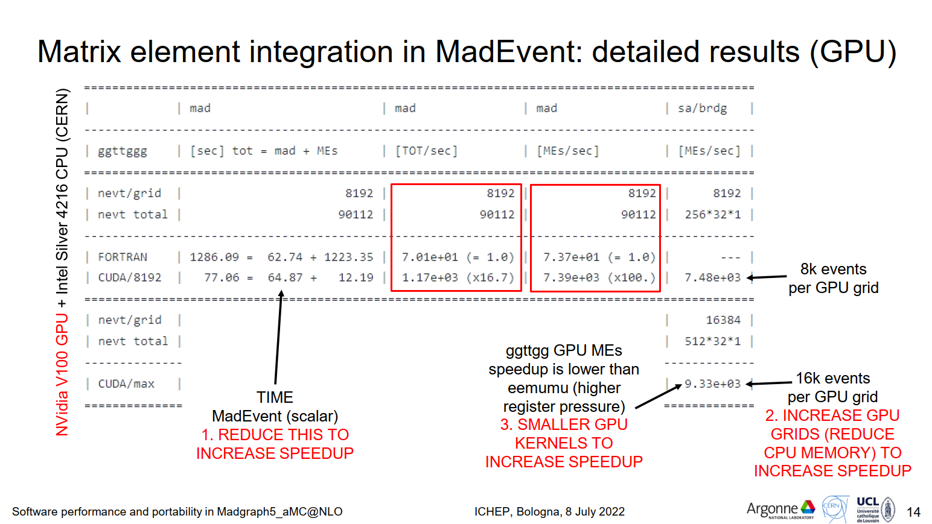

Slide 31
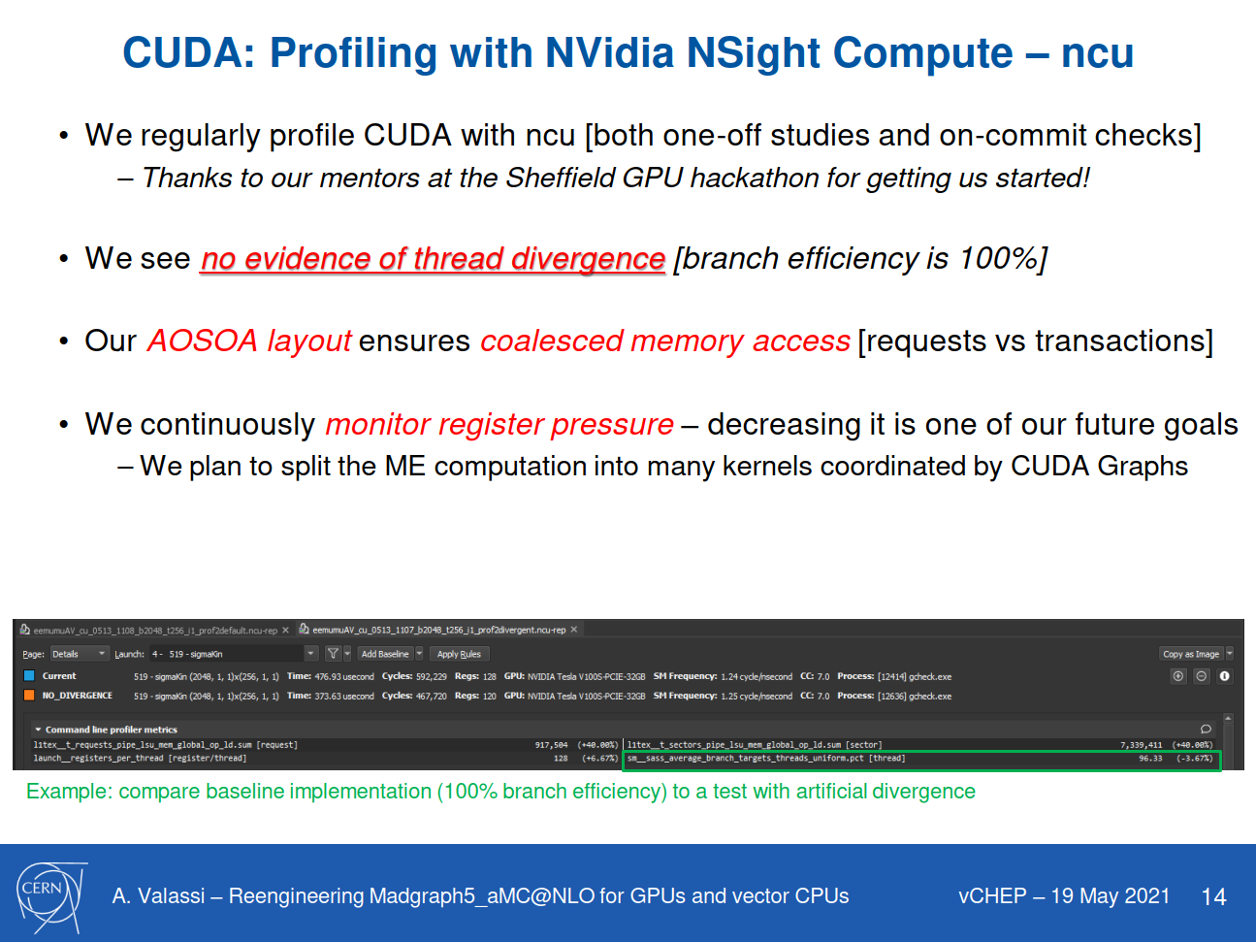

Slide 33
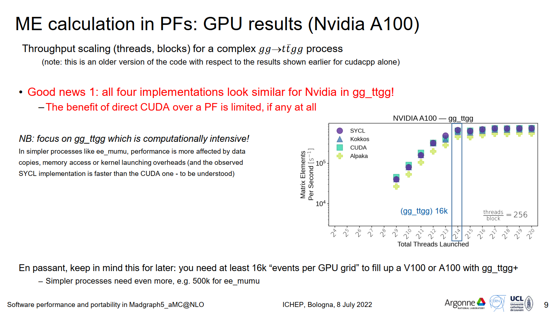

Slide 34
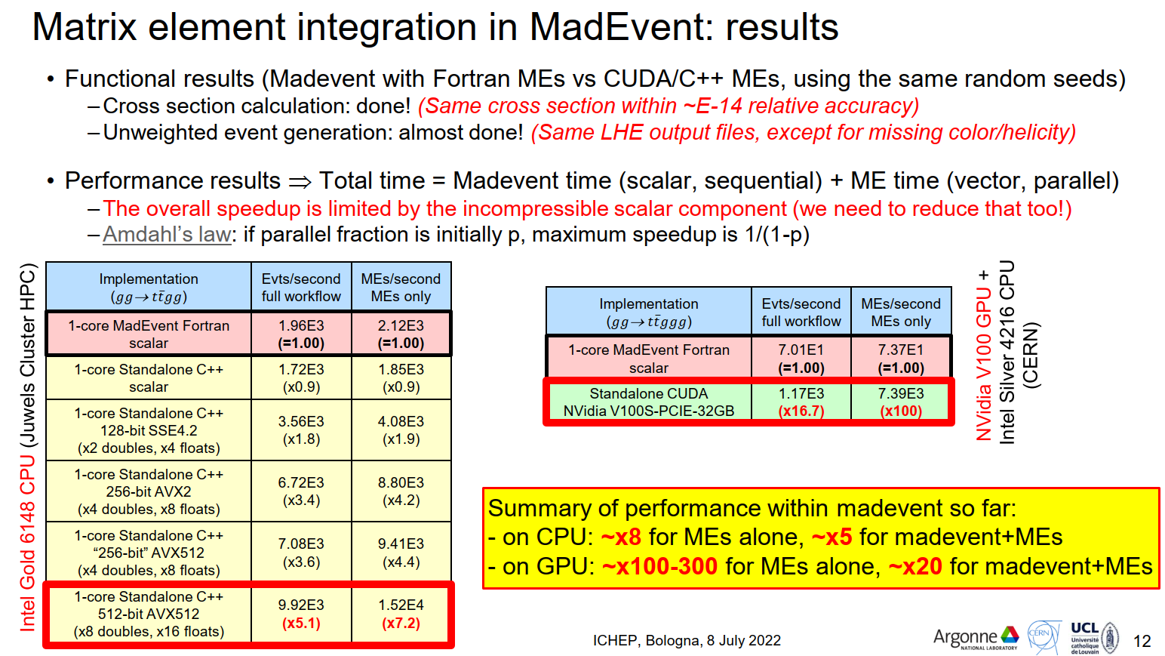

Slide 35
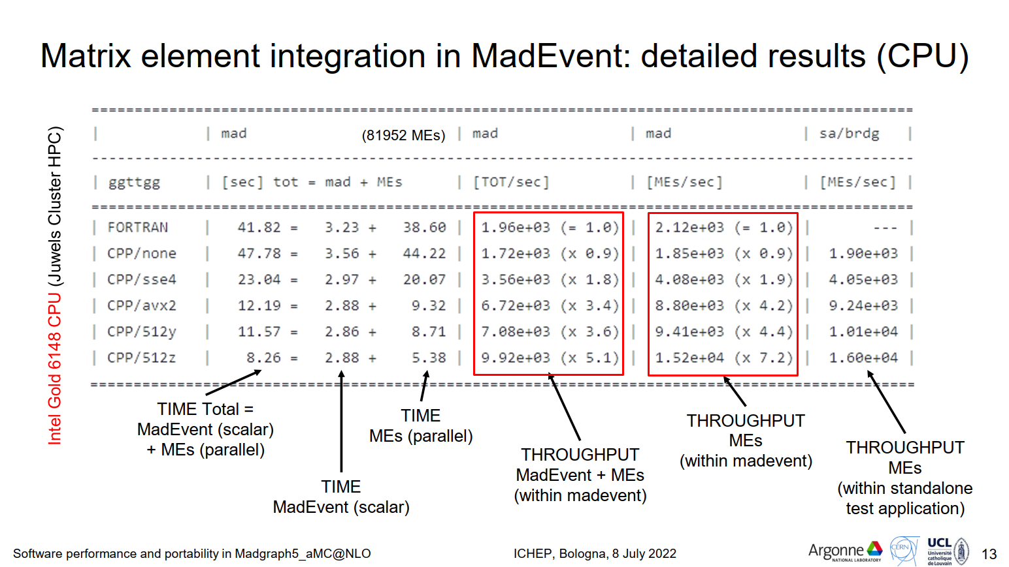

Slide 36
"Standalone" and "MadEvent" applications
GENERIC WORKFLOW
1. STANDALONE
(TOY APPLICATION)
2. MADEVENT
(LHC PRODUCTION)
PSEUDO RANDOM
NUMBERS
CUDA / C++:
cuRAND
FORTRAN:
RANMAR
PHASE SPACE
SAMPLING
CUDA / C++:
RAMBO
FORTRAN:
MADEVENT
MOMENTA
MATRIX ELEMENT
CALCULATION
CUDA / C++:
SIGMAKIN
CUDA / C++:
SIGMAKIN
MATRIX ELEMENTS

Slide 37
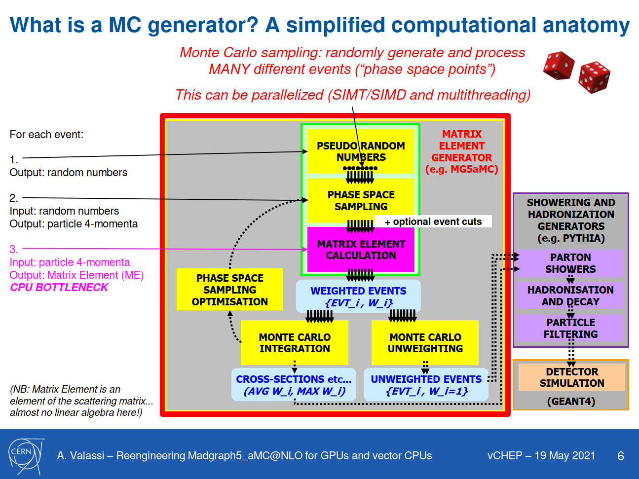

Slide 38
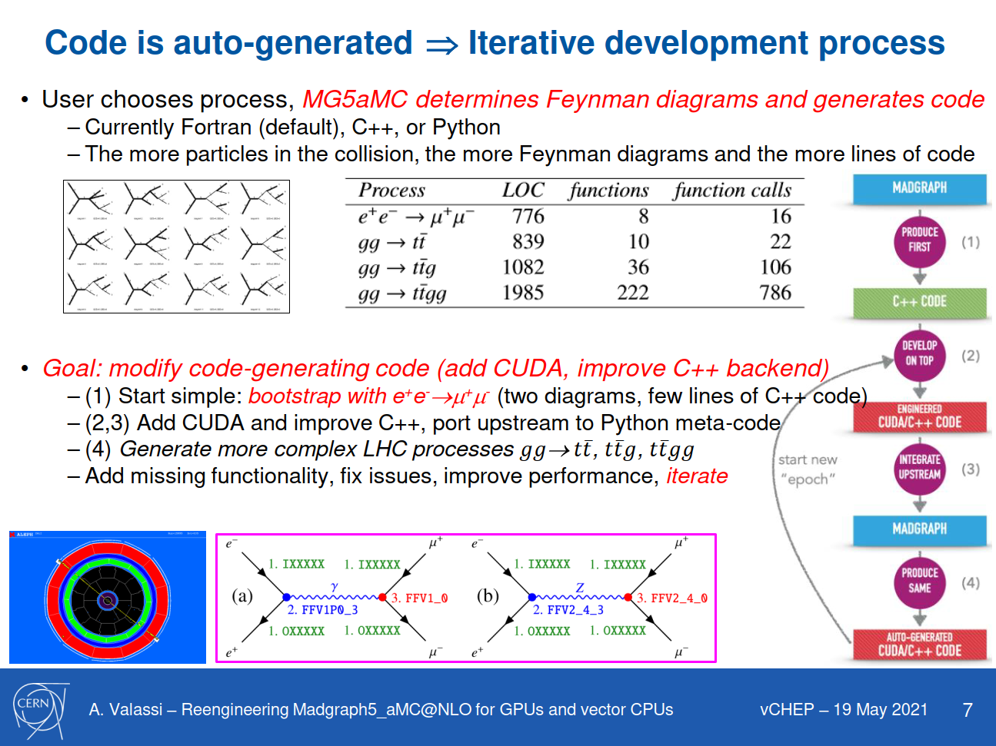

Slide 39
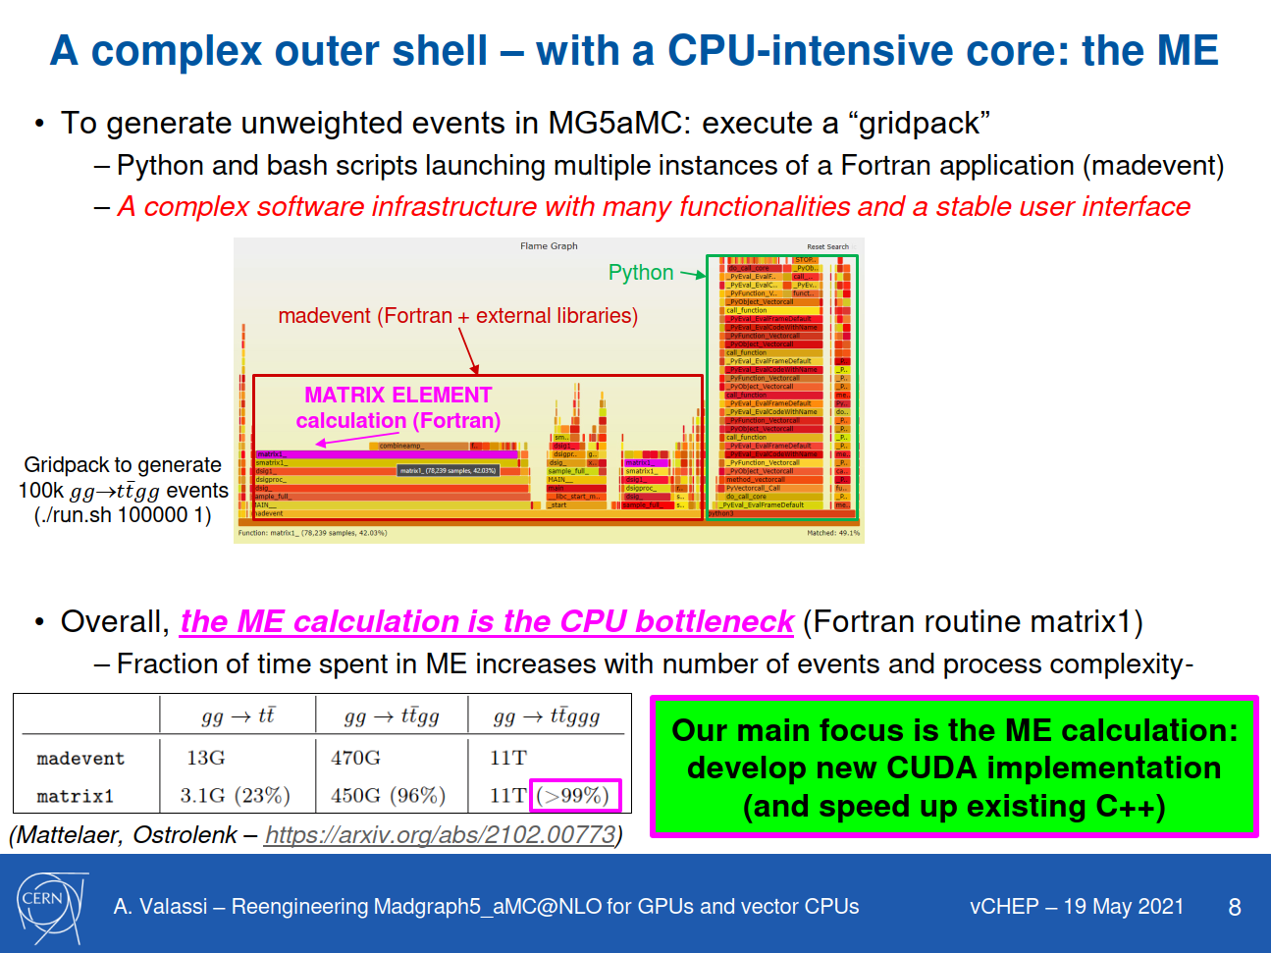

Slide 40
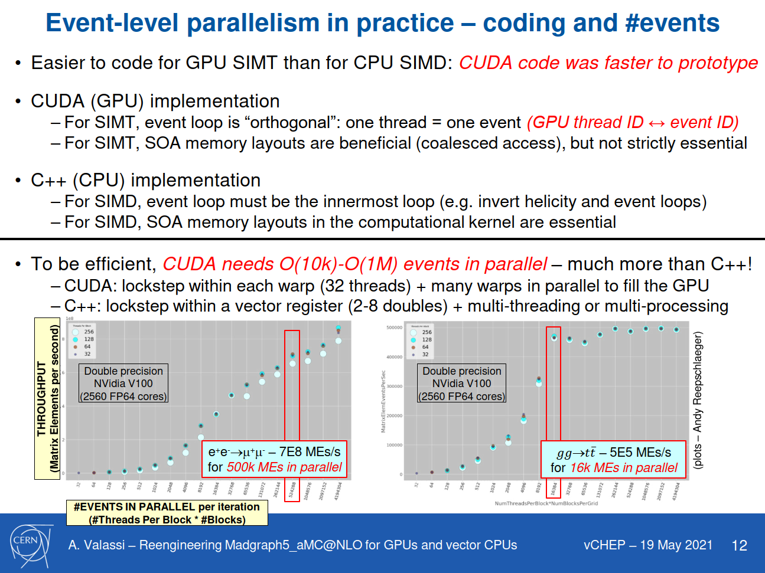

Slide 41
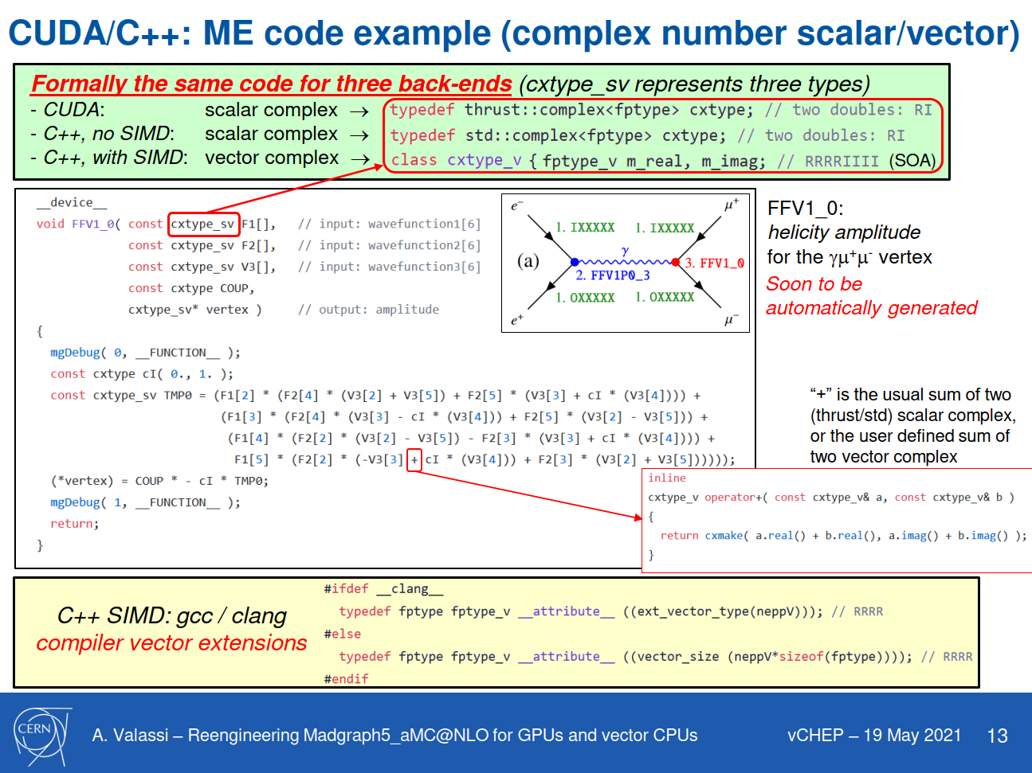

Slide 42
