Slide 1

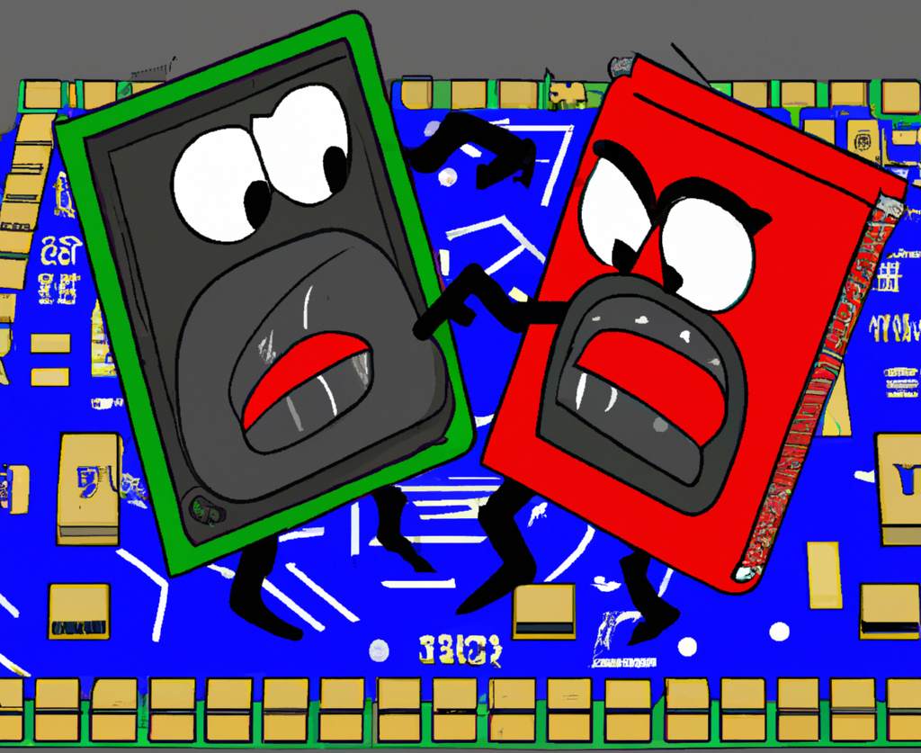
Power Efficiency: x86 vs ARM
(recap and outlook)
Dr. Emanuele Simili HEPiX WorkShop 20 September 2022
Notes:
PowA (redacted for the HEPiX workshop)

Slide 2




Outline
(transitional talk)
Power comparison x86_64 & arm64
- Available hardware (Glasgow + Leichester)
- Power reading & exporter tools
- Benchmarks & results (ATLAS)
- Limitations
Outlook
- New hardware at Glasgow
- Looking forward to HEP-Score
Original slides:
https://indico.cern.ch/event/1128343/contributions/4787174/attachments/2412950/4129612/PowA_GridPP47.pdf
Notes:
GidPP47 → ACAT2022

Slide 3
Abstract (old)
Leveraging the hardware available at Glasgow and Leicester, we have compared the power efficiency and execution speed of different architectures under similar loads.
The study was limited in scope, it only involved two remote arm64 machines and two local x86_64 machines of different generations.
Various benchmarks have been executed and several job profiles were collected (memory, CPU, power). The benchmarks included a BASH script, compiled C code and two different types of ATLAS full Geant4 MT simulations (where possible).
No substantial differences in power consumption were found among the architectures under exam, despite these being expected from different generations of processors.
Results are far from conclusive. Moreover, the whole study suffered from some obvious limitations (#), which must be addressed in the future ...
ScotGrid Glasgow:
Emanuele Simili, Gordon Stewart, Samuel Skipsey, David Britton
Special Thanks:
Davide Costanzo (Sheffield), Oana Boeriu (CERN), Johannes Elmsheuser (CERN),
Jon Wakelin (Leicester) and the Excalibur Project
Notes:
Abstract (old)

Slide 4
Available Hardware (old)
DELL Epyc (Glasgow)
DELL PowerEdge C6525
2 * 32cores Epyc x86_64 CPUs & 512GB RAM (128 threads)
HP Xeon (Glasgow)
HP ProLiant DL60 Gen9
2 * 10cores Xeon x86_64 CPUs and 156GB RAM (40 threads)
ARM+GPU (Leicester)
Ampere Q80
Neoverse-N1 arm64 CPU & 512GB RAM (80 threads)
+ 2 * Nvidia A100 (40GB) GPUs
ARM (Leicester)
HPE CN99XX
2 * 112cores arm64 Cavium ThunderX2 CPUs & 256GB RAM (224 threads)
Notes:
4 machines (2 good ones)

Slide 5
Power Readings
Power readings were achieved by two custom scripts, to collect and export metrics such as CPU, RAM and IPMI Power Usage:
Every 30 seconds, a cron job (root) exports IPMI power reading with timestamp to /tmp/ipmidump.txt (… because IPMItool requires root privileges).
The Cavium ARM machine has a custom Kernel module (tx2mon *) in place of IPMI.
Before starting the job, I (user) run a background script that grabs these IPMI readings, attaches more info (CPU, RAM) and appends them to a CSV file.
On the ARM+GPU machine I use also nvidia-smi to grab the GPUs’ power usage.
When the job is done, the CSV file is exported to Excel for analysis and visualization.
So … most of the analysis was painfully done in MS Excel ☹
The exact same apparatus has been installed on both remote and local machines, in order to get the same type of data for an easier comparison.
Next time will use ROOT !
(*)
https://github.com/Marvell-SPBU/tx2mon
Notes:
TimeStamp: date +"%F , %T"
CPU: top -bn1 | grep "Cpu(s)" | sed "s/.*, *\([0-9.]*\)%* id.*/\1/" | awk '{print 100 - $1}'
RAM: free -t | awk 'FNR == 2 {printf("%.2f"), $3/$2*100}'
GPU: nvidia-smi --query-gpu=power.draw --format=csv,noheader,nounits | awk '{s+=$1} END {print s}’
Power (IPMI): ipmitool dcmi power reading | grep "Instantaneous power reading:"
Power (tx2mon): tx2mon -T -d 10 -f $READFILE ; tail -2 ${READFILE} | head -1 | cut -d',' -f71

Slide 6
Benchmarks & Results (old)
Various benchmarks were attempted, where possible.
All benchmarks used some sort of multithreading (OMP, G4MT):
Prime number sieve (BASH script): prime numbers up to 1 M (78’498 primes)
Prime number sieve (C with OMP): prime numbers up to 100 M (5’761’455 primes)
Large Matrix Multiplication (C with OMP): 20k * 20k random matrix (int & double)
Full G4MT ATLAS Simulation (TTbar & Charginos): 1k and 10k events
 |  | x86 |  | arm64
 |  | DELL PowerEdge C6525 | HP ProLiant DL60 Gen9 | HPE CN99XX | Ampere Q80
bash | Prime Number Sieve (bash) | 4.45 kW*h , 18 h | 3.14 kW*h , 23 h | 4.55 kW*h , 31 h | 0.68 kW*h , 2 h
compiled | Prime Number Sieve (C + OMP) | 1.2 kW*h , 5 h | 2.3 kW*h , 13 h | 1.5 kW*h , 9 h | 0.8 kW*h , 2 h
 | Large Matrix Multiplication (int) | 0.14 kW*h , 30 min | 0.37 kW*h , 2 h | 0.33 kW*h , 2 h | 0.45 kW*h , 1 h
 | Large Matrix Multiplication (float) | 0.12 kW*h , 30 min | 0.2 kW*h , 1 h | 0.3 kW*h , 2 h | 0.27 kW*h , 45 min
AthSimulation | ATLAS TTbar (1k events) | 0.2 kW*h , 35 min | skipped | not possible | 0.23 kW*h , 35 min
 | ATLAS TTbar (10k events) | 0.86 kW*h , 2 h 30 min | skipped | not possible | 0.95 kW*h , 2 h 30 min
 | ATLAS Decaying Charginos (10k events) | 0.55 kW*h , 1 h 30 min | skipped | not possible | 0.68 kW*h , 1 h 45 min
I will not present all sets of results here. Please refer to the original slides presented at GridPP47.
Notes:
Jobs & Results

Slide 7
About ATLAS
We tried full ATLAS simulation as our HEP benchmark. It has been challenging:
Athena is a colossal piece of software, and we had very limited experience with it (*)
It was not easy to run it standalone by a non root user …
- It relies on CVMFS and picks up packages from several repos
- It uses Singularity (we found it easier to run in a container)
As a non-initiated ATLAS user, it has been hard to find a stable version …
- Stable releases are not compiled for ARM (https://bigpanda.cern.ch/globalview/)
- I had to rely on nightly builds, which eventually disappear after a month (#)
Also, not sure we used the best workload …
- Full G4 TTbar and Decaying Charginos test jobs (see .sh)
- Hand-crafted combination of flags o achieve multithreading
- There was no validation of the produced data (ROOT file readable)
(*) Luckily, a new colleague has just joined ScotGrid Glasgow, he used to work in ATLAS.
He will help to define an ATLAS workload that works on both architectures.
(#) Unless you bother the right people
ATHENA_CORE_NUMBER=128
Sim_tf.py \ …
--simulator 'FullG4MT’
--multithreaded True
Notes:
# unless you bother the right people

Slide 8
Simulation Inputs
#!/bin/sh
export ATHENA_CORE_NUMBER=128
export TRF_ECHO=1
export MAXEVENTS=10000
Sim_tf.py \
--conditionsTag 'default:OFLCOND-MC16-SDR-14' \
--physicsList 'FTFP_BERT_ATL' \
--truthStrategy 'MC15aPlus' \
--simulator 'FullG4MT' \
--postInclude 'default:PyJobTransforms/UseFrontier.py' \
--preInclude 'EVNTtoHITS:SimulationJobOptions/preInclude.BeamPipeKill.py,SimulationJobOptions/preInclude.FrozenShowersFCalOnly.py' \
--preExec 'EVNTtoHITS:simFlags.TightMuonStepping=True' \
--DataRunNumber '284500' \
--geometryVersion 'default:ATLAS-R2-2016-01-00-01' \
--inputEVNTFile "/cvmfs/atlas-nightlies.cern.ch/repo/data/data-art/SimCoreTests/valid1.410000.PowhegPythiaEvtGen_P2012_ttbar_hdamp172p5_nonallhad.evgen.EVNT.e4993.EVNT.08166201._000012.pool.root.1" \
--outputHITSFile "TTbar2022.HITS.pool.root" \
--imf False \
--maxEvents $MAXEVENTS \
--multithreaded True
TTbar_10k.sh
/cvmfs/atlas-nightlies.cern.ch/repo/sw/master_AthSimulation_x86_64-centos7-gcc11-opt/2022-01-29T2101/AthSimulation/22.0.53/InstallArea/x86_64-centos7-gcc11-opt/bin/test_RUN3_FullG4_ttbar_2evts.sh
#!/bin/sh
export ATHENA_CORE_NUMBER=128
export TRF_ECHO=1
export MAXEVENTS=10000
Sim_tf.py \
--conditionsTag 'default:OFLCOND-MC16-SDR-14' \
--physicsList 'FTFP_BERT_ATL' \
--truthStrategy 'MC15aPlusLLP' \
--simulator 'FullG4MT' \
--postInclude 'default:PyJobTransforms/UseFrontier.py' \
--preInclude 'EVNTtoHITS:SimulationJobOptions/preInclude.BeamPipeKill.py,SimulationJobOptions/preInclude.FrozenShowersFCalOnly.py' \
--DataRunNumber '284500' \
--geometryVersion 'default:ATLAS-R2-2016-01-00-01' \
--inputEVNTFile "/cvmfs/atlas-nightlies.cern.ch/repo/data/data-art/SimCoreTests/mc15_13TeV.448307.MGPy8EG_A14N23LO_mAMSB_C1C1_5000_208000_LL4p0_MET60.evgen.EVNT.e6962.EVNT.15631425._000001.pool.root.1" \
--outputHITSFile "DeCh_HITS.pool.root" \
--maxEvents $MAXEVENTS \
--imf False \
--multithreaded True
DeCh _10k.sh
Notes:
FullG4MT

Slide 9
ATLAS Simulations
The chosen version of the software: AthSimulation/22.0.53
(nightly builds were available for both x86_64 and aarch64)
DELL Epyc
Using AthSimulation/22.0.53 [cmake] with platform x86_64-centos7-gcc11-opt at
/cvmfs/atlas-nightlies.cern.ch/repo/sw/master_AthSimulation_x86_64-centos7-gcc11-opt/2022-01-29T2101
ARM+GPU
Using AthSimulation/22.0.53 [cmake] with platform aarch64-centos7-gcc8-opt at
/cvmfs/atlas-nightlies.cern.ch/repo/sw/master_AthSimulation_aarch64-centos7-gcc8-opt/2022-01-29T2101
Setting up the ATLAS framework with Singularity and CVMFS:
$ export ATLAS_LOCAL_ROOT_BASE=/cvmfs/atlas.cern.ch/repo/ATLASLocalRootBase
$ alias setupATLAS='source ${ATLAS_LOCAL_ROOT_BASE}/user/atlasLocalSetup.sh’
$ setupATLAS -c centos7
Singularity> asetup AthSimulation,master,r2022-01-29T2101
Singularity> ./TTbar_10k.sh
...
Notes:
Version and settings

Slide 10
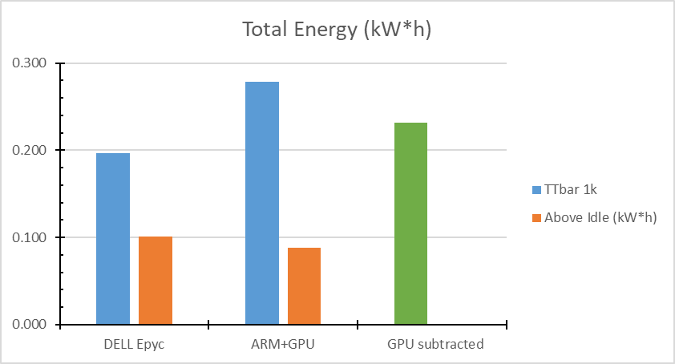
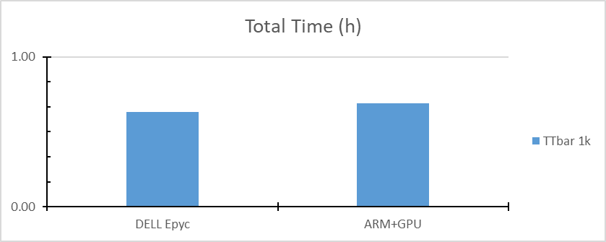
First Results (ATLAS 1k)
First look into an ATLAS simulation (TTbar, 1k events), comparing DELL Epyc with ARM+GPU
 | DELL Epyx | ARM+GPU
TTbar | 1,000 | 1,000 | events
Total time: | 00 00:38:00 | 00 00:41:31 | min
 | 2,280 | 2,491 | sec
Per event: | 2.2800 | 2.4910 | sec/event
 | 0.44 | 0.40 | event/sec
Total energy: | 709,200.00 | 1,001,640.00 | Joules
 | 0.20 | 0.28 | kW*h
Energy/Event: | 709.20 | 1,001.64 | J/event
 | 0.1970 | 0.2782 | W*h/event
Average Power | 307.01 | 402.27 | W
Max Power | 366.00 | 468.00 | W
Min Power | 151.00 | 268.00 | W
Idle (estimate) | 152.00 | 275.00 | W
GPUs (average) |  | 67.27 | W
Idle subtracted: | 152.00 | 275.00 | W
Total energy: | 362,640.00 | 316,615.00 | Joules
 | 0.10 | 0.09 | kW*h
Energy/Event: | 362.64 | 316.61 | J/event
 | 0.101 | 0.09 | W*h/event
Average Power | 155.01 | 127.27 | W
GPU subtracted: |  | 67.27 | W
GPU Total: |  | 167,499.30 | Joules
 |  | 0.05 | kW*h
Total energy: |  | 834,140.70 | Joules
 |  | 0.23 | kW*h
Energy/Event: |  | 834.14 | J/event
 |  | 0.23 | W*h/event
Average Power |  | 335.00 | W
TTbar 1k
Machine | threads | Time (h) | Tot. Energy (kW*h) | Peak Power (W) | Idle (W) | GPU (W) | Above Idle (kW*h)
DELL Epyc | 128 | 0.63 | 0.197 | 366 | 152 |  | 0.1007
ARM+GPU | 80 | 0.69 | 0.278 | 468 | 275 | 67 | 0.0879
GPU subtracted |  | 0.69 | 0.232 | 401 | 208 | 67 | 0.0000
(*) The energy/event tends to decrease with a larger simulation. E.g., total energy of the 10k simulation is about 4 times the 1k …
(*)
What a large idle !
Notes:
TTbar 1k

Slide 11
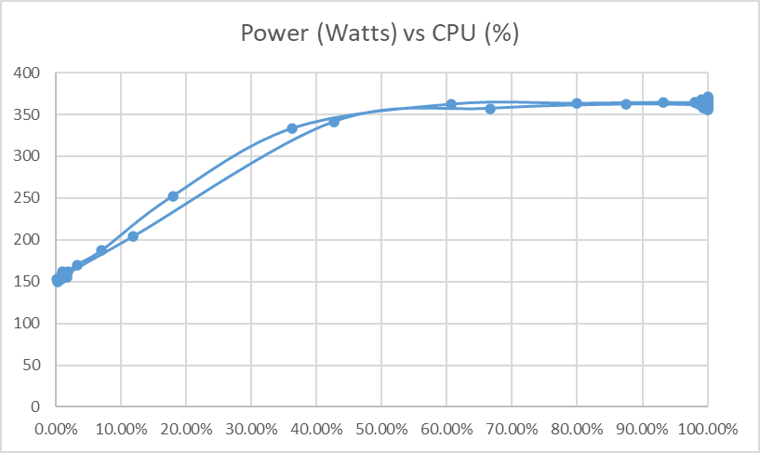
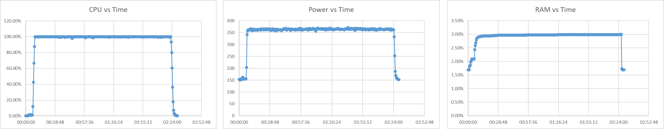
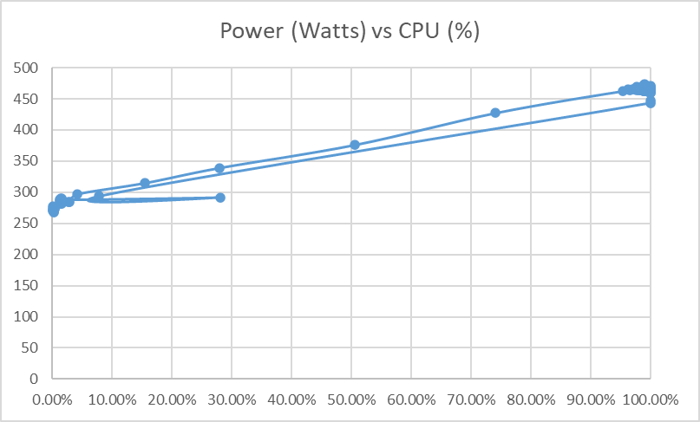
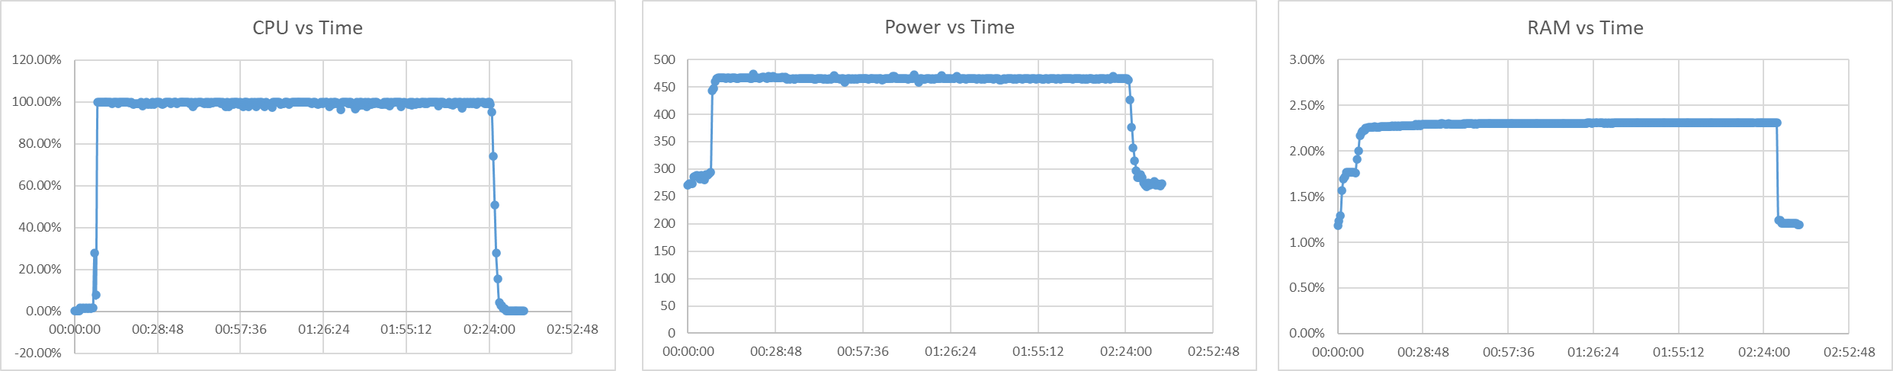
Job Profiles (ATLAS 10k)
DELL Epyc
ARM+GPU
What a large idle !
Notes:
Profiles (ATLAS TTbar simulation 10k events)

Slide 12
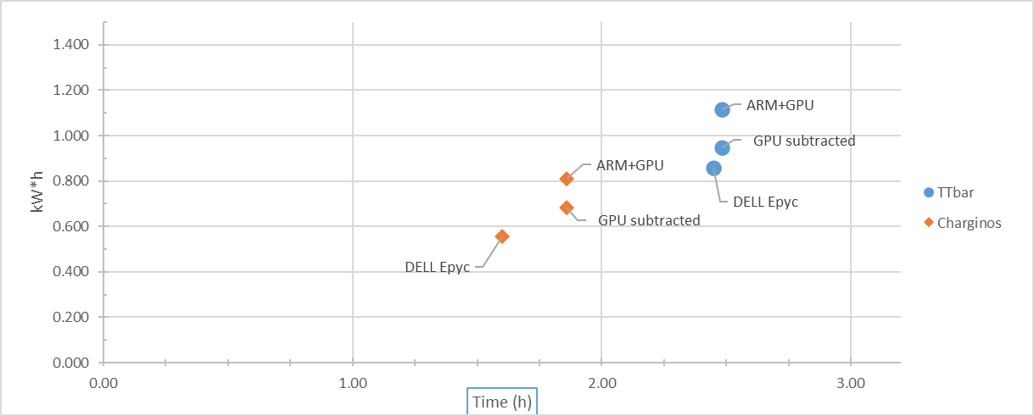
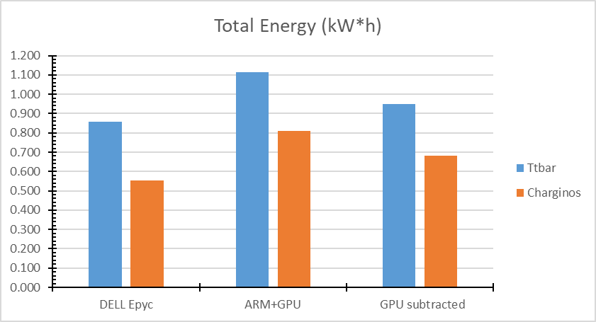
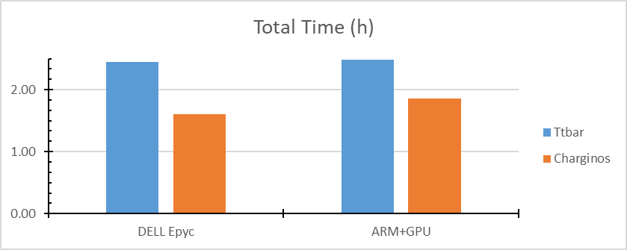
Results (ATLAS 10k)
In both cases, the execution times are very similar, especially after subtracting the GPU.
The DELL Epyc looks slightly more energy efficient.
TTbar
Machine | threads | Time (h) | Tot. Energy (kW*h) | Peak Power (W) | Idle (W) | GPU (W) | Above Idle (kW*h)
DELL Epyc | 128 | 2.45 | 0.858 | 371 | 150 |  | 0.4908
ARM+GPU | 80 | 2.48 | 1.114 | 474 | 274 | 67 | 0.4338
GPU subtracted |  | 2.48 | 0.949 | 407 | 207 | 0 | 0.0000
Charginos
Machine | threads | Time (h) | Tot. Energy (kW*h) | Peak Power (W) | Idle (W) | GPU (W) | Above Idle (kW*h)
DELL Epyc | 128 | 1.60 | 0.555 | 370 | 148 |  | 0.3182
ARM+GPU | 80 | 1.86 | 0.811 | 465 | 263 | 69 | 0.3223
GPU subtracted |  | 1.86 | 0.683 | 396 | 194 | 0 | 0.0000
Notes:
Results 10k

Slide 13
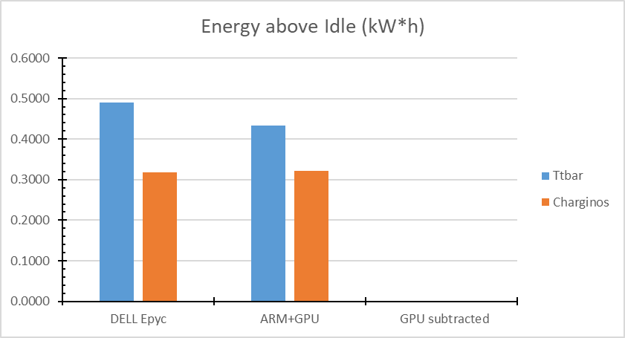
Results (ATLAS 10k)
Or … to account for the different idle consumption, we can subtract it from the total and compare the energy in excess of idle:
…
TTbar
Machine | threads | Time (h) | Tot. Energy (kW*h) | Peak Power (W) | Idle (W) | GPU (W) | Above Idle (kW*h)
DELL Epyc | 128 | 2.45 | 0.858 | 371 | 150 |  | 0.4908
ARM+GPU | 80 | 2.48 | 1.114 | 474 | 274 | 67 | 0.4338
GPU subtracted |  | 2.48 | 0.949 | 407 | 207 | 0
Charginos
Machine | threads | Time (h) | Tot. Energy (kW*h) | Peak Power (W) | Idle (W) | GPU (W) | Above Idle (kW*h)
DELL Epyc | 128 | 1.60 | 0.555 | 370 | 148 |  | 0.3182
ARM+GPU | 80 | 1.86 | 0.811 | 465 | 263 | 69 | 0.3223
GPU subtracted |  | 1.86 | 0.683 | 396 | 194 | 0
When we subtract the idle, the ARM+GPU machine looks slightly more power efficient.
However, this procedure might be questionable …
Notes:
Results 10k bis

Slide 14
Limitations (old)
(#) There were obvious limitations to this approach, which relied on resources at two different geographical locations: local x86 machines (Glasgow) & remote ARM machines at Leicester.
In Glasgow I have full sys-admin control, at Leicester I was just a normal user with limited privileges. Therefore, I had limited control over the activity of these remote machines, and indeed we could see different levels of usage depending on the day/time.
Machines have very different hardware, in particular the ARM+GPU node at Leicester that can run ATLAS had 2 powerful Nvidia Ampere GPUs just sitting and increasing the idle.
Power measurements were mainly read by IPMI tools interacting with different hardware, and in one case with a custom tool (tx2mon on Cavium). So, readings might not be directly comparable, and there was no validation of power data (e.g., an external power-meter).
The ARM+GPU machine was accessed through Slurm (which adds an extra layer).
I could send my job requests with the flag --exclusive, which gave me some sort of priority.
Cooling was totally neglected: more watts go in, more heat comes out. This might be an important factor for the overall power required by the data center (including coolers).
Notes:
Obvious limitations (#)

Slide 15
Outlook
To address the limitation of our previous study on efficiency and power consumption (ref. GridPP47), we have purchased two new servers with almost identical hardware specs but different CPU architectures: arm64 and x86_64.
This will allow us to re-run the various benchmarks while comparing power consumption in a very controlled environment, where all variables can be accounted for (e.g., raw PDU power output, cooling, …), and where we have access to the full range of machine metrics (node_exporter).
As we have done before, we will run different benchmarks including BASH scripts, compiled C programs, ATLAS simulations (*) and possibly HEP-Score (**).
Results will hopefully make more sense than previous ones (***), and they will be presented at ACAT 2022 next month (****).
(*) This time we have ATLAS people to provide an actual workload
(**) ARM builds of some benchmarks are already available (CMS, ATLAS)
(***) E.g., we already see a huge difference in idle (AMD almost twice than ARM)
(****) Both servers arrived (with huge delay), and work is in progress
Notes:
Raw PDU power output of the two servers will be measured this Thursday and compared to the output of IPMI tool both in idle and during a job …

Slide 16
Purchased Hardware
x86_64: Single AMD EPYC 7003 series processor family
Server: AMD EPYC 7003 UP Server System (SuperMicro)
CPU: AMD EPYC 7643 48 core 96 Thread 2.3GHz processor
RAM: 256GB (16 x 16 GB) DDR4 3200MHz ECC Registered memory
Storage: 3.84TB Samsung PM9A3 M.2 (2280)
arm64: Single socket Ampere Altra MAX Processor
Server: ARM 1U Rackmount Server system
CPU: ARM Q80-30 80 core 210W TDP processor
RAM: 256GB (16 x 16 GB) DDR4 3200MHz ECC Registered memory
Storage: 3.84TB Samsung PM9A3 M.2 (2280)
Already available @ Glasgow:
DELL Epyc (Glasgow)
DELL PowerEdge C6525
2 * 32cores Epyc x86_64 CPUs & 512GB RAM (128 threads)
HP Xeon (Glasgow)
HP ProLiant DL60 Gen9
2 * 10cores Xeon x86_64 CPUs and 156GB RAM (40 threads)
… old and cranky
Notes:
ARM server:
Single socket Ampere Altra MAX Processor
Architecture: aarch64
Byte Order: Little Endian
CPU(s): 80
Vendor ID:
Model name:
Manufacturer:
Ampere(R) Family: ARMv8
External clock: 1.650 GHz
Max speed: 3.000 GHz
Speed: 3.000 GHz
Core count: 80
Thread count: 80
TDP (*): 210W (https://www.tomshardware.com/news/ampere-altra-max-80-ccore-arm-delidded)
AMD server:
Single AMD EPYC 7003 series processor family
Architecture: x86_64
Byte Order: Little Endian
CPU(s): 96
Vendor ID: AuthenticAMD
Model name: AMD EPYC 7643 48-Core Processor
Manufacturer: Advanced Micro Devices, Inc.
Family: Zen
External clock: 100.000 MHz
Max speed: 3.625 GHz
Speed: 2.300 GHz
Core count: 48
Thread count: 96

Slide 17
Benchmarks (new)
Available benchmarks (already implemented/tested):
Prime number sieve (BASH script)
Prime number sieve (C with OMP)
Large Matrix Multiplication (C with OMP) and/or other compiled operations
Full G4MT ATLAS Simulation (~ in progress)
Other benchmarks (to implement/test):
HEP-Score / HEP Benchmark suite (~ if available)
I/O bound jobs (e.g., run ATLAS analysis on a remote data set)
CPU intensive Python tasks (e.g., PyTorch on CPU)
Other experiments …
I am still open to any suggestions and criticism on what / how I should run !
Notes:
Benchmarks (new)

Slide 18

HEP-Score & me
I started talking with the HEP-Score Working Group before the summer, because of mutual interest and partial overlap with my current research on power efficiency:
I wish to use HEP-Score as a standard HEP workload to rate different architectures on power consumption and execution efficiency
I can help testing the HEP-Score on different architectures (x86, ARM, and hopefully GPU - we already have one waiting :)
It would be good to include the power readings in the standard output of HEP-Score (peak / idle power and integrated energy consumption for a given load) *
* This is becoming increasingly important for future hardware procurement !
Notes:
ideally: kWh/evt

Slide 19
HEP-Scores @ Glasgow
So far, I have been able to successfully run the HEP-score on all types of hardware at Glasgow (except ARM). Results submitted to the global Kibana dashboard at CERN.
Local HEP-score results (UKI-SCOTGRID-GLASGOW):
d20 (DELL PowerEdge C6525, 2020) score: 2060.4333
d21 (DELL PowerEdge C6525, 2021) score: 1983.4387
d22 (DELL PowerEdge C6525, 2022) score: 2141.87
h17 (HP ProLiant DL60 Gen9, 2017) score: 451.9846
h16 (HP ProLiant DL60 Gen9, 2016) score: 368.671
s15 (SuperMicro SYS-6028TR-HTR, 2015) score: 389.7718
GPU (DELL PowerEdge R7525 + 2x Nvidia A100, 2022) score: 1906.9971 (CPU only)
I did not calculate the total score of our site just yet …
Notes:
Local HEP-Scores
bmkrun v2.1
hep-score v1.4.0

Slide 20
Thanks.
Dr. Emanuele Simili HEPiX WorkShop 20 September 2022
Notes:
☺

Slide 21
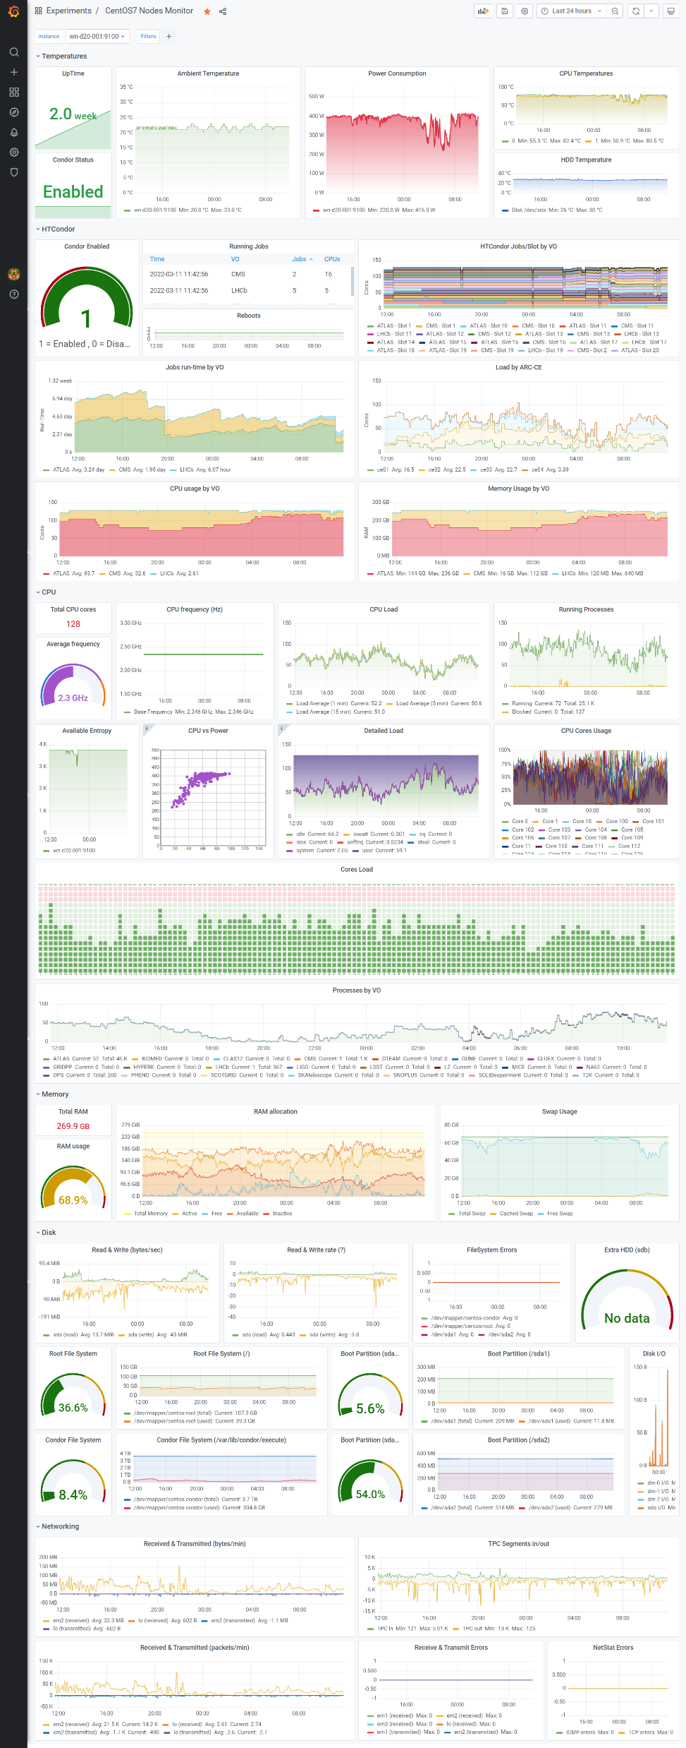

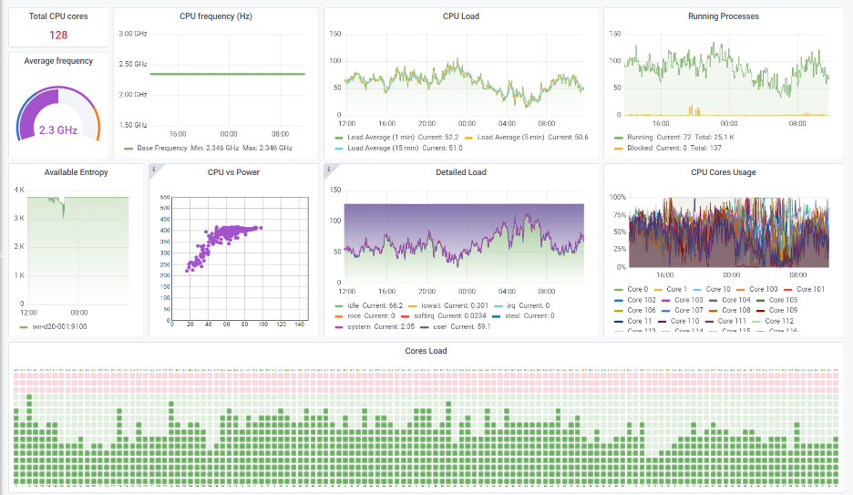
Visualization (local)
Local power readings and resource usage is extracted by node_exporter
(which can be customized with any metric).
Data is colourfully visualised in a custom Grafana dashboard,
and can be exported to CSV format via the Prometheus API and analysed in ROOT
WorkerNode View
Notes:
What do we do with all these data …

Slide 22
C Sieve
Eratostene’s prime number sieve in C compiled with OMP to find primes up to 100 M
Code from the web (*)
Compiled on each machine with gcc and the OMP library
It is executed while collecting metrics
$ ./get2IPMI.sh > ipminfo.csv
$ gcc -fopenmp mtprime.c
$ ./a.out
#include <omp.h>
...
#pragma omp parallel for schedule(dynamic) reduction(+ : primes)
for (num = 1; num <= limit; num++)
{
...
(*)
https://stackoverflow.com/questions/9244481/how-to-get-100-cpu-usage-from-a-c-program
Notes:
Are the GPUs influencing the prime number sieve?
Its power usage does not seem to increase during the execution!

Slide 23
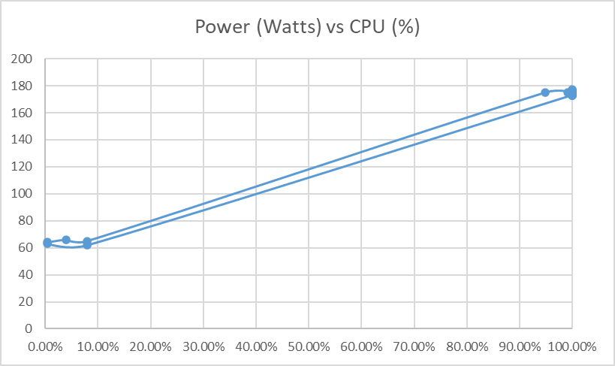
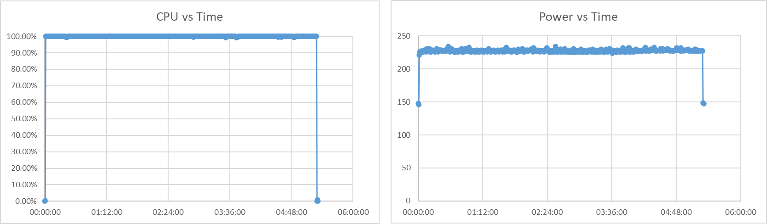
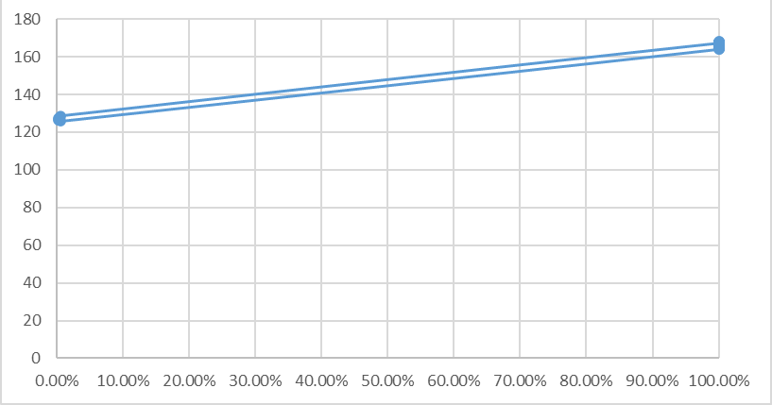
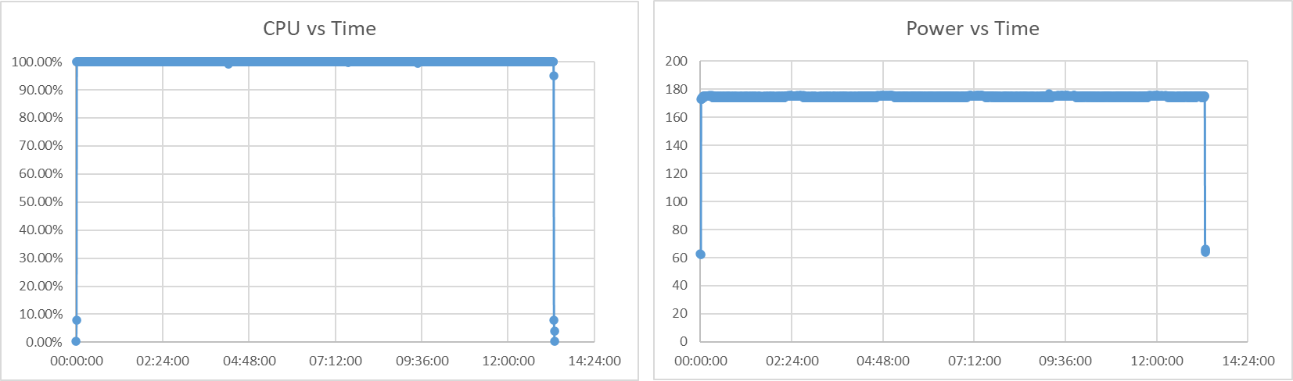
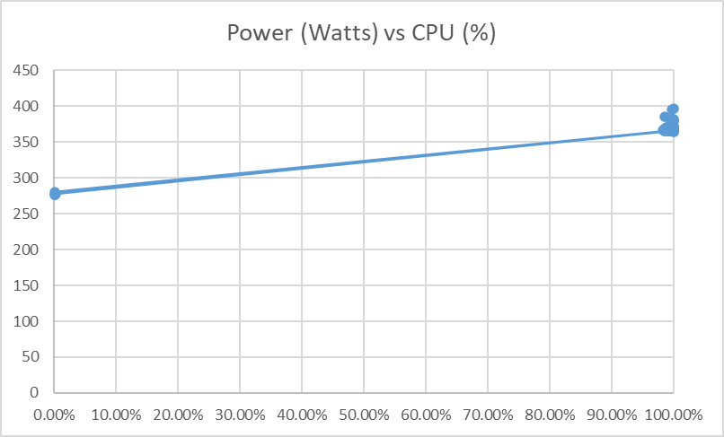
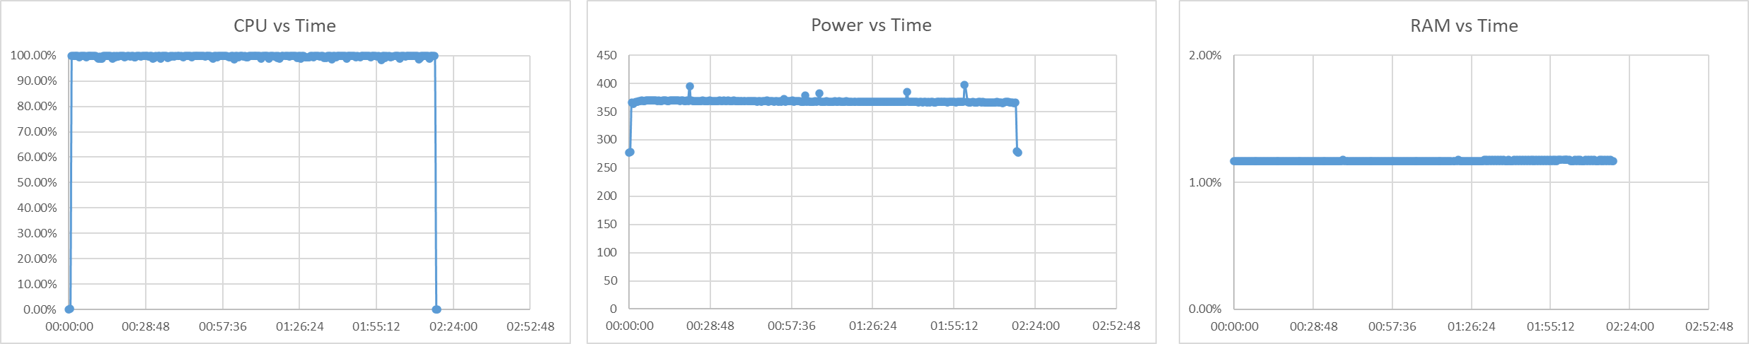
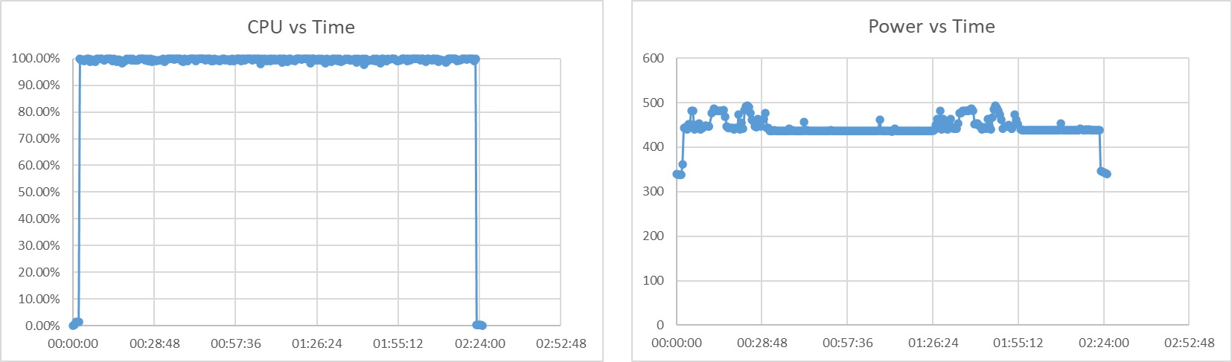
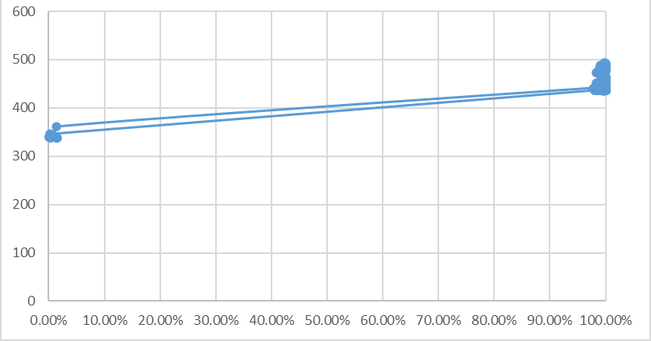
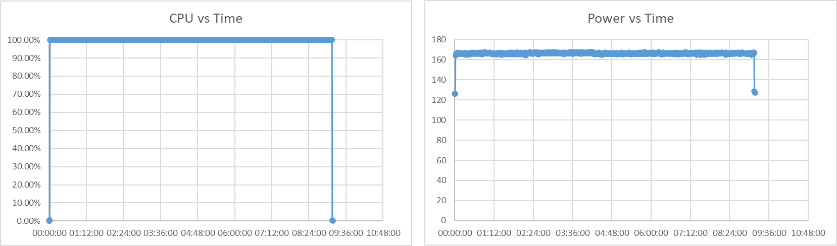
Job Profiles (C sieve)
DELL Epyc
HP Xeon
(*)
ARM+GPU
ARM
Notes:
Profiles (C sieve)
(*) = bad run

Slide 24
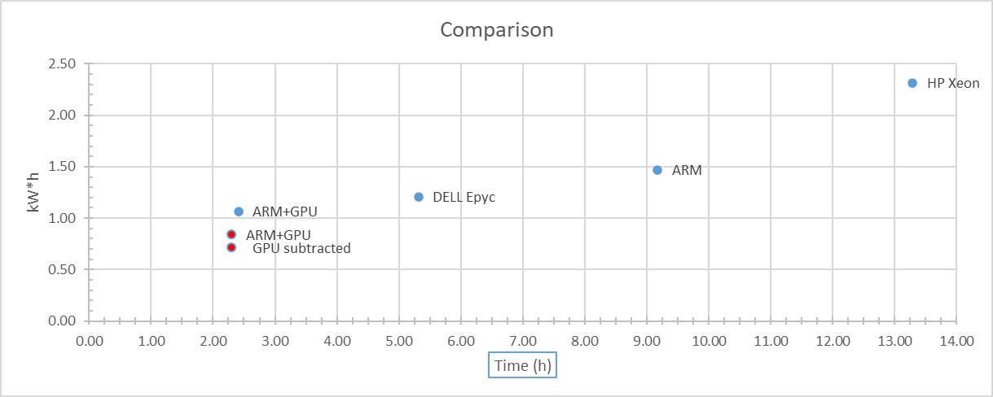
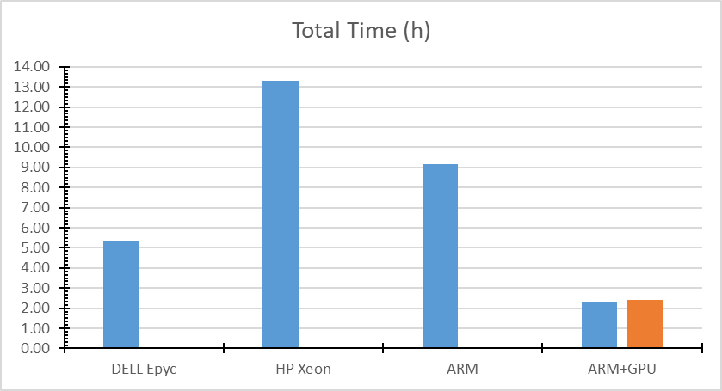
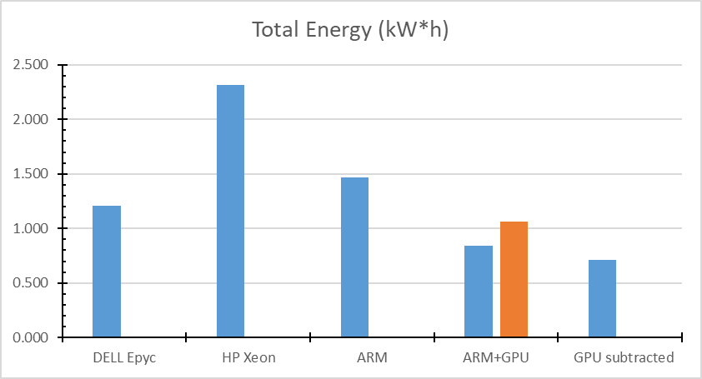
Results (C sieve)
Also with compiled code, it looks like the ARM+GPU machine is the best at finding primes …
Prime Numbers C
Machine | threads | Time (h) | Tot. Energy (kW*h) | Peak Power (W) | Idle (W) | GPU (W)
DELL Epyc | 128 | 5.32 | 1.209 | 234 | 146
HP Xeon | 40 | 13.29 | 2.316 | 177 | 62
ARM | 224 | 9.17 | 1.468 | 168 | 126
ARM+GPU | 80 | 2.30 | 0.838 | 397 | 277 | 68
GPU subtracted |  | 2.30 | 0.710 | 329 | 209 | 0
1st run (bad)
Notes:
Results (C sieve) + bad run

Slide 25
Large Matrix Multiplication
Large Matrix Multiplication in C with OMP using two 20k x 20k random matrices
Code is a modified version of a GitHub example (*)
Compiled with the OMP library and -mcmodel=large flag
Tried 2 types of matrices: integers and floating point (double)
$ ./get2IPMI.sh > ipminfo.csv
$ gcc -fopenmp -mcmodel=large matmul.c
$ ./a.out
#include <omp.h>
...
#define N 20000
...
#pragma omp parallel for private(i,j,k) shared(A,B,C)
for (i = 0; i < N; ++i)
{
for (j = 0; j < N; ++j)
{
for (k = 0; k < N; ++k)
{
C[i][j] += A[i][k] * B[k][j];
(*)
https://gist.github.com/metallurgix/0dfafc03215ce89fc595
Notes:
C with OMP code adapted from the original source: https://gist.github.com/metallurgix/0dfafc03215ce89fc595

Slide 26
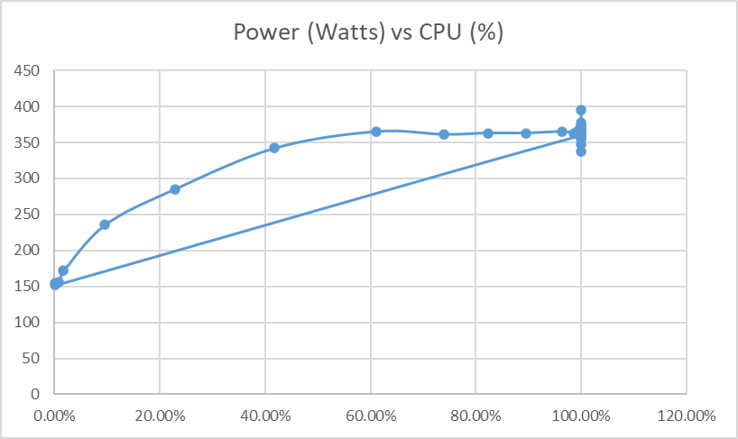
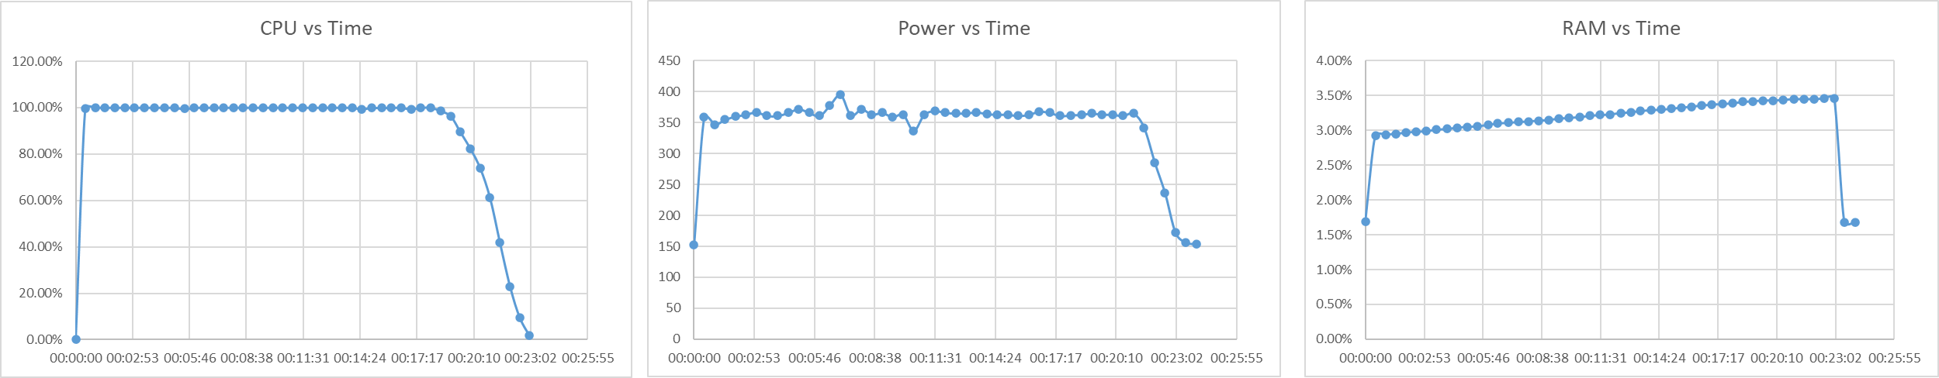
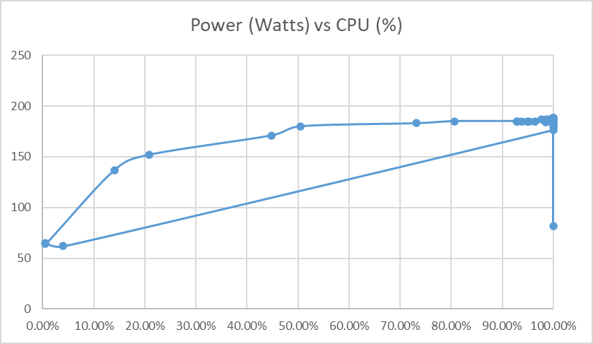
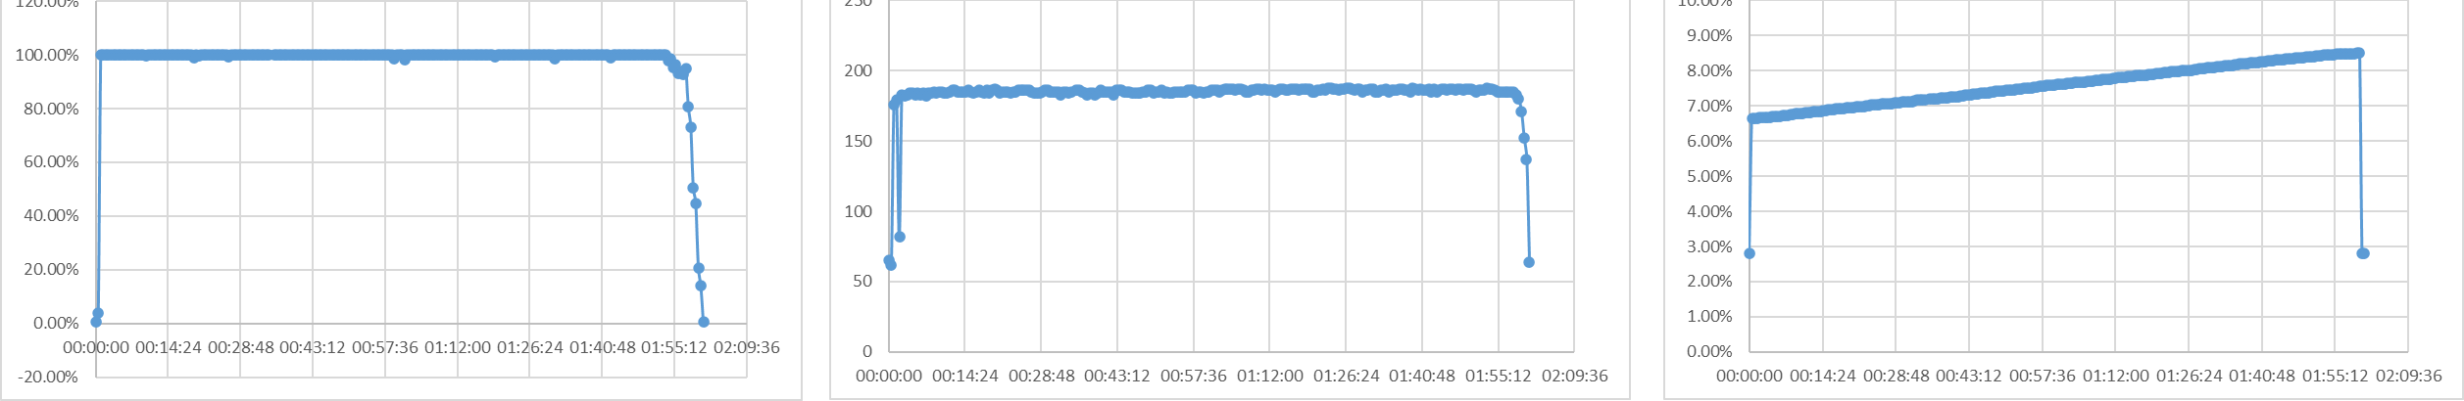
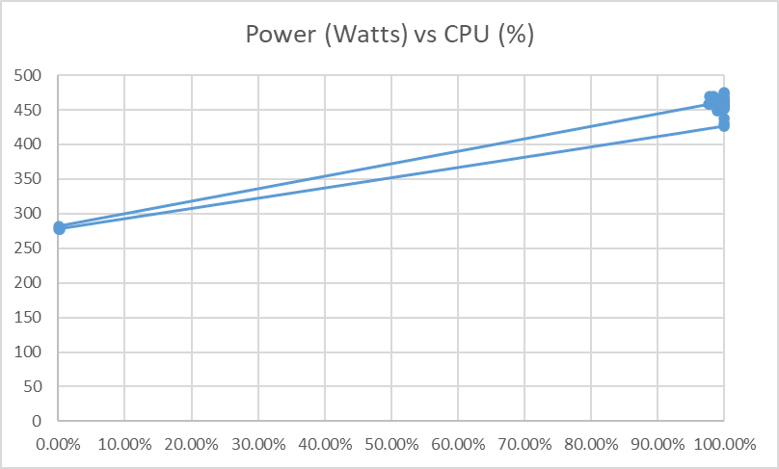
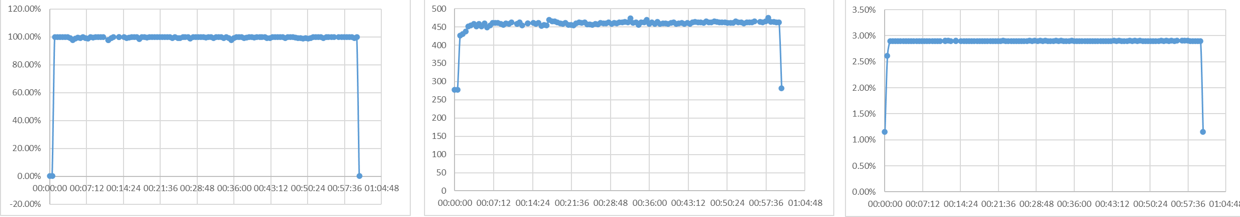
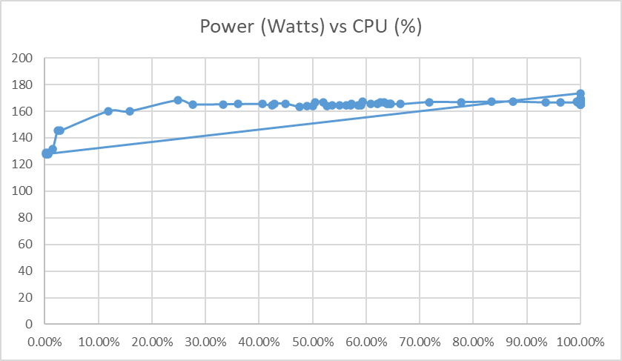
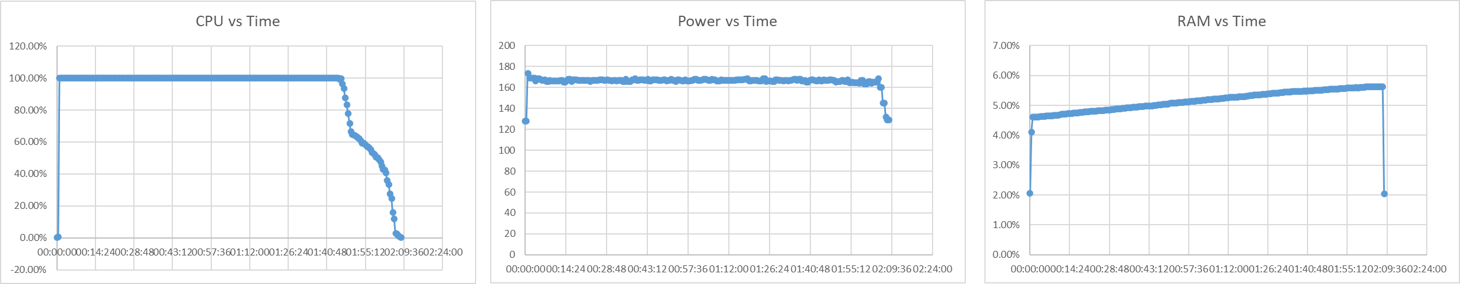
Job Profiles (mat. mult.)
DELL Epyc
HP Xeon
ARM+GPU
ARM
Notes:
Profiles (matrices of double)

Slide 27
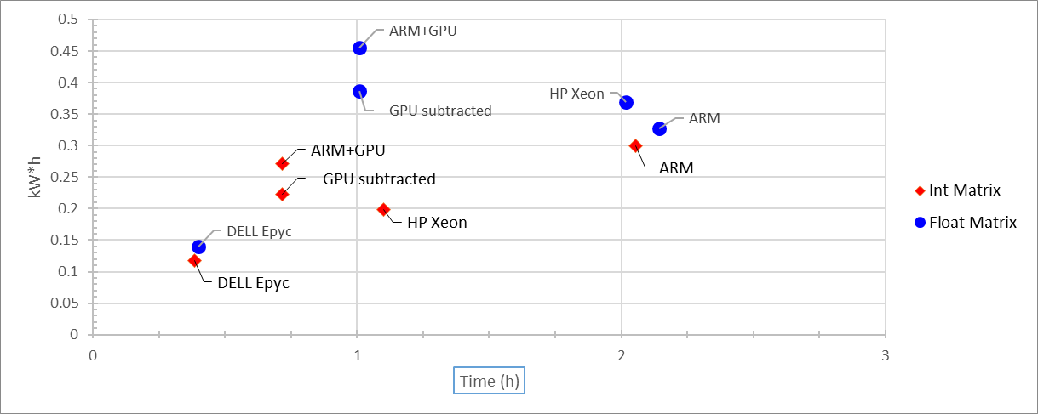
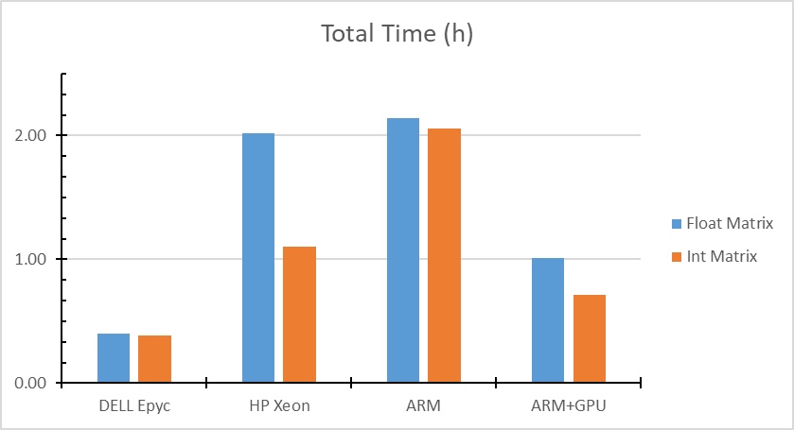
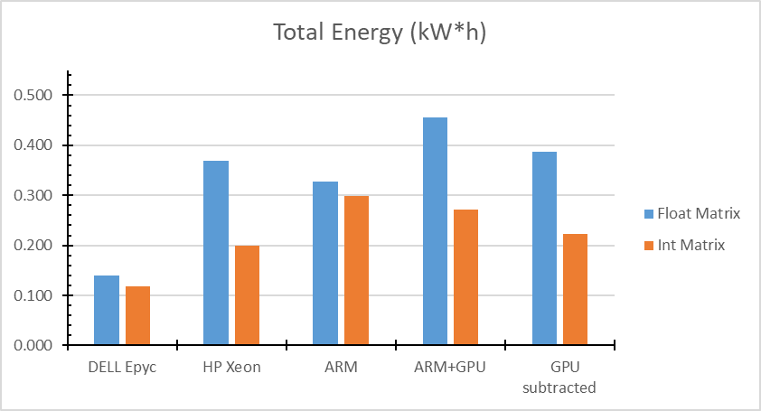
Results (mat. mult.)
When memory usage is involved, the DELL Epyc machine outperforms the ARM+GPU in speed and energy efficiency …
double Matrix
Machine | threads | Time (h) | Tot. Energy (kW*h) | Peak Power (W) | Idle (W) | GPU (W)
DELL Epyc | 128 | 0.40 | 0.140 | 395 | 152
HP Xeon | 40 | 2.02 | 0.369 | 188 | 65
ARM | 224 | 2.14 | 0.327 | 173 | 128
ARM+GPU | 80 | 1.01 | 0.455 | 475 | 278 | 68
GPU subtracted |  | 1.01 | 0.387 | 354 | 197 | 0
int Matrix
Machine | threads | Time (h) | Tot. Energy (kW*h) | Peak Power (W) | Idle (W) | GPU (W)
DELL Epyc | 128 | 0.38 | 0.118 | 368 | 149
HP Xeon | 40 | 1.10 | 0.199 | 184 | 62
ARM | 224 | 2.05 | 0.299 | 166 | 128
ARM+GPU | 80 | 0.72 | 0.272 | 393 | 272 | 68
GPU subtracted |  | 0.72 | 0.223 | 325 | 204 | 0
Notes:
Mat. Mult. results

Slide 28
Power Readings, etc.
TimeStamp: date +"%F , %T"
CPU: top -bn1 | grep "Cpu(s)" | sed "s/.*, *\([0-9.]*\)%* id.*/\1/" | awk '{print 100 - $1}'
RAM: free -t | awk 'FNR == 2 {printf("%.2f"), $3/$2*100}'
GPU: nvidia-smi --query-gpu=power.draw --format=csv,noheader,nounits | awk '{s+=$1} END {print s}’
Power (IPMI): ipmitool dcmi power reading | grep "Instantaneous power reading:"
Power (tx2mon): tx2mon -T -d 10 -f $READFILE ; tail -2 ${READFILE} | head -1 | cut -d',' -f71
Notes:
…

