Slide 1




RAL experience with HEPScore
Alastair Dewhurst
Notes:
The abstract pattern can be removed or repositioned if required. Be careful to ‘Send to Back’ so that it does not obscure any important information.

Slide 2
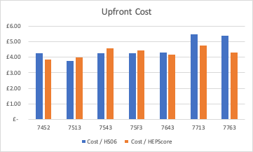
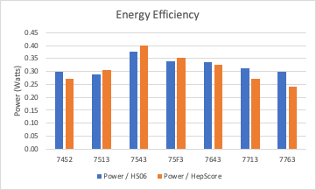
Last year’s procurement
In 2021 the RAL Tier-1 used HEPScore to decide on what hardware to procure:
  HEPiX Benchmarking WG meeting on 23rd Septembe 2021.
  HEP-SCORE deployment TF meeting on 6th October 2021.
Significant improvement for top end CPUs

Slide 3
Current Status
We ordered the hardware required to meet April 2022 pledges in August 2021.
Most of it turned up in December 2021, unfortunately the network cards didn’t arrive until August 2022!
The hardware went into production at the end of August as part of our HTCondor 9 and Rocky 8 upgrade.
  We will be re-benchmarking a server from each generation of hardware.

Slide 4
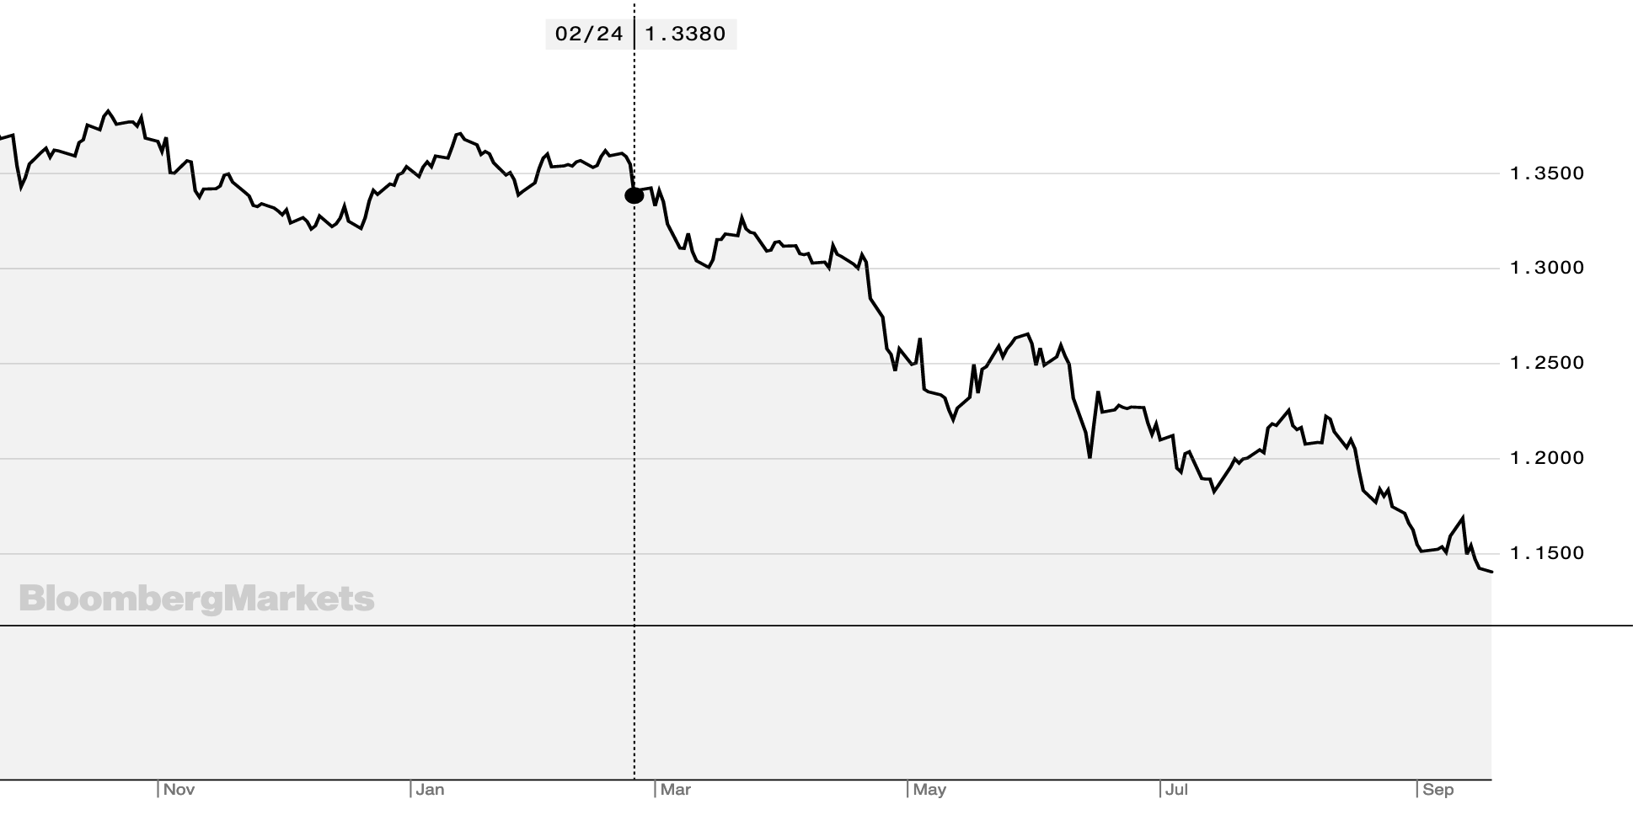
This year’s procurement
This year’s procurement was directly awarded again:
  Supply chain issues were still a big concern.
  Russia’s invasion of the Ukraine added further uncertainty.
No new high end CPUs were on the market so we purchased the same CPUs as last year.
We changed from a single 7.68TB SSD to a 480GB SSD for OS and 6.4TB NVMe for local scratch space.
This year’s hardware ordered in July.
  Using an exchange rate held since May.
We have delivery date of 10th October.
  Next years procurement hopefully in production by Christmas!

Slide 5
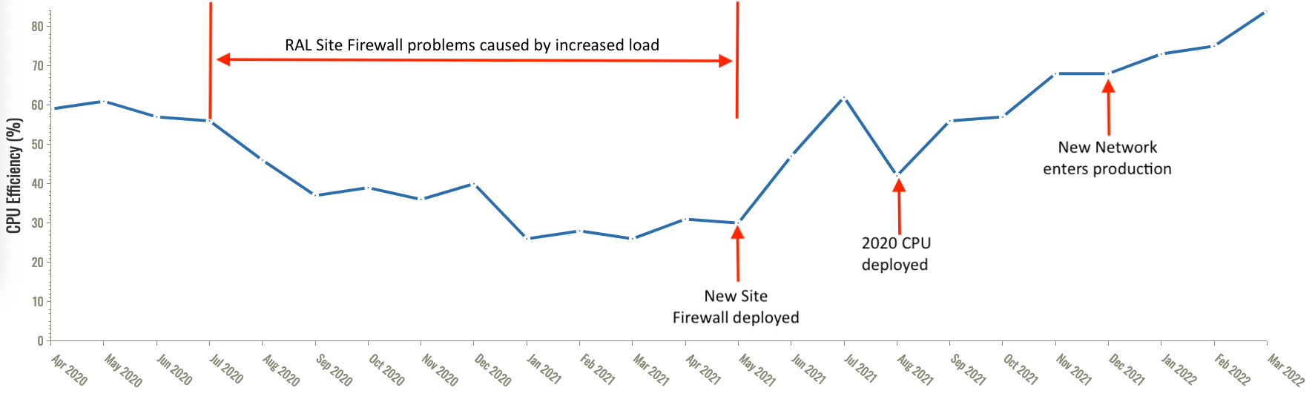
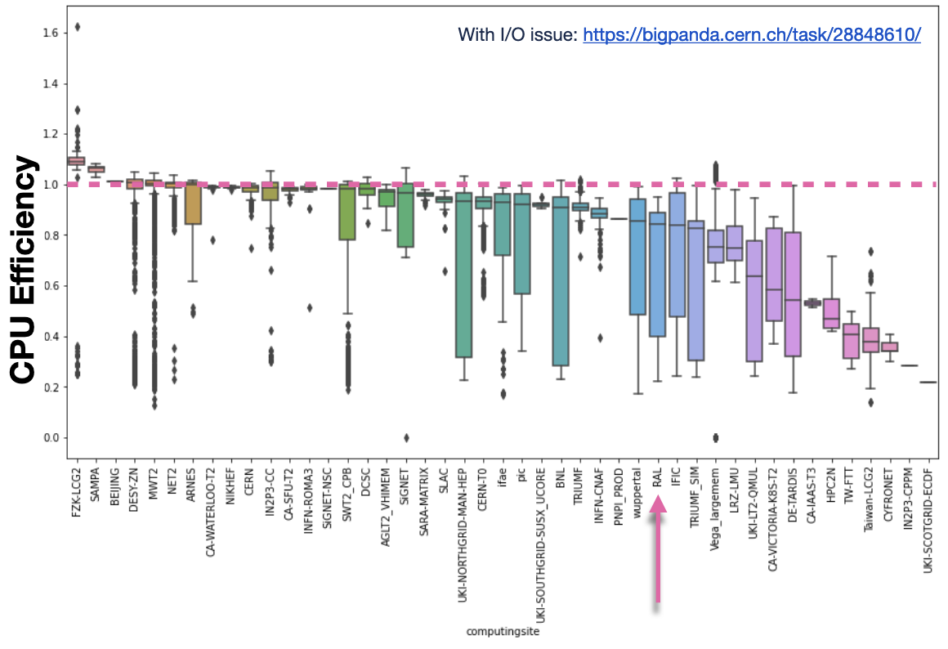
Real jobs
CMS Job Efficiency at RAL April 2020 to March 2022
RAL used to heavily optimize its procurement on HS06.
  Our Compute was under powered in other areas.
Real jobs are not on average as CPU intense or as heavily debugged as benchmarks.
E.g. Recent ATLAS Evgen task was continuously writing a 40byte file.
  ATLAS fixed the problem once reported.
  We still ran lower efficiency jobs for a while.
ATLAS Job Efficiency for a “problem” Evgen task

Slide 6
Next year’s procurement
Next year we hope to return to using a tender.
  Hope there will be significant competition between new Intel and AMD CPUs.
  HEPScore will help us select the best CPU, however there are many other requirements.
I think it is reasonably likely that we will be purchasing Liquid to Chip cooling.
  Better PUE, performance and density
  Will we be able to record the type of cooling in the database?

Slide 7
Conclusion / Suggestions
HEPScore has changed for the better what we decide to purchase.
  Compared to HS06 it’s easier to run, more flexible and more insightful.
  The 32bit requirement of HS06 was skewing results.
HEPScore will allow us to compare diverse types of hardware.
  E.g. x86 vs ARM vs GPU
HEPScore is still “just” a benchmark and doesn’t account for operational reality.
  E.g. RAL has purchased more memory per core than VOs specify for 5+ years.
We don’t want to over optimize for one fixed benchmark. Suggestion:
  Release a new HEPScore annually (in April) that sites can use to guide procurement if they so choose.
  Pick a Golden HEPScore for official use per X years / LHC Run.

Slide 8



Notes:
The abstract pattern can be removed or repositioned if required. Be careful to ‘Send to Back’ so that it does not obscure any important information.

