Slide 1
LHC scrubbing planning
L. Mether

Slide 2
Schedule
At the moment, the scrubbing looks set to start on Wednesday 15 June in the morning
Duration of first block and schedule for the rest of scrubbing not yet fully clear at this point
Injection of single trains will be set up on Tuesday morning
June
July
 | W 23 | W 24 | W 25 | W 26 | W 27
Mon | 6 | 13 | 20 | 27 | 4
Tue | 7 | 14 | 21 | 28 | 5
Wed | 8 | 15 | 22 | 29 | 6
Thu | 9 | 16 | 23 | 30 | 7
Fri | 10 | 17 | 24 | 1 | 8
Sat | 11 | 18 | 25 | 2 | 9
Sun | 12 | 19 | 26 | 3 | 10
Whit
Injection setup
LHC Scrubbing I
LHC II
LHC III
FMD1
FMD3
LHC IV
FMD2

Slide 3
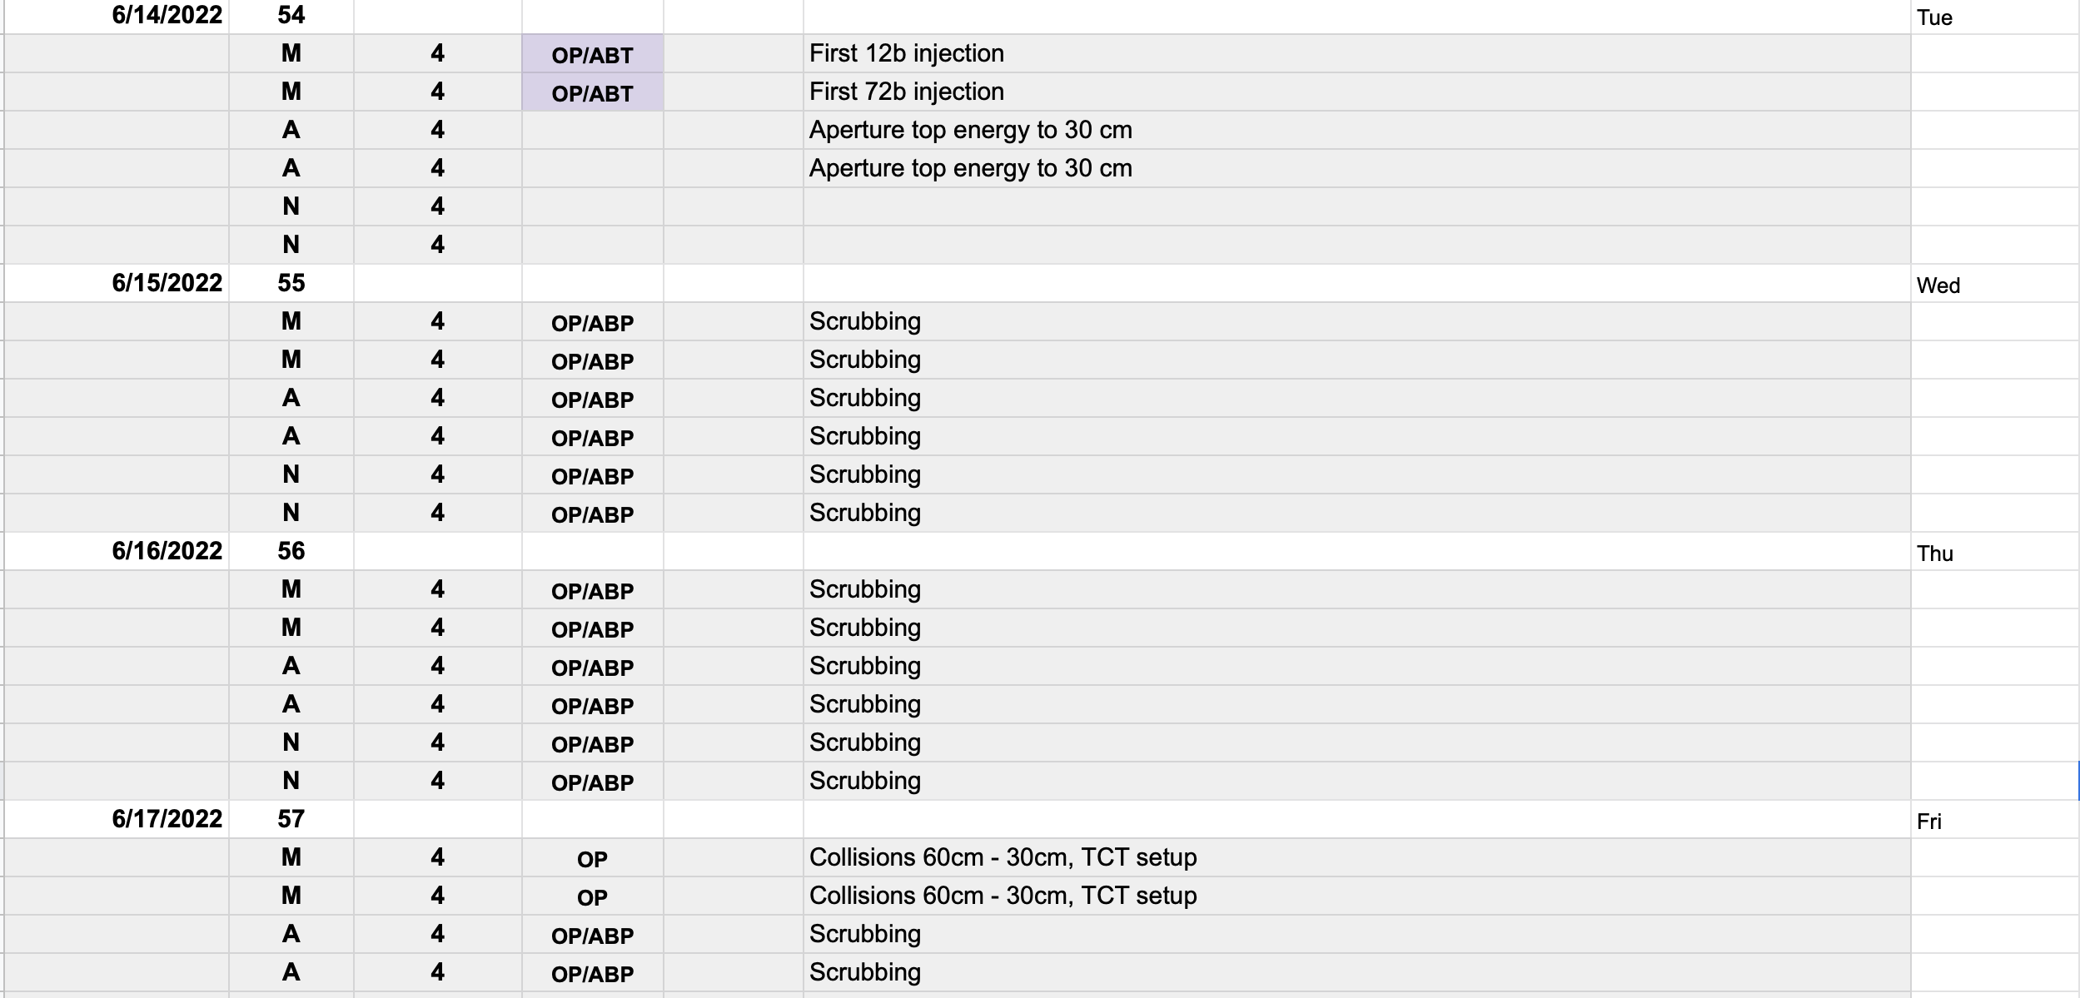
Schedule
At the moment, the scrubbing looks set to start on Wednesday 15 June in the morning
Duration of first block and schedule for the rest of scrubbing not yet fully clear at this point
Injection of single trains will be set up on Tuesday morning, starting with 12 bunches and then moving on to 72-bunch trains
A break in scrubbing is scheduled for Friday morning

Slide 4
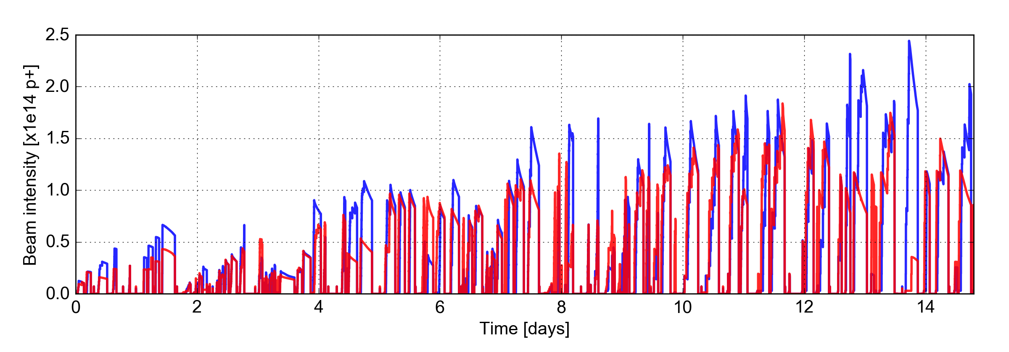

Strategy
Scrub using 25 ns beams with the standard production scheme
Over the duration of the scrubbing, the total number of bunches and the number of bunches per injection will be ramped up, as allowed by the evolving limitations
Beam characteristics: 1.2 $\text{×}$ 10¹¹ p/bunch, transverse emittances $\text{≤}$ 2.5 µm
Start scrubbing with single-train injections (roughly first half of the scrubbing, Wk. 24)
Start with short trains (24 b.) and gradually increase up to 72-bunch trains
Machine protection checklist required at ~500 bunches
Move to multi-train injection (roughly half-way through the scrubbing, Wk. 25)
Gradually increase number of bunches per injection: 144 → 216 → 288 bunches
Setup of multi-train injections needed before this step
[50 ns]
24
36
48
60
72
144b
Train length
Scrubbing progress in 2015
Major faults, tests and commissioning activities removed from the timeline

Slide 5
Equipment readiness
Experts for various devices have been contacted to ensure readiness for the scrubbing run
MKI vacuum interlock thresholds have been increased in advance of the scrubbing
A procedure for increasing interlocks further has been prepared
A list of experts to contact during the scrubbing has been provided
Vacuum experts will be monitoring the levels around the ring during the scrubbing run
A list of experts to contact in case of issues has been provided
The ADT should be ready to be used in high-bandwidth mode with short damping times (setup took place on Saturday morning)
The ADT team is ready assist if needed during the scrubbing run

Slide 6
Equipment readiness
MKI team

Slide 7
Equipment readiness
Experts for various devices have been contacted to ensure readiness for the scrubbing run
MKI vacuum interlock thresholds have been increased in advance of the scrubbing
A procedure for increasing interlocks further has been prepared
A list of experts to contact during the scrubbing has been provided
Vacuum experts will be monitoring the levels around the ring during the scrubbing run
A list of experts to contact in case of issues has been provided
The ADT should be ready to be used in high-bandwidth mode with short damping times (setup took place on Saturday morning)
The ADT team is ready assist if needed during the scrubbing run

Slide 8
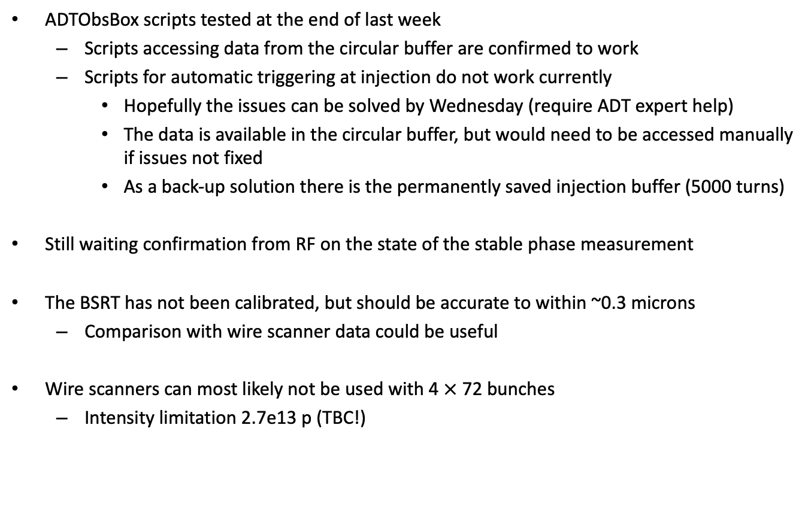
Diagnostic equipment readiness
ADTObsBox scripts tested at the end of last week
Scripts accessing data from the circular buffer are confirmed to work
Scripts for automatic triggering at injection do not work currently
Hopefully the issues can be solved by Wednesday (require ADT expert help)
The data is available in the circular buffer, but would need to be accessed manually if issues not fixed
As a back-up solution there is the permanently saved injection buffer (5000 turns)
Still waiting confirmation from RF on the state of the stable phase measurement
The BSRT has not been calibrated, but should be accurate to within ~0.3 microns
Comparison with wire scanner data could be useful
Wire scanners can most likely not be used with 4 $\text{×}$ 72 bunches
Intensity limitation 2.7e13 p (TBC!)

Slide 9
Status of e-cloud follow-up tools
An overview of the different tool repositories and their purpose can be found on github: https://github.com/PyCOMPLETE/LHCMeasurementTools/wiki
The new instrumented cells have been added to the heat load variable lists
Both standard and Coriolis calculated values are downloaded and can be plotted
Thanks to Benjamin for the variable names
Update of heat load recalculation tools in progress with new calibration data and updated calculation provided by Benjamin
Further updates to be done:
Update scripts for cell-by-cell analysis
Add BSRT calibration and published emittances to downloads from NXCALS
Modify BSRT plotting script to plot published or recalculated emittances
Heat load dictionaries for long term follow-up still need updating
Rewrite using pandas dataframes?

Slide 10
Scrubbing resources
Scrubbing shift schedule
A first draft for the scrubbing shift schedule is now available in the cernbox folder: https://cernbox.cern.ch/index.php/s/BoBlj4rrf2blCCl
Please have a look and let me know of any issues
CodiMD page with useful information for scrubbing shifters
The page is available here https://codimd.web.cern.ch/uinZvgrdR1yQDg4JSlKvPg
It has been updated with recent information
Please suggest further information that could be useful to add if you can think of something, or feel free to modify it yourself

