Slide 1
protoDUNE 2 – Daphne Integration in the SC
CERN 17/06/2022
Xavier Pons

Slide 2
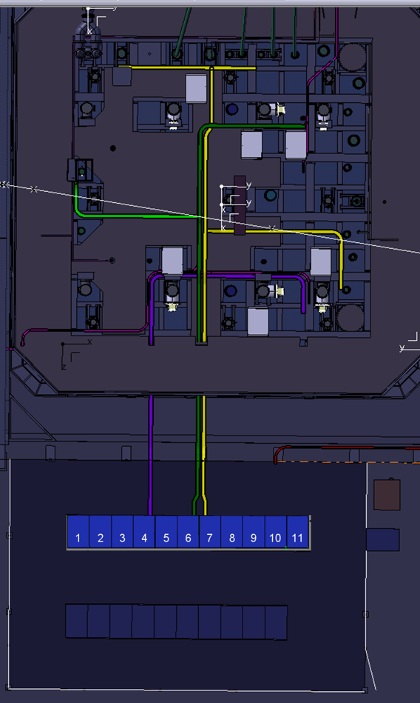
Installation of the Daphne boards in the cryostat
Old APA 5
The 4 units (or 5) Daphne 1U crate will be installed in the old SSP’s mini –12U rack on top of the cryostat
Constraint in the cable length of the warm cable from the flange to Daphne => maximum length 3 meters
The best option is to use the mini-racks close to the flange, so the ones used for old APA1 and APA5
According protoDUNE1 convention
APA 1 => PD US-Ras
APA 5 => PD US-Das
Old APA 1

Slide 3
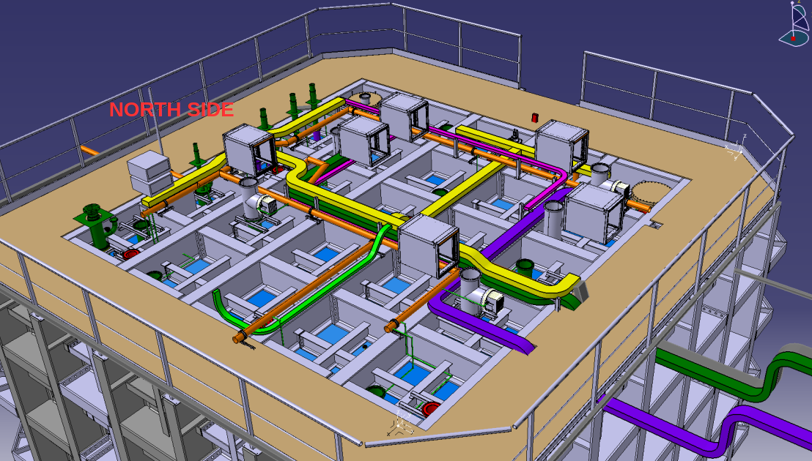
Installation of the Daphne boards in the cryostat
Old APA 5
Old APA 1

Slide 4
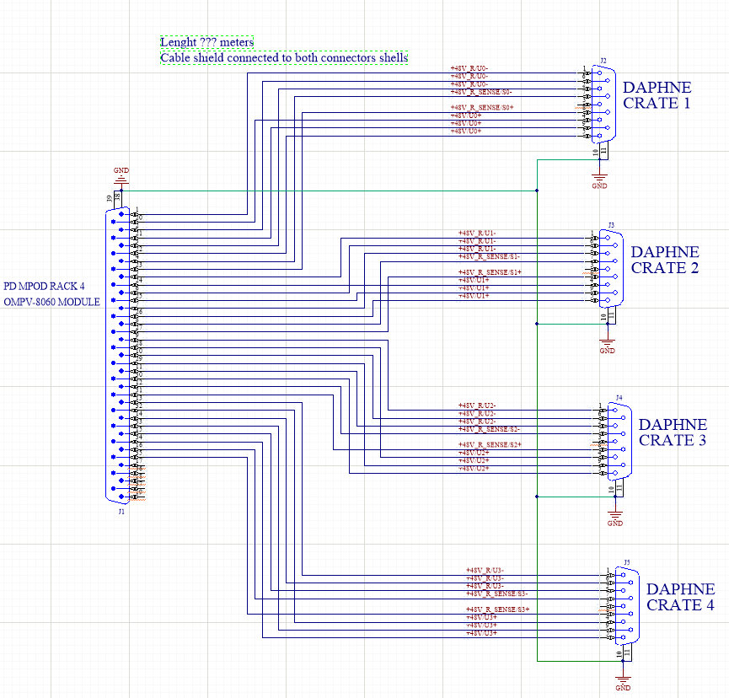
DAPHNE 48V power supply proposal
To use the old Photon Detector MPOD power supply
There is spare free connector Module OMPV 8060 (8x60V)
Slot 3 – Second Connector Capacity 4 channels
The idea is with one single cable from the
MPOD SUB-D 37 connector and then spited at the mini-crate to SUB-D 9 (X4) mapped for DAPHNE
Shield continuity to all connectors

Slide 5
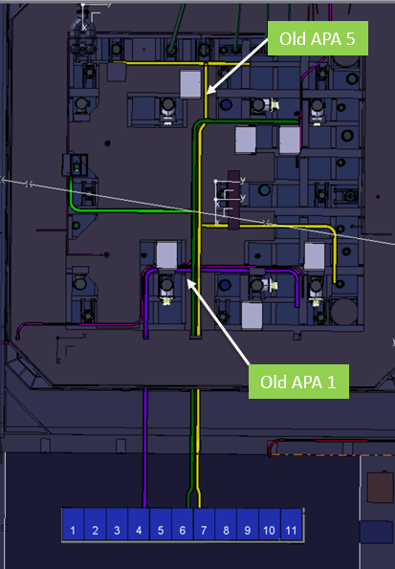
DAPHNE 48V power supply proposal
Cable length
RaS Side (Old APA1) => 10 meters
DaS Side (Old APA5) => 18 meters

Slide 6
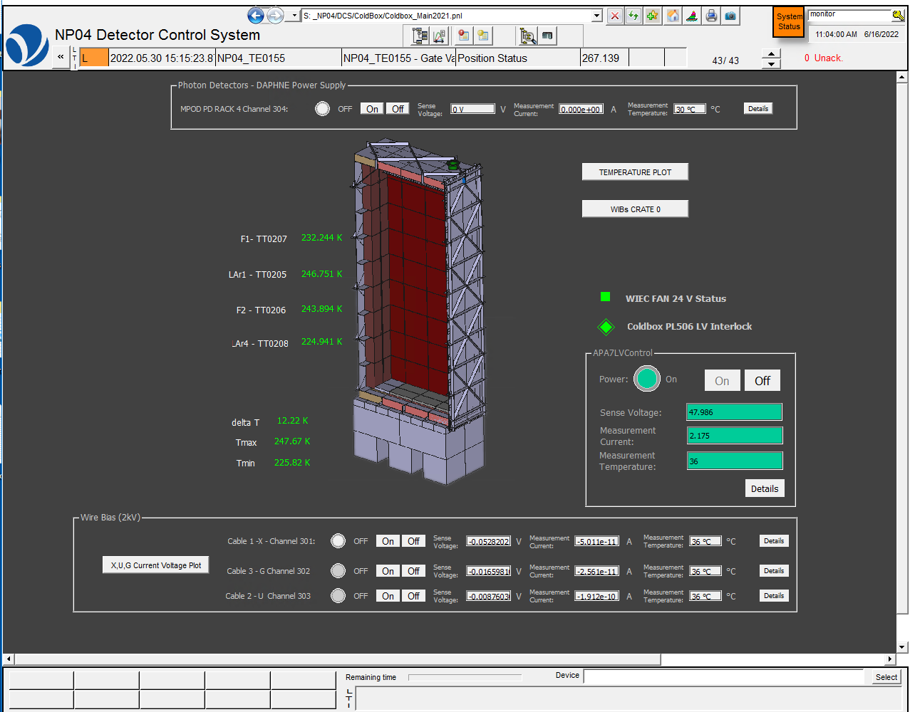
Daphne power supply and interlock in the WINCC OA SC
The power supply channels for DAPHNE will be controlled and monitored with WINCC OA Slow Controls like in the Cold-Box
Software Interlocks between DAPHNE, purity monitor and LED’s cameras can be implemented like in protoDUNE1
Hardware interlock can be implemented if the MPOD module allows it reference OMPV 8060I
Otherwise by cutting the power of the MPOD by DCS-DDSS PLC

Slide 7
Daphne Current interlock through OPC UA??

Slide 8
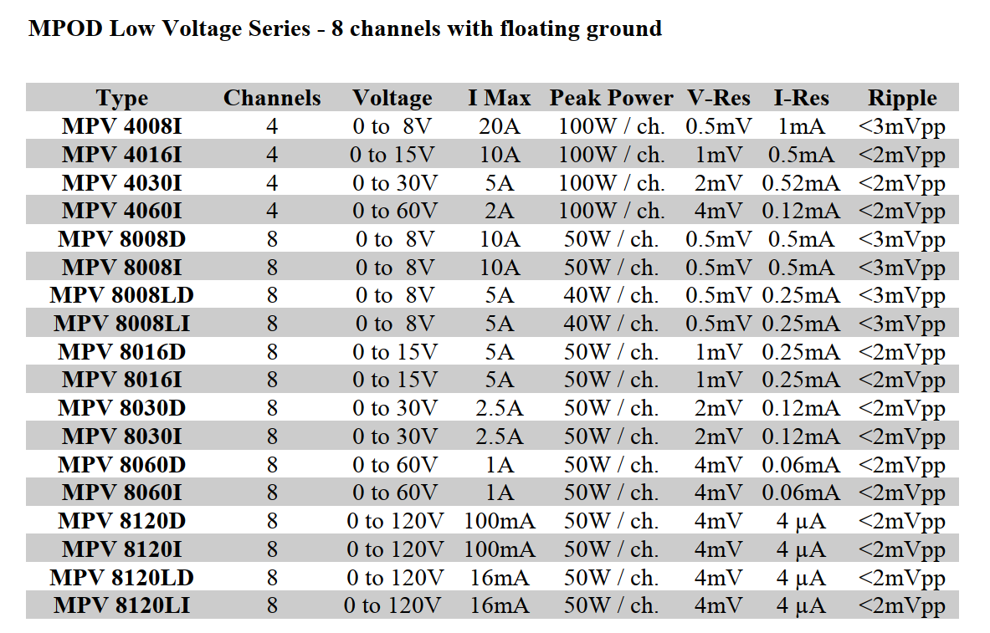
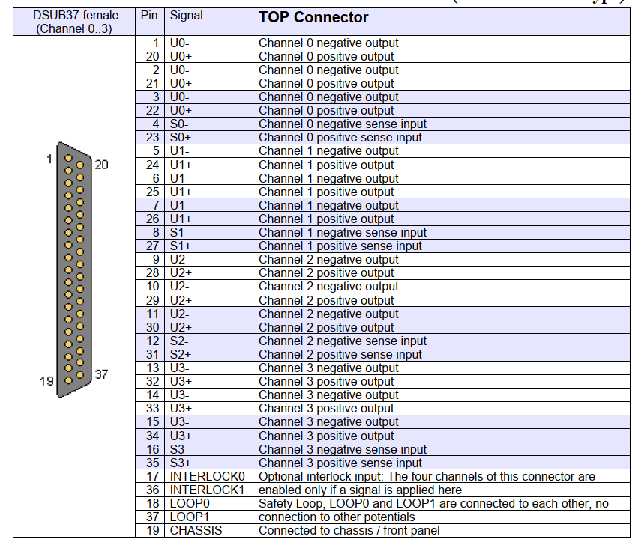
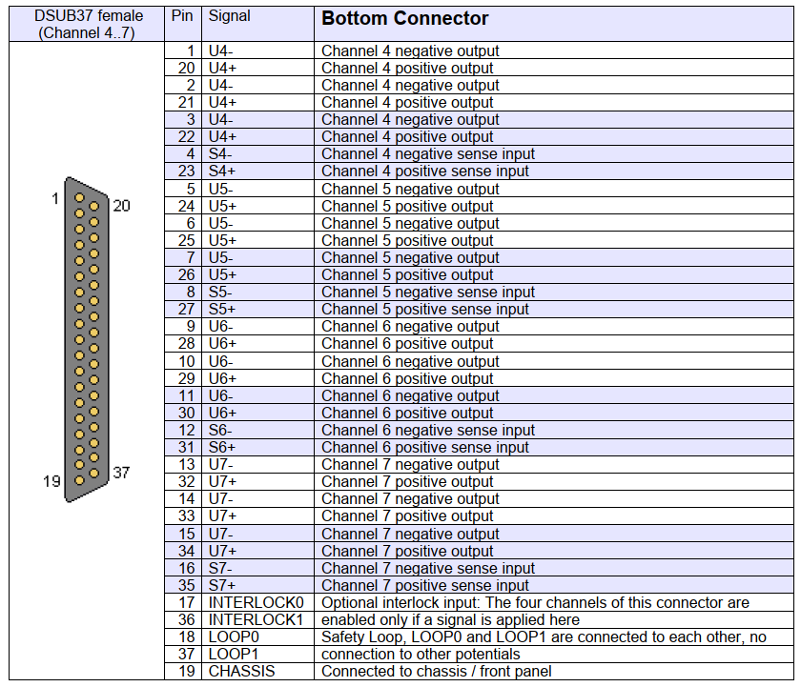
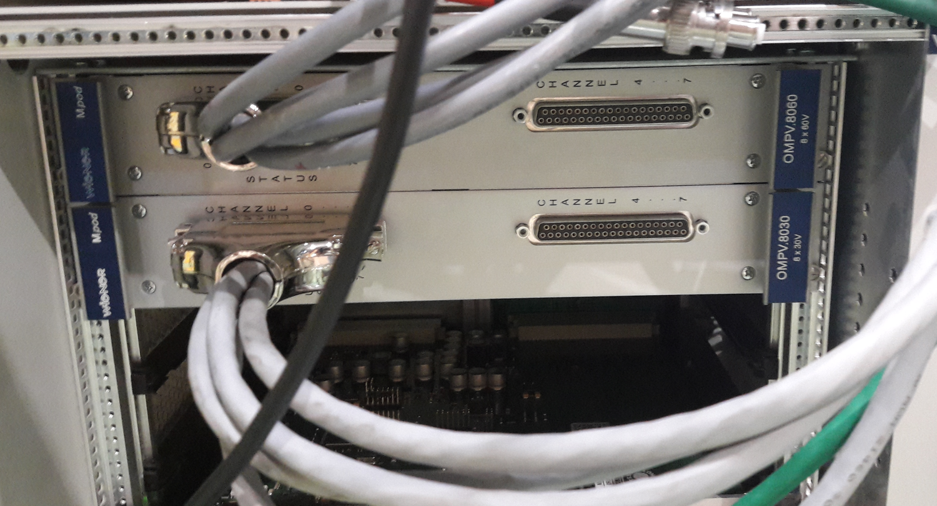
Wiener MPV8060 8X60v

Slide 9
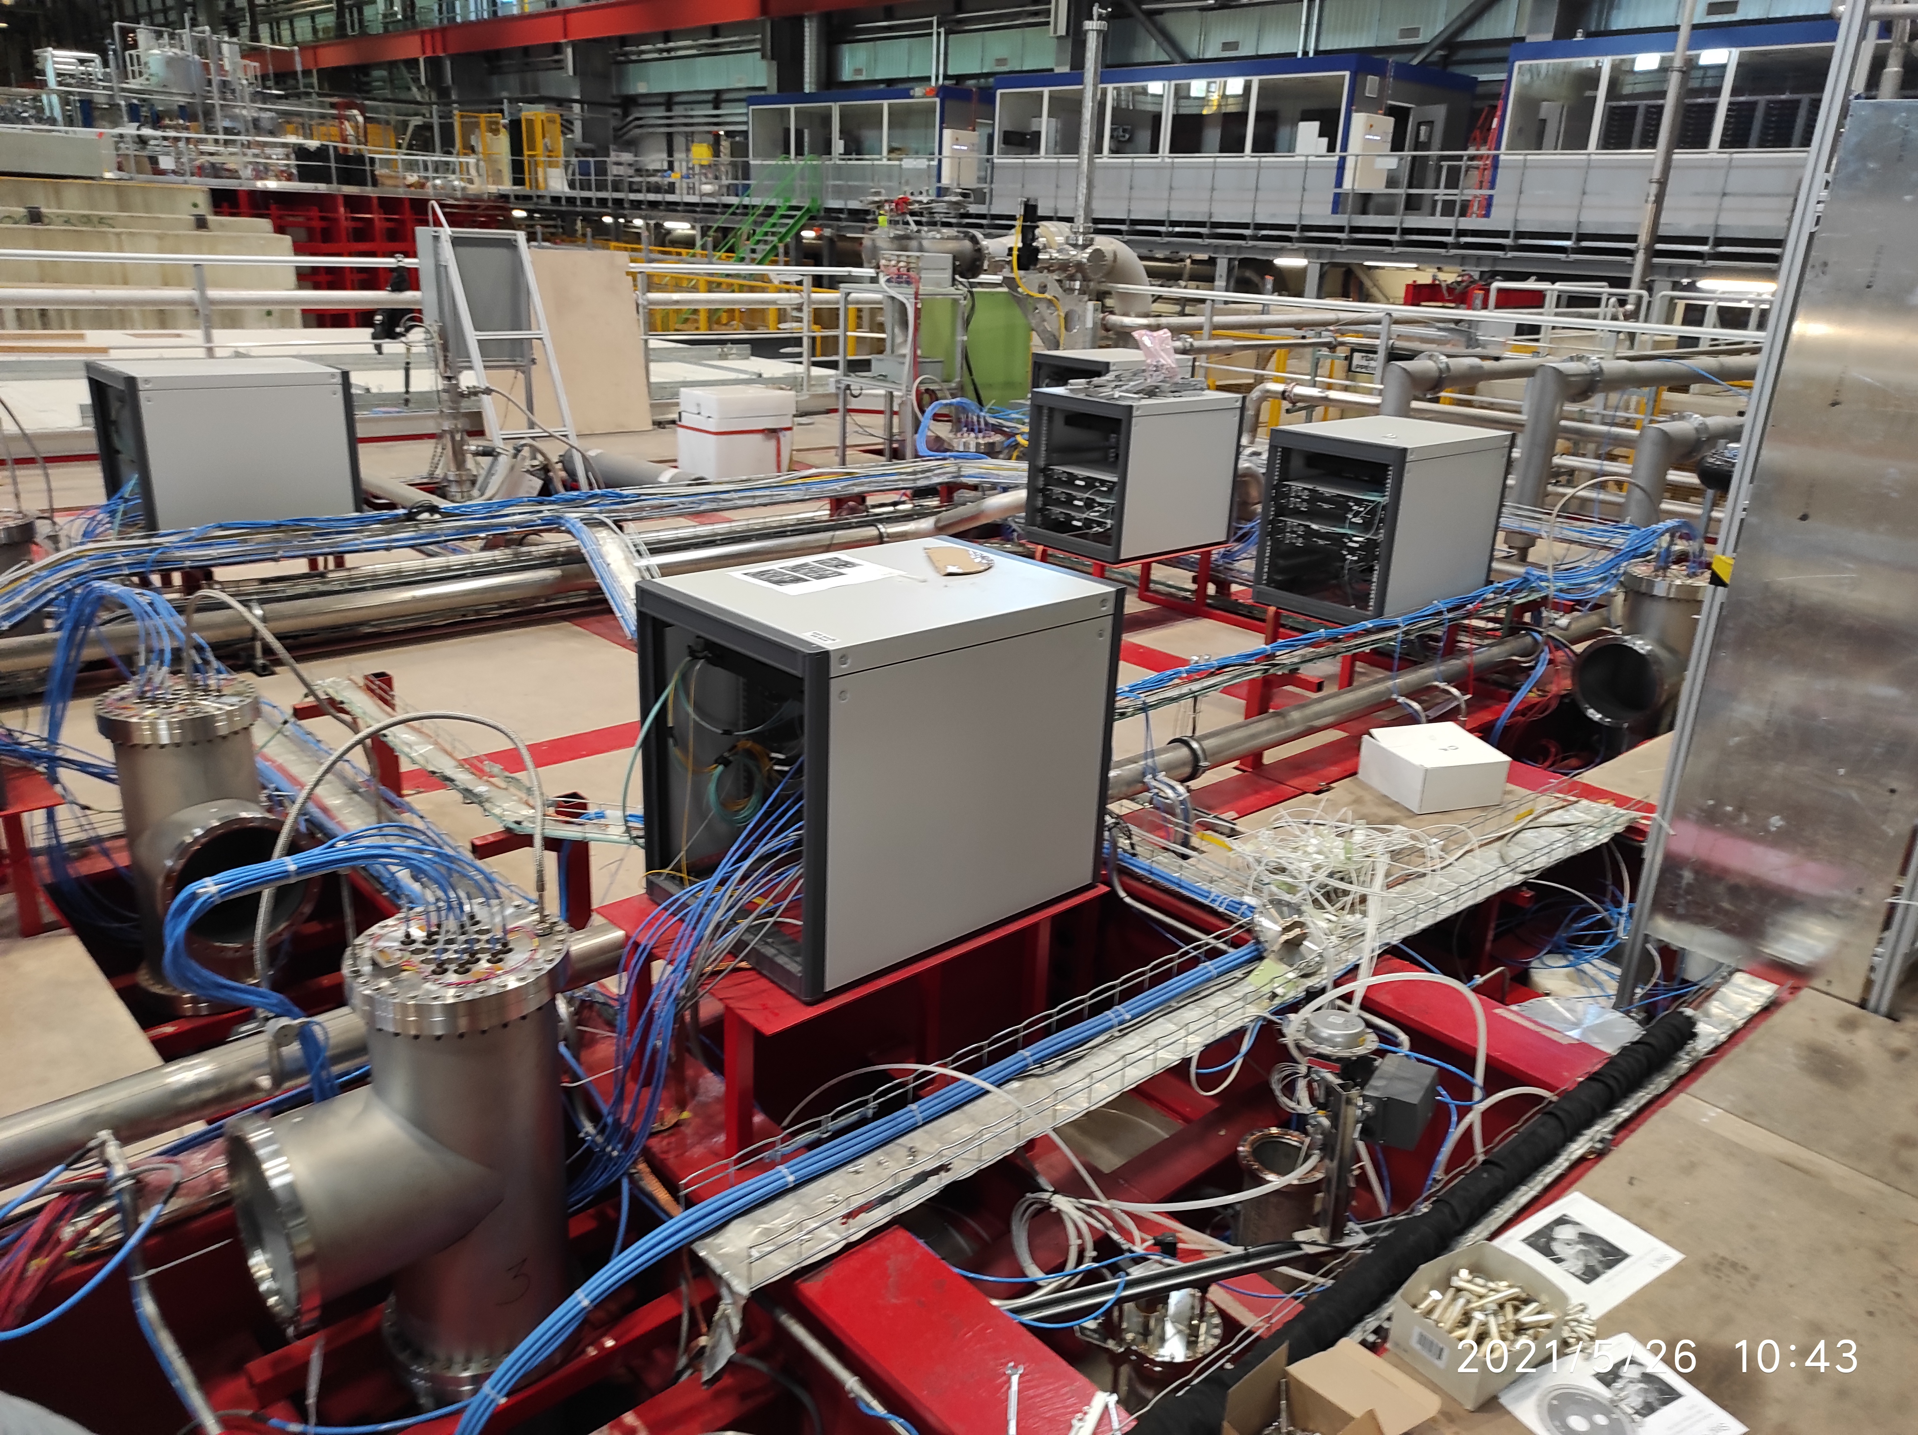
mini-rack 12 U

Slide 10
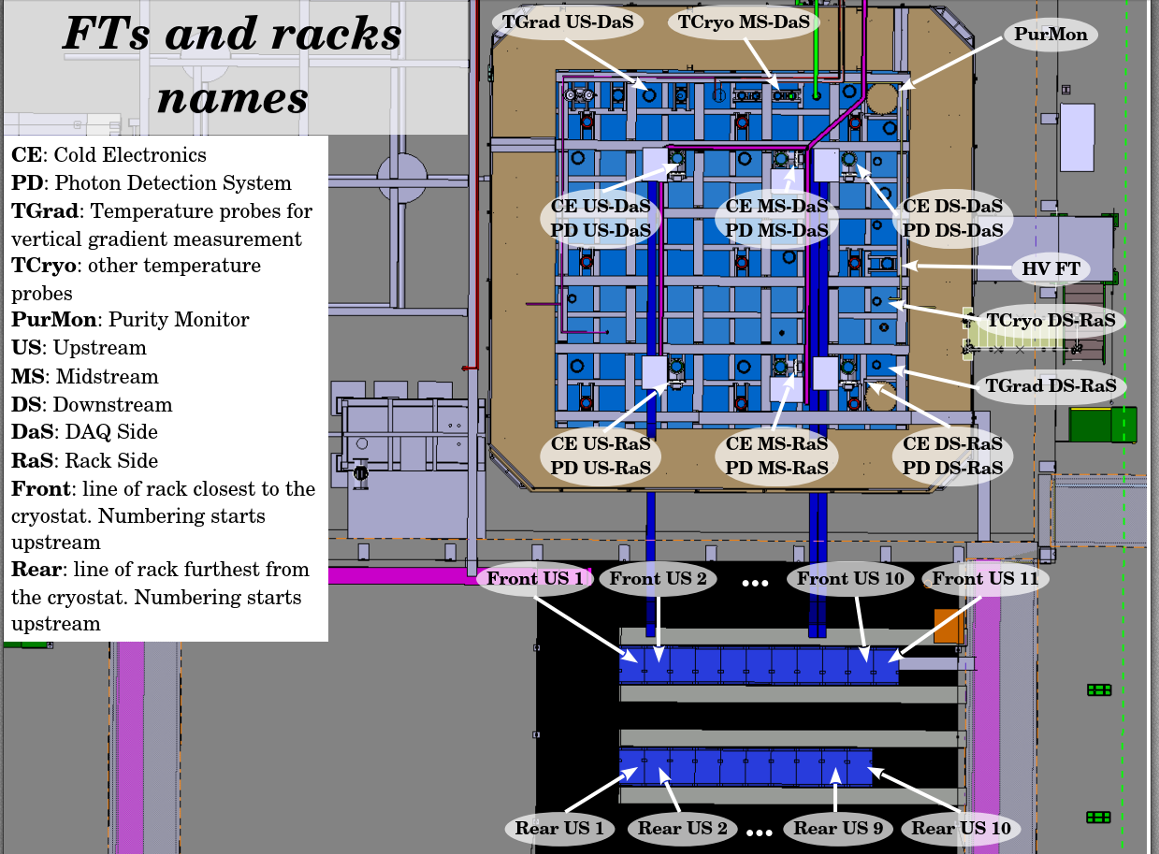
protoDUNE 1 – naming convention (R. Acciari)

