Slide 1


CryoSoft Users’ Meeting
15 June 2022
Code customization:
TACTICS, THEA transverse thermal coupling, THEA automation
B. Lacroix, Q. Le Coz (ASSYSTEM),
Q. Gorit, A. Louzguiti, S. Nicollet, F. Nunio (CEA/IRFU), A. Torre, L. Zani

Slide 2
Content
1 – TACTICS, co-simulation of THEA / Cast3M
2 – Introduction of transverse thermal coupling in THEA
3 – THEA-MADMACS, a tool for fast generation of tokamak CICC design
4 – THEA customization for automatic generation of important results (ΔT_{ma} …)

Slide 3
Content
1 – TACTICS, co-simulation of THEA / Cast3M
2 – Introduction of transverse thermal coupling in THEA
3 – THEA-MADMACS, a tool for fast generation of tokamak CICC design
4 – THEA customization for automatic generation of important results (ΔT_{ma} …)

Slide 4
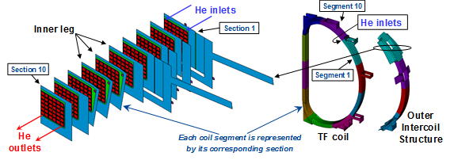
Existing codes and justification for developing TACTICS
  Superconducting magnet design (temperature margin criterion ΔT_{ma} and hotspot temperature T_{hotspot}) → 3D problem thermohydraulic / thermic
  Approach used in all existing codes = TH conductor in 1D + transverse thermal resolution in the structures in 2D → quasi 3D model
  Existing codes: SuperMagnet (THEA/Heater) - CryoSoft (L. Bottura, CERN)
  Venecia - EFREMOV institute & Alphysica (Russia)
  4C - Politecnico di Torino (Italy)
Motivations for developing TACTICS (THEA 1D + Cast3M 2D):
  Keep using THEA for 1D modeling of the conductor (code used at IRFM, open source);
  Benefit from Cast3M advantages:
    Ergonomic: mesh generation, user’s interface;
    Evolved user’s language (GIBIANE): model description, setting the coupling;
    Developer’s team available for debugging.
  Cast3M can also compute mechanics.
TF coil
JT-60SA

Slide 5
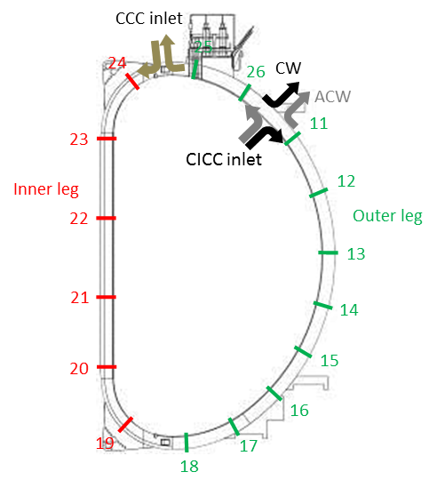
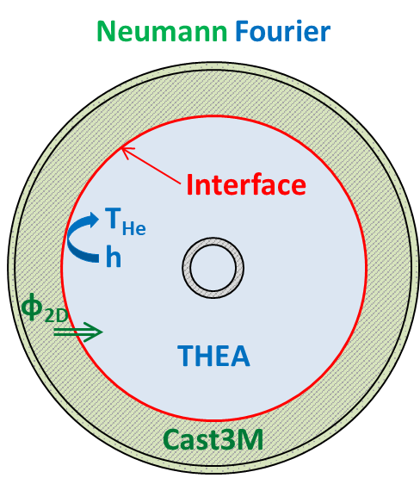
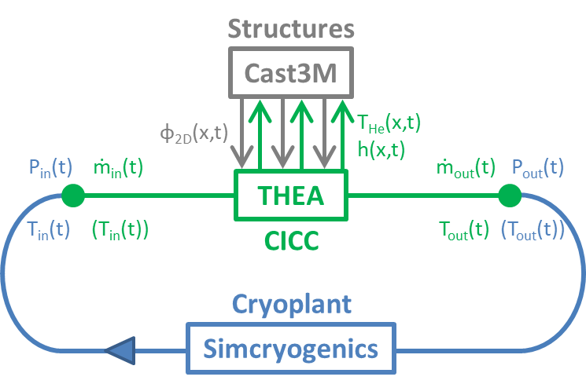
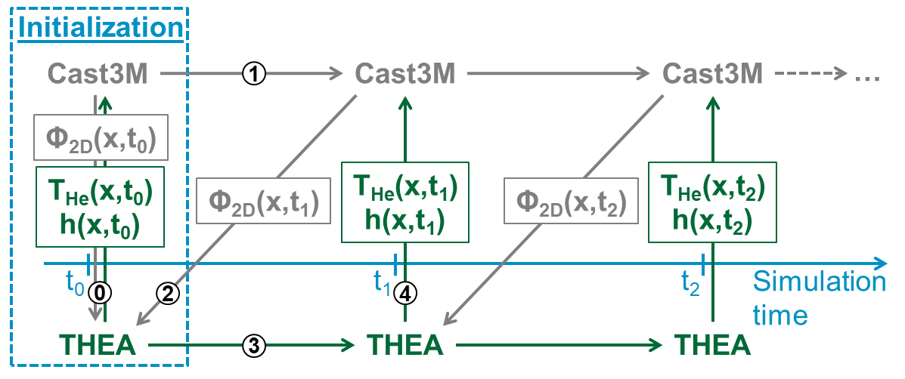
TACTICS - Presentation
TACTICS: THEA-Cast3M-SimCryogenics
Code coupling for transient pseudo-3D co-simulation:
THEA for 1D thermohydraulics in cables.
Cast3M for 2D finite element transverse thermal diffusion.
Simcryogenics for the cryodistribution
Purpose:
Better assessment of flux exchange between winding pack and casing
Modeling of the inter-turn / inter-pancake thermal coupling
The interface between THEA and Cast3M is the inner surface of the conductor jacket.

Slide 6
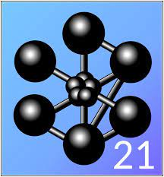
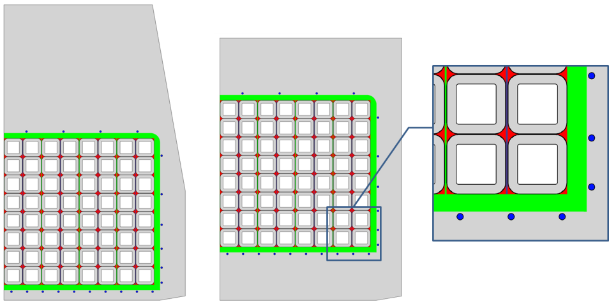
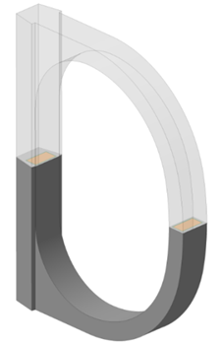
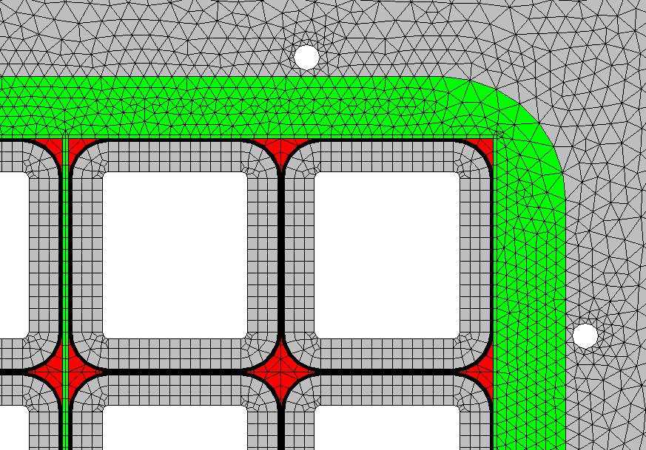
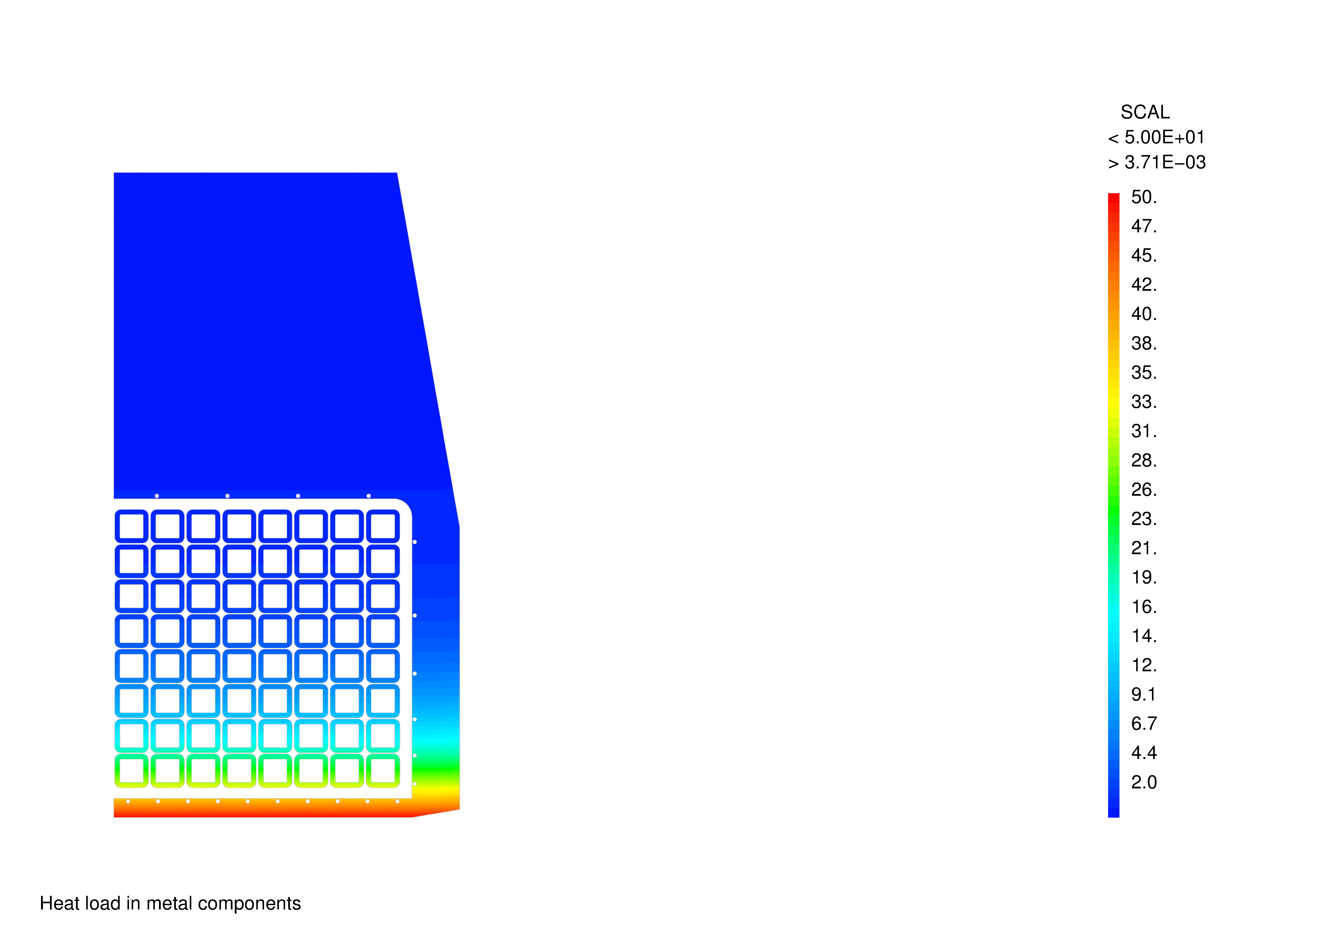
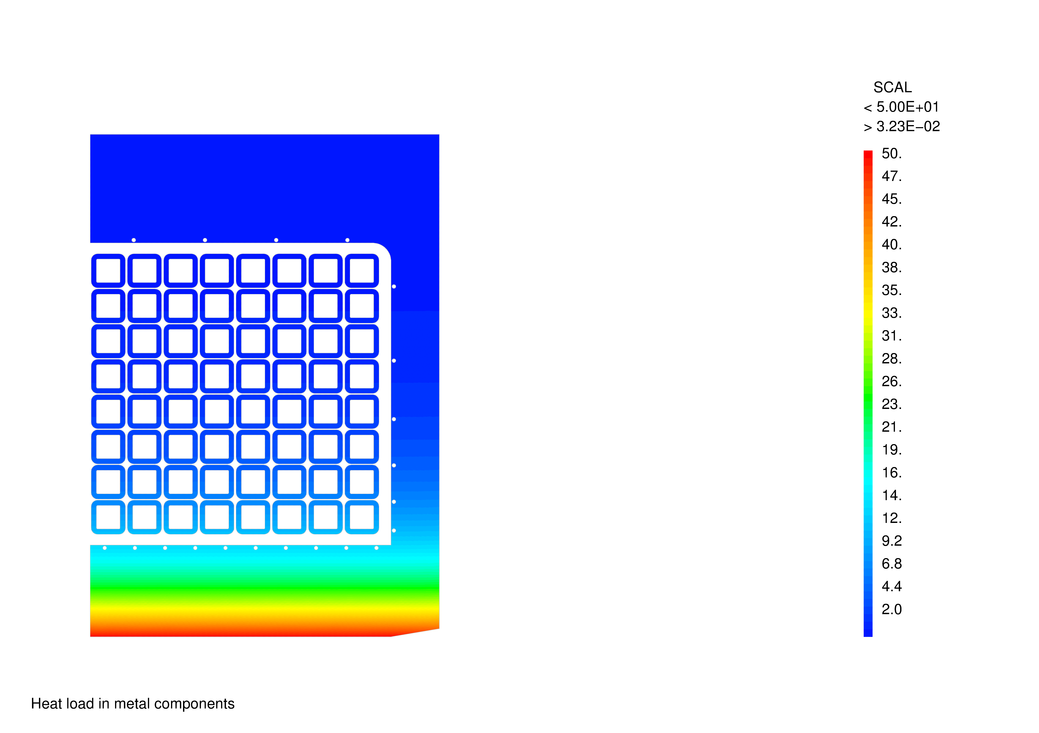
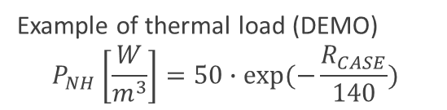
Presentation of Cast3M
Cast3M (CEA code)
Transient finite elements code used to solve the 2D temperature in the structures of the coil
Geometry, meshes.
Models.
Thermal loads.
Initialization & boundary conditions (co-simulation with THEA).
Casing cooling channels (CCC)
Inner leg
TF coil
Outer leg
Models:
Isotropic thermal conductivity
Orthotropic thermal conductivity (insulation parts)
Convection models (boundary condition with THEA)
Mechanical models
Example of thermal load (DEMO)
$$P_{NH}\left[\frac{W}{m^{3}}\right]=50∙exp(−\frac{R_{CASE}}{140})$$

Slide 7
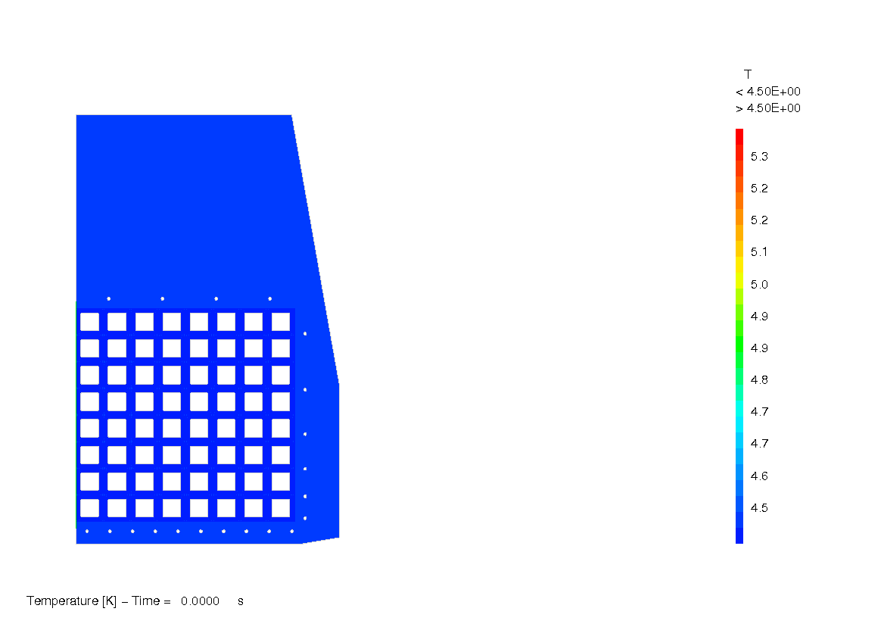
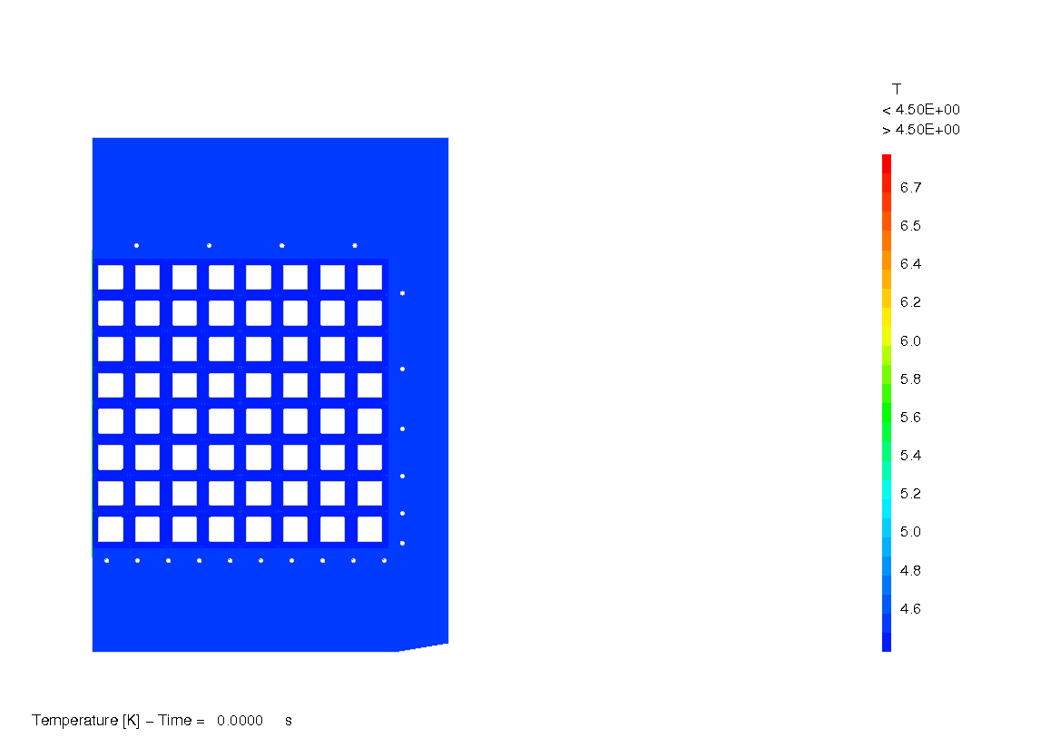
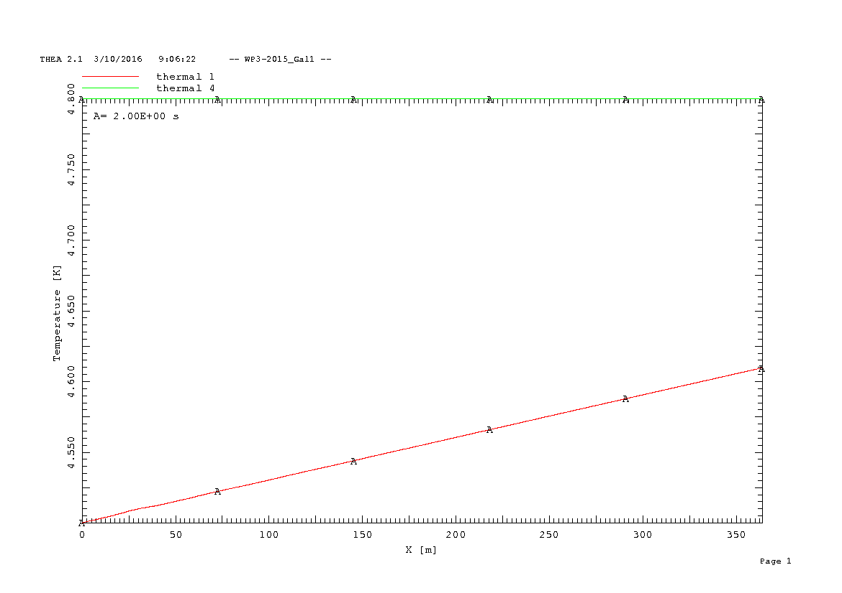

TACTICS example – burn simulation
Inner leg I₄
Outer leg O₁
Central pancake
Lateral pancake

Slide 8
Code communication on THEA side
In thea.f main loop:
c * time stepping loop
finish = SimulationTime.ge.EndTime
do while(.not.finish .and. Status.eq.0)
if(TACTICS) then
call RefreshFlux
endif
…
subroutine RefreshFlux
no
Test
Next communication step reached?
yes
Writing THEA results in text files for Cast3M: T_{He}, h
H_Temperature(component, node)
H_htc(component,node)
For each position of the Cast3M cross-sections
Writing of a flag for Cast3M to reprise (empty text file): THEA_flag
Pause, waiting for Cast3M
Cast3M
Bloc « Variables » in the input file is used to identify the conductors:
Begin Variables
Integer ID 11
Real Void 0.32
Integer NbTurn 10
Integer NbSec 8
Real ComStep_TC 5.
Integer Path 0
Integer CCC 0
End
do while(.not.file_exists)
inquire(file=Cast3M_flag,EXIST=file_exists)
enddo
Results: φ_{2D}
Cast3M_Flag
Reprise
Reading: Φ_{2D}
Then applied with userHHeating.f
end

Slide 9
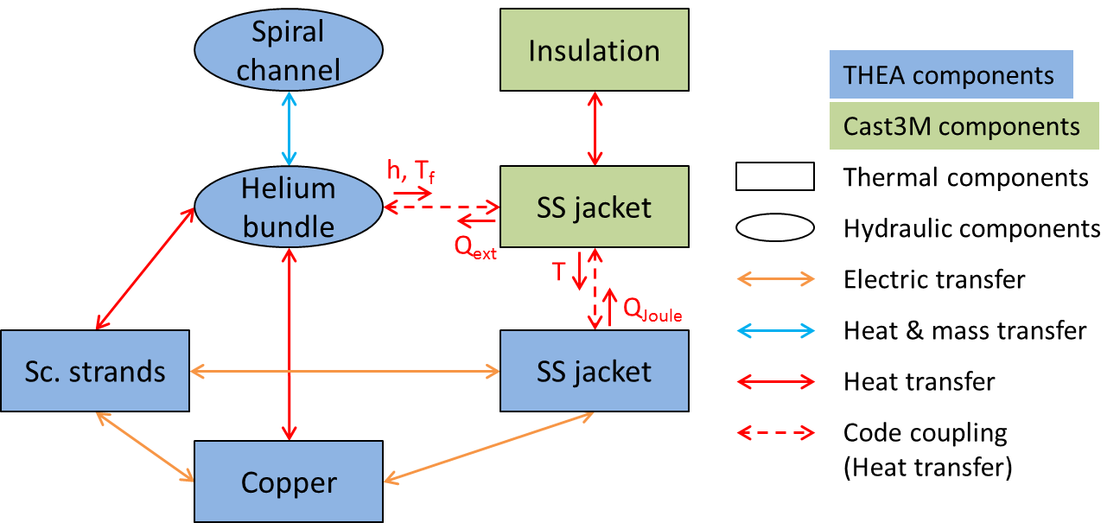
Quench methodology – current redistribution
Quench: transition to the resistive state.
Can be caused by: disruption, conductor degradation, cryogenic incident…
Important temperature rise due to Joule effect.
Risk of damage of the magnet if not detected in time.
  Local hotspot temperature → T_{hot spot} < 150 K
Pressure rise.
During a quench, where the superconducting materials have transited, the current is redistributed; mainly in the copper wires, but a fraction of it also passes through the jacket.
The jacket is considered ‘thermally’ in Cast3M and ‘electrically’ in THEA to account for the current redistribution during a quench.

Slide 10
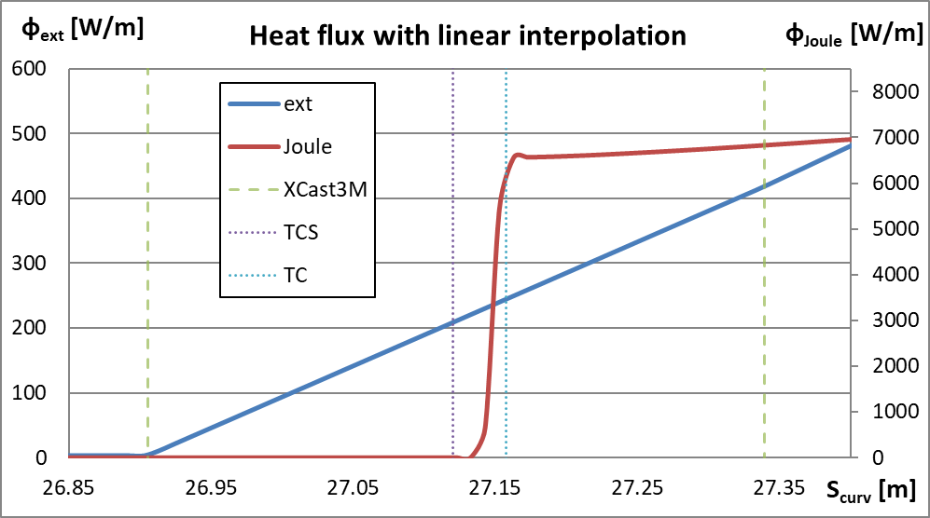
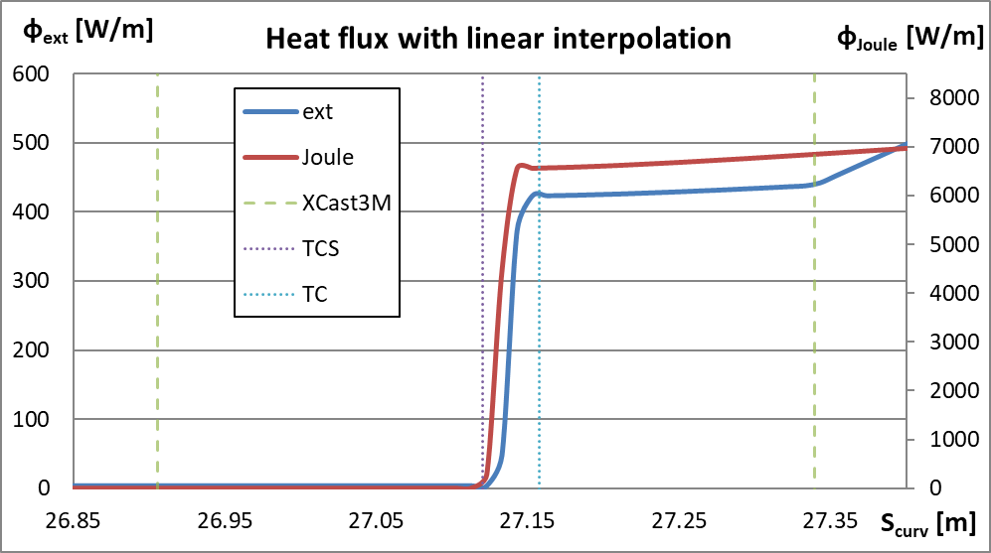
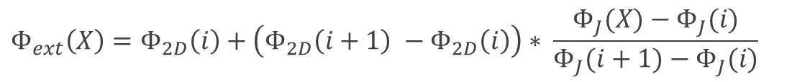
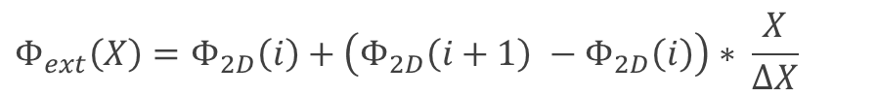
Quench methodology – Heat flux at quench fronts
Linear interpolations between sections:
$$Φ_{ext}\left(X\right)=Φ_{2D}\left(i\right)+\left(Φ_{2D}\left(i+1\right) −Φ_{2D}\left(i\right)\right)∗ \frac{X}{ΔX}$$
Specific treatment of the flux exchange:
If a quench front is detected between 2 consecutives Cast3M cross-sections, the following correction is applied:
$$Φ_{ext}\left(X\right)=Φ_{2D}\left(i\right)+\left(Φ_{2D}\left(i+1\right) −Φ_{2D}\left(i\right)\right)∗ \frac{Φ_{J}(X)−Φ_{J}(i)}{Φ_{J}(i+1)−Φ_{J}(i)}$$
Better numerical stability
More realistic

Slide 11
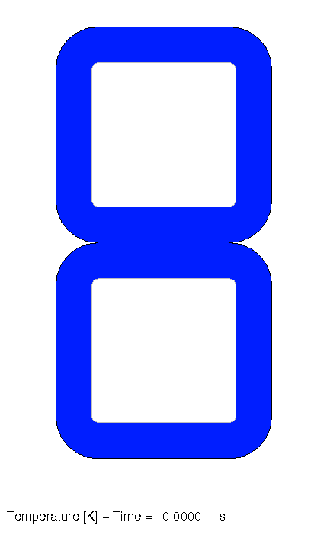
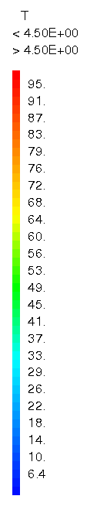
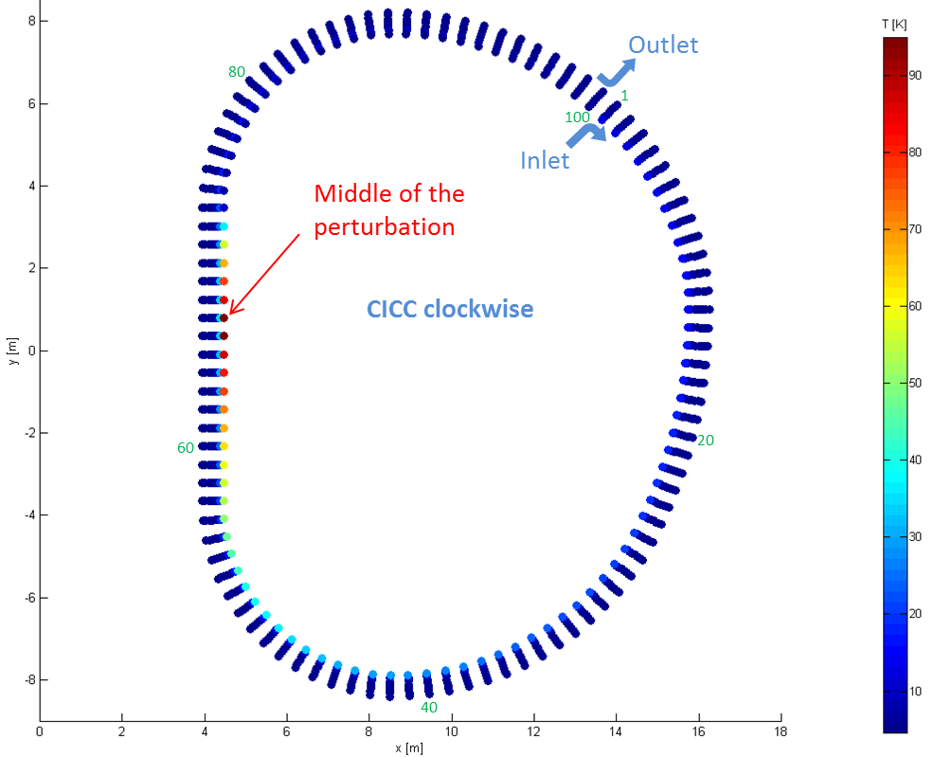
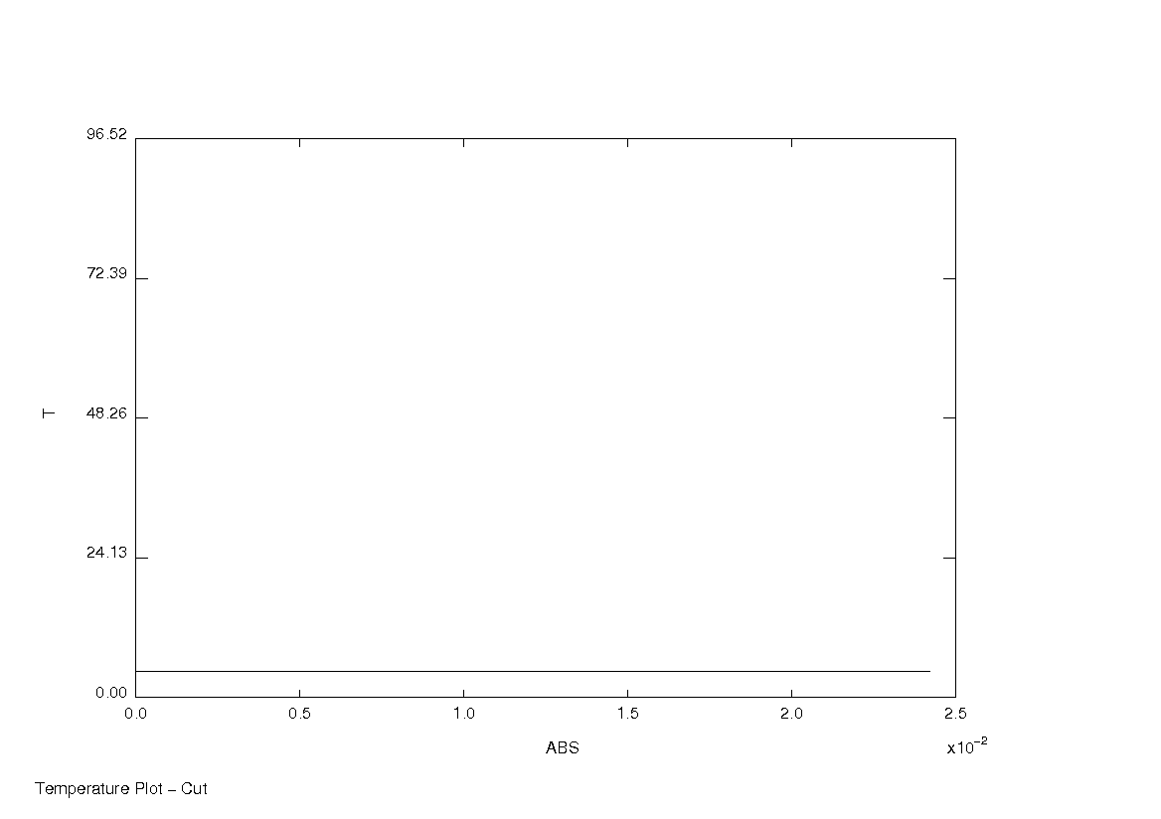
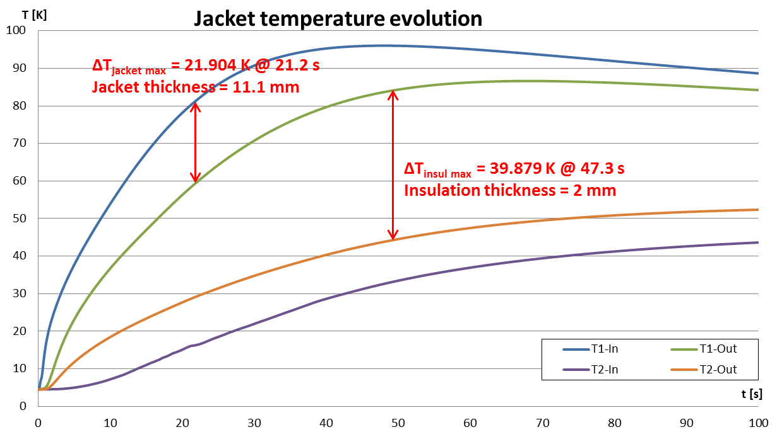
Quench methodology – Application
T2-In
T2-Out
T1-Out
T1-In
Temperature field map over the whole pancake (100 cross sections) at 100 s.
Temperature field map in the jacket and insulation of the two first turns of the pancake at the middle of the quench initiation.
The maximum temperature difference over the jacket thickness is 21.904 K.
The maximum temperature difference through the 2 mm insulation thickness is 39.879 K.
Better assessment of the hotspot value
The temperature map in the coil from a TACTICS simulation can be directly used in Cast3M as thermal load for mechanical simulations.

Slide 12
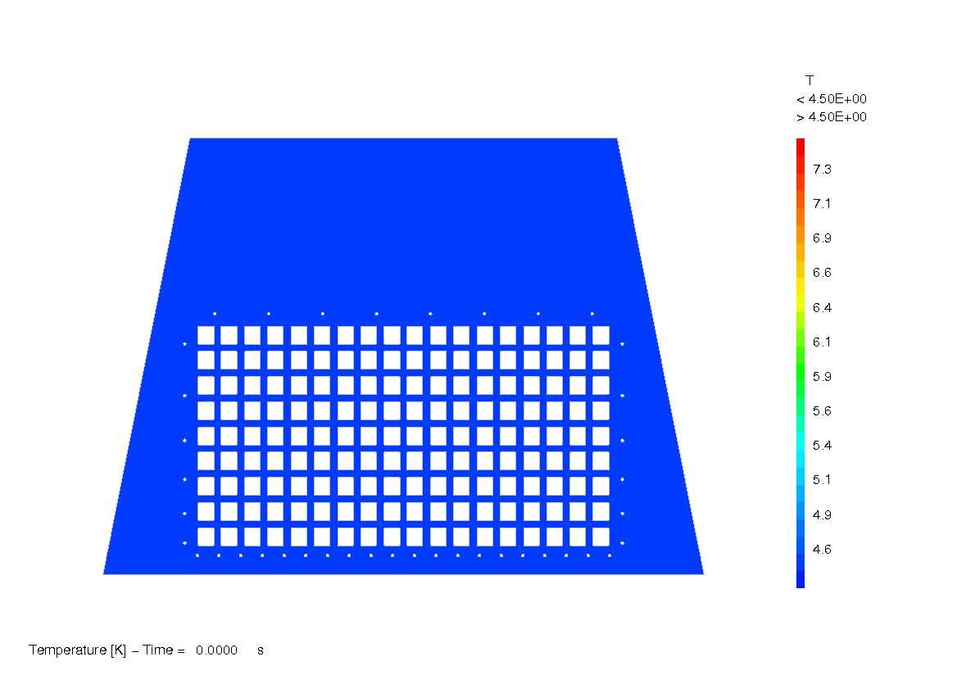
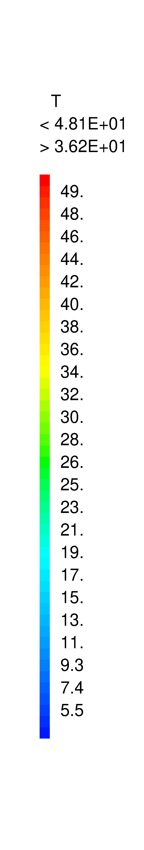
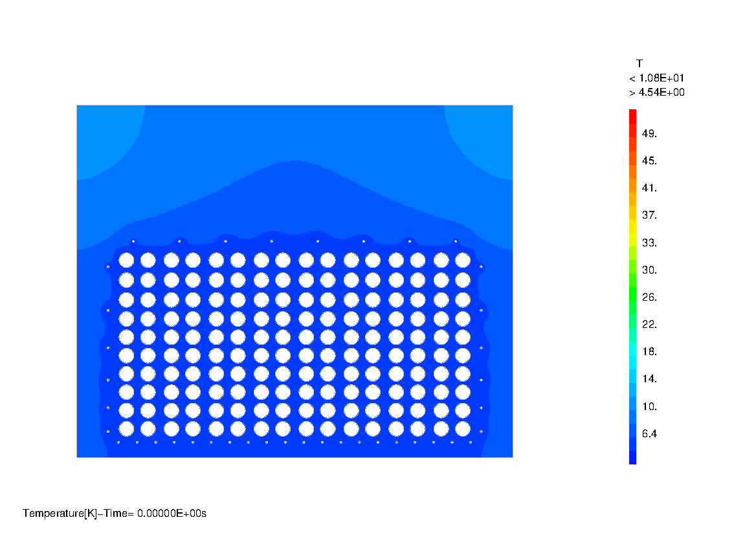
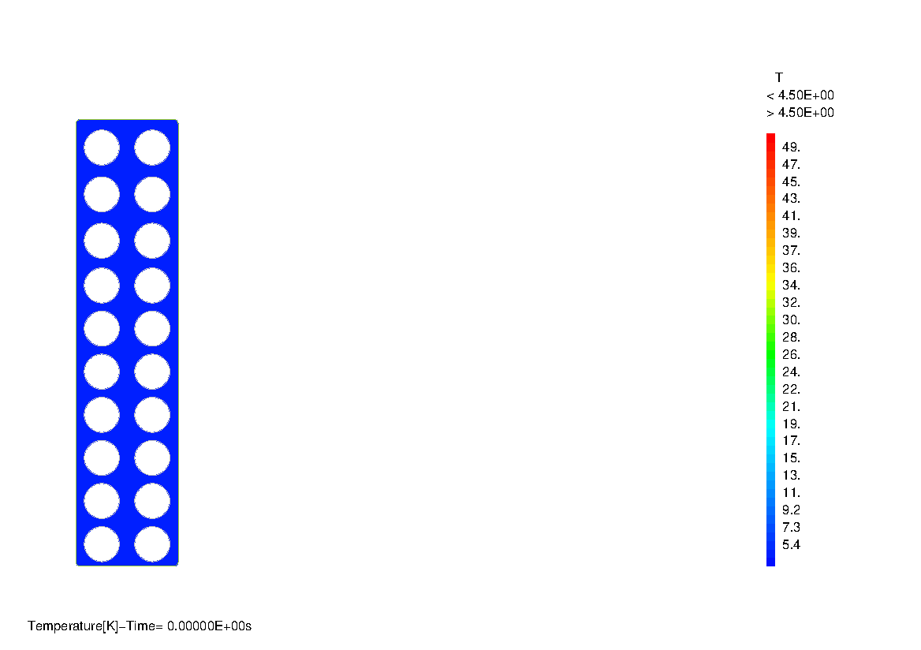
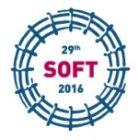


Results examples
Burn simulation on DEMO TF WP#3
Quench simulation on DEMO TF WP#4
FSD simulation on DEMO TF WP#4
Q. Le Coz, et al., “Towards a multi-physic platform for fusion magnet design - Application to DEMO TF coil”, Fusion Eng. Des. (2017), http://dx.doi.org/10.1016/j.fusengdes.2017.03.076
Q. Le Coz, et al., “Quench simulation of a DEMO TF coil using a quasi-3D coupling tool”, IEEE Transactions on Applied Superconductivity Vol. 28 n°3, Art. n° 4203105 (2018)
Q. Le Coz, et al., “TACTICS: overview of a multi-physic analysis tool for fusion magnet design and application to DEMO TF coil,” submitted for publication in Cryogenics

Slide 13
Content
1 – TACTICS, co-simulation of THEA / Cast3M
2 – Introduction of transverse thermal coupling in THEA
3 – THEA-MADMACS, a tool for fast generation of tokamak CICC design
4 – THEA customization for automatic generation of important results (ΔT_{ma} …)

Slide 14
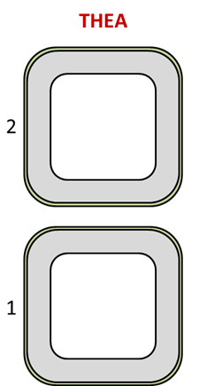
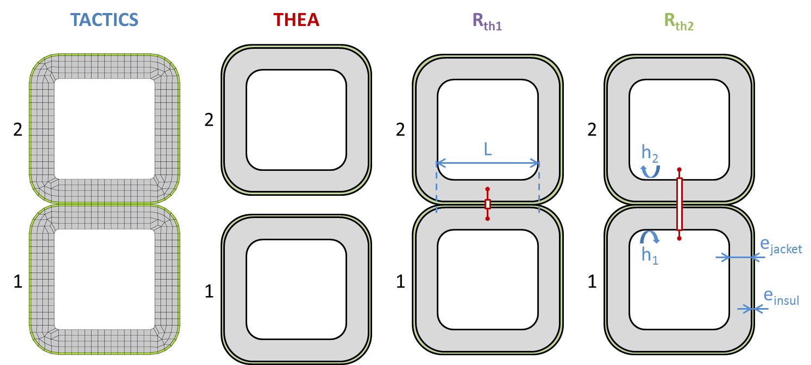
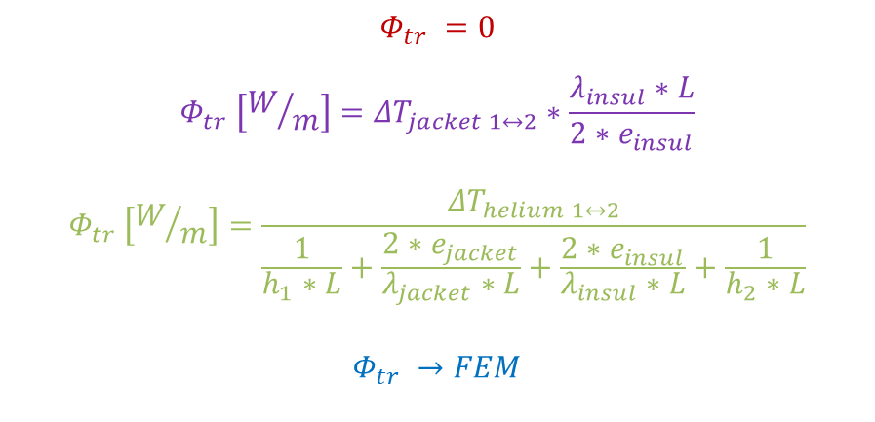
Introduction of transverse thermal coupling in THEA
At Chats-AS 2015 (Bologna), S. Izquierdo Bermudez (CERN) showed that:
  it is possible to introduce transverse thermal coupling in THEA, notably from turn to turn inside a conductor
  required developments are limited if the approach focuses on steady state (approach based on thermal resistances)
The method was implemented in THEA and investigated at CEA/IRFM
$$Φ_{tr} =0$$
$$Φ_{tr} \left[W/m\right]={ΔT}_{jacket 1↔2}∗\frac{λ_{insul}∗L}{2∗e_{insul}}$$
$$Φ_{tr} \left[W/m\right]=\frac{{ΔT}_{helium 1↔2}}{\frac{1}{h_{1}∗L}+\frac{2∗e_{jacket}}{λ_{jacket}∗L}+\frac{2∗e_{insul}}{λ_{insul}∗L}+\frac{1}{h_{2}∗L}}$$
$$Φ_{tr} →FEM$$
R_{th1}: ● Coupling jacket to jacket (modification of UserSHeating.f)
R_{th1}: ● Thermal resistance = insulation only
R_{th2}: ● Coupling bundle to bundle (modification of UserHHeating.f)
R_{th1}: ● Thermal resistance = insulation + jackets (×2) + HTC bundle/jacket (×2)

Slide 15
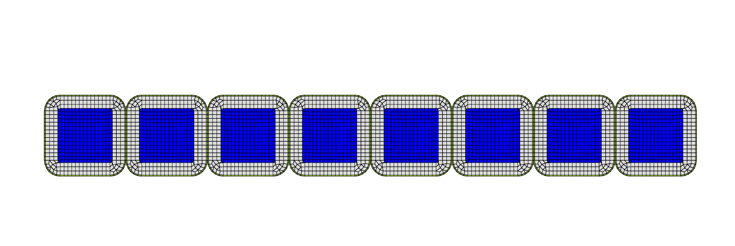
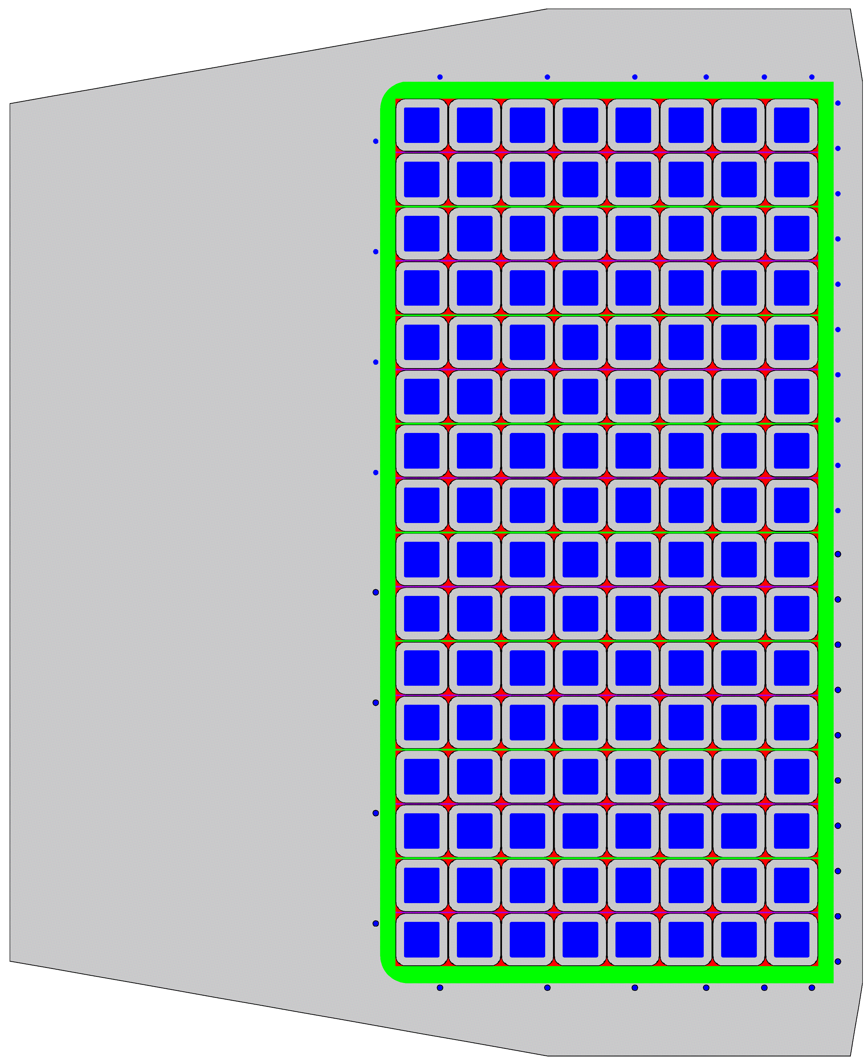
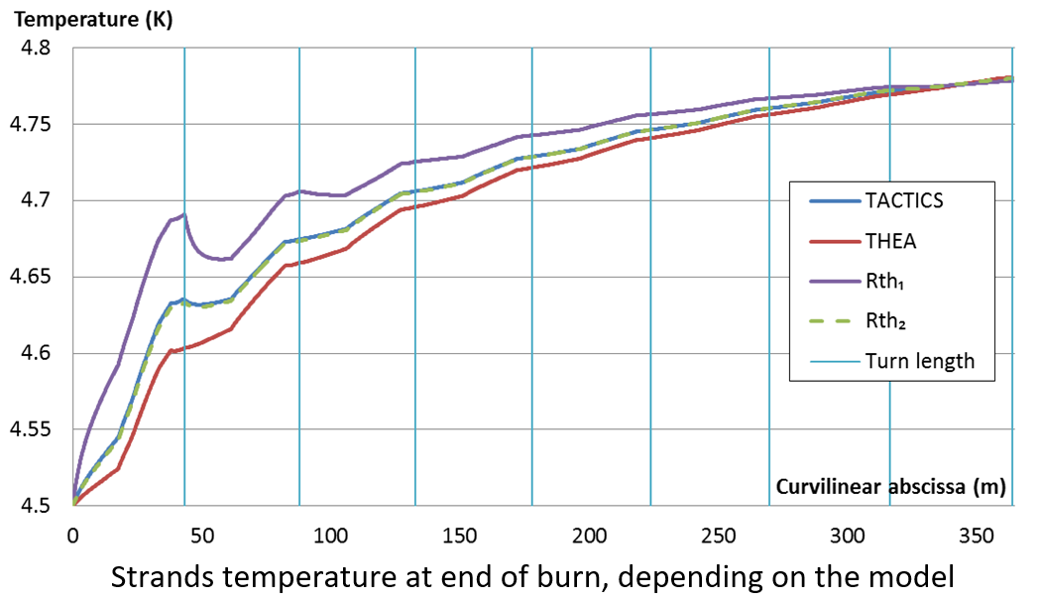
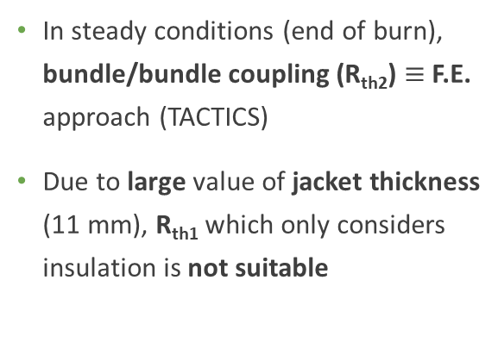
Introduction of transverse thermal coupling in THEA
Several simulations were performed for validating THEA modifications and for comparing the different approaches
Quasi steady state simulation: computation of a 2 hour burn scenario on EU-DEMO TF conductor
  CEA design w/o radial plate – 1 pancake with 8 turns modelled – Square cable size = 48.6 mm, jacket thickness = 11.1 mm
In steady conditions (end of burn), bundle/bundle coupling (R_{th2}) $≡$F.E. approach (TACTICS)
Due to large value of jacket thickness (11 mm), R_{th1} which only considers insulation is not suitable
  Results at End Of Burn

Slide 16
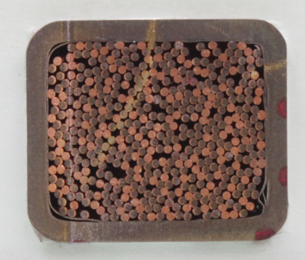
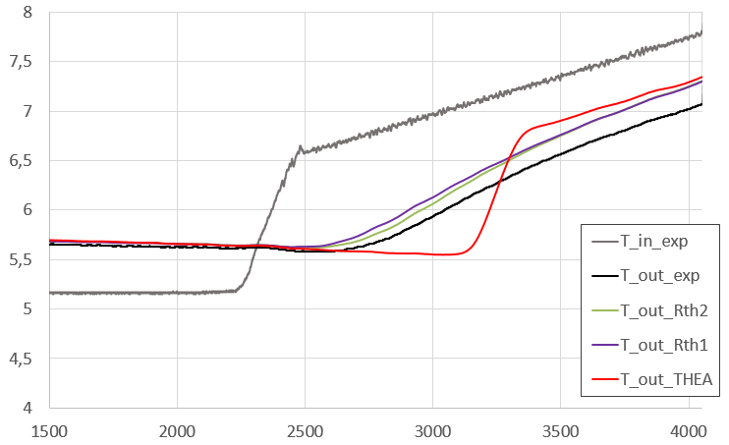
Introduction of transverse thermal coupling in THEA
Slow transient simulation: computation of acceptance test of JT-60SA TFC in Cold Test Facility
  Simulation of initial phase of acceptance test of TFC-02: inlet temperature ramp-up
  for controlled quench test
  Experimental inlet temperature ramp-up imposed in models
  THEA, THEA-R_{th1} and THEA-R_{th2} simulations performed – TACTICS simulation not performed
  Comparison of outlet temperatures: models versus experiment
Conductor
22×26 mm
Cable
18×22 mm
SS jacket thickness
= 2 mm
Introduction of transverse flux improves consistency with experimental T_{outlet}
Bundle/bundle (R_{th2}) is slightly better than jacket/jacket (R_{th1}) coupling, but both approaches results are close
A discrepancy remains between models and experiment after transit time (~ 1200 s)
T (K)
Time (s)

Slide 17
Introduction of transverse thermal coupling in THEA
Fast transient simulation: computation of quench scenario in EU-DEMO TF conductor
  Quench triggered on central pancake, current FSD imposed 3 s after quench initiation (quench detection not modelled)
  THEA, R_{th2} and TACTICS simulations performed – R_{th1} simulation not performed
  Comparison of models results, considering TACTICS ones as reference
Transverse thermal diffusion drives quench initiation on the 2nd turn:
  at 18.4 s with THEA-Rth
  at 41.8 s with TACTICS
  No quench on 2nd turn with THEA standard
The initiation of the quench by transverse diffusion happens faster with the thermal resistance model because the diffusion is not accounted for.
So the hypothesis of a negligible time constant of the diffusion through jacket and insulation makes the second quench initiation happen 23.4 s sooner than it should
THEA standard is conservative for such a scenario

Slide 18
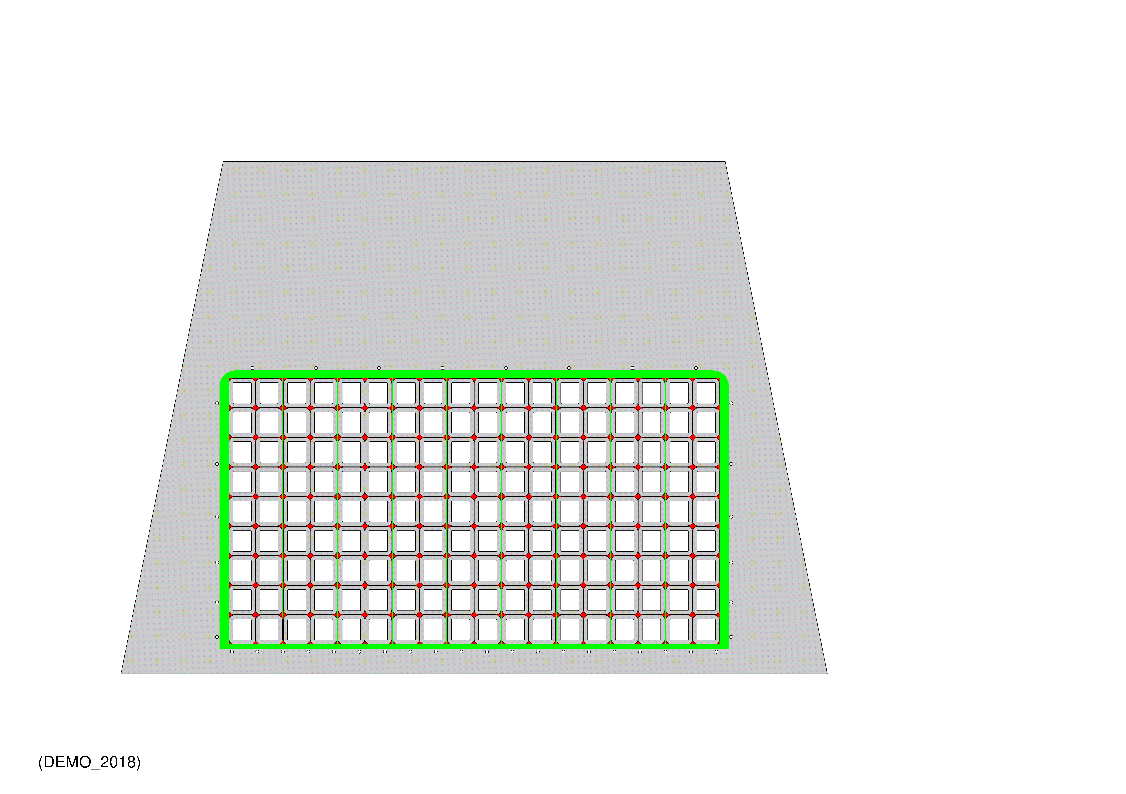

Introduction of transverse thermal coupling in THEA
Introduction in THEA of transverse thermal coupling based on thermal resistances:
is recommended for quasi steady simulation (DT_{ma} computation in long burn scenario)
can improve accuracy in case of slow transient scenario
is not recommended for fast scenario such as quench, for which THEA is conservative and thus prefered
A. Louzguiti suggests a similar method for introducing transient thermal coupling with consideration of thermal diffusion and thus valid in transient conditions. This approach would:
be based on modelling 3 pancakes in a single THEA calculation, for accessing neighbouring pancakes temperatures in memory mode
consider transient thermal equation with thermal capacity terms
require modelling current transport in series in the 3 pancakes
  For now, this latter point can not be resolved with THEA+POWER (would reduire current to be associated with a thermal component instead of overall model) → to be confirmed by Luca
  But it should be possible (being cautious) to modify dedicated code sources (current.f)
To be done ?...

Slide 19
Content
1 – TACTICS, co-simulation of THEA / Cast3M
2 – Introduction of transverse thermal coupling in THEA
3 – THEA-MADMACS, a tool for fast generation of tokamak CICC design
4 – THEA customization for automatic generation of important results (ΔT_{ma} …)

Slide 20
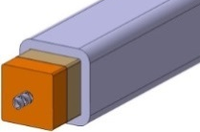
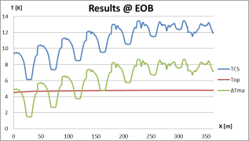
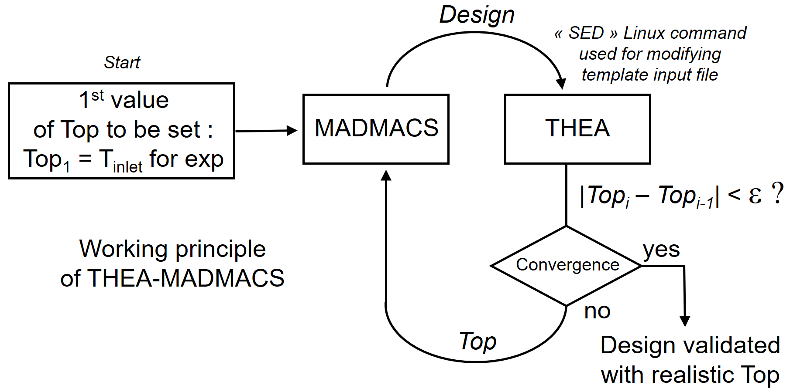
THEA-MADMACS, a tool for fast generation of tokamak CICC design
MADMACS = MAgnet Design MACroscopic Simulator
Pre-design
MADMACS
Thermohydraulics THEA
A_{sc}, A_{Cu}, A_{he}…
Figure(s) of merit of TF magnet
(cost ~ cost of composite Nb₃Sn strands, …)
T_{op}
design at constant DT_{ma} as a function of (∆P ; T_{in})
SC strand cost (M€)
Example of application:
impact of TH operating conditions on EU-DEMO TF magnet cost

Slide 21
Content
1 – TACTICS, co-simulation of THEA / Cast3M
2 – Introduction of transverse thermal coupling in THEA
3 – THEA-MADMACS, a tool for fast generation of tokamak CICC design
4 – THEA customization for automatic generation of important results (ΔT_{ma} …)

Slide 22
Automatic result file
Automatic generation of a result file with the hotspot temperature, minimum temperature margins
Hotspot temperature, minimal temperature margins are time and space dependent. Using theapost can be time consuming.
Automatically detect the number of components (Thermal and Hydraulic), and test if the Thermal is a superconductor or not to calculate ΔT_{ma} min.
The values are scanned at each simulation step. The results are more accurate than when calculated on the interpolated stored values (can be significant when the OutputStep is larger than the MaximumStep).
Thermal 1:
Tmax: 4.72723722 K, at Time: 6963.55664 s, and position: 483.958069 m
Tmamin: 1.85937166 K, at Time: 5910.55664 s, and position: 11.9779625 m
@Top: 4.50808382 K, at Tcs: 6.36745548 K, and Beff: 11.3208323 T
Thermal 2:
Tmax: 4.72723675 K, at Time: 6963.55664 s, and position: 483.958069 m
Thermal 3:
Tmax: 4.72736692 K, at Time: 6964.55664 s, and position: 483.958069 m
Hydraulic 1:
Tmax: 4.72723341 K, at Time: 6963.55664 s, and position: 483.958069 m
Pmax: 600000.000 Pa, at Time: 9.9999E-06 s, and position: 0.00000000 m
Hydraulic 2:
Tmax: 4.72635746 K, at Time: 6949.55664 s, and position: 483.958069 m
Pmax: 600000.000 Pa, at Time: 9.9999E-06 s, and position: 0.00000000 m
Modification done in thea.f (version 2.2) →
(The modified script is embedded in the PowerPoint)

Slide 23
Questions?
Question from our part:
What is the status of the development of MrX?
Extract from the SuperMagnet notice:
MrX coupling
MrX provides a mechanism for generic data exchange from or to one of the codes coupled by SUPERMAGNET. MrX does not perform calculations, but can substitute to any of the coupling ends detailed earlier, to interface a data exchange to other codes that are running concurrently to SUPERMAGNET. Launched by SUPERMAGNET, MrX receives data from one of the CryoSoft codes, running a coupled simulation, and reformats it into an ASCII file with a given protocol that can be read and used by a concurrent simulation code. The concurrent simulation is then expected to produce coupling results that MrX reads and converts as appropriate to provide it to the coupled CryoSoft code.
Note
At the time of writing of this manual, MrX is in conceptual design and testing, and is not yet available to the end user.

Slide 24
Thank you for your attention

