Slide 1
ELISA
Experimental Linac for Surface Analysis
A miniature proton accelerator for Science Gateway
10th Joint Technical Meeting
23 June 2022

Slide 2
Agenda
Comments on the last minutes
Planning – Next steps
Proton Source – Recent measurements (Eleonora)
RFQ module 2 & antennas – RF measures (Mariangela)
Safety – Electrical risks
Integration @ Science Gateway – Last model

Slide 3
1 – Comments on the last minutes
1: Eric about the RF pulses measurement:
- “Eric explained that many RF behaviors can be explain and demonstrate using ELISA and a 1 GHz oscilloscope and that this is the best option. He proposes to provide the oscilloscope.”
The expense must be cover by the ELISA project. To be decided in view of the budget and on the necessity to have this oscilloscope to adjust the RF amplifier.

Slide 4
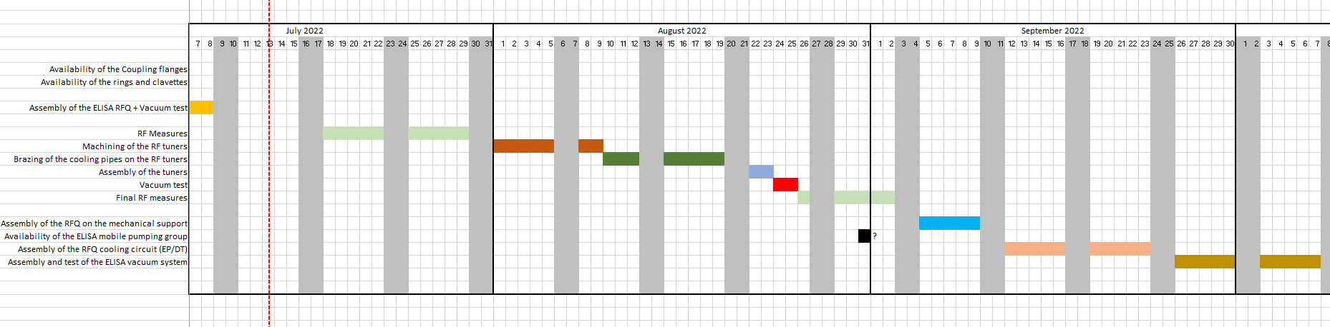
2 – Planning – Next steps
--> Assembly of the source on the RFQ will depend of the sources tests & results (October ??)
--> Control of the source should start before, as well as for the vacuum system + chiller (August – September ??)
--> Delivery of the amplifier (still) for end of 2022
--> Location for the RF tests not yet decided!

Slide 5
3 – Proton source → Eleonora
4 – RF measures → Mariangela

Slide 6


5 – Safety → Electrical risks
--> Main outcome of the 1th ELISA Safety workshop focused on the electrical risks:
The electrical conformity of the ELISA installation must controlled / certified by an external company or organism accredited by the Swiss authorities.
The idea is to have our electrical protections, described in the safety file, and defined following recommendations from HSE specialists and from external consultants + the certification / control performed by the accredited company (or compagnies) for the constitution of a solid file to be presented to the local authorities (Cantonal Office) which give the authorization to receive the public.
--> Contacted companies up to now: EFFITEC (meeting 22 of June) and Electrosuisse (meeting 5 of July)
First discussions, with EFFITEC, were positive. The conformity with the legislation should be not a big problem. Next steps: For us, to prepare a complete schematic of the electrical installation.
For then: To consult with other partners, authorities for also the non-ionizing radiation.
https://www.effitec.ch/
https://www.electrosuisse.ch/

Slide 7
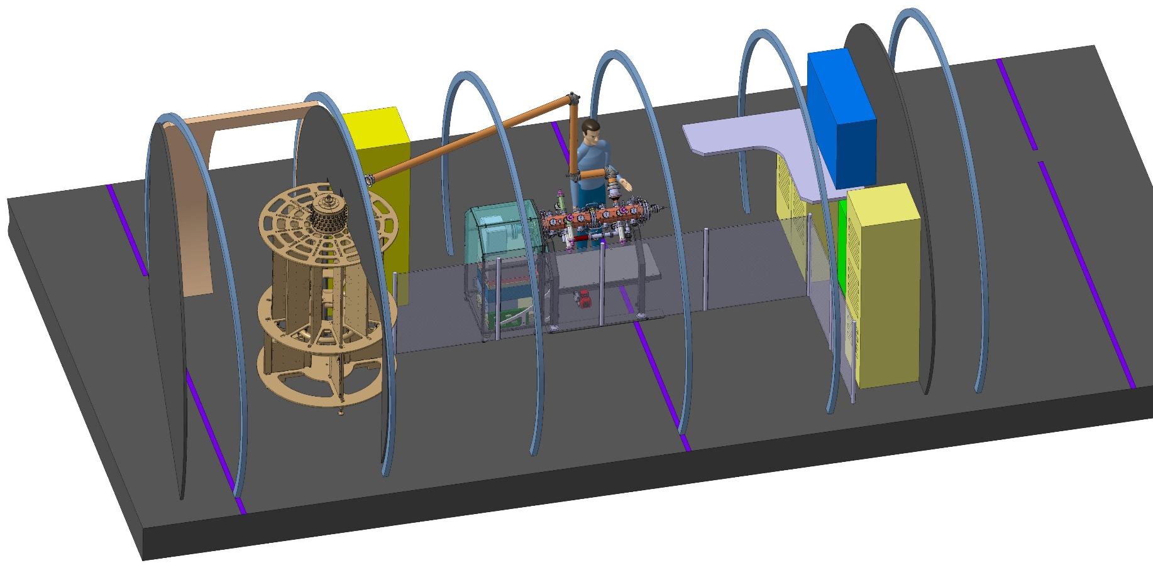
6 - Integration @ Science Gateway
Laurent Zuccalli (22.06.22): Implementation of a 1 m high barrier in front of the whole ELISA forbidden the access to the operator area for the public.

Slide 8
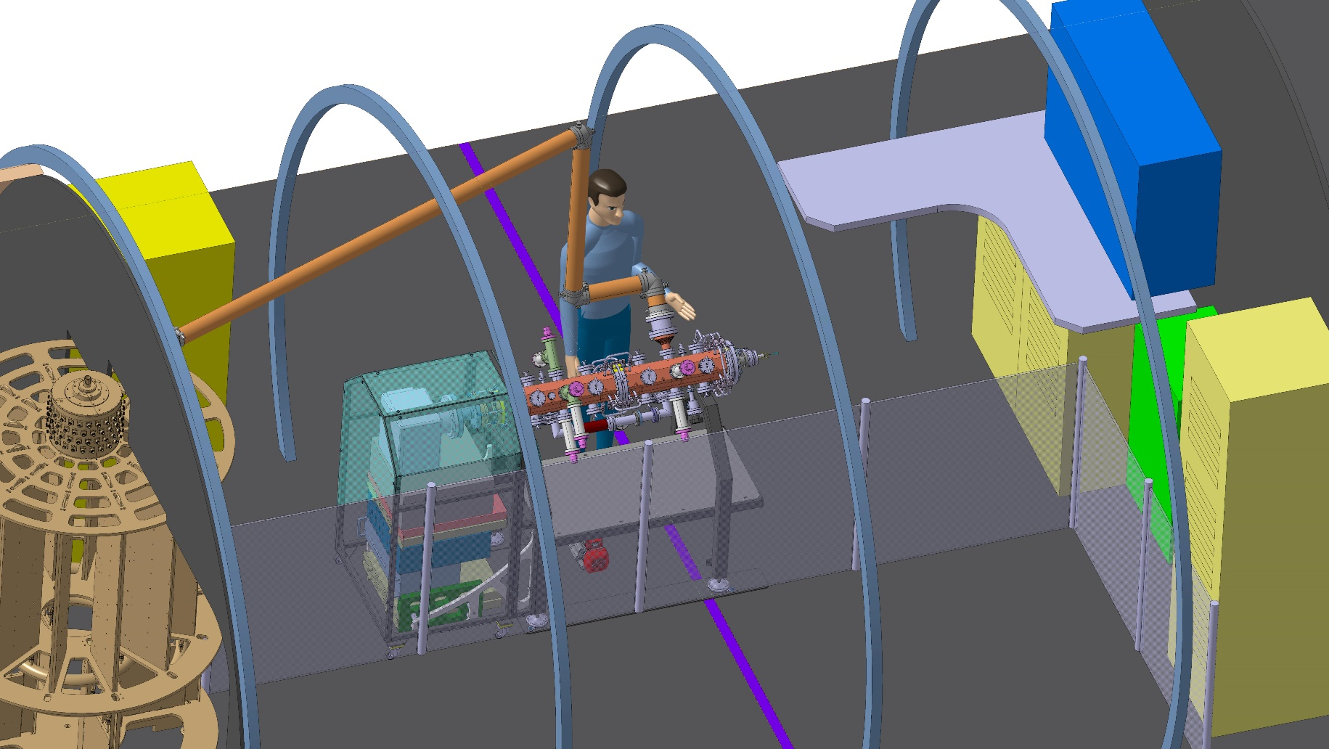
6 - Integration @ Science Gateway

Slide 9
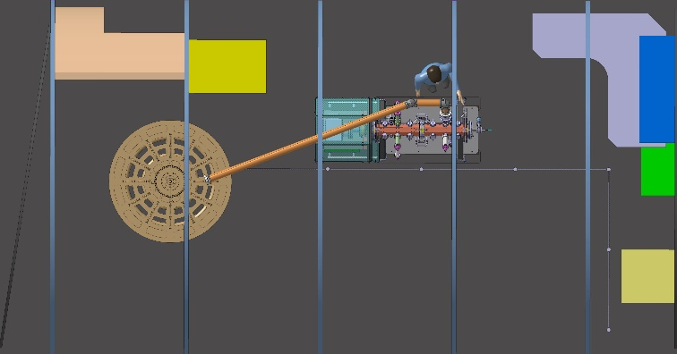
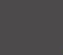







6 - Integration @ Science Gateway
Demonstration mode with operator
(1 m high barrier)
Demonstration mode without operator
(1 m high barrier + crossing detection and automatic cut-off)
Surface analysis mode with operator and collaborators
(1 m high barrier on more limited area)
Closed area for maintenance, development, ….
(No public access)

Slide 10
6 - Integration @ Science Gateway
Questions / Discussions / Comments:
- Does this barrier seem necessary for everyone?
- Is the height of 1 m really a compromise to stop careless children and see the beam and the experiments clearly?
- Does this barrier make it possible to envisage an environment closer to a real CERN beam line, with visible cable trays for example?
- How to fix this barrier to the ground, what materials to use.
- Does a detection system allowing power to be cut off on sensitive elements (Source, RF, etc.) if a person crosses the barrier seem sufficient? Which system(s) to use?
- Should one or two gates be integrated allowing the operator to enter but also to quickly leave the area in the event of an emergency.
- How to ensure that the barrier is removable and transformable quickly?
-> Questions to be discussed also during the next ELISA Safety Workshop devoted to layout. With security specialists, all volunteers are welcome to participate.

