Slide 1
Area Integration Reports for:
RR13 (P1 Left) | RR17 (P1 Right) EDMS 1758110
RR53 (P5 Left) | RR57 (P5 Right) EDMS 1758153
J. Oliveira
17/06/2022

Slide 2
RR17 (P1 Right) LHC Integration 3D model

Slide 3
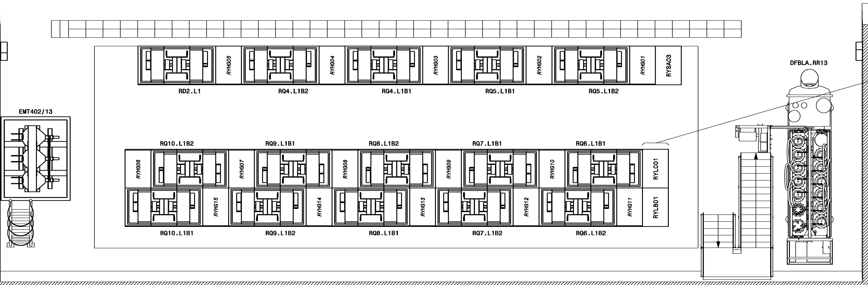
RR13 (P1 Left)
To modify
To de-install
New Rack
Possible modification of the shielding for HL-LHC
CYCIP01
GYPOS01
RYSA04
RYLAD01
RYLAD02
RYLAD03

Slide 4
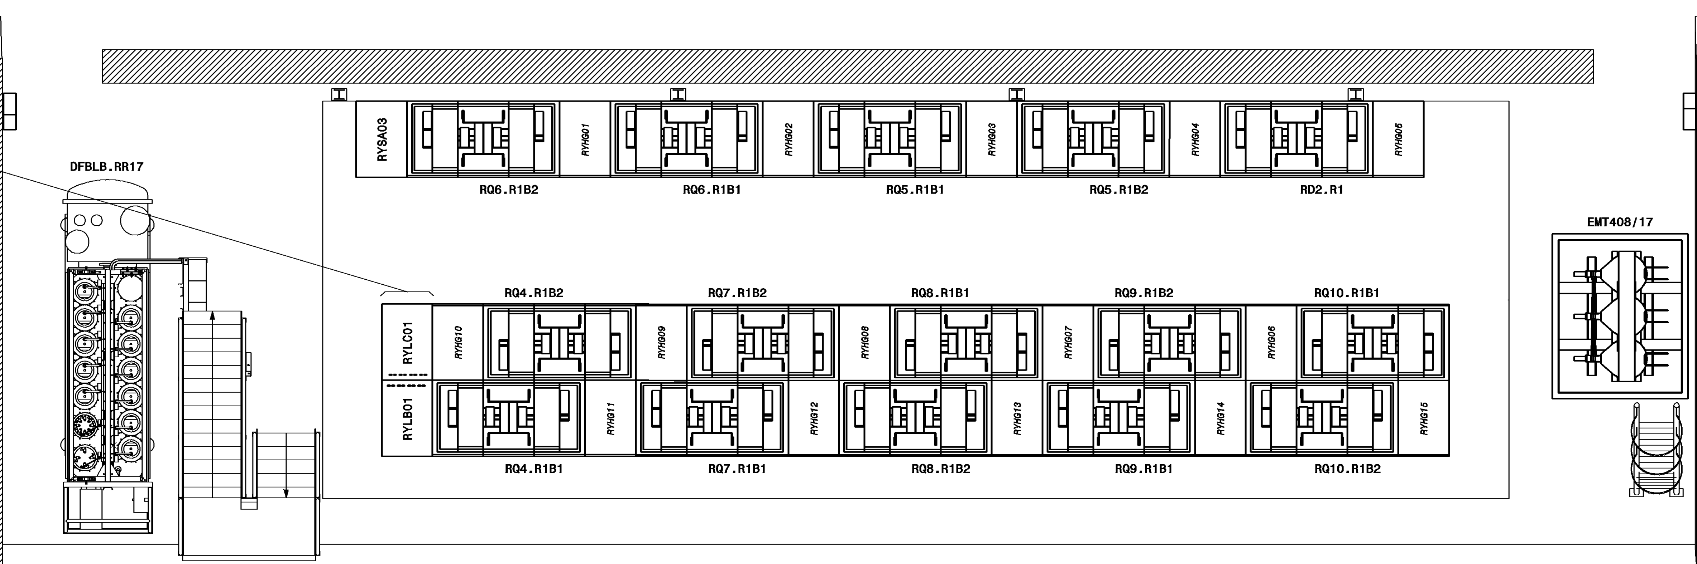
RR17 (P1 Right)
To modify
To de-install
New Rack
Possible modification of the shielding for HL-LHC
RYLAD03
RYSA04
GYPOS01
CYCIP01
RYLAD01
RYLAD02

Slide 5
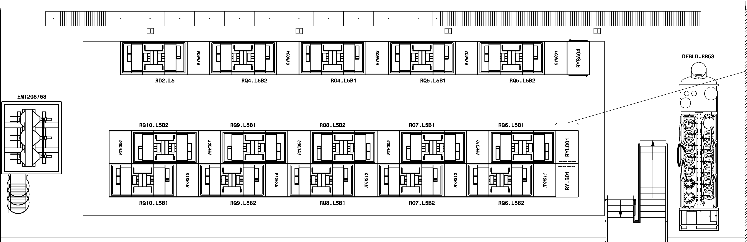
RR53 (P5 Left)
To modify
To de-install
New Rack
Possible modification of the shielding for HL-LHC
CYCIP01
GYPOS01
RYLAD03
RYSA05
RYLAD01
RYLAD02

Slide 6
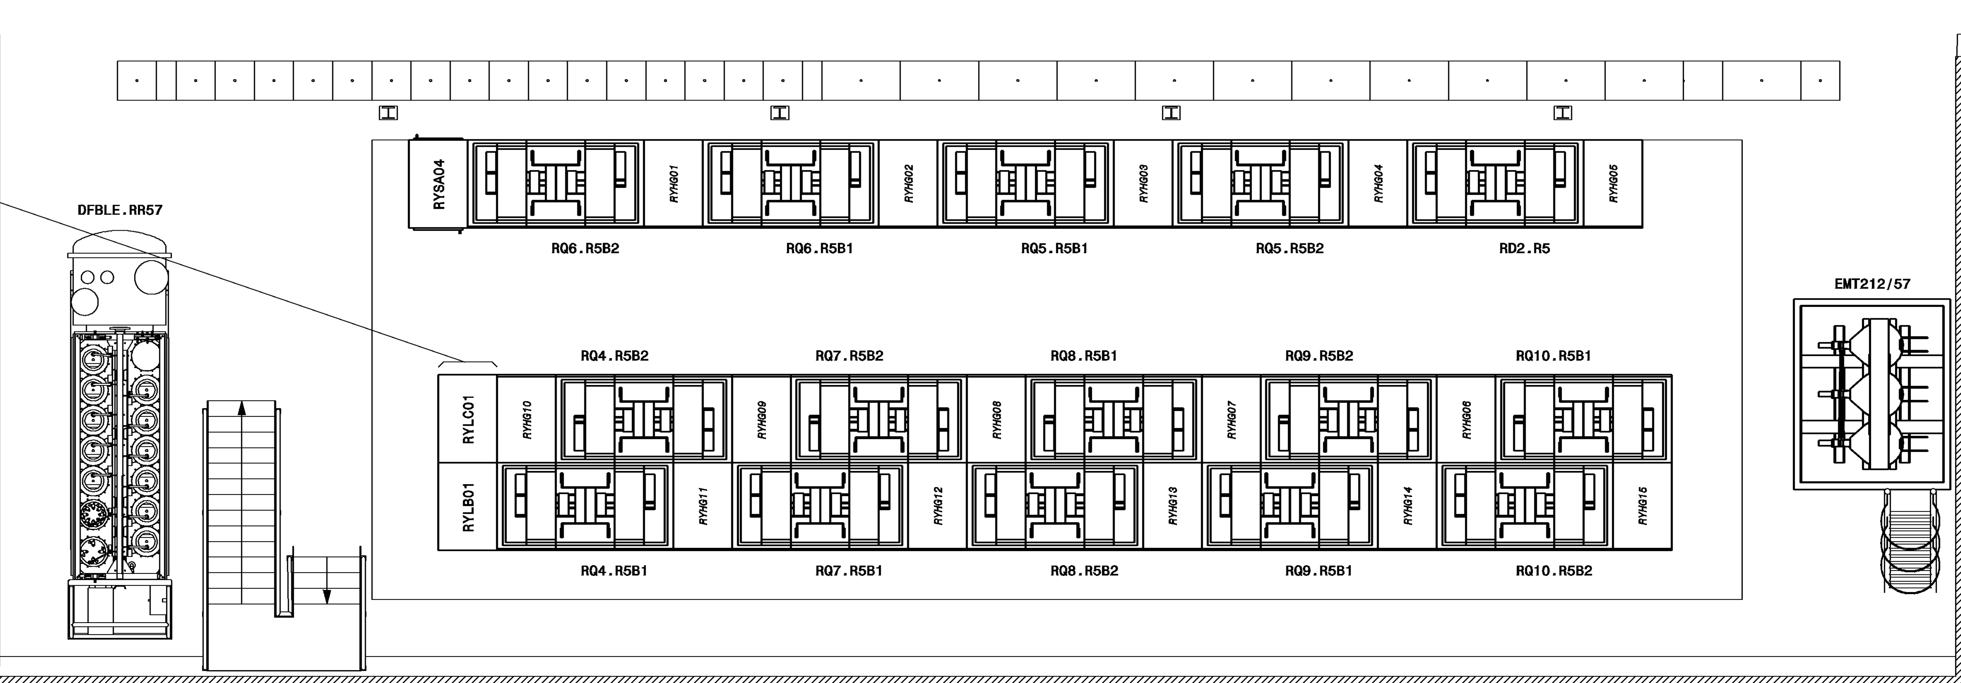
RR57 (P5 Right)
To modify
To de-install
New Rack
Possible modification of the shielding for HL-LHC
RYSA05
RYLAD03
GYPOS01
CYCIP01
RYLAD01
RYLAD02

Slide 7
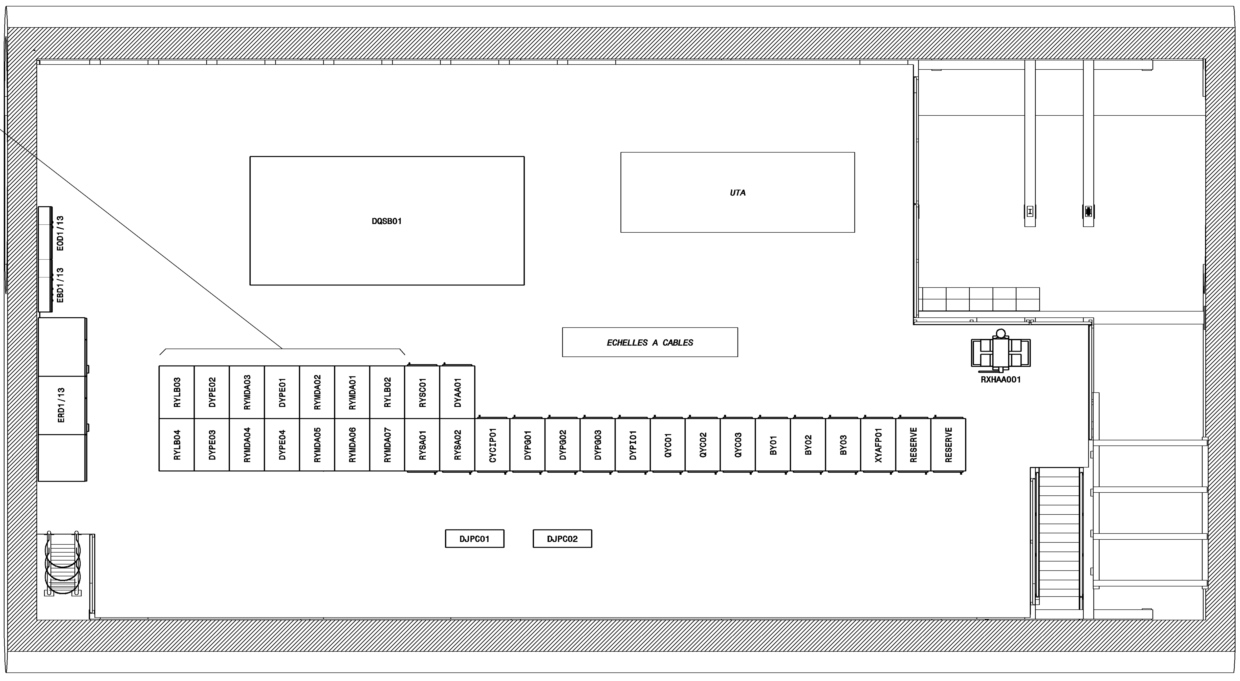
RR13 (P1 Left)
To modify
To de-install
New Rack
RES
CYFIB01
DYPG04
(spare)

Slide 8
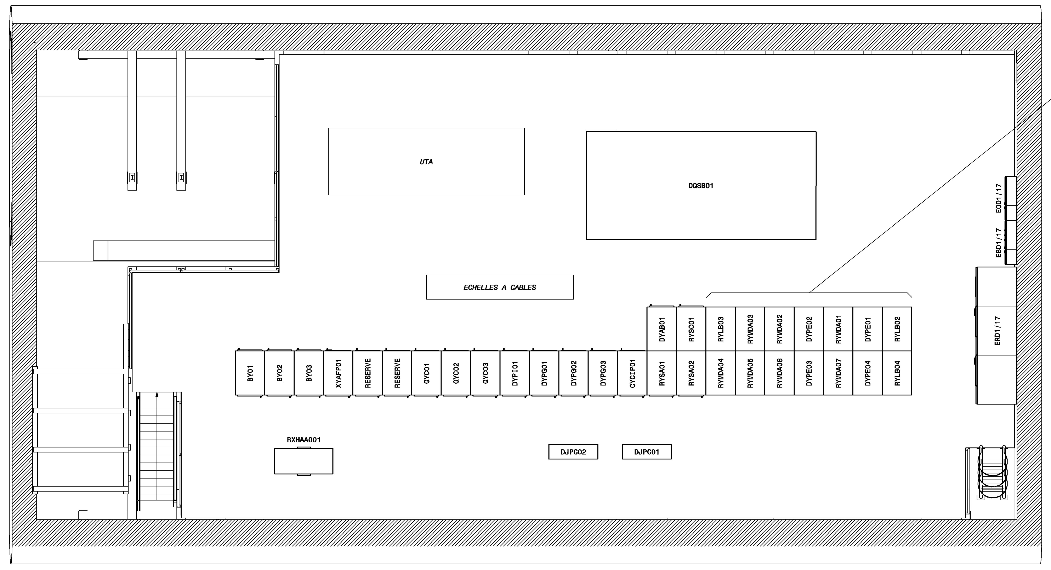
RR17 (P1 Right)
To modify
To de-install
New Rack
RES
CYFIB01
DYPG04
(spare)

Slide 9
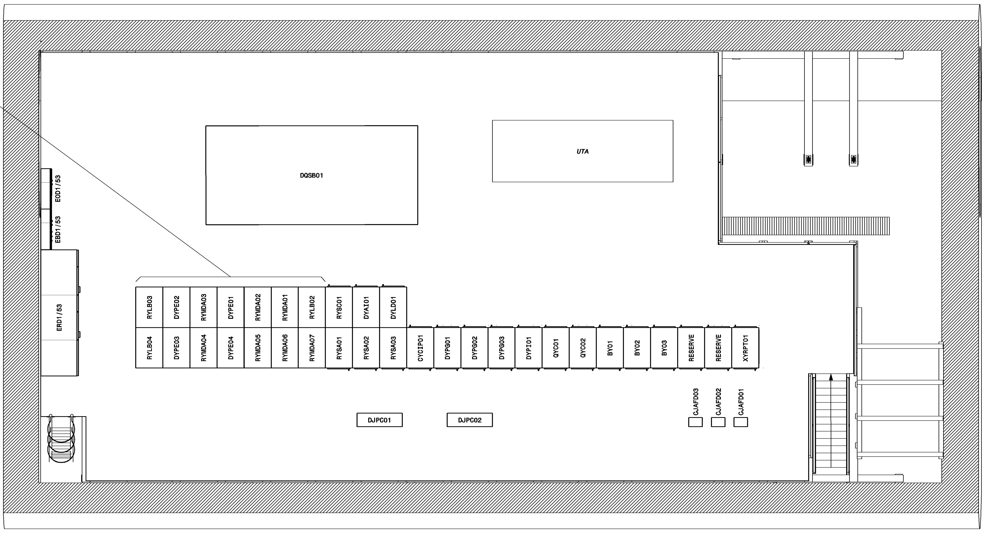
RR53 (P5 Left)
To modify
To de-install
New Rack
TOTEM (PPS)
Rack pre-booked waiting and if the CERN management approves the new installation.
CYFIB01
DYPG04
(spare)

Slide 10
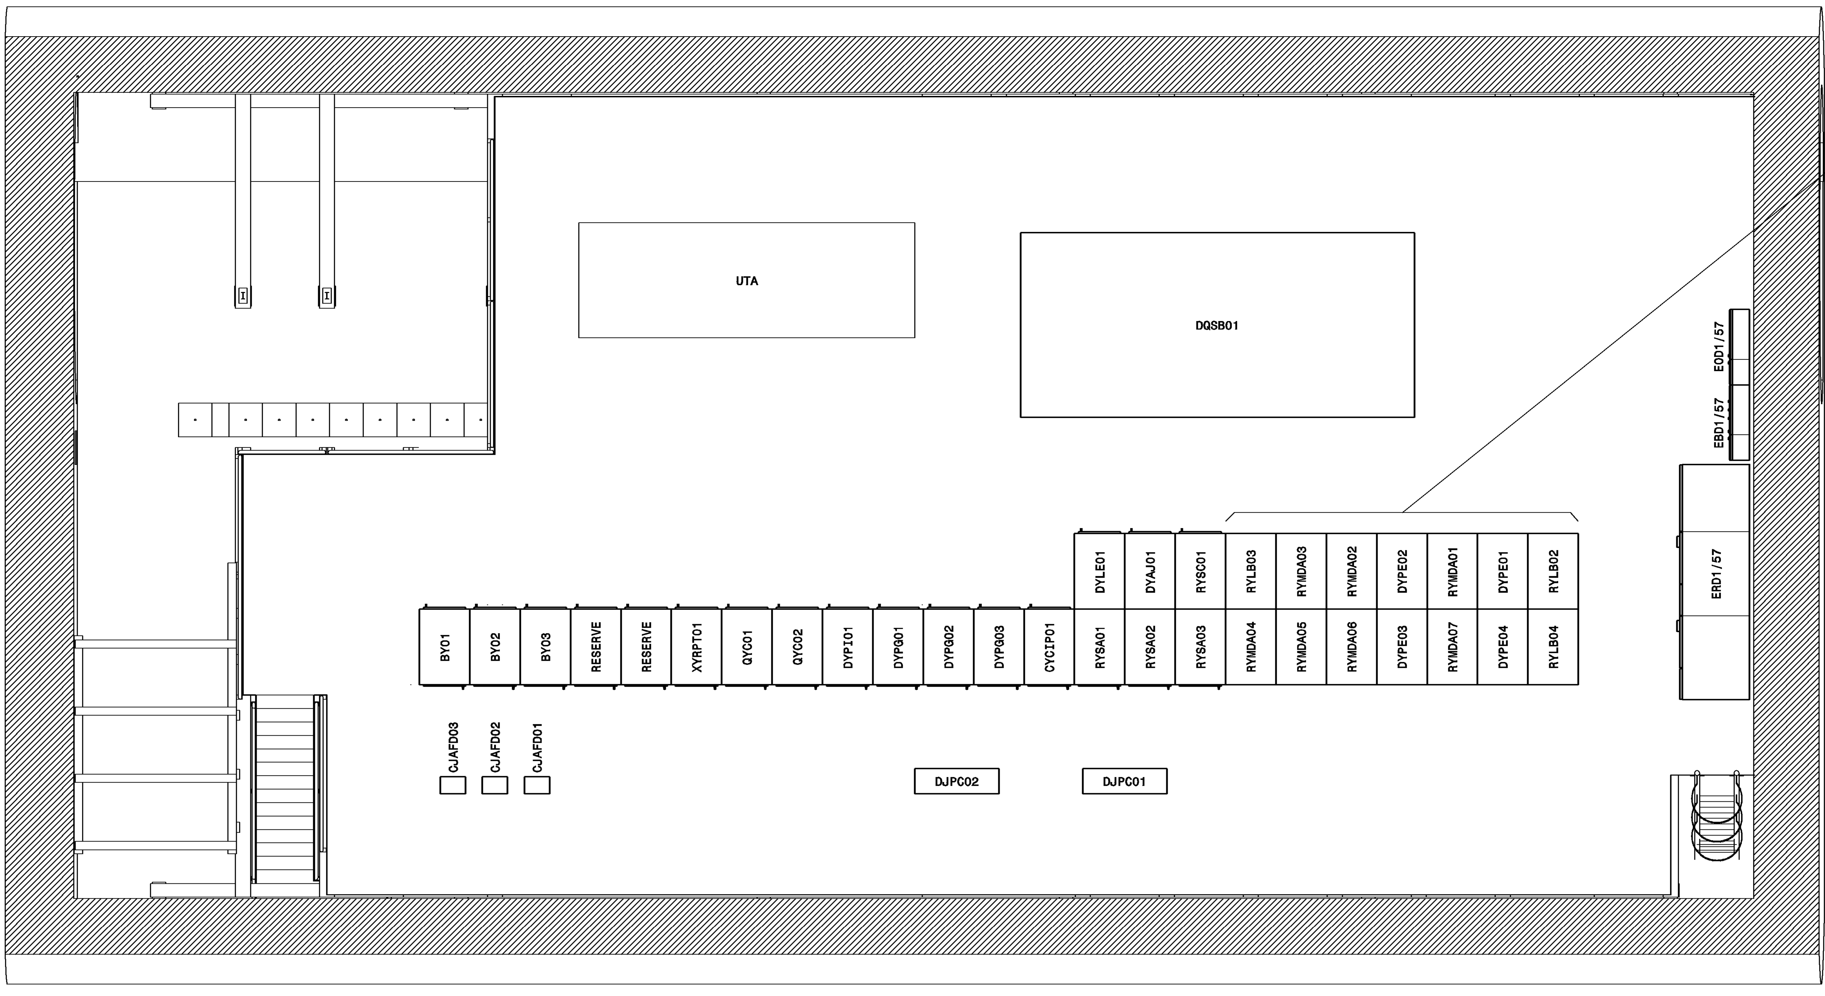
RR57 (P5 Right)
To modify
To de-install
New Rack
TOTEM (PPS)
Rack pre-booked waiting and if the CERN management approves the new installation.
CYFIB01
DYPG04
(spare)

Slide 11

Thank you for your time.
“Strive not to be a success, but rather to be of value.” – Albert Einstein

Slide 12
Spare Slides

