Slide 1
Schedule of integration activities during Run3 for SY-BI
Gerhard Schneider
HL-LHC integration meeting 17th June 2022

Slide 2
Activities
BGC discussed on 3rd June 2022 in the integration meeting
BSRT up-grade see next slide

Slide 3
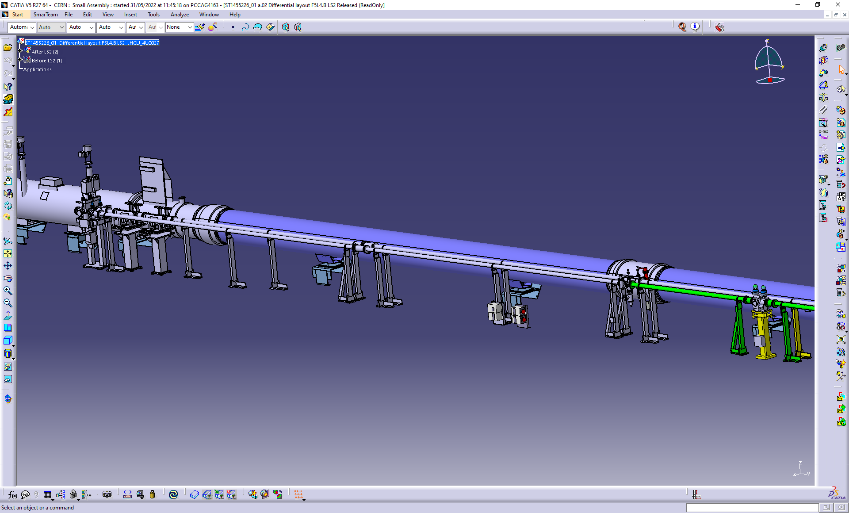
BSRTM activities – On hold
Installation of an operational mirror on the instruments(foreseen YETS 22/23)
Final positioning of the BSRTMB tank
(YETS 23/24)
Installation of enlarged chambers ID 130
(YETS 23/24)

Slide 4
Questions?

