Slide 1
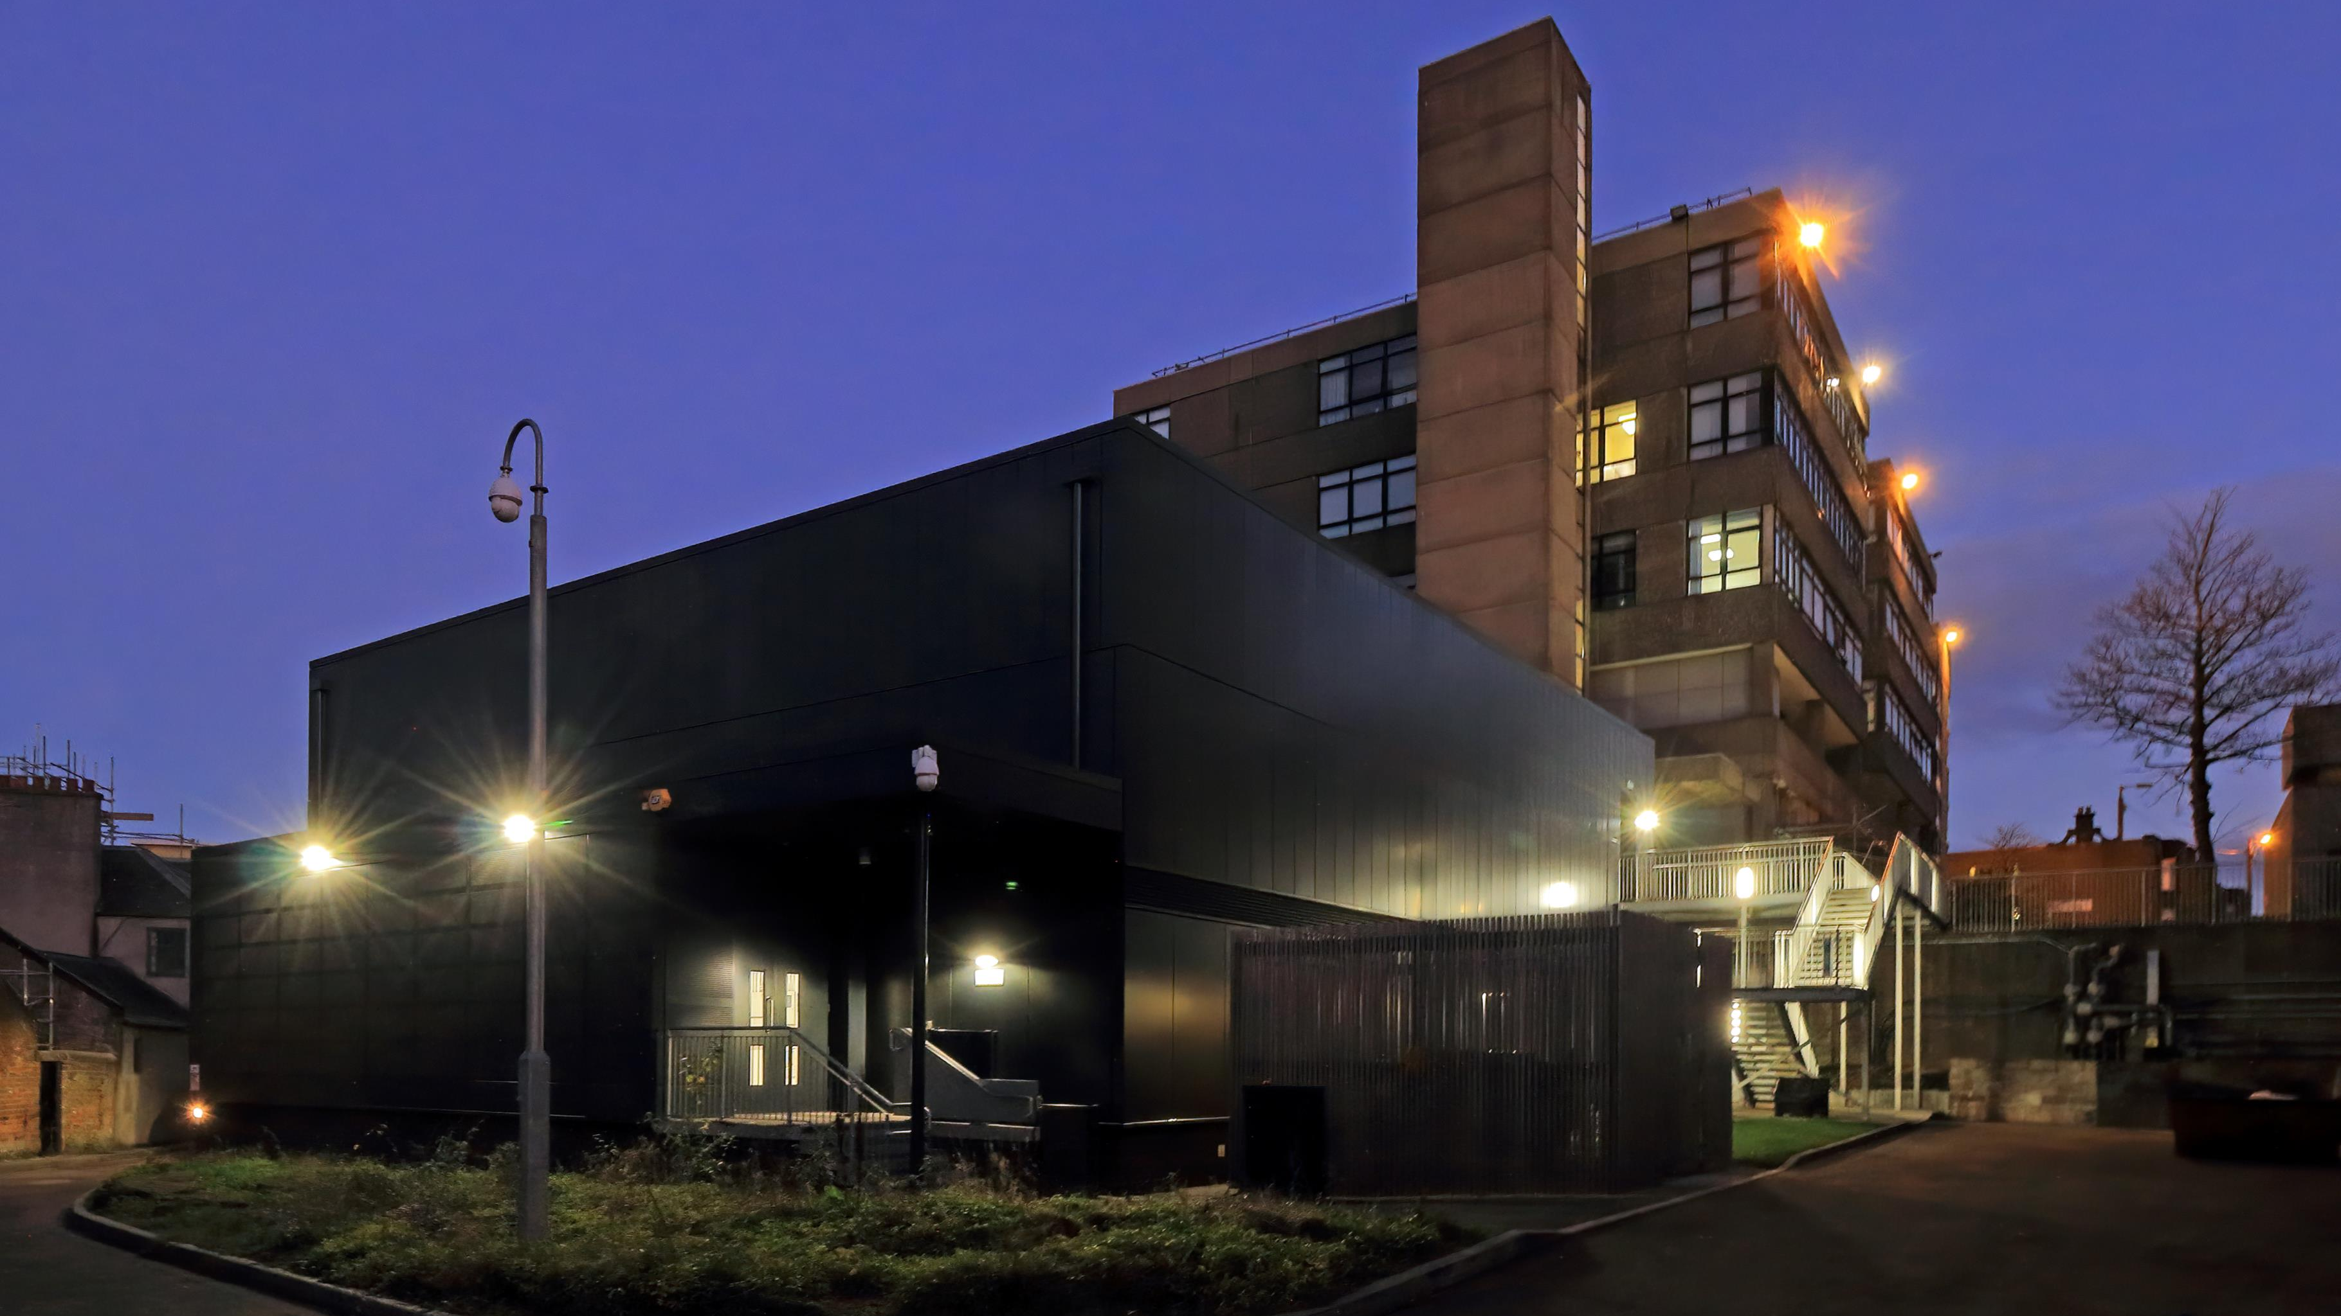
ScotGrid Glasgow
How things have changed over the last 1,323 days…
ScotGrid Face-to-Face
Glasgow, 10th June 2022

Slide 2
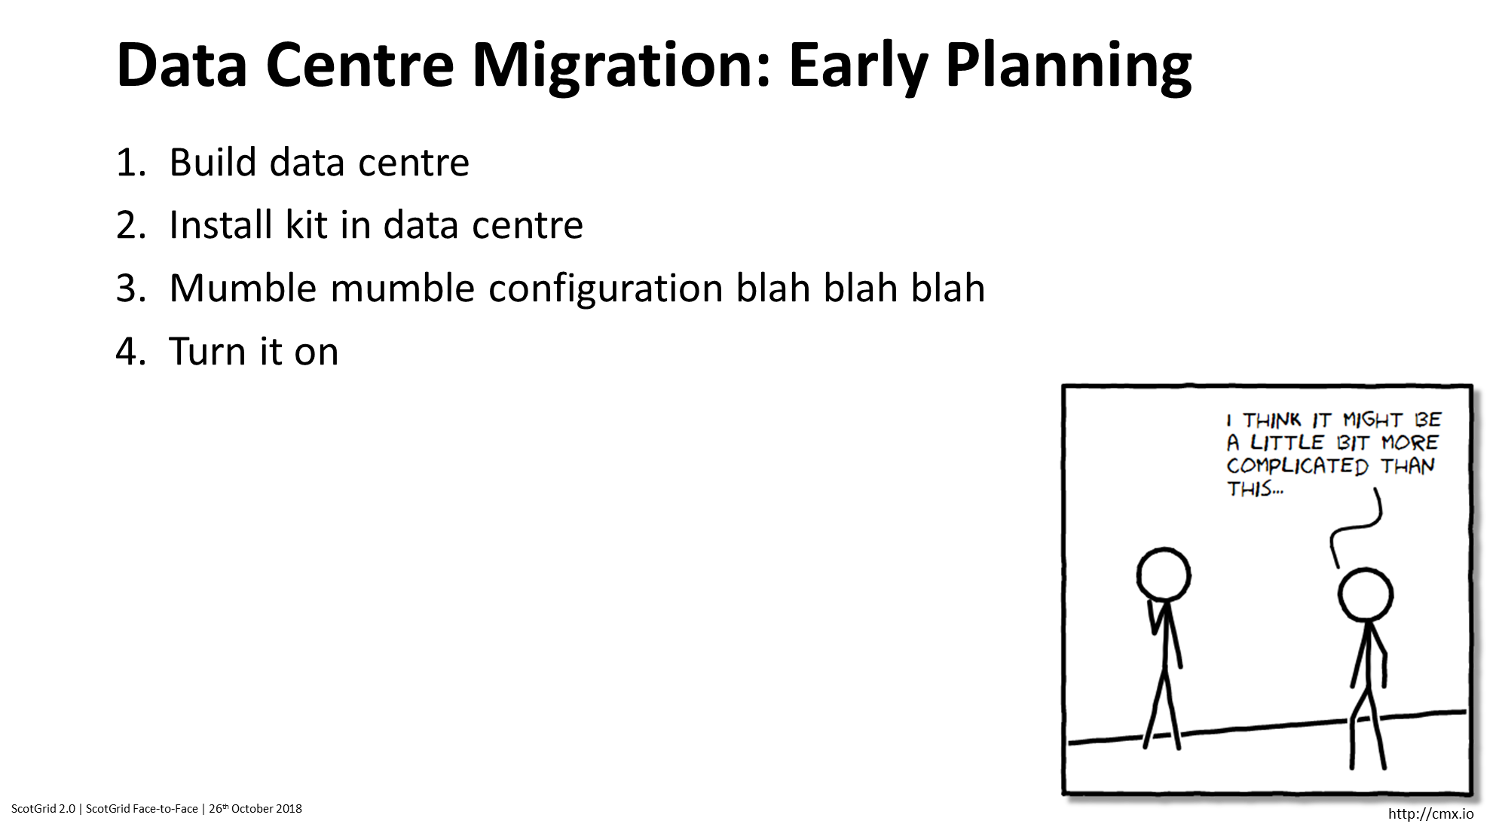

Slide 3
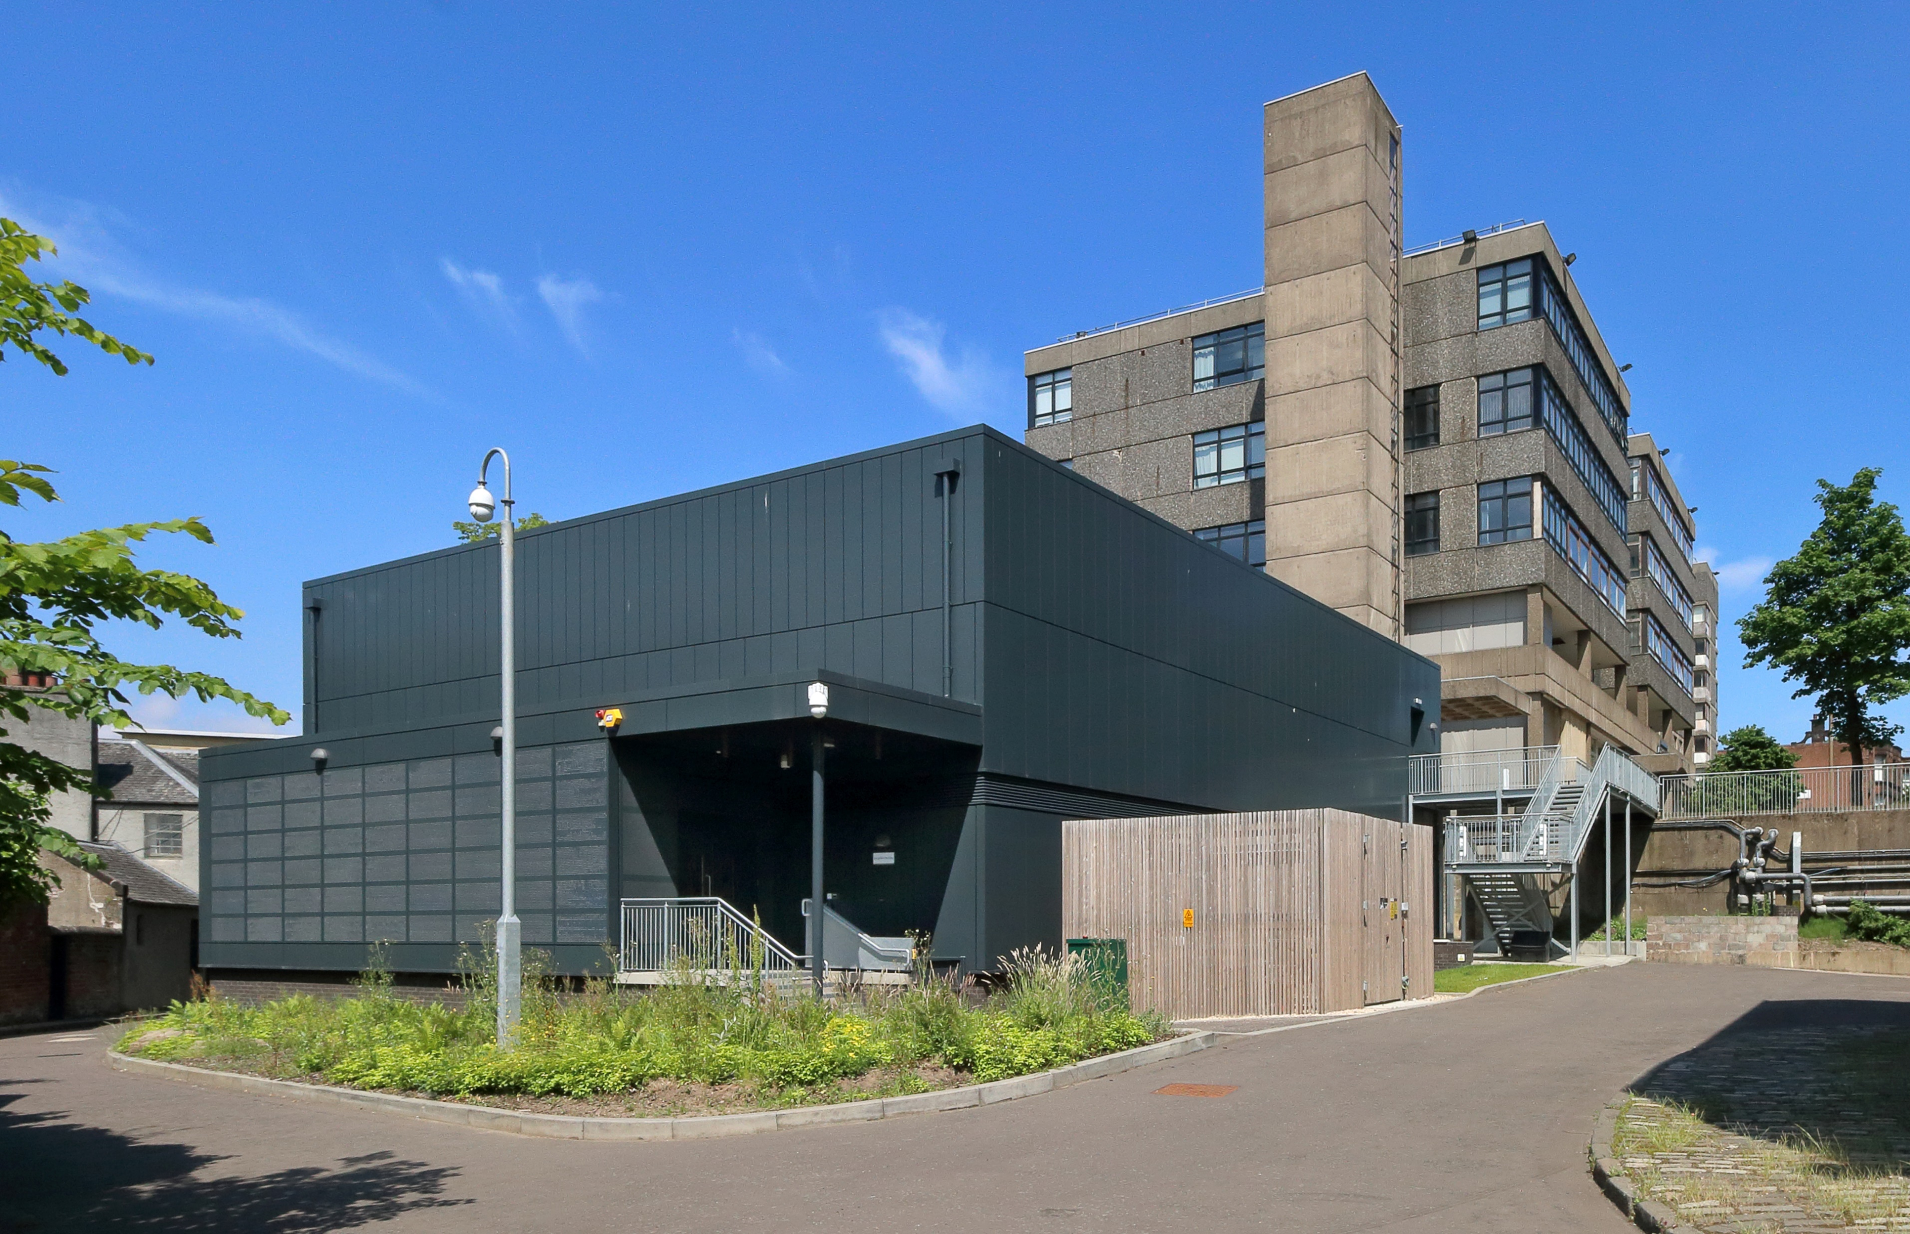

Slide 4
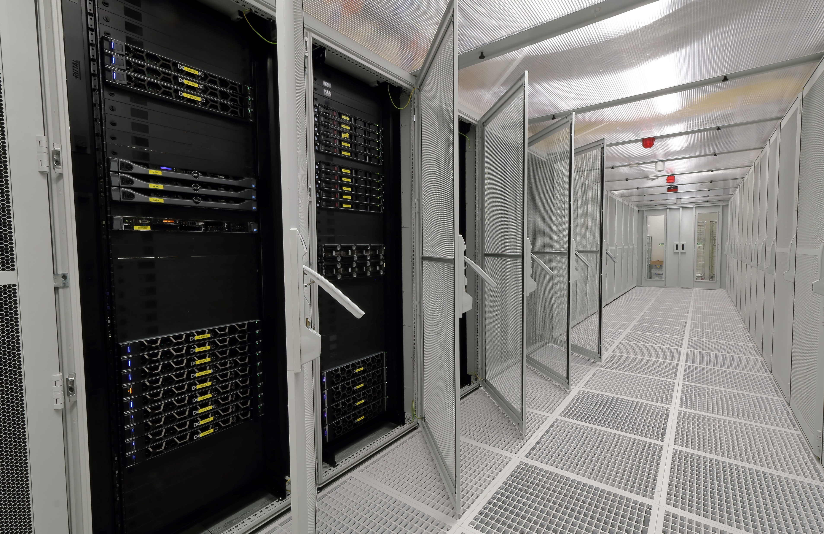

Slide 5
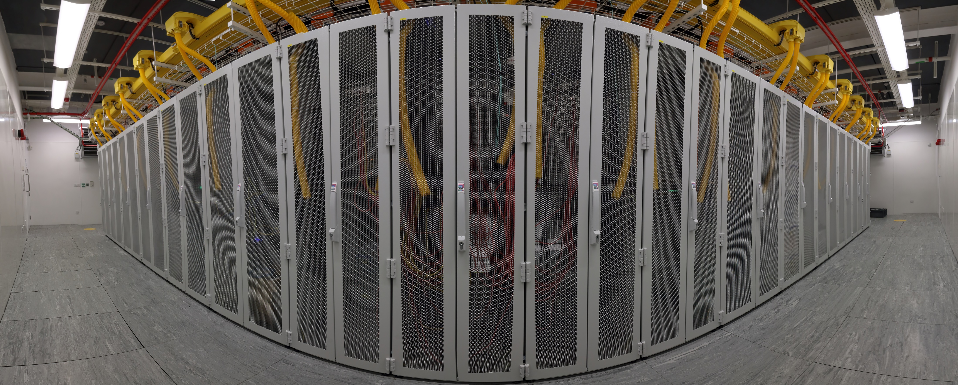
Saughfield Building
Plenty of space, but power and cooling are restrictive
  Designed when income was typically ~£250K every other year, and 6 kW per rack was reasonable
  We spent £1.1M in 2021…

Slide 6
Reshuffle
Gareth moved to IT Services (April 2021)…
…so Gordon took over Gareth’s site role (August 2021)…
…and Sam became GridPP Project Manager…
…and Jonathan arrived to replace Gordon in PPE (December 2021)
(And Emanuele kept the site running while the rest of us were playing musical chairs)

Slide 7
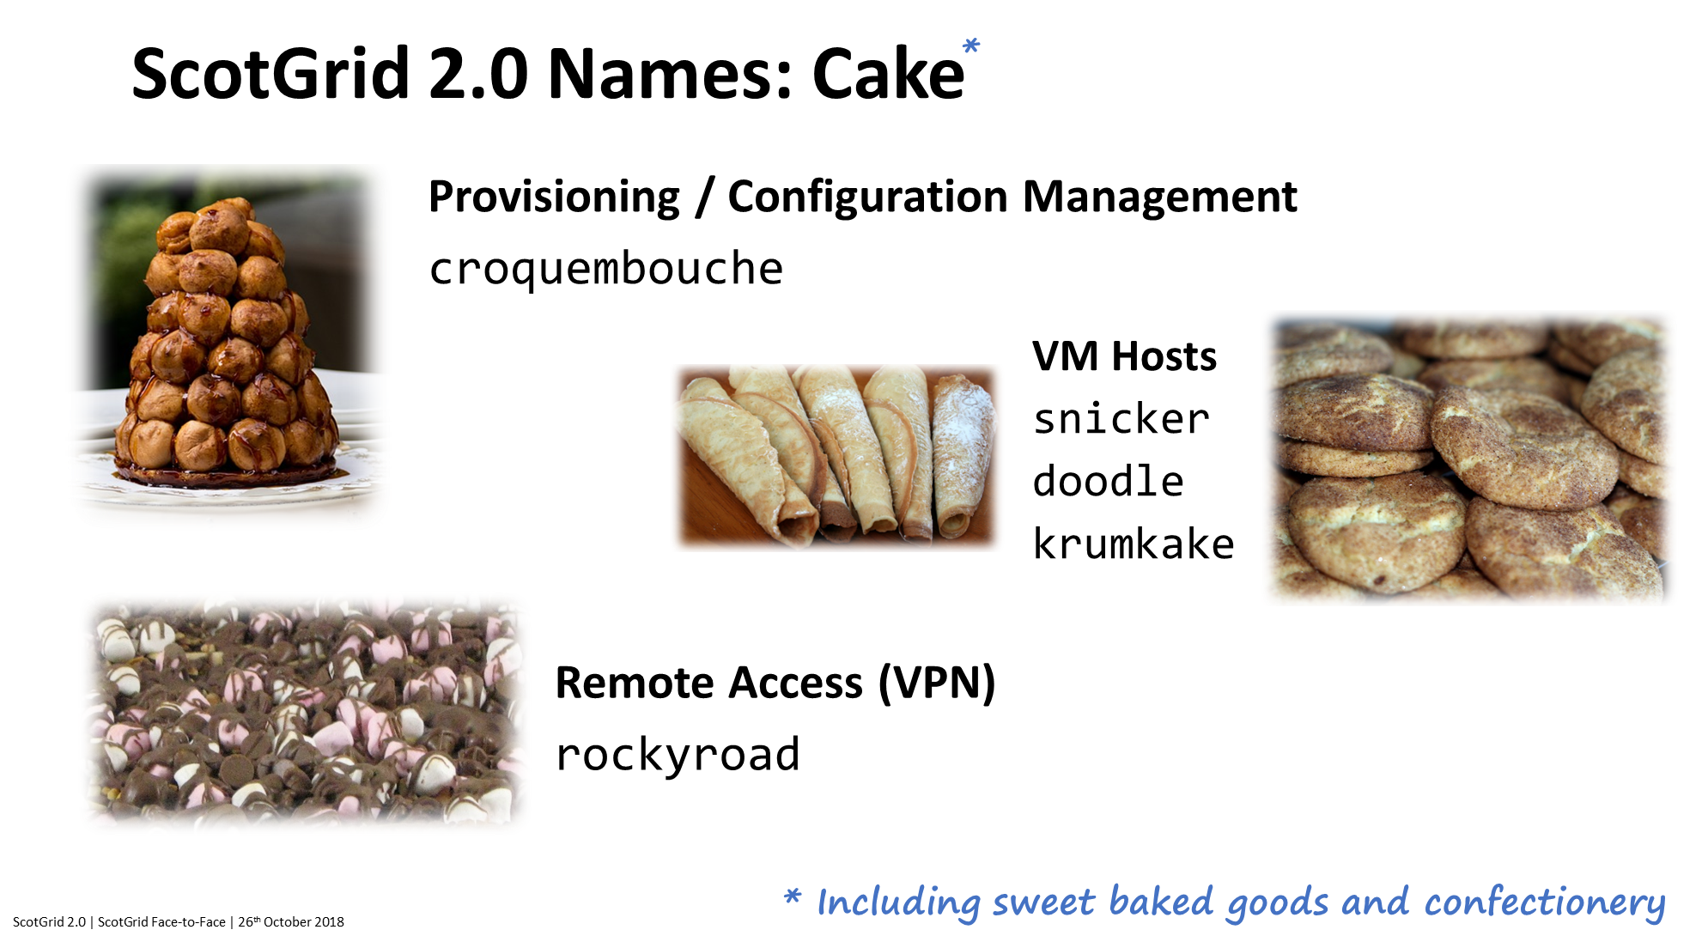

Slide 8
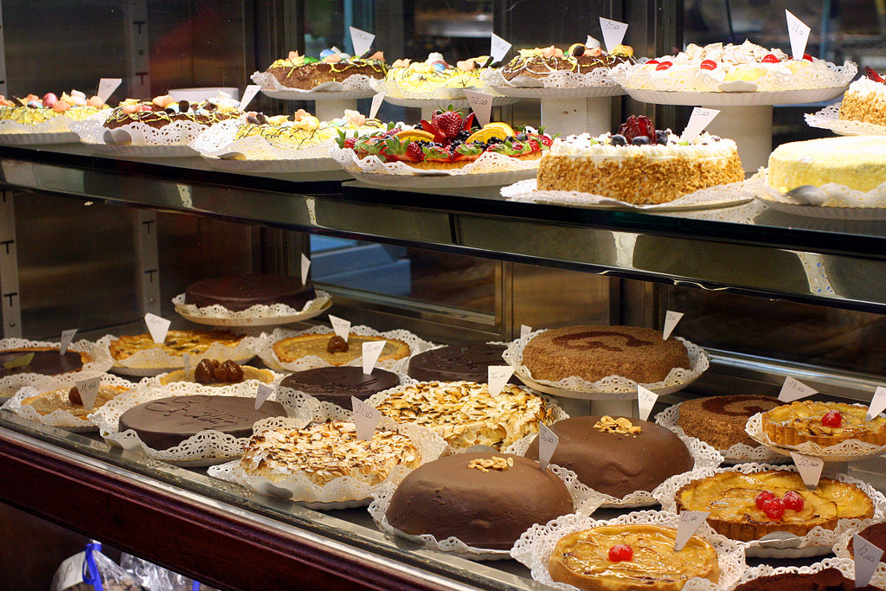
Naming scheme
Provisioning
croquembouche
DNS
baklava
tulumba
chalvas
DHCP
kataifi
NAT
stroop
wafel
VPN
rockyroad
Squid
biscotti
cantucci
Proxmox
snicker
doodle
krumkake
tiramisu
Argus
chocobox
Services
foithong
panettone
flaskerund
Monitoring
gingersnap
speculaas
yulelog
whoopie
victoria
jammydodger
twizzlers
pancake

Slide 9
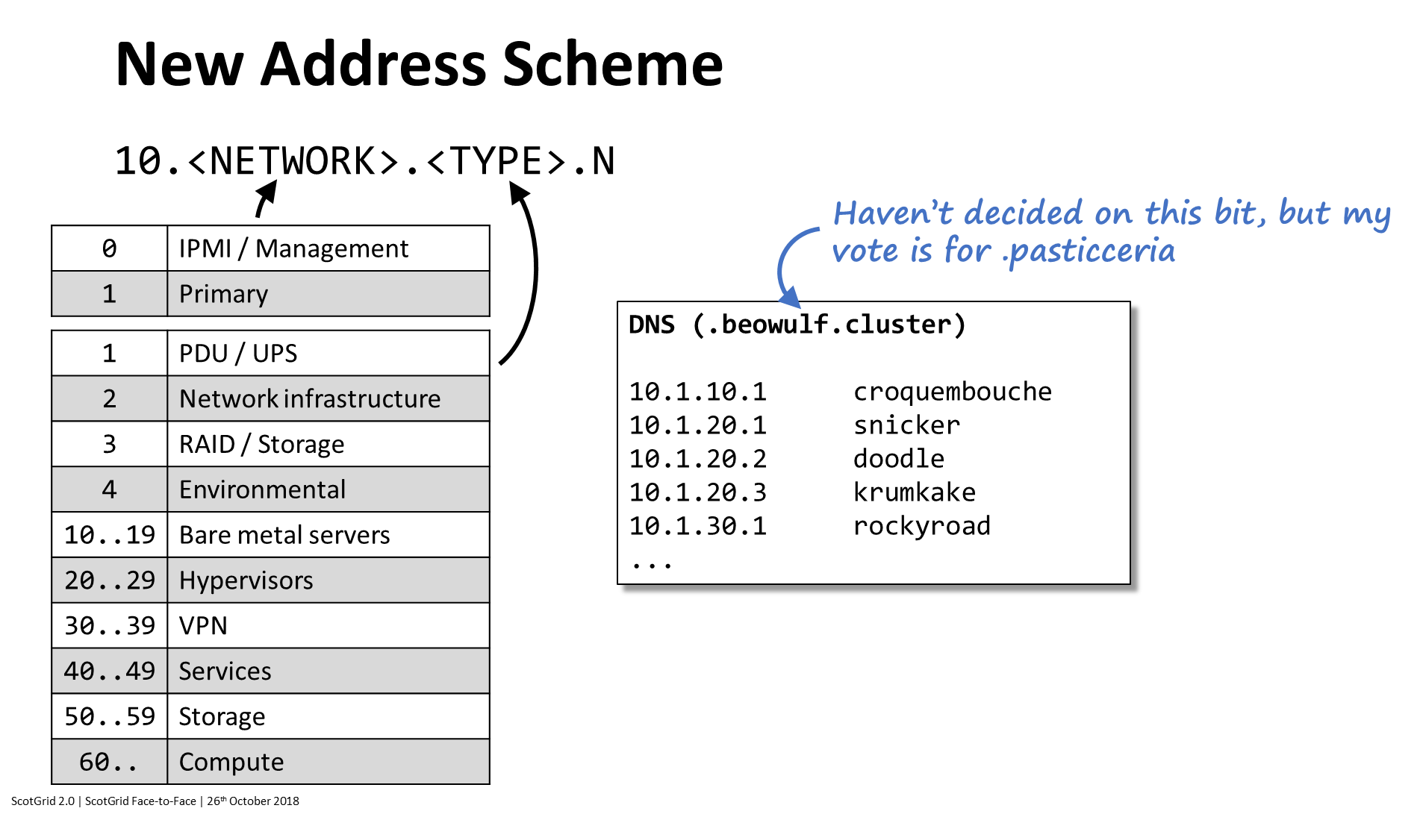

Slide 10
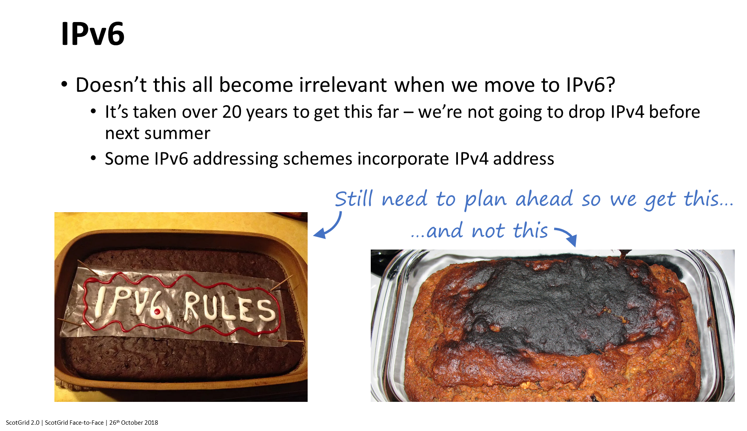


Slide 11
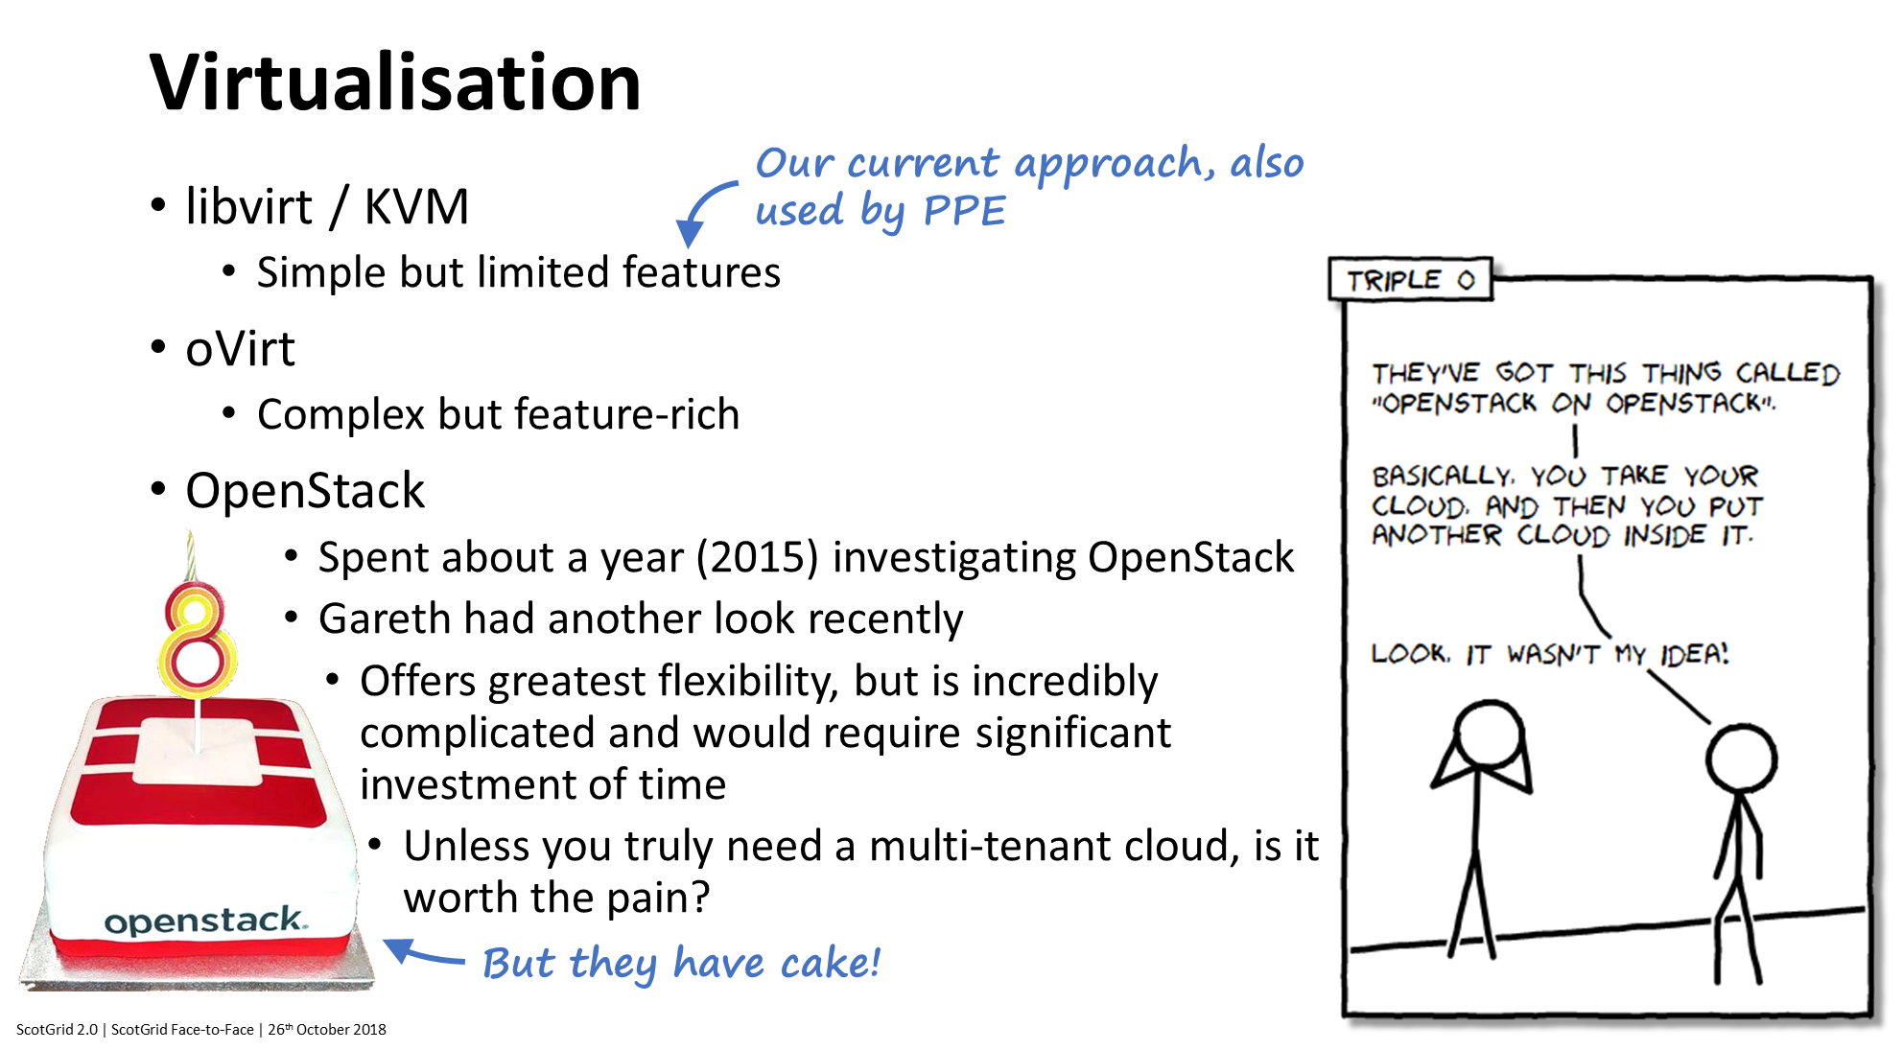

Slide 12
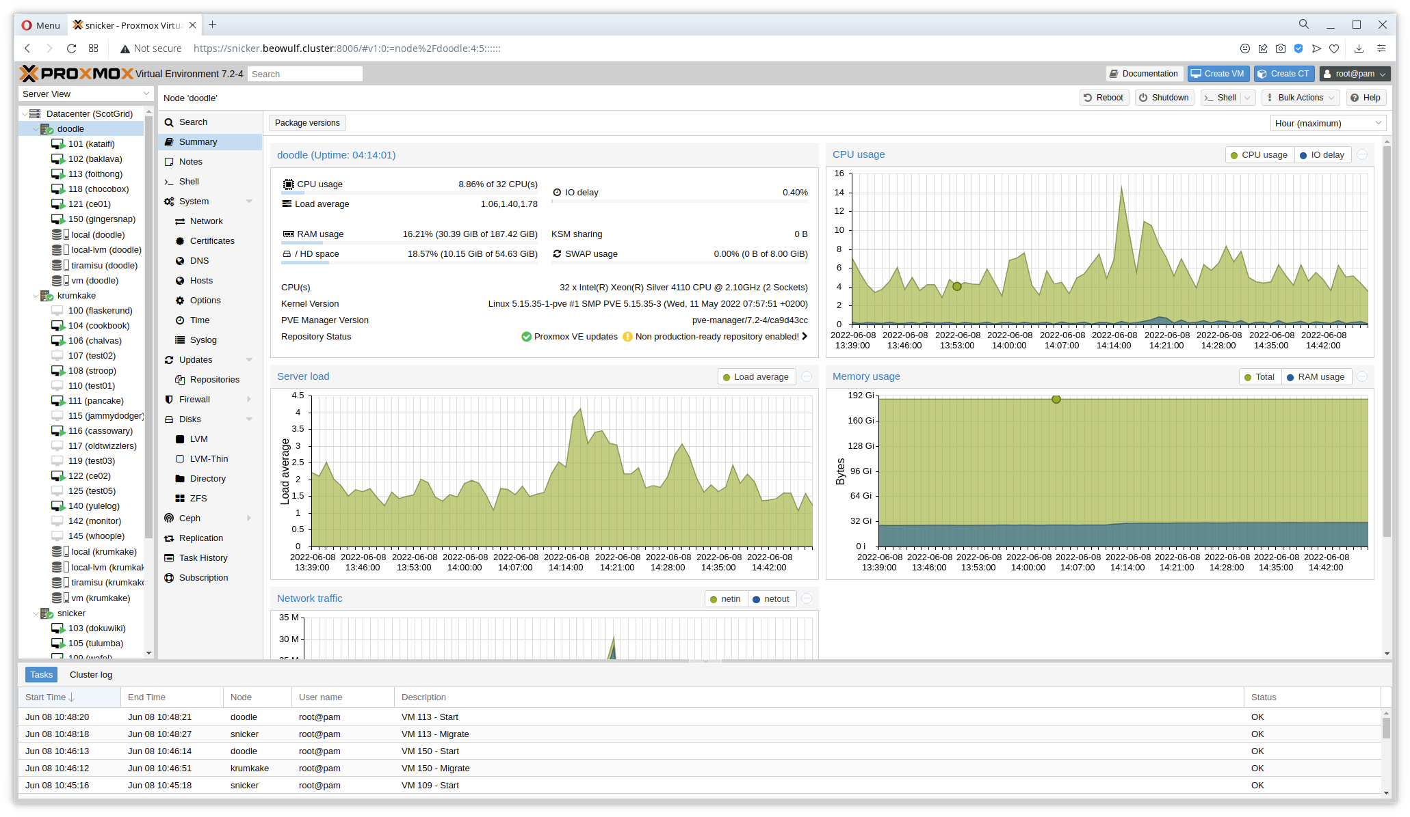

Slide 13
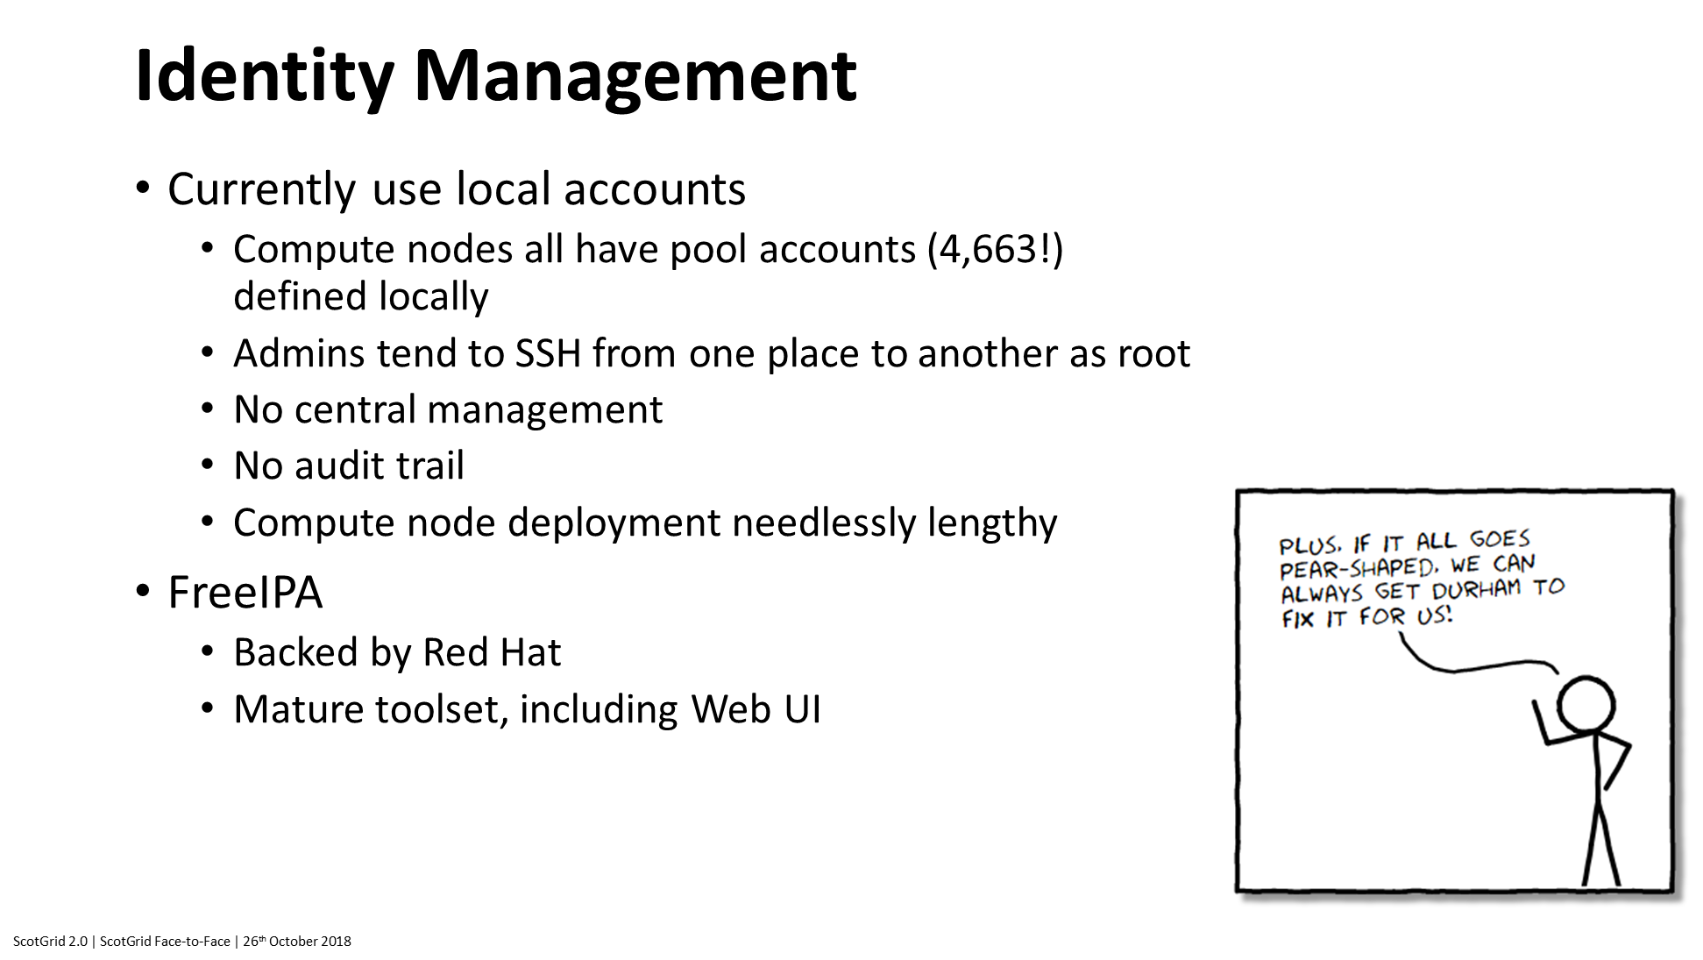

Slide 14
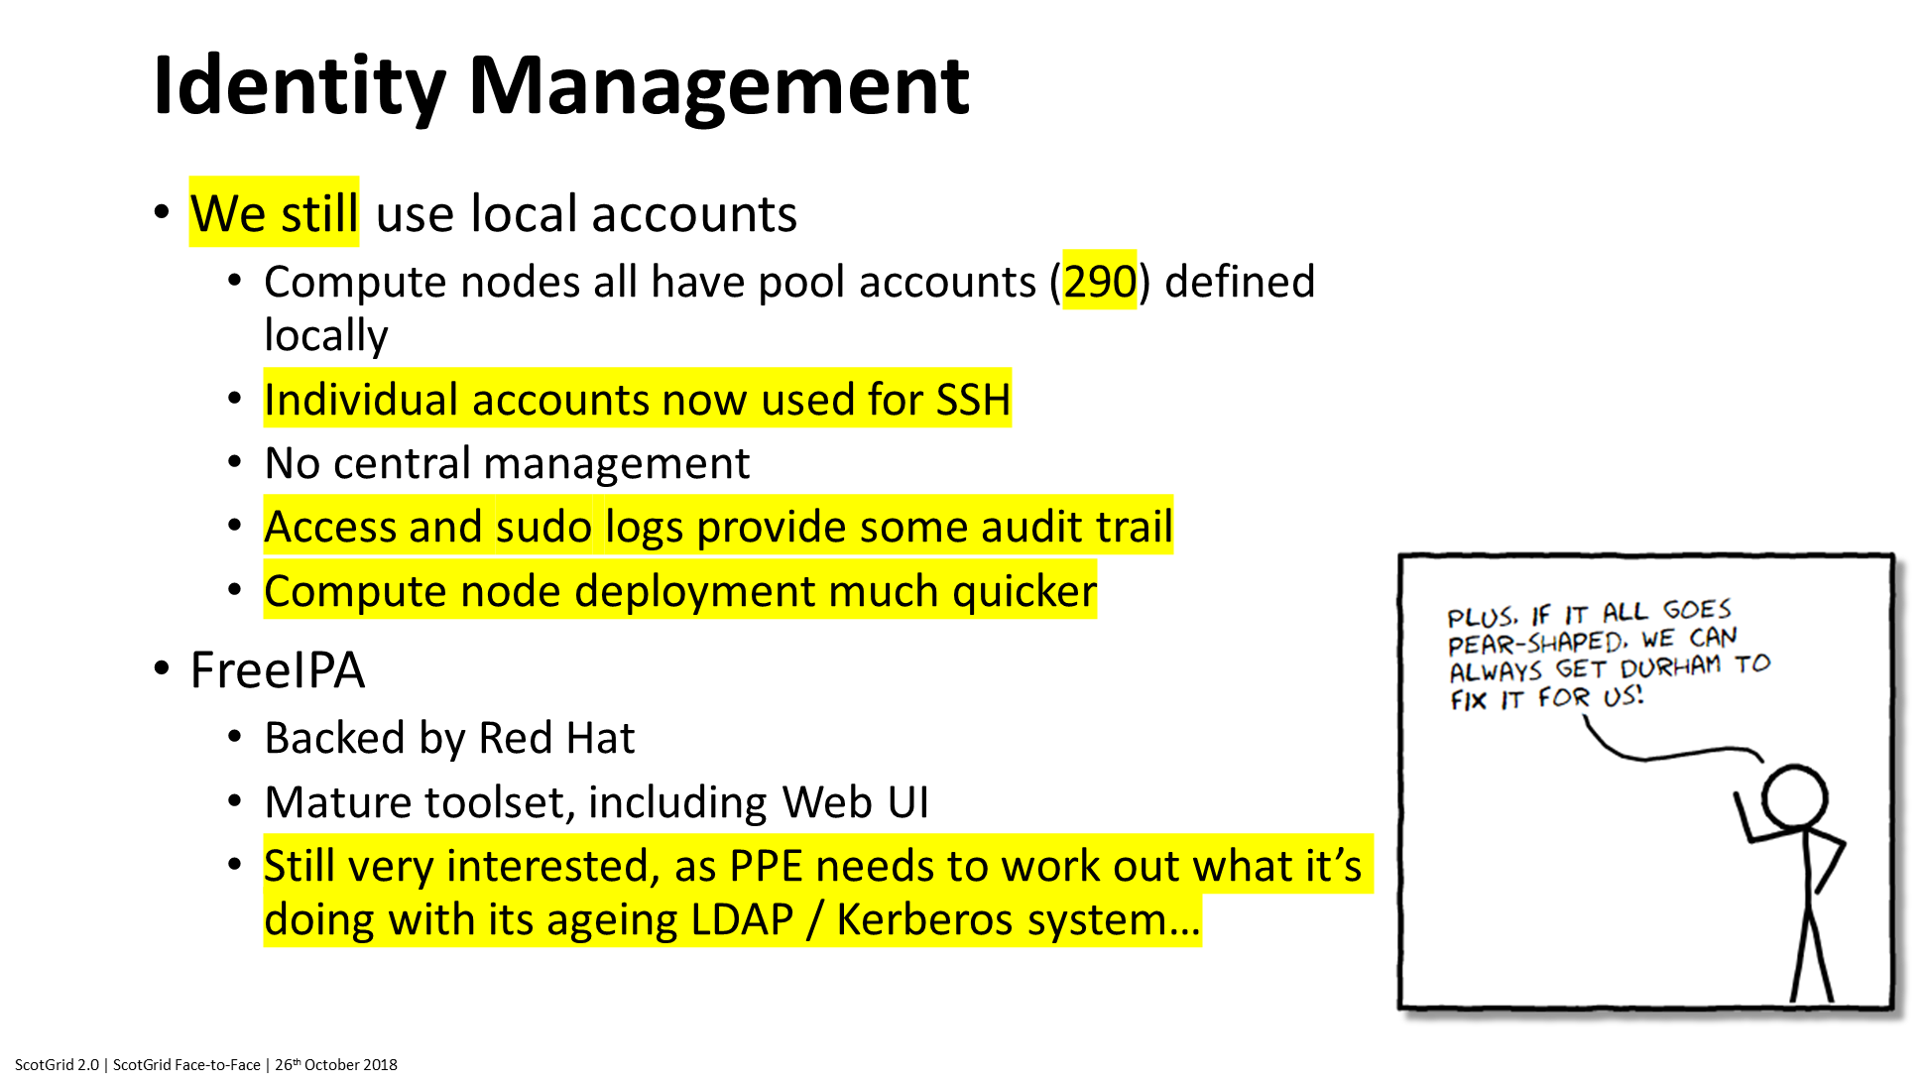

Slide 15
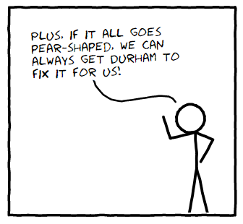
Identity Management
We still use local accounts
  Compute nodes all have pool accounts (290) defined locally
  Individual accounts now used for SSH
  No central management
  Access and sudo logs provide some audit trail
  Compute node deployment much quicker
FreeIPA
  Backed by Red Hat
  Mature toolset, including Web UI
  Still very interested, as PPE needs to work out what it’s doing with its ageing LDAP / Kerberos system…
ScotGrid 2.0 | ScotGrid Face-to-Face | 26th October 2018

Slide 16
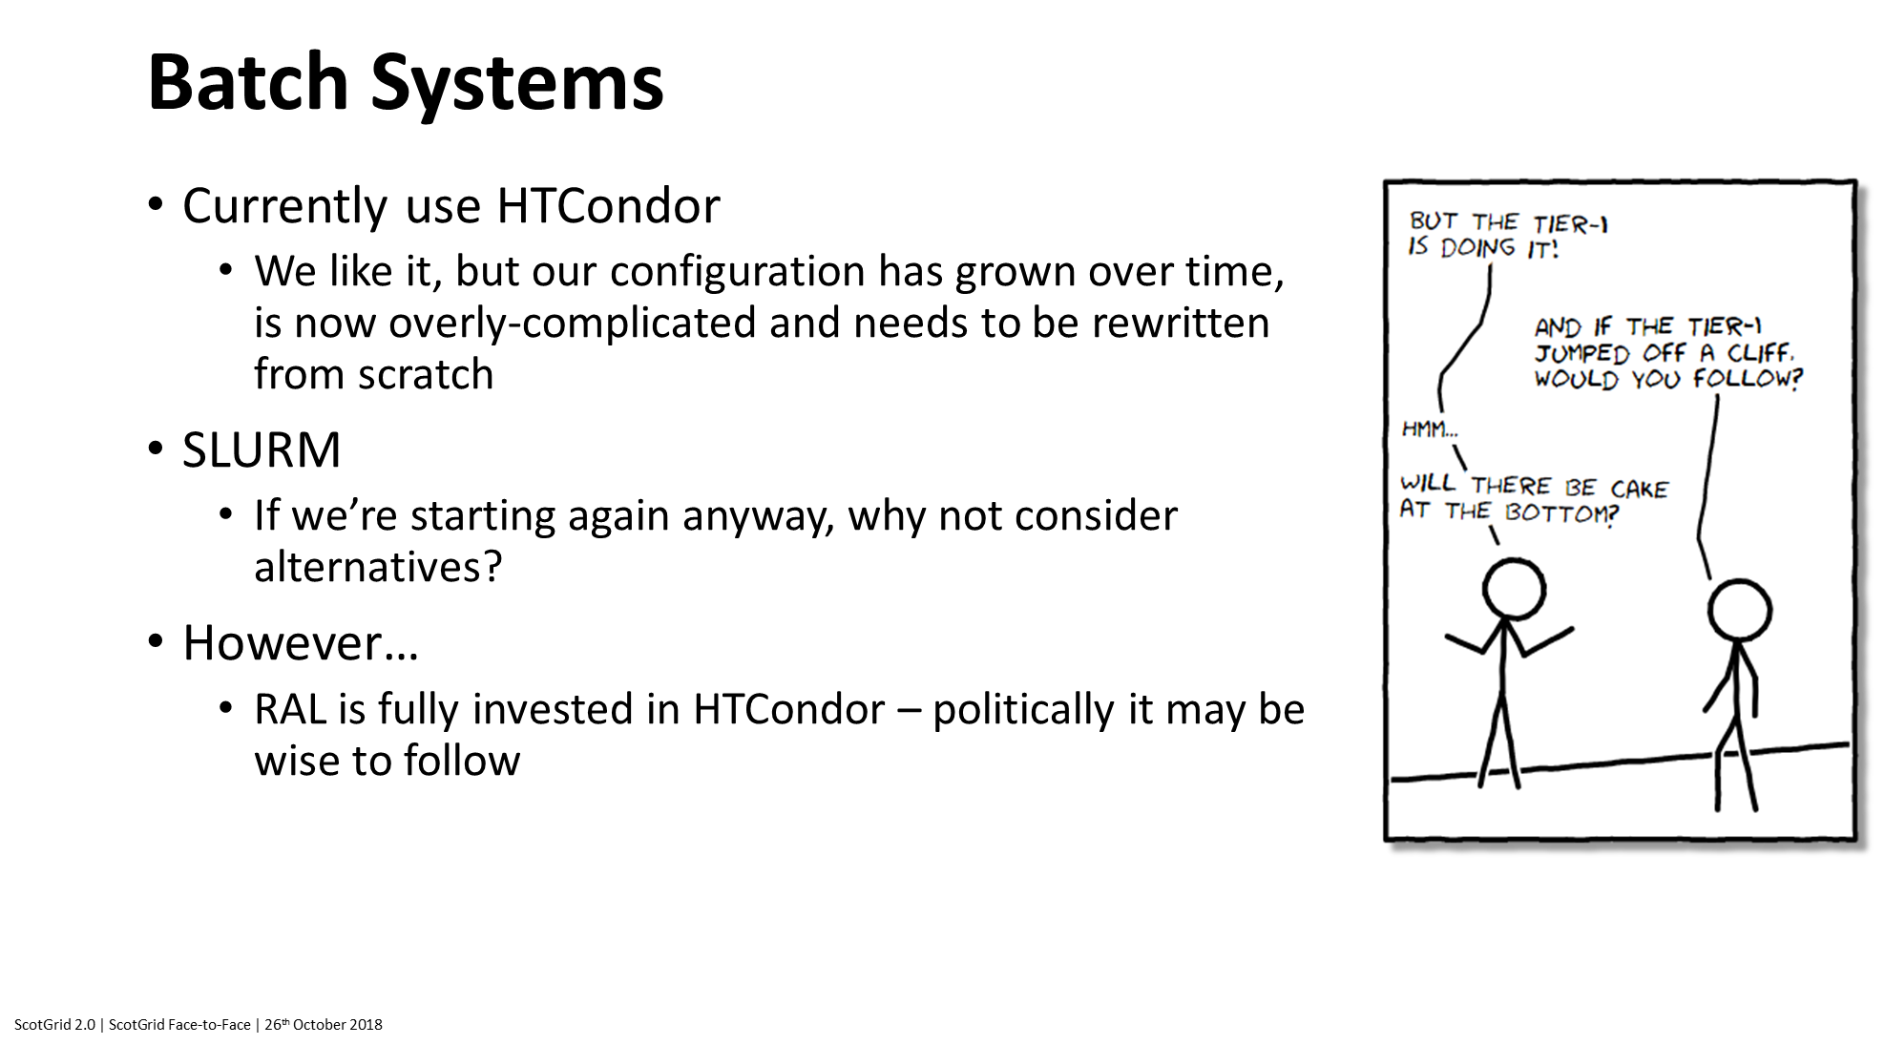

Slide 17
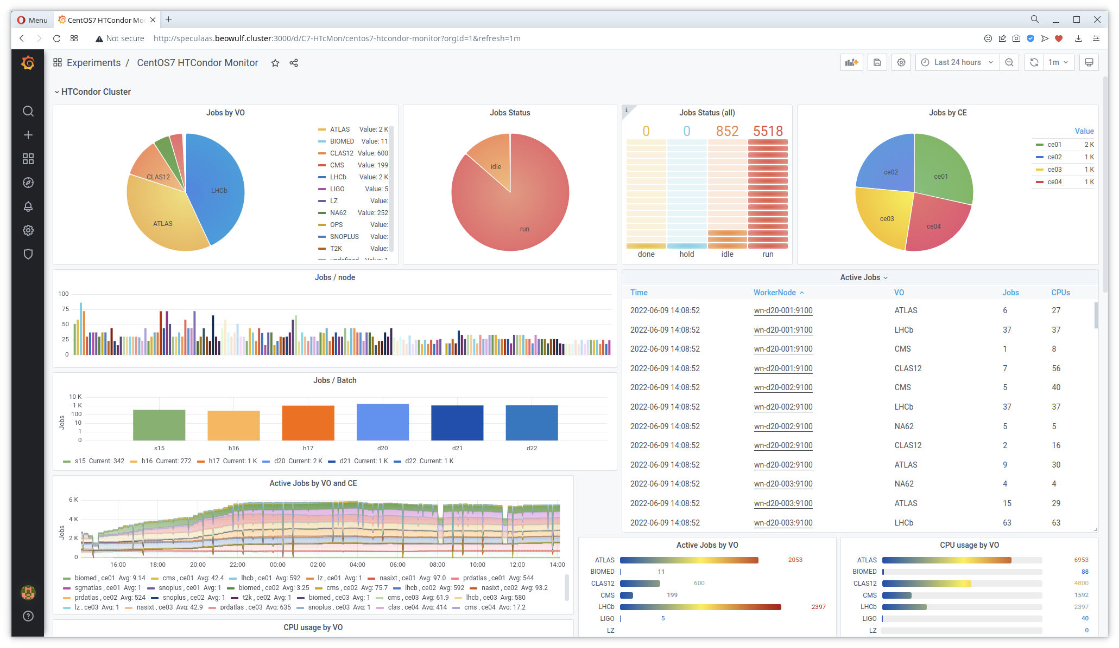

Slide 18
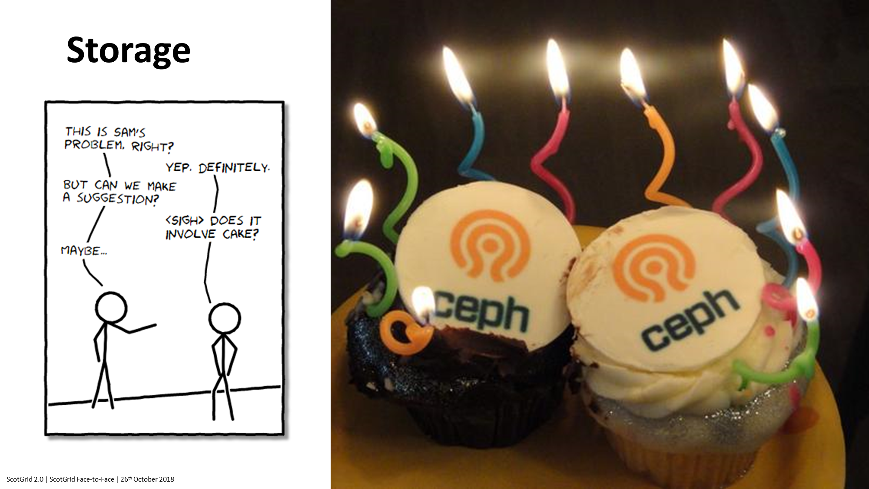

Slide 19
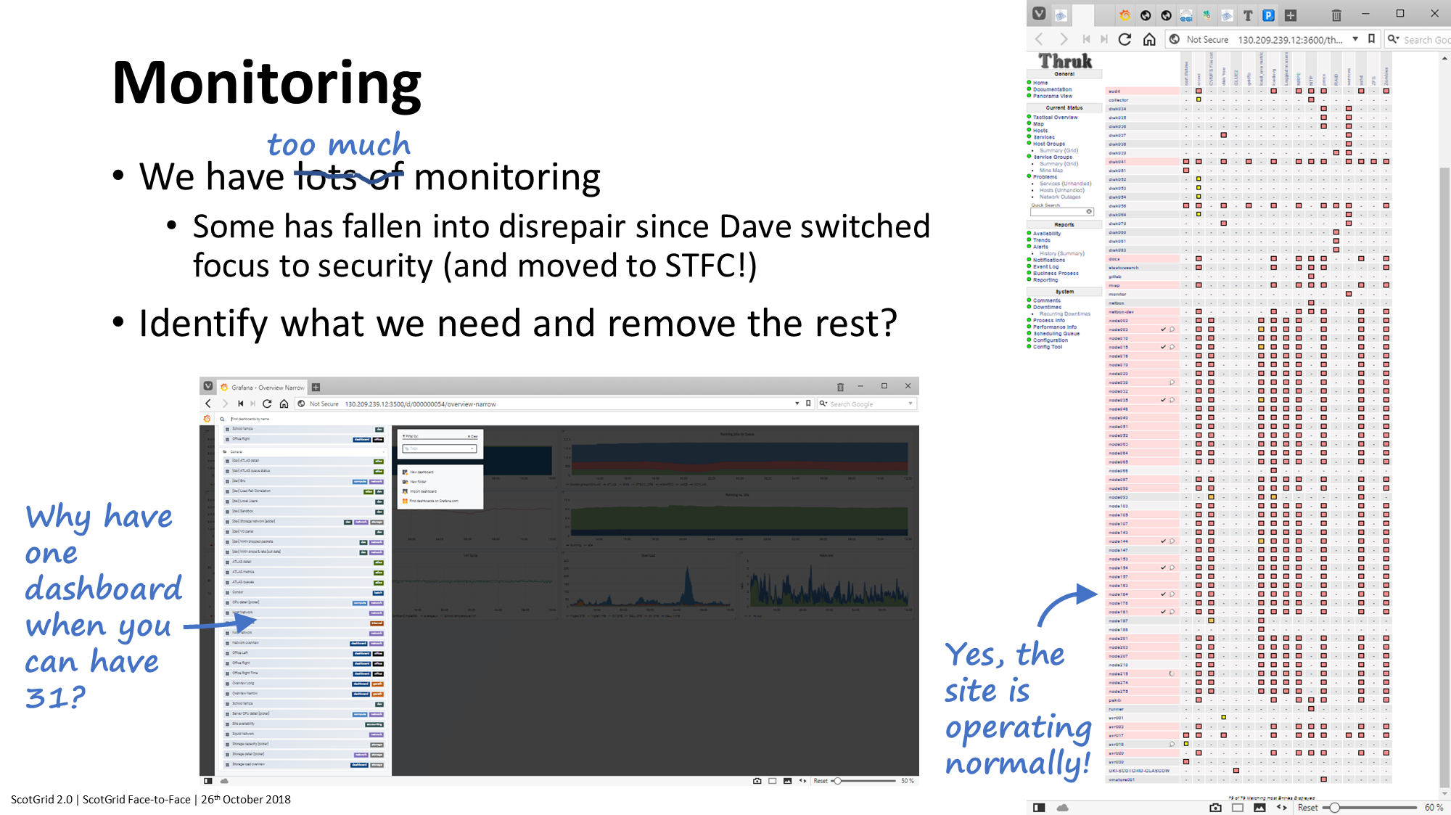

Slide 20
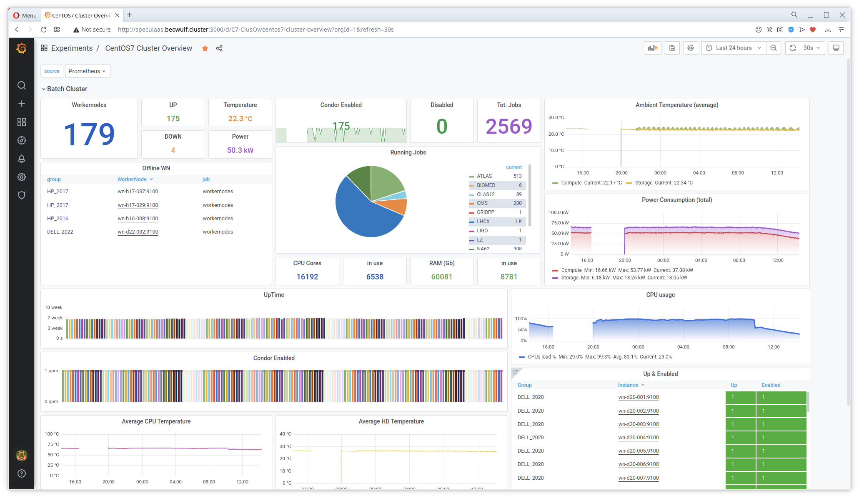

Slide 21
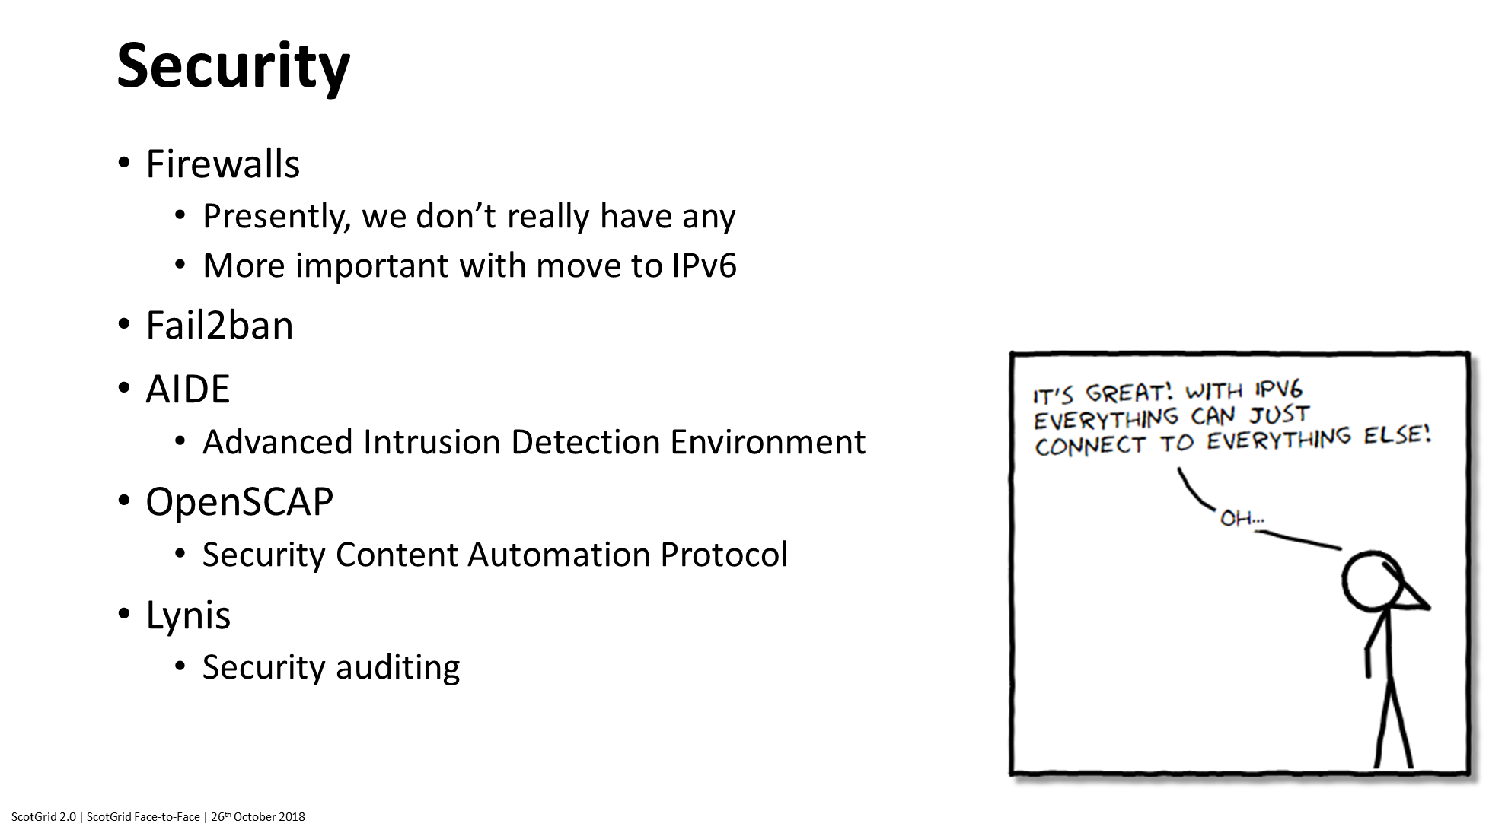

Slide 22
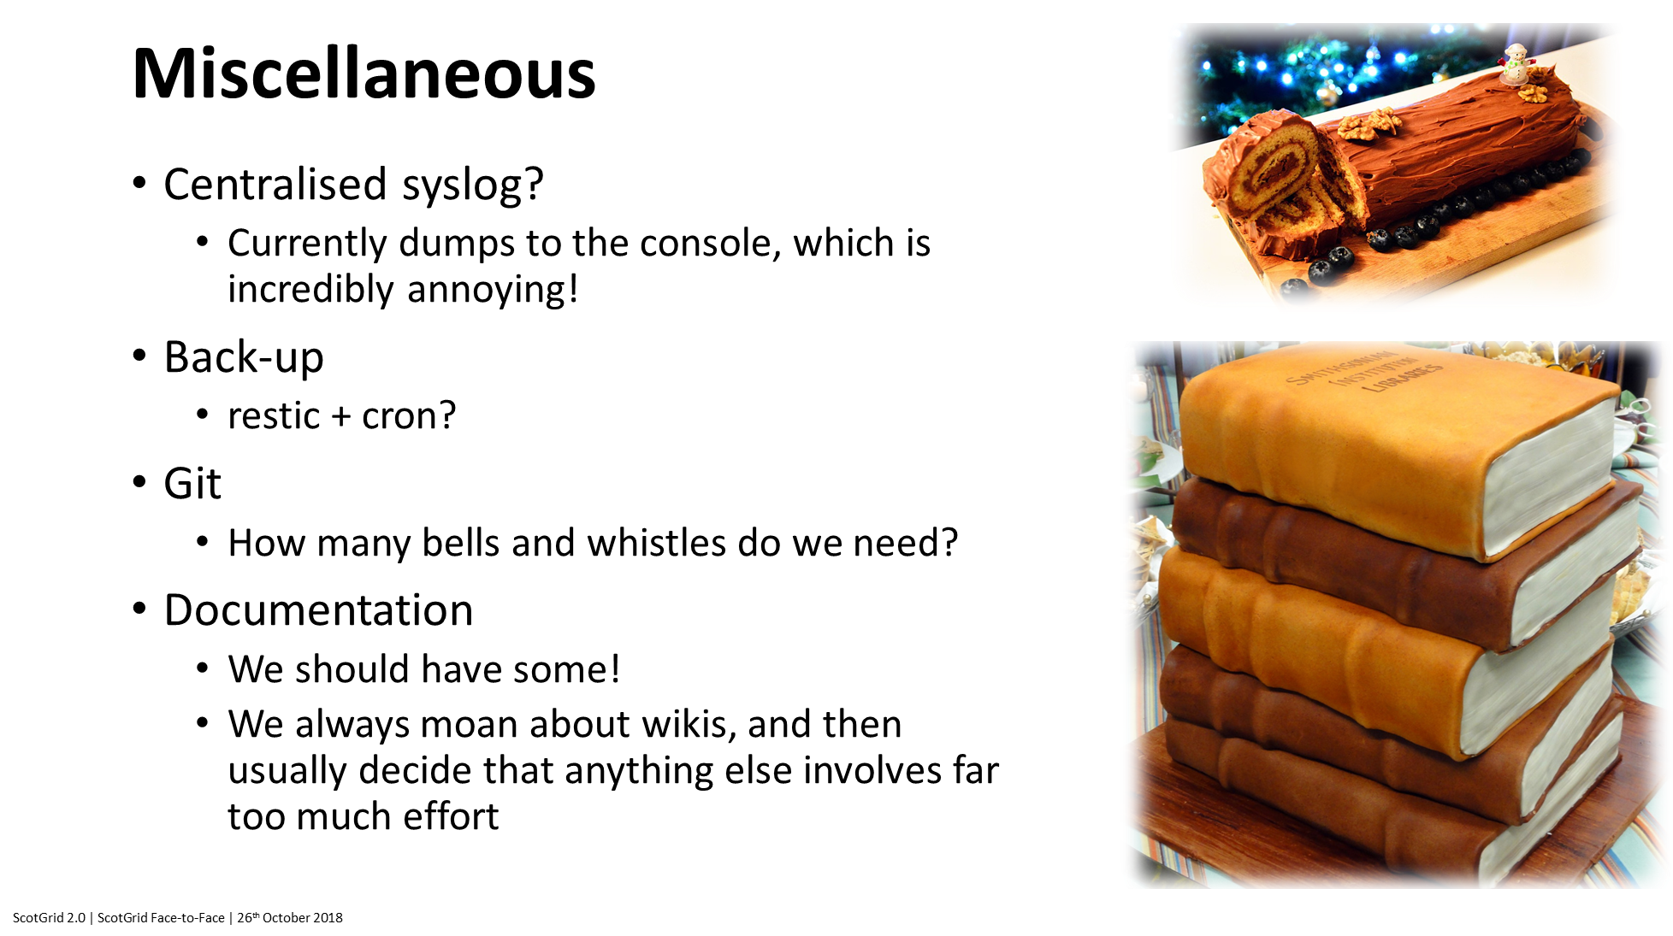

Slide 23
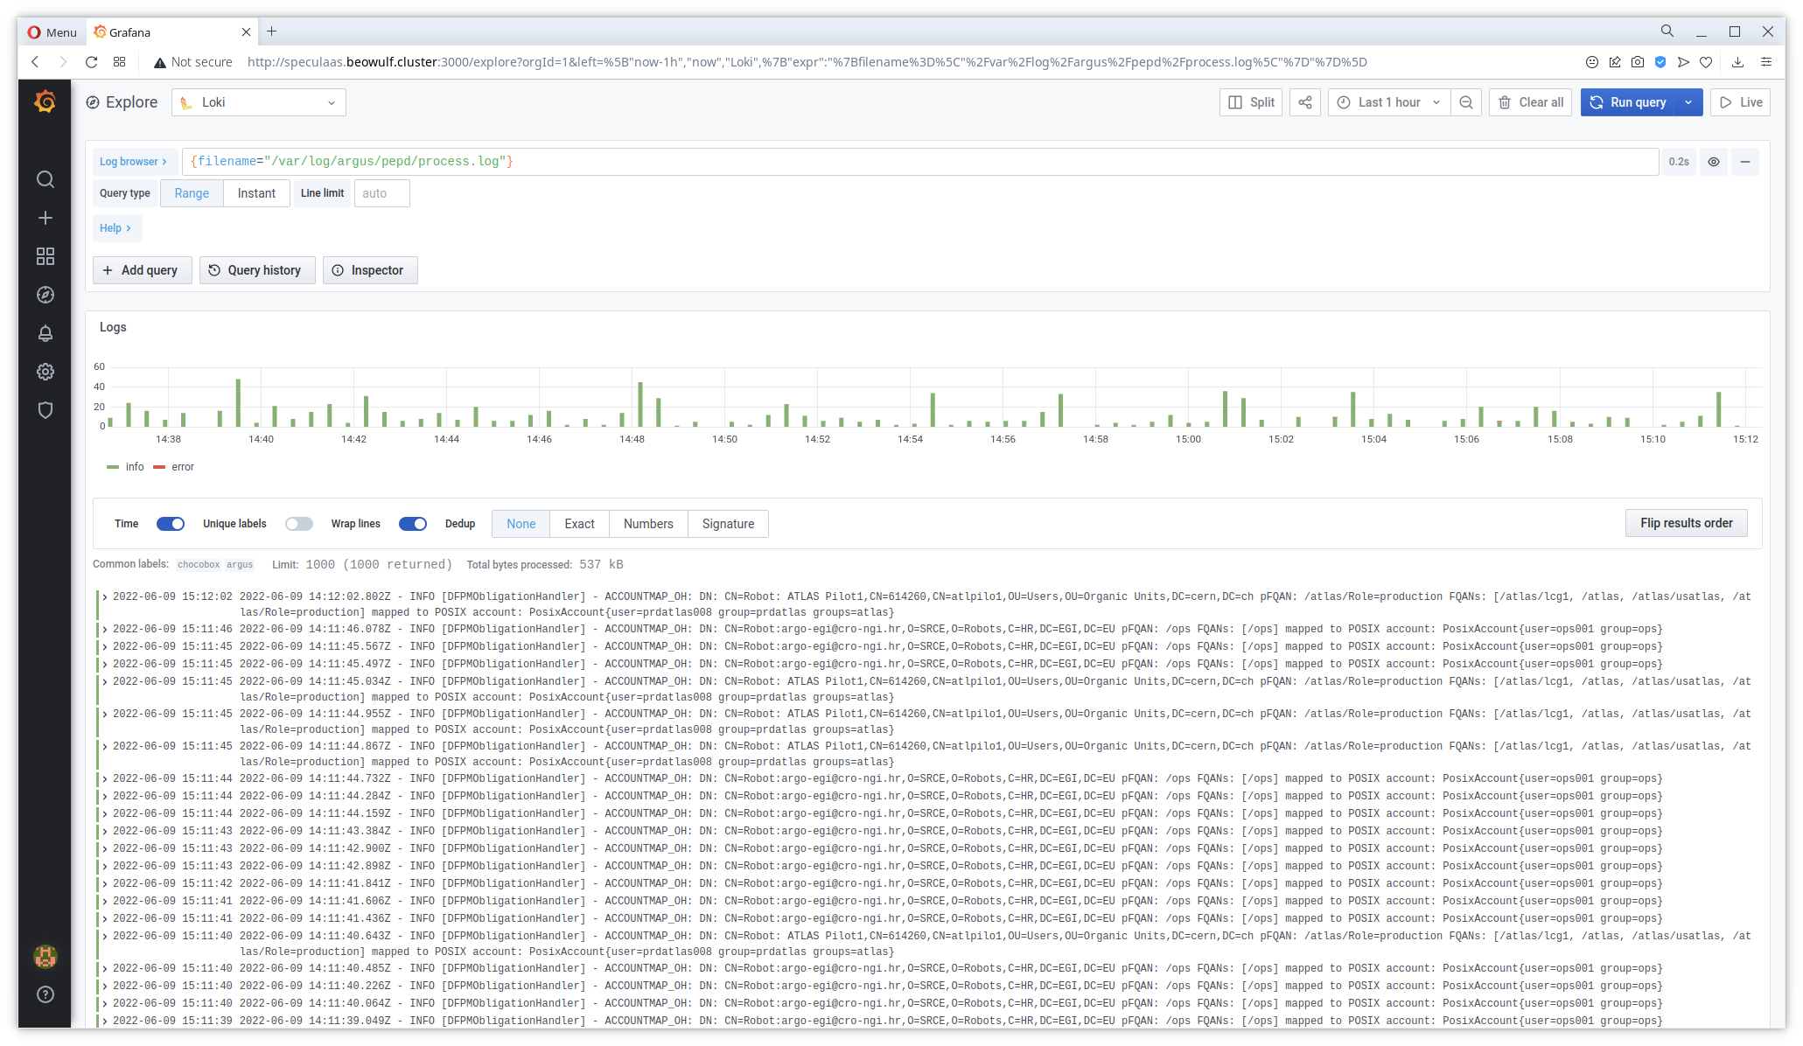

Slide 24
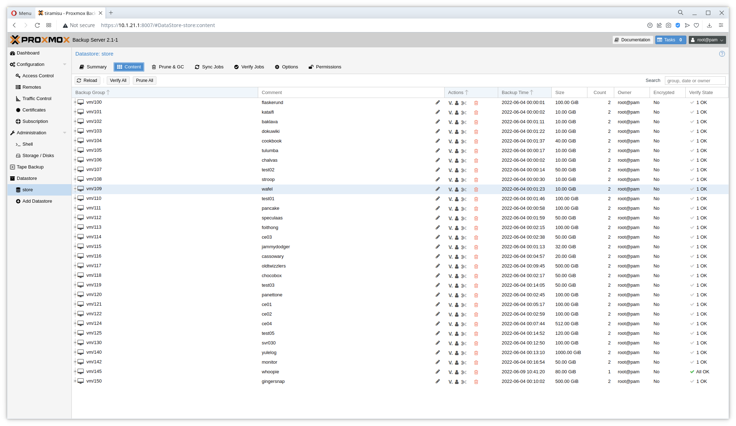

Slide 25
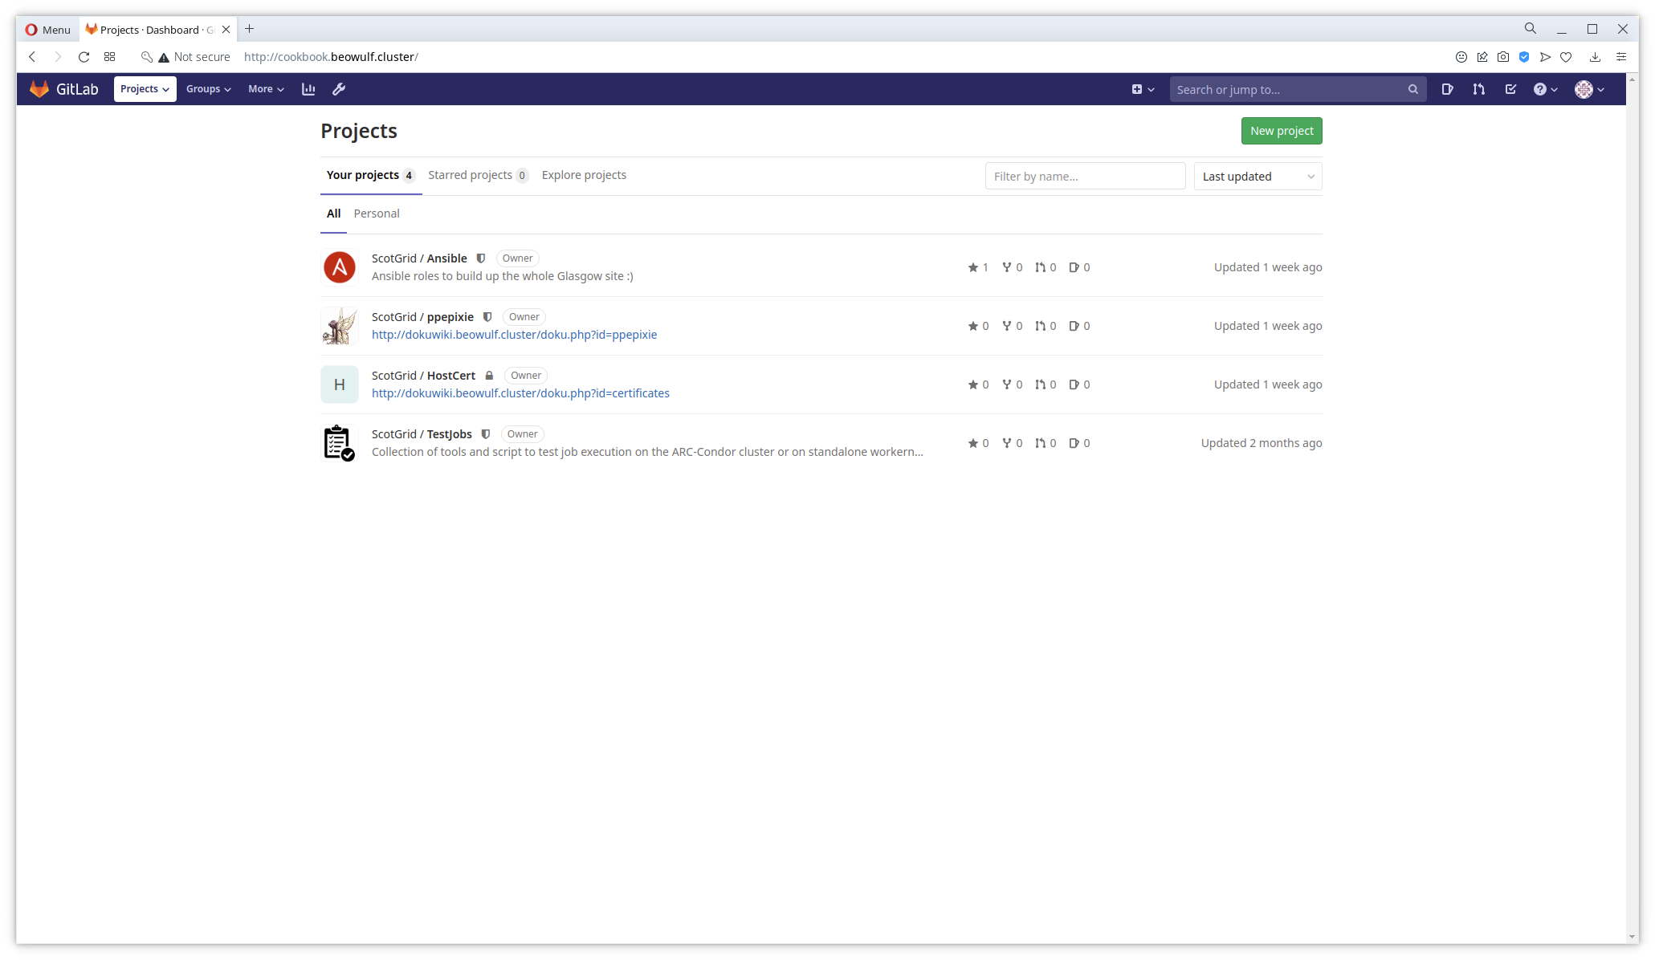

Slide 26
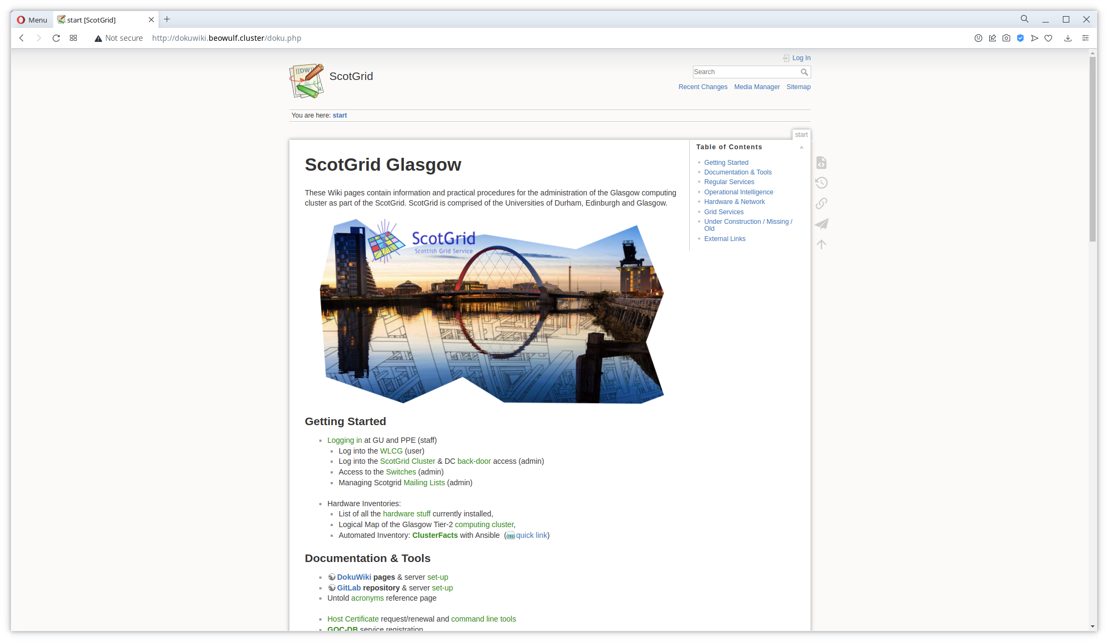

Slide 27
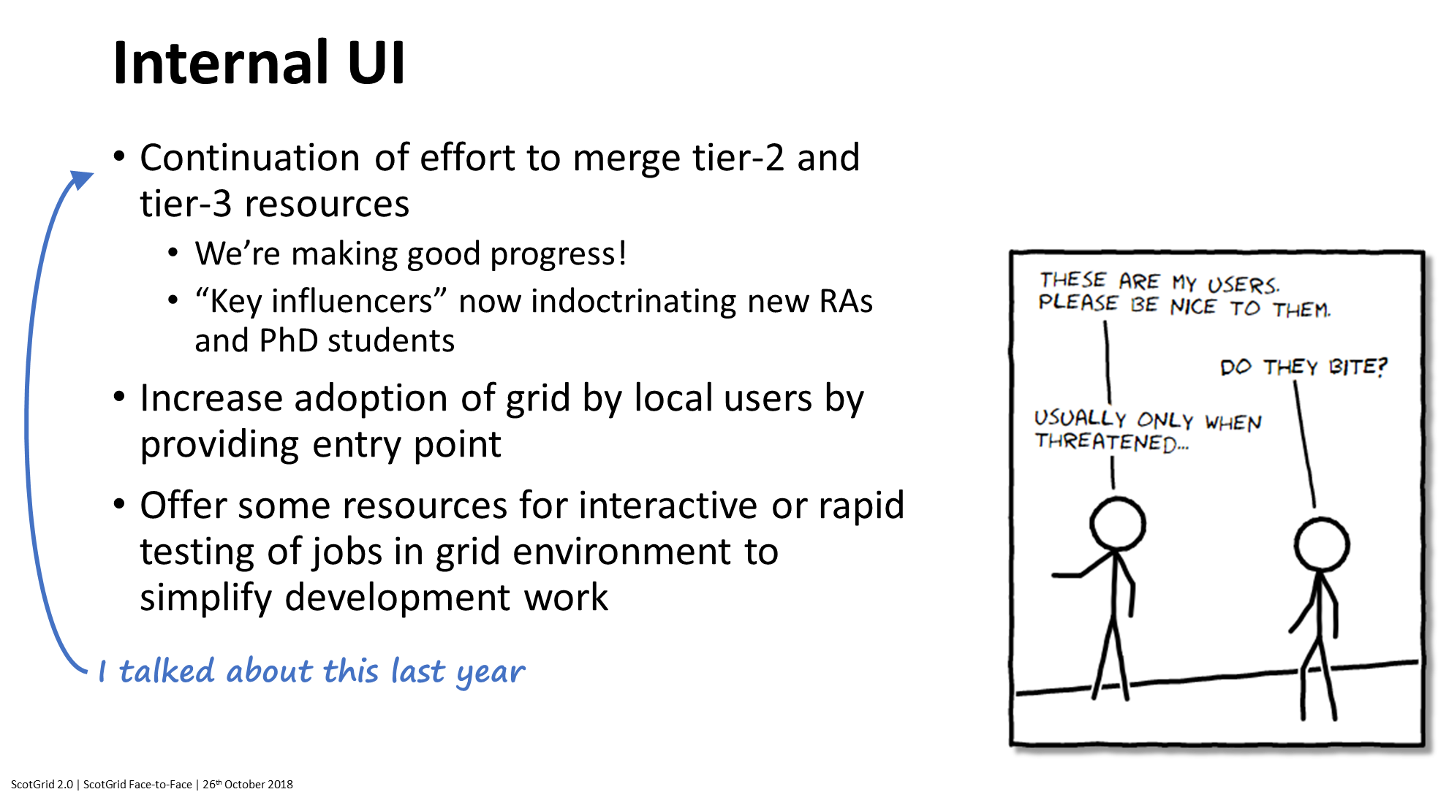

Slide 28
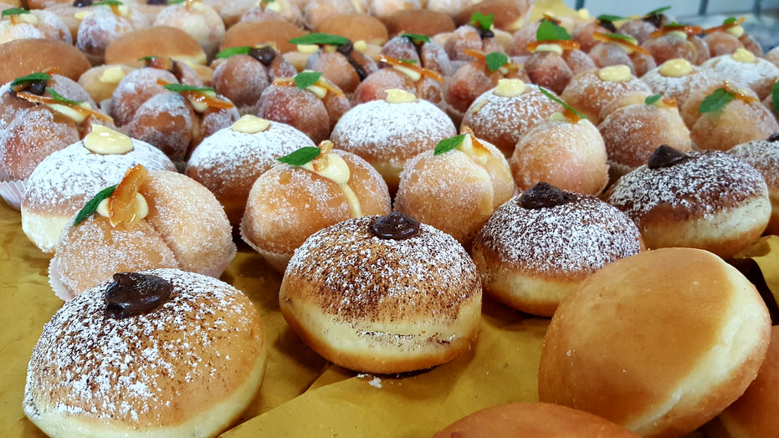
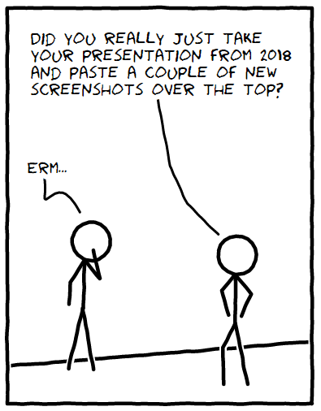
Summary
Data centre migration almost complete…
Site management is generally much better than it was, but still lots to do
What’s next?

