Slide 1
Carbon gantry project(s)
Marco Pullia

Slide 2
Comparison of the depth dose profiles
Protons/Carbon
Electrons
Photons
Tumour
Beam

Slide 3
Treatment delivery
(courtesy of Siemens Medical)

Slide 4
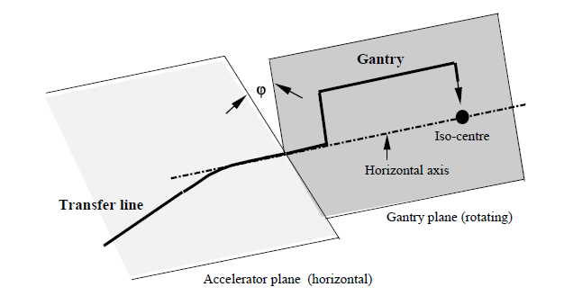
What is a gantry
A gantry is a section of beamline that can rotate around the isocenter in order to direct the beam onto the patient from any direction

Slide 5
Why a gantry?
To treat patients in supine position (eventually prone) in the same position in which CT, PET and MRI were acquired. Patient rotation only around gravity to preserve internal organs and soft tissue geometry.
To provide the maximum flexibility in selecting the irradiation direction when optimising the dose delivery.
To allow a “robust” treatment planning. Exploiting the sharp distal fall off can be risky in some cases and a gantry helps in avoiding fields directed towards an Organ At Risk (OAR).
Avoid density heterogeneities
Minimize SOBP extension (less energies required and better peak to plateau ratio)

Slide 6
Why a gantry
Allows better, more robust planning:
e.g. minimize fields pointing towards OAR (Organ At Risk)
With horizontal line only
With gantry
O.A.R.

Slide 7
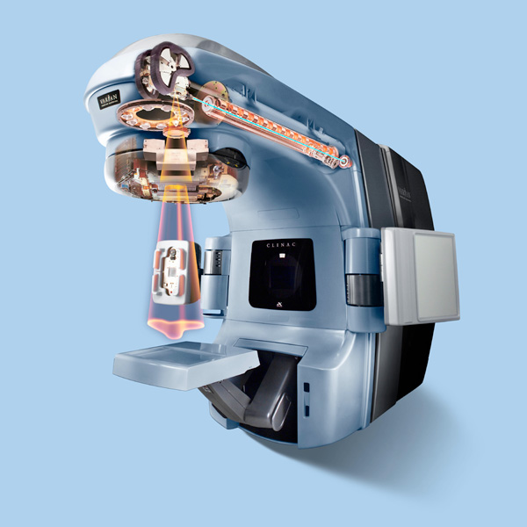
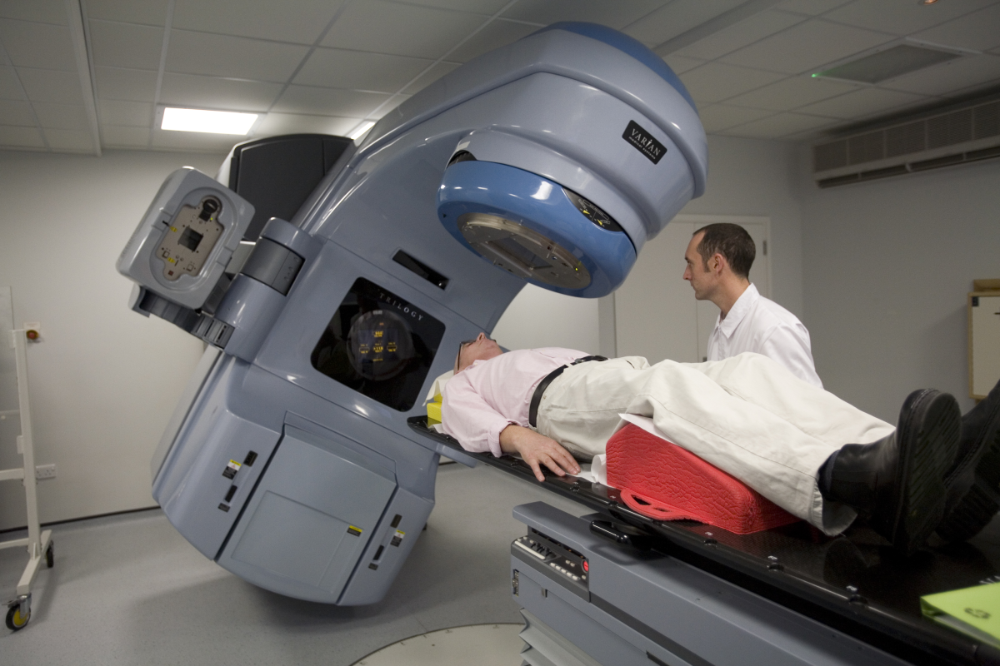
Gantry in conventional radiotherapy
The whole linac is inside
the gantry
The gantry head can pass
between patient and floor
for irradiation from below
3.5 m
2.6 m
(Varian Clinac IX)
Notes:
4-25 MeV
R ~ 1.3 m
Space around isocenter ~ 43 cm
The gantry is small!

Slide 8
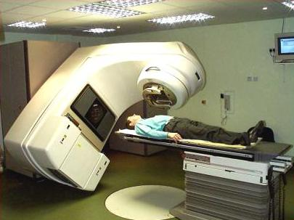
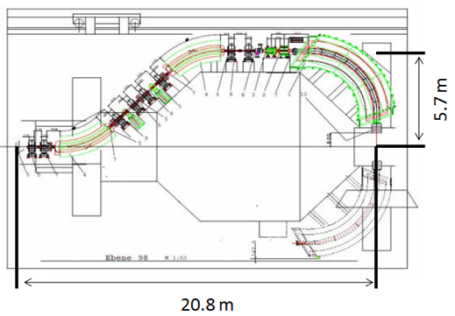
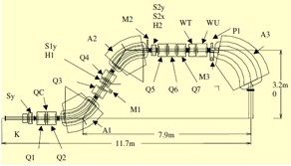
Size and magnetic rigidity
Carbon Ion Gantry
Bρ < 6.4 Tm
Conventional RT
Proton Gantry
Bρ < 2.4 Tm
Deep pit under the patient
Notes:
Deep pit under the patient

Slide 9
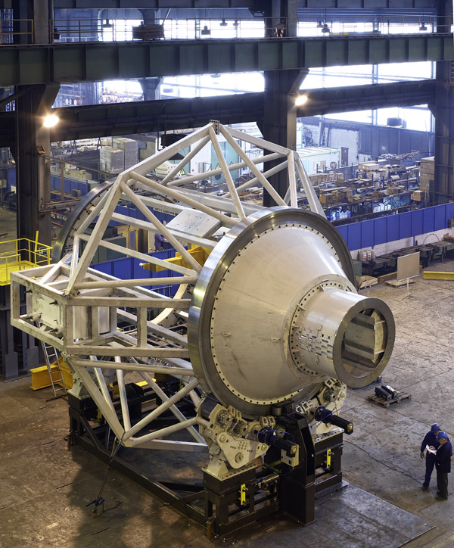
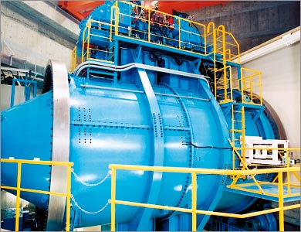
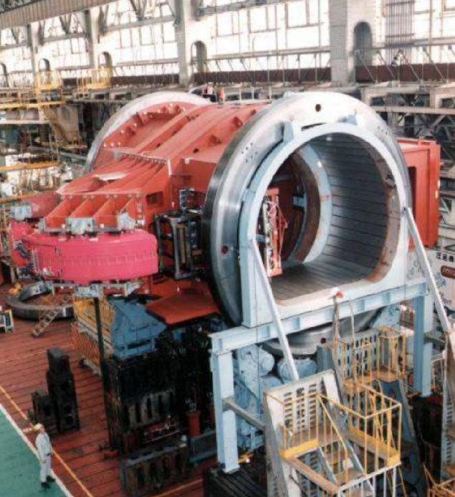
Proton gantry
Mitsubishi
Hitachi
IBA

Slide 10
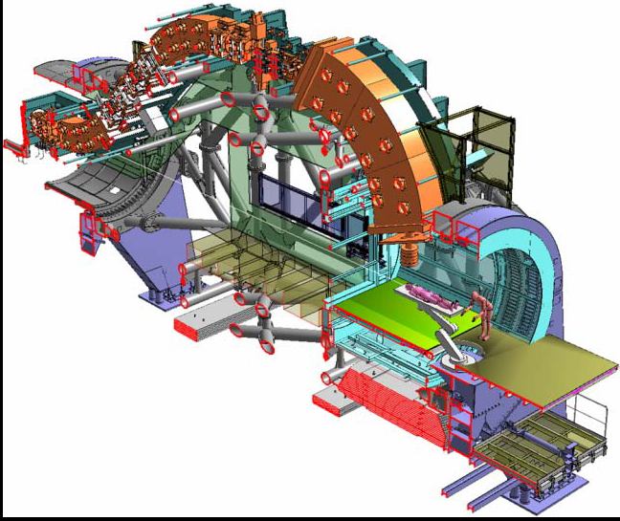
HIT
HIT C gantry: L = 25 m x φ = 13 m, 600 t
Very large, very heavy,
very expensive
360° rotation
Parallel scanning
200 mm x 200 mm field
140 t magnets
120 t shielding-counterweight
600 t total rotating mass
(Udo Weinrich, GSI)

Slide 11
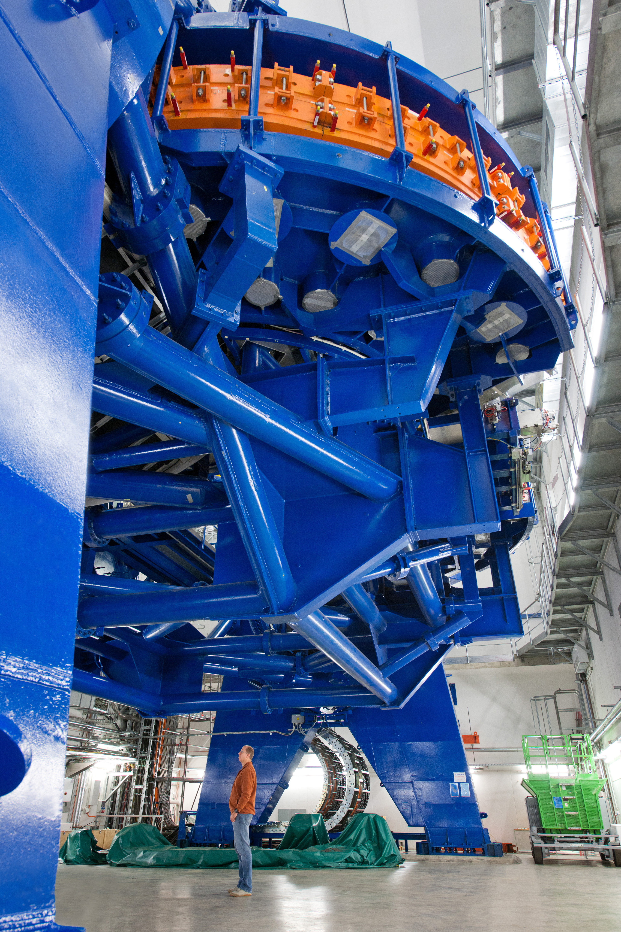
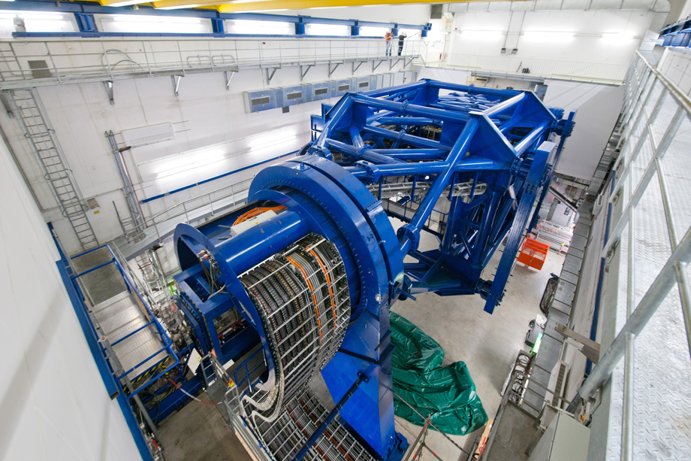
Carbon Ion Gantry
The HIT Gantry
L = 25 m x φ = 13 m,
600 t rotating mass

Slide 12
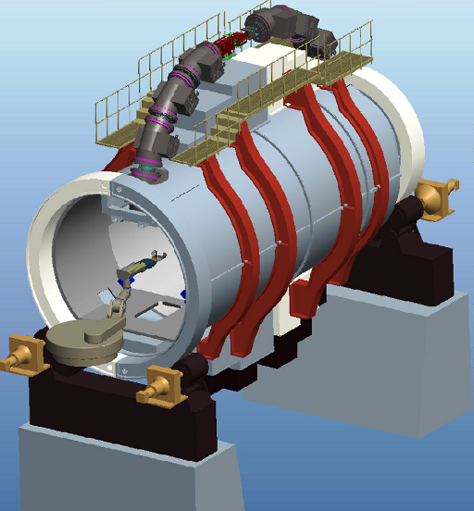
HIMAC Superconducting rotating-gantry
Use of superconducting (SC) magnets
Ion kind : ¹²C
Irradiation method: 3D Scanning
Beam energy : 430 MeV/n
Maximum range : 30 cm in water
Scan size : 200×200 mm²
Beam orbit radius : 5.45 m
Length : 13 m
The size and weight are considerably reduced
Weight: order of 300 tons
Courtesy of Y. Iwata

Slide 13
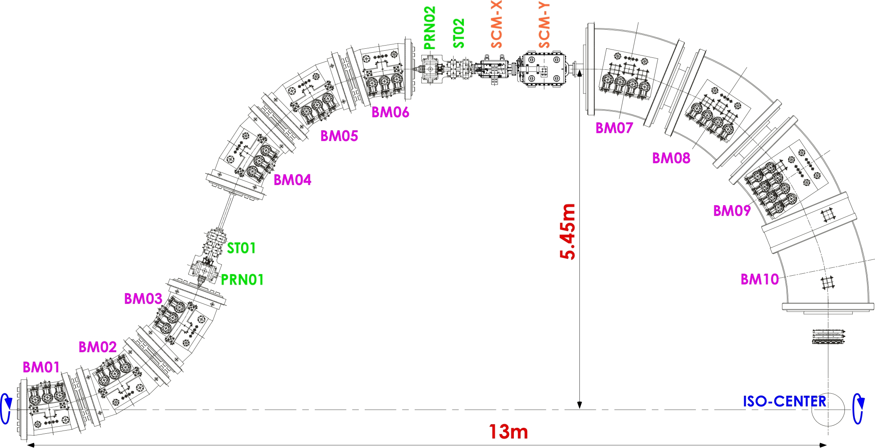
Layout of the SC gantry
Combined function SC magnets
（BM01～BM06）
→No quadrupole magnet required
Scanning magnets on top
→Large scan size
Combined function SC magnets
→Square irradiation field
→Parallel beam
Courtesy of Y. Iwata

Slide 14
HIT
HIMAC
NIRS superconducting rotating gantry

Slide 15
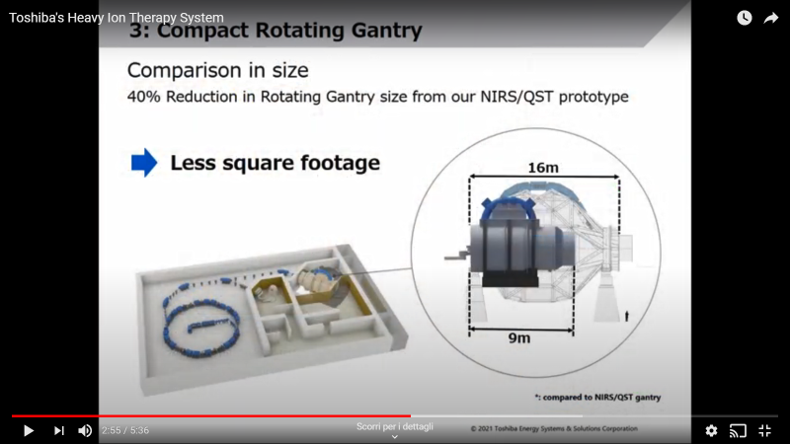
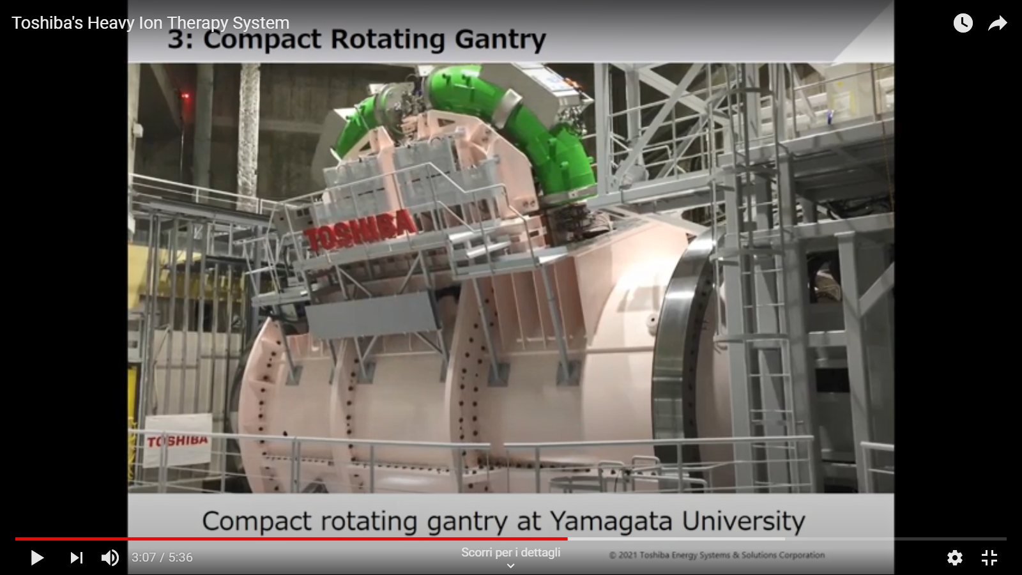
Yamagata
First treatment a few days ago

Slide 16
Launch of a gantry design
CNAO collaboration with CERN – INFN – MedAustron
Design to be ready in 3 (4) years (when present expansion will be completed)
… find the money, design building and plants, build everything… to be ready in 8-10 years?
Advisor committee selected

Slide 17
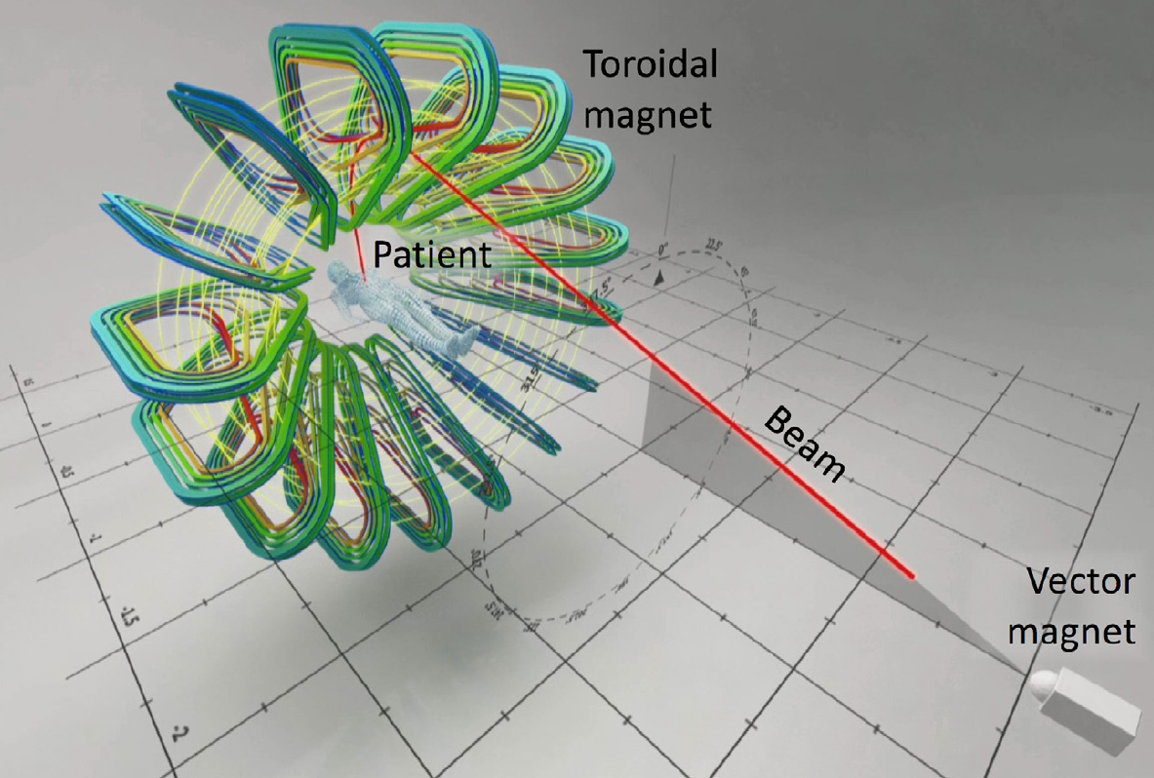
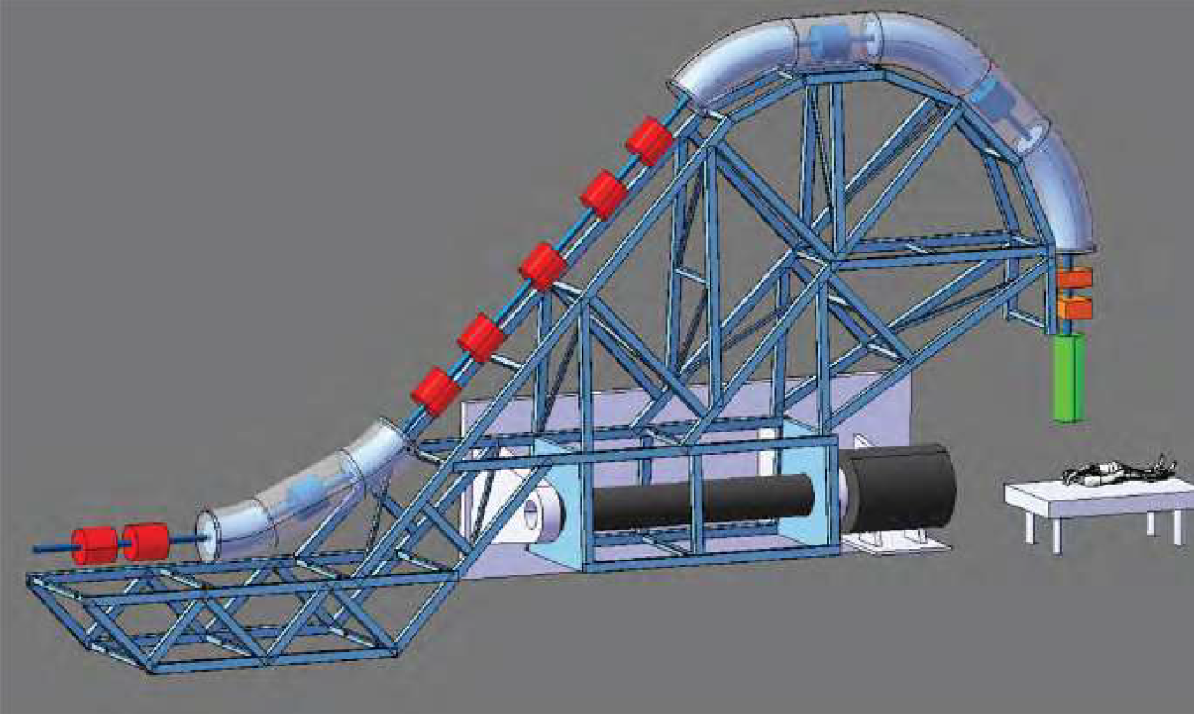
The starting point
GaToroid
SIGRUM
Toroidal gantry operating in steady-state with a discrete number of irradiation directions
Rotating gantry attached to the wall with no counterweight and a partial rotation of ±110 degrees.
L. Bottura et al., GaToroid - Status and Perspectives,
CERN-NIMMS-Note-003: https://cds.cern.ch/record/2776464
U. Amaldi et al, SIGRUM gantry, CERN-NIMMS-Note-002: https://cds.cern.ch/record/2766876

Slide 18
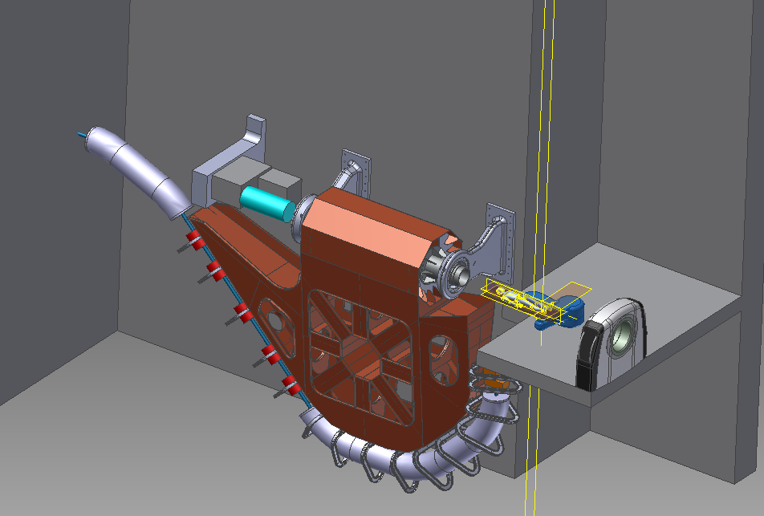
Gantry for carbon ions
Advisor committee, Dec 16th 2020: SIGRUM type gantry with recommendations:
revise specifications (180 vs 360, dipole specs, 3T vs 4T, scanning system, scan with quads, upstream scanning and so on)
Many alternative optics studies
Many alternative mechanical studies
Evaluation of the feasibility of SC dipoles for many different requirements
(embedded gradient, fixed vs variable gradient, field and gradient
level, ramp rate, aperture, technology, cooling, number of feedthroughs
and so on)
Study of the space available at CNAO for the gantry/layout linee

Slide 19
Many synergic projects
Sigrum
(CNAO - CERN – INFN – MedAustron) Signed 31 March 22
Hitriplus Started April 2021
Ifast Started May 2021

