Slide 1
Magnets and Cryostat integration on the gantry optics layout
E. Felcini, M. Pullia
13/06/2022

Slide 2
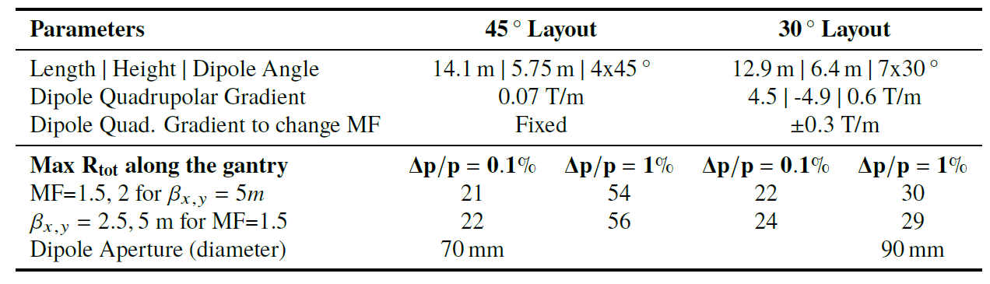
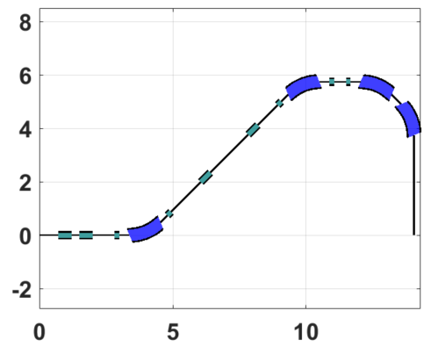
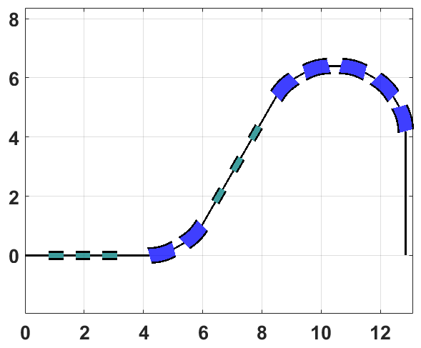
Gantry Layouts
45° Layout
30° Layout
5.75 m
6.4 m
4 m
3.5 m
14.05 m
12.9 m

Slide 3
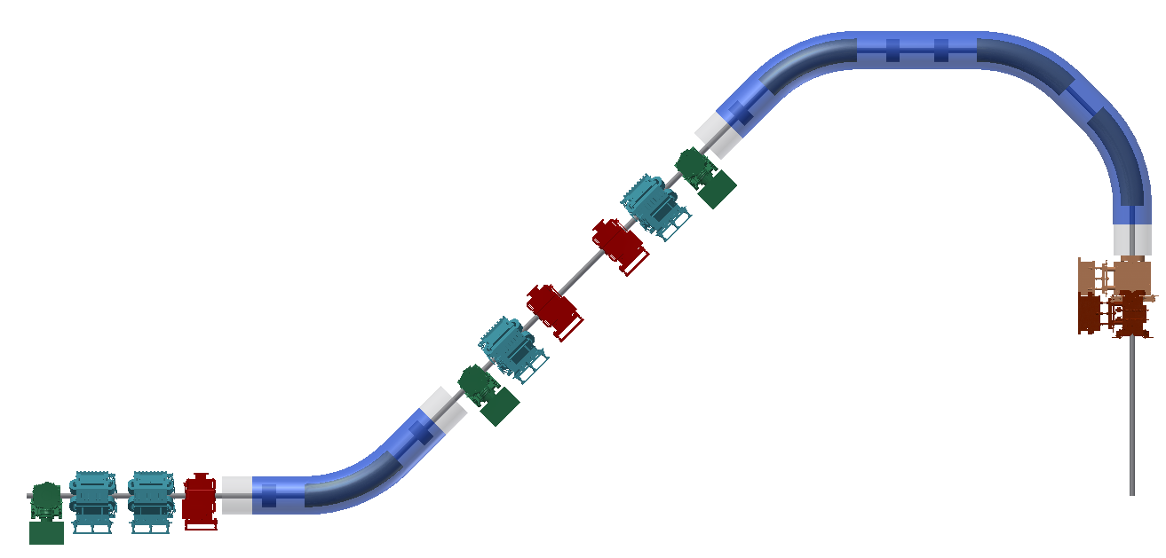
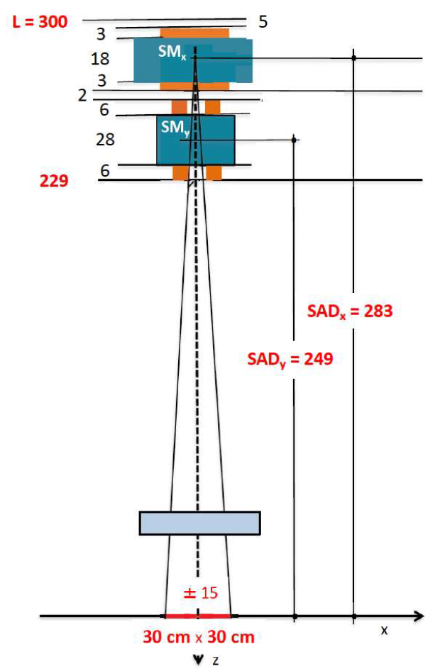
Preliminary elements integration
  Using existing CNAO elements, a preliminary (and rough) integration study was done
  → the line became immediately quite packed
  cryostat
  corrector
  monitor
5.75 m
3.5 m
  cold-warm transition
14.05 m
  NC quadrupole

Slide 4
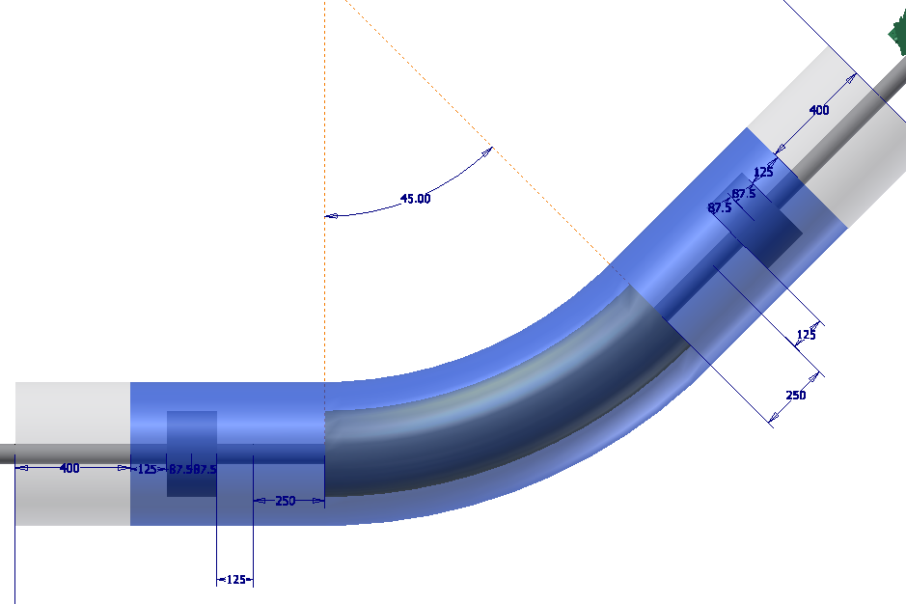
Preliminary elements integration
  SC spool-piece
  quadrupole
  SC spool-piece
  quadrupole
  cold-warm transition
  Dipole+Quadrupole heads
  Dipole+Quadrupole heads
  cold-warm transition
  SC Dipole

Slide 5
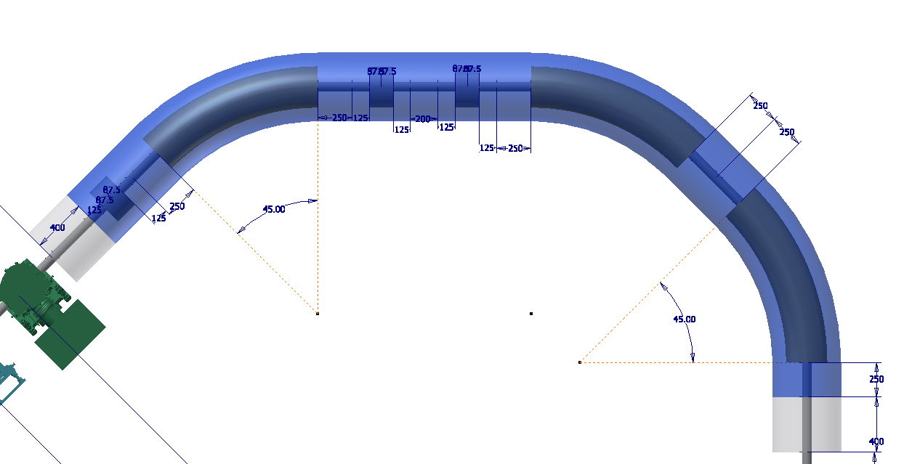
Preliminary elements integration
  Can we use a single cryostat for the three Dipoles and Quadrupoles?
  Directly linked to the gantry radius
  cold-warm transition

Slide 6
Discussion
The integration between the magnets, cryogenics, diagnostic, etc… is of uppermost importance for the optics studies and, more importantly, for the whole gantry project
The definition of the the space required to integrate the various elements in the gantry layout is a foudamental step to validate the optics and to create a sound desing
The collaboration and iteration between the working groups is crucial and need to be established on a regular basis
… (?)

Slide 7
Questions on dimensions, space, geometry…
Large or small cryostat considering:
Alignment (of magnets)
Maintenance
Cooling/current leads
Cold-to-warm transition (one or many)
Cryogenic solution?
Cryocooler
He gas (no liquid because of quenching noise)
He gas line with conductors inside
Maintenance
cool down time (also for small vs large cryostat)
Vacuum chamber
bellows
flanges
share vacuum between beam and magnets?
installation/replacement/maintenance
Spool piece quadrupoles
Remember that it rotates!
Examples to copy!?

