Slide 1


Integration of Magnets/Cryostats on the structure
CERN TE-MSC, EN-MME, RTU and UNIBS
Luca Piacentini, Diego Perini, Toms torims,
Luca Dassa, Jānis Vilcāns, Andris Ratkus, Stefano Uberti
VPP-IZM-CERN-2020/1-0002

Slide 2
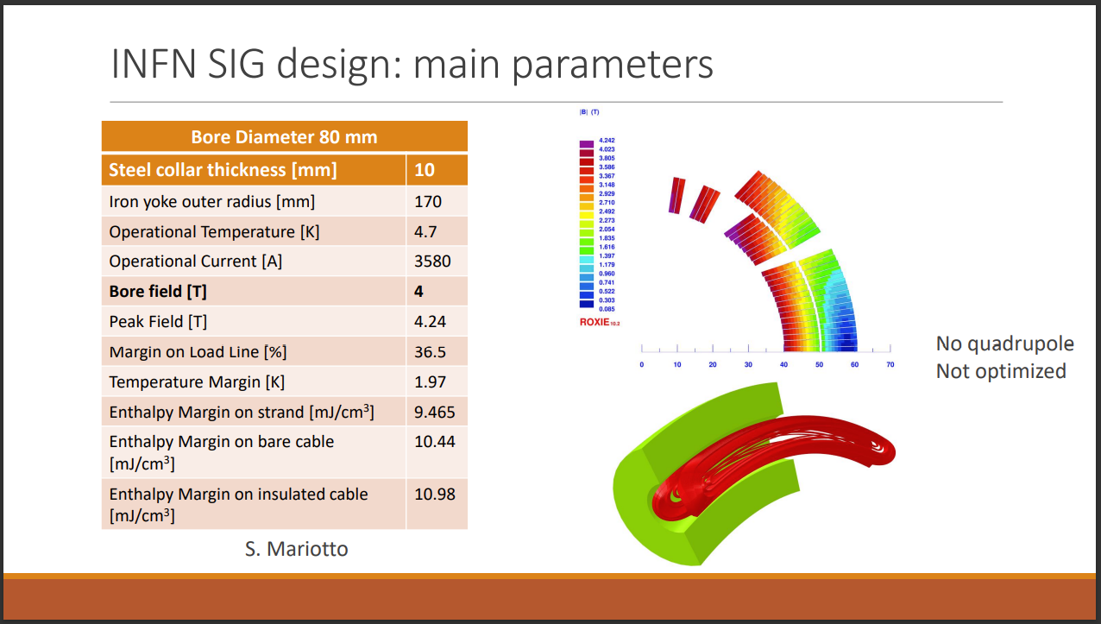
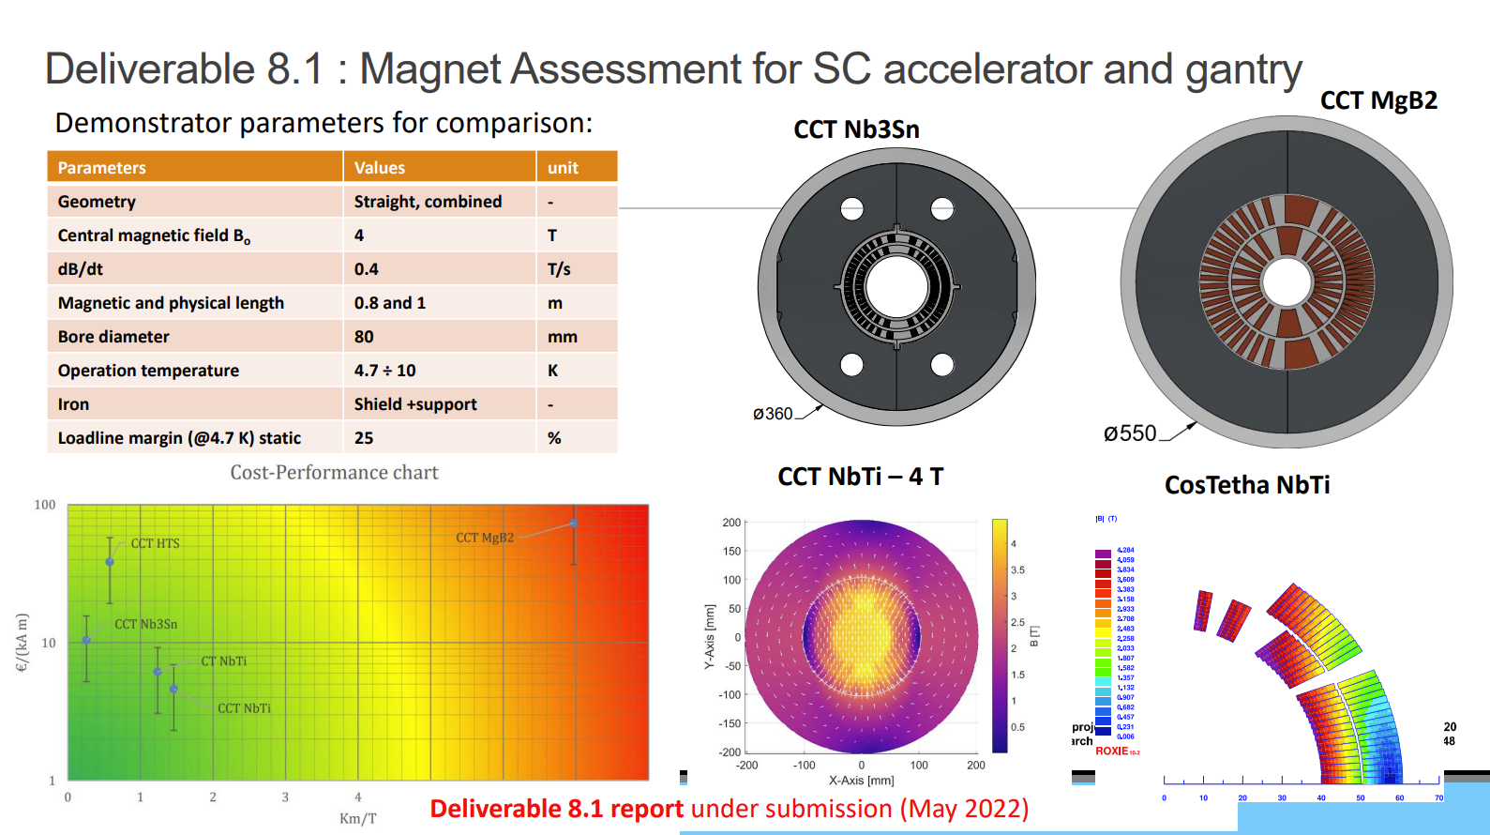
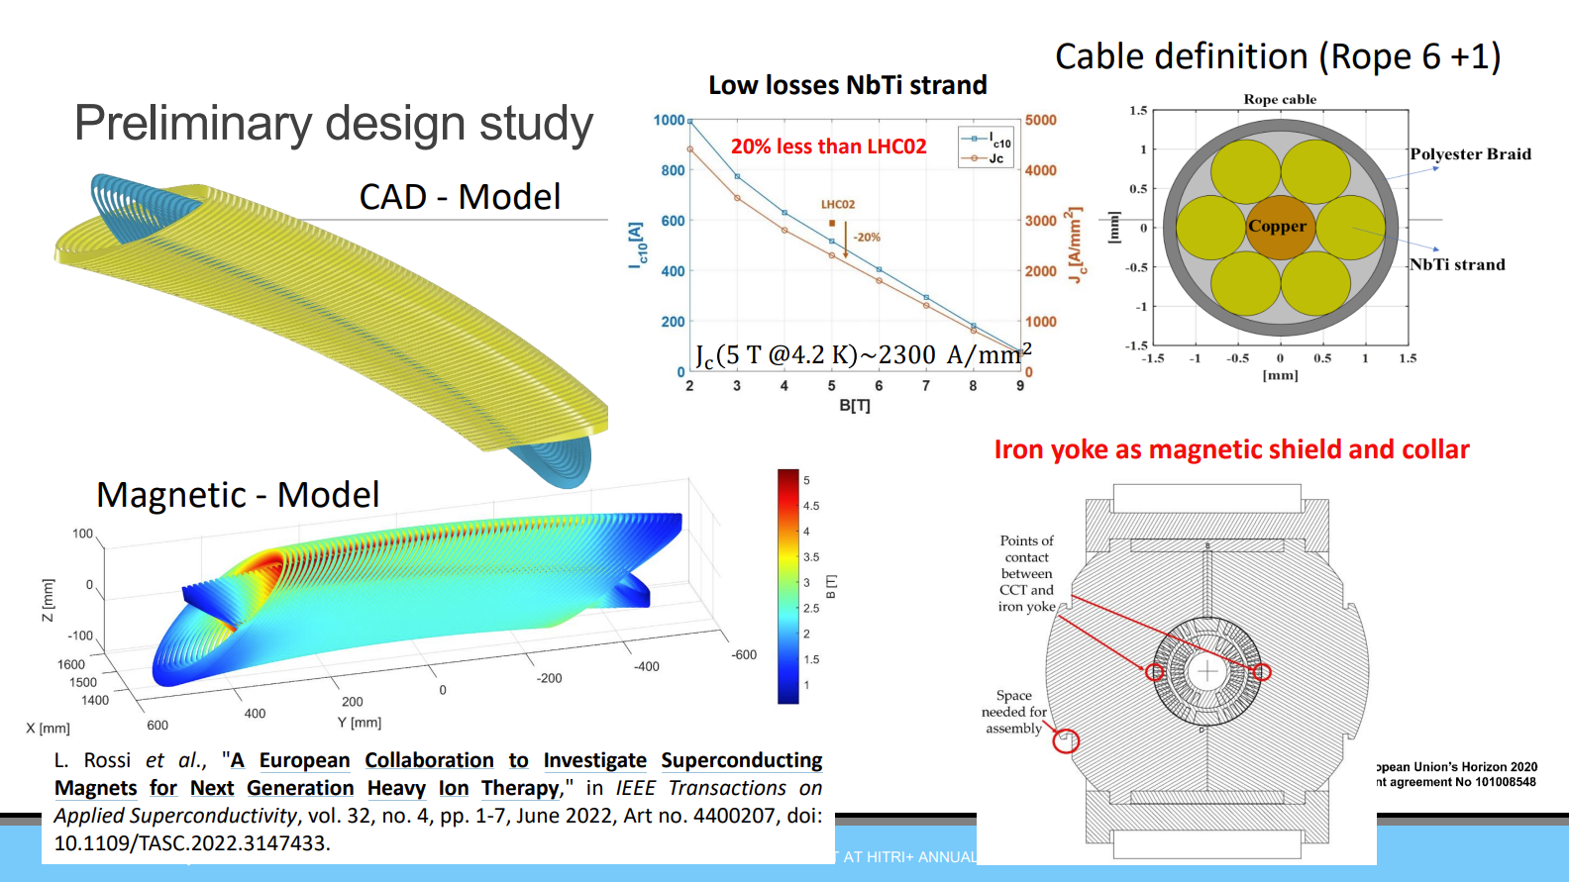
OD > 600

Slide 3
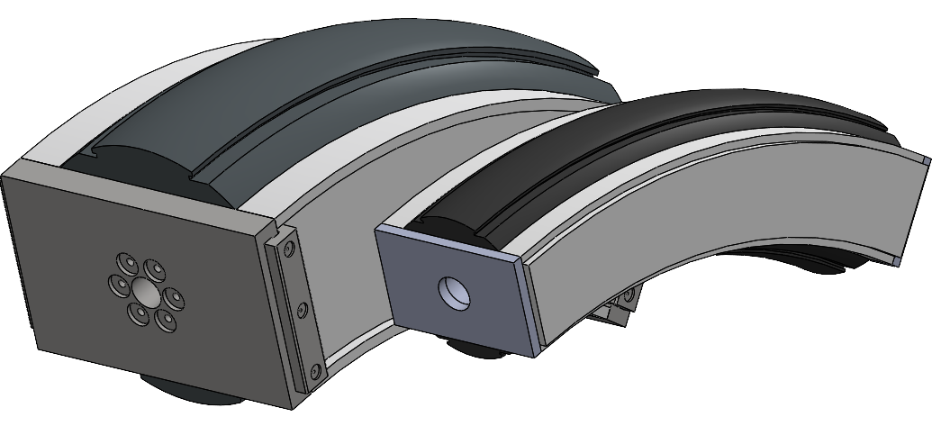
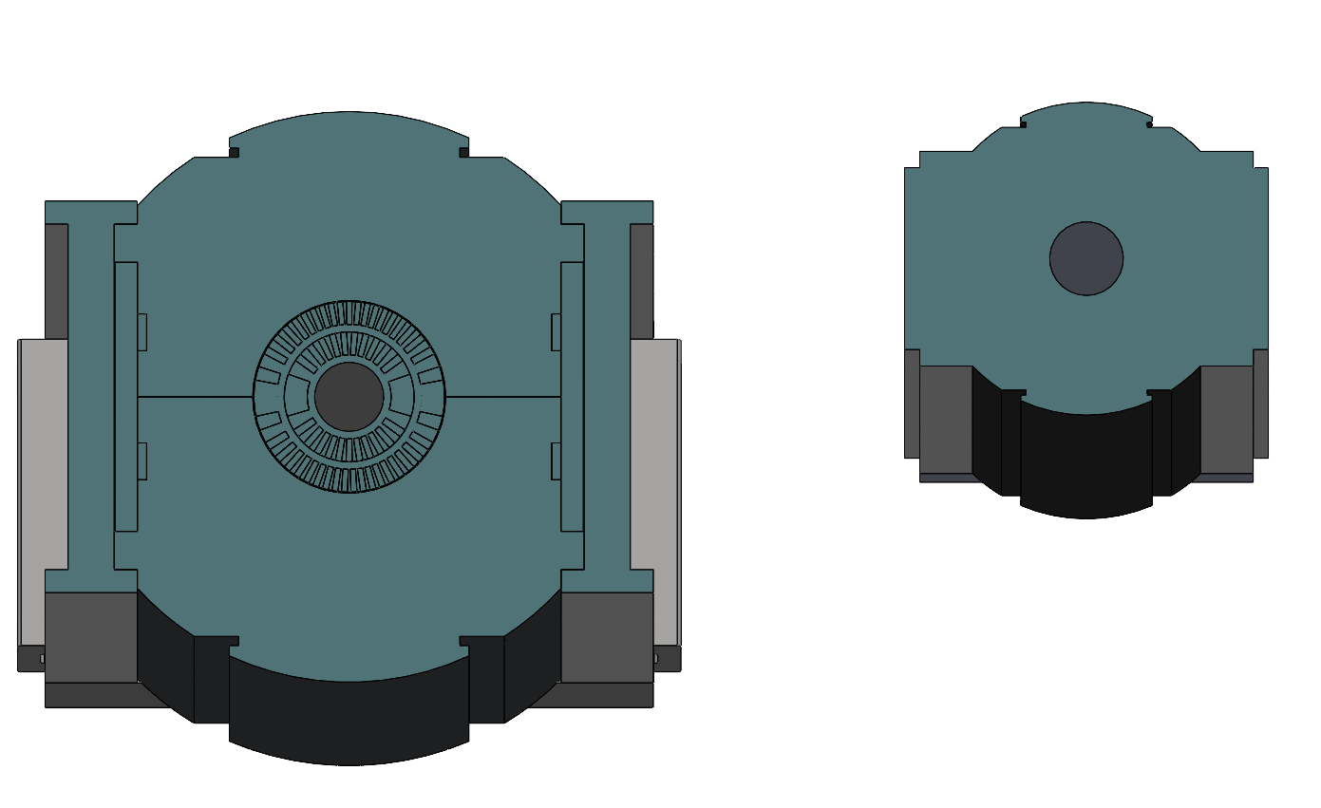
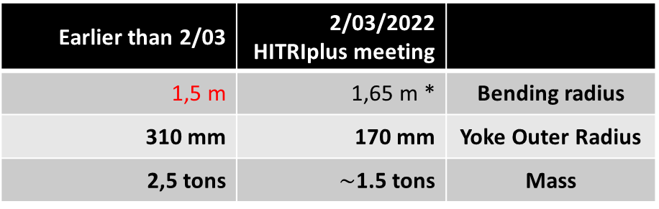
Earlier than 2/03 | 2/03/2022 HITRIplus meeting
1,5 m | 1,65 m * | Bending radius
310 mm | 170 mm | Yoke Outer Radius
2,5 tons | $\sim$1.5 tons | Mass
Dimensions have been scaled with a ratio: 17/31
* Compatible with the bending radius of the latest beamline studied by CNAO

Slide 4
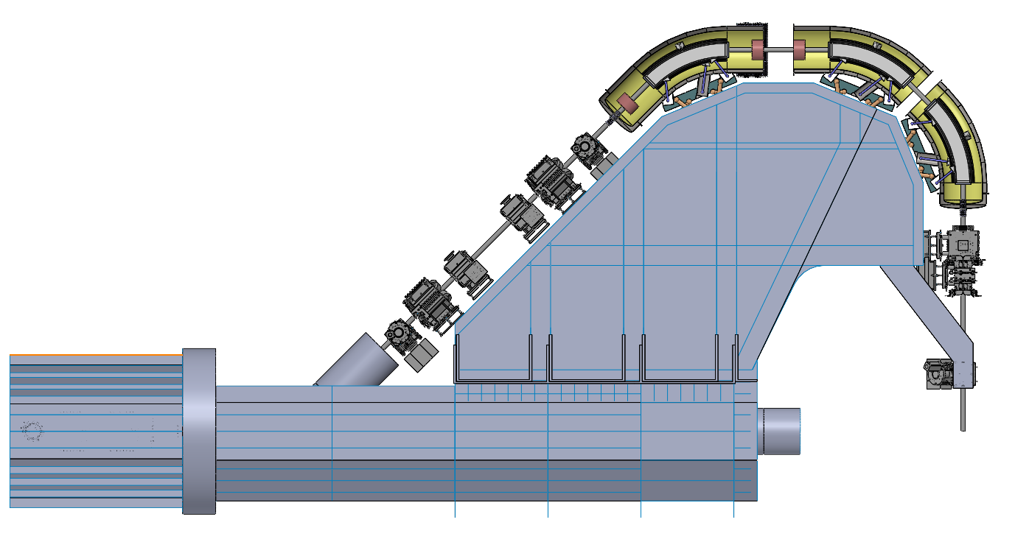
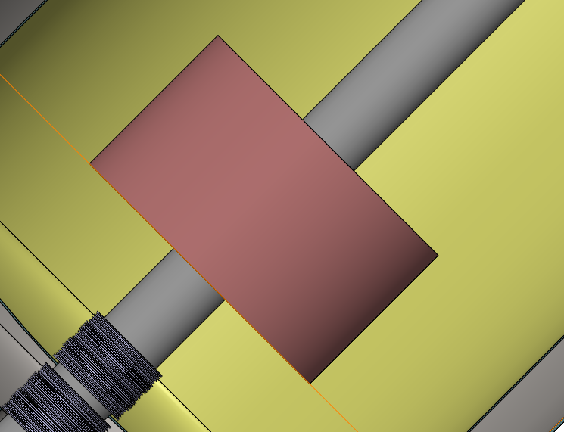
SC Quadrupoles &/or correctors dimension specifiactions
Geometry?
Mass?
-> Supports

Slide 5
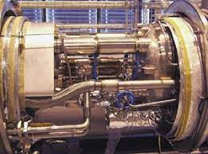
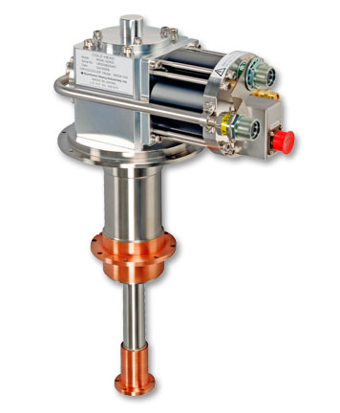
Auxiliary systems in the cryostat
Intersection elements?
Cryostat elements?
Cryogenic calculations? (Dimensions)

Slide 6
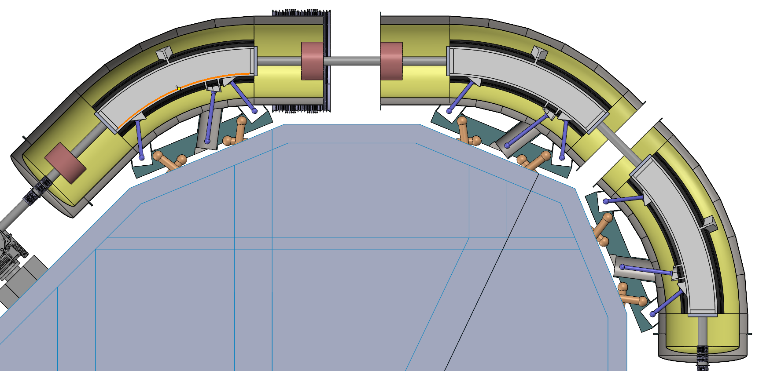
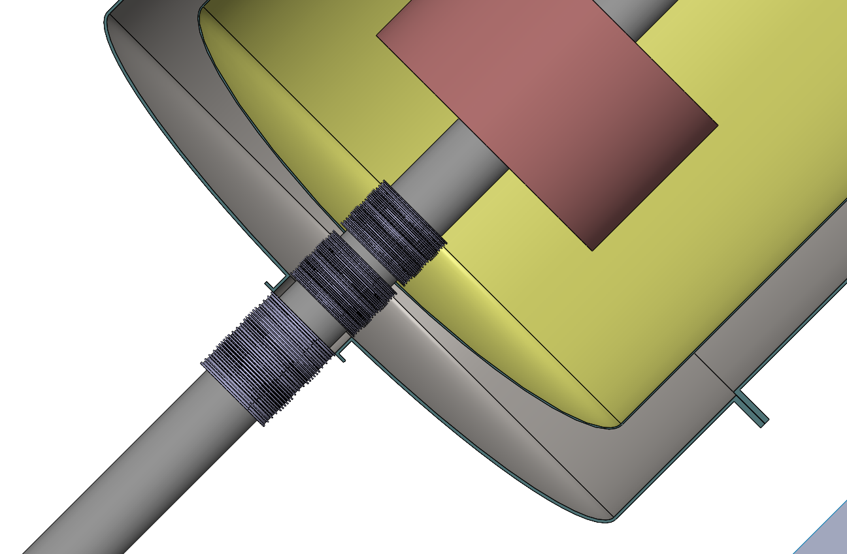
Feasibility of the Top cryostat
Cold/Warm transitions specifics & elements
3 Separated vacuum vessels
Common vacuum vessel

Slide 7
