Slide 1



Update Path length variation in a hybrid synchrotron
by Antoine Chance (CEA)
21 June 2022

Slide 2
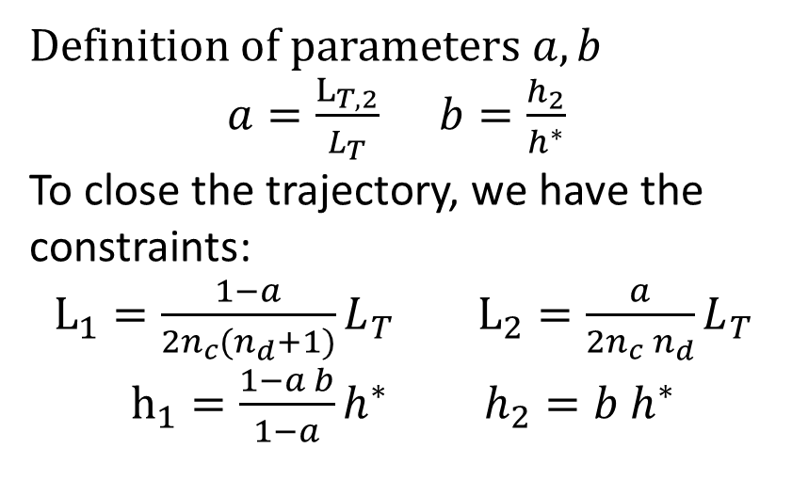
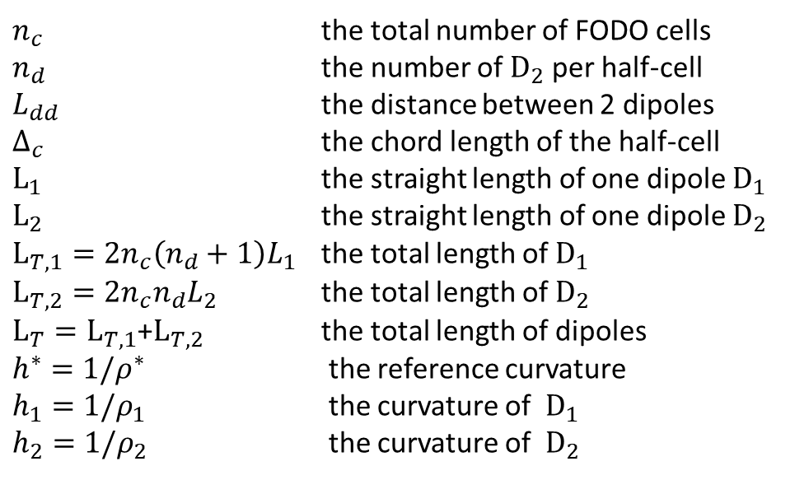



A set of parameters to create a hybrid RCS
$$L_{dd}$$
$$L_{dd}$$
$$Δ_{c}$$
D1
D2
D1
D2
D1
$n_{c}$ the total number of FODO cells
$n_{d}$ the number of $D_{2}$ per half-cell
$L_{dd}$ the distance between 2 dipoles
$Δ_{c}$ the chord length of the half-cell
$L_{1}$ the straight length of one dipole $D_{1}$
$L_{2}$ the straight length of one dipole $D_{2}$
$L_{T,1}=2n_{c}\left(n_{d}+1\right)L_{1}$ the total length of $D_{1}$
$L_{T,2}=2n_{c}n_{d}L_{2}$ the total length of $D_{2}$
$L_{T}=L_{T,1}$+$L_{T,2}$ the total length of dipoles
$h^{∗}=1/ρ^{∗}$ the reference curvature
$h_{1}=1/ρ_{1}$ the curvature of $D_{1}$
$h_{2}=1/ρ_{2}$ the curvature of $D_{2}$
Definition of parameters $a, b$
$a=\frac{L_{T,2}}{L_{T}}$ $b=\frac{h_{2}}{h^{∗}}$
To close the trajectory, we have the constraints:
$L_{1}=\frac{1−a}{2n_{c}{(n}_{d}+1)}L_{T}$ $L_{2}=\frac{a}{2n_{c}{ n}_{d}}L_{T}$
$h_{1}=\frac{1−a b}{1−a}h^{∗}$ $h_{2}=b h^{∗}$

Slide 3
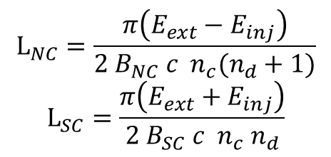
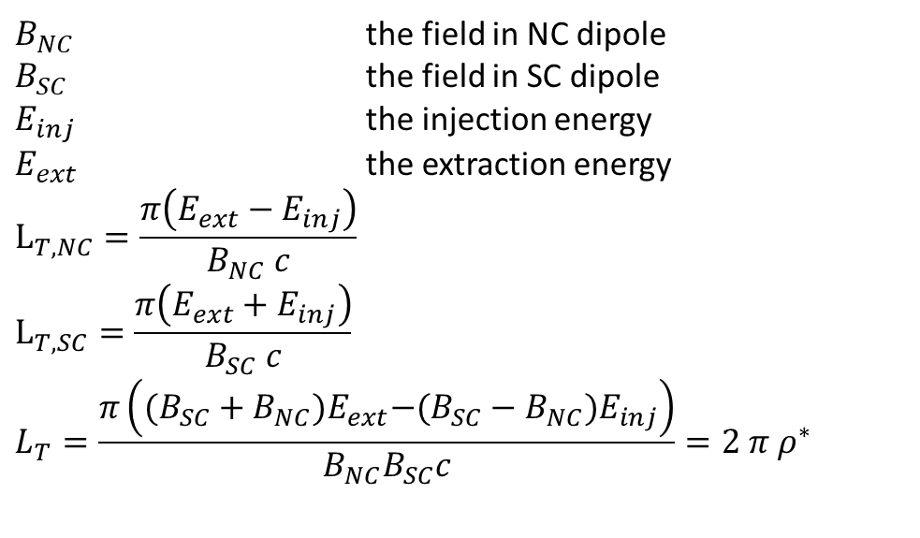
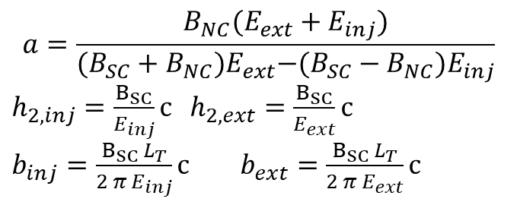
Case: NC dipoles first
$$L_{dd}$$
$$L_{dd}$$
$$Δ_{c}$$
D1
D2
D1
D2
D1
$B_{NC}$ the field in NC dipole
$B_{SC}$ the field in SC dipole
$E_{inj}$ the injection energy
$E_{ext}$ the extraction energy
$$L_{T,NC}=\frac{π\left(E_{ext}−E_{inj}\right)}{B_{NC} c}$$
$$L_{T,SC}=\frac{π\left(E_{ext}+E_{inj}\right)}{B_{SC} c}$$
$$L_{T}=\frac{π\left({(B_{SC}+B_{NC})E}_{ext}−(B_{SC}−B_{NC})E_{inj}\right)}{B_{NC}B_{SC}c}=2 π ρ^{∗}$$
$$a=\frac{B_{NC}(E_{ext}+E_{inj})}{{(B_{SC}+B_{NC})E}_{ext}−(B_{SC}−B_{NC})E_{inj}}$$
$h_{2, inj}=\frac{B_{SC}}{E_{inj}}c$ $h_{2,ext}=\frac{B_{SC}}{E_{ext}}c$
$b_{inj}=\frac{B_{SC }L_{T}}{2 π E_{inj}}c$ $b_{ext}=\frac{B_{SC }L_{T}}{2 π E_{ext}}c$
$$L_{NC}=\frac{π\left(E_{ext}−E_{inj}\right)}{{2 B}_{NC} c n_{c}(n_{d}+1)}$$
$$L_{SC}=\frac{π\left(E_{ext}+E_{inj}\right)}{{2 B}_{SC} c n_{c} n_{d}}$$

Slide 4
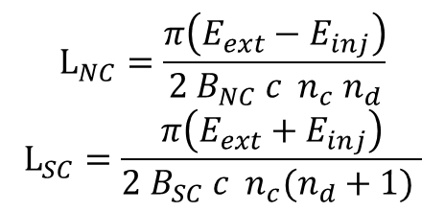
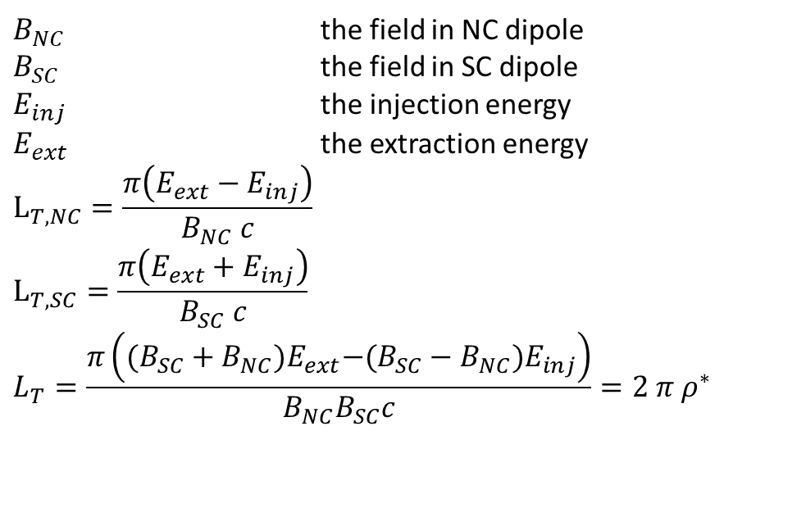
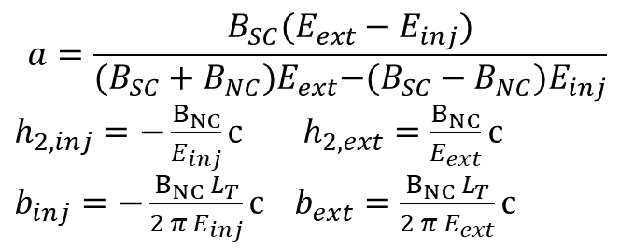
Case: SC dipoles first
$$L_{dd}$$
$$L_{dd}$$
$$Δ_{c}$$
D1
D2
D1
D2
D1
$B_{NC}$ the field in NC dipole
$B_{SC}$ the field in SC dipole
$E_{inj}$ the injection energy
$E_{ext}$ the extraction energy
$$L_{T,NC}=\frac{π\left(E_{ext}−E_{inj}\right)}{B_{NC} c}$$
$$L_{T,SC}=\frac{π\left(E_{ext}+E_{inj}\right)}{B_{SC} c}$$
$$L_{T}=\frac{π\left({(B_{SC}+B_{NC})E}_{ext}−(B_{SC}−B_{NC})E_{inj}\right)}{B_{NC}B_{SC}c}=2 π ρ^{∗}$$
$$a=\frac{B_{SC}(E_{ext}−E_{inj})}{{(B_{SC}+B_{NC})E}_{ext}−(B_{SC}−B_{NC})E_{inj}}$$
$h_{2, inj}=−\frac{B_{NC}}{E_{inj}}c$ $h_{2,ext}=\frac{B_{NC}}{E_{ext}}c$
$b_{inj}=−\frac{B_{NC }L_{T}}{2 π E_{inj}}c$ $b_{ext}=\frac{B_{NC }L_{T}}{2 π E_{ext}}c$
$$L_{NC}=\frac{π\left(E_{ext}−E_{inj}\right)}{{2 B}_{NC} c n_{c} n_{d}}$$
$$L_{SC}=\frac{π\left(E_{ext}+E_{inj}\right)}{{2 B}_{SC} c n_{c}(n_{d}+1) }$$

Slide 5
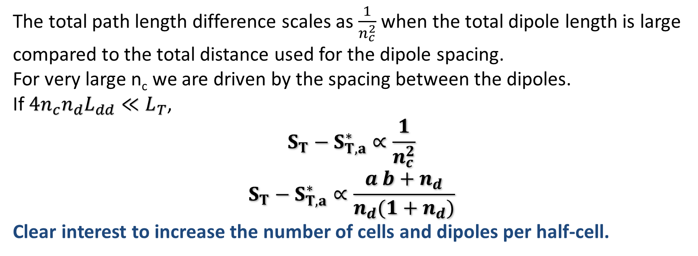
Total path length: analytic formulae
The total path length difference scales as $\frac{1}{n_{c}^{2}}$ when the total dipole length is large compared to the total distance used for the dipole spacing.
For very large n_{c} we are driven by the spacing between the dipoles.
If ${4n}_{c}n_{d}L_{dd}≪L_{T}$,
$$S_{T}−S_{T,a}^{∗}∝\frac{1}{n_{c}^{2}}$$
$$S_{T}−S_{T,a}^{∗}∝\frac{a b+n_{d}}{n_{d}(1+n_{d})}$$
Clear interest to increase the number of cells and dipoles per half-cell.

Slide 6
Example for the medium RCS
Distance between dipoles: 400 mm
Length quadrupoles + correctors: 2.5 m
Distance quadrupole block – dipole: 0.5 m
Injection energy: 300 GeV
Extraction energy: 750 GeV
NC field: 1.5 T
SC field: 10 T
Total length of the dipoles: 4244 m (determined by injection/extraction energies and maximum dipole field).

Slide 7
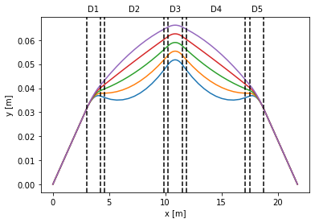
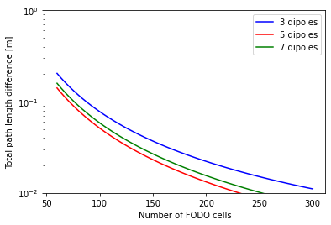
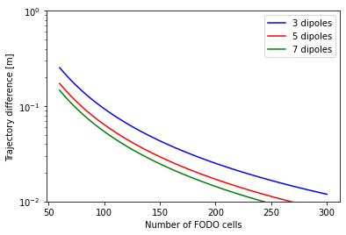
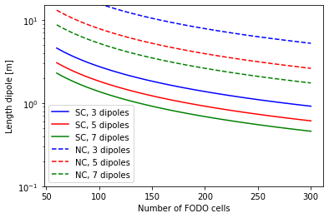
Case with SC dipole first and last
B_{NC} = 1.5 T; B_{SC} = 10 T; n_{c}=150

Slide 8
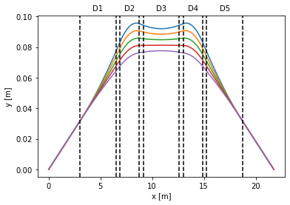
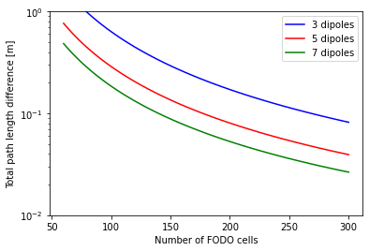
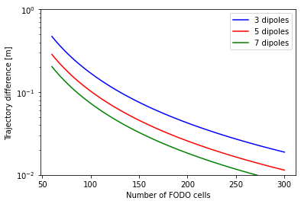
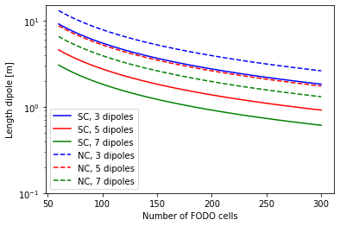
Case with NC dipole first and last
B_{NC} = 1.5 T; B_{SC} = 10 T ; n_{c}=150

Slide 9
Example for the medium RCS
Distance between dipoles: 400 mm
Length quadrupoles + correctors: 2.5 m
Distance quadrupole block – dipole: 0.5 m
Injection energy: 300 GeV
Extraction energy: 750 GeV
NC field: 1.8 T
SX field: 10 T
Total length of the dipoles: 3720 m (determined by injection/extraction energies and maximum dipole field).

Slide 10
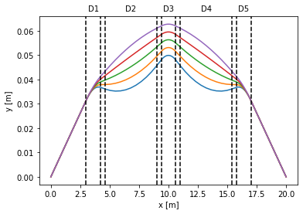
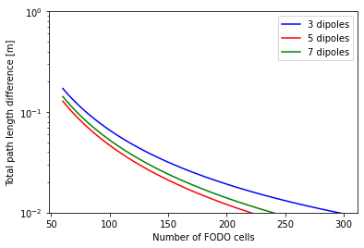
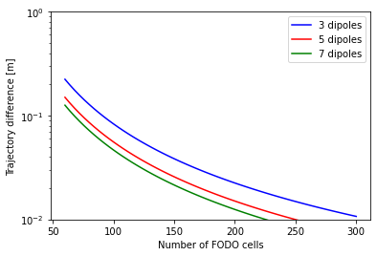
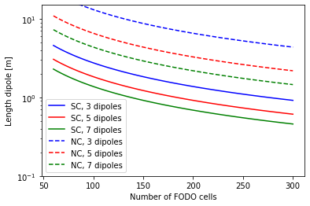
Case with SC dipole first and last
B_{NC} = 1.8 T; B_{SC} = 10 T; n_{c} = 150

Slide 11

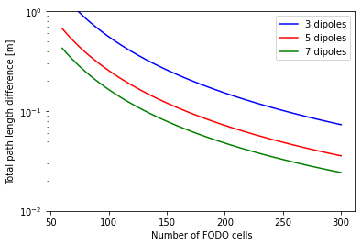
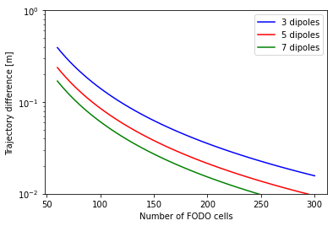
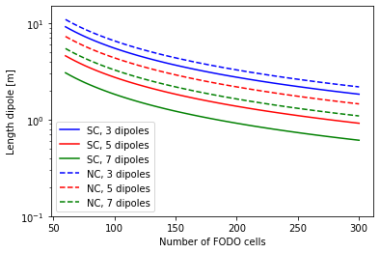
Case with NC dipole first and last
B_{NC} = 1.8 T; B_{SC} = 10 T; n_{c} = 150

Slide 12
Example for the medium RCS
Distance between dipoles: 400 mm
Length quadrupoles + correctors: 2.5 m
Distance quadrupole block – dipole: 0.5 m
Injection energy: 300 GeV
Extraction energy: 750 GeV
NC field: 1.8 T
SX field: 16 T
Total length of the dipoles: 3308 m (determined by injection/extraction energies and maximum dipole field).

Slide 13
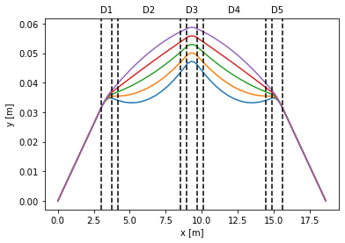
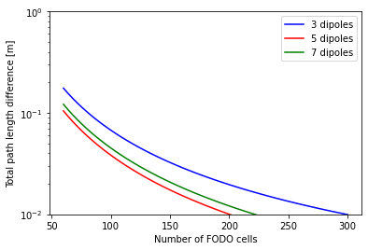
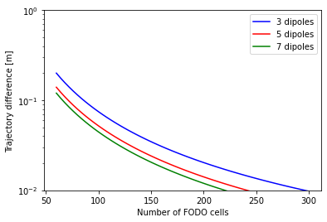
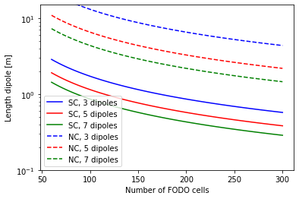
Case with SC dipole first and last
B_{NC} = 1.8 T; B_{SC} = 16 T; n_{c} = 150

Slide 14



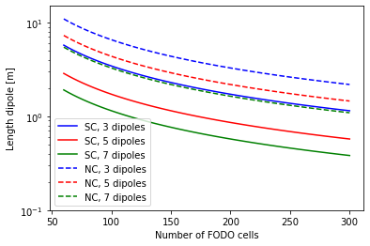
Case with NC dipole first and last
B_{NC} = 1.8 T; B_{SC} = 16 T; n_{c} = 150

Slide 15
Thank you
for attention

