Slide 1

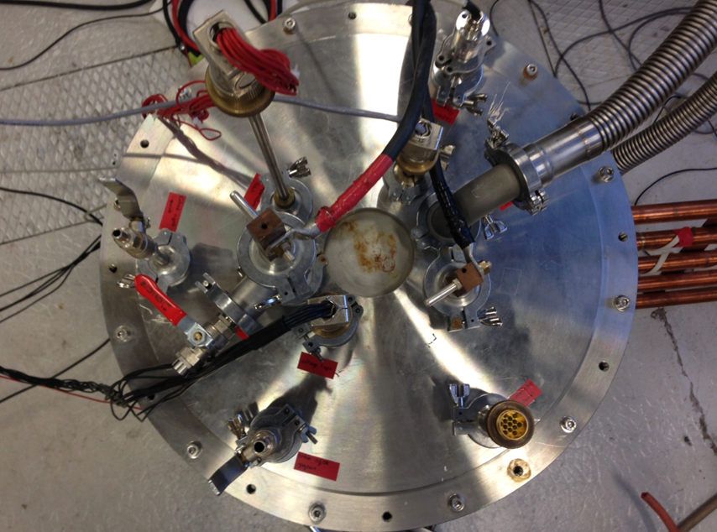


14th July 2022
A. Zampa, P. Tixador and A. Badel
Current redistribution in the surrounding of a defect during an inhomogeneous quench on a 2G HTS tape

Slide 2
OUTLINE
Influence of local inhomogeneities in the REBCO layer
Conclusions
Context
1
2
3
4
5
Experimental observations of inhomogeneous quenches
Current redistribution around a dissipative zone
1

Slide 3
OUTLINE
Influence of local inhomogeneities in the REBCO layer
Conclusions
Context
1
2
3
4
5
Experimental observations of inhomogeneous quenches
Current redistribution around a dissipative zone
1

Slide 4
OPERATION OF A R-SFCL
Current
Vsfcl
Zgrid
Zsfcl
Igrid
Ic
Z
load
Vgrid
Time
1
2
3
4
5
2
Context

Slide 5
OPERATION OF A R-SFCL
Current
Vsfcl
Zgrid
Zsfcl
Igrid
Ic
Z
load
Vgrid
In
Normal operation
Time
1
2
3
4
5
2
Context

Slide 6
OPERATION OF A R-SFCL
Current
Vsfcl
Zgrid
Zsfcl
Igrid
Ic
Z
load
Vgrid
In
Normal operation
Time
Time
1
2
3
4
5
2
Context

Slide 7
OPERATION OF A R-SFCL
Current
Vsfcl
Zgrid
Zsfcl
Igrid
Ic
Z
load
Vgrid
In
Dissipative state
Normal operation
Time
1
2
3
4
5
2
Context

Slide 8
OPERATION OF A R-SFCL
Current
Vsfcl
Zgrid
Zsfcl
Igrid
Ic
Z
load
Vgrid
In
Dissipative state
Normal operation
Time
1
2
3
4
5
2
Context

Slide 9
OPERATION OF A R-SFCL
Current
Vsfcl
Zgrid
Zsfcl
Zsfcl
Igrid
Ic
Z
load
Vgrid
In
Dissipative state
Clearing Fault Time
Normal operation
Time
1
2
3
4
5
2
Context

Slide 10
OPERATION OF A R-SFCL
Benefits of Resistive-type Superconducting Fault Current Limiter (R-SFCL)
● A theoretical "infinite" maximum prospective current
● An easier fault current interruption in DC transmission (also AC)
Current
Vsfcl
Zgrid
Zsfcl
Igrid
Ic
Z
load
Vgrid
In
Dissipative state
Clearing Fault Time
Normal operation
Normal operation
Time
1
2
3
4
5
2
Context

Slide 11
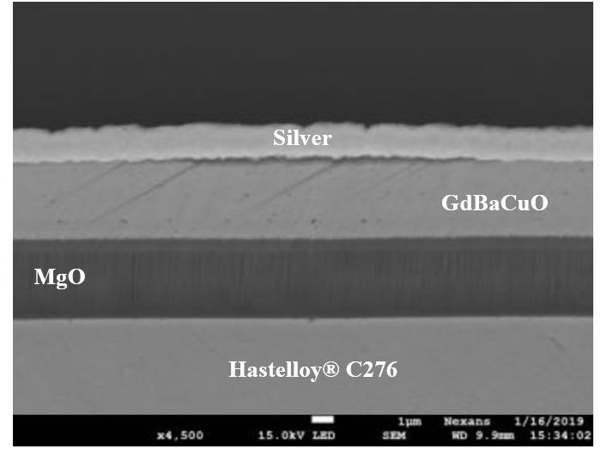
REBCO TAPES FOR R-SFCL
Substrate
Buffer layers
REBaCuO
Stabilizer
Courtesy of Nexans® - THEVA
High resistance per unit length
High current density (600 A/cm,w at 77 K)
Low cryogenics costs (Tc=92 K)
No copper stabilization !
1
2
3
4
5
3
Context

Slide 12
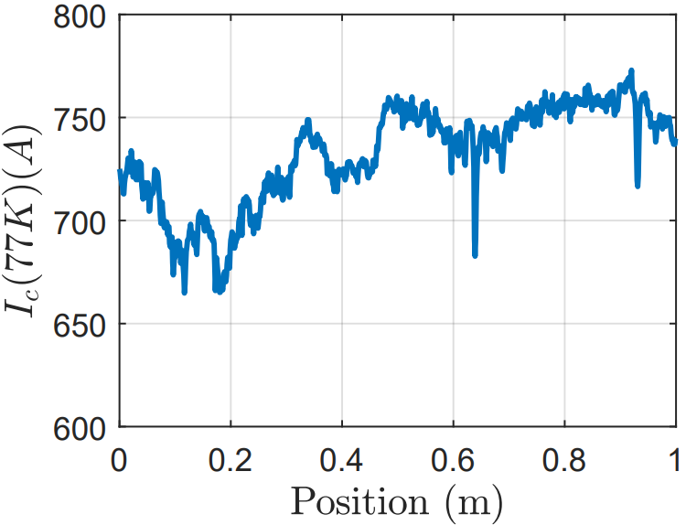
INHOMOGENEITY OF THE IC IN REBCO TAPES
Data from THEVA (77 K, self-field)
Ic dependencies - Ic(x,T,|B|,θ)
Current
Current
Ic is inhomogeneous along the tape length
Ic
Ic
Dissipative state
In
Normal operation
Dissipative state
In
Normal operation
Time
Time
1
2
3
4
5
4
Context

Slide 13
OUTLINE
Influence of local inhomogeneities in the REBCO layer
Conclusions
Context
1
2
3
4
5
Experimental observations of inhomogeneous quenches
Current redistribution around a dissipative zone
6

Slide 14
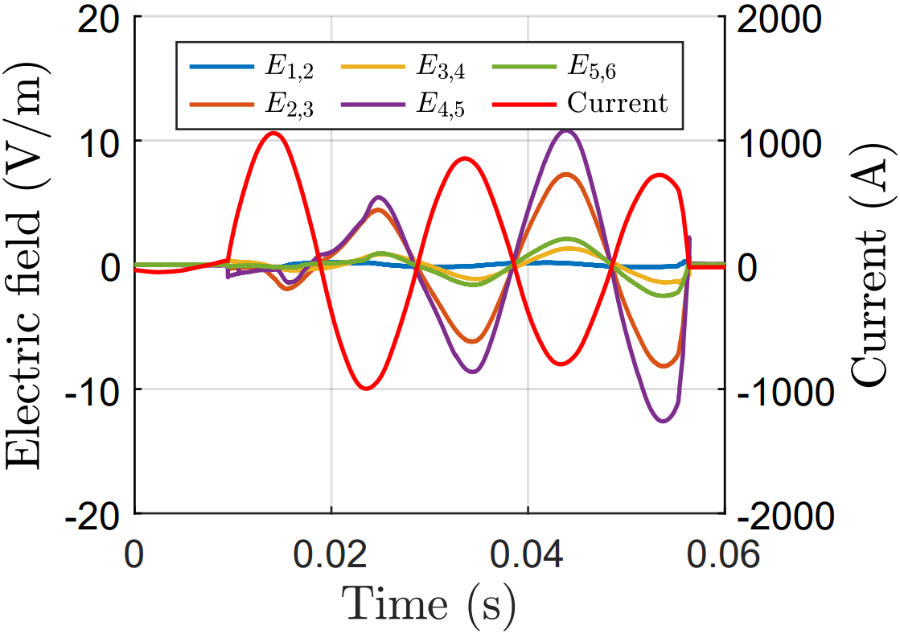
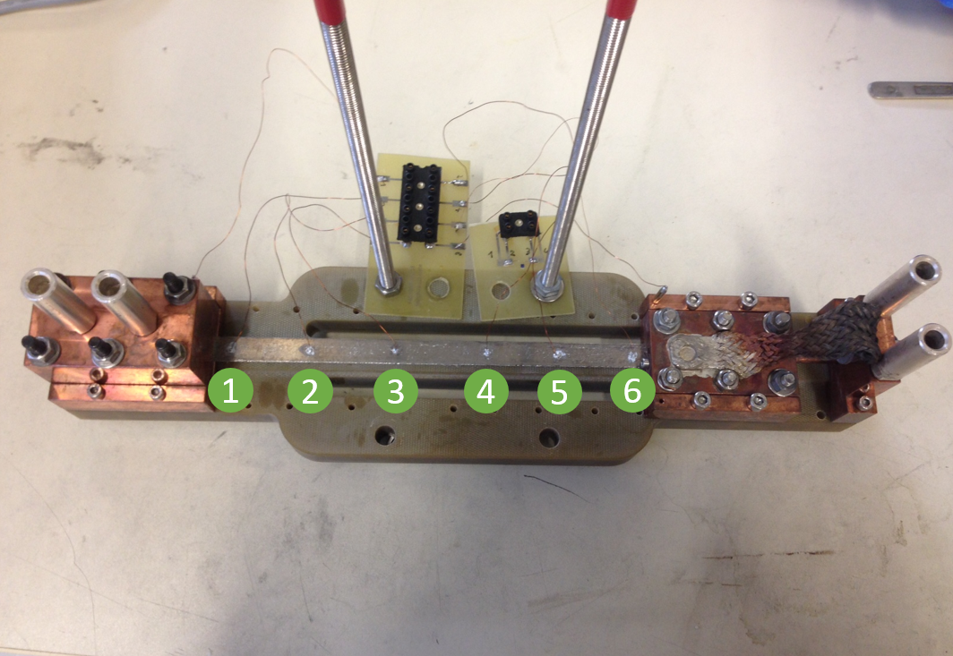
OBSERVATION THROUGH VOLTAGE MEASUREMENTS
A HTS tape from THEVA with multiple voltage taps connected to a power supply shows inhomogeneous voltages along its length
I
1
2
3
4
5
6
Sample from Theva (77 K)
1
2
3
4
5
7
Experimental observations of inhomogeneous quenches

Slide 15
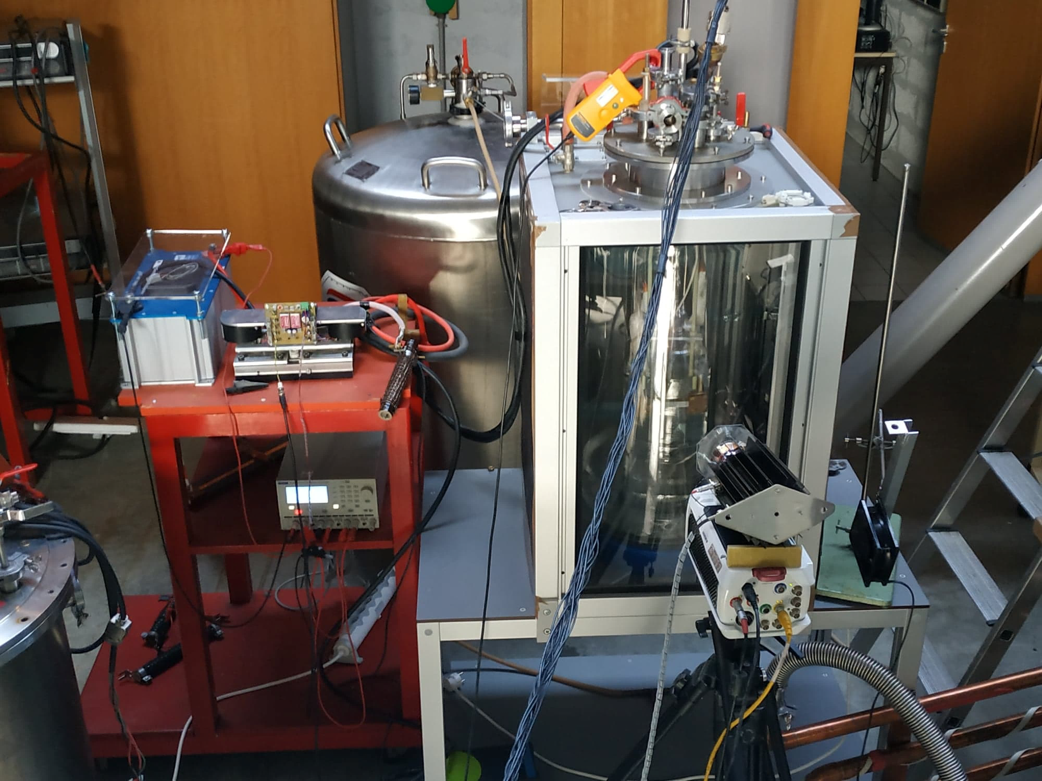
VISUALIZATION OF A TAPE DURING A QUENCH
Experimental set-up to observe the very beginning of a quench
1
2
3
4
5
8
Experimental observations of inhomogeneous quenches

Slide 16
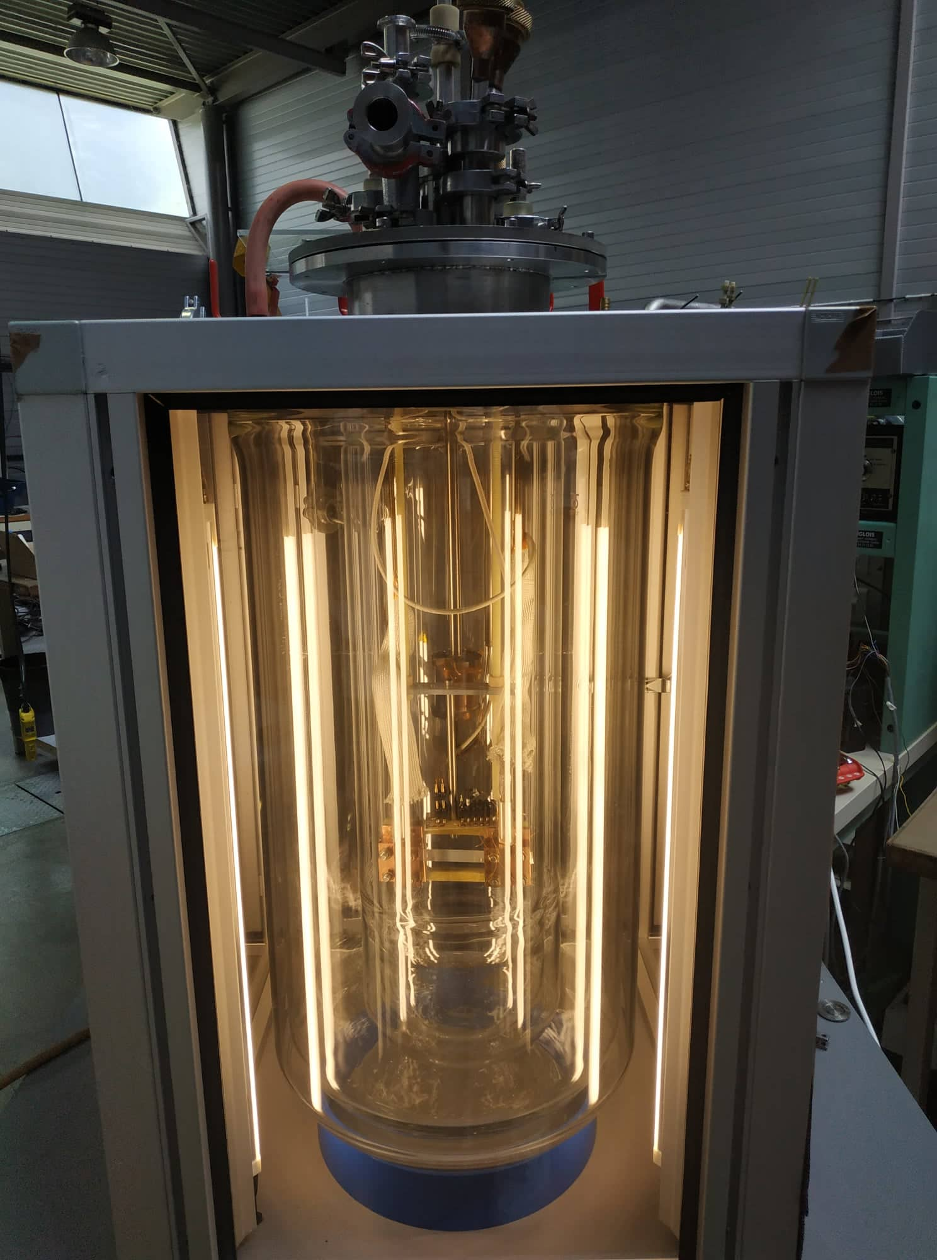
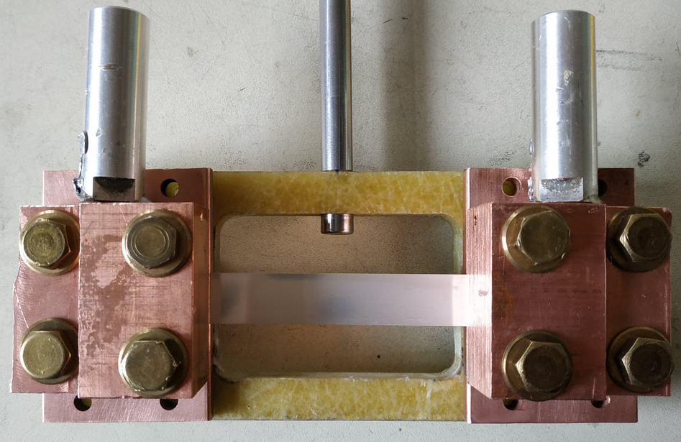
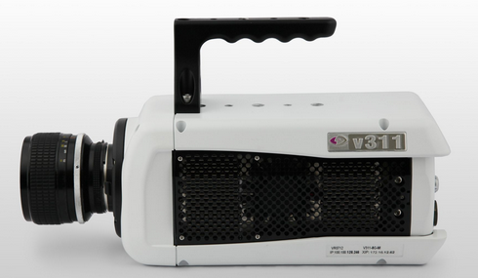
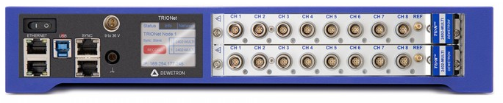
VISUALIZATION OF A TAPE DURING A QUENCH
Help from A.Derbey & B.Sarrazin
Pulse
Zgrid
+
Igrid
Z
sfcl
Vgrid
-
10 ms
Fault current set-up
Sample Superpower ® 67 mm
High-speed camera
50 000 fps
Cryostat (77 K)
Data recorder
Help from J.Vessaire & M.Gibert
1
2
3
4
5
9
Experimental observations of inhomogeneous quenches

Slide 17
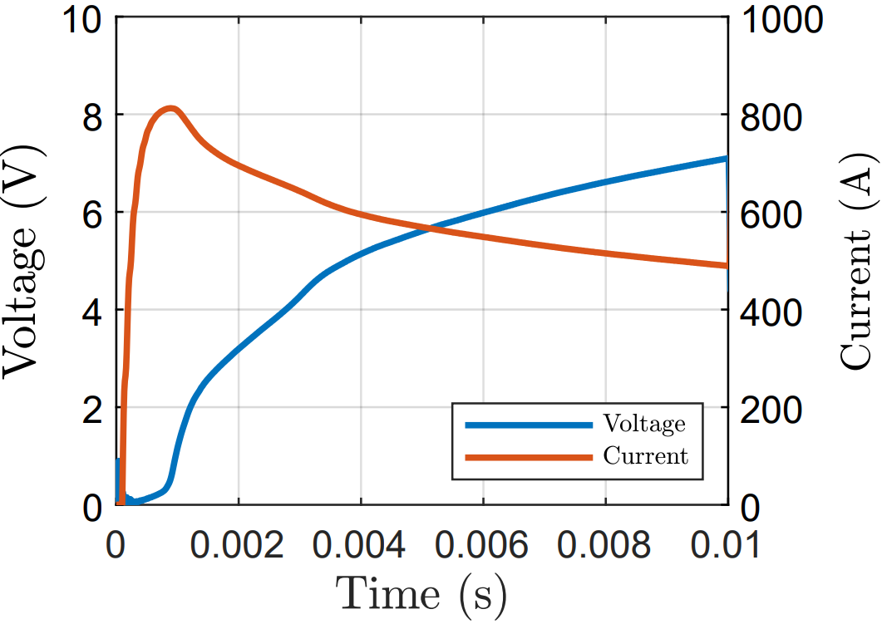

VISUALIZATION OF A TAPE DURING A QUENCH
Images recorded
for 10 ms
12
mm
67 mm
1
2
3
4
5
10
Experimental observations of inhomogeneous quenches

Slide 18

OUTLINE
Influence of local inhomogeneities in the REBCO layer
Conclusions
Context
1
2
3
4
5
Experimental observations of inhomogeneous quenches
Current redistribution around a dissipative zone
11

Slide 19
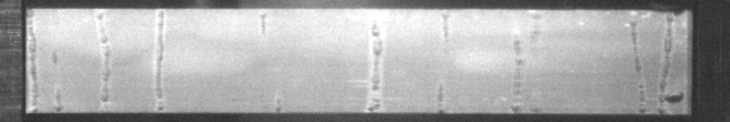
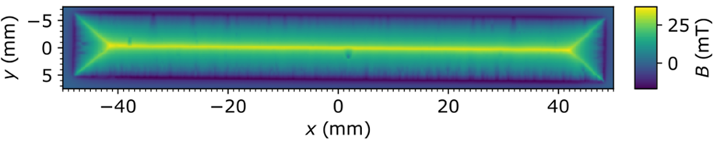
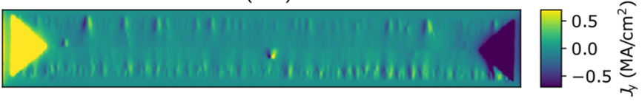
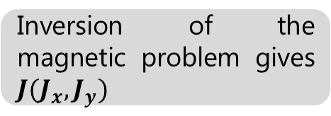
RECOGNITION OF LOCAL INHOMOGENEITIES
Work carried out by S.Holleis and M.Eisterer from TU Vienna
Measurement of the remnant field after magnetization
y
Inversion of the magnetic problem gives $J(J_{x},J_{y})$
x
1
2
3
4
5
12
Influence of inhomogeneities in the REBCO layer

Slide 20
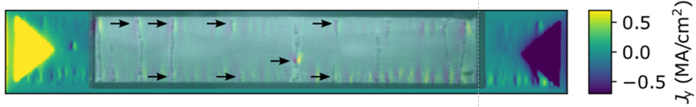
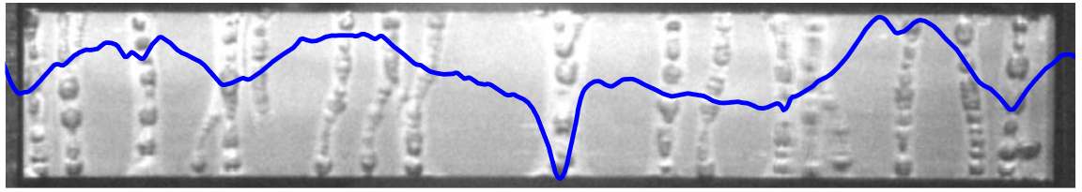

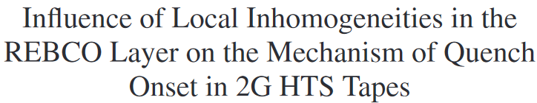
RECOGNITION OF LOCAL INHOMOGENEITIES
y
Work carried out by S.Holleis and M.Eisterer from TU Vienna
x
y
Positions of bubble columns and inhomogeneities match well
y
x
Local Ic based on magnetization does not describe all the dissipation phenomena
x
IEEE TAS
1
2
3
4
5
13
Influence of inhomogeneities in the REBCO layer

Slide 21
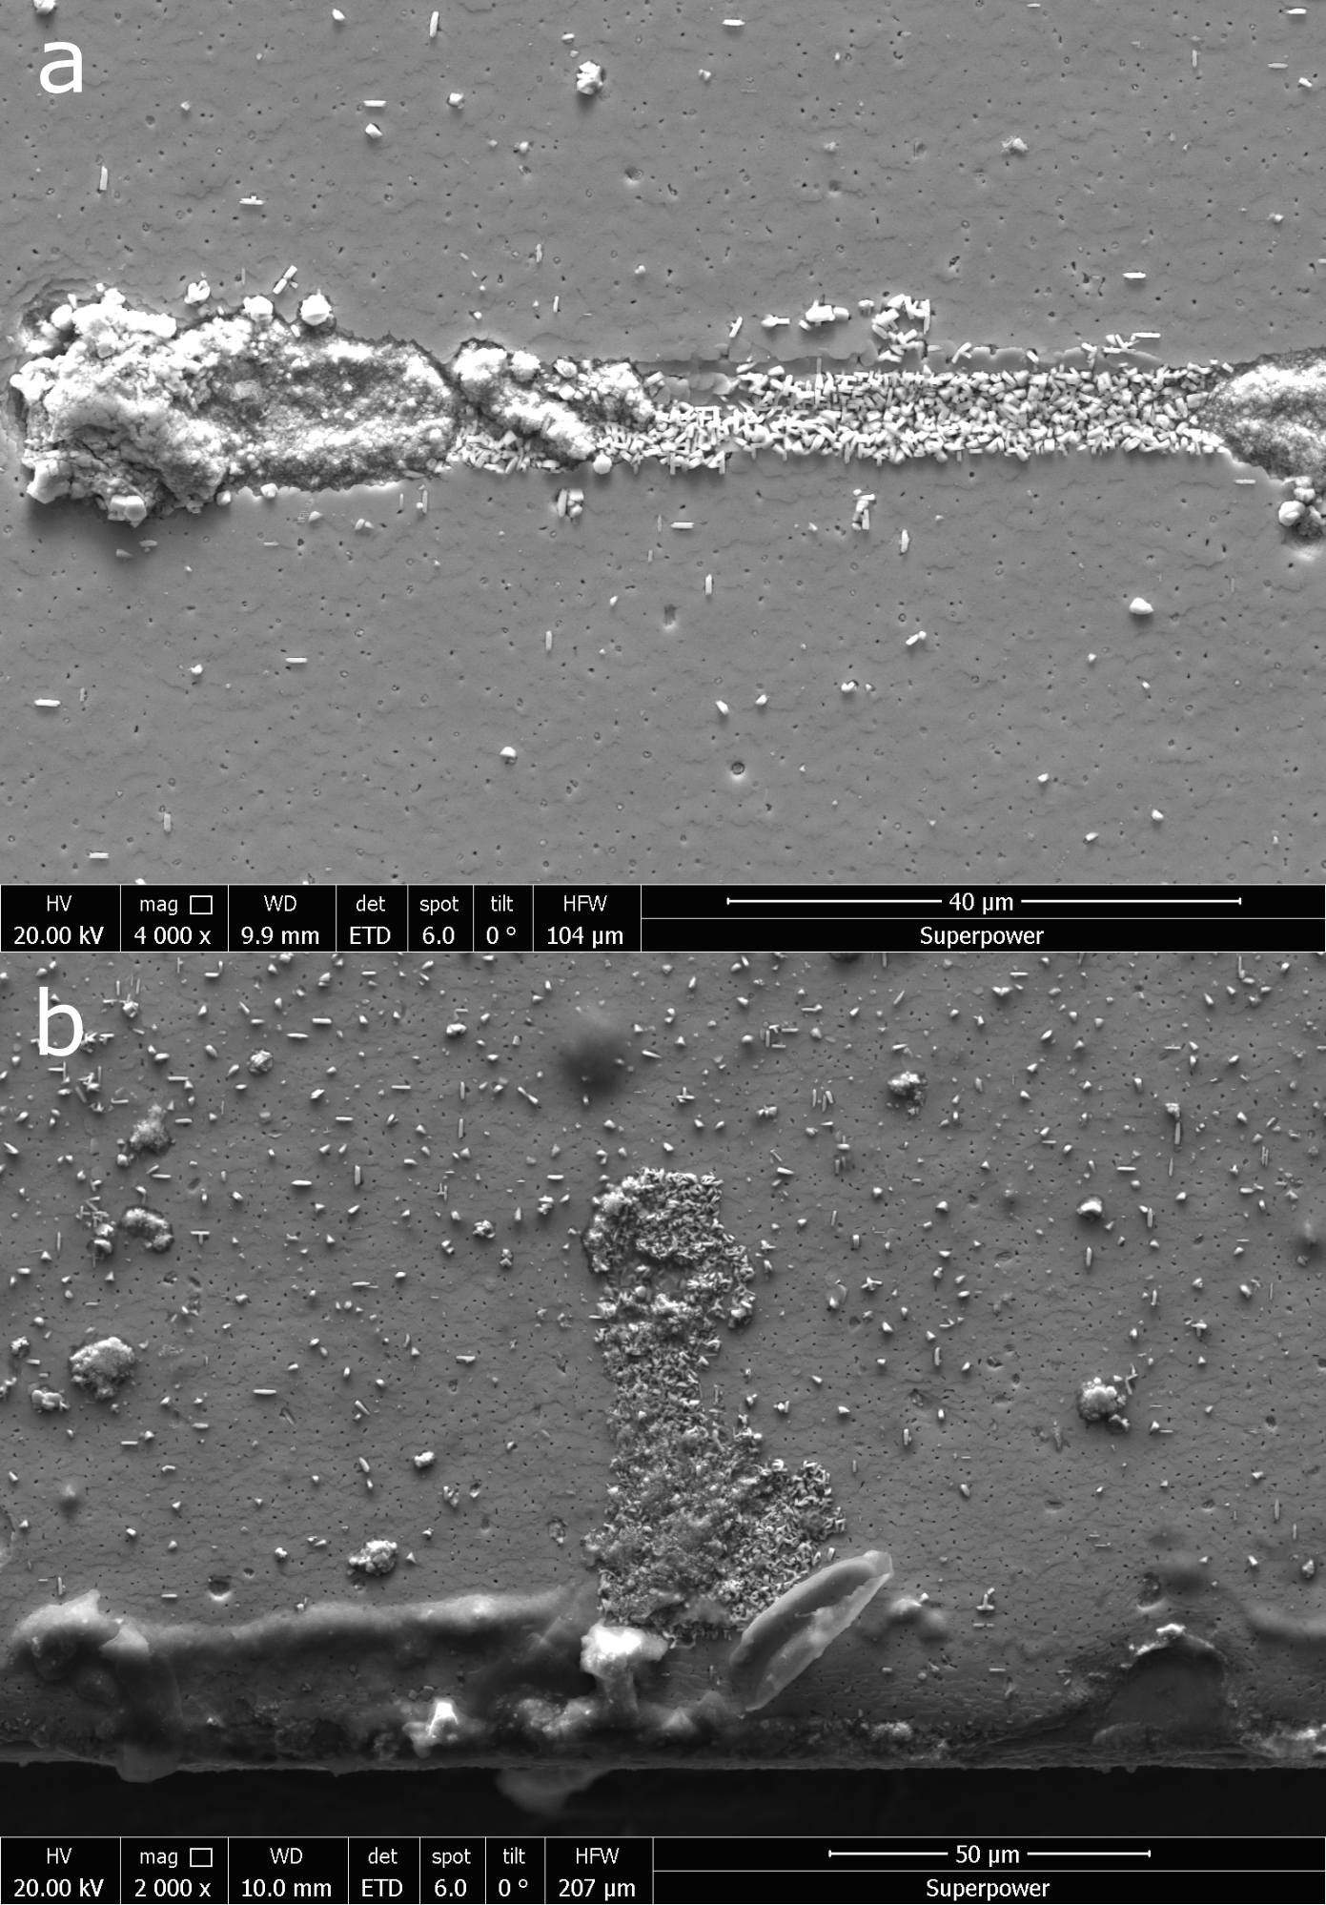
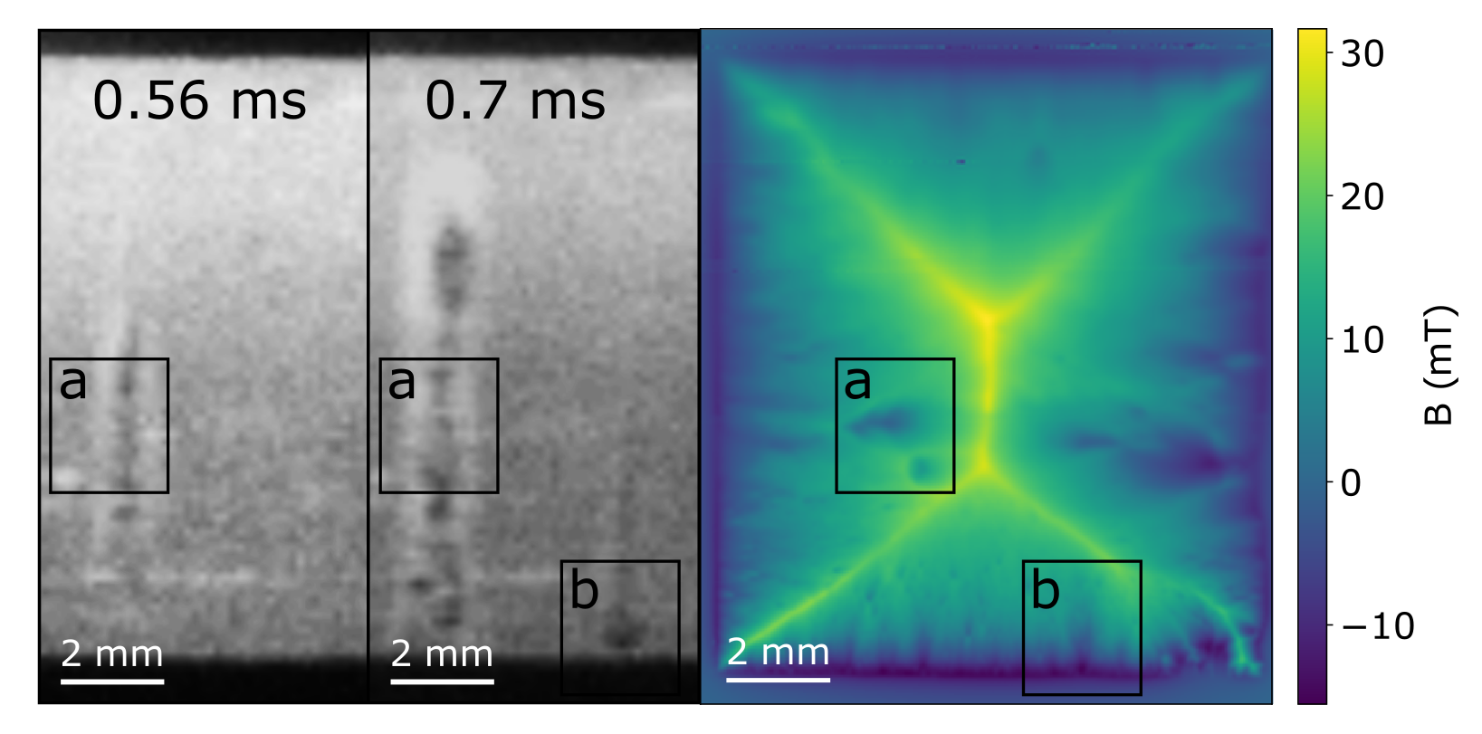
NON-EPITAXIAL GROWTH OF THE REBCO LAYER
Work carried out by S.Holleis and M.Eisterer from TU Vienna
1
2
3
4
5
14
Influence of inhomogeneities in the REBCO layer

Slide 22
OUTLINE
Influence of local inhomogeneities in the REBCO layer
Conclusions
Context
1
2
3
4
5
Experimental observations of inhomogeneous quenches
Current redistribution around a dissipative zone
15

Slide 23

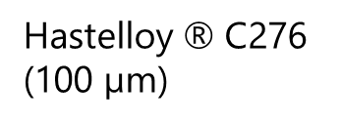
3D FEM ELECTRO-THERMAL MODEL
Width (12 mm)
Thermo-electrical model developed by C.Lacroix & F.Sirois from EPM
Top silver layer (2 µm)
Hastelloy $\text{®}$ C276
(100 µm)
Silver on lateral side (1 µm)
REBCO layer (1.5 µm)
● Temperature and current dependence of REBCO layer under Tc
Buffer layers (2D/interface)
Bottom silver layer (1 µm)
Rcircuit
Xcircuit
Idc
+
R
sfcl
Vsource
60 mm
-
1
2
3
4
5
16
Current redistribution around a dissipative zone

Slide 24
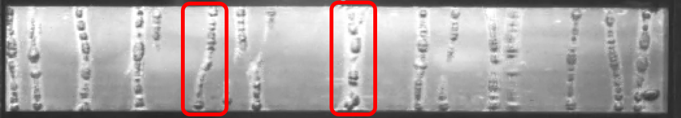
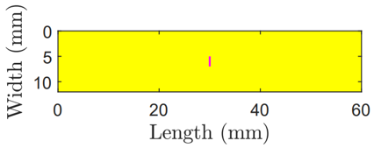
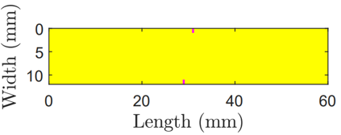


3D FEM ELECTRO-THERMAL MODEL
Thermo-electrical model developed by C.Lacroix & F.Sirois from EPM
● Temperature and current dependence of REBCO layer under Tc
● Inhomogeneous critical current density (x,y)
$$J_{c}=3.3 {10}^{10}A/m^{2}$$
$$J_{c}=0.33 {10}^{10}A/m^{2}$$
1
2
3
4
5
16
Current redistribution around a dissipative zone

Slide 25
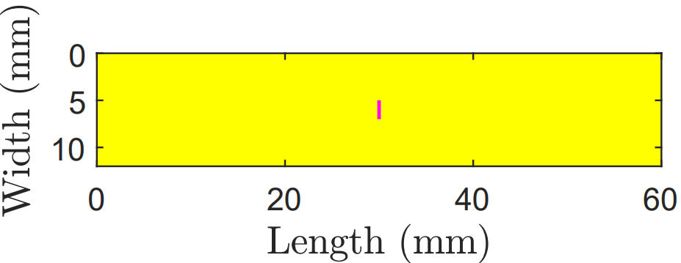
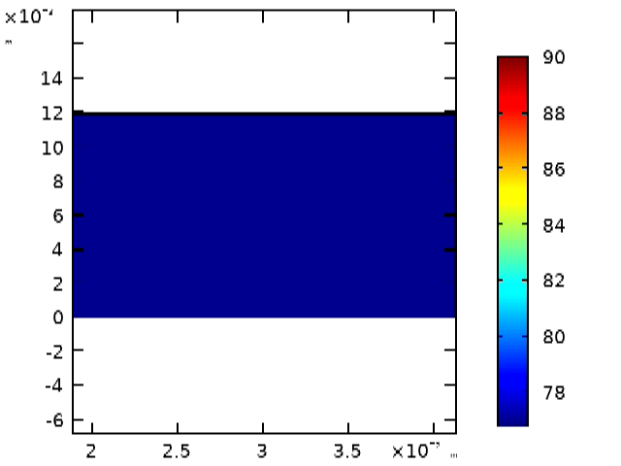
TEMPERATURE EVOLUTION ALONG THE WIDTH
y (mm)
3 ms
12
60 mm
0 mm
0
I
I
I
z
x
y
z
20
40
x (mm)
1
2
3
4
5
17
Current redistribution around a dissipative zone

Slide 26
TEMPERATURE EVOLUTION ALONG THE WIDTH
y (mm)
3 ms
12
60 mm
0 mm
0
I
I
I
z
x
y
z
20
40
x (mm)
1
2
3
4
5
17
Current redistribution around a dissipative zone

Slide 27
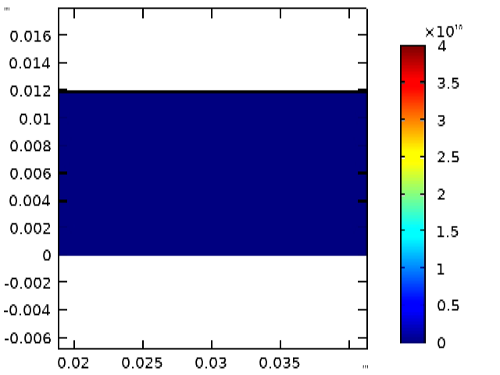

CURRENT DENSITY EVOLUTION ALONG THE WIDTH
z
x
y
I
I
I
I
I
I
I
I
I
With an increasing transport current!
y (mm)
y (mm)
y (mm)
3 ms
3 ms
3 ms
12
12
12
0
0
0
x (mm)
x (mm)
x (mm)
20
40
20
40
20
40
1
2
3
4
5
18
Current redistribution around a dissipative zone

Slide 28
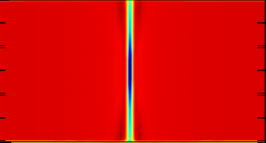
CURRENT DENSITY EVOLUTION ALONG THE WIDTH
z
x
y
I
I
I
I
I
I
I
I
I
With an increasing transport current!
y (mm)
y (mm)
y (mm)
3 ms
3 ms
3 ms
12
12
12
0
0
0
x (mm)
x (mm)
x (mm)
20
40
20
40
20
40
1
2
3
4
5
18
Current redistribution around a dissipative zone

Slide 29
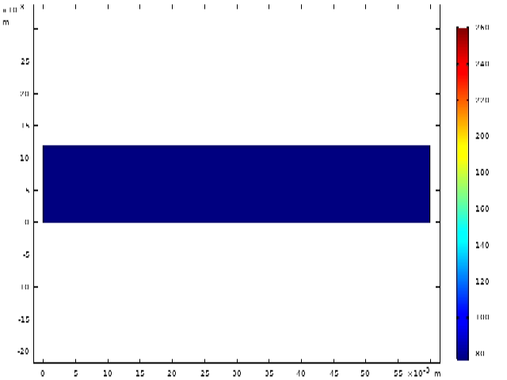
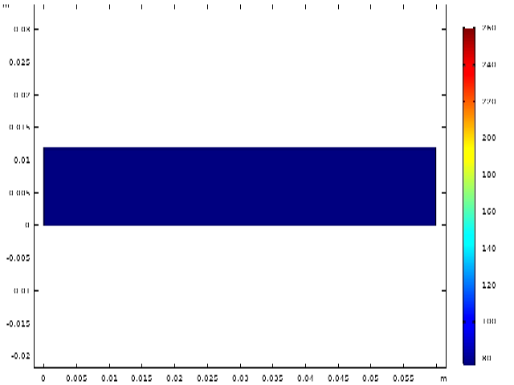
TEMPERATURE EVOLUTION ALONG THE LENGTH
z
With an increasing transport current!
x
y
I
I
I
Temperatures similar on each side of the tape…
I
I
I
y (mm)
260 K
y (mm)
260 K
10 ms
10 ms
12
12
0
0
x (mm)
x (mm)
70 K
70 K
0
60
0
60
60
1
2
3
4
5
19
Current redistribution around a dissipative zone

Slide 30


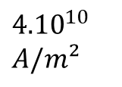

CURRENT DENSITY EVOLUTION ALONG THE LENGTH
z
With an increasing transport current!
x
y
Temperatures similar on each side of the tape…
I
I
I
y (mm)
y (mm)
${4.10}^{10}$ $A/m²$
${4.10}^{10}$ $A/m²$
10 ms
10 ms
12
12
The current density is not identical on the top and bottom silver layers
0
0
0
0
0
60
x (mm)
0
x (mm)
60
1
2
3
4
5
20
Current redistribution around a dissipative zone

Slide 31
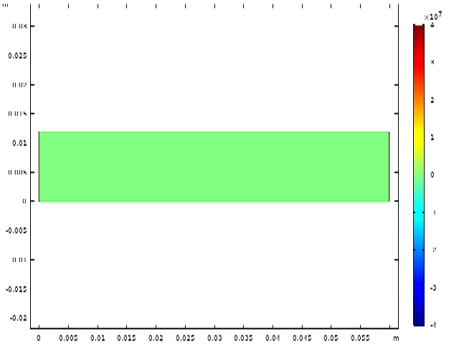



CURRENT DENSITY EVOLUTION ALONG THE LENGTH
z
x
y
I
I
I
I
I
I
$$4{.10}^{7}$$
$$4{.10}^{7}$$
y (mm)
10 ms
y (mm)
10 ms
12
12
$$−4.{10}^{7}$$
$$−4.{10}^{7}$$
0
60
x (mm)
0
60
x (mm)
1
2
3
4
5
21
Current redistribution around a dissipative zone

Slide 32
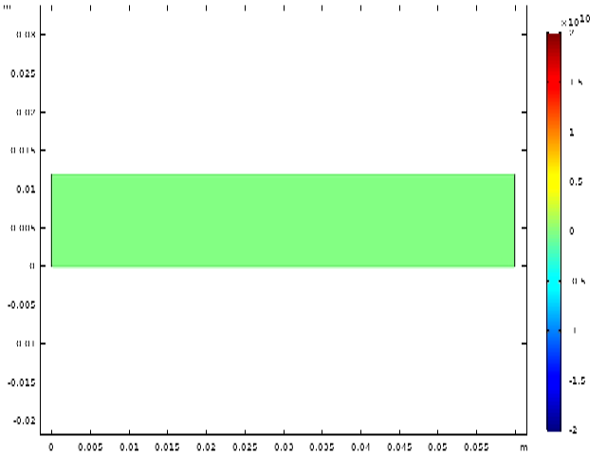



CURRENT DENSITY EVOLUTION ALONG THE LENGTH
z
x
I
I
I
I
I
I
y
2${.10}^{10}$
2${.10}^{10}$
y (mm)
10 ms
y (mm)
10 ms
12
12
$$−2.{10}^{10}$$
$$−2.{10}^{10}$$
60
x (mm)
x (mm)
0
0
60
1
2
3
4
5
22
Current redistribution around a dissipative zone

Slide 33
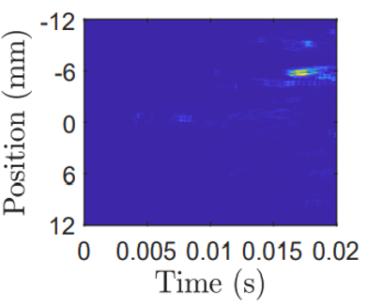
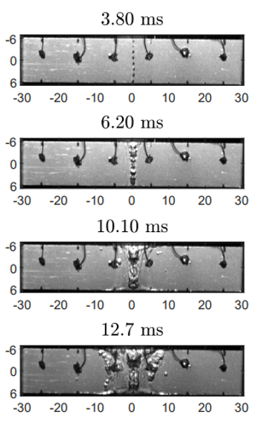
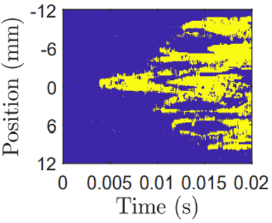
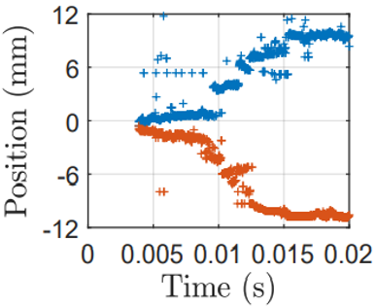
CONCLUSIONS
Inhomogeneous and homogeneous dissipation regimes are successive behaviors
Positions of dissipation spots and zones of non-epitaxial growth of the REBCO are in good agreement
Ic as a function of the position should be improved to describe dissipation phenomena
Thermo-electrical mechanism of quench onset
Three practical outputs of the study :
Assessment of the impact of a lack of stabilizer on one side
Voltage taps positions for Ic measurement (superconductor side VS substrate side)
Evaluation of the NZPV through data processing
1
2
3
4
5
23
Conclusions & Perspectives

