Slide 1

Test Infrastructures and Accelerator
Research Area
Kickoff meeting
R. Aleksan
23 February, 2011
Introduction
Objectives
Deliverables
Conclusion

Slide 2
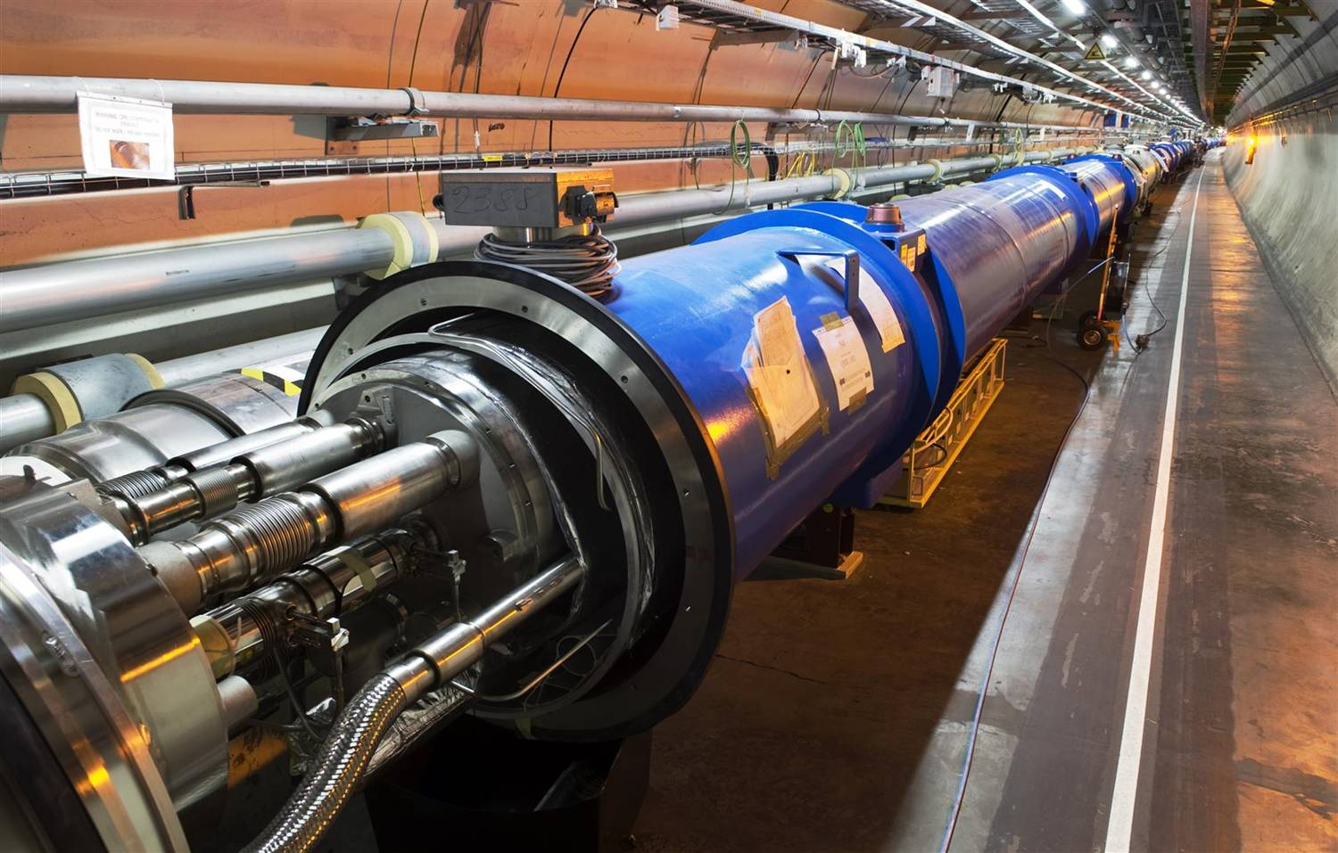
The use of Accelerators
The development of state of the art accelerators is essential for many many fields of science (fundamental, applied or industrial)
Research accelerators
Particle Physics, Nuclear Physics, Research fields using light source, Research fields using spallation neutron sources, Study of material for fusion, Study of transmutation…
In past 50 years, about 1/3 of Physics Nobel Prizes are rewarding work based on or carried out with accelerators
This « market » represents ~15 000 M€ for the next 15 years, i.e. ~1 000M€/year
Clinical accelerators
radiotherapy, electron therapy,
hadron (proton/ion)therapy…
Industrial accelerators
ion implanters, electron beam and X-ray irradiators, radioisotope production…
This market represents ~3 000M€/year and is increasing at a rate of ~10% /year

Slide 3
The use of Accelerators
Examples
projects | Science field | Beam type | Estimated cost
LHC | Particle Physics | proton | 3700M€
FAIR | Nuclear Physics | Proton /ion | 1200M€
XFEL | multi fields | electron aphoton | 1050M€
ESS | multi fields | Proton aneutron | 1300M$
IFMIF | Fusion | Deuton aneutron | 1000M€
MYRRHA | Transmutation | Proton aneutron | 700M€
In past 50 years, about 1/3 of Physics Nobel Prizes are rewarding
work based on or carried out with accelerators
This « market » represents ~15 000 M€ for the next 15 years, i.e.
~1 000M€/year

Slide 4
Clinical accelerators
Industrial accelerators
radiotherapy
electron therapy
hadron (proton/ion)therapy
ion implanters
electron cutting&welding
electron beam and X-ray irradiators
radioisotope production
…
Application | Total systems (2007) approx. | System sold/yr | Sales/yr ($M) | System price ($M)
Cancer Therapy | 9100 | 500 | 1800 | 2.0 - 5.0
Ion Implantation | 9500 | 500 | 1400 | 1.5 - 2.5
Electron cutting and welding | 4500 | 100 | 150 | 0.5 - 2.5
Electron beam and X-ray irradiators | 2000 | 75 | 130 | 0.2 - 8.0
Radioisotope production (incl. PET) | 550 | 50 | 70 | 1.0 - 30
Non-destructive testing (incl. security) | 650 | 100 | 70 | 0.3 - 2.0
Ion beam analysis (incl. AMS) | 200 | 25 | 30 | 0.4 - 1.5
Neutron generators (incl. sealed tubes) | 1000 | 50 | 30 | 0.1 - 3.0
Total | 27500 | 1400 | 3680
Courtesy: R. Hamm
Total accelerators sales increasing more than 10% per year

Slide 5
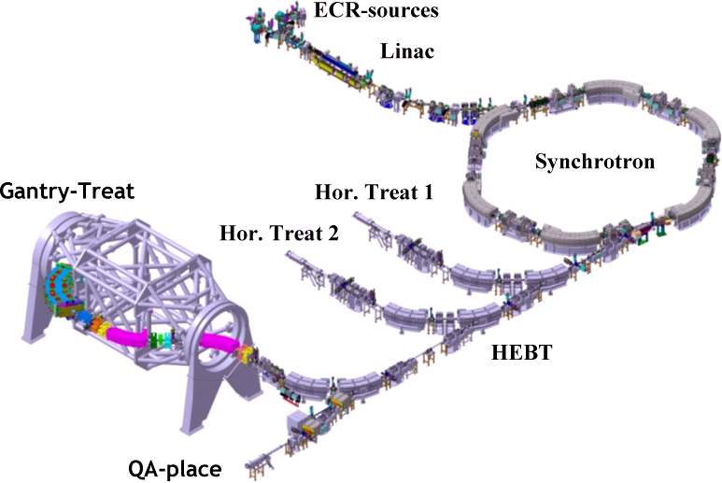
Clinical accelerators
Varian
radiotherapy
electron therapy
hadron (proton/ion)therapy
Radiotherapy linac
Gantry PSI
HIT (Heidelberg)

Slide 6
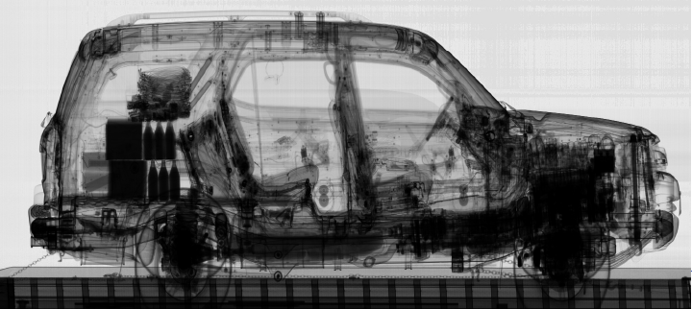
Industrial accelerators
ion implanters
electron cutting&welding
electron beam and X-ray irradiators
radioisotope production
…
Ion Implatation
accelerators
Energy (KeV)
Atoms/cm²
Security and inspection
X-ray accelerators

Slide 7
The LHC is the most recent illustration of
a state of the art research accelerator
for High Energy Physics
The LHC results will largely determine the future
course of HEP… and the next accelerators to be built
… but not only
For example, results from
ν−experiments
  (Doublechooz, Minos, OPERA, T2K…)
  (CUORE, NEMO…)
WIMPS searches (CDMS, Edelweiss, Xenon100…
Others …
may have consequences for future accelerators

Slide 8

Unraveling the fundamental mysteries of the universe requires
to “recreate” the initial conditions of the “Big Bang”,
to search for rare events,
State of the art accelerators
“Energy Frontier” able to reach higher energy
“Intensity/Power Frontier” able to produce higher luminosity
with different accelerated “Probes”
State of the art accelerator technology, instrumentation and
test facilities
These infrastructures and technology can be useful (vital)
to many research fields, as well as for industrial developments

Slide 9


The Virtuous Triangle
R&D projects
Test Infrastructures
Education and Training
Innovations for
Cultural, Medical,
Industrial…
applications
Innovations for
Fundamental
Research
Infrastructures
Coordination and Funding Mechanism

Slide 10


Creation of a coordinated panEuropean multi-purpose distributed Test Infrastructure
Joint Strategic Analysis of the accelerator needs
and perspective for the development of R&D RI
Joint R&D programming and launching of a set
of consistent integrated accelerator R&D projects
Promotion of the education and training for accelerator science
Strengthening the collaboration with the industry

Slide 11
Needed Infrastructures
Test accelerators
for carrying accelerator R&D
10-100M€
TIER1
Specific large scale equipments
1-10M€
TIER2
Laboratory equipments
0.1-1M€
TIER3
A rough estimate of all these infrastructure is 500-1000 M€
These infrastructures need to be upgraded and/or new infrastructures are necessary

Slide 12
Creation of a coordinated panEuropean
multi-purpose distributed Test Infrastructure
Monitoring and coordinating the use and the development of the
European test infrastructures for accelerator R&D
Monitoring accesses, including industry involvement
Identifying weaknesses and needed upgrades/investments and
assessing their costs
Making recommendations and contributing to upgrade
and/or construction of new R&D Infrastructures as well as
their corresponding R&D programs

Slide 13
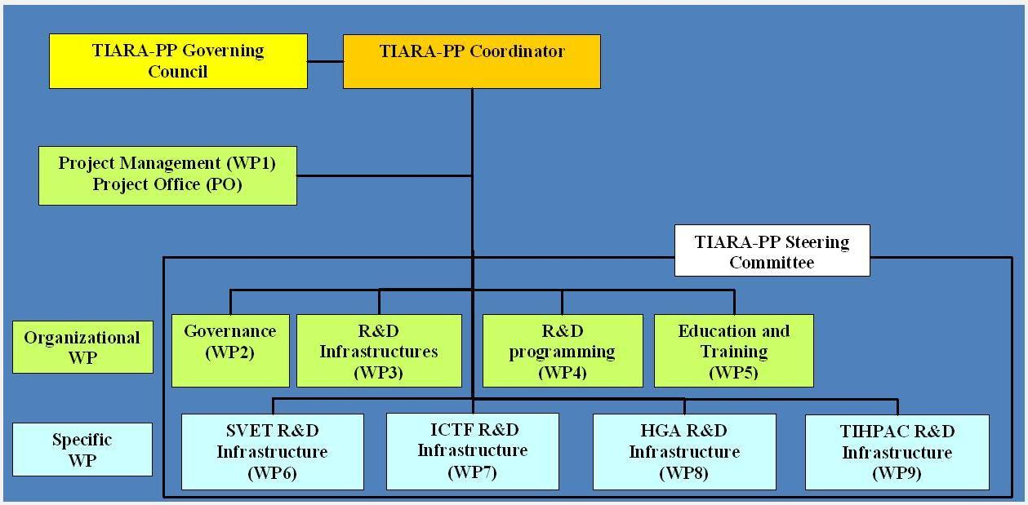
Organization
R. A.
F. Kircher
C. Tanguy
R. A.
A. Unnervik
F. Cervelli
P. Burrows
E. Jensen
K. Long
M. Biagini
S. Bousson
WP1-5: total cost = k€ 5 758
WP6-9 : total cost = k€ 3 381
All: total cost = k€ 9 139

Slide 14
Organization (cont’d)
1. Management of TIARA-PP
WP1: Management of the consortium (MGT)
Objective: Organization of the Preparatory Phase work,
Dissemination and outreach
2. General Coordination and Support Work Packages
WP2: Governance of TIARA (SUPP)
Objective: Developing governance allow one to involve as many fields as possible
WP3: Accelerator R&D Infrastructures in Europe (COORD)
Objective: Integrating and optimizing European Infrastructures for accelerator R&D
WP4: Joint R&D programming (COORD)
Objective: Defining a Joint R&D Programme in the field of accelerator science
WP5: Education and Training for accelerator sciences (SUPP)
Objective: Promoting education and training for accelerator research in Europe

Slide 15
Organization (cont’d)
3. Specific RTD Work Packages
WP6: SLS Emittance Tuning System Infrastructure (SVET)
Objective: Upgrade of SLS at PSI for very low emittance studies
Main interested projects: CLIC, Light Sources, SuperB
WP7: Ionisation Cooling Test Facility (ICTF)
Objective: Upgrade of Test Infrastructure at RAL for ionisation cooling studies
Main interested projects: Neutrino Factory
WP8: High Gradiant Acceleration Infrastrcuture (HGA)
Objective: Construction at LNF of SC C-Band High Gradiant Test Infrastructure
Main interested projects: SuperB, FEL
WP9: Test Infrastructure for High Power Accelerator Components (TIHPAC)
Objective: Design of infrastructures for multi MW target complex tests and of test cryostat for SC low beta SC cavity tests
Main interested projects: EURISOL, ESS, MYRRHA

Slide 16
Deliverables
To achieve these ambitious and challenging objectives,
two main deliverables:
« Final memorandum of Agreement », detailing
the structure, methods and means of operation TIARA
(requires the input of WP2-5)
« Upgrade, design and/or construction of some
specific (not exhaustive) R&D infrastructures »,
(WP6-9) to be included in TIARA, anticipating its formal
establishment.

Slide 17
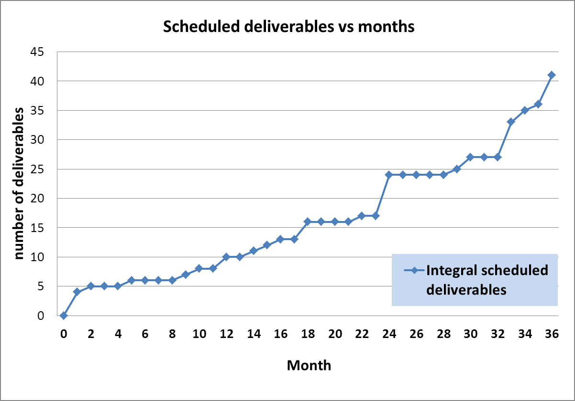
Deliverables (cont’d)
To get there, 41 deliverables, (with 16 till mid term report)
have to be achieved
Mid term
report
Now

Slide 18

Deliverables (cont’d)
Num | Nat[1] | Short name | Description | month
D1.1 | O | OWSF | Overall Web Site Frame ready | 1 | PU
D1.2 | O | CAP | Consortium Agreement between participants ready | 1 | CO
D1.3 | O | CCE | Contract of the Consortium with the EC signed | 1 | CO
D1.4 | O | OKM | Organization of the Kickoff meeting | 1 | CO
D1.5 | O | IWSF | Internal Web Site Frame Ready | 2 | CO
D4.1 | R | KIR | General Report on Key Accelerator Research Areas and Key R&D Issues | 5 | PU
D6.1 | R | D_SLS_NOW | Report on existing hardware limitations and needed upgrades. | 9 | PU
D5.1 | R | ETR | Education and Training Survey Report | 10 | PU
D2.1 | O | MoA-GI | Memorandum of Agreement on General Issues | 12 | CO
D3.1 | R | ISR | Infrastructure Survey Report. | 12 | PU
D5.2 | O | ETD | Education and Training resources Database | 14 | PU
D7.1 | R | RFSysV-Spec | Report on the design and specification of ICTF RF power distribution system for MICE Step V | 15 | PU
D3.2 | O | IWD | Infrastructure Web-based Database. | 16 | PU
D1.6 | R | TTR | Midterm Report | 18 | CO
D2.3 | R | COB | Report on Collaboration with Other Bodies | 18 | CO
D6.2 | R | D_SPEC | Specifications ready | 18 | PU
D1.2: CA is written, final version awaiting approval from beneficiaries
D1.5: being done (see C. Tanguy)

Slide 19
Organization
Most of the logistics aspects are (or close to being) in place
  Grant Agreement/Consortium Agreement
  Web site
  Documentation database
  EC Funding received and transferred to Beneficiaries
Communication actions should be (are) starting
  Articles (such as CERN courier, local courier…)
  Editing of brochure on impact of accelerators on society
  …
  Your help/suggestions will be needed
…now we need to do the work we have promised

Slide 20
TIARA Kickoff meeting
Date: February 23-24, 2011
Website: http://indico.cern.ch/internalPage.py?pageId=0&confId=117195
Feb. 23:
14:00-15:30 : Plenary session (general TIARA informations)
16:00-18:30 : Parallel sessions for the Work Packages activities
19:30: Dinner
Feb. 24:
8:30-10:00 : Parallel sessions for the Work Packages activities
10:30-12:30 : Plenary session (Reports from the Work Packages)
14:00-16:00 : Plenary session (Reports from the WP packages)
Parallel sessions Rooms
WP2 | 61:1-007 | WP3 | 60/2-023 | WP4 | 72/1-020 | WP5 | 61/1-017
WP6 | 14/3-021 | WP7 | 4/3-021 | WP8 | 72/R-036 | WP9 | 60/R-006
For any special needs: Nathalie Gouriou, Anders Unnervik

Slide 21
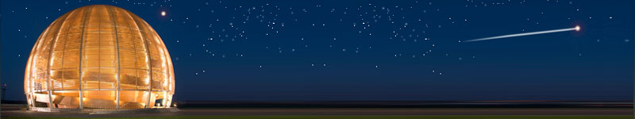
Conclusions
After having established an accelerator R&D strategy,
implemented through several projects in FP6 and FP7,
ESGARD is proposing to go one step further with the TIARA
Concept, submitted to the EC as a Preparatory Phase project
The CERN member states are supporting this initiative.
EC has approved TIARA with an EC funding of 3.9 M€.
The project is on track for signing the contract in the fall.
TIARA will hopefully establish the groundwork for supporting sustainably Accelerator R&D and infrastructures in Europe through “program funding” in FP8
Accelerator science is a powerful mean
toward scientific, technical
and industrial breakthroughs…
TIARA will strengthen significantly this potential

