Slide 1


Communication,
Dissemination & Outreach
Céline Tanguy
February 23rd, 2011
TIARA : Test Infrastructure and Accelerator Research Area / Kick-off meeting

Slide 2

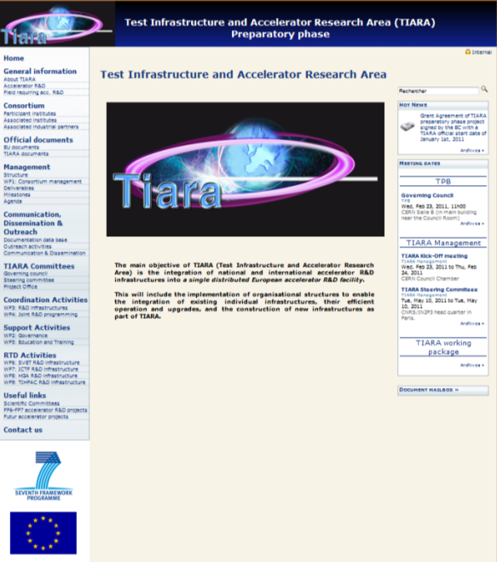

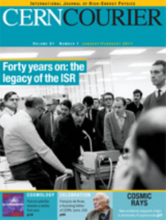
Outline
TIARA Website | Doc. management system | Com. & O
TIARA Website
  Deliverables / Milestones follow-up
  Access to documentation database
Document management system
CERN Document Server
Communication & Outreach

Slide 3
TIARA Website: How to use it?
TIARA Website | Doc. management system | Com. & O
http://www.eu-tiara.eu/
TIARA
Website
News, agenda
meeting dates
Deliverables
& milestones
General information & useful links
Documentation database
Notes:
Show : Home, Agenda, Structure, WPs, deliverables milestones and data base

Slide 4
TIARA Website: How to use it?
TIARA Website | Doc. management system | Com. & O
Document mailbox
to distribute documents
temporarily
Notes:
Document mailbox only in particular case

Slide 5

Outline
TIARA Website | Doc. management system | Com. & O
TIARA Website
Document management system
Communication & Outreach

Slide 6
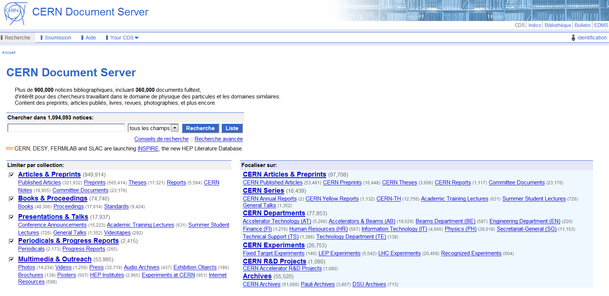
Document management system
TIARA Website | Doc. management system | Com. & O
Adapted tool: CERN Document Server (CDS)
Available within 3 months
(System being implemented by CERN CDS support)
Notes:
Solution pour consulter les documents d’ici la mise en place de CDS pour TIARA

Slide 7
To consult documents
TIARA Website | Doc. management system | Com. & O
2 ways :
  Via TIARA Website / documentation database
  Via CDS
Access restrictions on documents
Public
Notes
Reports
Confidential
Minutes
Conference papers
Publications
(thesis)
Reports
Conference papers
Publications
(thesis)
Notes

Slide 8
To consult documents
TIARA Website | Doc. management system | Com. & O
To access to confidential documents
  Create a CERN account (if you do not have one)
  on CDS Home page:
    Login: username or email address
    Password: xxxxxxxx

Slide 9

To submit documents
TIARA Website | Doc. management system | Com. & O
Documents submitted on CDS by the management team
  Email to celine.tanguy@cea.fr
Notes:
Document mailbox only in particular case

Slide 10
Outline
TIARA Website | Doc. management system | Com. & O
TIARA Website
Document management system
Communication & Outreach

Slide 11


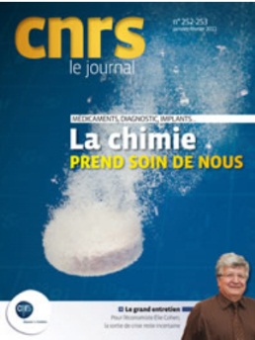

Communication
TIARA Website | Doc. management system | Com. & O
Articles in newspapers
Other proposals?
Notes:
Contact de journeaux locaux (Les echos?), quotidiens : le monde, liberation

Slide 12











Communication: TIARA brochure
TIARA Website | Doc. management system | Com. & O
Subject: the impact of Accelerator R&D
Formation of an Editorial Board
Brochure diffused by december 2011 (if possible) Creation of DVD?
Notes:
Brochure : we will put in place an editorial board composed of a representative per insitute or at least country

Slide 13

Questions and comments welcome
TIARA Website | Doc. management system | Com. & O

