Slide 1
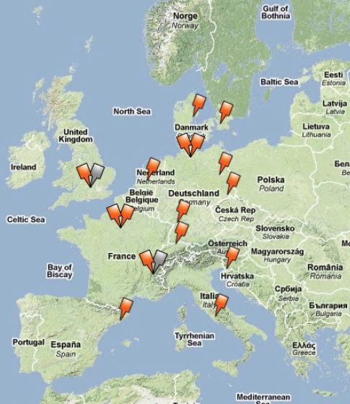
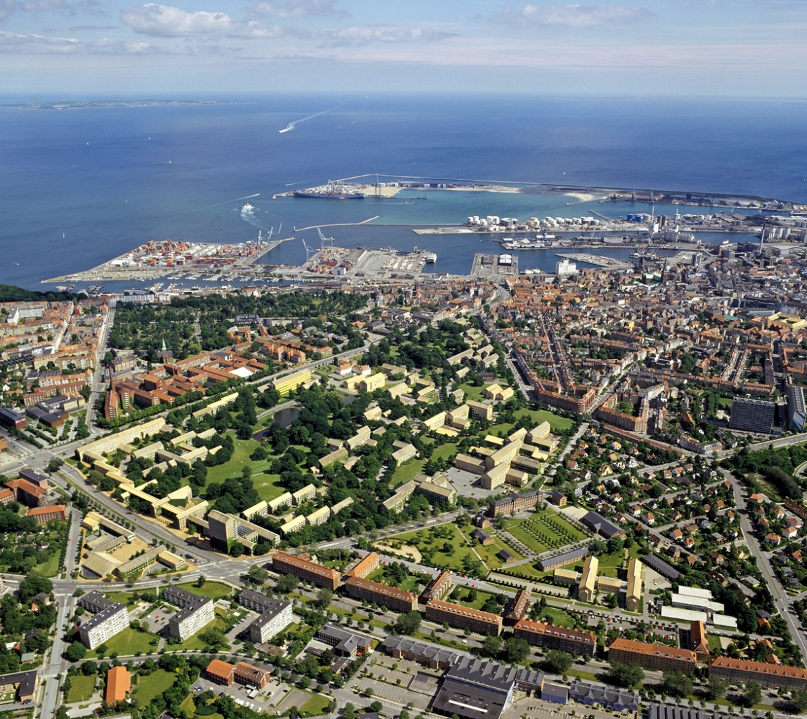
Aarhus University, DK
Aarhus
10,000 staffs, 38,000 students

Slide 2
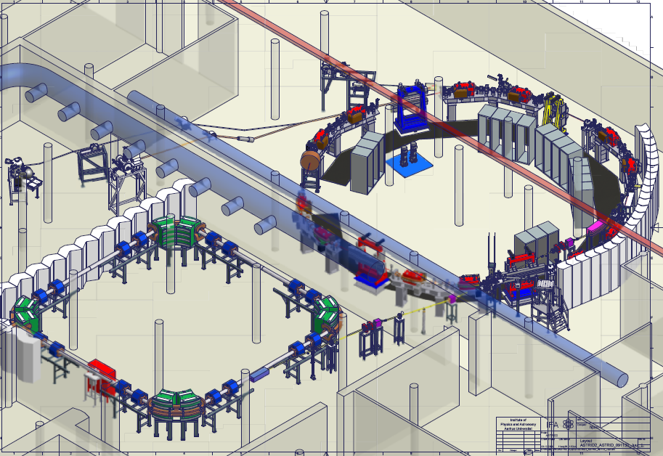
Accelerator development
Single stage accelerators from 1960
ASTRID storage ring since 1990; ions and SR
Electrostatic storage ring
Involved in several accelerator projects like Particle Therapy with Siemens, and booster synchrotrons with DANFYSIK and …
ASTRID2 is being built and soon commissioned

Slide 3
Accelerator science students in DK (and S)
At Aarhus University, ~15 students attend the course mentioned below. Very few write their master thesis in Accelerator Physics (2/10 years).
Every 3 years PhD student over 10 years in Accelerator Physics/Industrial PhD (Technical Physics)
Nothing else in DK.

Slide 4
Existing resources in DK
Students may graduate in medical physics as master, or after their masters at hospitals as part of their medical physics curriculum. An 5 ECTS in accelerator physics course takes place every other year.
Course is based on Klaus Wille: The Physics of Particle Accelerators. Previously Edmund Wilson: Particle Accelerators was tried
Accelerators are also part (15%) of a course in Experimental Methods

Slide 5
MAX-LAB Lund, Sweden
Lund
Lund University
Intro to Accelerators and FEL
Accelerators are an important tool for research in
many disciplines of natural sciences and for
applications in medicine and industry. In this course
we will focus on the basic technology of
accelerators.
MAXM07, 7.5 ECTS credits Course information...
Accelerator technique
Electromagnetic fields, particle sources, accelerator types, vacuum, basic physics, magnetic elements, synchrotron radiation.
MAXM03, 7,5 ECTS credits Course information...
I guess ~1masters or PhD students graduating annually

