Slide 1


UK Export Finance
Win contracts. Fulfil orders. Get paid.
Presentation to UK @ CERN November 30 2022
Hugh Francis
Export Finance Manager, Bristol, Gloucestershire, N Wilts,Oxon, Worcs
M: 07880 358220 email: hugh.francis@ukexportfinance.gov.uk

Slide 2

Mission
To ensure that no viable UK export fails for lack of finance or insurance from the private sector, while operating at no net cost to the taxpayer.

Slide 3



About UK Export Finance
The world’s first export credit agency, established in 1919
Work with Department for International Trade, Her Majesty’s Treasury and over 70 private lenders and credit insurers
Complement, not compete with the private sector
We support UK businesses that export – our tried and tested product range includes:
  Export insurance policies
  Buyer finance
  Working capital products
Winner – TXF Perfect 10 Deals of the Year and GTR Best Deals awards

Slide 4







All sectors;
goods, services and intangibles
Support SMEs and
large corporations
£
Support exports to 200+ countries
60+ local currencies

Slide 5




In 2020-21:
Provided £12.3bn
in support of UK exports
Directly supported 549 UK businesses
Supported an estimated 107,000 UK jobs

Slide 6
Our capacity
£38bn
£50bn
current exposure
total capacity
£12bn
remaining capacity
As at 31 December 2021

Slide 7
Our products
Buyer Finance
Exporter Guarantees
Insurance
        Win contracts: attractive financing terms for overseas buyers of UK goods and services can help exporters make their offering more competitive
        Fulfil orders: help companies access the support they need to fulfil a contract, giving them the confidence to take on more contracts and increase their turnover
        Get paid: help companies manage risks in challenging markets, ensuring that they get paid even where the private market is not able to offer insurance
        Buyer Credit Facility
        Direct Lending
        Lines of Credit
        Standard Buyer Loan Guarantee
        Bills and Notes Guarantee
        Bond Support Scheme
        Export Working Capital Scheme
        General Export Facility
        Export Development Guarantee
        Supply Chain Discount Guarantee
        Bond Insurance Policy
        Export Insurance Policy
        Overseas Investment Insurance

Slide 8
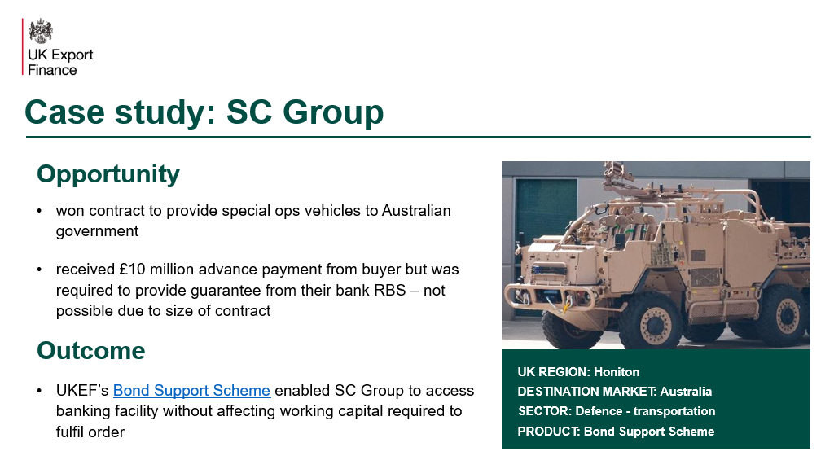

Slide 9
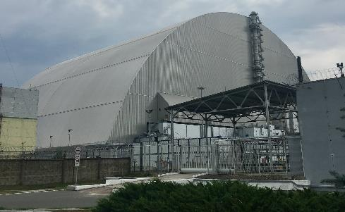
Case study: Flamgard Calidair
Opportunity
won contract to provide fire and shut off dampers to Chernobyl New Safe Confinement Site
contract required an advance payment bond, which usually requires sizeable deposits
Outcome
UKEF provided guarantee to their bank, Lloyds, removing requirement for a deposit and freeing up cashflow to complete contract
UK REGION: Pontypool
DESTINATION MARKET: Ukraine
SECTOR: Manufacturing – fire dampers
PRODUCT: Bond Support Scheme

Slide 10
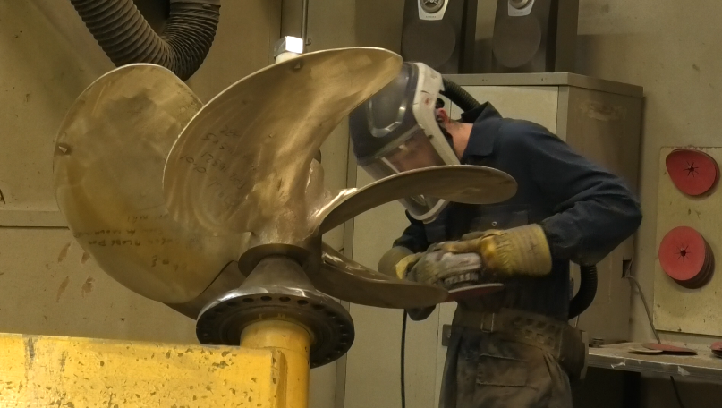
Case study: Teignbridge Propellers International
Opportunity
new customer in Bangladesh ordered propellers for ferries – commercial credit insurance unavailable
Outcome
UKEF provided cover through our Export Insurance Policy
“UKEF’s support has secured jobs in our Devon facility and has given us the confidence to explore and target new markets in the Far East. This is now bearing fruit now with new orders of over £500,000.”
Ian Mills, Finance Director,
Teignbridge Propellers International
UK REGION: Newton Abbot, Devon
DESTINATION MARKET: Bangladesh
SECTOR: Manufacturing – propellers and stern gear
PRODUCT: Export Insurance Policy
Notes:
https://www.gov.uk/government/case-studies/propeller-manufacturer-secures-order-to-bangladesh-with-ukef-support

Slide 11

Export Finance Manager network
Regional point of contact for businesses
Provide information on:
  Payment methods and risks
  Types of finance available
  Making an application
Notes:
https://www.gov.uk/government/publications/find-an-export-finance-manager/the-role-of-our-export-finance-managers

Slide 12
Export Finance Manager network
Midlands, Wales and South West
Regional Head for Export Finance Managers | Phill Potter
Black Country, Staffordshire and Shropshire | Anne Lockett
Derbyshire, Nottinghamshire, Lincolnshire and Rutland | Andy Mannix
Bedfordshire, Cambridgeshire, Northamptonshire | Jo Archer
Birmingham, Coventry and Warwickshire, Leicestershire | Mark Lynam
Wales and Herefordshire | Steve Wilson
Bristol, Gloucestershire, North Wiltshire, Worcestershire and Oxfordshire | Hugh Francis
Somerset, Devon, Cornwall, Dorset and South Wiltshire | Tim Burden
Regional point of contact for businesses
Find your regional Export Finance Manager on our website
Provide information on:
  Payment methods and risks
  Types of finance available
  Making an application
Notes:
https://www.gov.uk/government/publications/find-an-export-finance-manager/the-role-of-our-export-finance-managers

Slide 13

Thank you.

