Slide 1
Digital Asset Assessment with HSE
Tim Bell
27/06/2022

Slide 2
Assessment goals
Following a review of CERN’s cybersecurity risks, an action was agreed at the ED
  “All departments to contact the computer security officer with a view to establishing the necessary back-ups to be implemented in order to ensure business continuity in the event of a cyber-attack.”
With the new IT operating model definition, the contact point is being updated (Tim responsible for Business Continuity/Disaster Recovery in IT department)
Assessment has been completed by the IT department (118 replies) and BE (136 replies). SCE and EN are underway.
Goal is to inventory the critical assets and their backup / restore process maturity
  Review resilience to disaster scenarios such as ransomware or human error
  Not just where IT is managing the backup / restores
  Includes all critical assets such as PCs with process spreadsheets or public cloud services
  Restore / rebuilding testing is also in scope
  Identify impact, risks and areas for further investigations

Slide 3
How to provide input ?
Survey site set up at http://disaster-recovery.web.cern.ch
  Assessments -> Backup / Restore assessment -> HSE (Direct URL)
  Incorporating IT and BE feedback to improve data entry
Simple questionnaire - around 10-20 minutes per application
  Entries can refer to the Service-Now catalog so no need to duplicate information already in SNOW
  For IT managed backups, you can define the IT service looking after it (e.g. databases)
Access to the responses can be given to an HSE point of contact so they can review progress

Slide 4
Suggested next steps for assessment
  HSE nominates a point of contact for the assessment
  Try the survey with some sample cases so we can improve help text and response choices
  Once input is collected, I will review with the HSE contact and also IT services where appropriate to clarify the data and make sure there is a consistent understanding
  A report will then be produced with findings and recommendations
  I would also be interested to discuss with HSE regarding wider organisation wide business continuity and disaster recovery topics which are an area that IT is investing in as part of the IT Strategy 2022-2025

Slide 5
Backup Slides

Slide 6
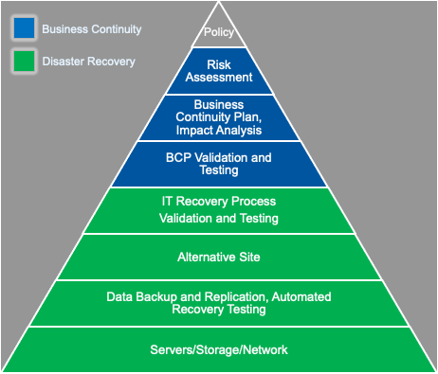

Slide 7
HSE Safety Computing
From https://hse.cern/services-support/safety-computing
Application | Support
REMUS | remus-support@cern.ch
REMUS-Web | remus-support@cern.ch
ERGO | remus-support@cern.ch
Dosimetry System | safetycomputing-websupporttech@cern.ch
SAILOR | sailor.support@cern.ch
SAILOR Planning | sailor.support@cern.ch
SAILOR Light | sailor.support@cern.ch
Safety Reporting | sailor.support@cern.ch ​​​​​​​
RAISIN ​​​​​​​ | raisin-support@cern.ch ​​​​​​​
CERES ​​​​​​​ | ceres-support@cern.ch ​​​​​​​

