Slide 1
Connecting the DOTS
E. Mosselmans & P. Berset

Slide 2
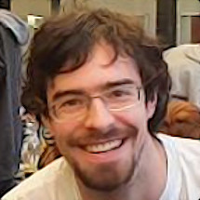
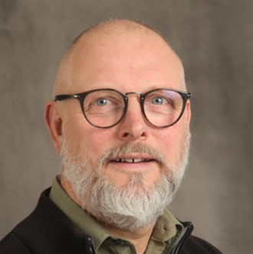
About us
Welcome
Bienvenue
Erwin
MOSSELMANS
HR Department
Learning Specialist
Philippe
BERSET
HR Department
Learning Specialist

Slide 3
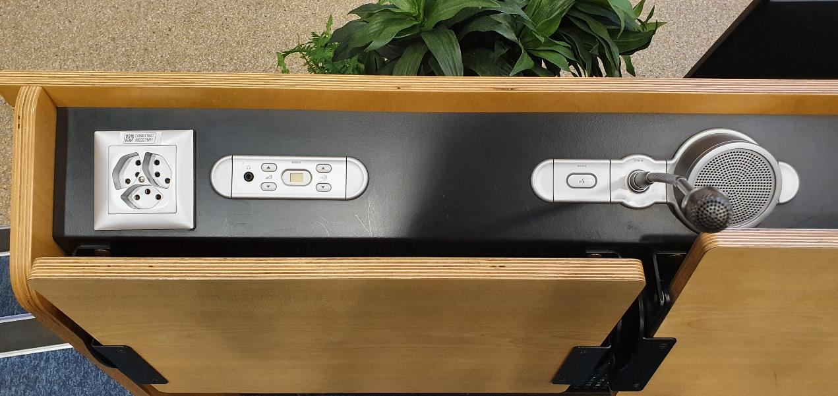

Logistics
During Q&A sessions
Notes:
During presentations – switch off your microphone to avoid parasitic noise
During the Q&A session :
Please switch on your cameras and microphone
To ask a question:
raise hand (you can lower)
write in the chat
You can ask your question in English or in French

Slide 4
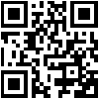

Agenda, slides & Videos
Available on Indico

Slide 5

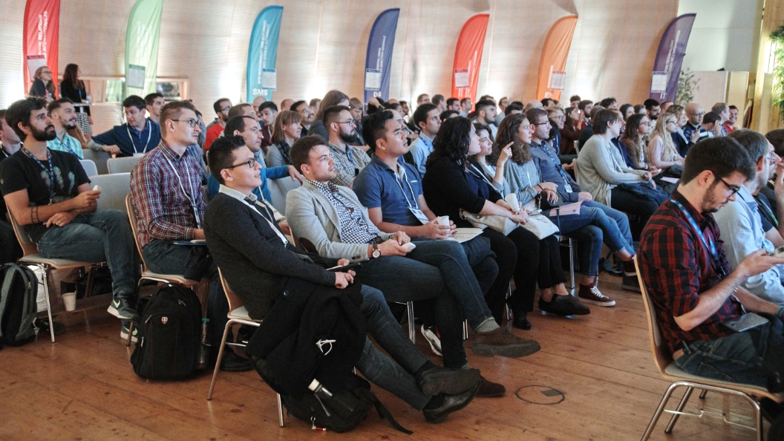
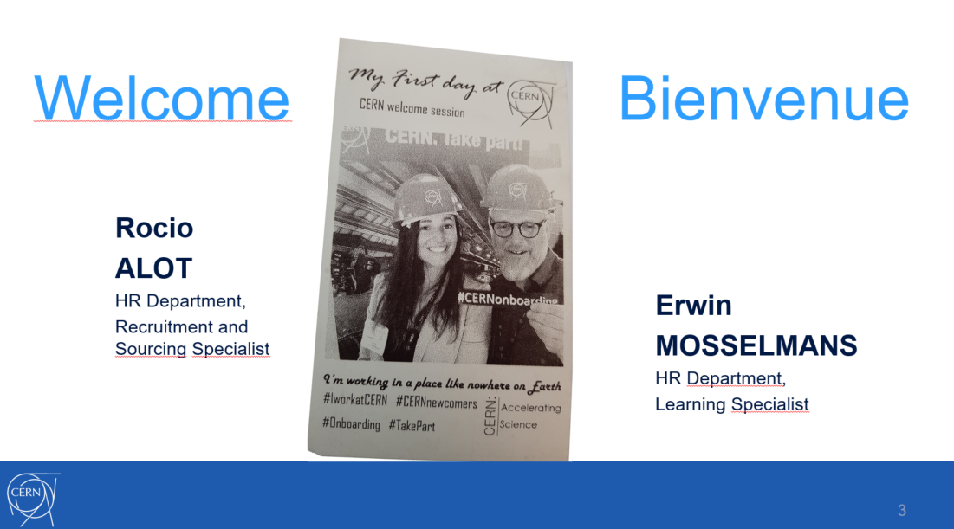
Your first day at CERN

Slide 6

Today
Notes:
How do you feel today?

Slide 7
Today - Goals
Integration
Interactions

Slide 8
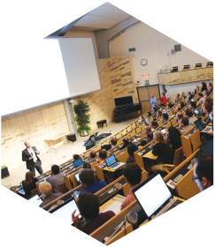
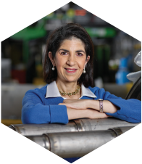
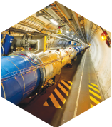
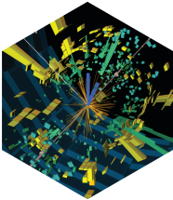
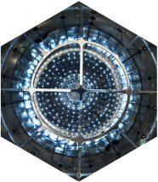
Any Questions ?

Slide 9
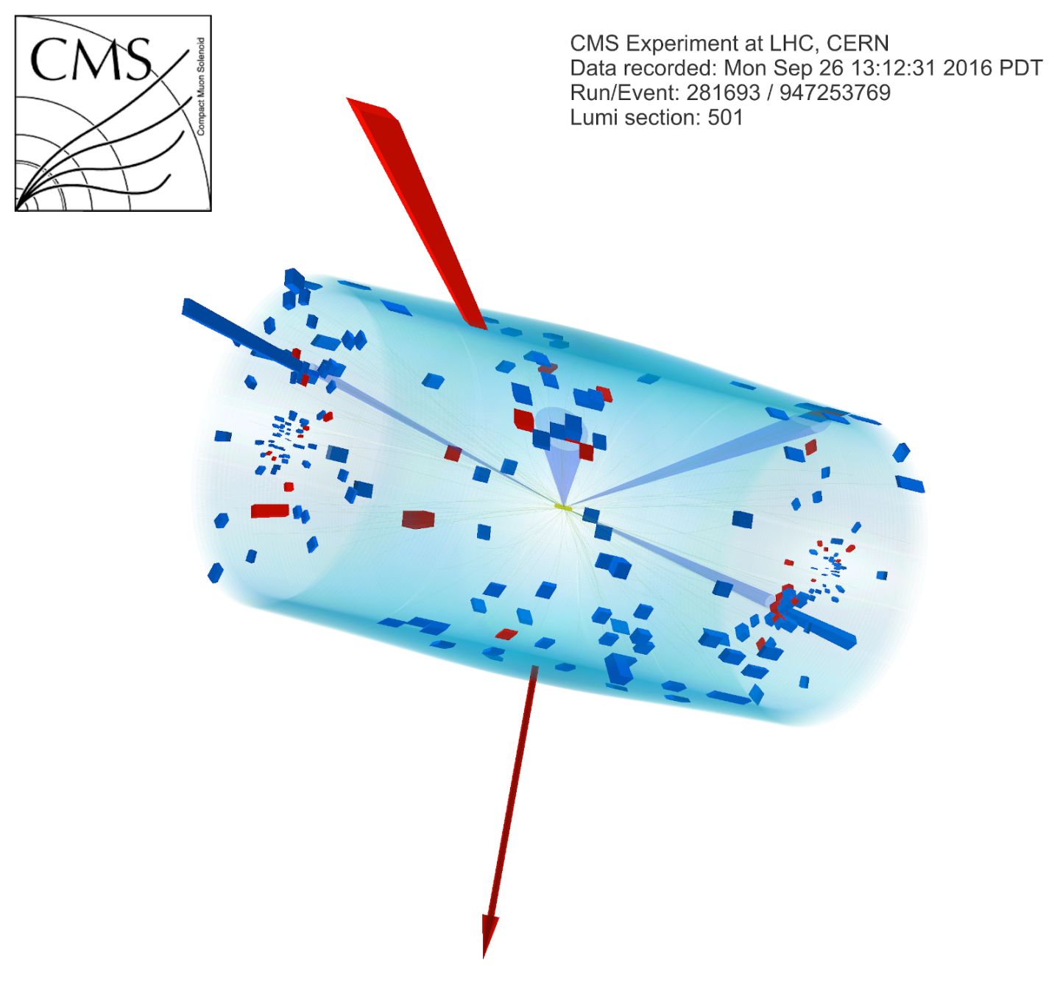
Ice-breaker 10’
In small groups, discuss:
What is my role at CERN and how does my job contribute to CERN’s mission?
En petits groupes, discutez:
Quel est mon rôle au CERN, et comment mon travail contribue à la mission du CERN ?
Notes:
Participants placés en breakout rooms aléatoires

Slide 10
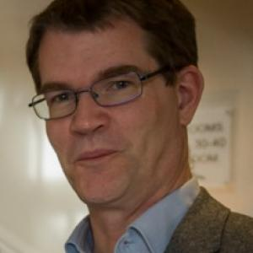
Scientific activities
Richard Hawkings
EP Deputy Department Head

Slide 11
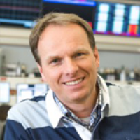
CERN’s accelerator complex
Rende Steerenberg
BE Operation Group Leader

Slide 12



Stands and/or Break
Please be back in this room at 16h10
CERN Clubs
CERN Services
Coffee/drinks
Free chat

Slide 13
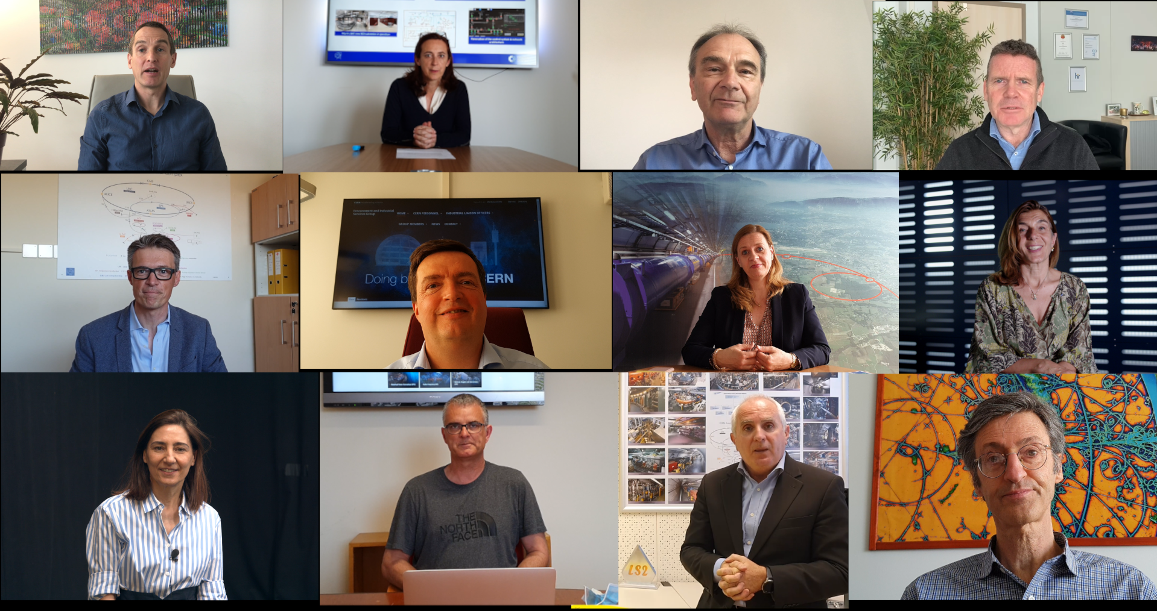
Introduction to CERN departments
Video Presentation

Slide 14
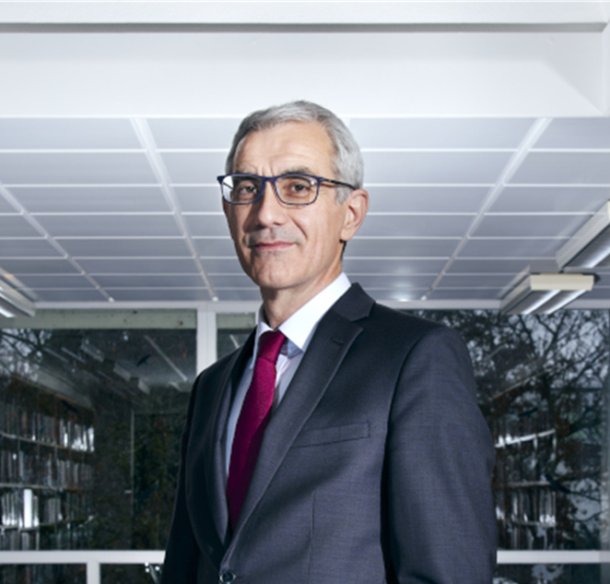
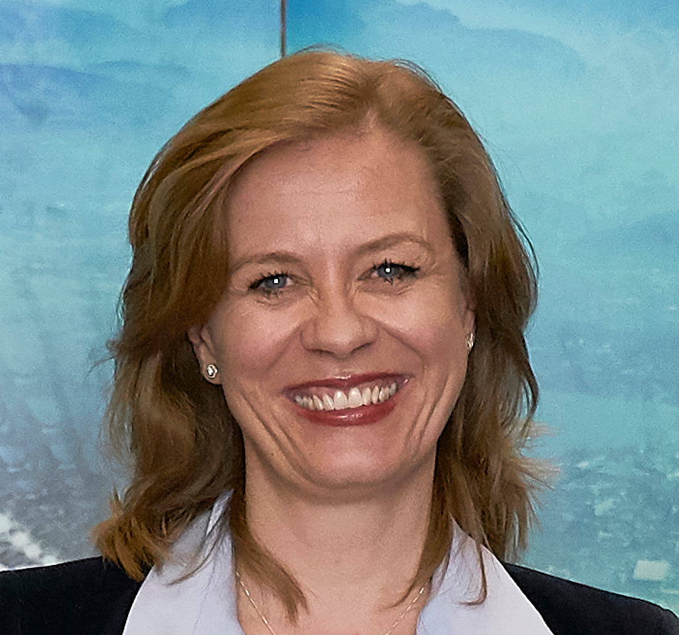
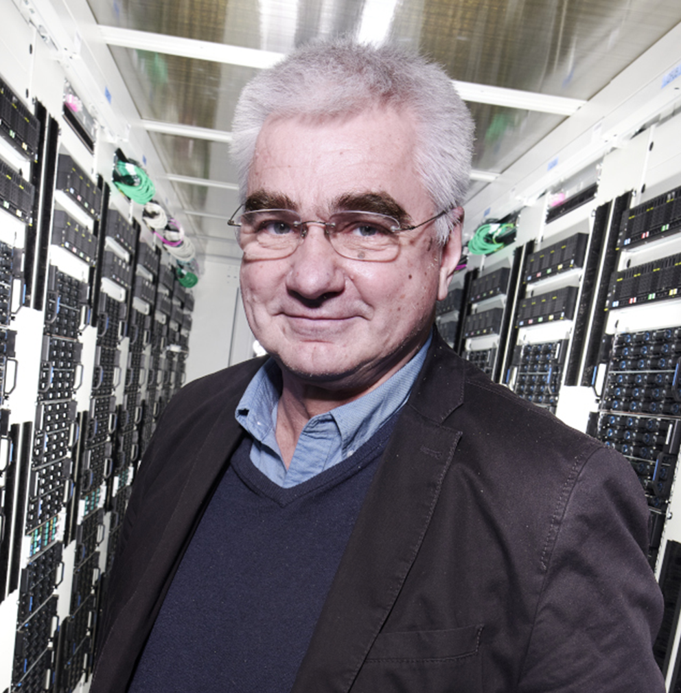
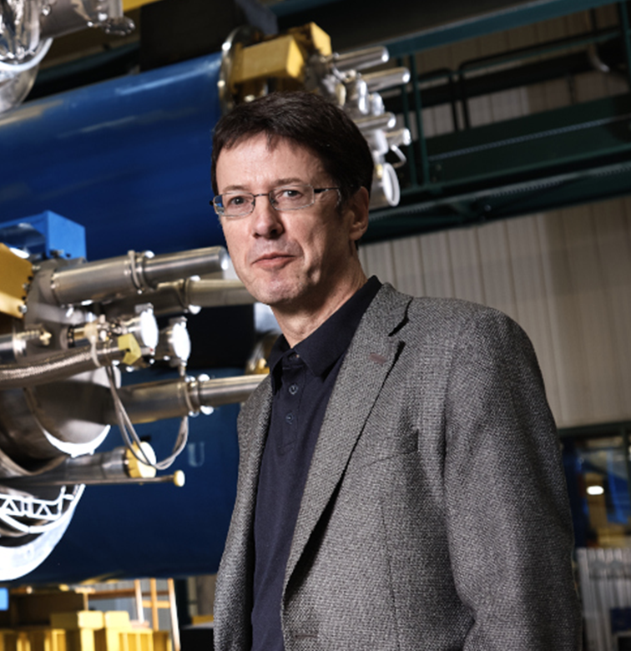
Q&A with the directorate
Raphaël Bello
Director for Finance and Human Resources
Charlotte Lindberg Warakaulle
Director for International Relations
Joachim Mnich
Director for Research and Computing
Mike Lamont
Director for Accelerators and Technology
Fabiola Gianotti, Director General

Slide 15

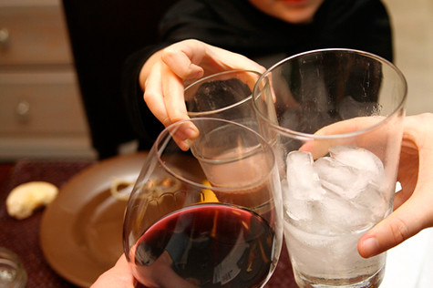
Closing Drinks
Meet with Department Heads, HR and colleagues.
Free chat
Snacks and Drinks
Notes:
Participants placés en breakout rooms aléatoires

