Slide 1
CERN Knowledge Transfer

Slide 2
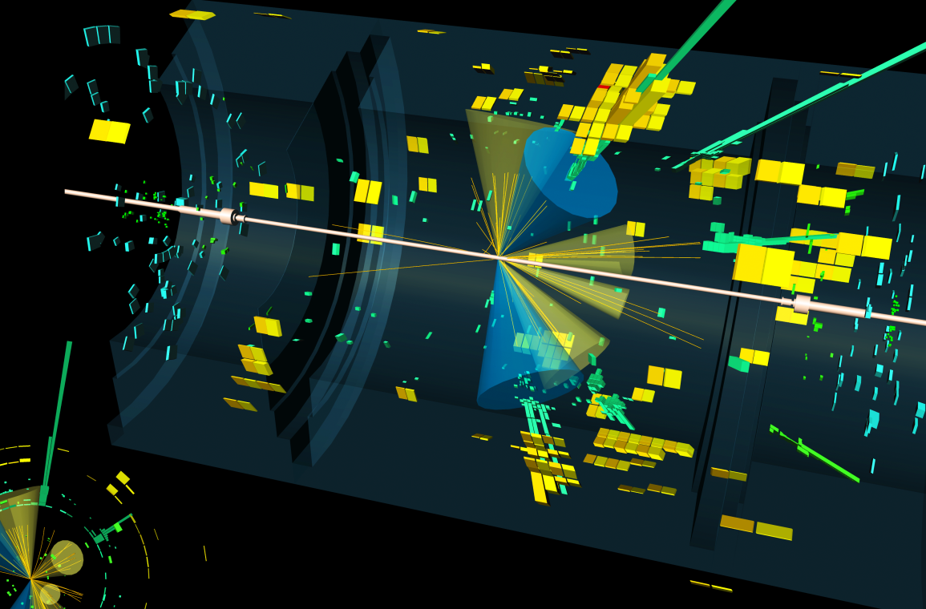
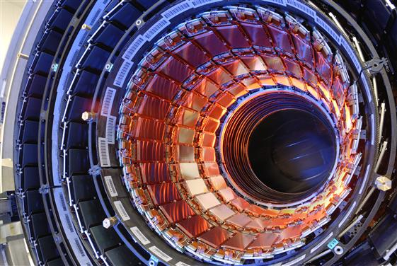

Training
CERN’s Mission
Science
Technology
Collaboration

Slide 3



KT’s Mission
Maximise the technological and knowledge return to society, in particular through Member States industry
Promote CERN as a centre of excellence for technology and innovation
Demonstrate the importance and impact of fundamental research investments

Slide 4
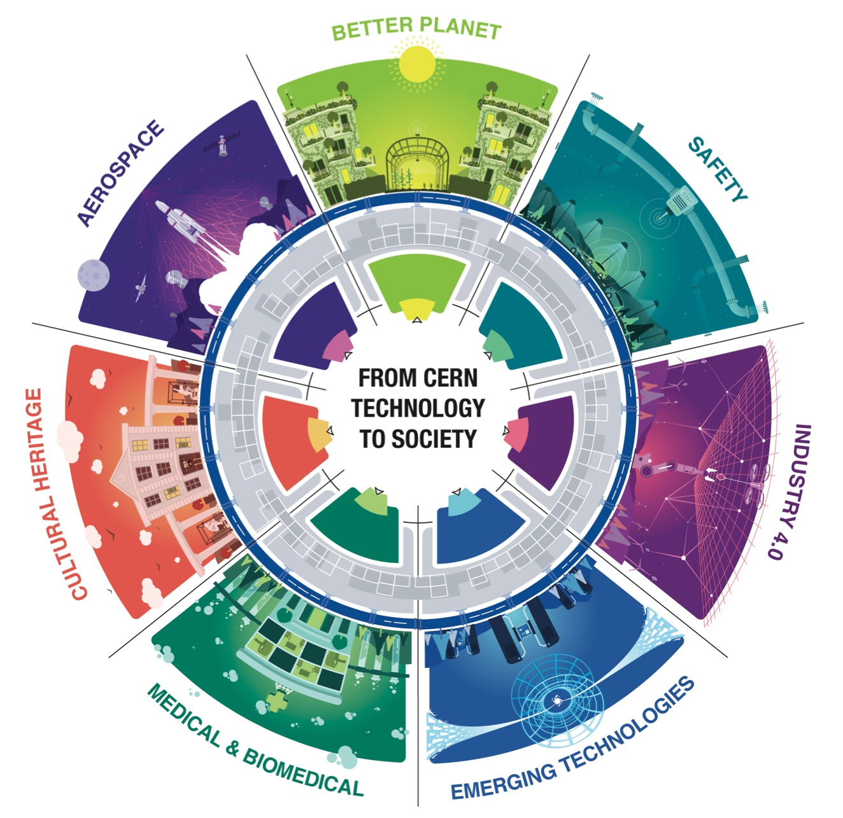
From CERN technology…
… to society

Slide 5
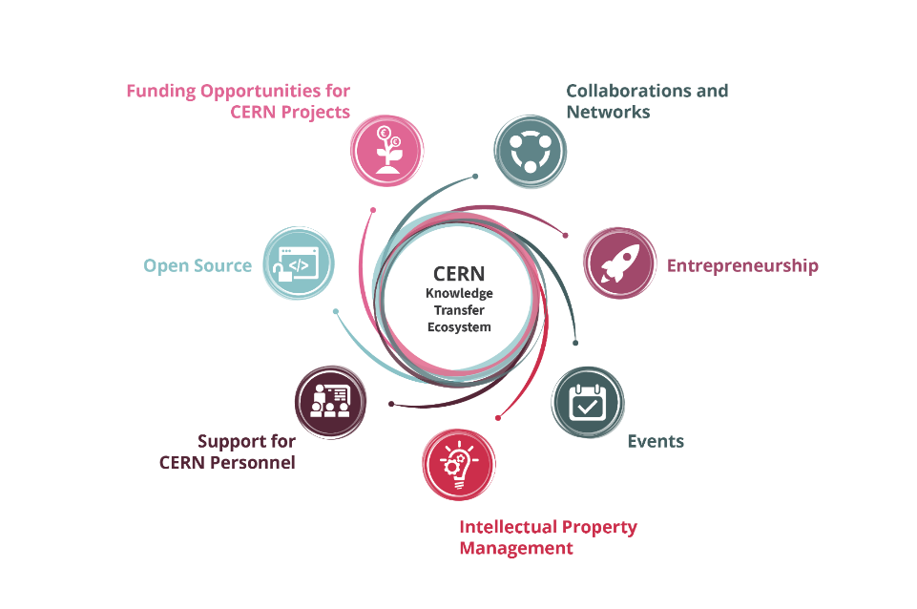
Knowledge Transfer Tools

Slide 6




Knowledge Transfer Policies
Intellectual Property Policy
Patent Policy
Software Dissemination Policy
Spin-off Policy

Slide 7
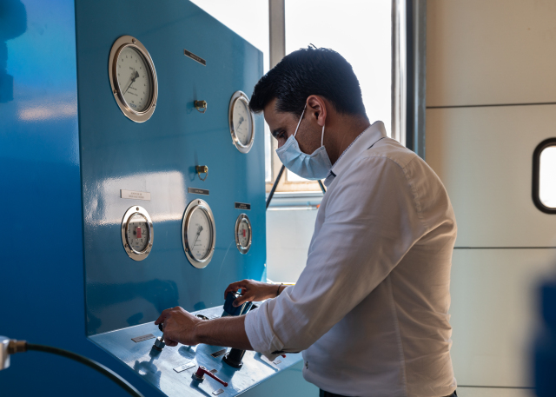
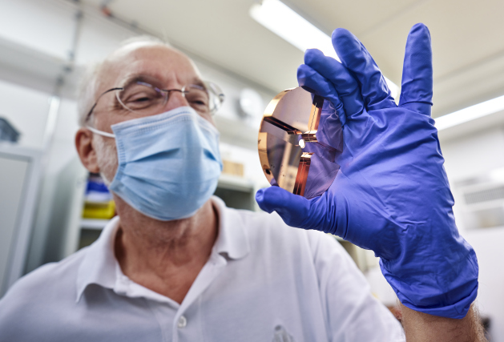
Funding Opportunities for CERN personnel
>50
>50
Projects funded since 2011
Projects funded since 2014
CERN Knowledge Transfer Fund
CERN Medical Applications Budget
In 2021 37kCHF-900kCHF Range of funding received per project

Slide 8
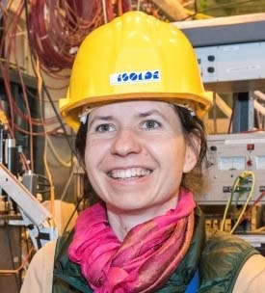

Funding Opportunities for CERN Personnel
Gamma MRI
supported by the KT fund
“
The grant we obtained from the KT fund allowed us to start working on the Gamma MRI project, which aims at performing sensitive MRI studies.
Additionally, the KT Fund and MA Budget gave us a solid basis to apply for additional EU funding.
Magdalena Kowalska,
Senior Researcher at CERN
“
In 2020, their application within the European Commission’s FET-OPEN Programme was successful, enabling work on a full-scale prototype and first in-vivo experiments.
Renaud B. Jolivet,
Senior Lecturer, University of Geneva

Slide 9
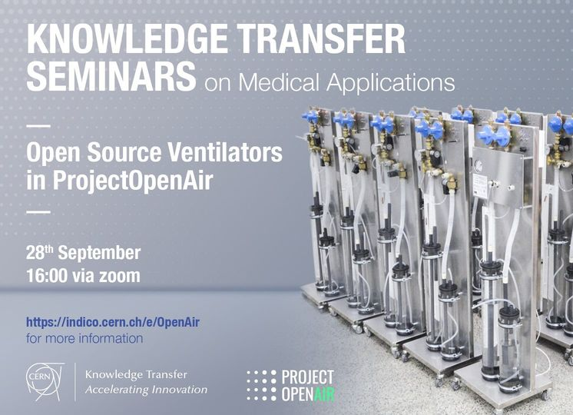
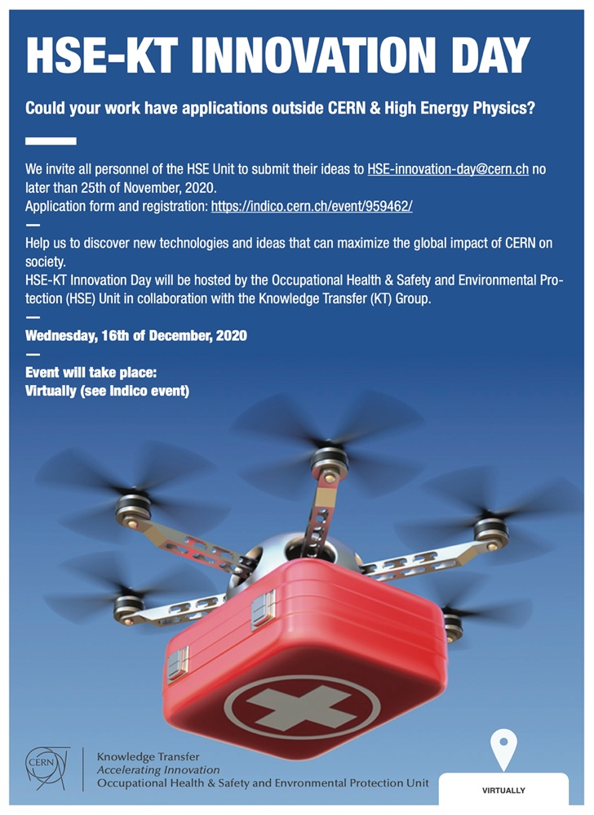
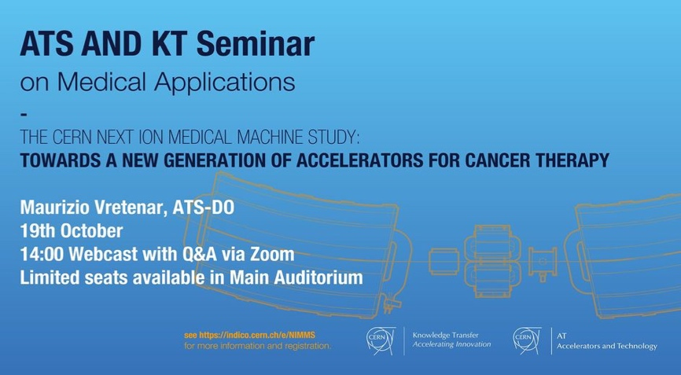
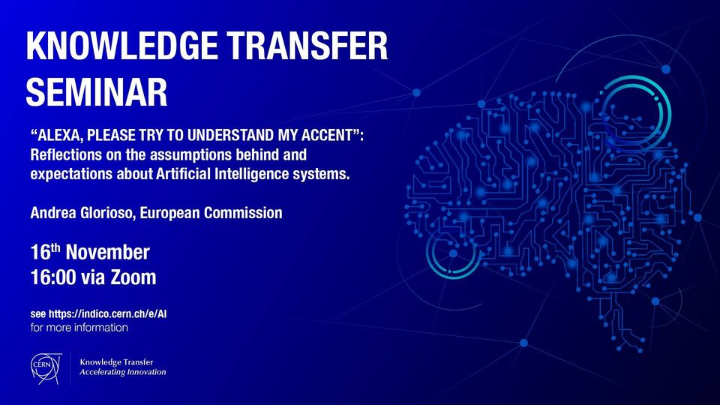

Events

Slide 10
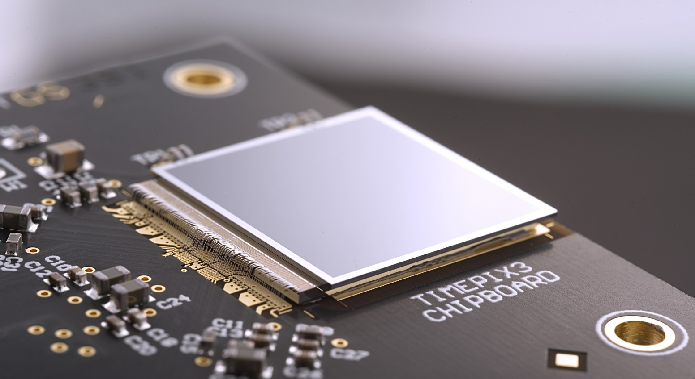
Training sessions
Find out more about IP at our patents course

Slide 11
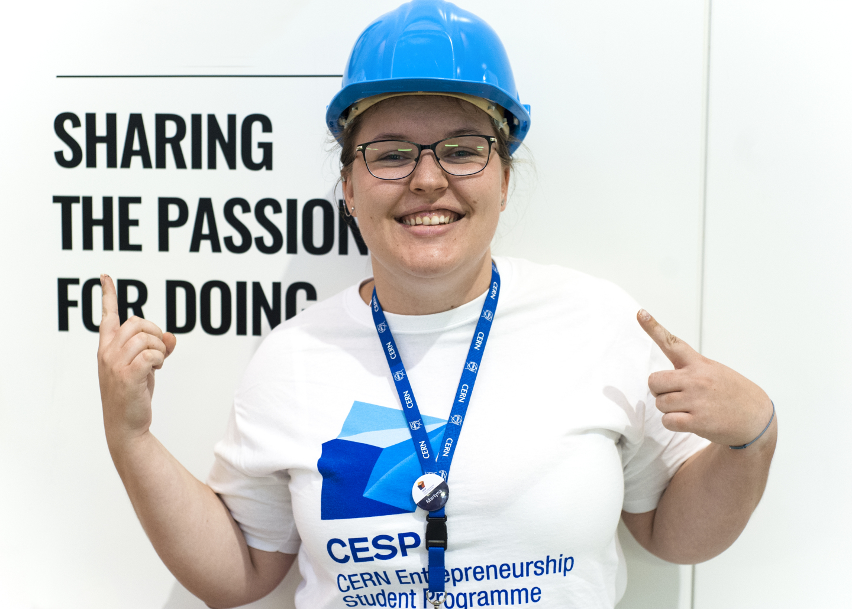
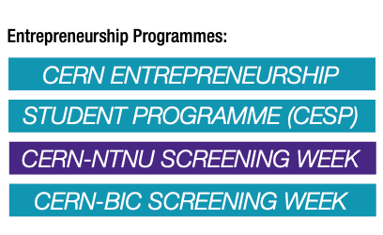
Entrepreneurship
Find out more at our Meet-Ups

Slide 12

Find out more at kt.cern
Subscribe to the KT newsletter
Visit KT.CERN
Follow us on social media
#CERNKT
Notes:
https://kt.cern
https://kt.cern/newsletter

