Slide 1

You need to talk? I am here to listen …
Laure Esteveny , CERN Ombud
Connecting the dots, 13 April 2022

Slide 2
Who are you talking to?
Laure Esteveny, French , 60 years old
Started at CERN as a fellow in IT department in 1986
Engineer in information systems
IT Project leader for 10 years
1 year in LHC budget office
4 years internal auditor, 7 years Head of Internal Audit
Project leader for CERN Alumni network
Head of Alumni Relations for 4 years
CERN Ombud since April 2021

Slide 3
Who is the CERN Ombud?
A service provided by CERN, in its dual role of host laboratory and employer, to all in the CERN Community to:
  Provide confidential assistance for the informal resolution of interpersonal conflicts
  Raise awareness of and provide guidance in the application and interpretation of the CERN Code of Conduct
The detailed mandate is here:
  https://ombud.web.cern.ch
An alternative to or supplement to other response channels
The Ombud exercises this mandate according to professional standards set by the International Ombuds Association
Notes:
The ombud is also frequently called “designated neutral“
The CERN Community encompasses users , associates, students (inc. doctoral students) , fellow and staff, .i.e anyone working for or on behalf of CERN
One tool for raising awareness if the Ombud’s corner in the CERN Bulletin

Slide 4
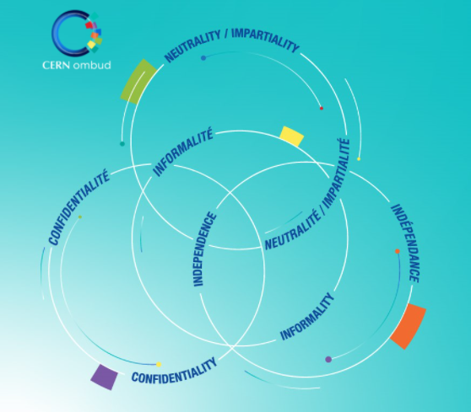
So what makes the function unique?
Confidentiality
Neutrality &
Impartiality
Informality
Independence
Notes:
What makes the Ombud a unique support service is the combination of these four principles. They create a unique safe space for visitors to voice concerns and problems

Slide 5
The four principles in the OO
Neutrality / Impartiality
  The ombud tries to understand and help communicate the interests and rights of everyone but:
    Does not take sides in disputes
    Does not try to help one person “win” and another “lose”
    Does not advocate for individuals
Independence
  The ombud is not part of any operations/management and it is a last job before leaving CERN
    No conflicts of interest and a truly external view
Confidentiality
  The conversation is between the visitor and the ombud, no one else.
  If asked and given permission, the ombud may contact other designated individuals.
  Exception: Imminent risk of serious harm to anyone.
Informality
  Not an agent of notice; not the place where to make a formal complaint.
  The ombud does not conduct investigation.
  It does not trigger any process, the visitor remains in full control of what happens next.
  See a comparison of informal vs formal dispute resolution systems
Notes:
I have no mandate to establish facts nor am I interested in them. I listen to your story from your side, with empathy, but I always keep in mind that there is another side of the story.
Neutral: Favouring neither the supporting nor opposing viewpoint of a topic of debate; unbiased.
Impartial: Treating all parties, rivals, or disputants equally; not partial; not biased; fair.

Slide 6
It is all about empowering YOU!
  Active listening and a sounding board
  Conflict resolution guidance
  Facilitated conversations
  Shuttle mediation
  Structured mediation
  Exploring options with you
  Information about policies, rules, rights, procedures, “how things work here”
  Referrals to other response channels
  Raising awareness on specific topics
  Etc.

Slide 7

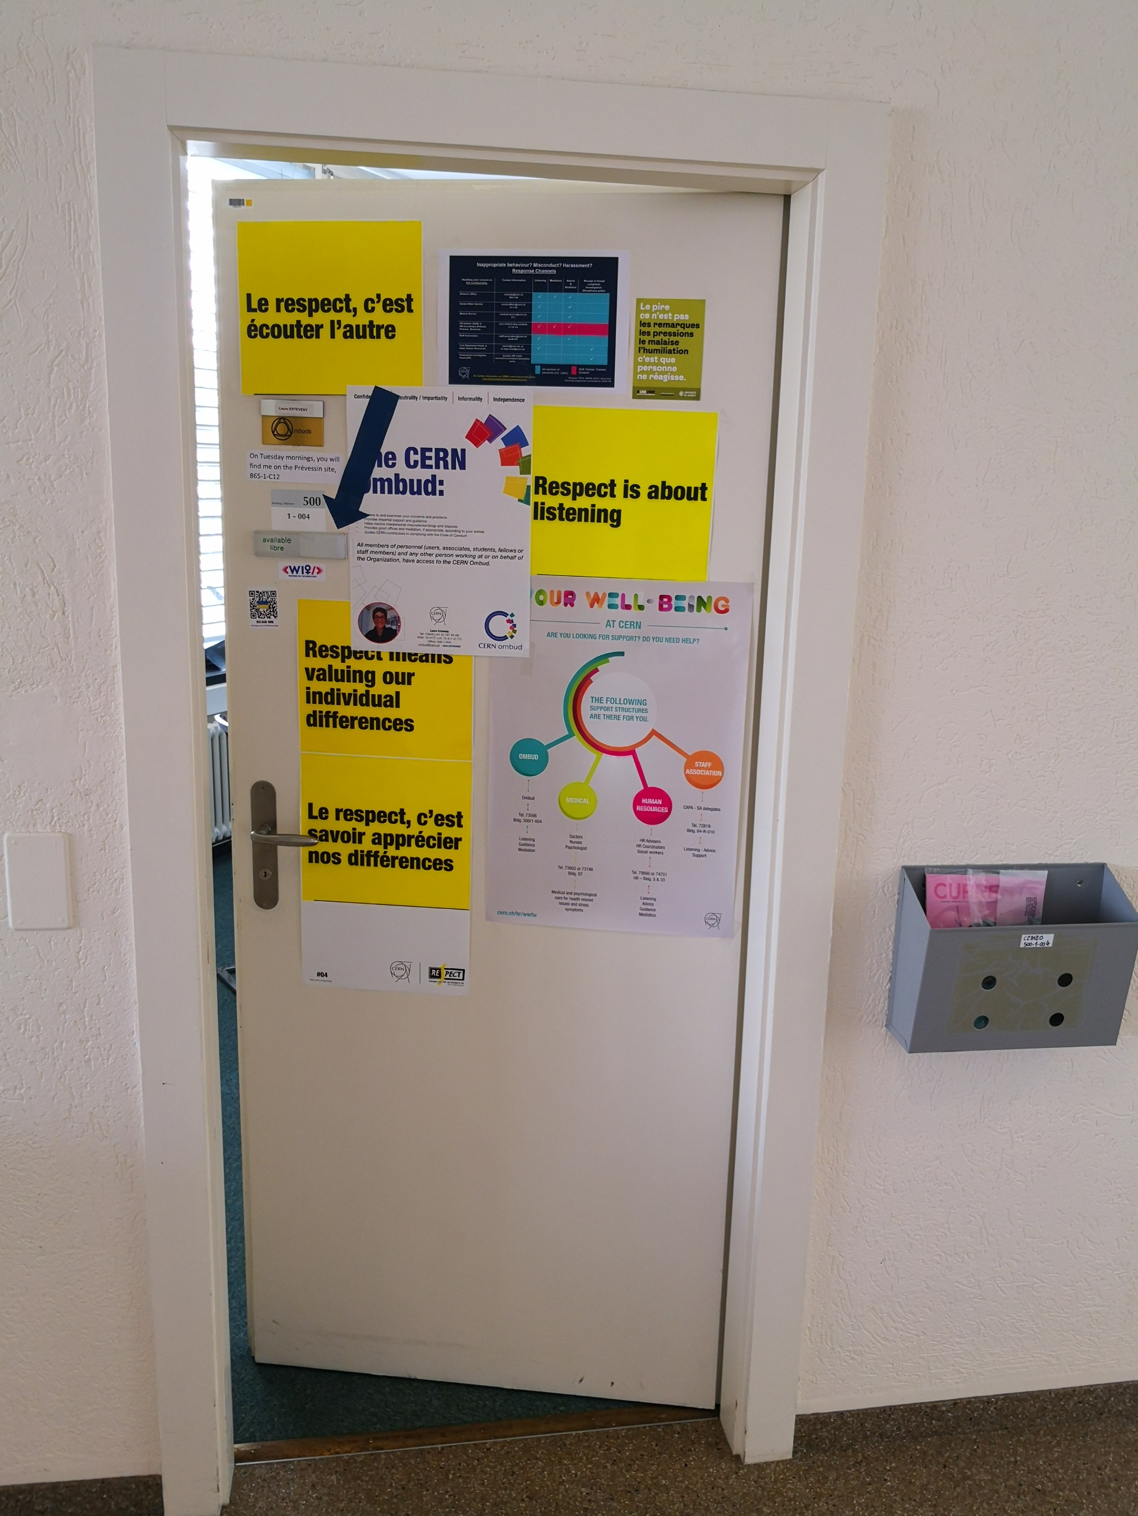



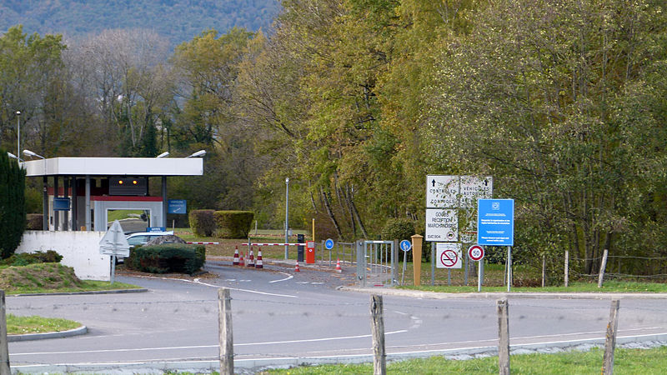
Where do you find me?
ombud.web.cern.ch
Meyrin, 500-1-004
73948
16 4177
ombud@cern.ch
Prévessin, 865-1-C12
Tuesday mornings
https://cern.zoom.us/my/laure.esteveny

Slide 8
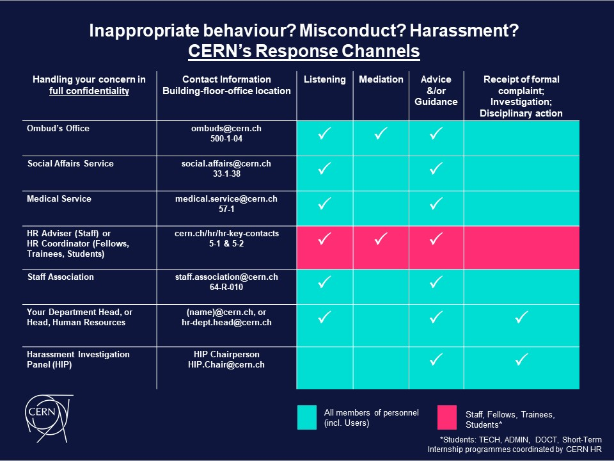
Response channels
Back

Slide 9
22 posts from the Ombud to the CERN weekly bulletin in 2021
Bread-and-butter issues
The third chair in the Ombud’s Office: Impartiality
Respect and internal mobility
Ten good reasons to opt for the ombud
2020 annual report by the Ombud – a role driving change
My own visit to the ombud
Sexism: let’s face the facts
Humor in the time of Corona
The judgment of Solomon
Should you tell your colleagues everything?
Oh no, a new boss!
Best wishes for 2021!
Each and everyone of us matters
Knowing how to set limits for ourselves and others
Seven ways to protect your team from conflicts
The “I need” behind the “I want”
The power of mediation
Listening as an effective management tool
A purposeful return to work
Don’t sweep conflicts under the carpet
Five ways to jump-start a new job
Staying in the driver’s seat: on the principle of informality
Back

Slide 10
Informal vs formal?
Informal vs formal conflict resolution systems
Informal conflict resolution systems | Formal conflict resolution systems
Contribute to the prevention or de-escalation of conflicts | Are reactive
Are based on the willingness of parties to find and agreement and on their cooperation | Are inherently adversarial
They bring the parties together | They polarize the parties
They aim to identify the root cause of conflicts | They rarely identify the root cause of conflicts
They focus on unmet needs as these are always at the origin of conflicts | Individual needs are ignored
They allow parties to explore all possible solutions and to come up with new ideas | They impede creativity
They are self-determined | Once started, parties lose control of the process
They leverage and further promote a culture of collaboration, responsibility and openness. | They create a blame, grievance, entitlement or litigation culture
Back

