Slide 1
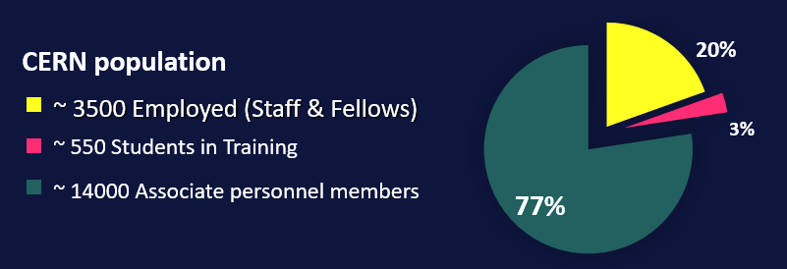
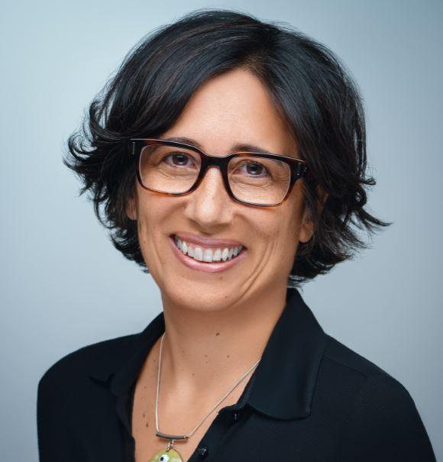
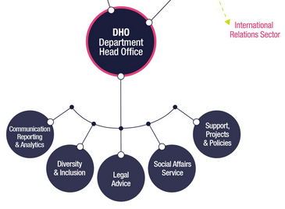
The Diversity & Inclusion (“D&I”) Programme
Under
Recruitment
Louise Carvalho
D&I Programme Leader (50%)
Legal Adviser (50%)
start date: 01 Apr 2022
D&I Analyst (100%)
Fellow

Slide 2
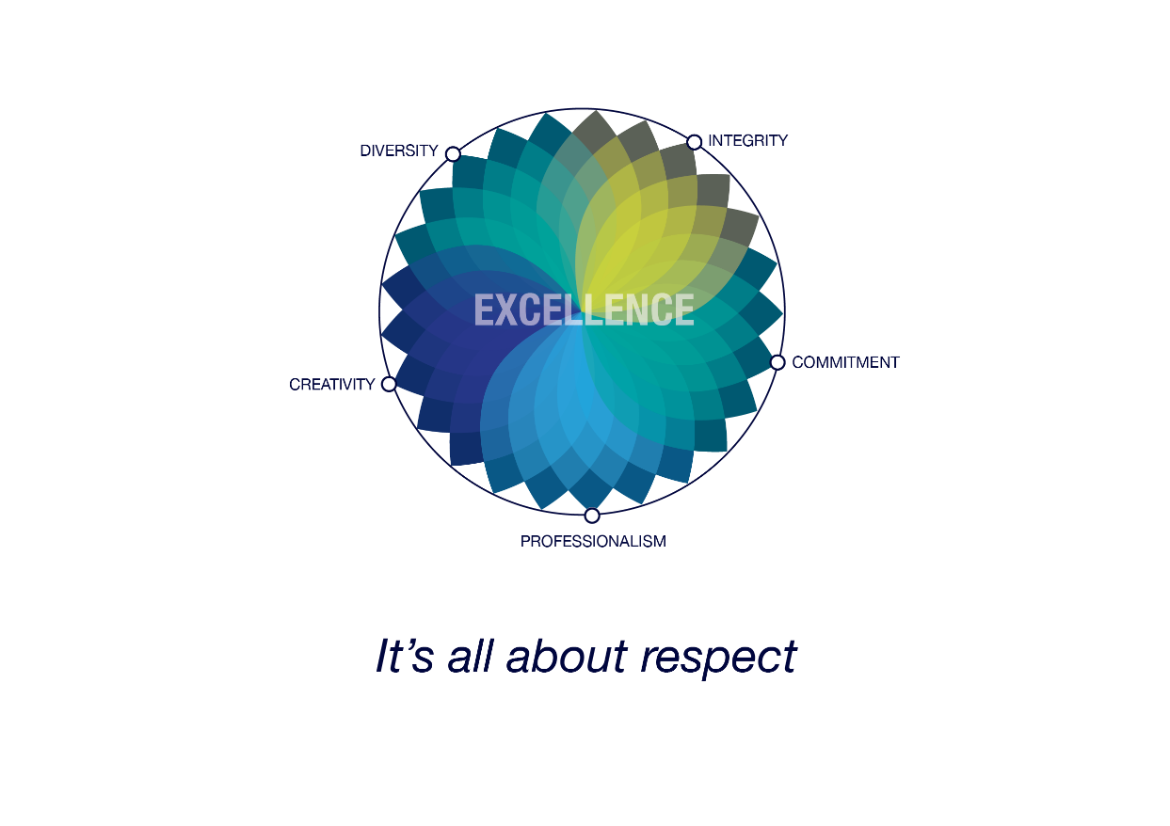
Diversity & Inclusion: for scientific excellence
Diversity & Inclusion at
CERN is based on the three principles of :
appreciating differences, fostering equality,
promoting collaboration
CERN's Diversity value

Slide 3
Diversity = No.1 most appreciated workplace attribute
Mission/ Scientific Contribution
Pride
Benefits and
Remuneration
Diversity
Diversity | 256
Mission/Scientific Contribution | 251
Other | 187
Colleagues and Collaboration | 132
The work itself | 131
Work environment | 83
Challenges | 78
Technologies | 63
Benefits and Remuneration | 57
Pride | 32
Technologies
Other
Challenges
Colleagues
The work
itself
CERN Staff Survey 2019

Slide 4
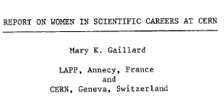
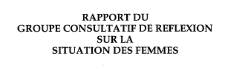
1983
1992
1996
Creation of an Equal Opportunity Office
First E.O and non discrimination statement published
History of
D&I at CERN
2010
Introduction of Code of Conduct
Creation of the Ombuds role
Professionalization of the Harassment resolution process
Diversity Office and Policy created
2012
2019
Diversity & Inclusion Programme

Slide 5

Diversity & Inclusion at work – what do You say?
« When I bring my full self to work, I work at my full potential»
YES!
But…
« Isn’t this postitive discrimination? »
« We need to reflect the diverse communities whom our Science serves»
« Women don’t even like STEM jobs! »
« Diverse teams get better results »
« My co-workers see neurodiversity
as a disability.
But it’s an asset! »
« More diverse management
= leading by example»
« CERN is doing very well as it is.
Why change? »
« This is the reason I joined an International Organization»
« My team prefers to speak in French »
« If I take a longer
Paternity Leave, I risk being left out of cool projects.»
« Gender Equity Plan is required for EC grants in 2022»

Slide 6
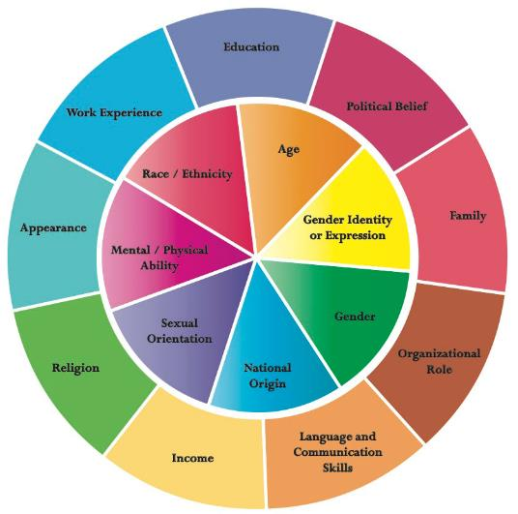
Diversity & Inclusion: the basics
Diversity celebrates differences between individuals and groups:
  - values
  - nationality
  - gender
  - education
  - social background
Inclusive cultures make people feel respected and valued for who they are as an individual or group:
  - equal opportunities
  - fair treatment
  - collaborative work environment
  -embracing differences
  - diverse voices sought and heard
To read: "Why Diverse Teams are Smarter" - HBR
To watch: Inclusion Starts With "I"
and: A Pixar animated short on fitting in
Ongoing objective: embed D&I in processes & workplace culture

Slide 7
Diversity & Inclusion: the business case
“The particle physics
community commits to
placing the principles of
equality, diversity & inclusion
at the heart of all the
physics community’s
activities.”
- ESPP 2020 update
Gender Equality Plans
in place by 2022
= New EC requirement
for all public research
organisations seeking funding
under Horizon Europe.
Companies with more diverse management teams have 19% higher revenues due to innovation.
- BCG 2018
As an International Organisation,
we need to reflect the diverse communities of our Member States

Slide 8



“We commit to
placing the principles of
equality, diversity & inclusion
at the heart of all the
physics community’s
activities.”
- ESPP 2020 update
OUR VISION
scientific excellence through diversity and inclusion
OUR GOAL
to increase the nationality and gender diversity
of Staff & Fellows (MPE) population by 2025
The STRATEGY
GENDER target
NATIONALITY indicator
(aspirational)
Leadership-led
Leverage existing progress: gender balance increased in Senior Management
25% as an average across MPE population (not per Department)
Diversity & inclusion in recruitment (and talent pipelines), promotion, training, communications
Sustainable actions toward long-term gender parity
(not a cap, not a quota)
GOAL:
With a particular focus on women in STEM:
GOAL:
With a particular focus on under-represented MS and a more balanced return by 2025:
from 21%
in 2020
address nationality clusters
> 25%
25% in 2025
and increase our conscious efforts toward nationality diversity in recruitment & retention

Slide 9
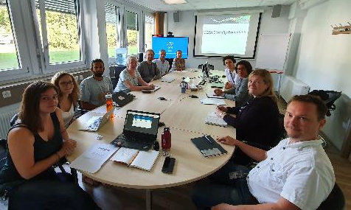

The Diversity Roundtable
Diversity Roundtable Recommendations “wholeheartedly” approved by the
DG 2020
Making CERN’s Science Gateway accessible and inclusive.
Gender-inclusive language for Staff Rules and Regulations.
Extension of Fellow’s employment contract following maternity leave.
ATLAS, ALICE, CMS, LHCb
LGBTQ Network
Women in Technology Network
Disability Network
TH Diversity & gender representative
International Relations taskforce
Staff Association
Chaired by D&I Programme
Notes:
Barriers: D&I Reporting, bring the activists to the table

Slide 10

Disability inclusion
Short-term internship for STEM students with disabilities
“This was an excellent experience. We have benefited not only from a smart and very productive student but also from integrating a co-worker with special needs into the team. It was a good change for the team (even though they might not have noticed) and definitely a good challenge for me.”
- Supervisor, Experimental Physics

Slide 11
Additional Resources
D&I Programme homepage
HR Key Contacts
Ombuds Office
Integrity / Conduct
Medical Service
Psychologist
LGBTQ CERN
Disability Network
Staff Association
Mission/ Scientific Contribution
Pride
Benefits and Remuneration
Diversity
Tech- nologies
Other
Challenges
Colleagues
The work itself

