Slide 1


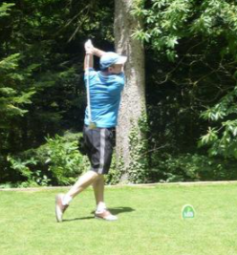
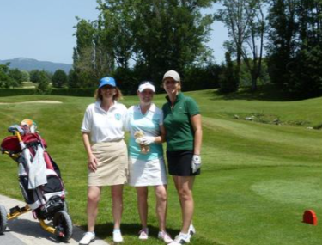

Slide 2




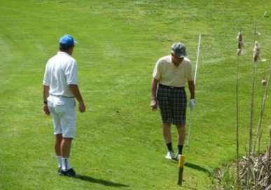

Slide 3
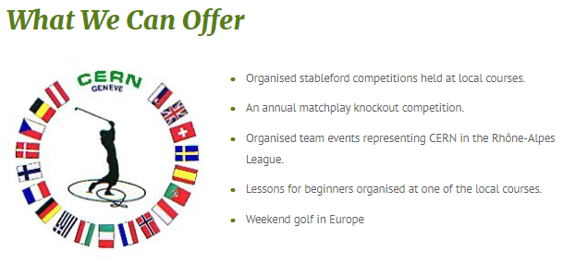
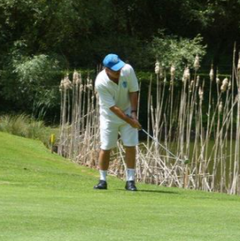
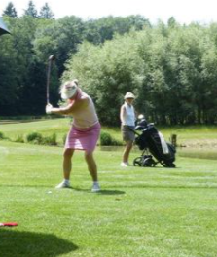

Slide 4
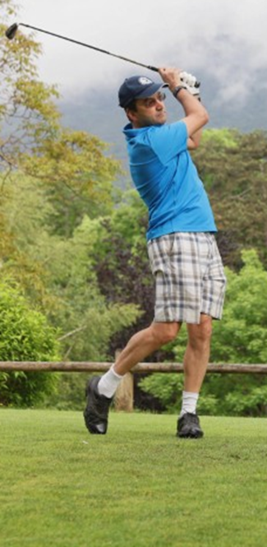
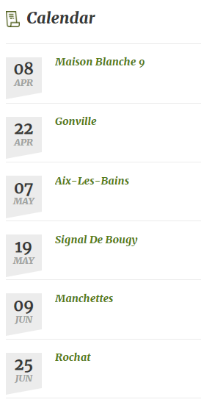
And more…

Slide 5
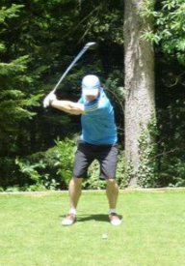
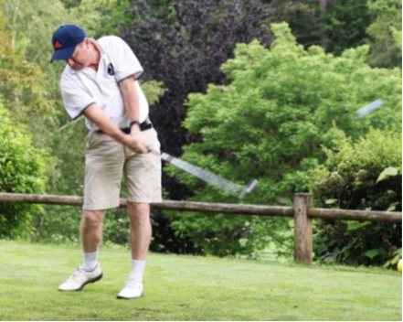
Become a member:
You pay 30 E /year to be a member of the club (and a small fee for the competitions)
For 52 E, you can have a golf license in the French Golf Federation via the
  CERN Golf club
Welcome to join our club, you can participate in our pleasant friendly golf
competitions, matchplay tournament, Team events and more fun.

Slide 6
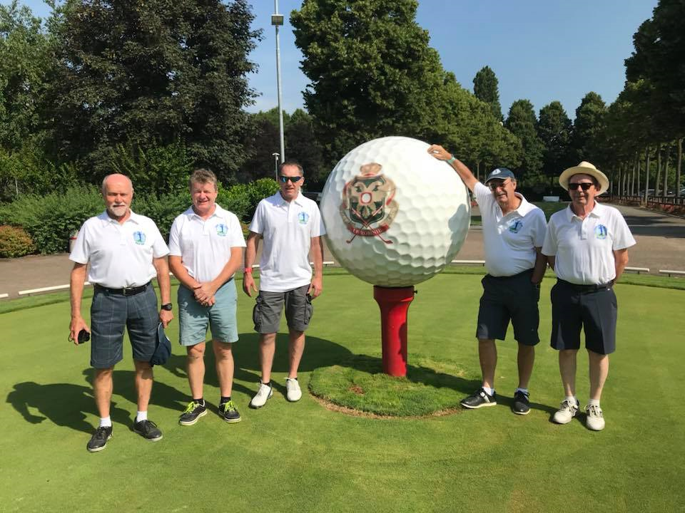

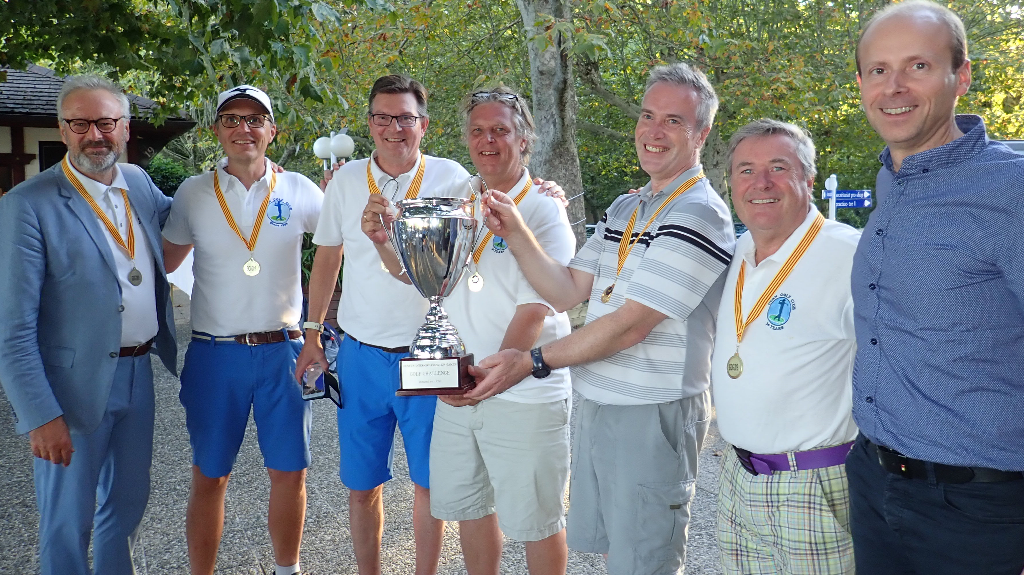
Team events :
CERN Team at Atomiade
CERN Team at Coupe de France Entreprises
CERN Team Winning tem at the Geneva Inter Organisations Games

Slide 7
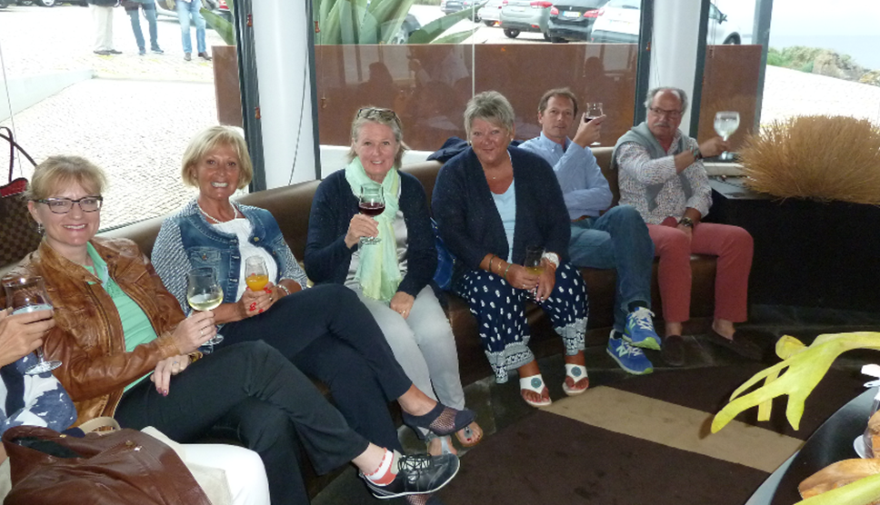
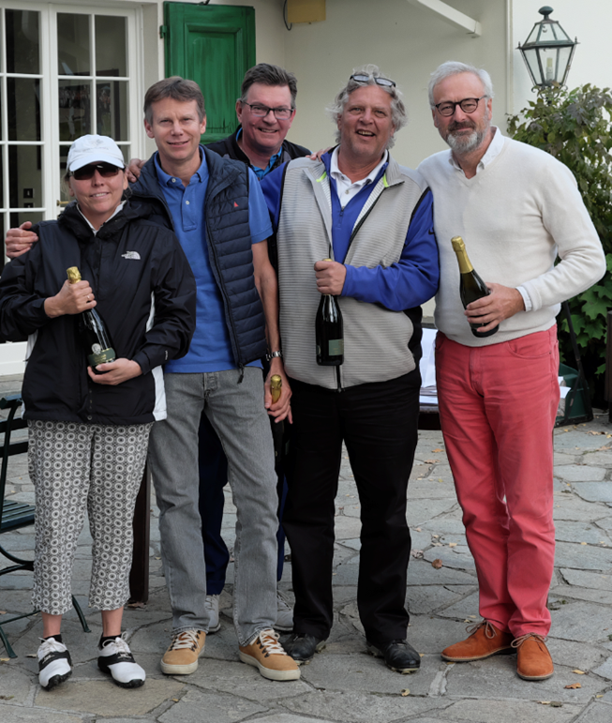
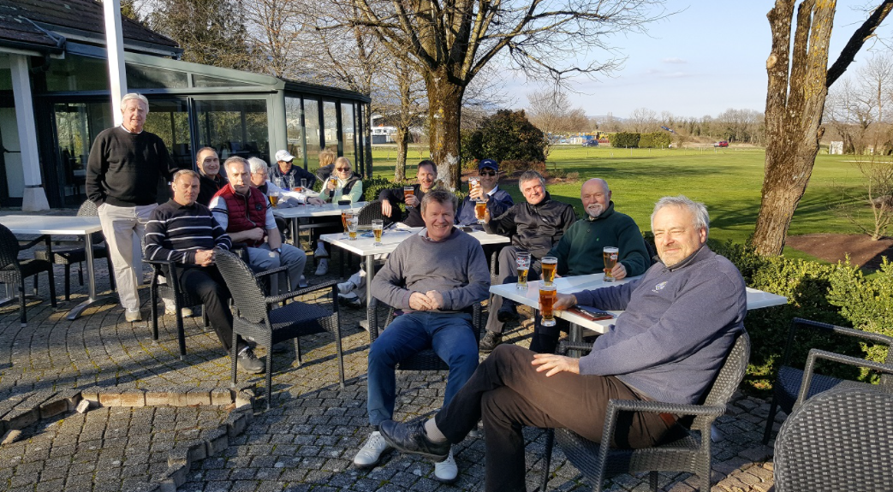
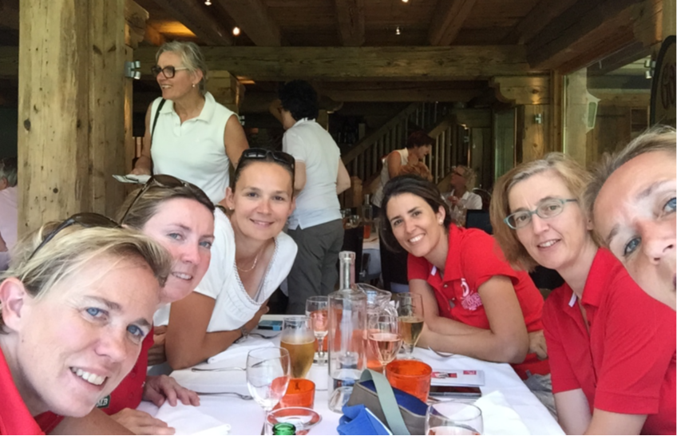
Aprés Golf:

Slide 8
Welcome to the CERN Golf Club

