Slide 1
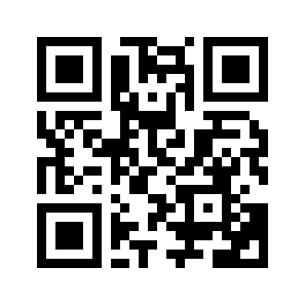
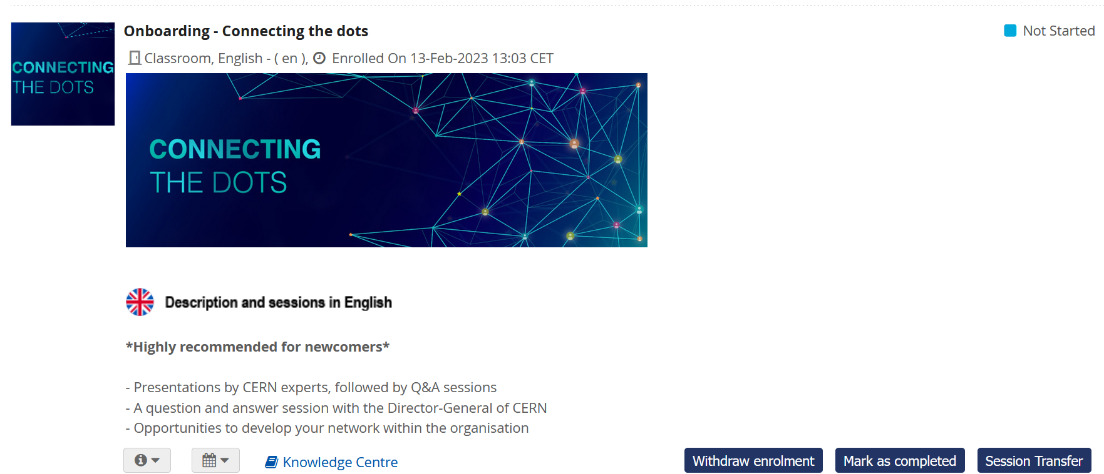
Please mark yourself as COMPLETED in the Learning Hub
https://cern.ch/pfiy9

Slide 2
Connecting the DOTS
F. Licci-Ounnough & E. Mosselmans

Slide 3
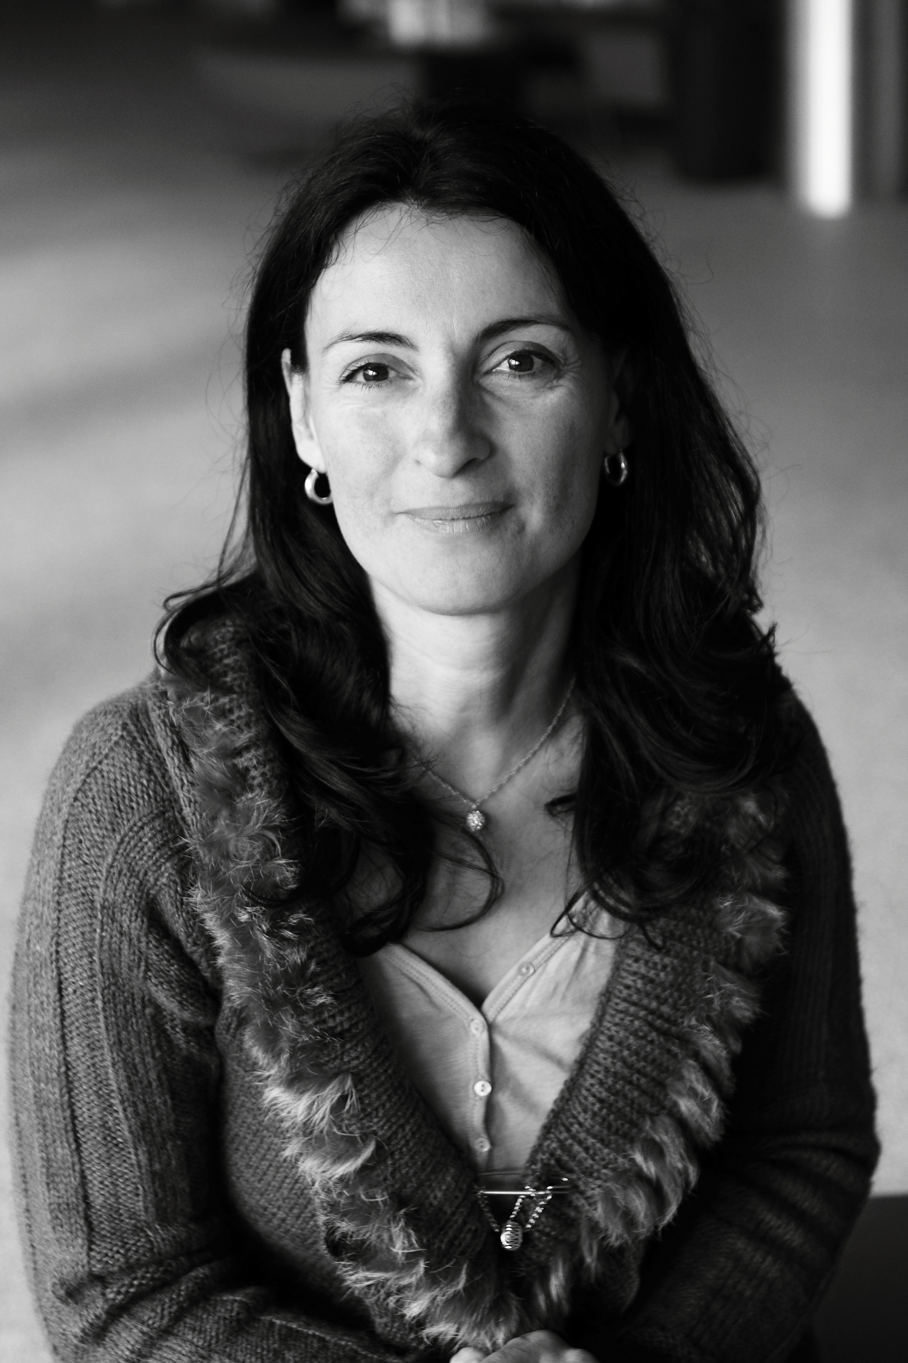
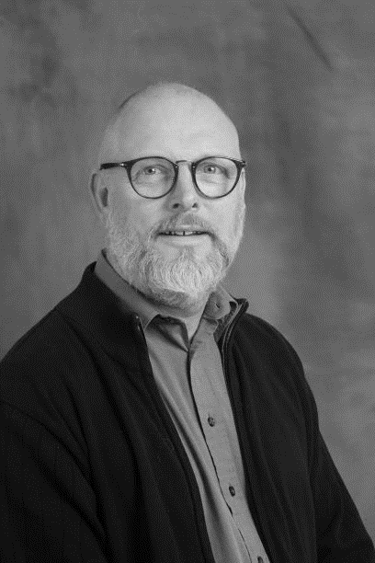
About us
Welcome / Bienvenue
Florence
LICCI-OUNNOUGH
HR Department
Learning Specialist
Erwin
MOSSELMANS
HR Department
Learning Specialist

Slide 4



Logistics

Slide 5
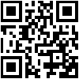

Agenda, Slides & Videos
Available on Indico
https://indico.cern.ch/event/1172672/

Slide 6

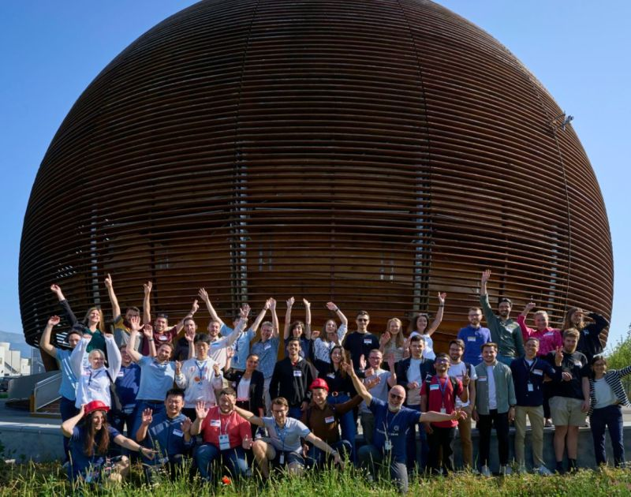



Your Onboarding Journey at CERN
Welcome Session
ONLINE short sessions:
Computer Security Awareness
Scientific Information Service (Library & Open Science)
Pension Fund Benefits (members)
CERN visit for you and members of your family or friends
Connecting the Dots…

Slide 7
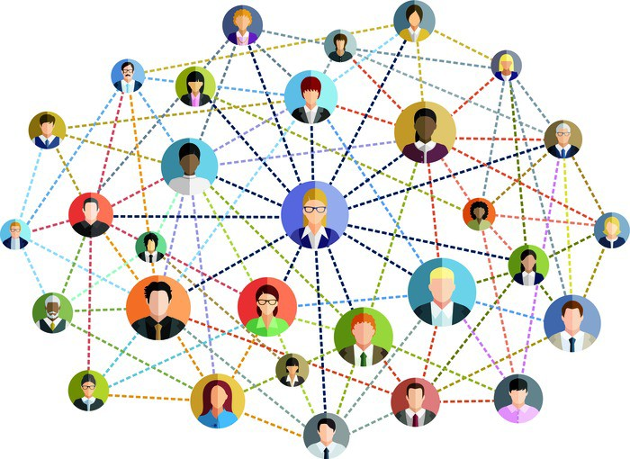
Today’s Objective

Slide 8
Today’s Agenda
Welcome to CERN - James Purvis, HR Department Head
Ice-Breaker
Scientific Activities - Richard Hawkings, EP Deputy Department Head
CERN’s Accelerator Complex - Rende Steerenberg, BE Operation Group Leader
Break - Meeting the CERN Services, Clubs & informal networks + Game
Video - Department Heads presenting the activities of their Department
Q&A with one CERN Director
Price Draw
Drink and Networking

Slide 9


Slide 10
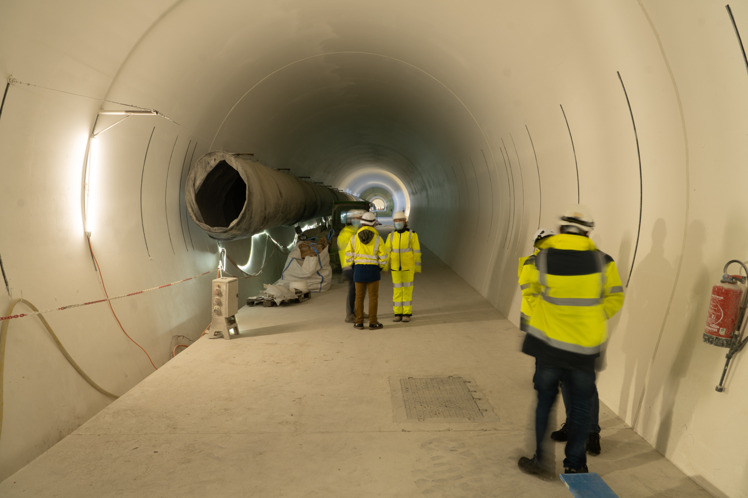
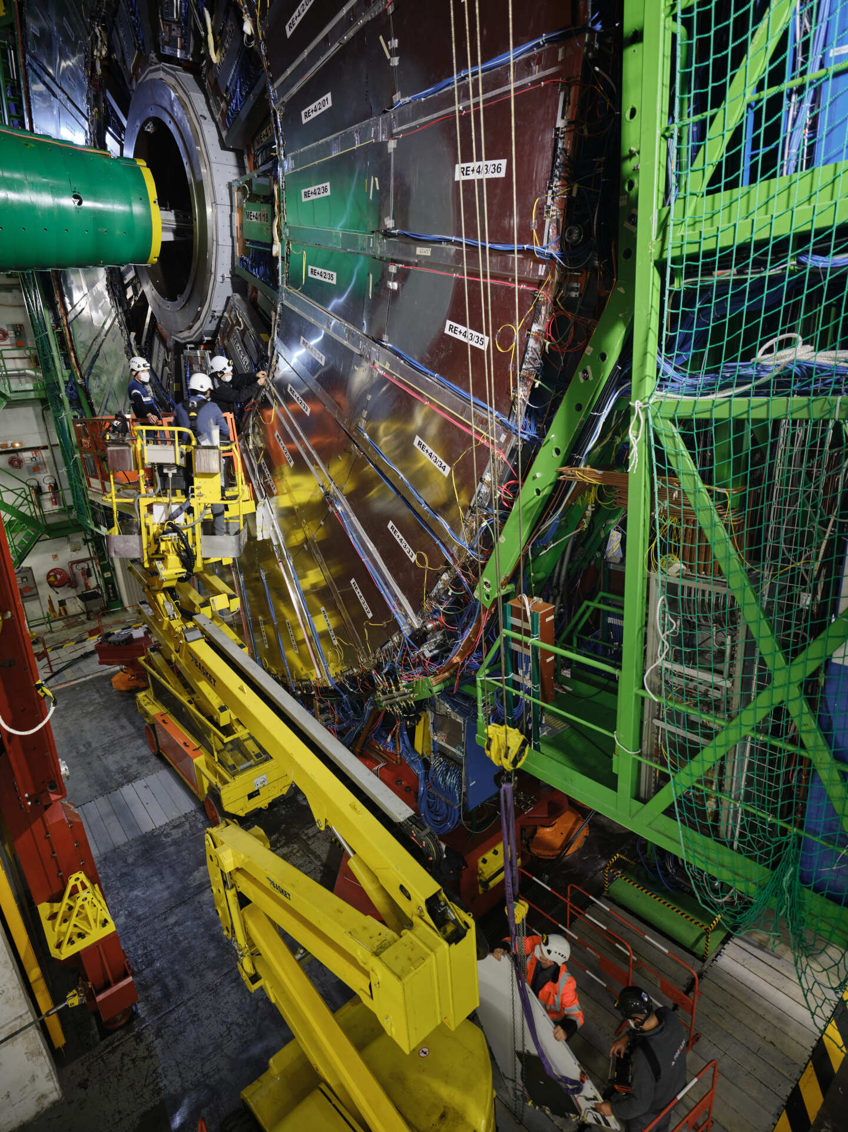
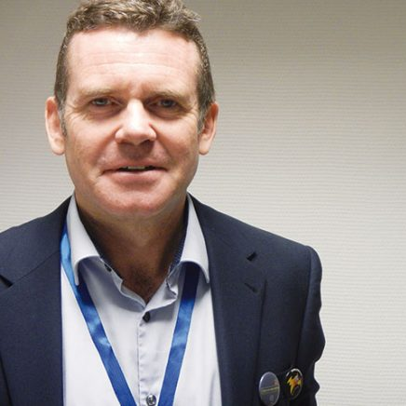
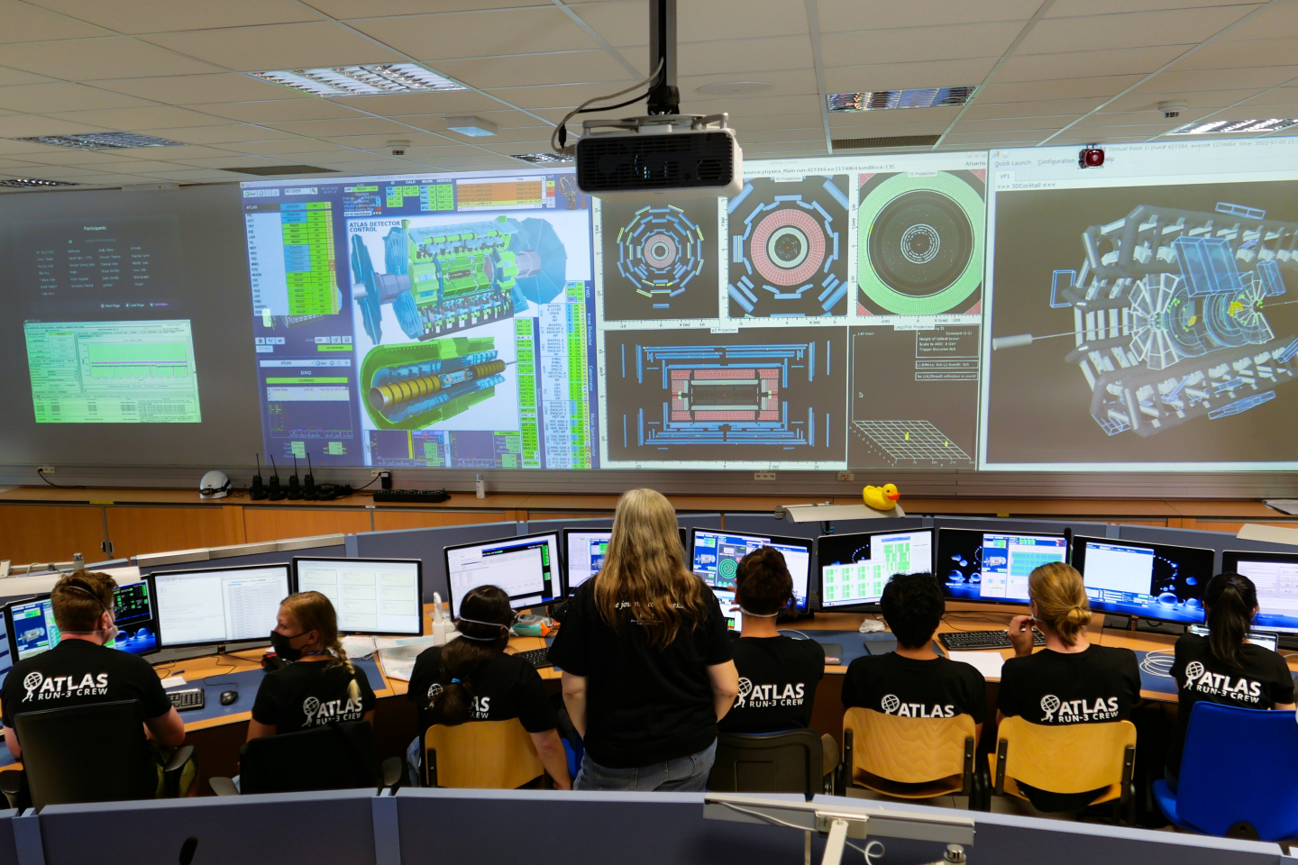
Welcome to CERN
James Purvis
HR Department Head

Slide 11

Ice-Breaker
In small Buzz groups, discuss together:
What is my role at CERN and how does/will my job contribute to CERN’s mission?
En petits groupes, discutez ensemble :
Quel est mon rôle au CERN, et comment mon travail contribuera-t-il à la mission du CERN ?

Slide 12
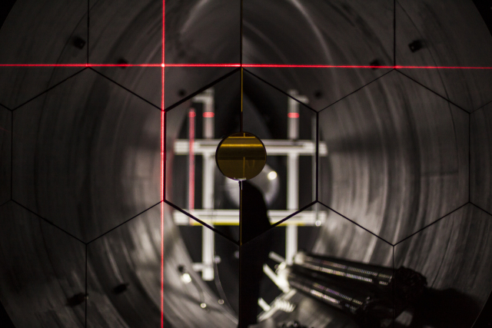
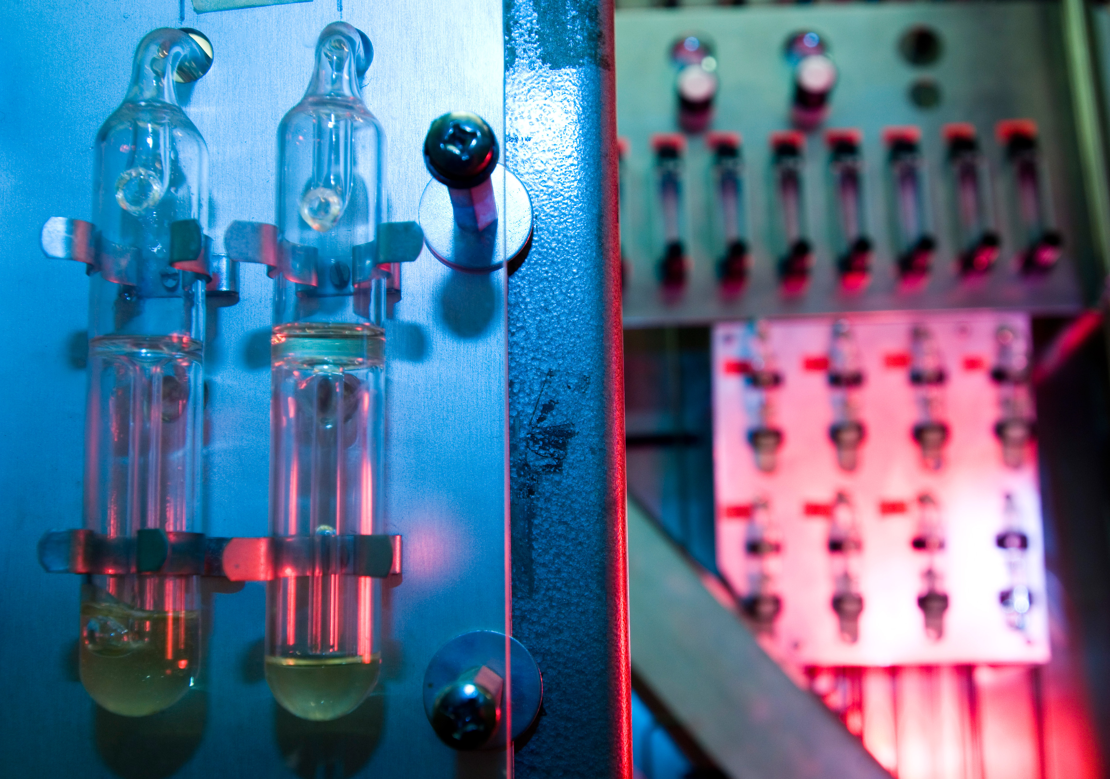
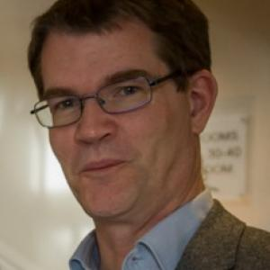
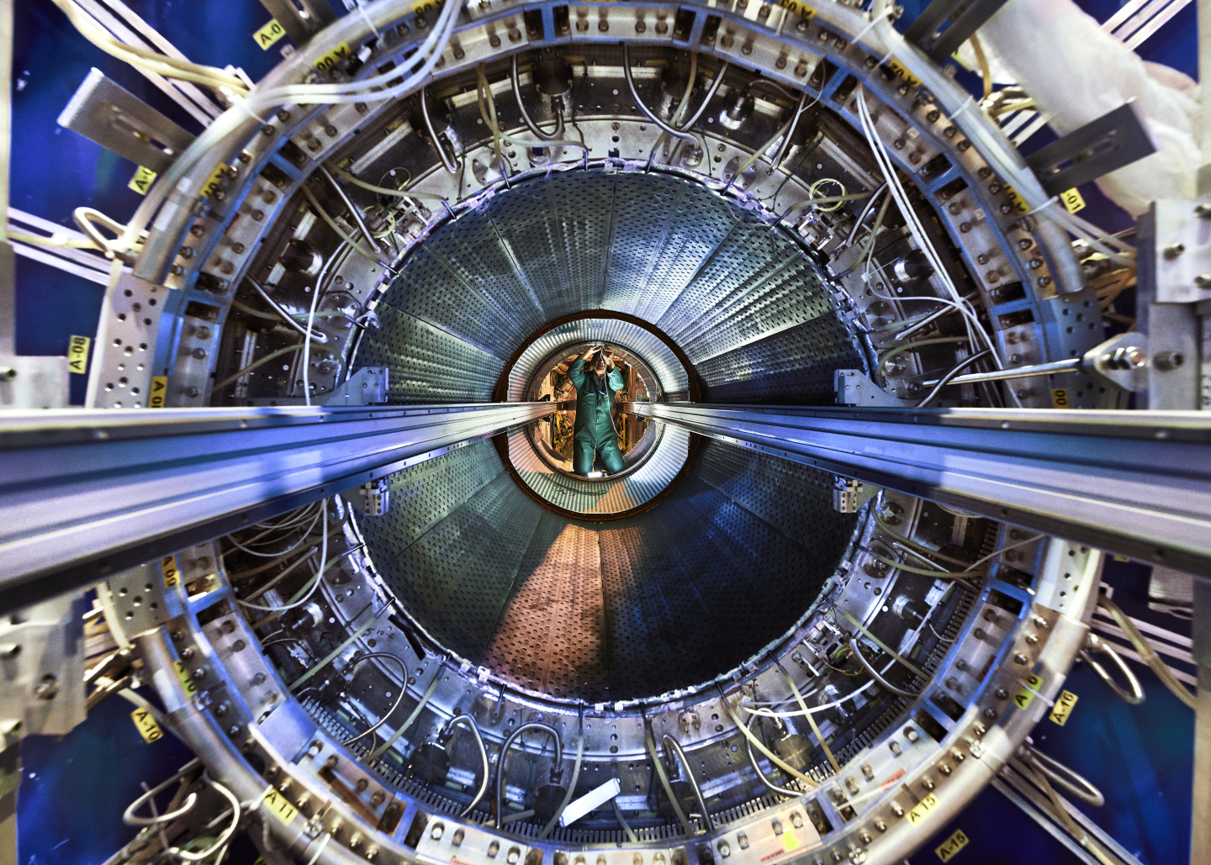
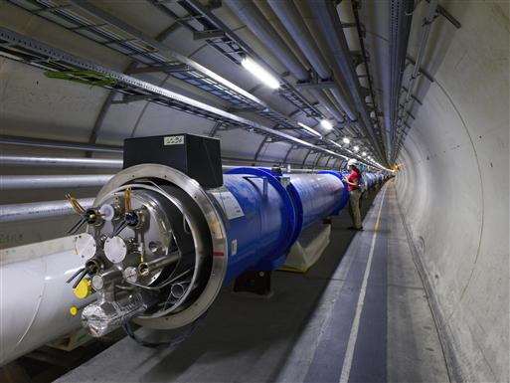
Scientific Activities
Richard Hawkings
EP Deputy Department Head

Slide 13

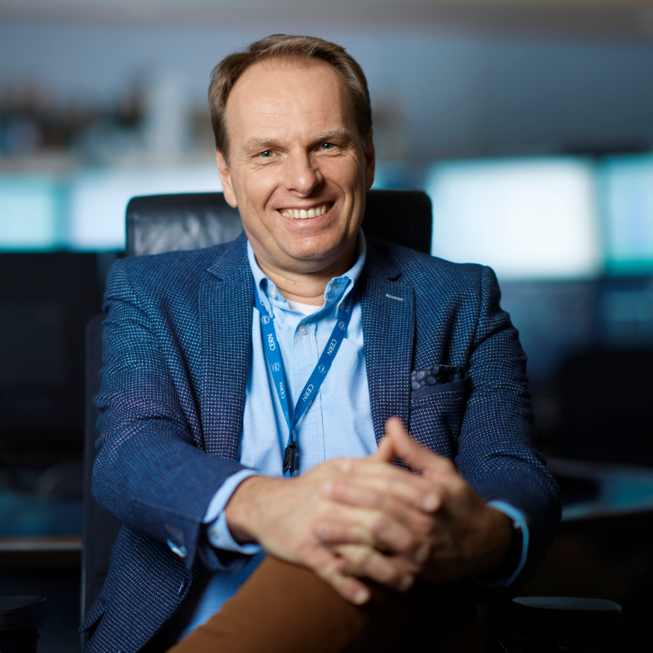
CERN’s Accelerator Complex
Rende Steerenberg
BE Operation Group Leader

Slide 14

Today’s Goals: Networking during the break
Game: 9 specific questions
Aim: fill the boxes with 9 different names of people attending the session today
Get a pen and paper
Write your name and surname on the piece of paper before submitting it for the prize draw
Watch out, we will check the information

Slide 15








Stands & Break
Please be back in this room at 16:10
Coffee/drinks/free chat/game
CERN Services and informal networks

Slide 16
Please mark yourself as COMPLETED in the Learning Hub
https://cern.ch/pfiy9

Slide 17
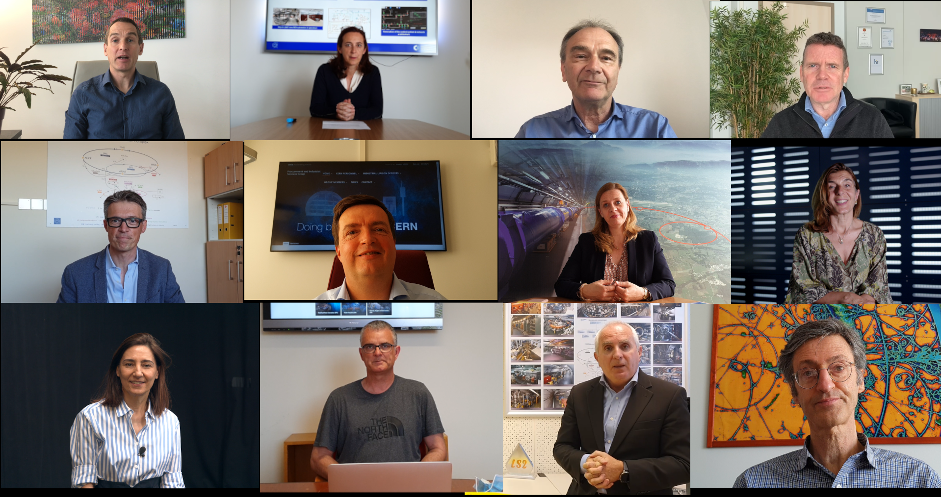
Introduction to CERN Departments
Video Presentation

Slide 18
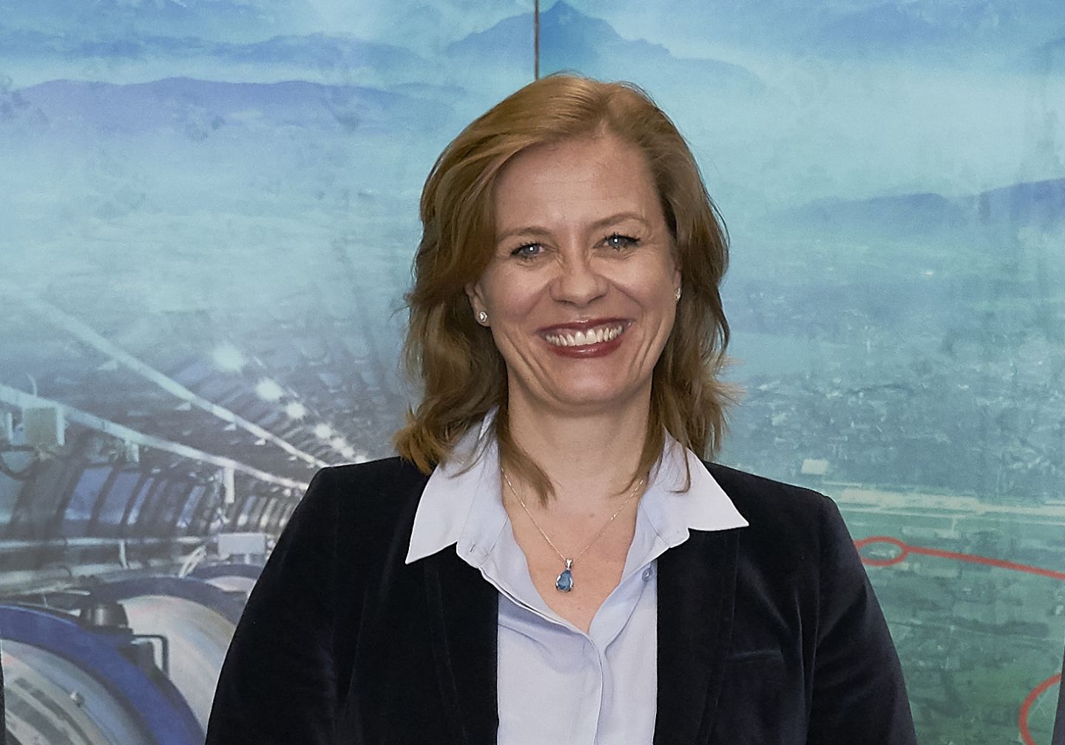
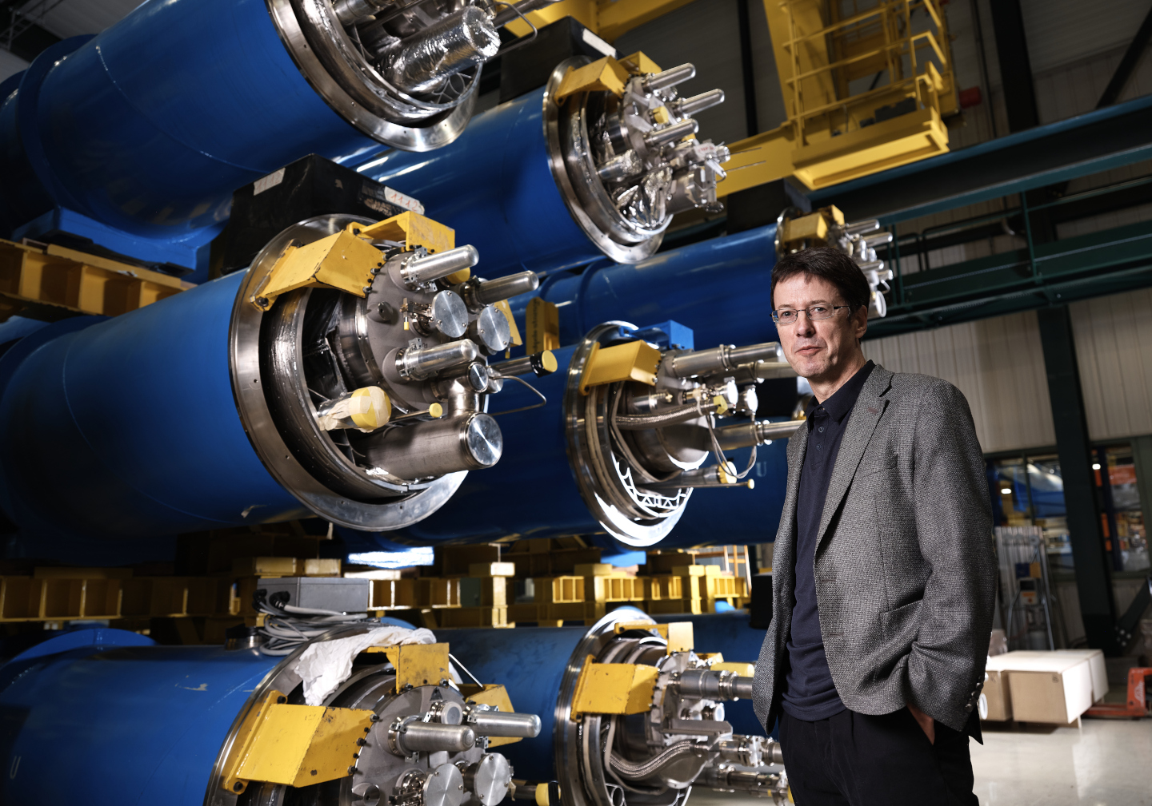
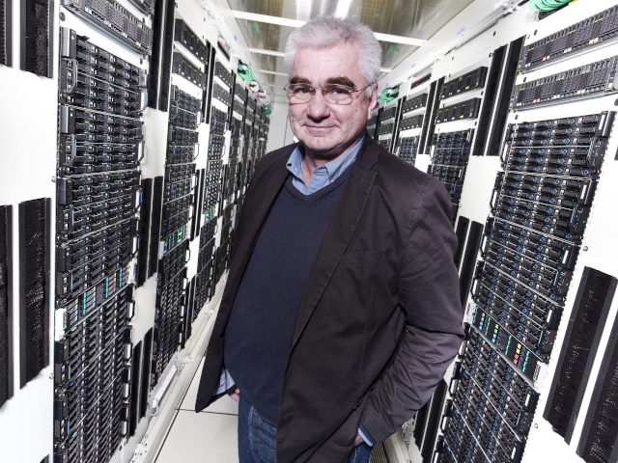
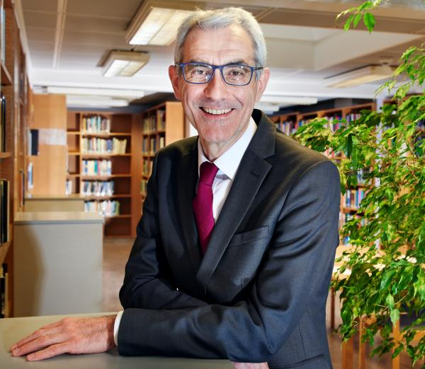
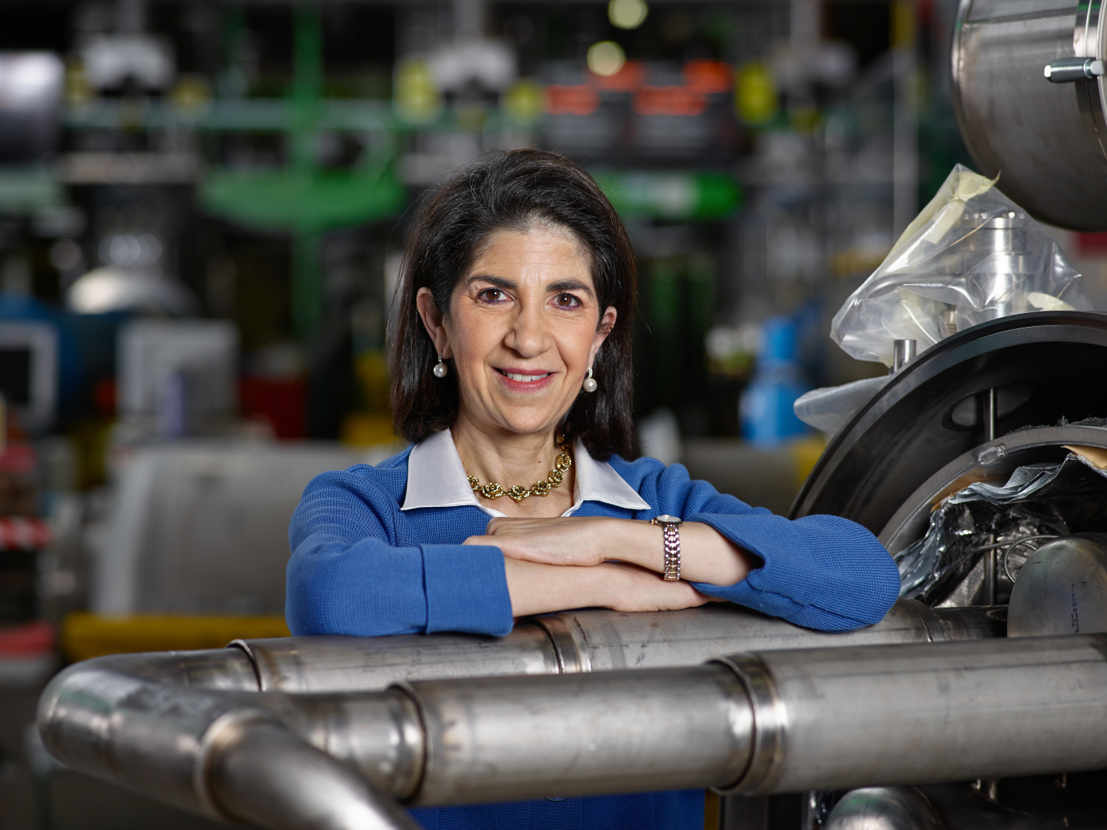
Q&A with the Directorate
Charlotte Lindberg Warakaulle
Director for International Relations
Mike Lamont
Director for Accelerators &
Technology
Joachim Mnich
Director for Research & Computing
Raphaël Bello
Director for Finance & Human Resources
Fabiola Gianotti, Director General

Slide 19




Closing Drinks
Meet with Department Heads, HR and Colleagues
Free chat
Snacks & Drinks

