Slide 1
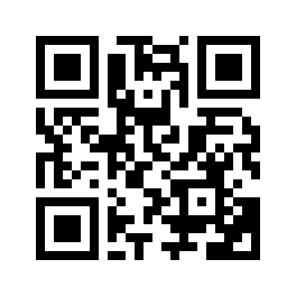
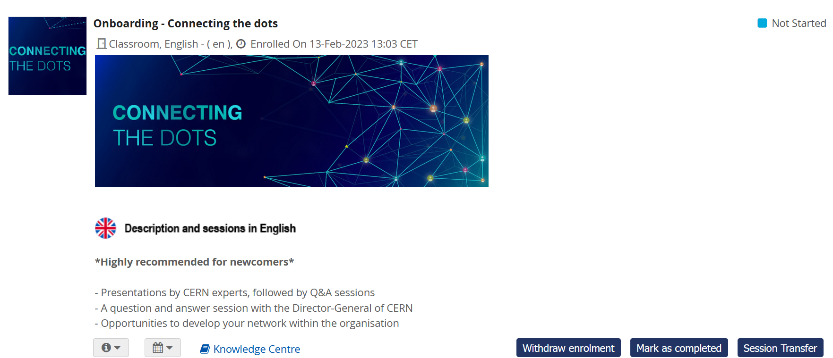
Please mark yourself as COMPLETED in the Learning Hub
https://cern.ch/pfiy9

Slide 2
Connecting the DOTS
Florence Licci-Ounnough & Kyriaki Fakoureli
Notes:
KF

Slide 3
About us
Welcome / Bienvenue
Kyriaki
FAKOURELI
HR Department,
Learning & Development
Florence
LICCI-OUNNOUGH
HR Department,
Learning & Development
Notes:
KF

Slide 4
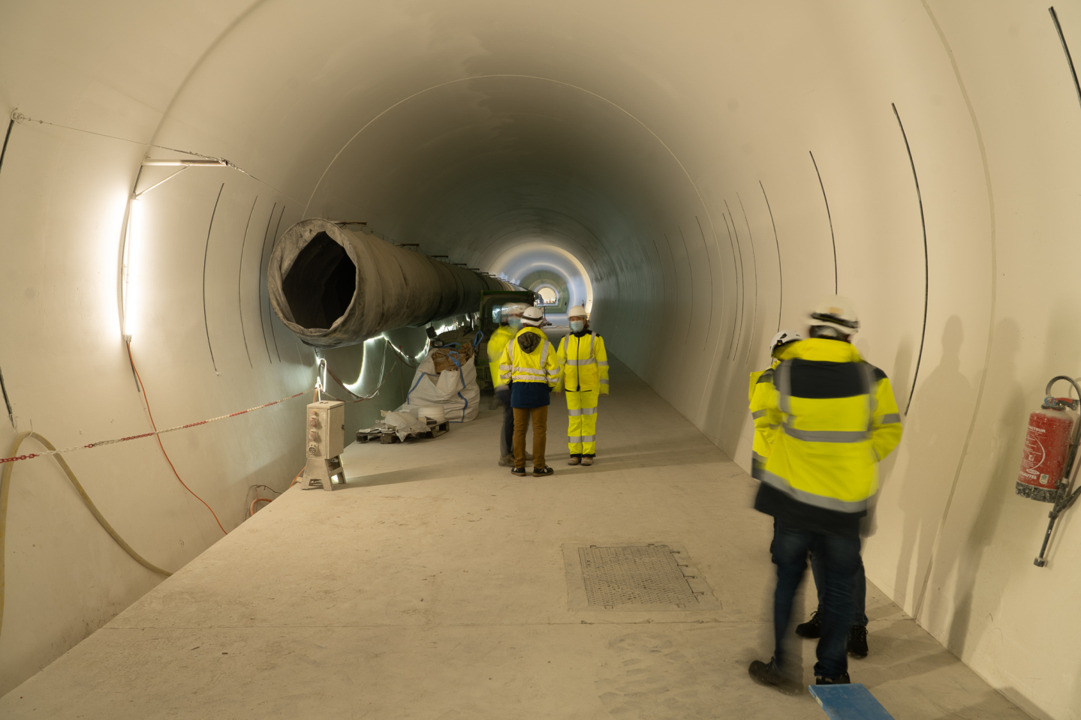
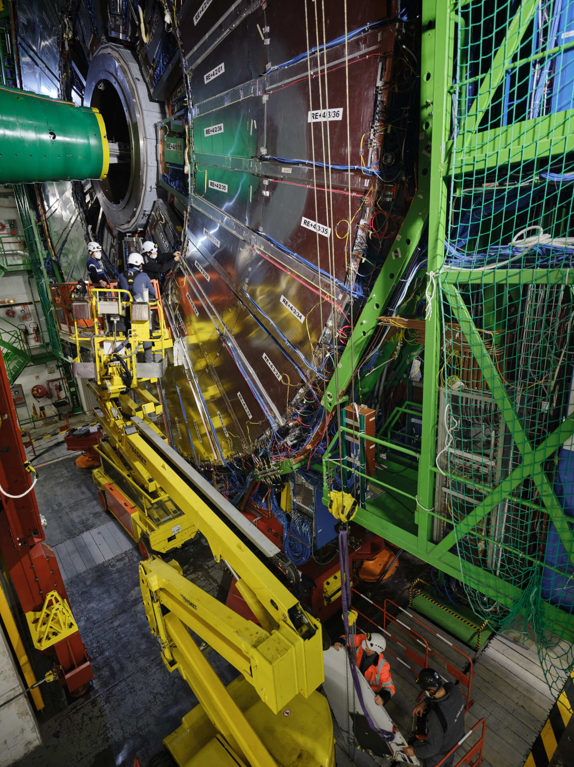
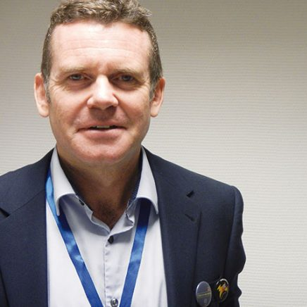
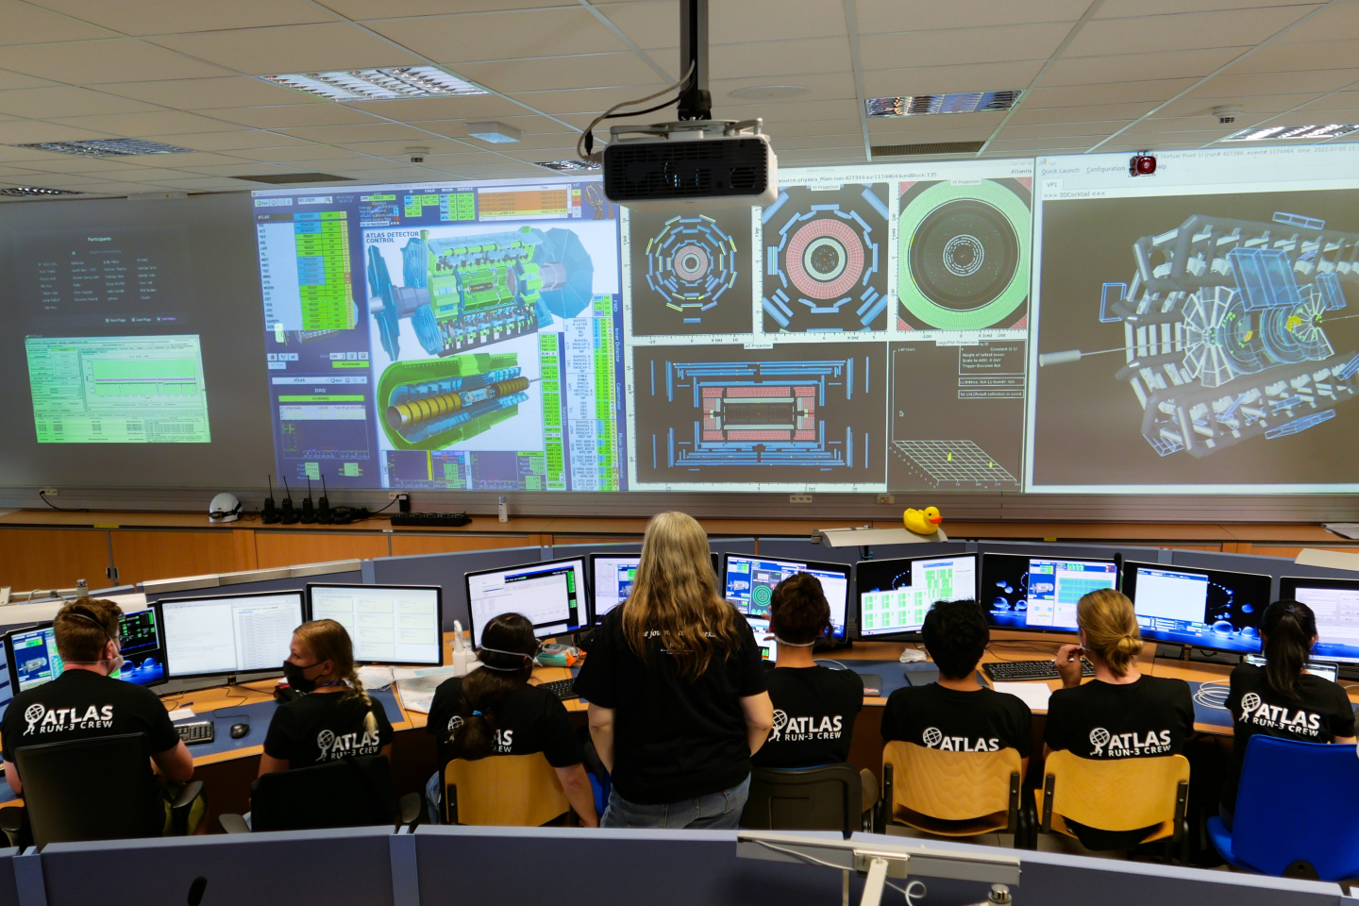
Welcome to CERN
James Purvis
HR Department Head

Slide 5



Logistics
Notes:
FLO

Slide 6
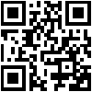

Slides & Videos
Available on Indico
https://indico.cern.ch/event/1172672/
Notes:
FLO Slides on INDICO page

Slide 7

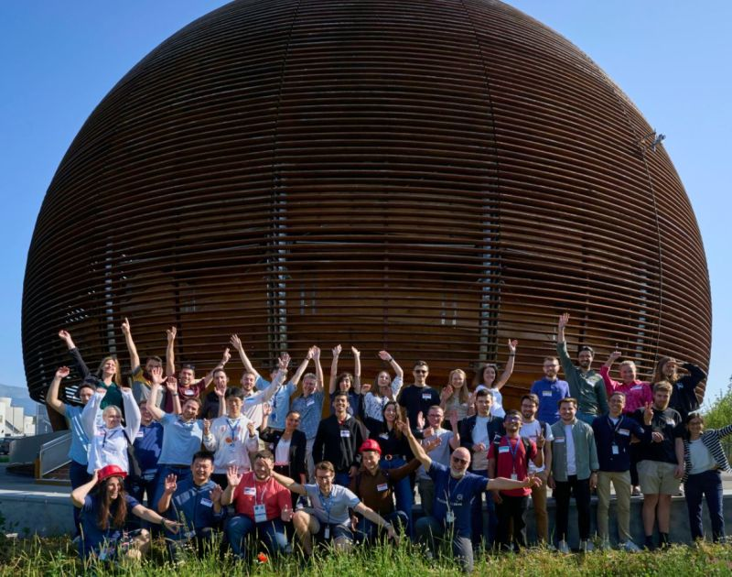



Your Onboarding Journey at CERN
Welcome Session
ONLINE short sessions:
Computer Security Awareness
Scientific Information Service (Library & Open Science)
Pension Fund Benefits (members)
CERN visit for you and members of your family or friends
Connecting the Dots…
Notes:
KF

Slide 8
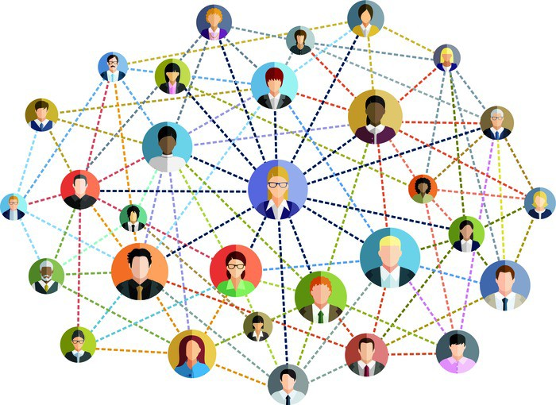
Today’s Objective
Notes:
Networking

Slide 9
Today’s Agenda
Intro
Ice-Breaker
Scientific Activities, Richard Hawkings
CERN’s Accelerator Complex, Rende Steerenberg
Coffee break and/or Stands + Game
Introduction to CERN Departments, Department Heads - video
Q&A with a CERN Director, Raphaël Bello
Prize Draw
Closing drink and Networking
Notes:
FLO

Slide 10


Slide 11
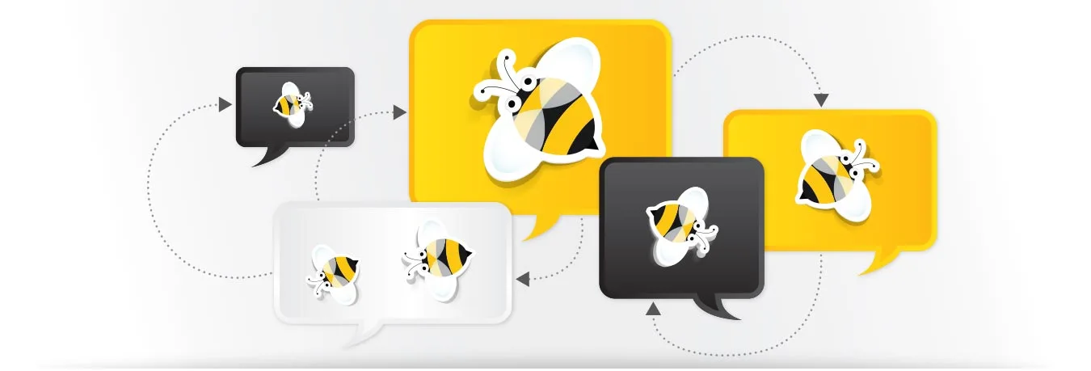
Ice-Breaker
In small Buzz groups, discuss together:
What is my role at CERN and how does/will my job contribute to CERN’s mission?
En petits groupes, discutez ensemble :
Quel est mon rôle au CERN, et comment mon travail contribuera-t-il à la mission du CERN ?
Notes:
FLO

Slide 12
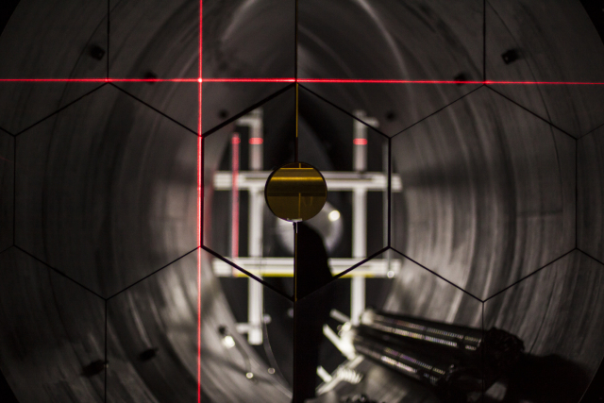
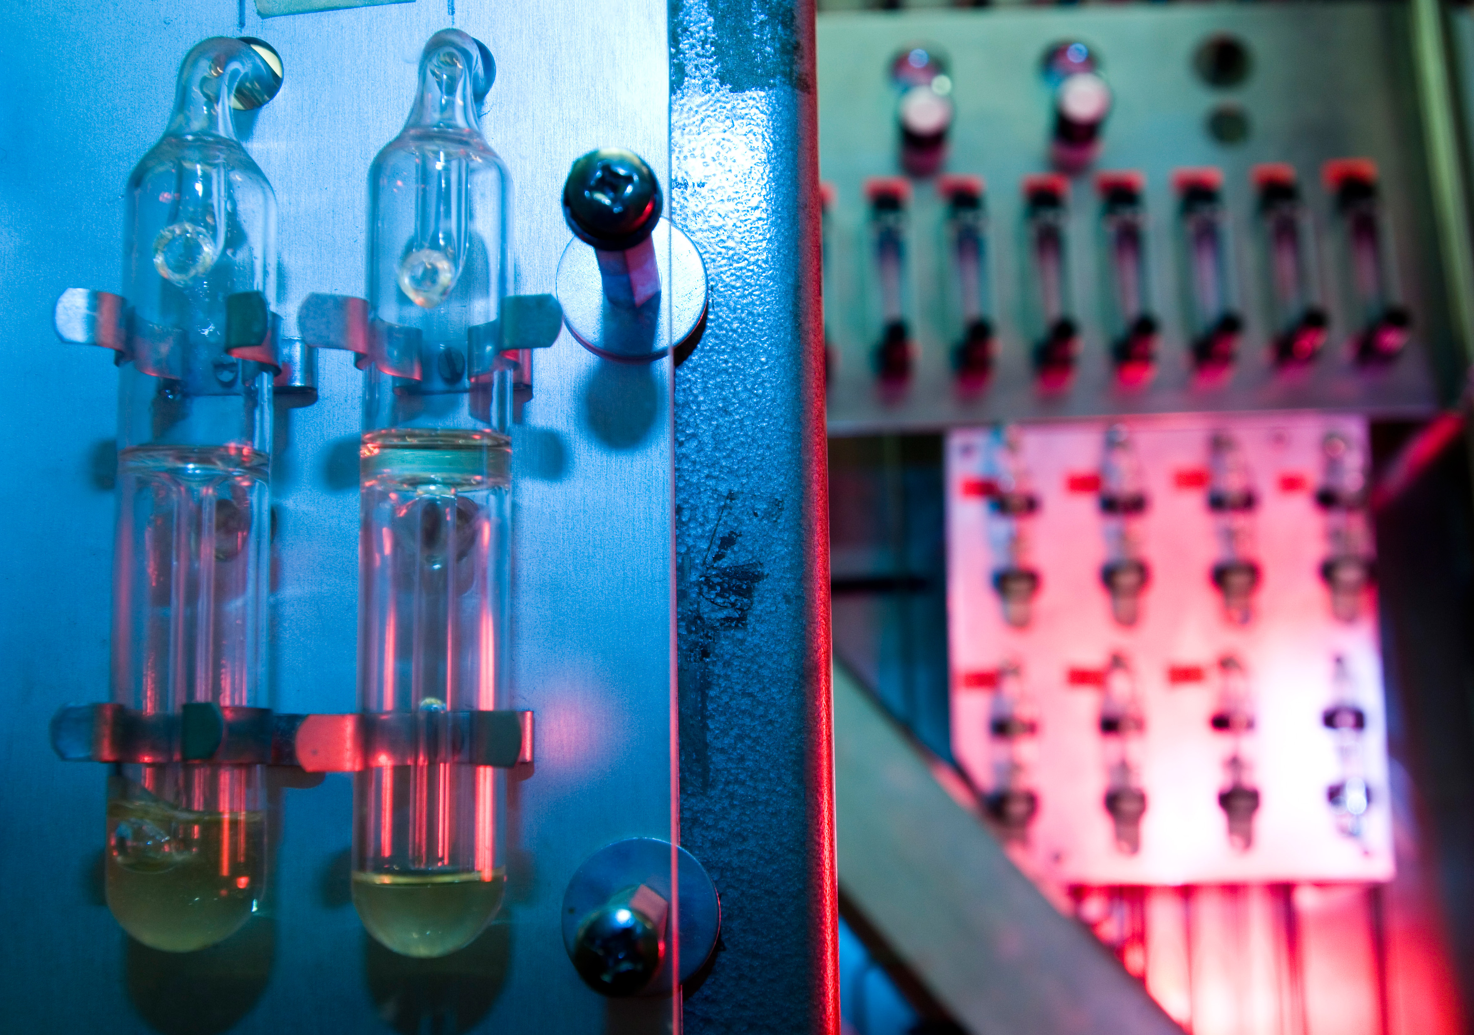
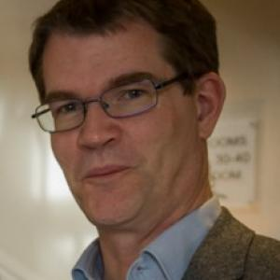
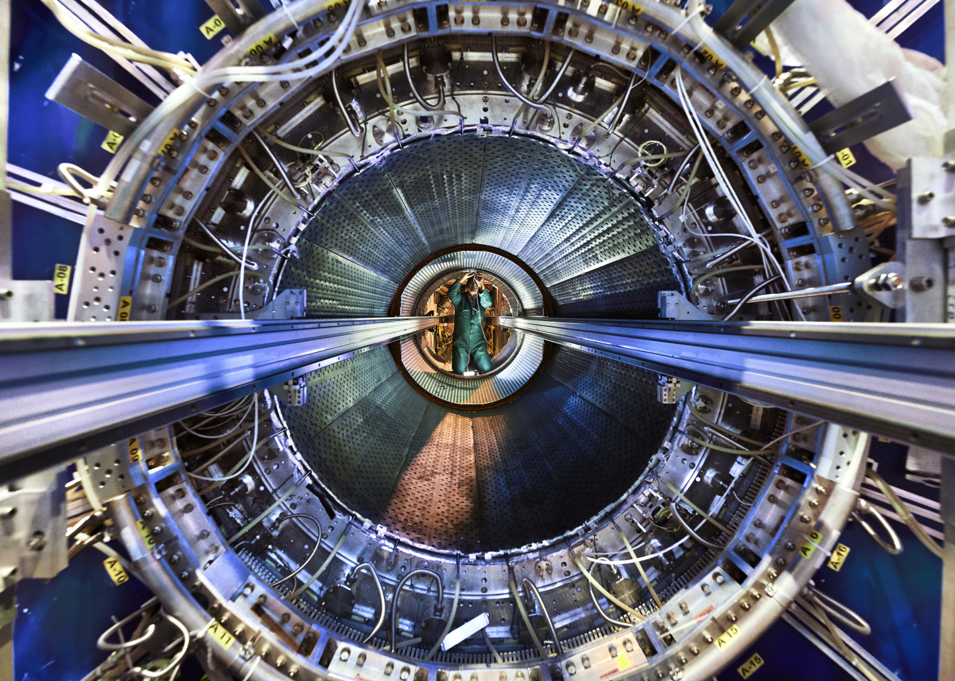
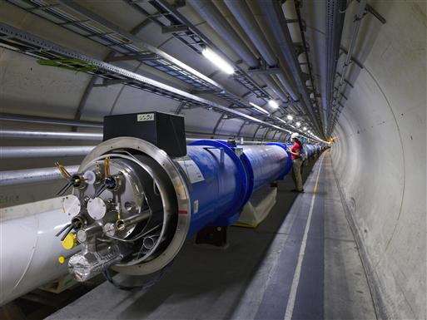
Scientific Activities
Richard Hawkings
EP Deputy Department Head
Notes:
KF

Slide 13
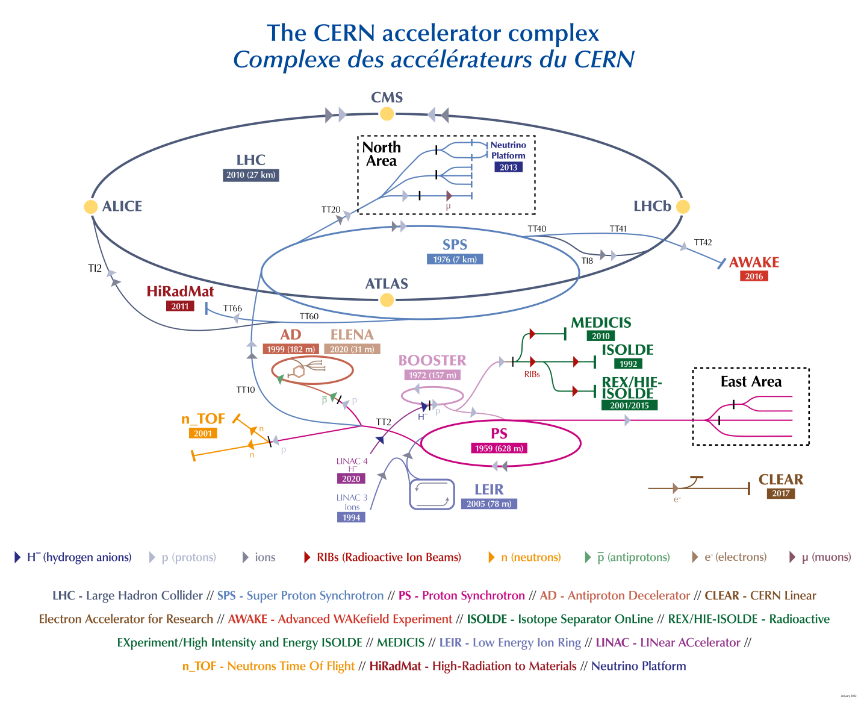
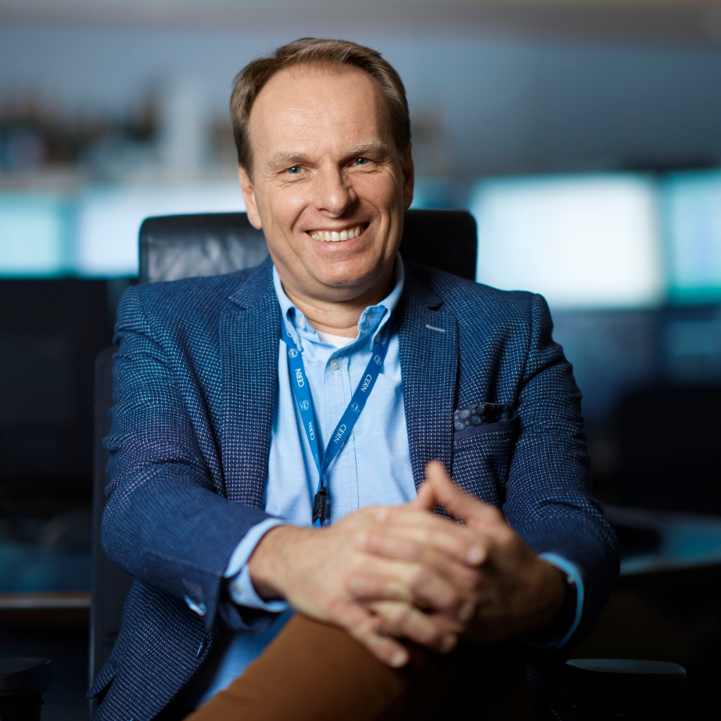
CERN’s Accelerator Complex
Rende Steerenberg
BE Operation Group Leader
Notes:
KF

Slide 14

Today’s Goals: Networking during the break
Game: 9 specific questions
Aim: fill the boxes with 9 different names of people attending the session today
Get a pen and paper
Write your name and surname on the piece of paper before submitting it for the prize draw
Watch out, we will check the information
Notes:
FLO

Slide 15







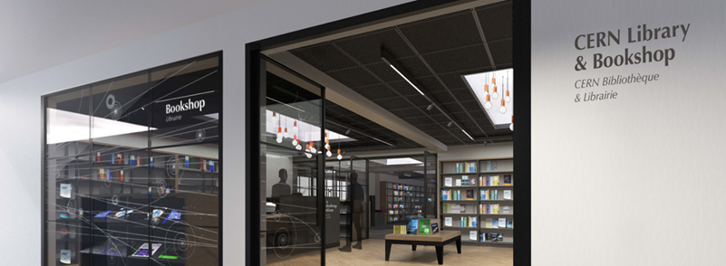
Stands & Coffee break
Please be back in this room at 16:10
Networking & Game time
CERN Services and informal networks
Notes:
FLO

Slide 16
Please mark yourself as COMPLETED in the Learning Hub
https://cern.ch/pfiy9
Notes:
KF

Slide 17
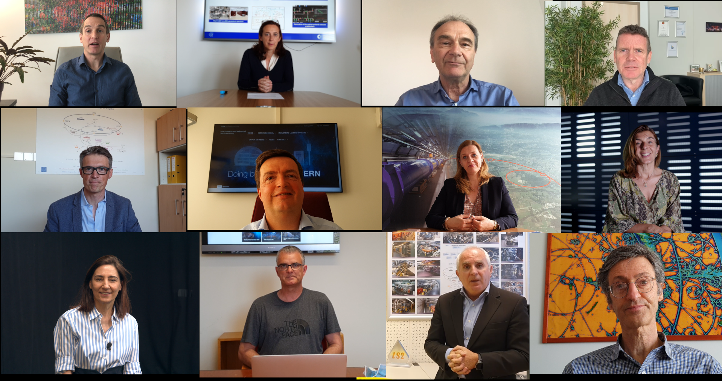
Introduction to CERN Departments
Video Presentation
Notes:
FK

Slide 18
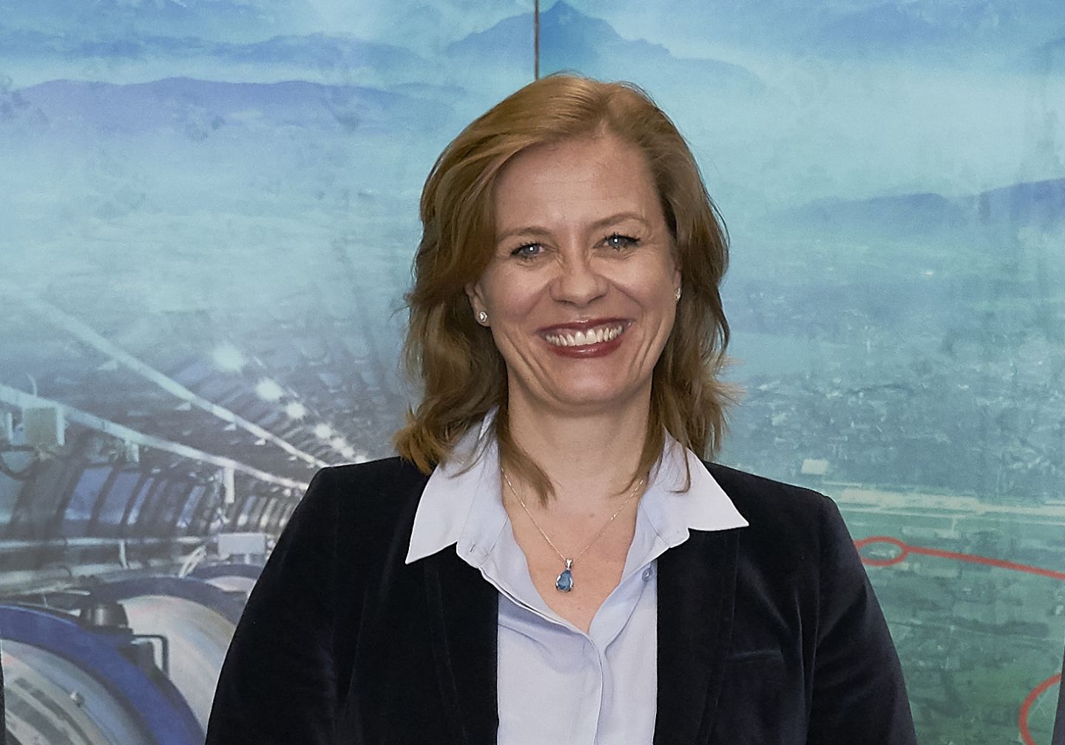
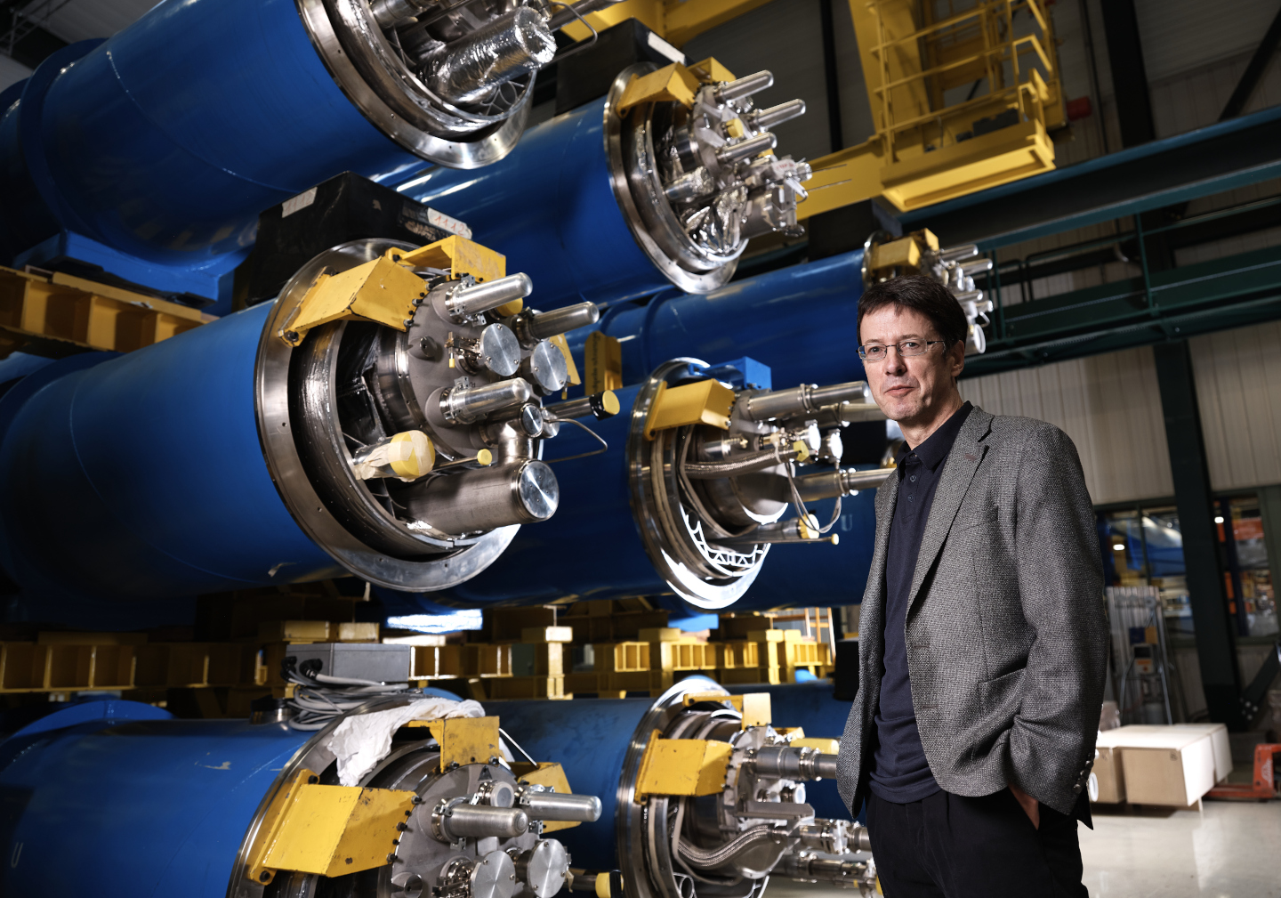
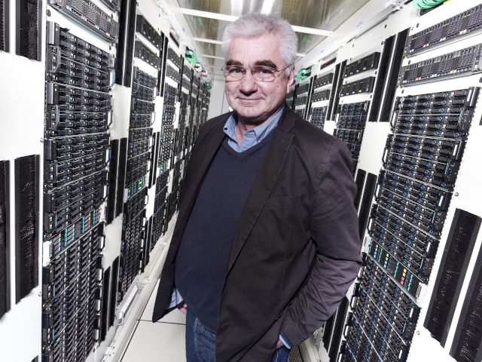
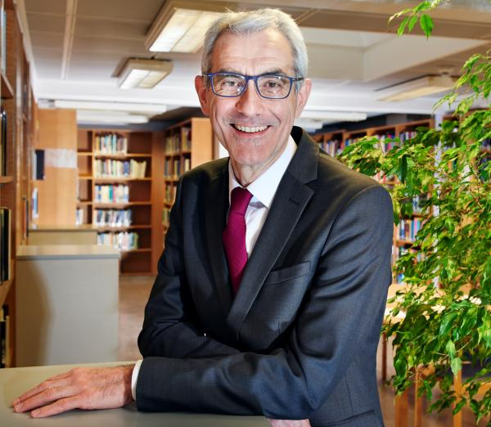
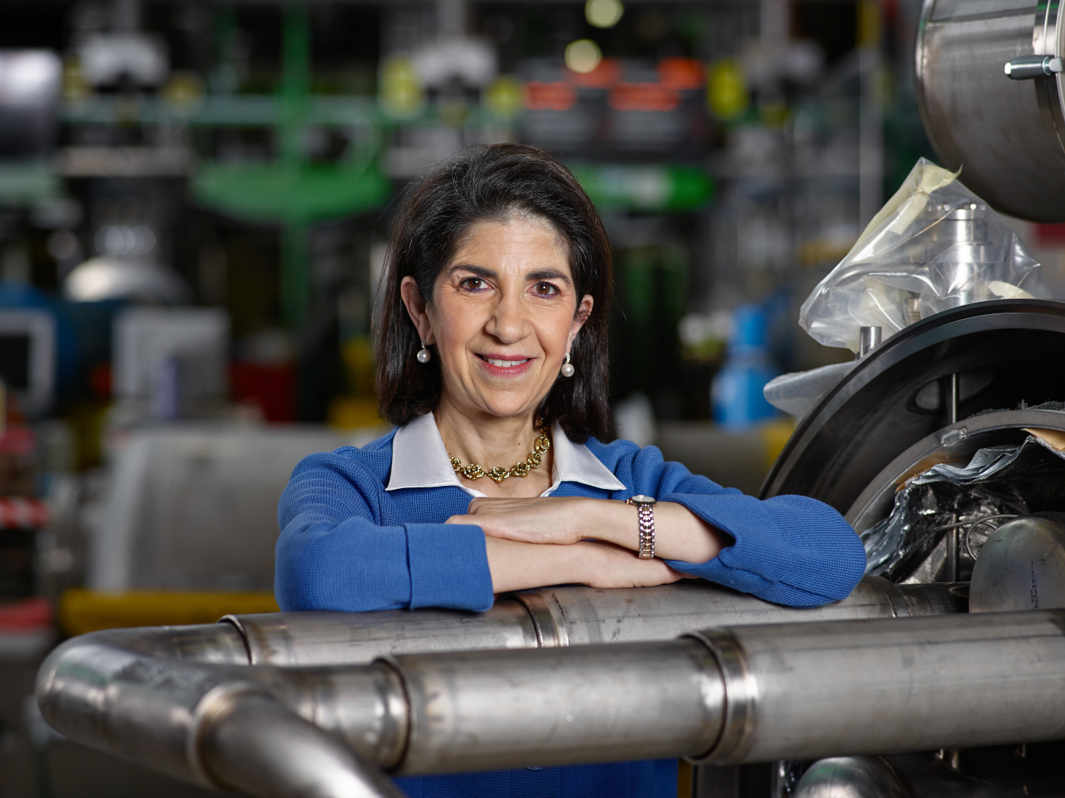
Q&A with a CERN Director
Charlotte Lindberg Warakaulle
Director for International Relations
Mike Lamont
Director for Accelerators &
Technology
Joachim Mnich
Director for Research & Computing
Raphaël Bello
Director for Finance & Human Resources
Fabiola Gianotti, Director General
Notes:
FLO

Slide 19


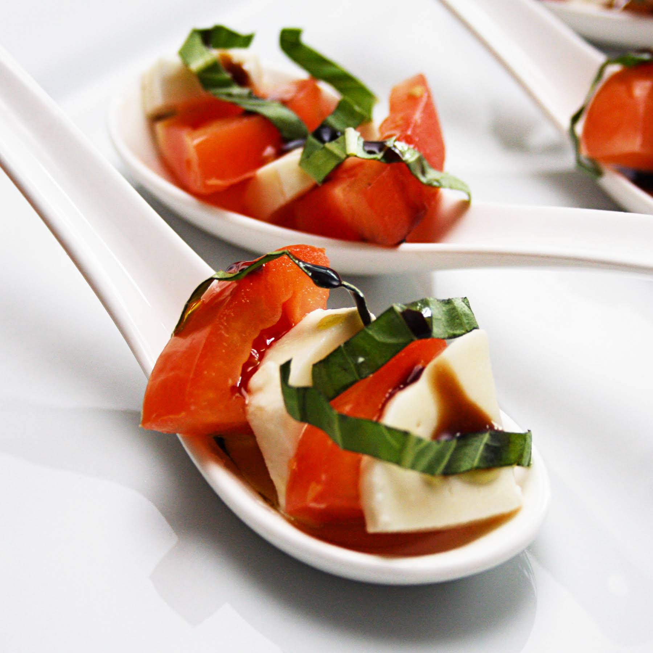

Closing Drinks
Meet with Department Heads, HR and Colleagues
Networking
Snacks & Drinks
Notes:
FLO

