Slide 1
Become a CERN Guide Become an ambassador for science
International Relations – ECO and SG groups
Connecting the dots - June 2023

Slide 2
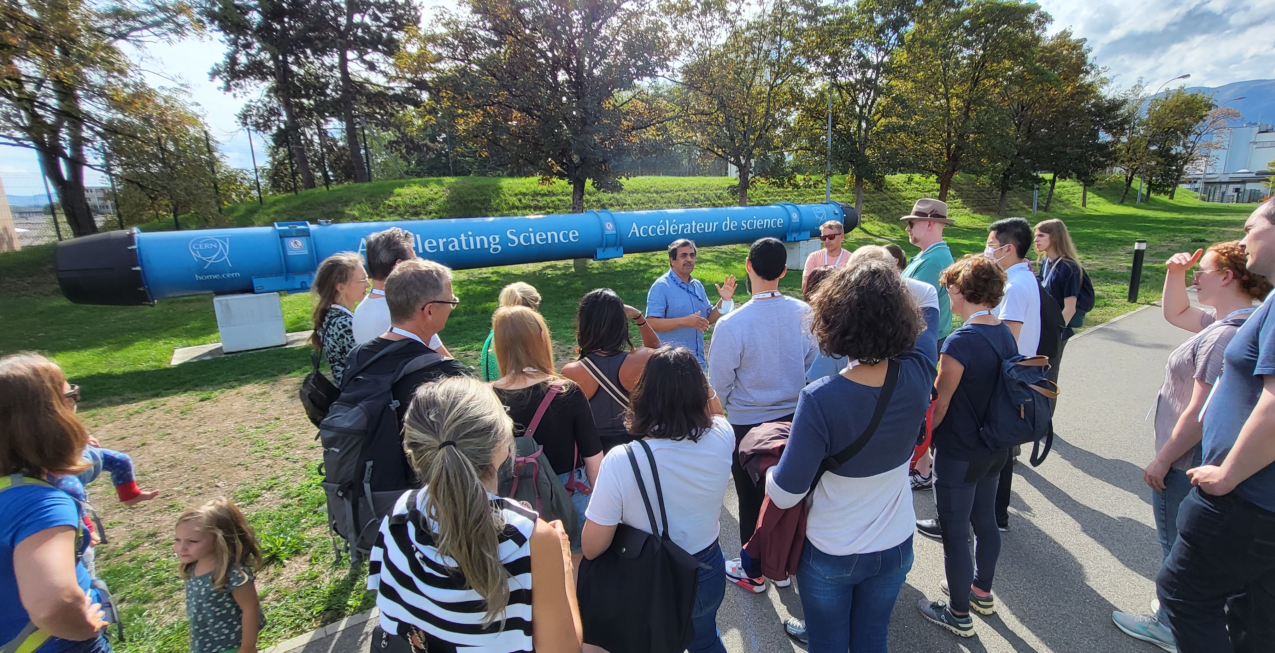
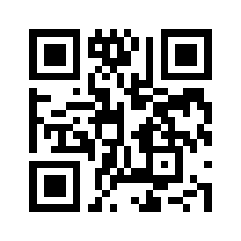
Every year CERN welcomes more than 200 000 visitors
Try our quiz and find out which guide you are!

Slide 3
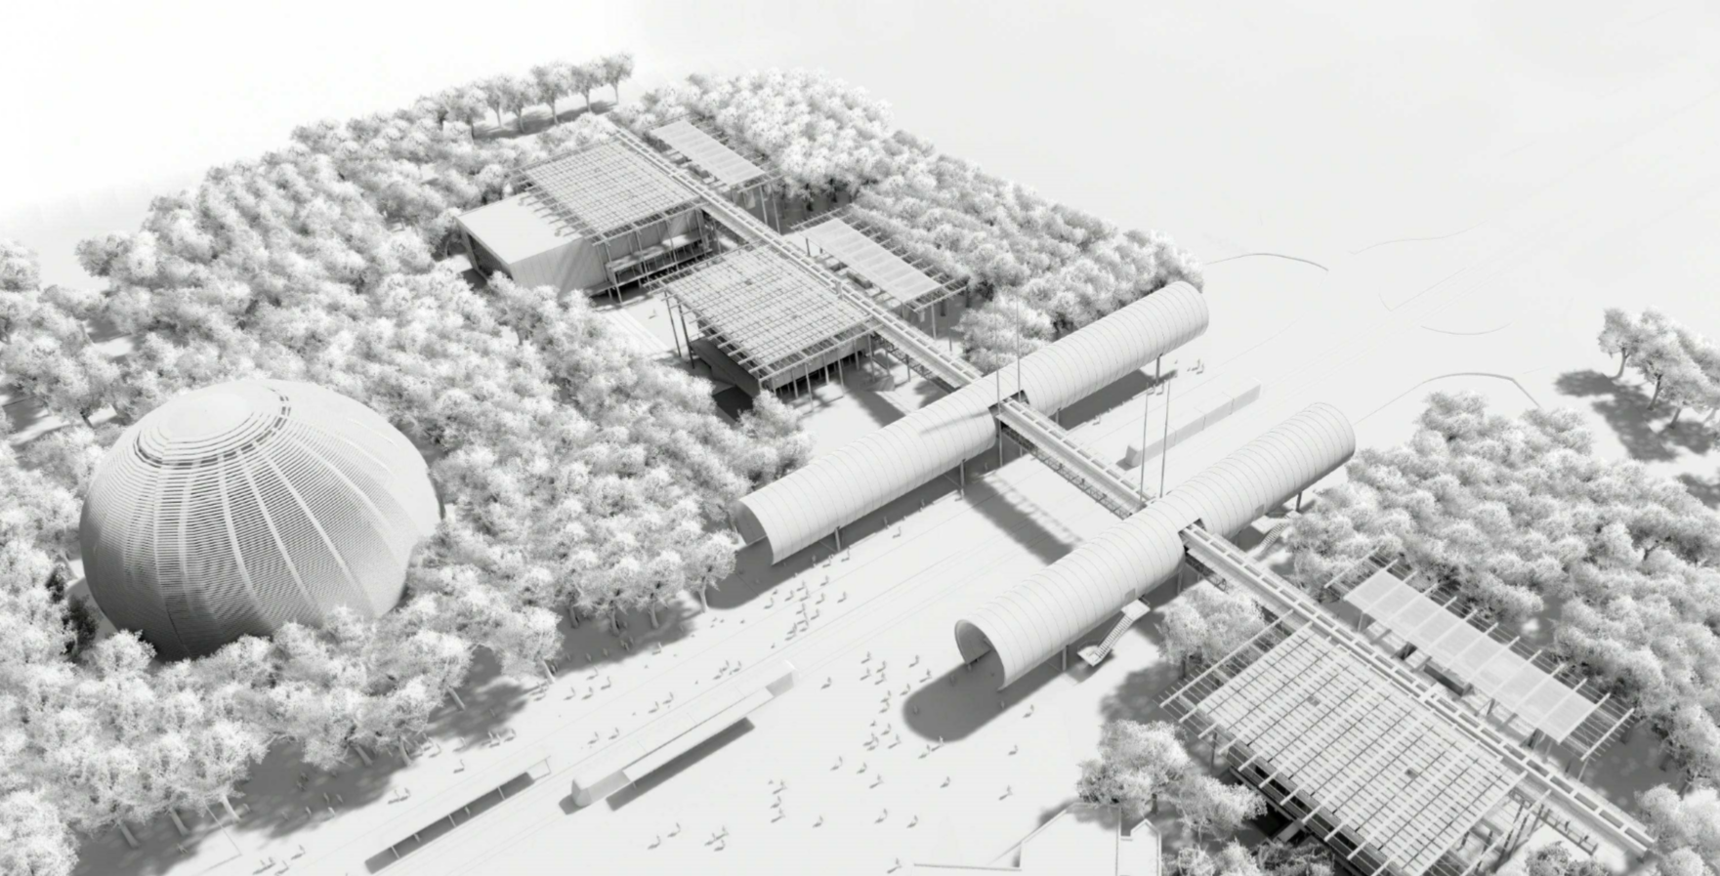
CERN Science Gateway will open its doors to the public on 8 October 2023
Auditorium
Labs Reception & Shop Restaurant
Exhibitions
Try our quiz and find out which guide you are!

Slide 4
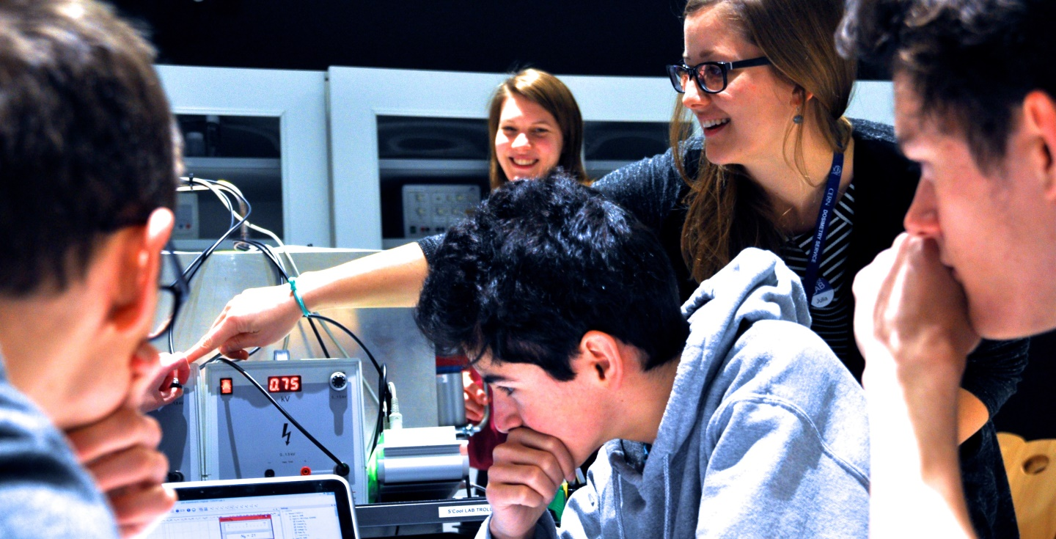
You can be part of it!
Try our quiz and find out which guide you are!

Slide 5
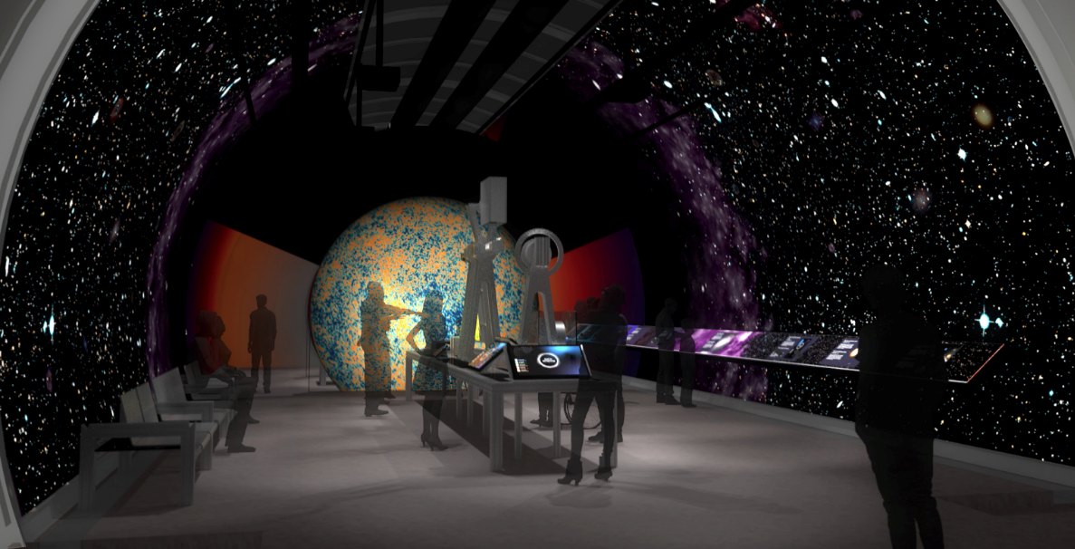
Activities that suit your profile
Exhibitions
Lab workshops
Science shows
Guided tours
Local events
All profiles are welcome!
Try our quiz and find out which guide you are!

Slide 6
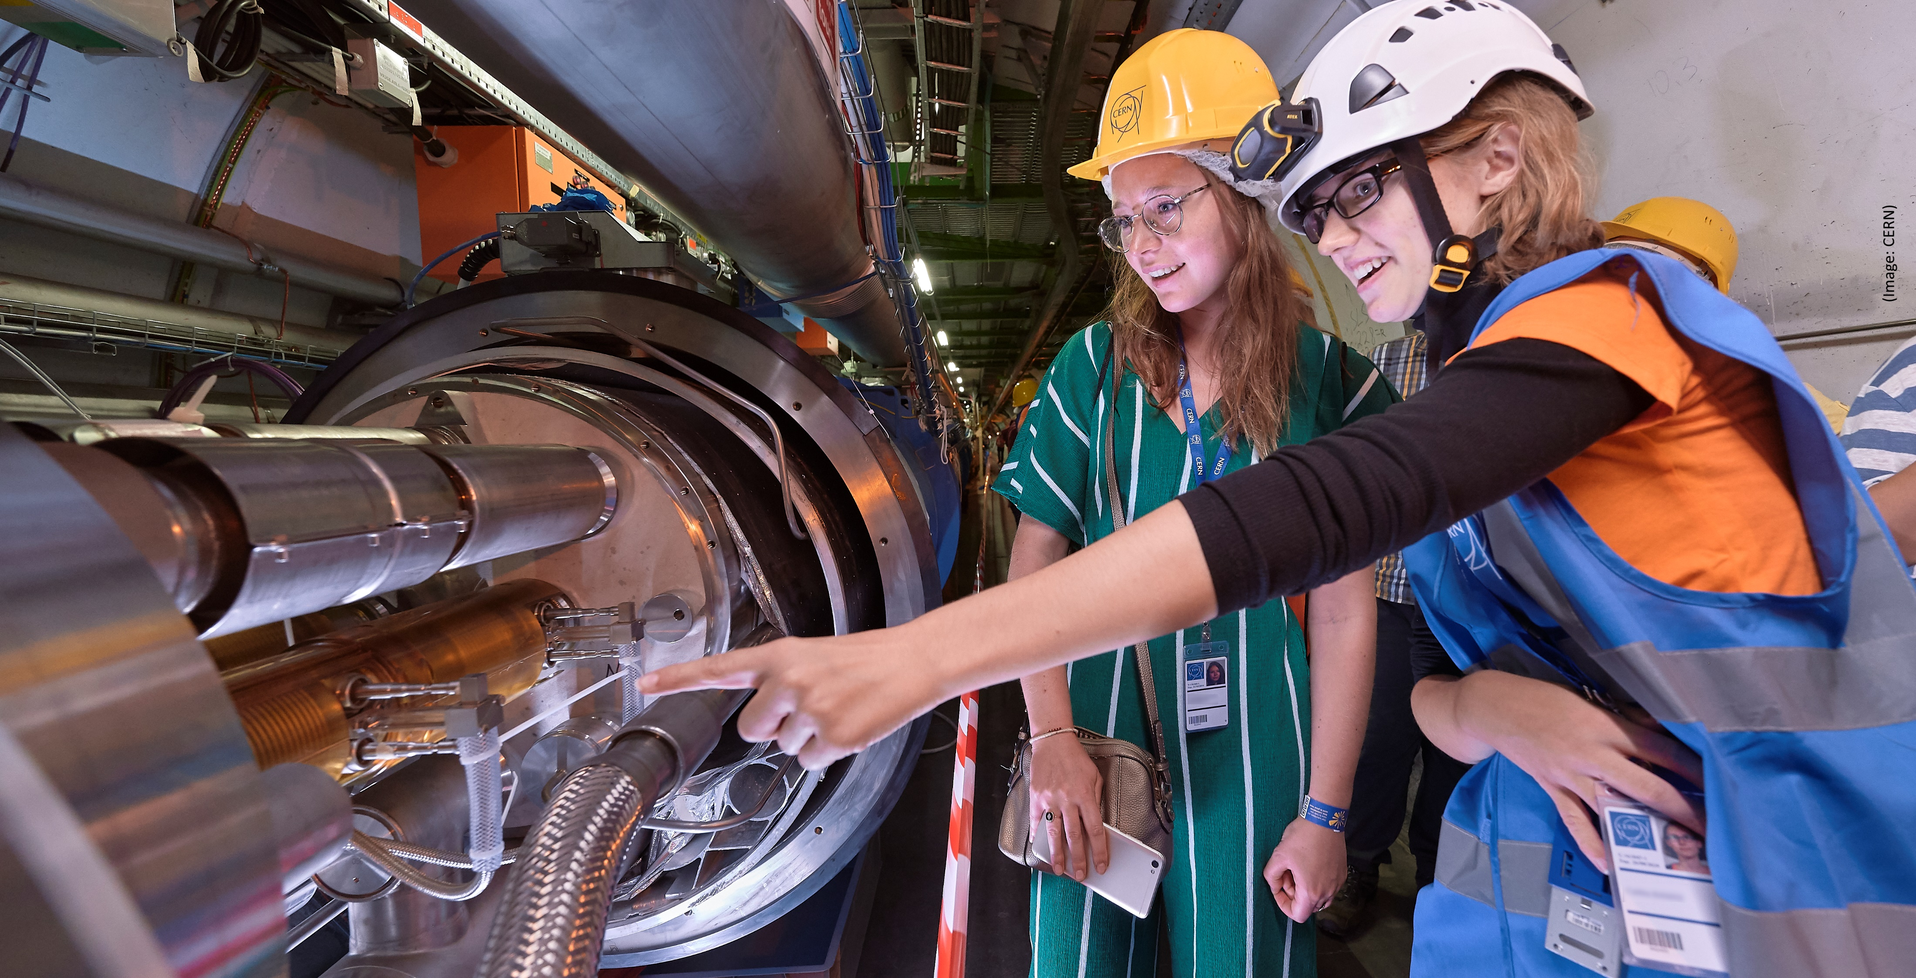
Expand your work experience
Develop your communication skills
Learn about CERN
Meet new colleagues
Become an ambassador for science
Try our quiz and find out which guide you are!

Slide 7
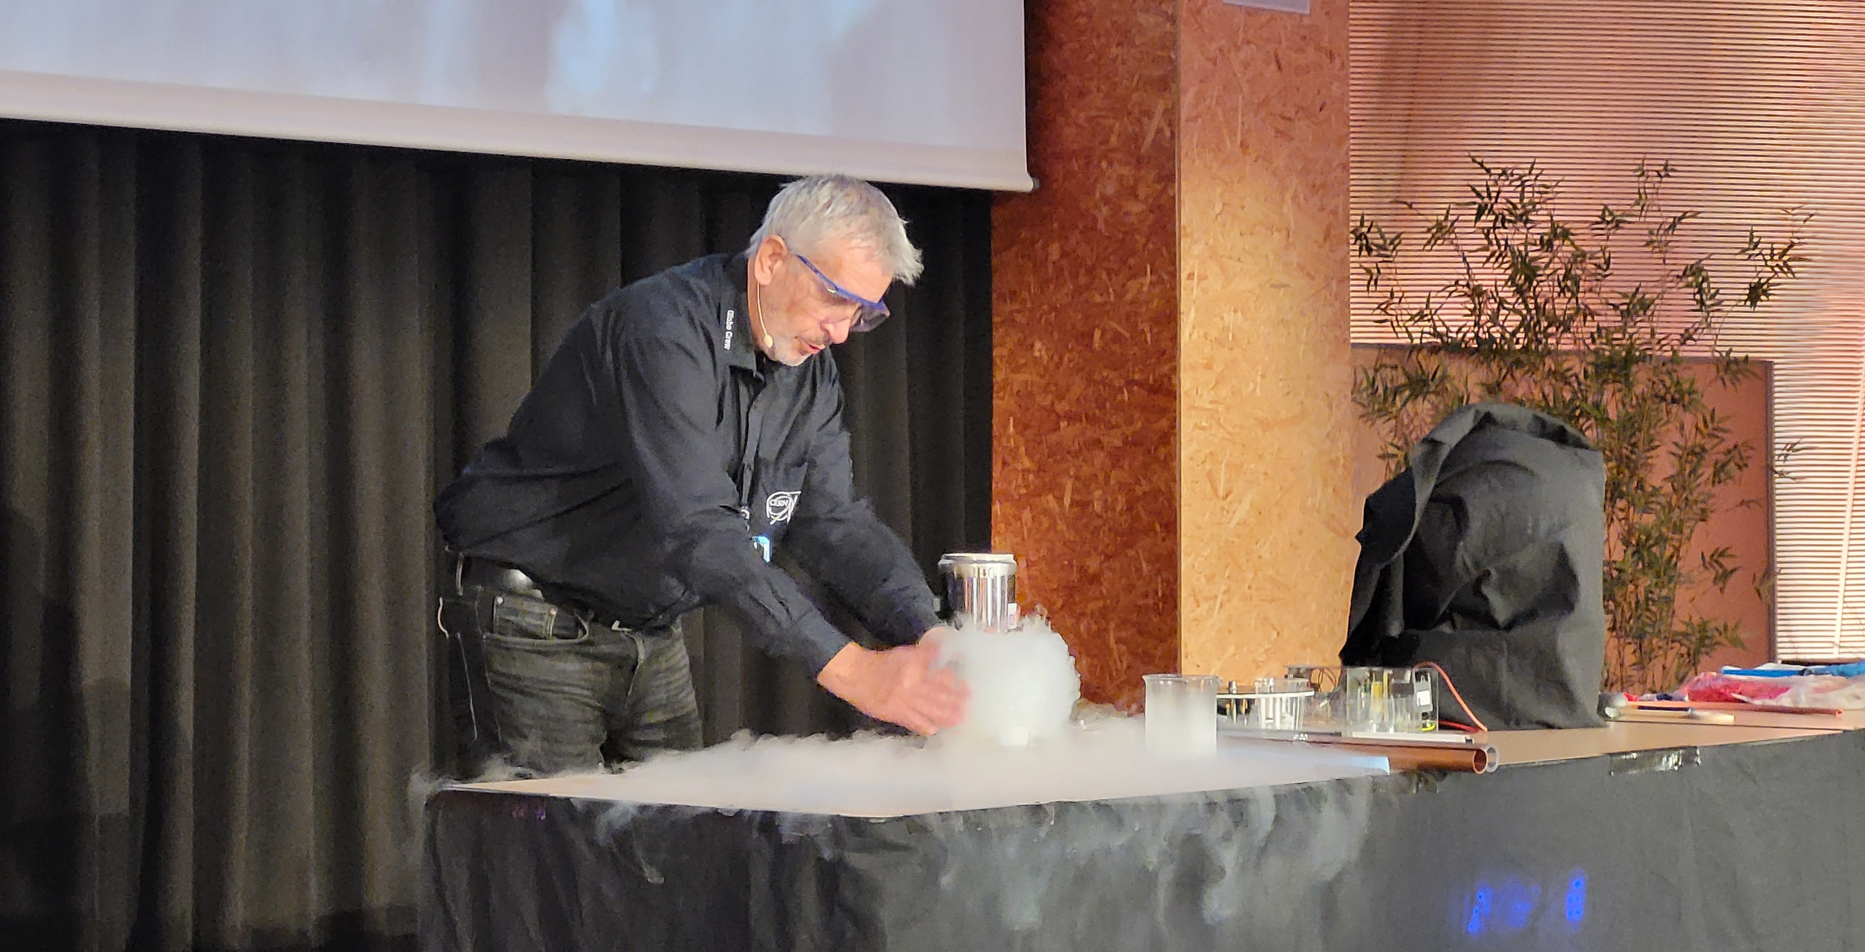
Exclusive benefits
Special trainings
Special events
CERN Guides exclusive space
Certificates
Try our quiz and find out which guide you are!

Slide 8
A modular training system
Start small, guide quickly
Choose the activities you prefer
Expand your portfolio as you gain experience
Introduction course * (45 min)
Science Gateway facilities (1h)
Science communication * (4 h)
Exhibitions (2 h)
Show 1 (3 h)
Ad hoc Training (1h)
Workshop 1 (1-2 h)
Workshop 2 (1-2 h)
Etc.
Show 2 (3 h)
Etc.
Visit Point 1 (1h)
Visit Point 2 (1h)
Etc.
Try our quiz and find out which guide you are!

Slide 9
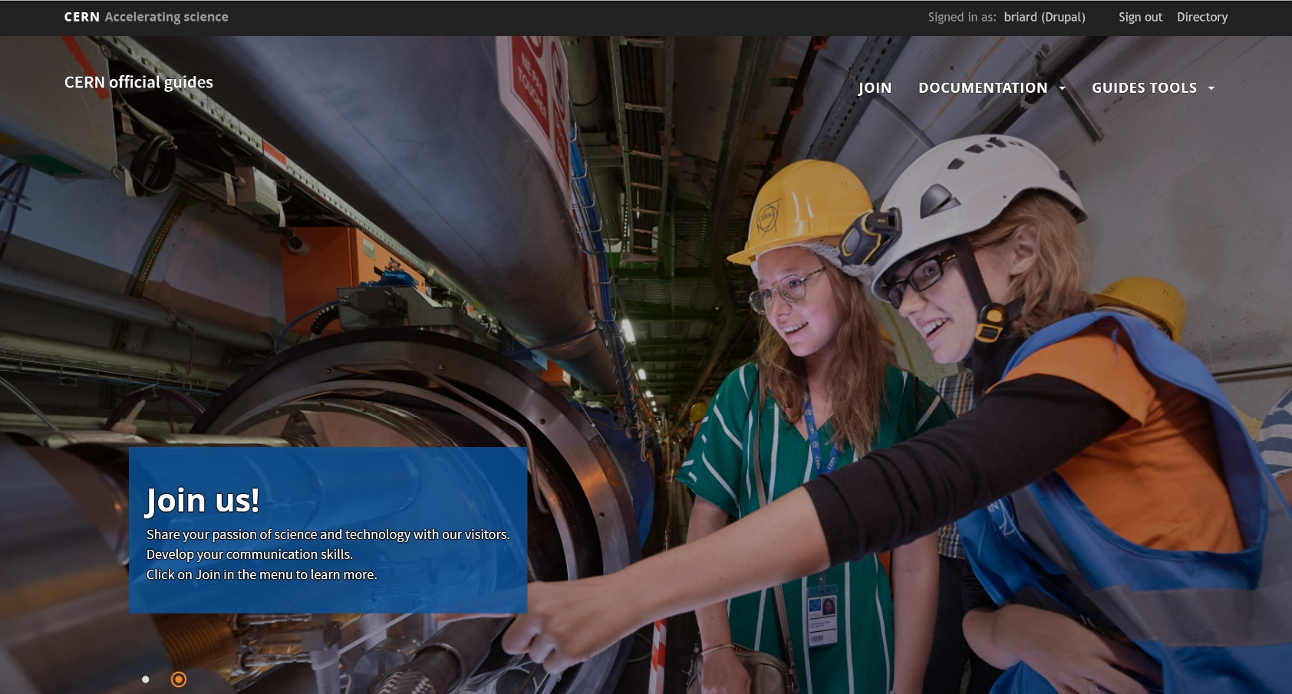
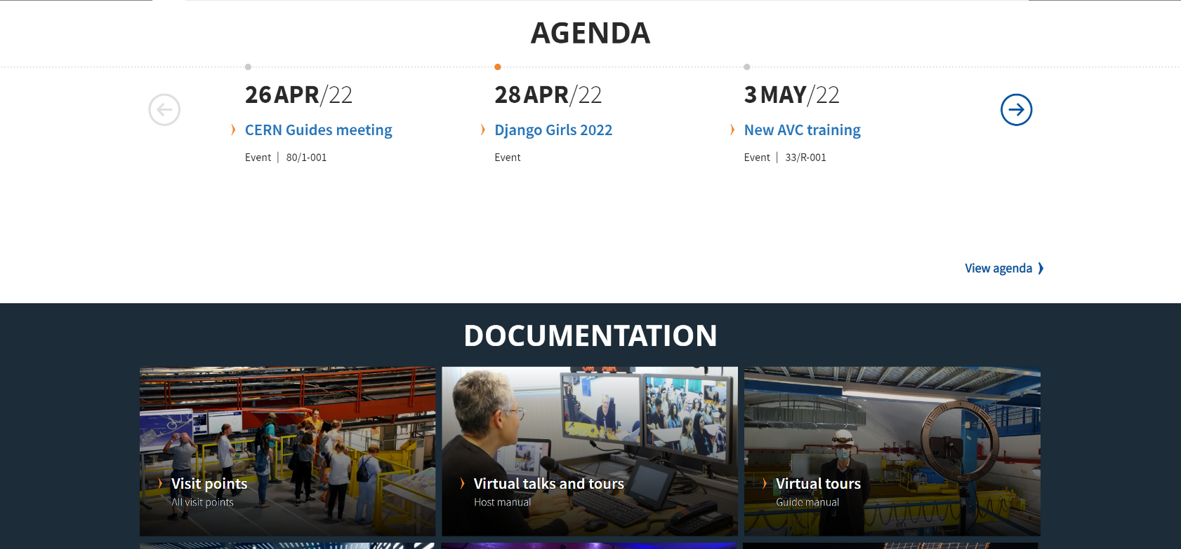
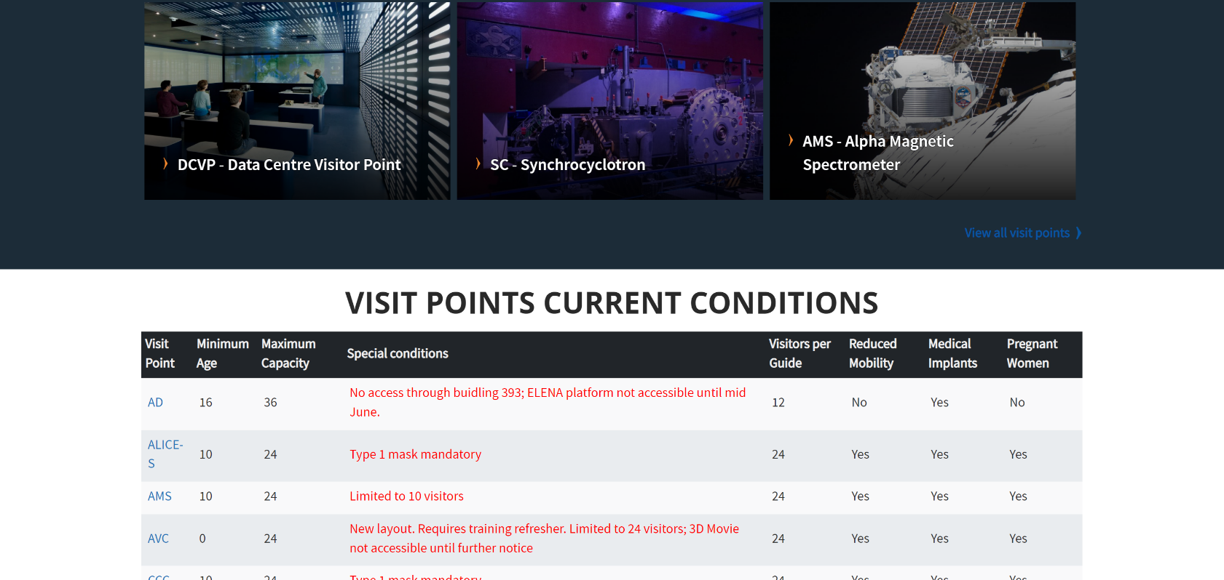
Many resources to help
Guides website at https://guides.web.cern.ch
Online documentation
Training catalogue
Articles, news, best practices etc.
Guides channels at https://cern.ch/mattermost
Join the community
Ask questions
Share your experience
Visits service at visits.service@cern.ch
To answer any of your question

Slide 10

Join us!
More information on
https://guides.web.cern.ch/join
Try our quiz and find out which guide you are!

