Slide 1
Probing the formation and evolution of quark-gluon plasma in nuclear collisions
Jasmine Brewer

Slide 2






  Bozeman, MT
  Boulder, CO
Undergrad 2011-2015
  Boston, MA
PhD
2015-2020

Slide 3
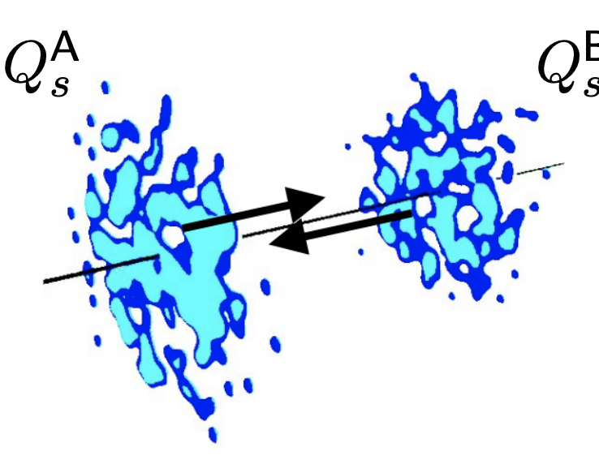
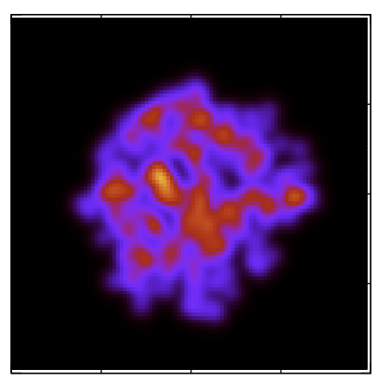
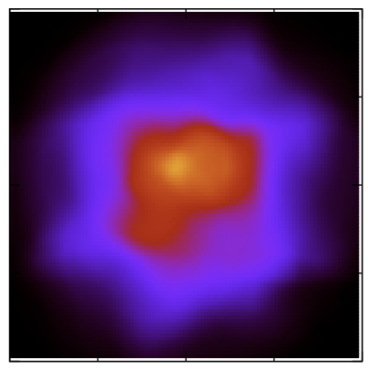

  energy
  Heavy-ion collisions
  Momentum
  transfer
  high energy scatterings
  energy loss
  Asymptotic freedom
  far from equilibrium initial state
  hydrodynamics
  hadron gas
  Perfect liquid
  time
Notes:
Unfortunately, the interpretation of jet modification observables often depends crucially on which proton-proton jets are taken to be a comparable baseline for a given heavy-ion measurement. In di-jet and inclusive jet studies, the standard answer is to compare heavy-ion jets to a proton-proton baseline with the same reconstructed pT. For example, comparing the jet production spectra for p-p and HI at the same reconstructed pT (as illustrated by the blue arrows) gives rise to the famous jet RAA.

Slide 4
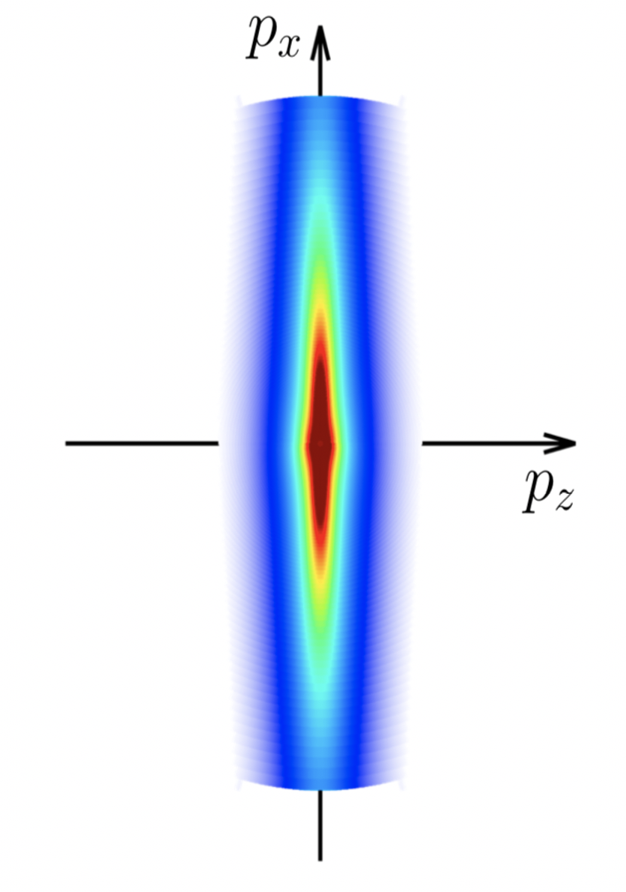
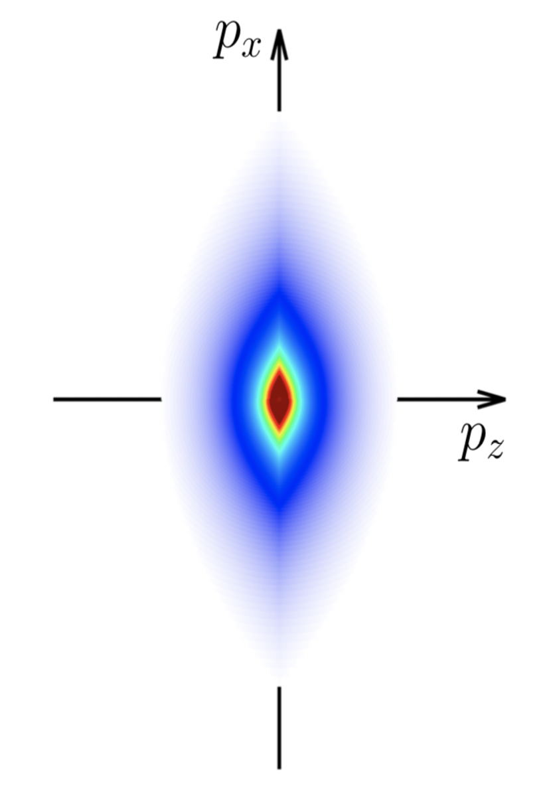
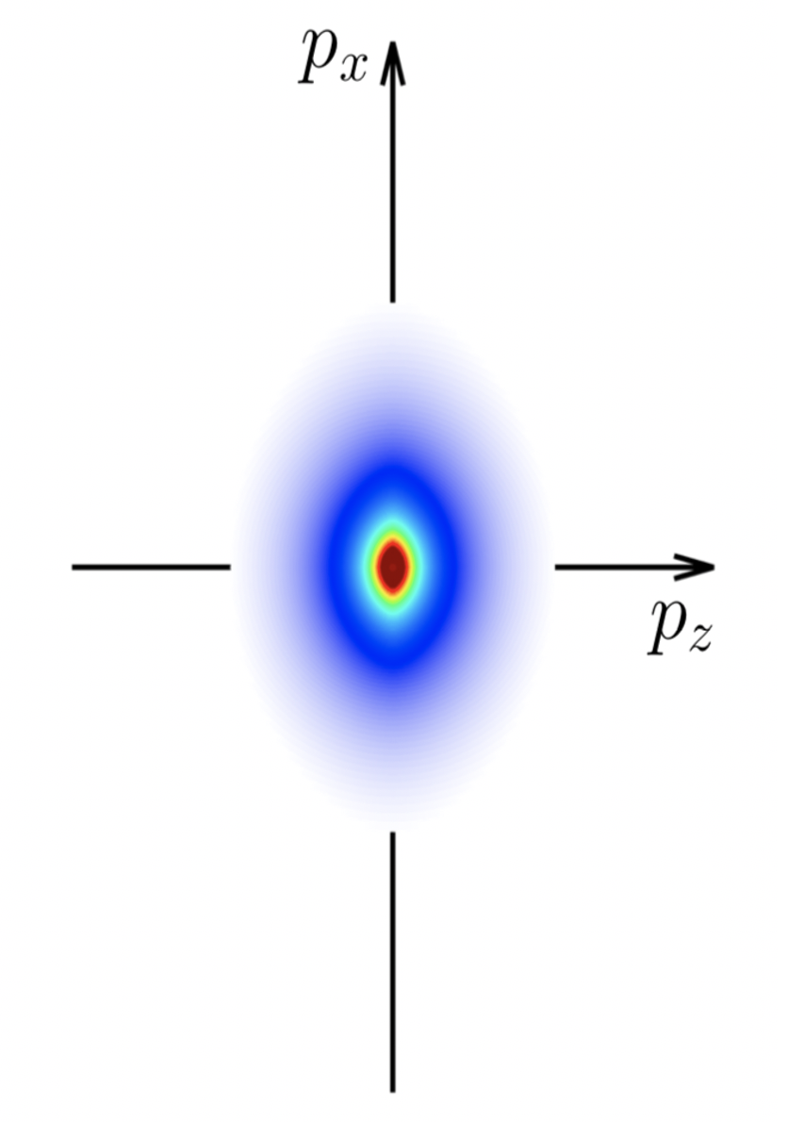

  Stages of thermalization in QCD
  QCD equilibration at weak coupling in kinetic theory
  Rapid expansion
  Collisional equilibration
  Universality far-from-equilibrium
  Fixed points:
  Free-streaming
  Non-thermal
  Large $f$
  Small $f$
  Thermal
JB, Schiehing-Hitschfeld, Yin [2203.02427]
Notes:
Unfortunately, the interpretation of jet modification observables often depends crucially on which proton-proton jets are taken to be a comparable baseline for a given heavy-ion measurement. In di-jet and inclusive jet studies, the standard answer is to compare heavy-ion jets to a proton-proton baseline with the same reconstructed pT. For example, comparing the jet production spectra for p-p and HI at the same reconstructed pT (as illustrated by the blue arrows) gives rise to the famous jet RAA.

Slide 5
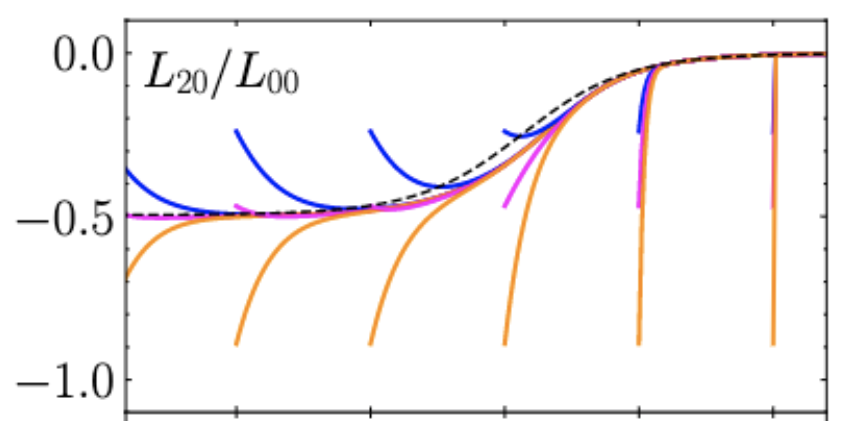
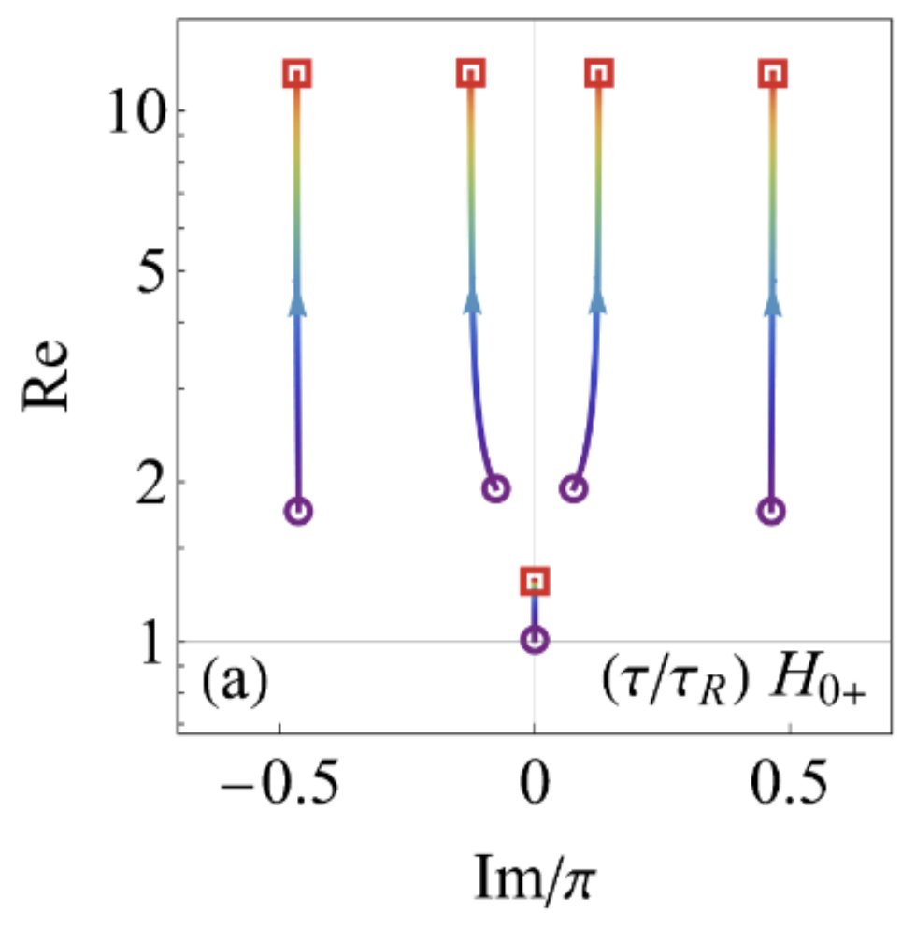
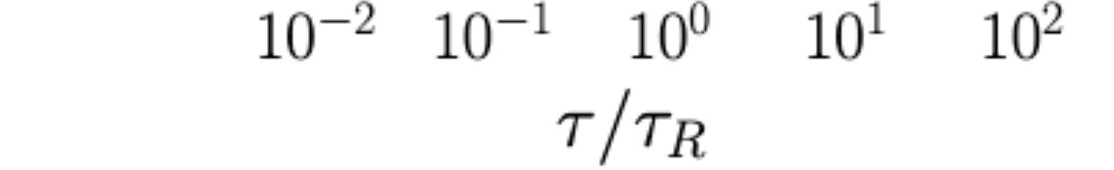
  Ground state: far-from-equilibrium slow mode
  Initial conditions decay to ground state on time scale set by energy gap
JB, Yan, Yin [1910.00021]
  Momentum-space anisotropy may evolve slowly far-from-equilibrium
JB, Ke, Yan, Yin; upcoming
Notes:
Unfortunately, the interpretation of jet modification observables often depends crucially on which proton-proton jets are taken to be a comparable baseline for a given heavy-ion measurement. In di-jet and inclusive jet studies, the standard answer is to compare heavy-ion jets to a proton-proton baseline with the same reconstructed pT. For example, comparing the jet production spectra for p-p and HI at the same reconstructed pT (as illustrated by the blue arrows) gives rise to the famous jet RAA.

Slide 6
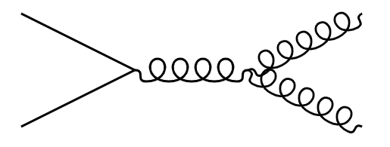
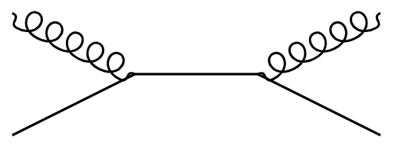
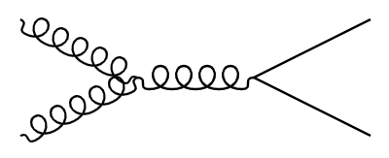
  Jets as a probe of the quark-gluon plasma
  hadrons
  Probes
  momentum-dependence of interactions
  Spatial location of splittings
  Decreasing momentum
  Building a picture of a medium-modified jet from phenomenology
  hadrons
  hadrons
Notes:
Unfortunately, the interpretation of jet modification observables often depends crucially on which proton-proton jets are taken to be a comparable baseline for a given heavy-ion measurement. In di-jet and inclusive jet studies, the standard answer is to compare heavy-ion jets to a proton-proton baseline with the same reconstructed pT. For example, comparing the jet production spectra for p-p and HI at the same reconstructed pT (as illustrated by the blue arrows) gives rise to the famous jet RAA.

Slide 7
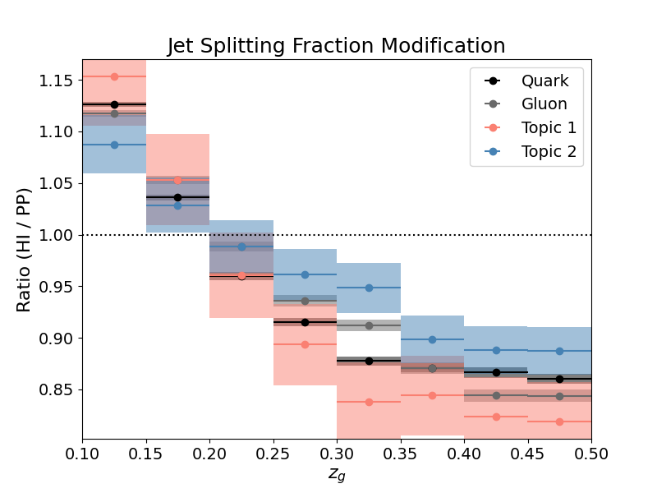
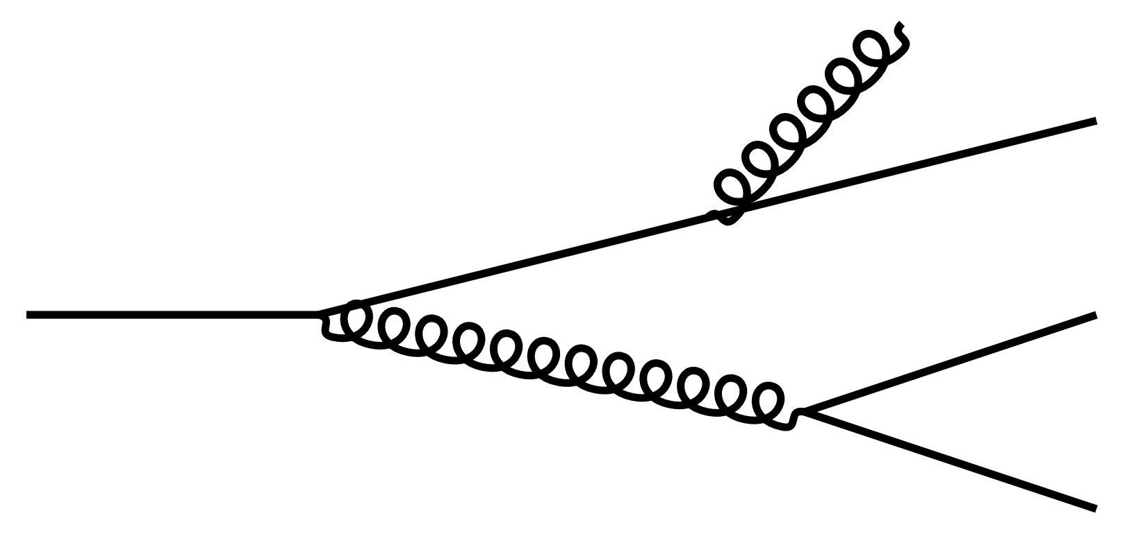
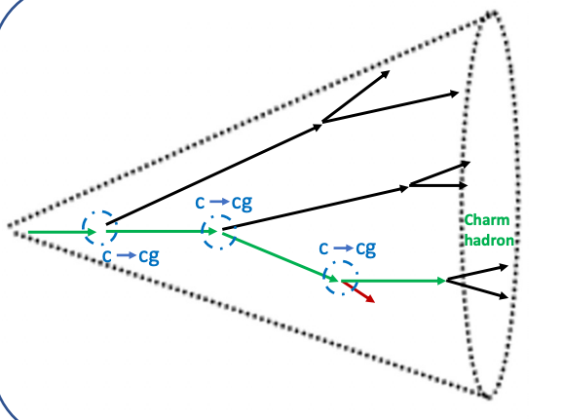
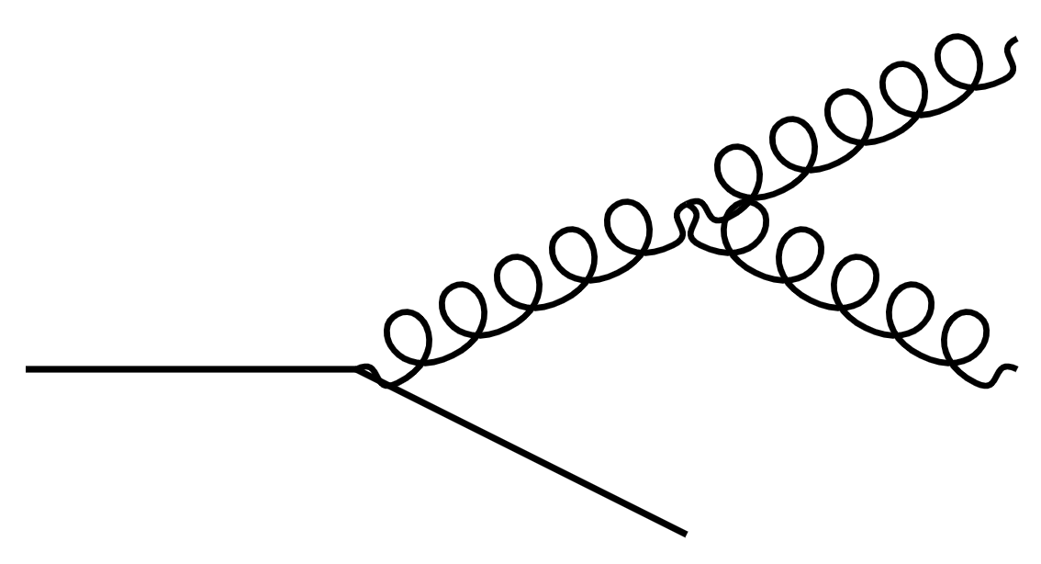




  Accessing parton flavor of QCD splittings
  Modified q,g splitting functions
  Modification of jets initiated by a quark or gluon
  Data-driven quark, gluon
  “gluon jet”
  “quark jet”
JB, Jesse Thaler, Andrew Patrick Turner [2008.08596]; Ying, JB, Chen, Lee [2204.00641]
  Monte Carlo quark, gluon
  Modification of later splittings in the shower: heavy quarks
$$c$$
$$c$$
$$\overline{c}$$
$$c$$
Notes:
Unfortunately, the interpretation of jet modification observables often depends crucially on which proton-proton jets are taken to be a comparable baseline for a given heavy-ion measurement. In di-jet and inclusive jet studies, the standard answer is to compare heavy-ion jets to a proton-proton baseline with the same reconstructed pT. For example, comparing the jet production spectra for p-p and HI at the same reconstructed pT (as illustrated by the blue arrows) gives rise to the famous jet RAA.

Slide 8
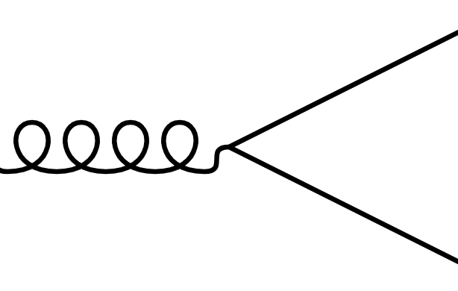


  Modification of the $g→c\overline{c}$splitting function
  Arbitrarily-many soft gluon interactions with a medium of length L
  Results of the calculation:
  Medium-enhanced rate of $c\overline{c}$ production!
  gluons promoted above threshold
Attems, JB, Innocenti, Mazeliauskas, Park, van der Schee, Wiedemann [2203.11241, 2209.13600]
Notes:
Unfortunately, the interpretation of jet modification observables often depends crucially on which proton-proton jets are taken to be a comparable baseline for a given heavy-ion measurement. In di-jet and inclusive jet studies, the standard answer is to compare heavy-ion jets to a proton-proton baseline with the same reconstructed pT. For example, comparing the jet production spectra for p-p and HI at the same reconstructed pT (as illustrated by the blue arrows) gives rise to the famous jet RAA.

Slide 9
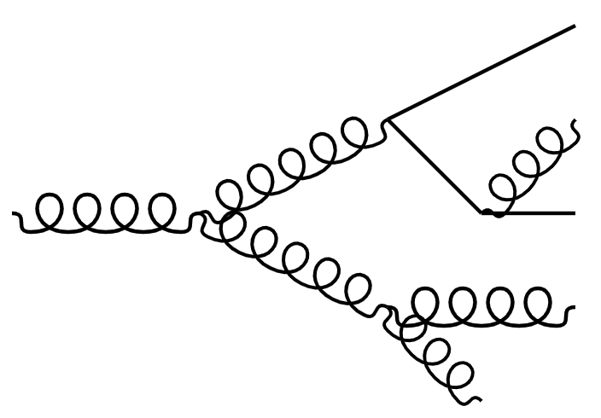




  Unique phenomenology of the modified $g→c\overline{c}$ splitting
  Momentum transfer-dependence of medium interactions
$$\overline{c}$$
  Broadening of splittee momenta due to medium interactions
$$g$$
  …Including at lower scales in the shower
$$c$$
  Spatial location of QCD splittings
  Gluons have a “lifetime” proportional to their energy/virtuality
  Access modification of $c\overline{c}$ pair at later times in the QGP
  $∼1−6 fm$ delay for $20−100 GeV$ gluons
  time
  time
  time
  Increasing gluon energy
Another time-delayed probe: Apolinario, Milhano, Salam, Salgado [1711.03105]
Notes:
Unfortunately, the interpretation of jet modification observables often depends crucially on which proton-proton jets are taken to be a comparable baseline for a given heavy-ion measurement. In di-jet and inclusive jet studies, the standard answer is to compare heavy-ion jets to a proton-proton baseline with the same reconstructed pT. For example, comparing the jet production spectra for p-p and HI at the same reconstructed pT (as illustrated by the blue arrows) gives rise to the famous jet RAA.

Slide 10
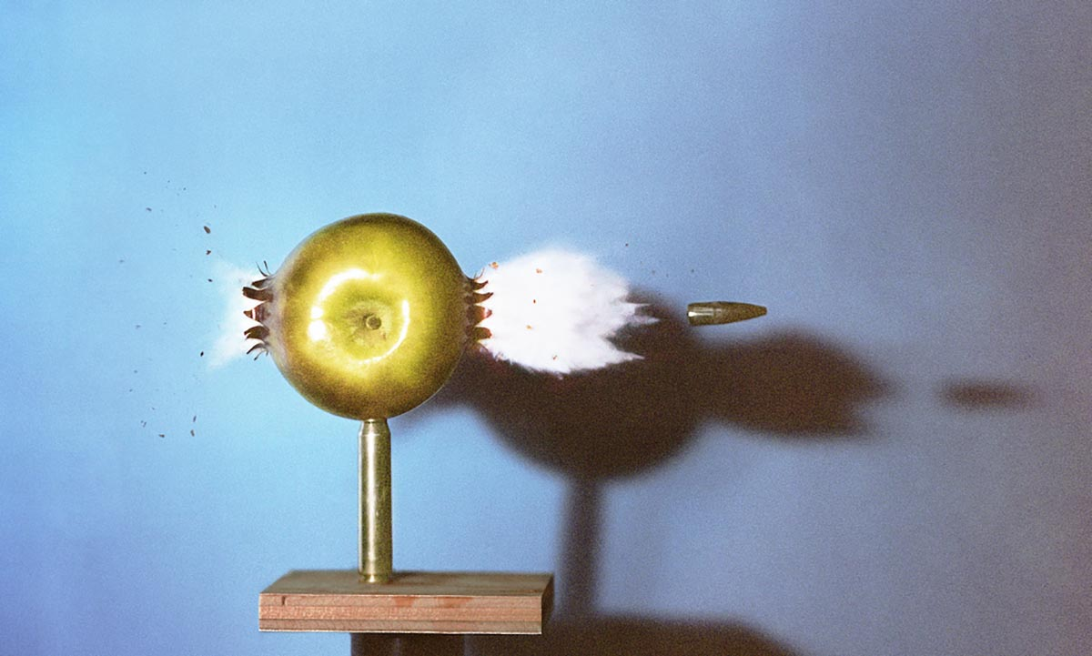
  Outlook
  Medium modification of all QCD splittings from phenomenology
  hadrons
  Intersection of jets and equilibration
  Jet features are sensitive to response of the medium
  Observables to disentangle this: Brewer, Brodsky, Rajagopal [2110.13159]
  Access to non-equilibrium effects in the medium
Notes:
Unfortunately, the interpretation of jet modification observables often depends crucially on which proton-proton jets are taken to be a comparable baseline for a given heavy-ion measurement. In di-jet and inclusive jet studies, the standard answer is to compare heavy-ion jets to a proton-proton baseline with the same reconstructed pT. For example, comparing the jet production spectra for p-p and HI at the same reconstructed pT (as illustrated by the blue arrows) gives rise to the famous jet RAA.

