Slide 1
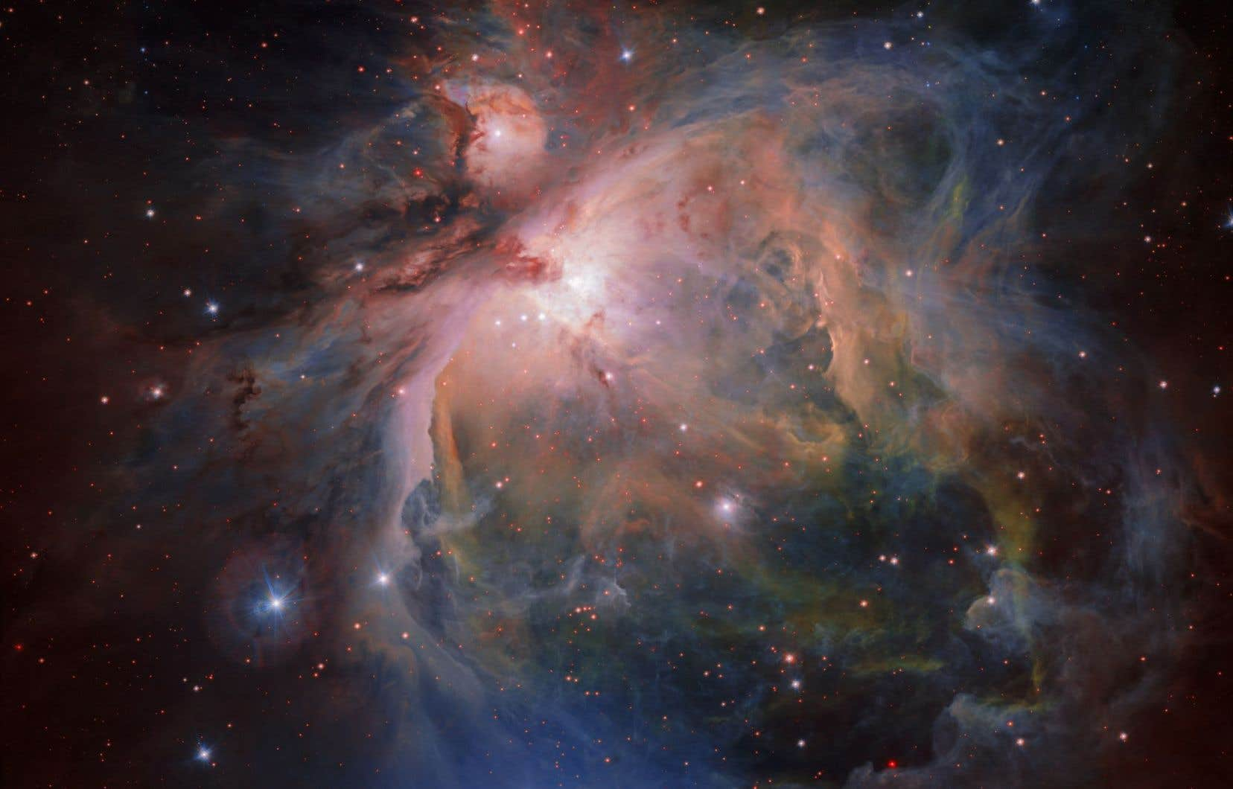
The Importance of Financial and Technical Support for the Improvement of Cosmology in Cameroon and Africa
Presented by
Ragil NDONGMO,
PhD Student in Physics,
University of Yaoundé 1, Cameroon
Science popularizer,
Member of Astro&Cosmo WG, ASFAP

Slide 2
Table of contents
I- Overview of Cameroonian Team
II- Issues we face
III- Outlooks

Slide 3
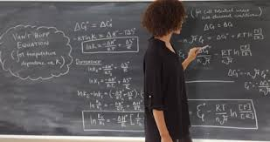
I- Overview of Cameroonian and African Team
In Cameroon only five physicist cosmologists over a thousand researchers in Physics
3 at the University of Maroua
1 at the University of Dschang,
1 at the University of Yaoundé I
2 researchers who support us

Slide 4
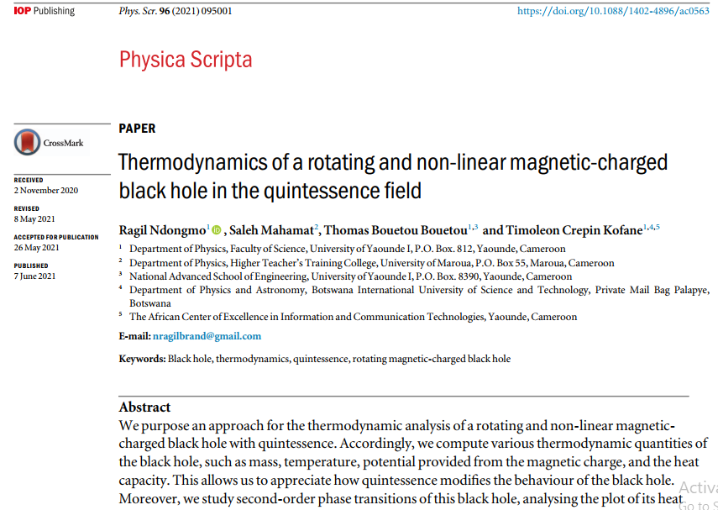
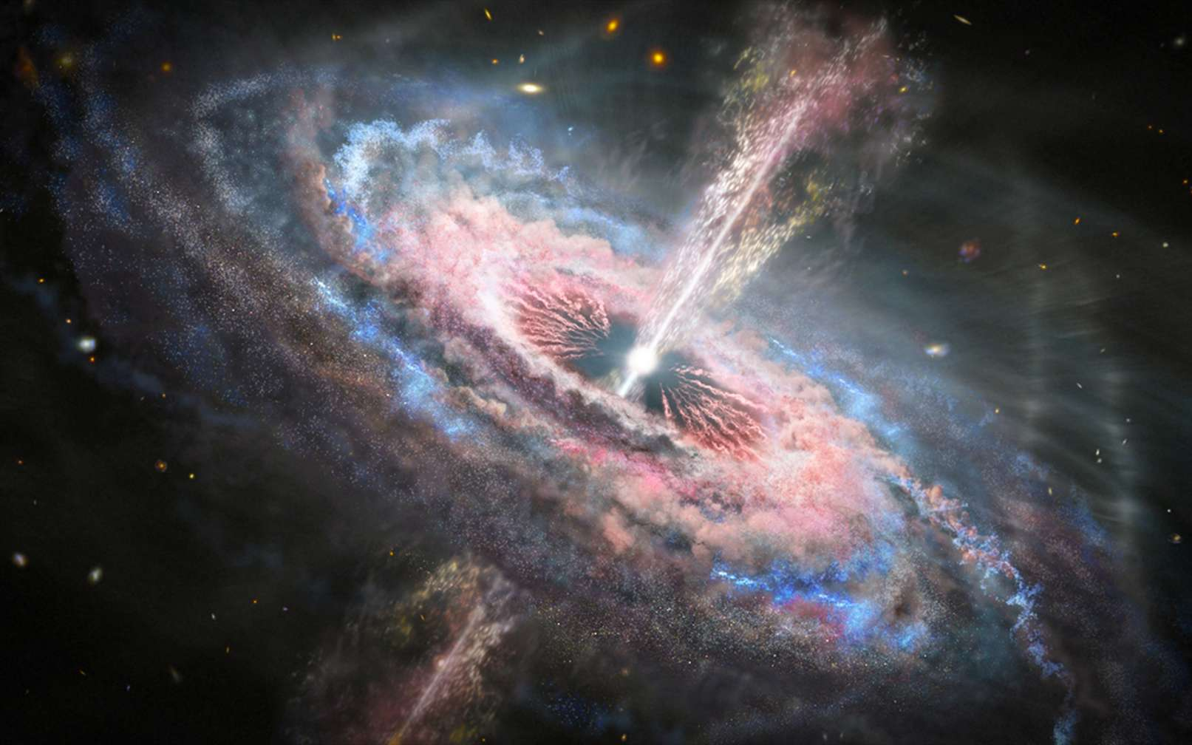
I- Overview of Cameroonian and African Team
Papers

Slide 5
II- Issues we face

Slide 6


II- Issues we face
Lack of financial and technical support
No national grant,
No support from the international community
No internet conexion, room
Lack of education in Cosmology
No academic courses at universities
No Master/PhD program, even workshops
No Laboratory(We are on Mechanic laboratory)

Slide 7
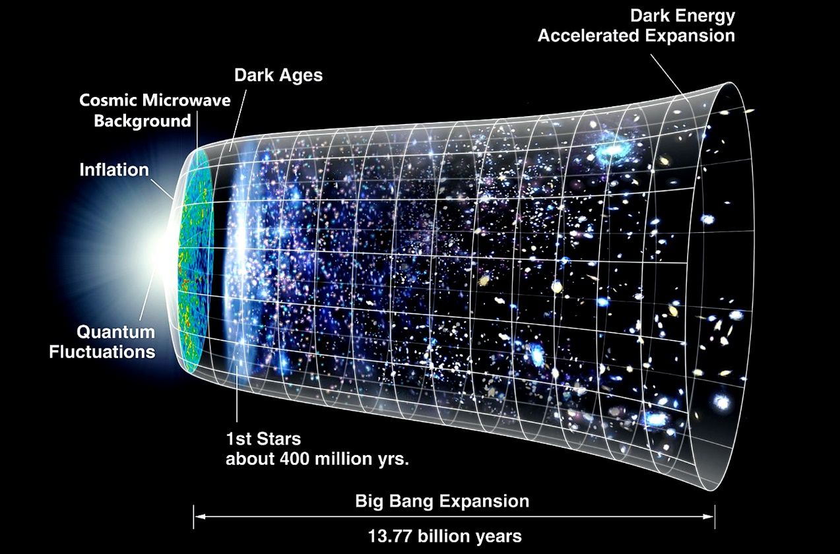
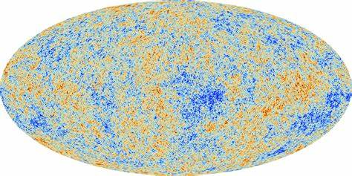
II- Issues we face
Hence the question:
How to be competitive behind the rest of the world?(North/South Africa, America,, Asia… )
Dark matter
Dark energy
String theory
Inflation
Cosmic Microwave background

Slide 8
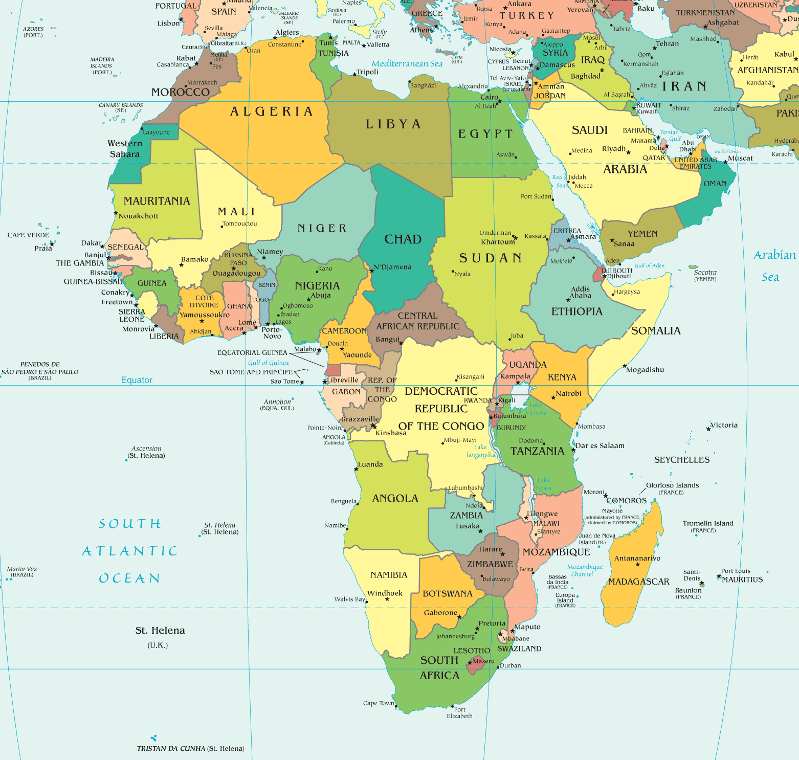
Many students want, but no one does
II- Issues we face
This happen in several countries in Africa

Slide 9
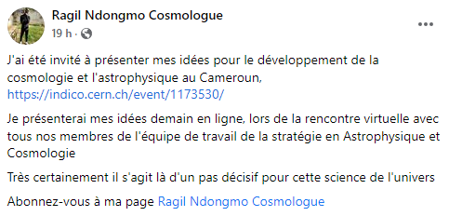
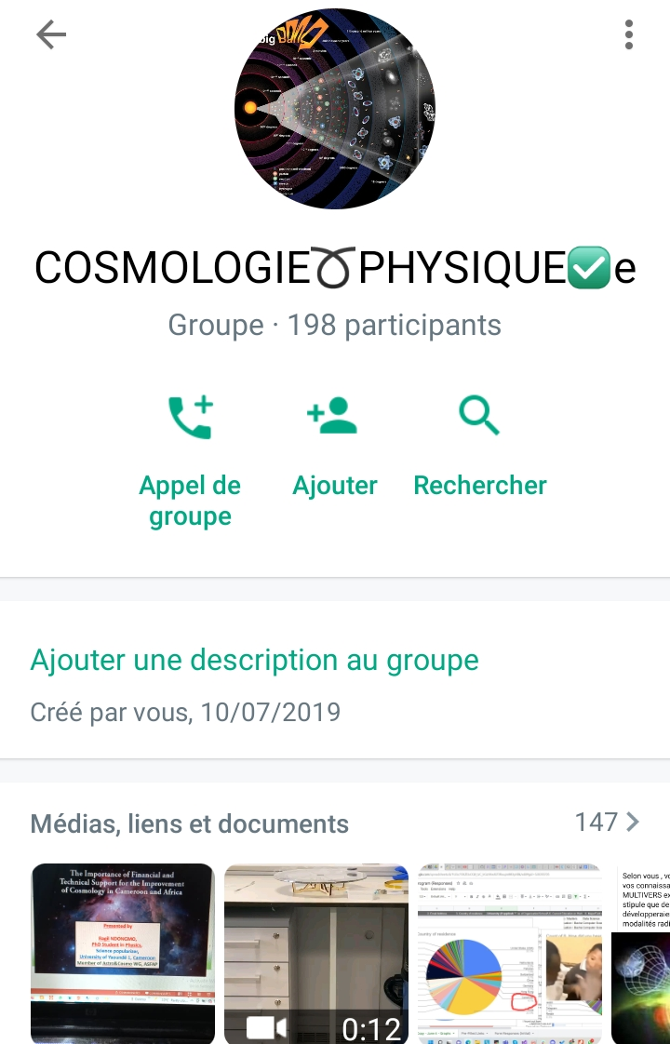
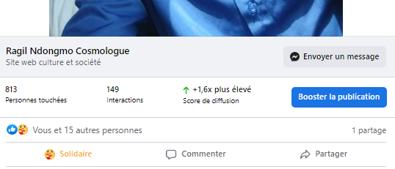
Many students want, but no one does
II- Issues we face
Huge human resources!!!

Slide 10

II- Outlooks
How to manage in order to engage more students in the field?
How to manage in order to have financial and technical support in the future?
Do we have a possibility to develop a strong scientific culture from secondary school?

Slide 11
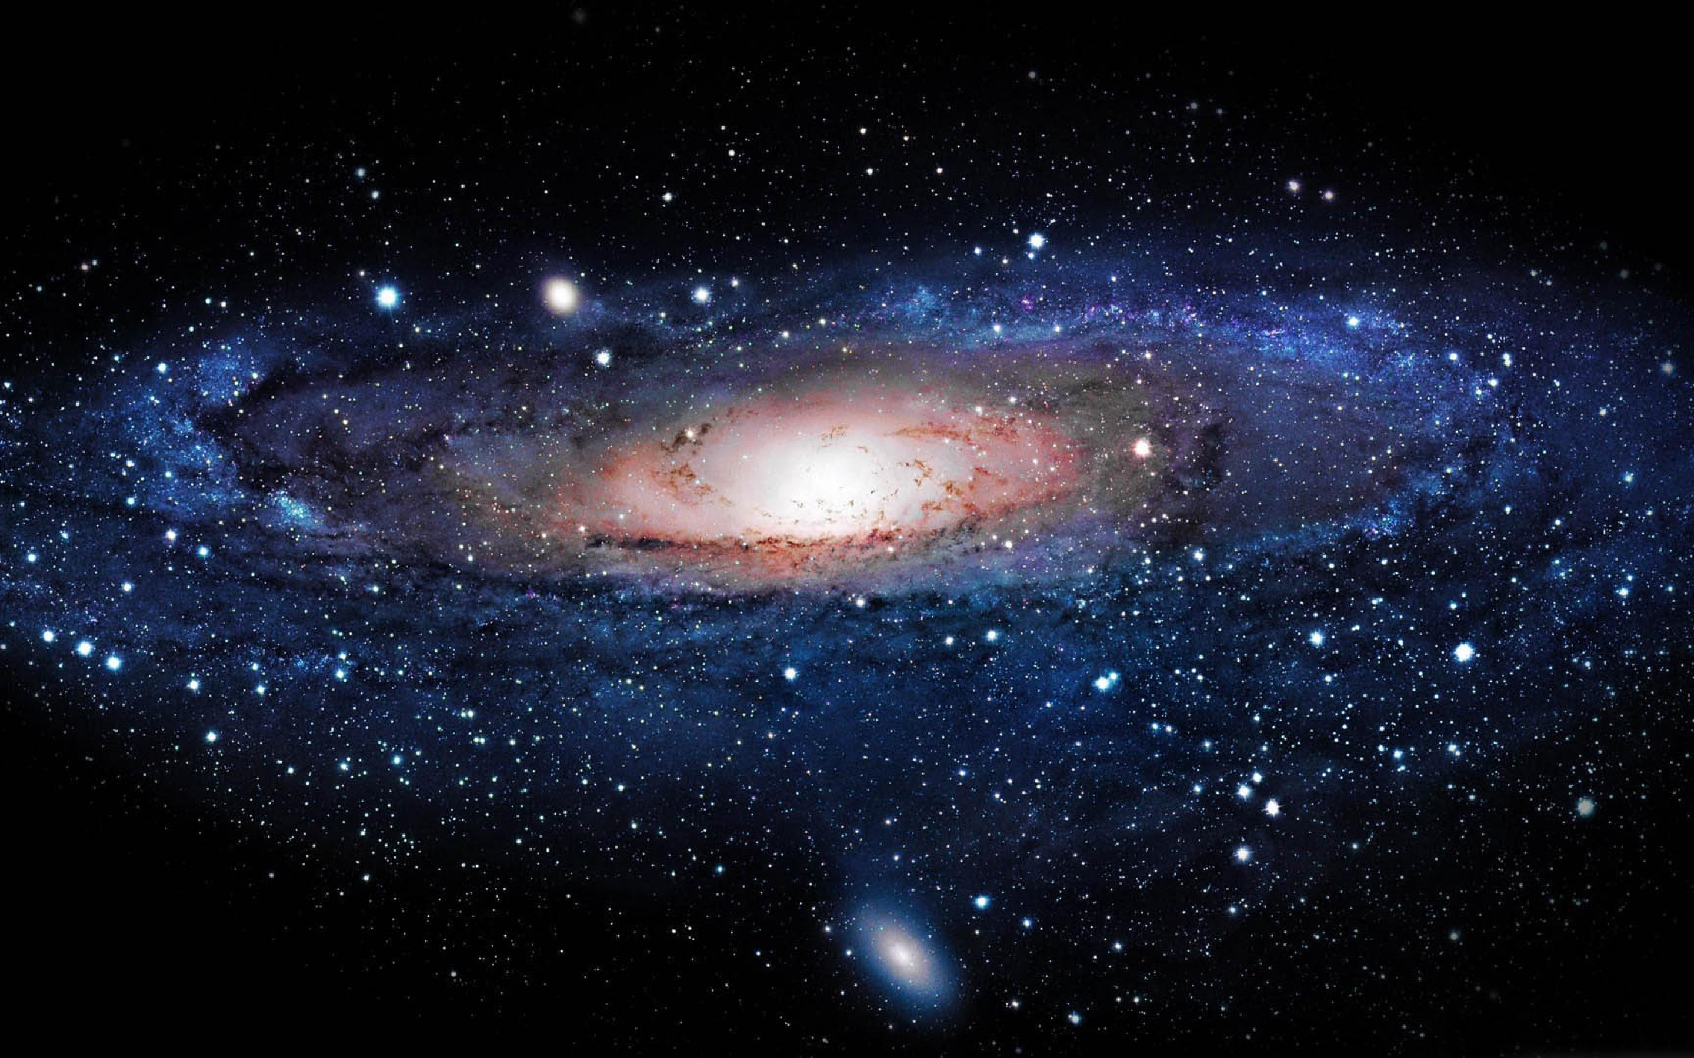
THANK YOU FOR YOUR KIND ATTENTION
THANK YOU FOR YOUR KIND ATTENTION

