Slide 1

Cell Mechanobiology Research for Health Development in Africa
29/06/2022
Kayode A. DADA*; Fatai A. BALOGUN
(*kayodeayodejidada@yahoo.com)
Centre for Energy Research and Development, Obafemi Awolowo University, Ile-Ife, Nigeria

Slide 2
Motivation
The intrinsic properties of a cell is guided by how it interacts with its neighbours and environment.
The effect of the interaction is felt at the tissue and organism level.
The interaction involve generation, sensing and transmission of mechanical forces.
Conventional methods of diseases/illness diagnosis and progression are conventionally through biochemical principles.

Slide 3
Basic principles in mechanobiology
Cell mechanobiology is a field of study that combines efforts from materials science, mechanics, cell and molecular biology.
Mechanobiology can be described as an interdisciplinary field that involve the study of physical forces and how they affect cell mechanics.
It helps in understanding the role of mechanical forces in the well-being of a cell as it interacts with its neighbours and environment

Slide 4
Facilities
TECHNIQUE | FORCES | MAIN APPLICATIONS | MERITS | DEMERITS
Atomic force microscopy | Compressive and tensile forces (pN and mN range) | Molecular, cellular and tissue stiffness measurements, protein unfolding, cell adhesion measurements, stress application to biological samples, surface scanning | High spatial and temporal resolution, combination with other techniques, working range over several scales | Restricted to surfaces, not high throughput
Optical stretcher | Tensile forces (pN range) | Cell deformation assays | High throughput, contact-free | Limited spatial resolution and force, heating of samples
Optical tweezers | Tensile, compressive, shear forces (pN range) | Stress application to cells and molecules | High temporal and spatial resolution | Limited force, often μm-sized beads have to be attached to the sample, heating of samples

Slide 5
TECHNIQUE | FORCES | MAIN APPLICATIONS | MERITS | DEMERITS
Cell poking | Compressive forces (nN- μN range) | Cell stiffness measurements | Easy to set up | Restricted to surfaces, limited force and spatial resolution
Magnetic bead twisting | Shear forces (pN- nN range) | Cell rheology, stress application to cell surface receptors | High throughput, good force resolution | Restricted to surfaces, binding may cause secondary effects
Magnetic tweezers | Tensile forces (pN- nN range) | Cell stiffness measurements | Easy to set up | Requires magnetic beads to be taken up by or bound to cells
Micropipette aspiration | Tensile forces (tens of pN–μN range) | Cell stiffness, membrane tension measurements | Easy to set up | Limited spatial and force resolution
Microrheology | Passive method (no forces actively applied) | Cell rheology | Easy to set up, high throughput, in vivo measurements possible | Position of the particles difficult to control

Slide 6
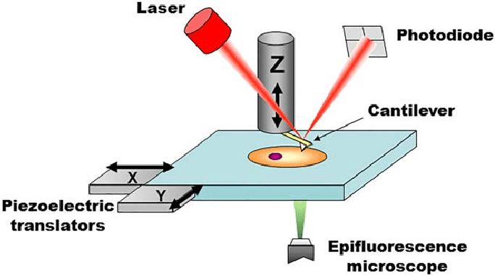
Atomic force microscope
Easy to use
Simple or no sample preparation
Can be operated in any medium.
Require lesser time when compared to conventional biochemical techniques.
Cost: $150 – 200 k

Slide 7
Institutions with Mechanobiology +++
University of Cape Town: http://www.mechanobiology.uct.ac.za/
Department of Biomedical Engineering, University of Medical Sciences and Technology (UMST)
University of Pretoria (Department of Physiology; Microscopy and microanalysis laboratory; Physics#)
iThemba Labs (Materials Science division#)
University of Witwatersrand (Microscopy and Microanalysis Unit#)
Stellenbosch University: Chemistry#

Slide 8
Major health issues of interest
Malaria
Wound healing
Cancer
Sickle cell
Diabetes
UD = undetected
International diabetes
federation
Case | World Stat WS (X10⁶) |  | Africa (% of WS) |  | Year | Source
 |  |  | Incidents | Fatality
 | Incidents | Fatality
Malaria | 241 | 0.627 | 95 | 96 | 2020 | W.H.O
Cancer | ~ 19.292 | ~9.958 | 5.75 | 7.144 | 2020 | GLOBOCAN
Diabetes | 537 | 6.7 | 4.47 (54% UD) | 6.21 | 2021 | IDF

Slide 9
Present obstacles facing Mechanobiology in Africa
Inadequate research facilities for exploration of the field of study.
Very minimal research scientists within Africa venture into mechanobiology.
Funding for the available scientist to carryout novel study in mechanobiology is very low in many African countries and in others, funding is not available.
A handful of postgraduate education is geared towards mechanobiology.
Clinical obstacles usually arise during clinical research in mechanobiology in many parts of Africa.

Slide 10
Support for Cell Mechanobiology in Africa …
Governments are encouraged to make adequate funding available for procurements of facilities that can be used to carry out novel studies in mechanobiology. Funding should also be provided for the researchers as incentives. Such facilities can also be used to carried out clinical trials for such novel studies.
Mechanobiology should be incorporated into present basic medical graduate studies. Government should support the collaboration with research scientists outside Africa. Such collaboration should be geared towards encouraging students and indigenous scientists to take up researches in mechanobiology for application in the health sector.

Slide 11
… support for Cell Mechanobiology in Africa
The barriers in clinical research should be reduced. Government should make policies that will make it easy for scientist in mechanobiology to have access to clinical specimens that will help in improving the transfer of scientific results into clinical applications.
Adequate support for mechanobiology field of study will help to provide basic information on the (a) efficacy of locally produced sickle cell anaemia drugs; (b) metastatic nature of common cancers types in Africa; (c) procedures for fast wound healing; (d) nature of the erythrocyte of HIV/AIDS, diabetic and malaria patients.
Active collaborations should be in place among various institutions and/or research centres.

Slide 12
References
Jansen K.A., Donato D.M., et al. (2015). doi: 10.1016/j.bbamcr.2015.05.007.
Ladoux B. and Mege R-C. (2017). doi:10.1038/nrm.2017.98
Mohammed D., Versaevel M., et al. (2019). doi: 10.3389/fbioe.2019.00162
Wang J.H.-C and Thampatty B.P. (2006). doi: 10.1007/s10237-005-0012-z
https://gco.iarc.fr/today/data/factsheets/populations/900-world-fact-sheets.pdf
https://gco.iarc.fr/today/data/factsheets/populations/903-africa-fact-sheets.pdf
https://www.idf.org/our-network/regions-members/africa/diabetes-in-africa.html
https://diabetesatlas.org/

Slide 13
Thank you for your attention

