Slide 1
Determining Trends in Silicon Module Production
Anne Graf
NC State University/CMS Experiment

Slide 2
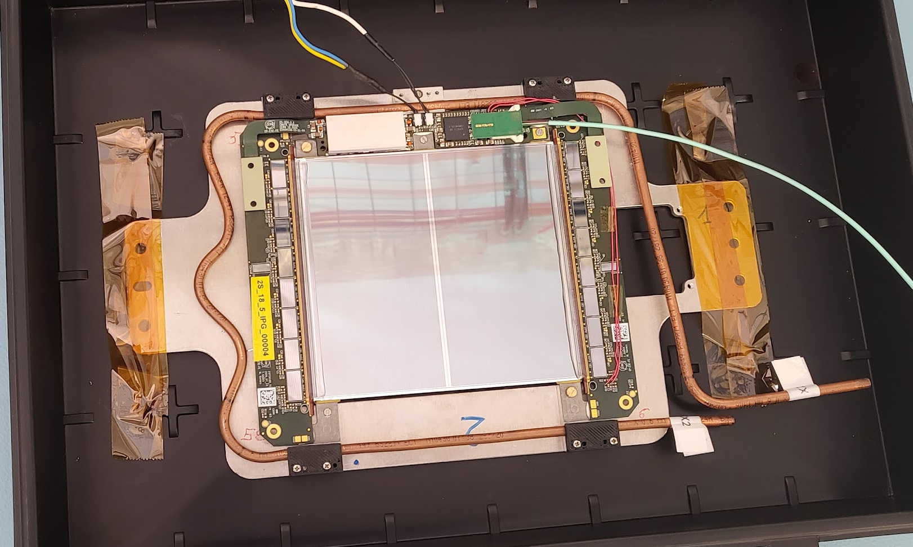
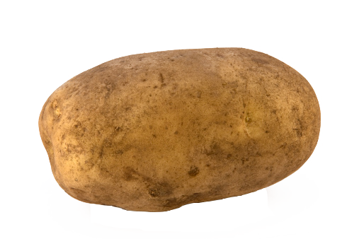
Experiment
Compact Muon Solenoid (CMS)
  Detector on the Large Hadron Collider (LHC)
Working with Lesya Horyn & Stefano Mersi
Specifically, I am working with the silicon modules of the upgrade of the tracker
4”
  Writing a code that show trends in usable silicon modules
  Integrated with Phase 2 Outer Tracker Analyzer of Test Outputs
  Or: POTATO

Slide 3
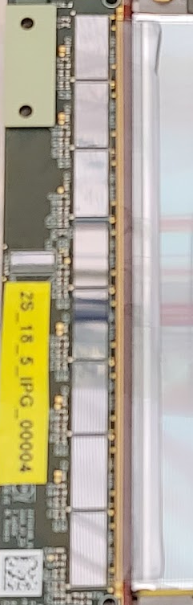
Why?
Silicon modules detect charged particles from interactions, and sends that data
The upgrade will generate a lot more data (like 20x as much)
We need to figure out which data is interesting so that valuable offline space is not taken up with uninteresting interactions
New silicon modules have been designed that can detect interactions faster & send that data to the trigger
To do this, the silicon modules need to be working to incredible precision
Charged particles hit on this panel
The signal is sent through one of the 1024x4 tiny wires to the Asic chips
From there, the data is sent to the main computers

Slide 4
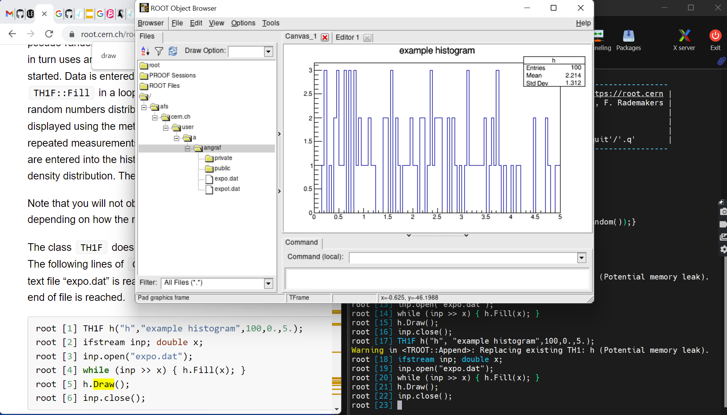
What I’m Doing
POTATO already exists
  POTATO determines whether a silicon module is working or defective
I need to write an additional program
  that reads data files of silicon module output, extracts and collates particular interesting pieces of data, and creates histograms, to visualize issues with the silicon modules
  This can show patterns in the modules to determine trends in the production of the modules like
    Different locations producing different levels of quality
    If the modules are improving or worsening with time
This program will be integrated with POTATO and used in the testing of the silicon modules before they are put into the new and improved tracker

Slide 5
Accomplishment(s)?
Becoming familiar with Root
Becoming competent at Root
Creating GUIs for the first time
Creating a working GUI to interface with POTATO

Slide 6
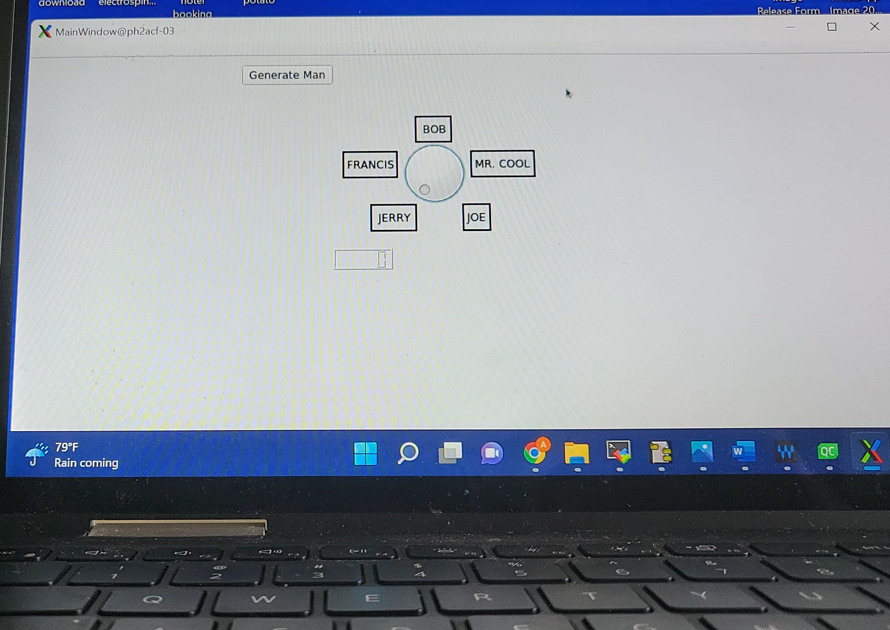
Accomplishment(s)?
Becoming familiar with Root
Becoming competent at Root
✔
✔
Creating GUIs for the first time
Creating a working GUI to interface with POTATO
Using C++ a lot more
Creating a final, working code to be used in the future LHC upgrade
Maybe learn a little French

Slide 7
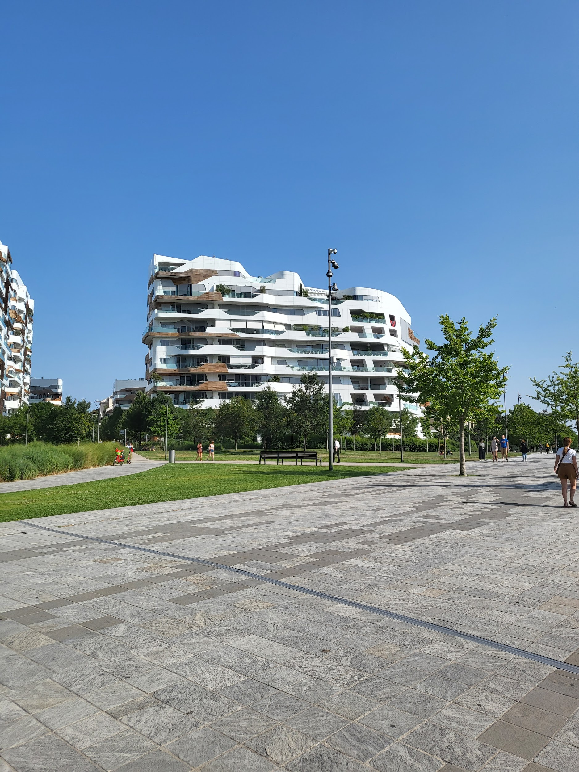
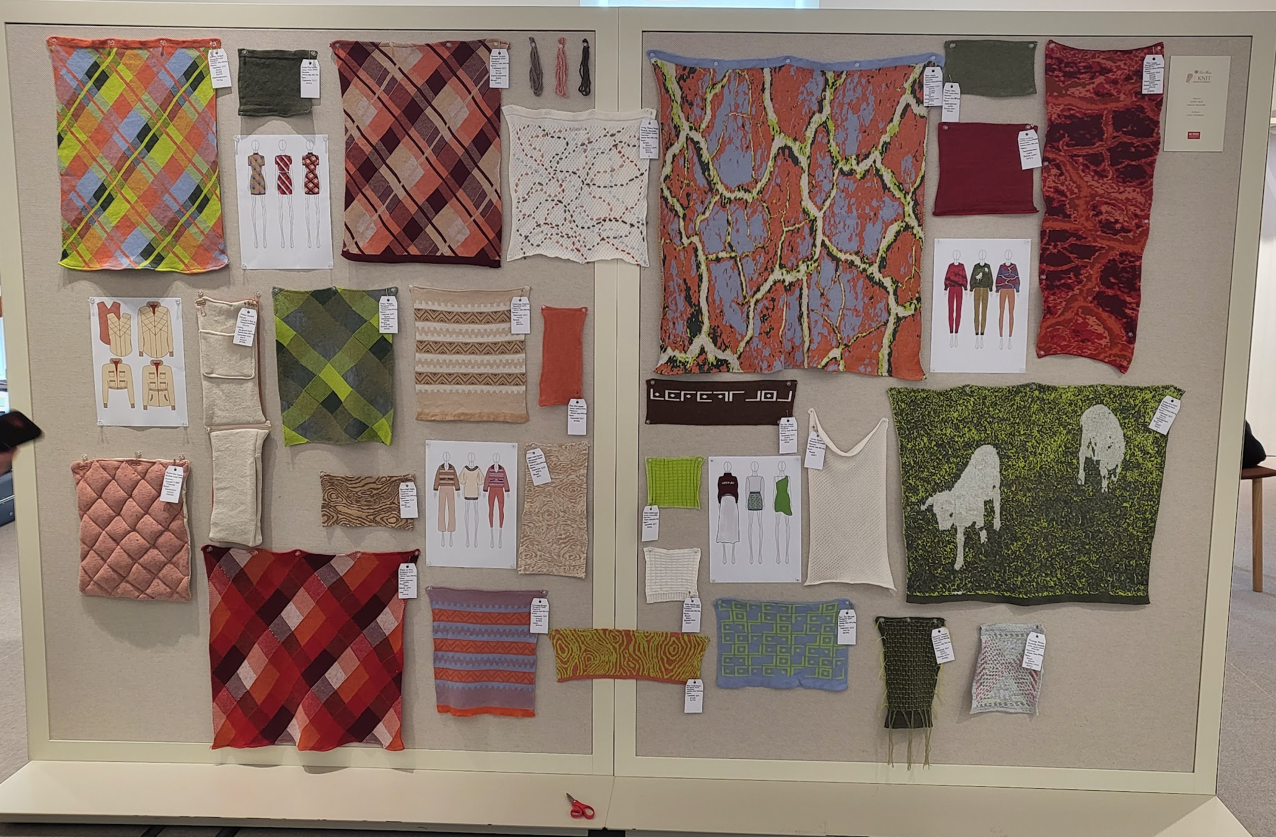

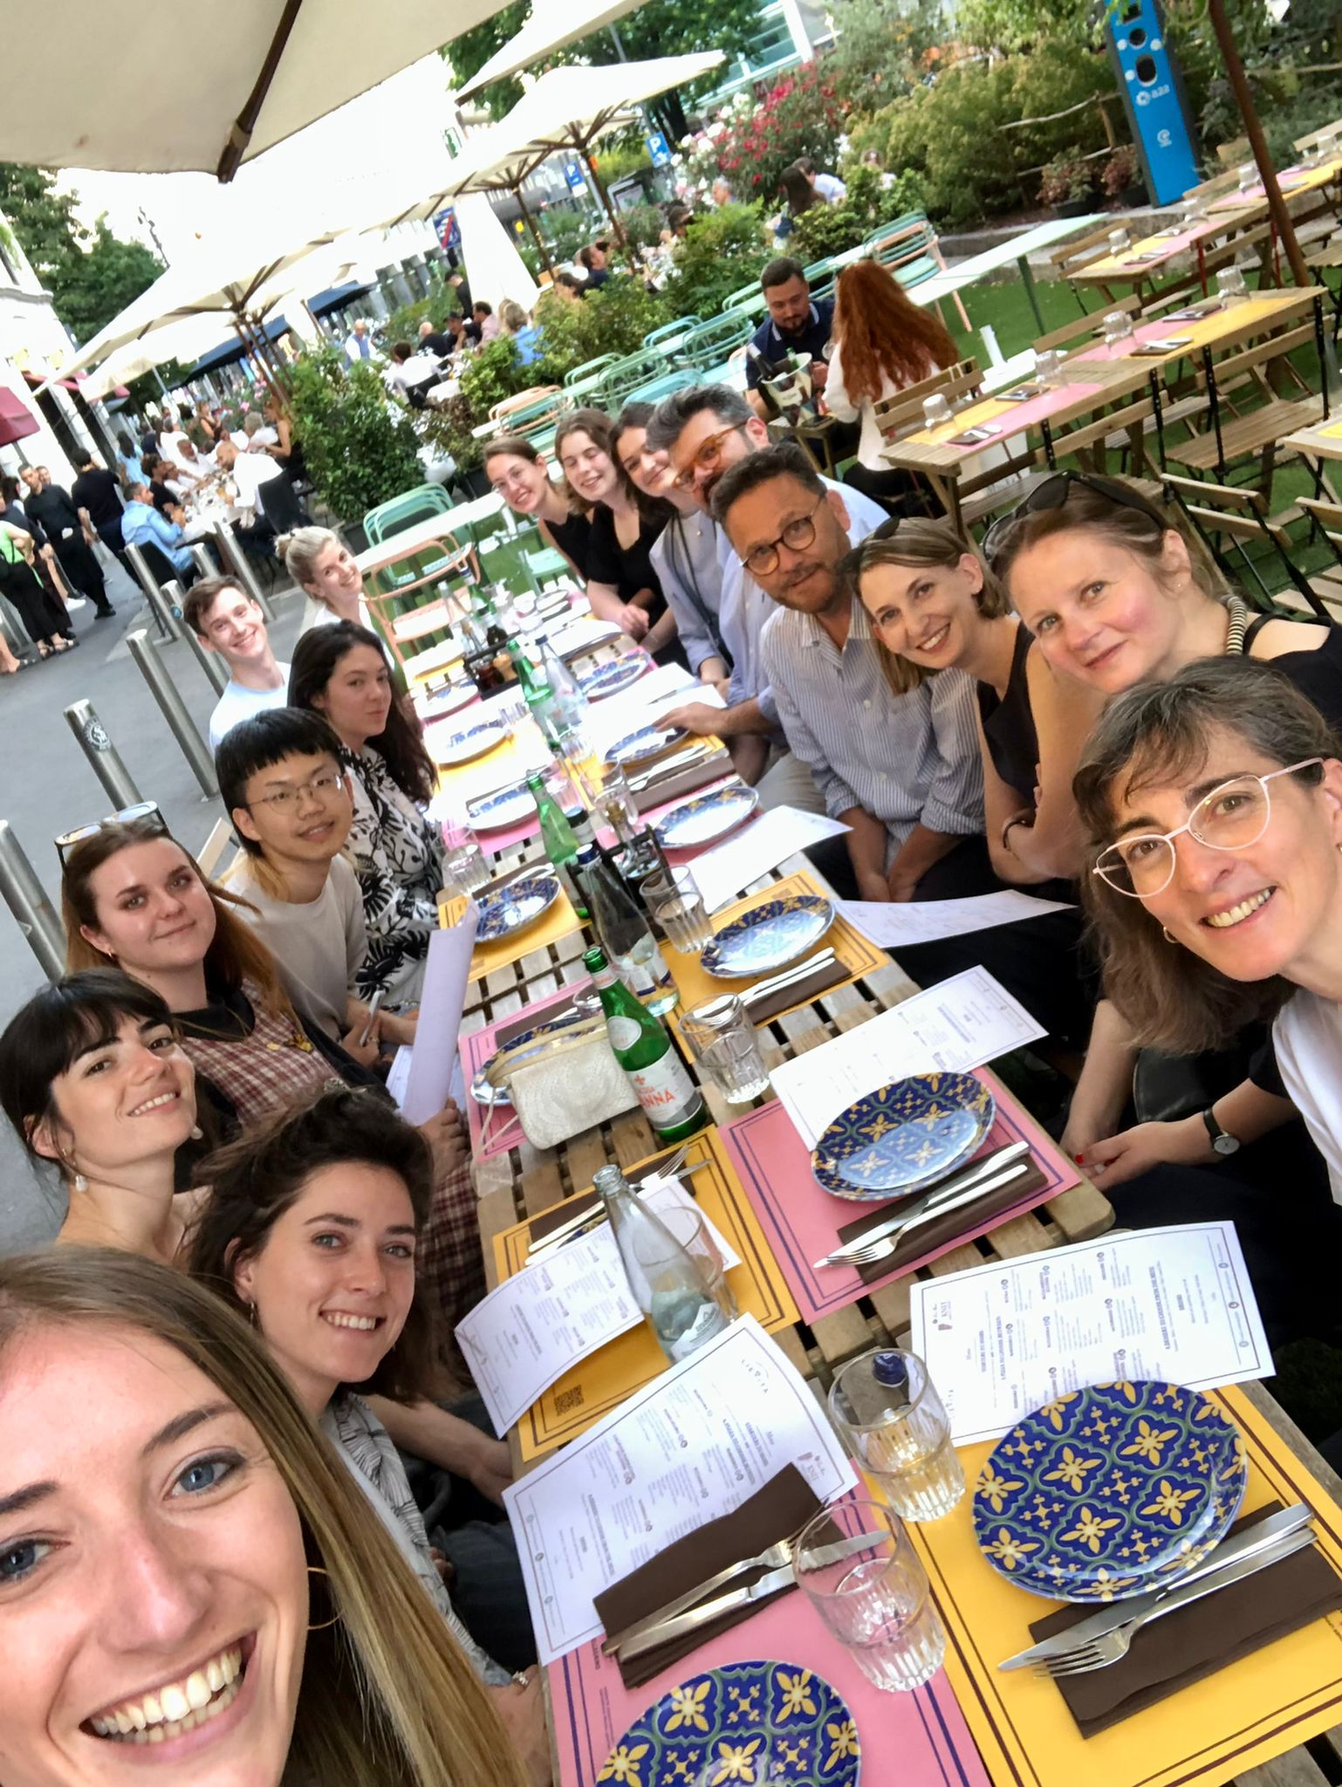

My Weekend

