Slide 1

Towards a New Lepton Flavor Universality Test with Baryons
Presenter: Sebastian Rocks
Supervisors: Dr.ssa Anna Lupato, Prof. Gabriele Simi, & Dr. Marcello Rotondo

Slide 2
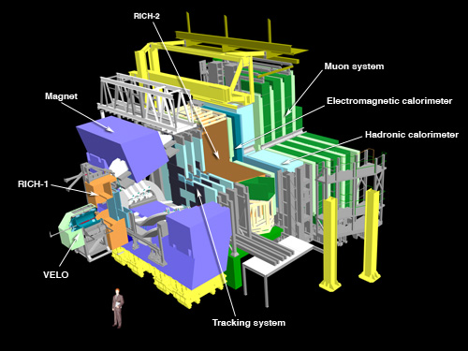
Experiment I Am Working On
LHCb
Specializes in examining differences between matter and antimatter by studying the beauty/b quark [1].
Made up of a forward spectrometer and planar detectors [1].
21 meters long, 10 meters high and 13 metres wide, and sits 100 meters below ground near Ferney-Voltaire, France [1].
About 1565 scientists, engineers and technicians from 20 countries come together to work at the LHCb [1].

Slide 3
Supervisors
Dr.ssa Anna Lupato
  Postdoctoral research associate at the University of Manchester in Manchester England
  Scientist with over 7 years of experience in data analysis collected by the LHCb
  Convener for an analysis group
  Responsible for group of a python-based software project dedicated to filtering LHCb data before it’s accessible to analysts
  Over 450 research works
Professor Gabriele Simi
  Associate Professor at the University of Padova at Padua, Italy
  Aided in development of radiation detectors, data analysis for BaBar, and future experiment design
  Taught Physics courses for environmental and civil engineering
  Was a research associate at the University of Maryland, College Park as well as the Stanford Linear Accelerator Center
  Over 1300 research works
Dr. Marcello Rotondo
  Researcher with over 16 years of experience at the Istituto Nazionale di Fisica Nucleare (research society for nuclear, particle and astroparticle physics based in Rome, Italy)
  Obtained PhD in Physics at University of Padova, Italy
  Over 1300 research works

Slide 4
A Taste of Lepton Flavor Universality
Postulate: The coupling of charged leptons to all types of gauge bosons are flavor-independent: the interaction between leptons and a gauge boson measures the same for each lepton [2].
Consequences
  In decays of b hadrons, the electrons and muons should be produced at similar rates and that the small difference due to the lepton masses is calculable [2].
  LHCb found deviations in these predictions by comparing specific rates of decays which I will also be exploring this summer [2].

Slide 5
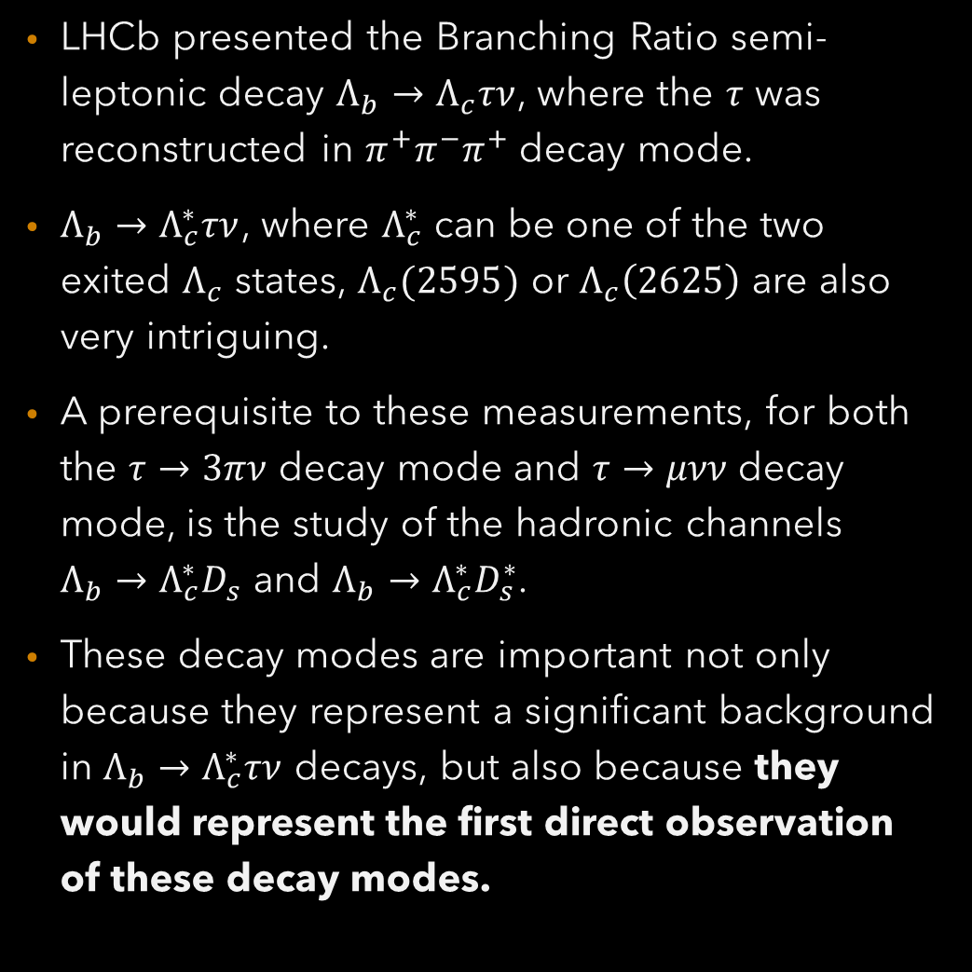
A New Test
LHCb presented the Branching Ratio semi-leptonic decay $Λ_{b}→Λ_{c}τν$, where the $τ$ was reconstructed in $π^{+}π^{−}π^{+}$ decay mode.
$Λ_{b}→Λ_{c}^{∗}τν$, where $Λ_{c}^{∗}$ can be one of the two exited $Λ_{c}$ states, $Λ_{c}(2595)$ or $Λ_{c}\left(2625\right)$ are also very intriguing.
A prerequisite to these measurements, for both the $τ→3πν$ decay mode and $τ→μνν$ decay mode, is the study of the hadronic channels $Λ_{b}→Λ_{c}^{∗}D_{s}$ and $Λ_{b}→Λ_{c}^{∗}D_{s}^{∗}$.
These decay modes are important not only because they represent a significant background in $Λ_{b}→Λ_{c}^{∗}τν$ decays, but also because they would represent the first direct observation of these decay modes.

Slide 6
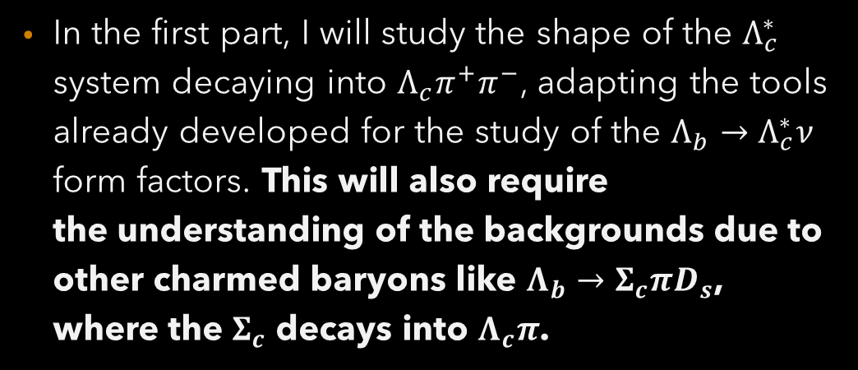
My Job: Part I
In the first part, I will study the shape of the $Λ_{c}^{∗}$ system decaying into $Λ_{c}π^{+}π^{−}$, adapting the tools already developed for the study of the $Λ_{b}→Λ_{c}^{∗}ν$ form factors. This will also require the understanding of the backgrounds due to other charmed baryons like $Λ_{b}→Σ_{c}πD_{s}$, where the $Σ_{c}$ decays into $Λ_{c}π$.

Slide 7

My Job: Part II
In the second part, I will develop a $Λ_{b}→Λ_{c}^{∗}D_{s}^{∗}$ selection and I will develop a simultaneous fit to the $Λ_{b}$ mass and the $Δm$ where the $D_{s}$ decays into 3 pions.

Slide 8
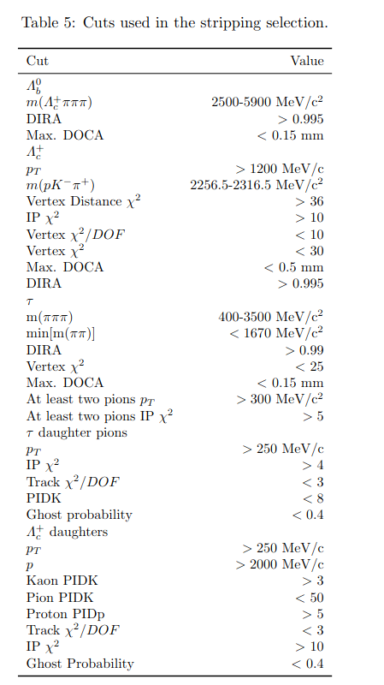
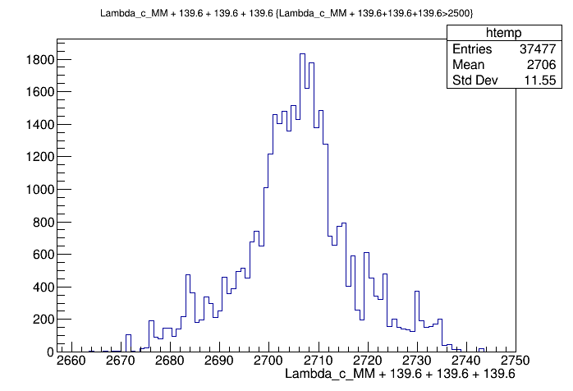
Obtaining Bearings
Confirmation that $2500≤m\left(Λ_{c}^{+}πππ\right)≤5900 MeV/c^{2}$
Confirmed other variables given in the list
Completed a summary of a thesis
Practice generating distributions and other plots; overall practice with ROOT.

Slide 9
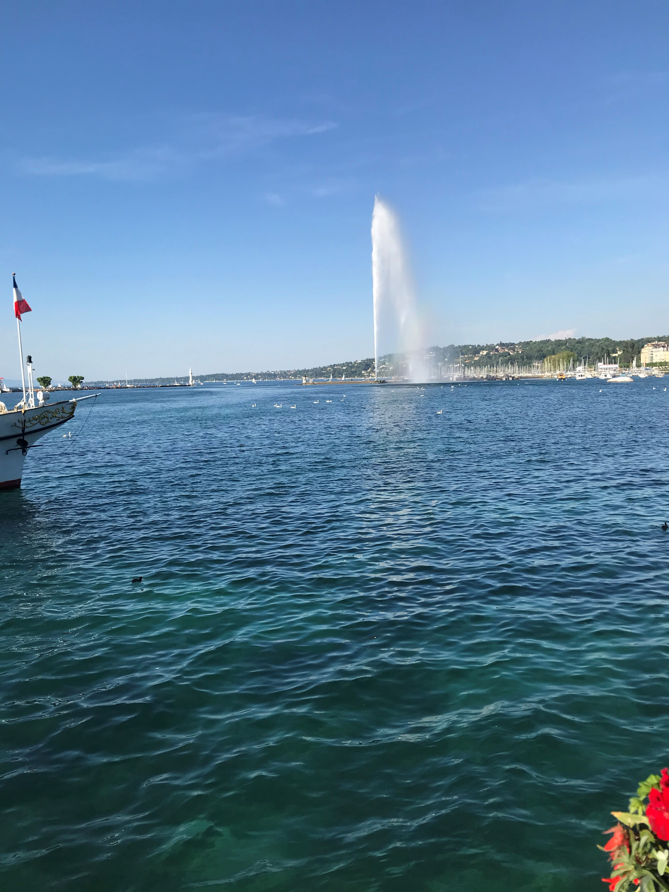
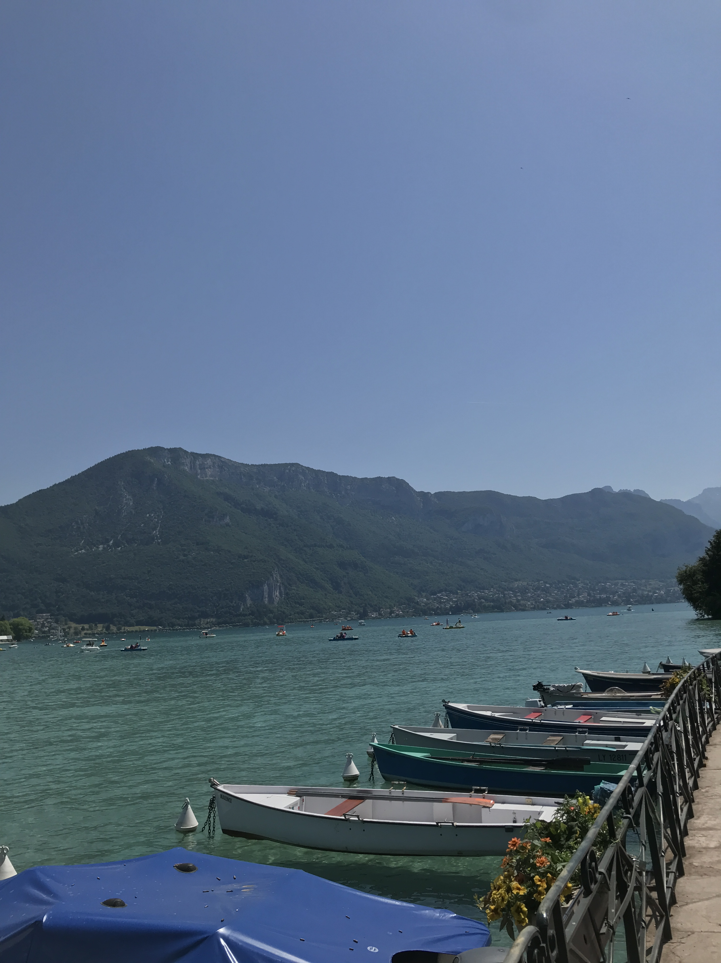
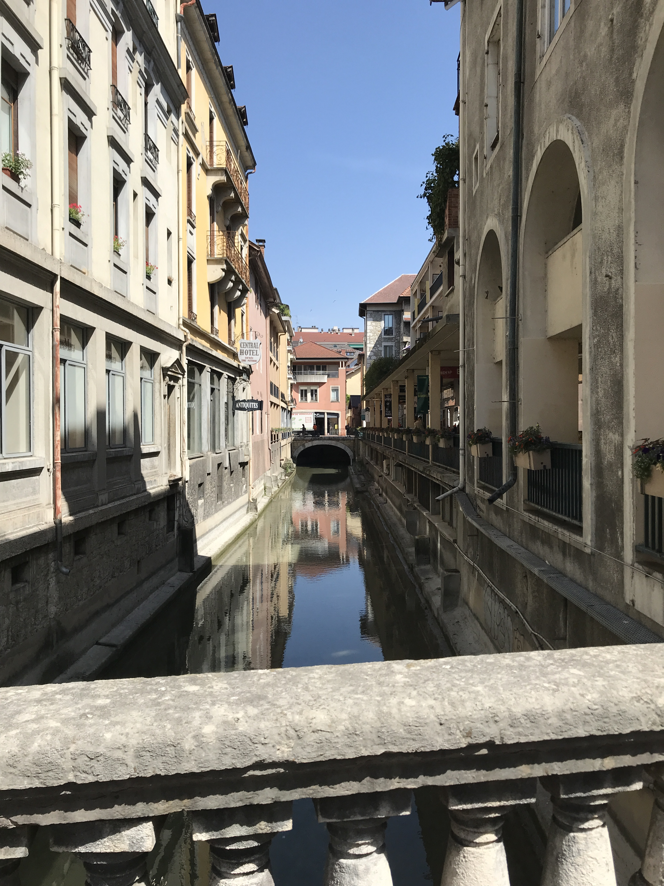
Weekend Outings
Annecy, France
Geneva, Switzerland

Slide 10
References:
[1]: LHCb
[2]: Lepton flavor universality

