Slide 1
Search for production of a Higgs boson and a single-top quark in the tHq(bb) channel using ML
Arthur Alves

Slide 2

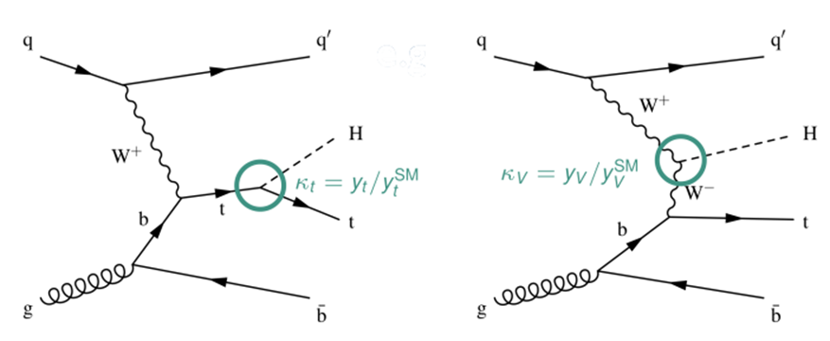
Overall Project
Dr. Nello Bruscino’s project focuses on the analysis of the H→bb decay mode from the tHq(bb) channel.
The goal is to measure the strength of this specific signal, which can be a very difficult task due the large background coming from other decays channels.
The main intention behind this research is to increase our knowledge of how the Yukawa Coupling behaves through the improvement of ML techniques .

Slide 3
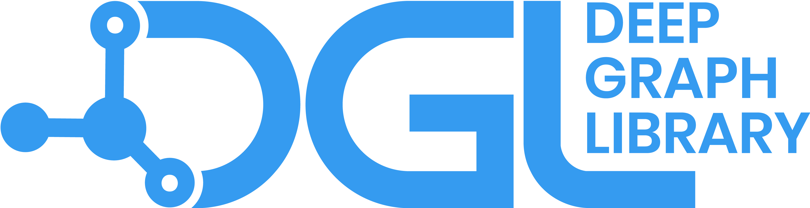
Machine Learning
The only way to filter the desired information from the background is to train a machine to do this task for us.
A Boosted Decision Tree will be to used to distinguish the different tHq decays. During the training section, a total of 26 variables with different weights are considered, leading to an overall very complex system.
A new approach decided by the group was to use the Deep Graph Library (DGL) to help us deal with the data.
DGL is a library with algorithms that focuses mainly on Graph Convolutional Networks (GCN)

Slide 4
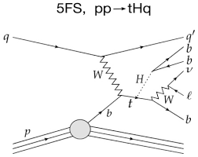
My role on the project
Use the features DGL offers us to improve the identification of the tHq(bb) decay channel.
Compare our new system with GCNs to the previous one with only the BDT.
By the end of the summer, I hope to have a better understanding about the Higgs boson, ROOT, ML in general (Pytorch and DGL) and Neural Networks.
https://www.kceta.kit.edu/grk1694/downloads/poster/cboeser_GK-workshop.pdf

Slide 5
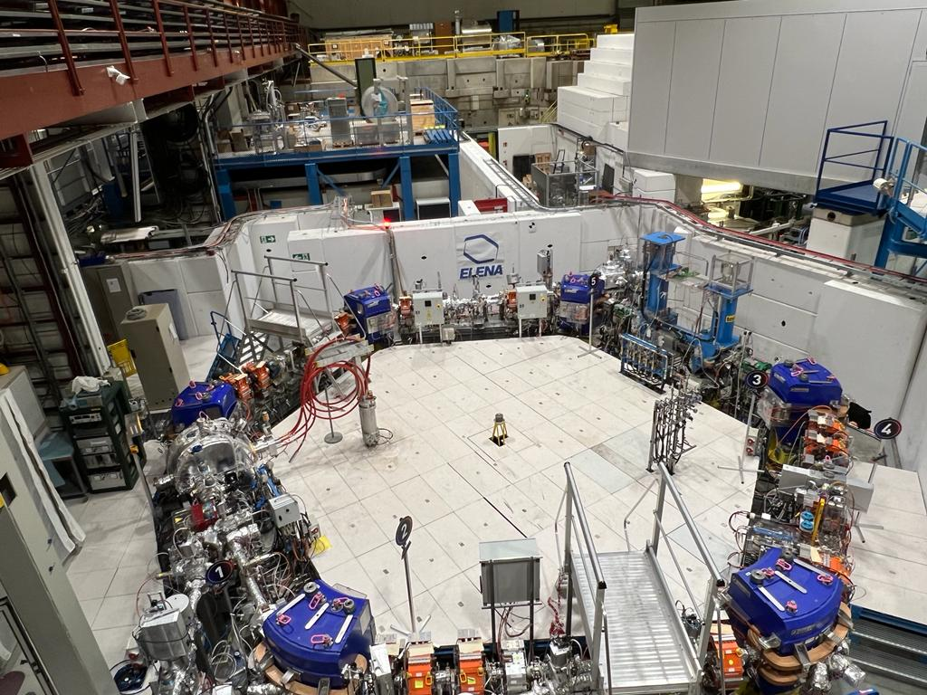


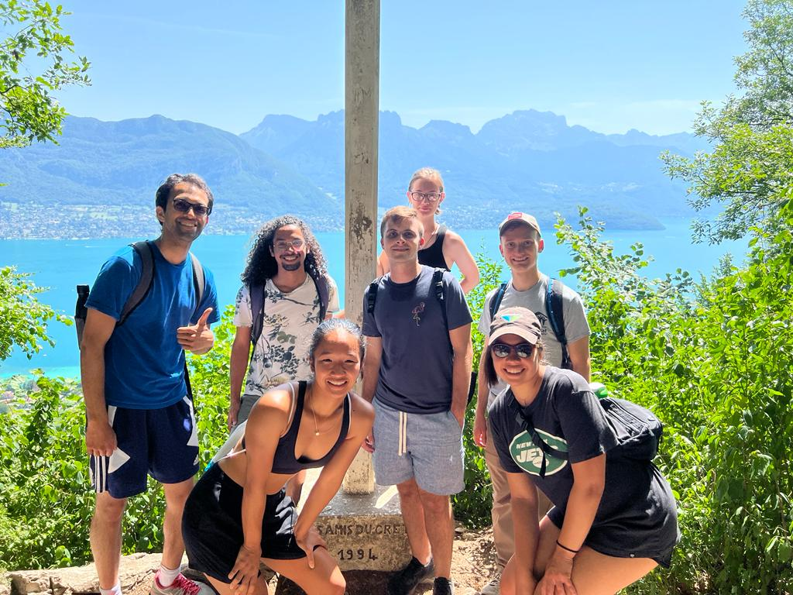
First Two Weeks here ☺

Slide 6
Questions?

