Slide 1

CERNbox UI Metrics Scraping and Analysis – IT Department
By Tyler Hellstern

Slide 2
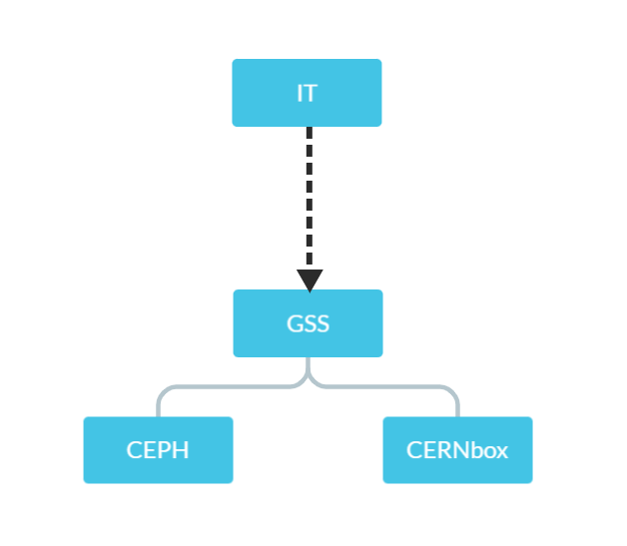
The CERNbox Team
What is CERNbox?
  Good Question
  Strengths:
    Provides 1TB of data for all CERN users
    Projects

Slide 3
Making a Switch
A new (and improved) CERNbox:
URLs will be consistent with EOS directories
More sharing options for better flexibility when sharing files
Compatible with other applications like Microsoft and Jupyter
Other useful features

Slide 4
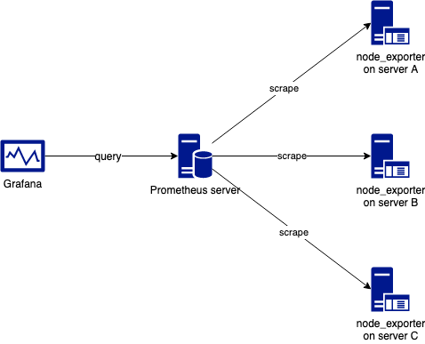

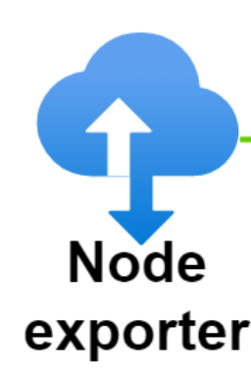

UI Metric scraping
How do users interact with the interface?
Using Prometheus, Node Exporter, and Grafana

Slide 5
My Goals
Learn as much as I can about coding and data science
Get to know the people in IT (they are all amazing people)
Get to know you guys, and the other summer students
Go to the lectures, talks, and presentations that have to do with the LHC (or physics in general)
And of course…

Slide 6
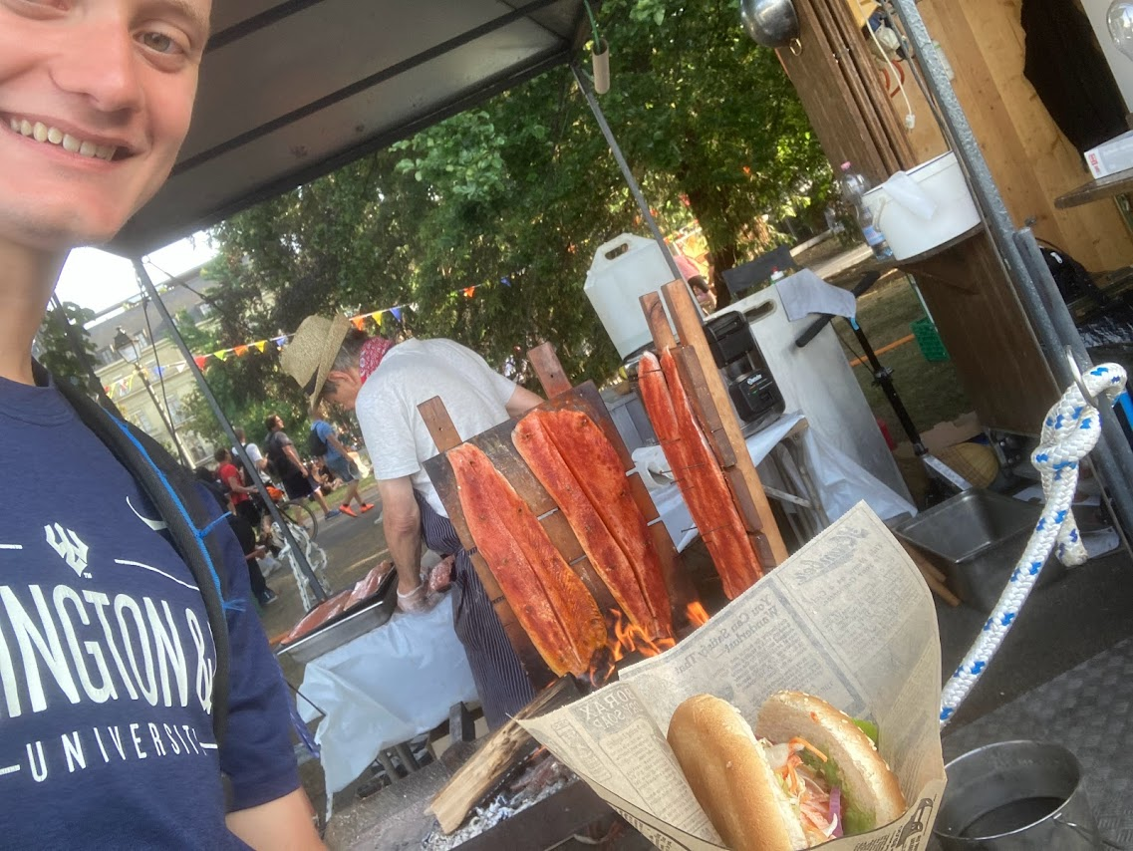

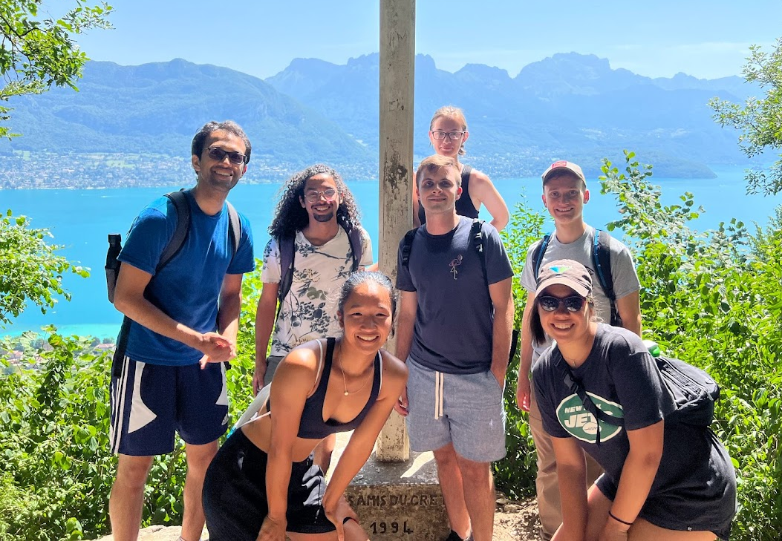
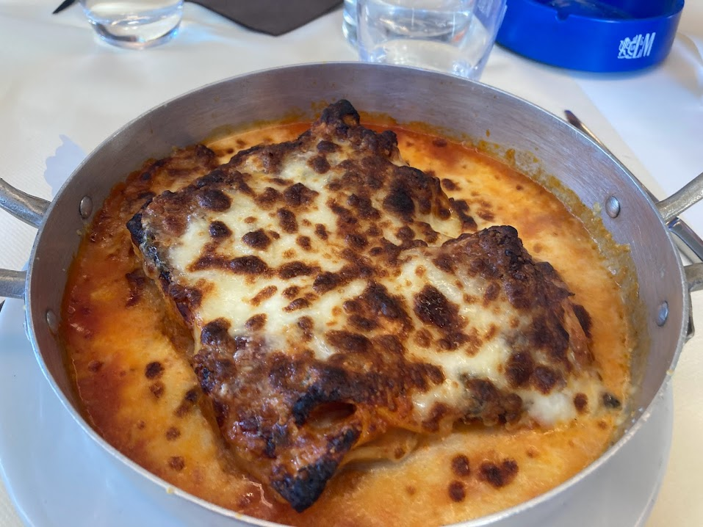
EXPLORE EUROPE

Slide 7

Questions?

