Slide 1
Characterizing ALPIDE Pixel Sensors for ALICE ITS2
August Muller
UM CERN Summer Student Program 2022

Slide 2
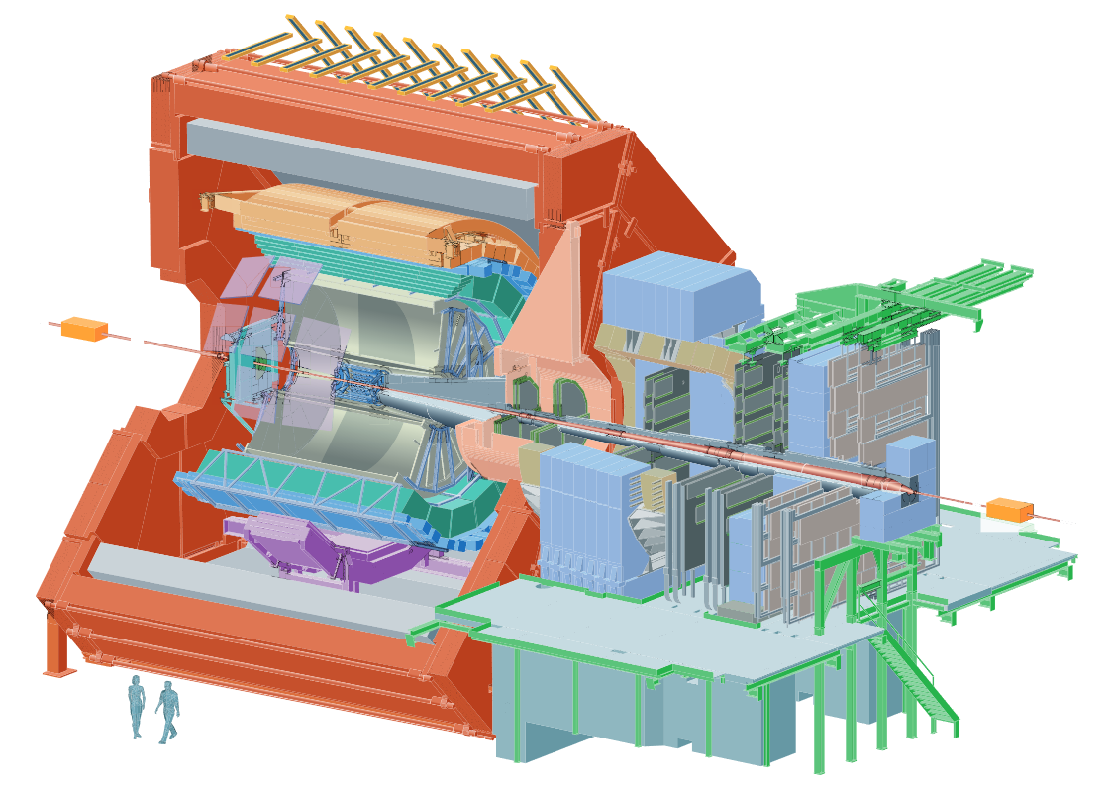
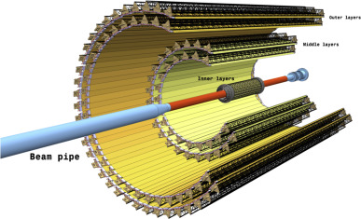

The ALICE Inner Tracker
ITS (Inner Tracking System)
Closest sensors to collision point
Fine-grain resolution
Fast processing
ITS Project Team
My supervisor: Magnus Mager

Slide 3
The Project
Develop & test sensors used for the ALICE ITS
ITS2
Installed
Thorough testing: MIPs
What about other particles?
ITS3
In development
ITS2
ITS3
ALPIDEs
APT/DPT Chips?
ITS
Si Pixel Detectors
Notes:
MIPs: Minimum ionizing particles ☺
ALPIDE: ALICE pixel detector

Slide 4
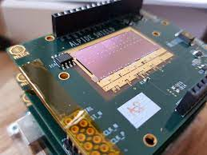
Goals
How do ALPIDE chips detect highly ionizing particles?
Ex. low energy protons
Deposit more energy
Fire more pixels per particle
Data collection:
PS Test Beam (< 1 GeV)
Analysis:
Detection efficiency
Particle energy vs. cluster size
Bethe-Bloch formula for thin sensors
Notes:
PS: Proton Synchrotron

Slide 5
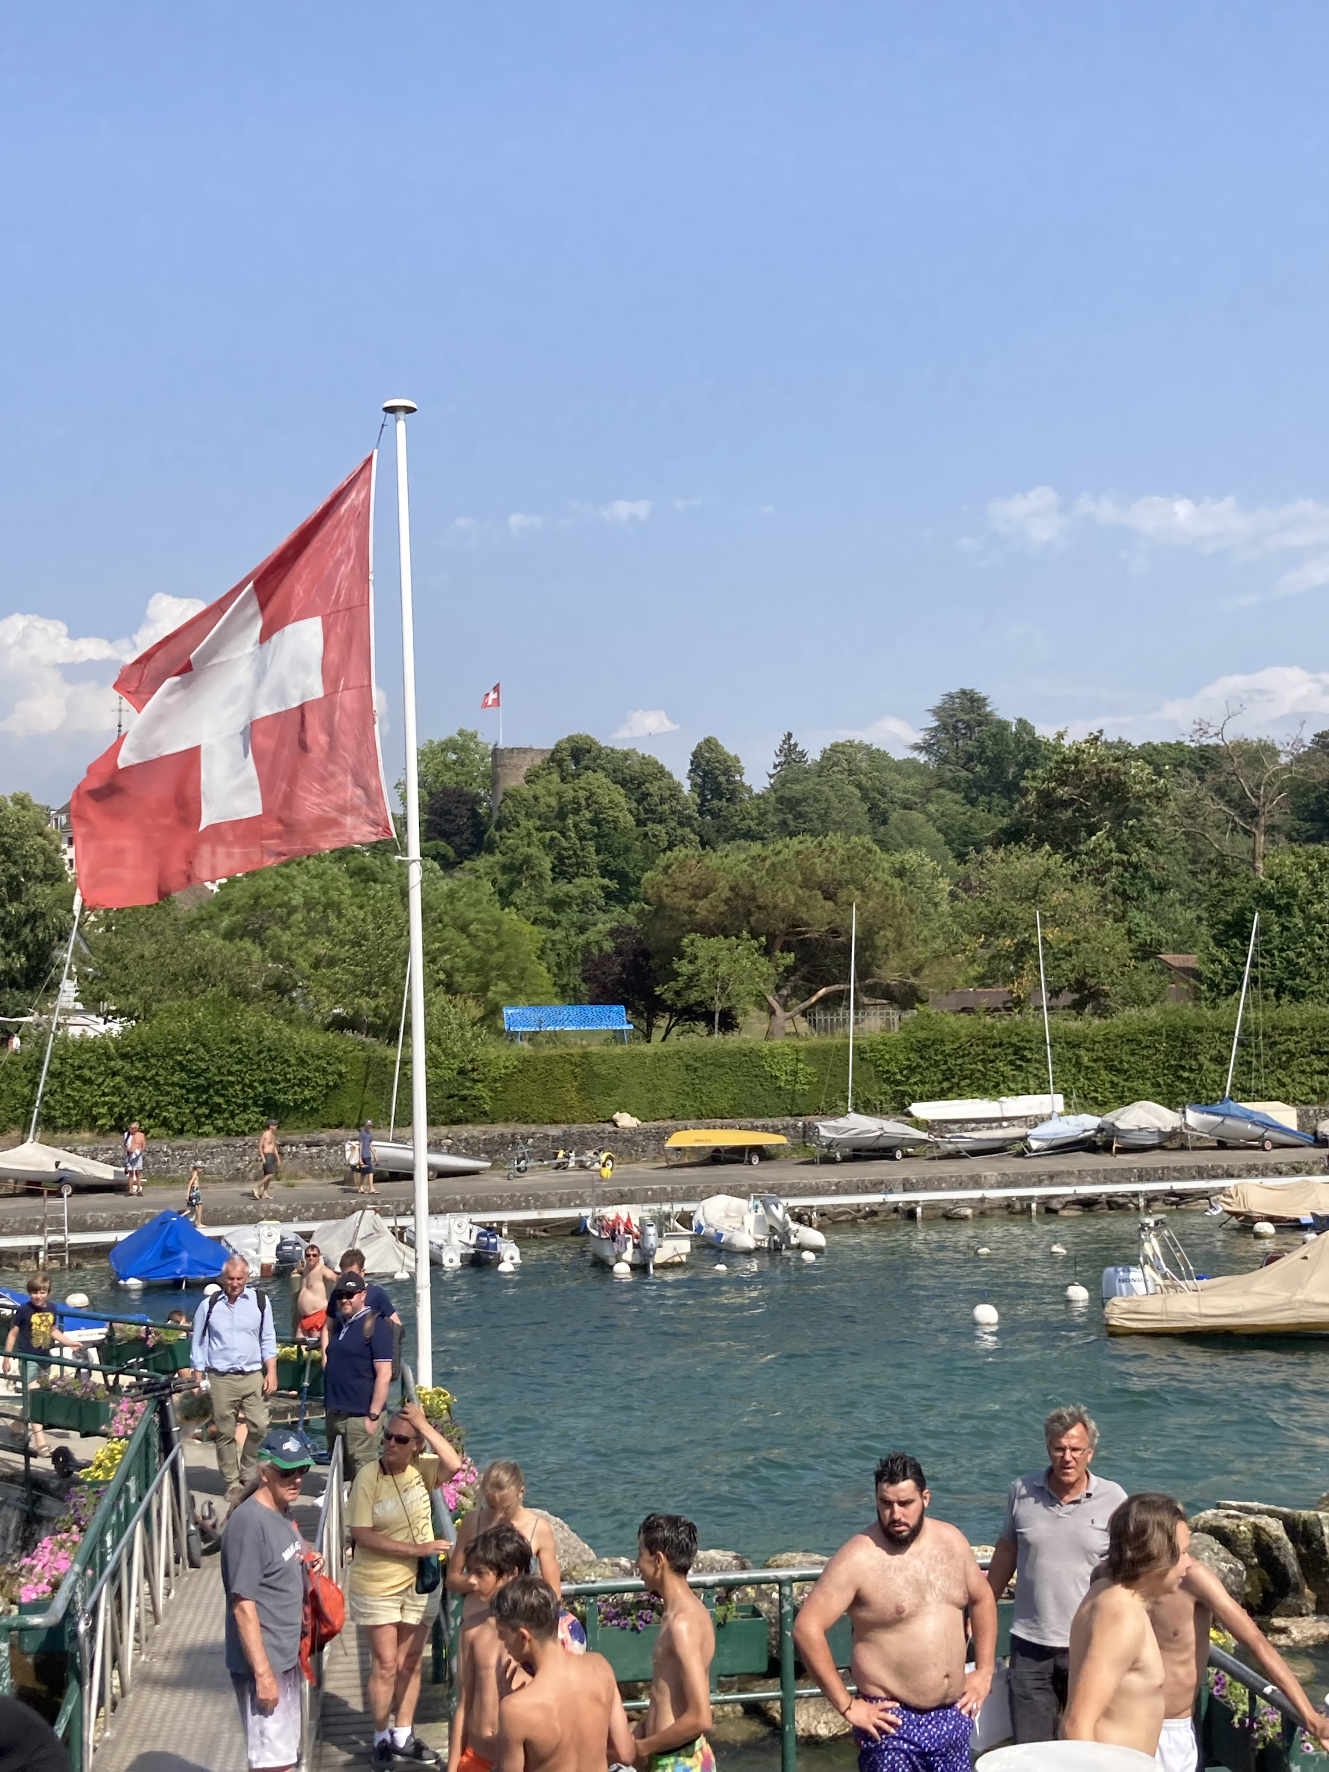
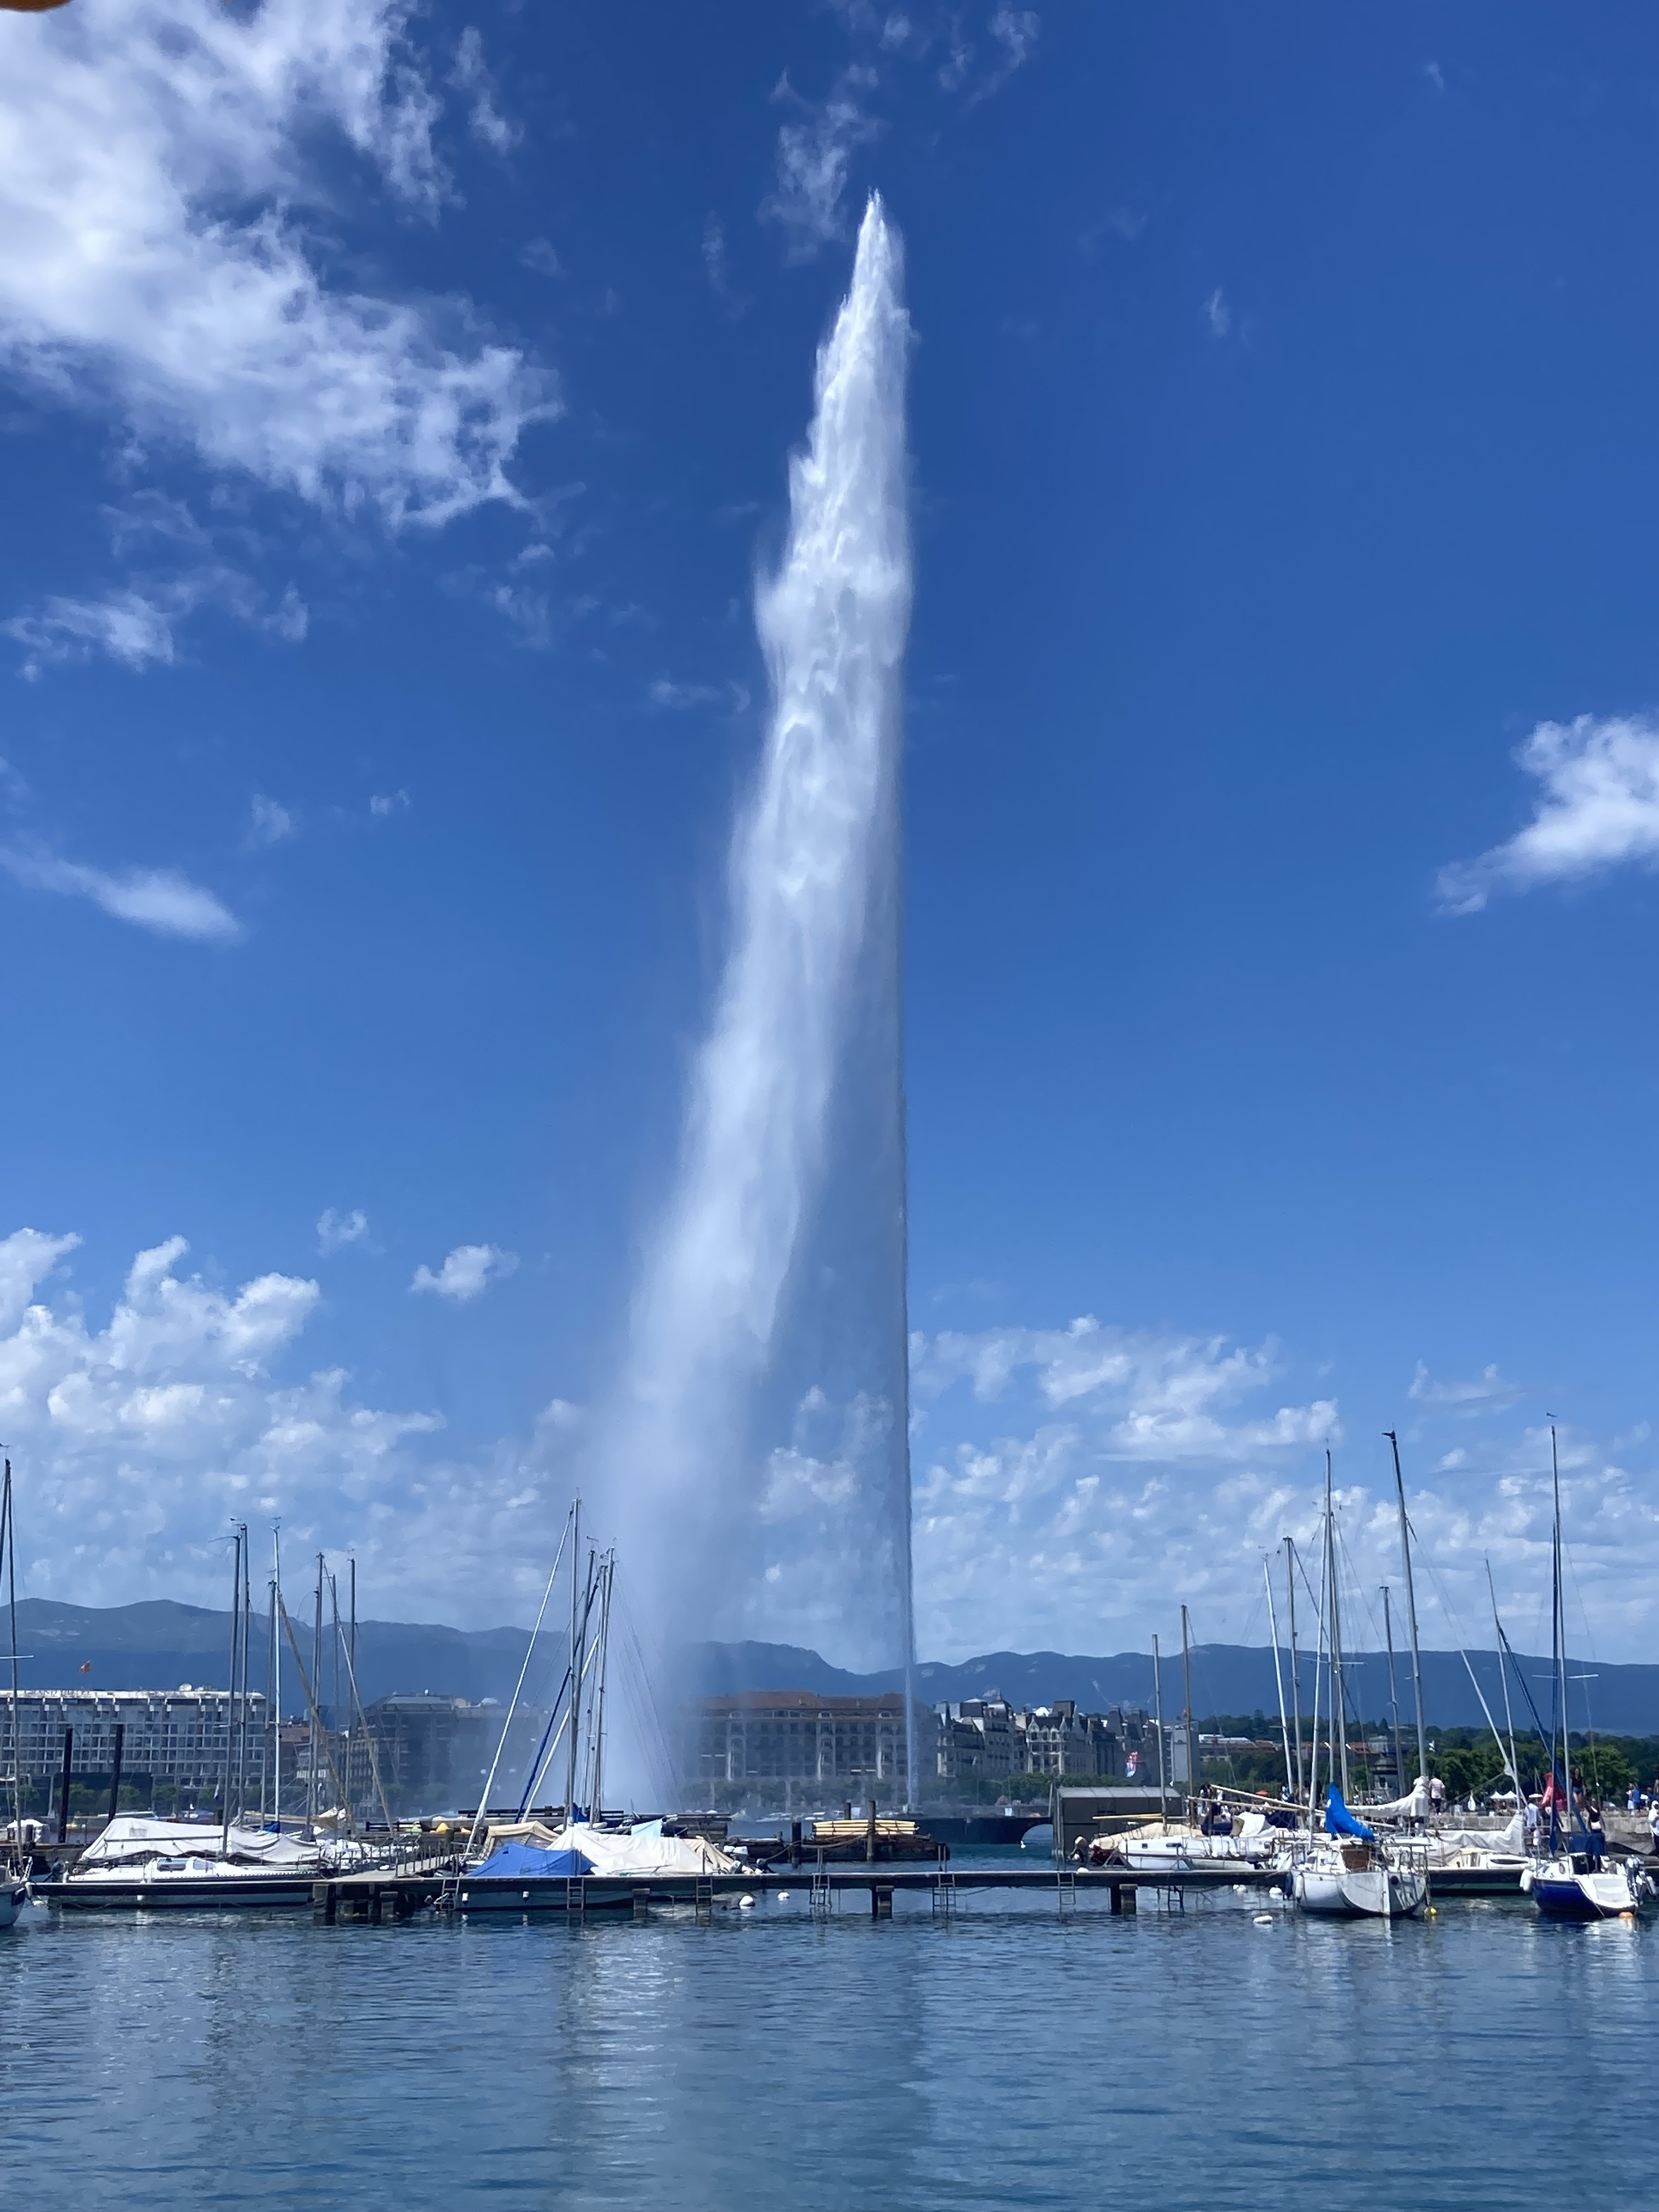
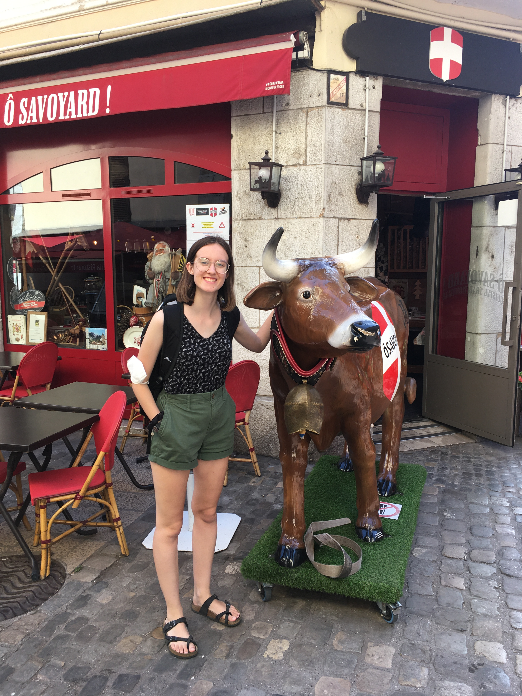
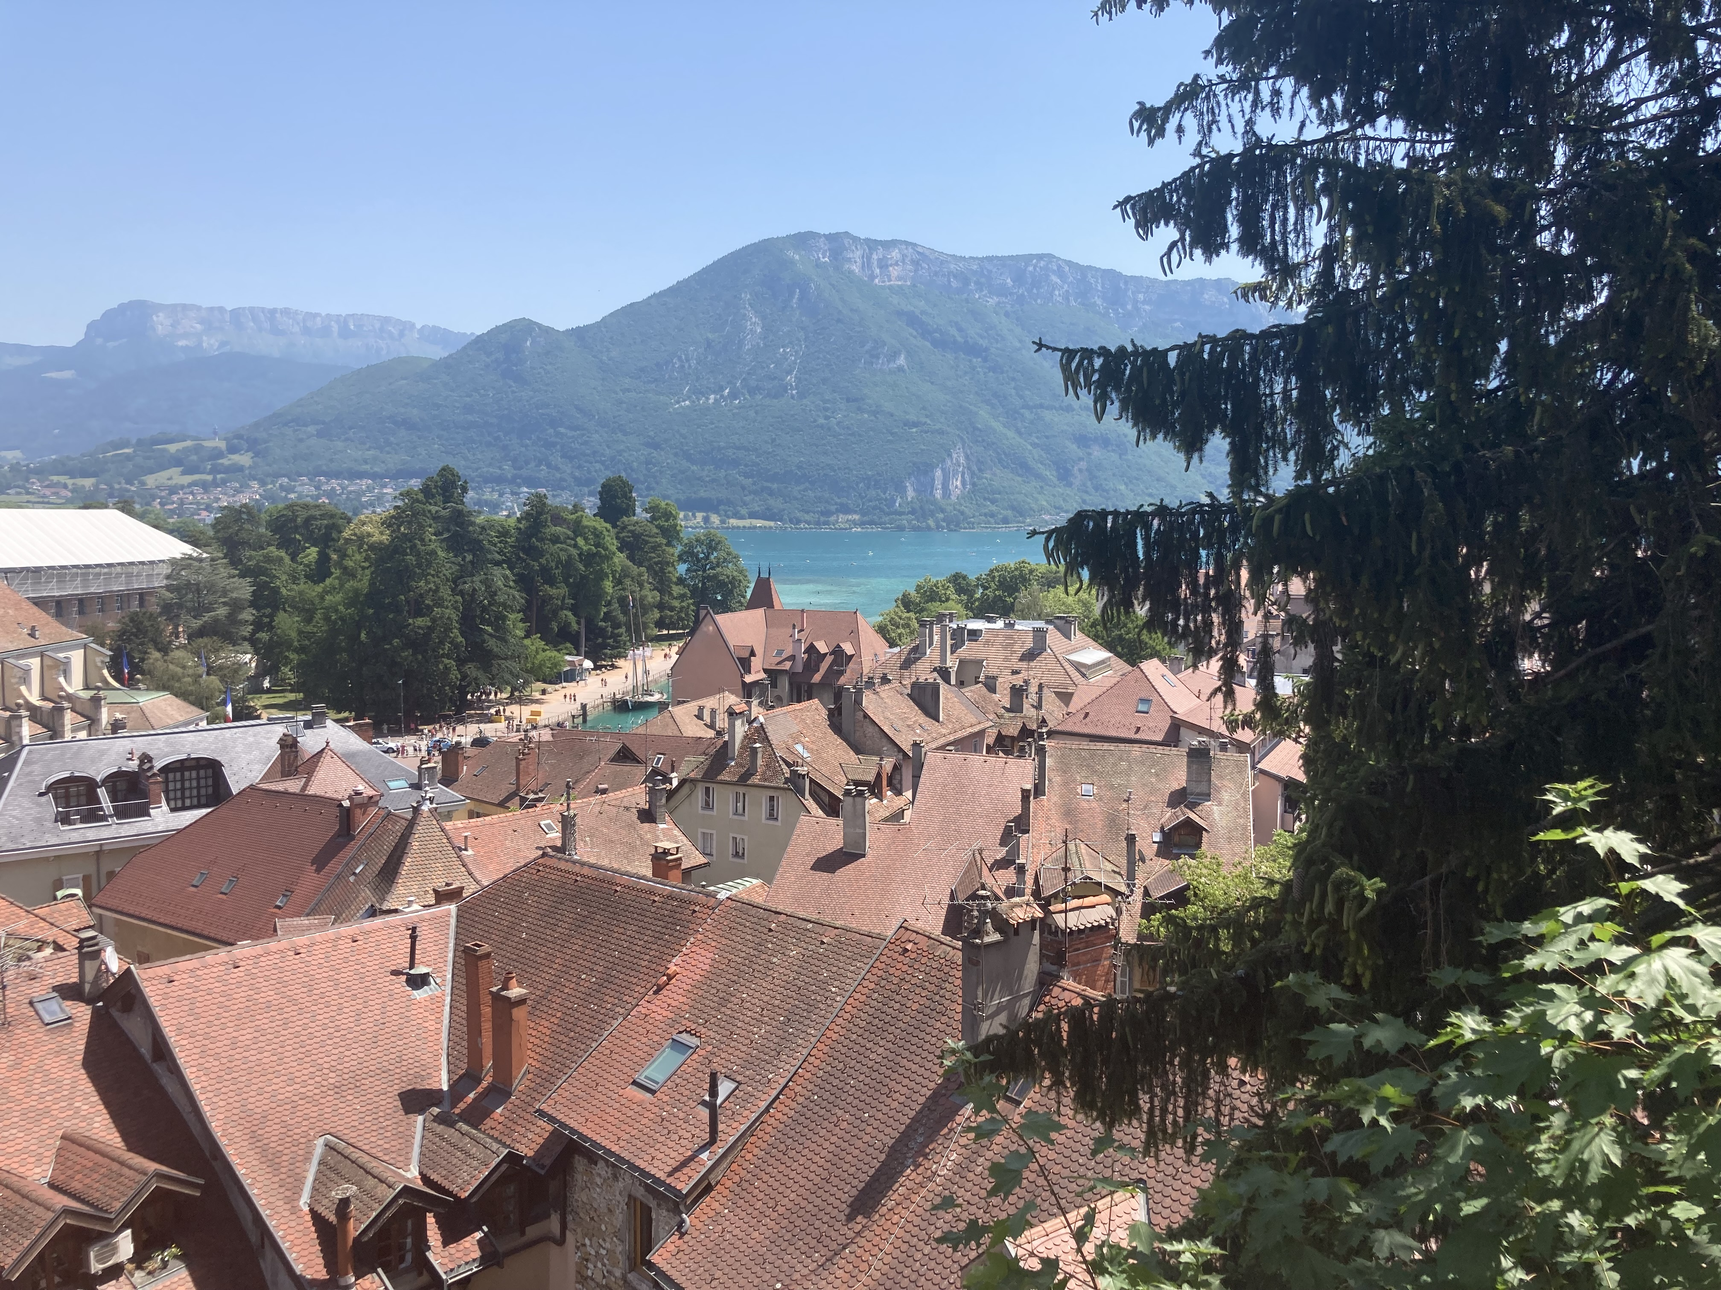
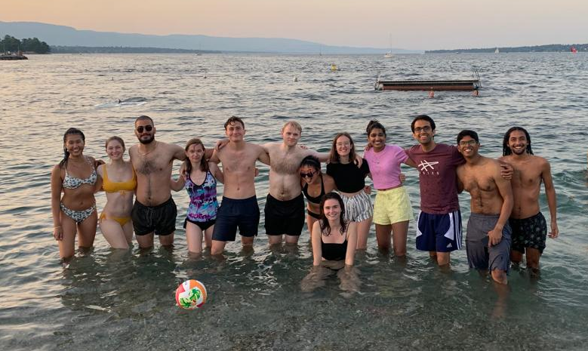
Outside the Office
Annecy
Geneva

